Slide 1
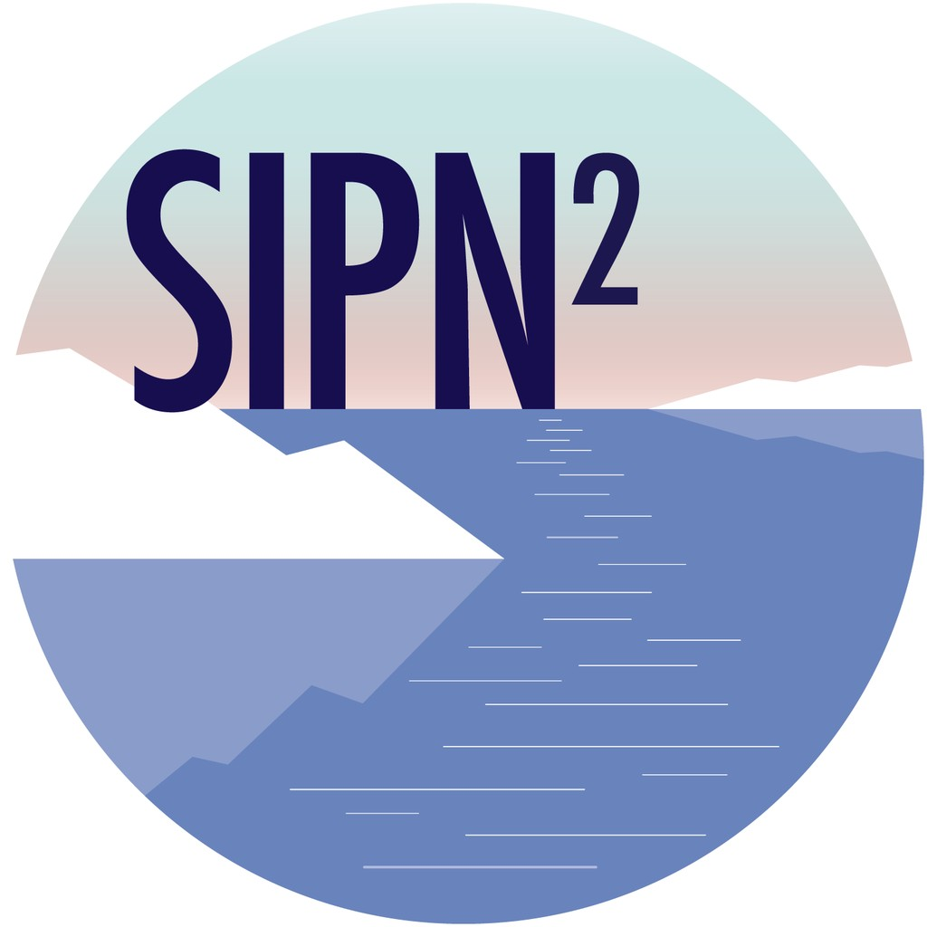
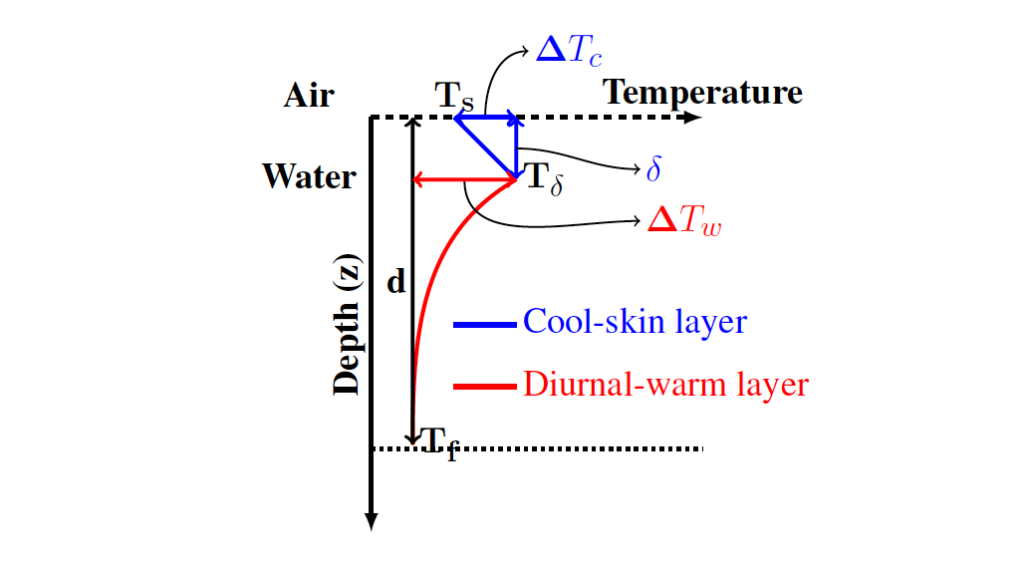


SIO Contributors Forum: Lightning Talk
NASA GMAO: GEOS S2S
NASA GMAO uses the GEOS coupled Earth-System model and analyses, in conjunction with satellite and in situ observations.
GEOS-S2S-2 released in November 2017 (Molod et al. 2020). The system suffers from exceptionally low summertime Arctic ice cover due to the analysis scheme and an overly warm mixed layer. We have been performing additional experiments for SIPN, initialized with CryoSat-2 ice thickness.
GEOS-S2S-3 system frozen in December.
  ½° GEOS atmosphere, ¼° × L50 MOM5 Ocean.
  Interactive aerosol model, two-moment cloud microphysics.
  Ensemble forecast strategy: an ensemble of 40 three-month forecasts is subsetted to 10 members, based on a clustering analysis, and run to nine months.
  Atmosphere-Ocean Interface Layer.
  https://gmao.gsfc.nasa.gov/seasonal/
Akella and Suarez, 2018

Slide 2
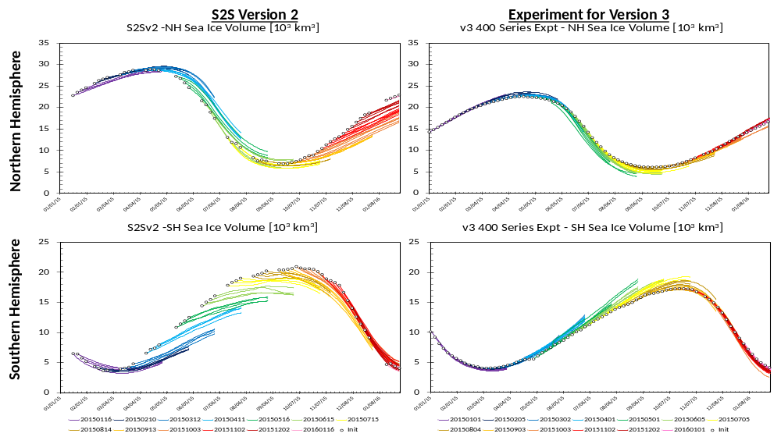
SIO Contributors Forum: Lightning Talk
NASA GMAO: GEOS-S2S
Forecast Sea Ice Volume [ 10³ km³ ]
The more realistic initialization and the improved model skin layer in GEOS-S2S-3 will improve performance over GEOS-S2S-2.
Additional improvements are expected with refinement of sea ice albedo and analysis method.

