Slide 1

Fluid Shifts Study
PI: Steven Laurie, Ph.D.
PI: Michael Stenger, Ph.D.
PI: Alan Hargens, Ph.D.
PI: Scott Dulchavsky, M.D., Ph.D.
Co-I: Irina Alferova, M.D., Ph.D.
Co-I: Valerie Bogomolov, M.D.
Co-I: Philippe Arbeille, M.D.
Co-I: Richard Danielson, Ph.D.
Co-I: Doug Ebert, Ph.D.
Co-I: David Kemp, Ph.D.
Co-I: Stuart Lee, Ph.D.
Co-I: John Liu, Ph.D.
Co-I: Brandon Macias, Ph.D.
Co-I: David Martin, M.S.
Co-I: Larry Minkoff, M.D.
Co-I: Rob Ploutz-Snyder, Ph.D.
Co-I: L. Christine Ribeiro, M.S., J.D.
Co-I: Ashot Sargsyan, M.D.
Co-I: Scott M. Smith, Ph.D.
Co-I: Babs Soller, Ph.D.
Co-I: Sara Zwart, Ph.D.
Human Research Program Investigators’ Workshop
February 2021
Virtual Meeting

Slide 2
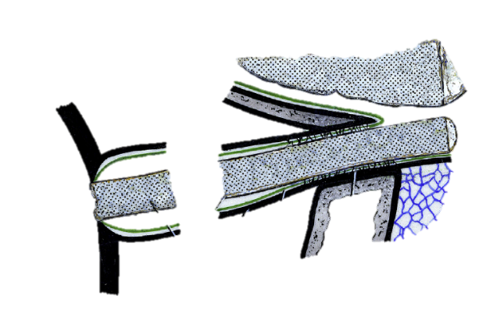
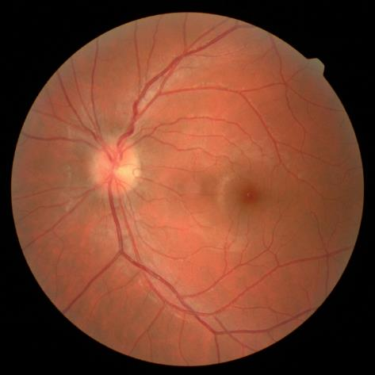
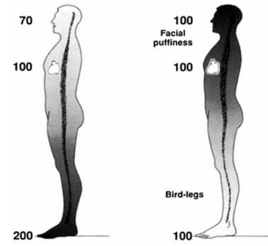
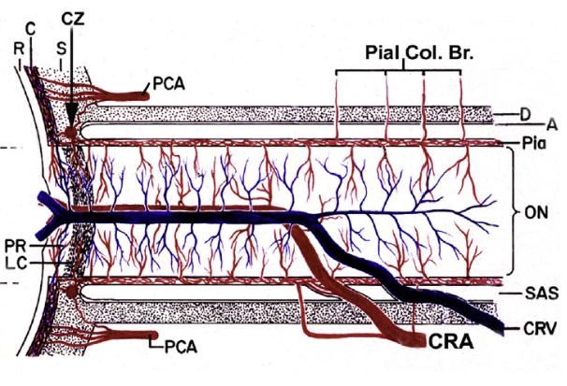
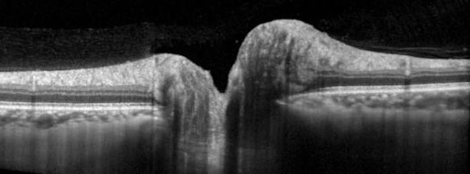
Fluid Shift Hypothesis for SANS
Brain
Axoplasmic stasis
Neuronal swelling
Elevated ICP
Earth
Weightlessness
Eyeball
Optic Nerve
Optic Nerve Sheath
Optic Canal
Characterize the Fluid Shift during Long-Duration Spaceflight
Determine how the Fluid Shift relates to SANS findings
(Modified from: Hayreh, 1965)
(Hargens, Eur J Appl Physiol, 2013)
Vascular Effect
Increased capillary filtration
Accumulation of extravascular fluid
(Hayreh, Prog. Retin. Eye Res., 2016)

Slide 3
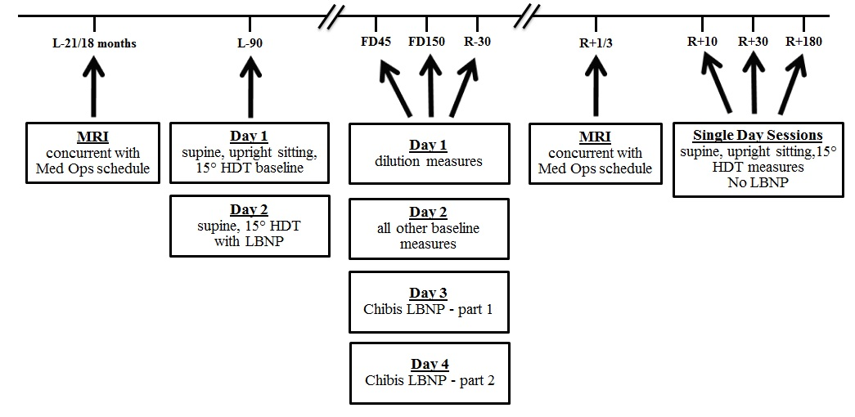
Fluid Shifts Study Overview
Data Collection in 13 Subjects Completed October 2020

Slide 4
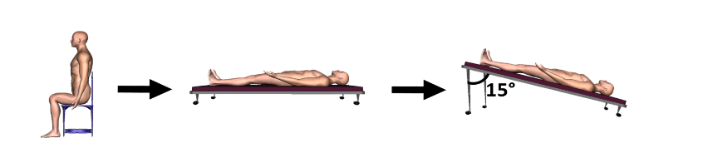
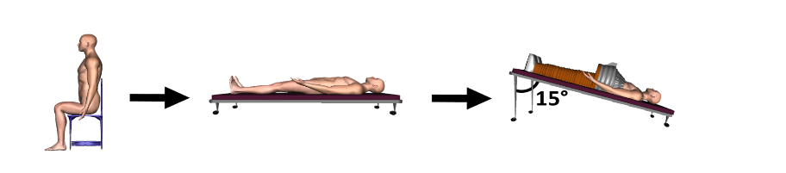
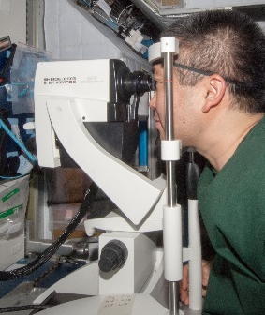
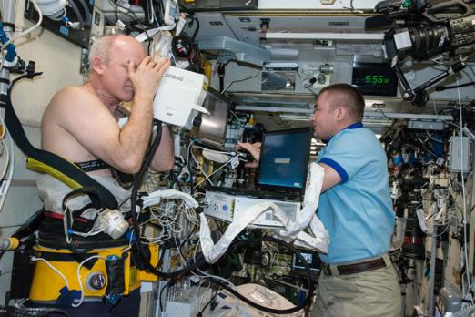
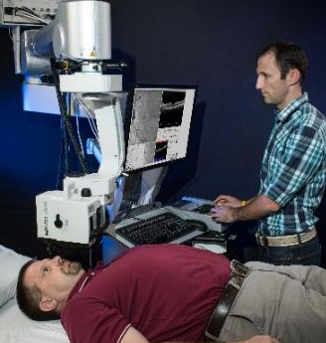
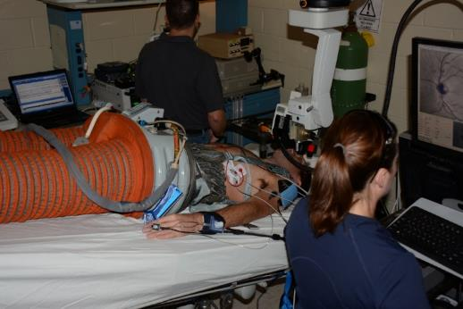
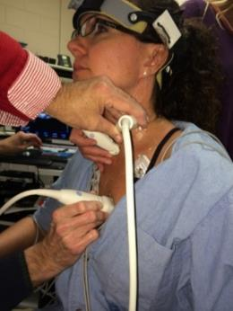
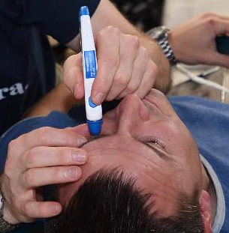
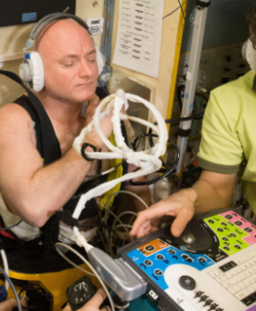
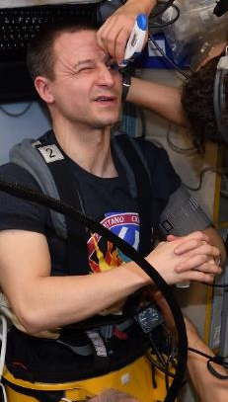
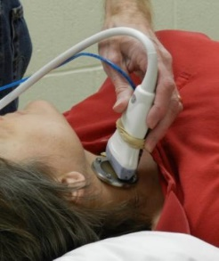
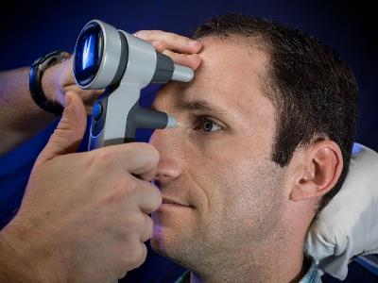
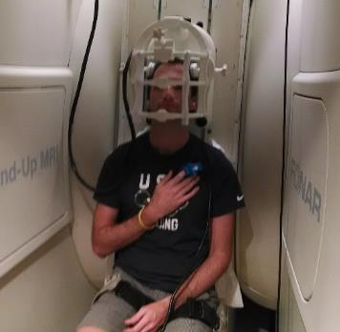
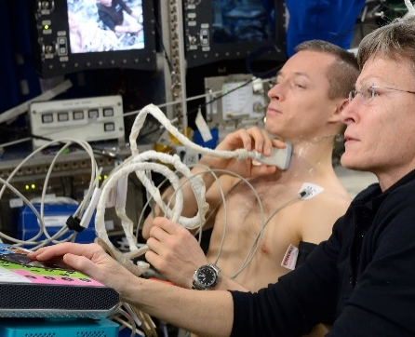
Fluid Shifts Study Overview
Earth
ISS - USOS
ISS – Russian Service Module

Slide 5
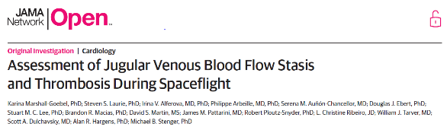
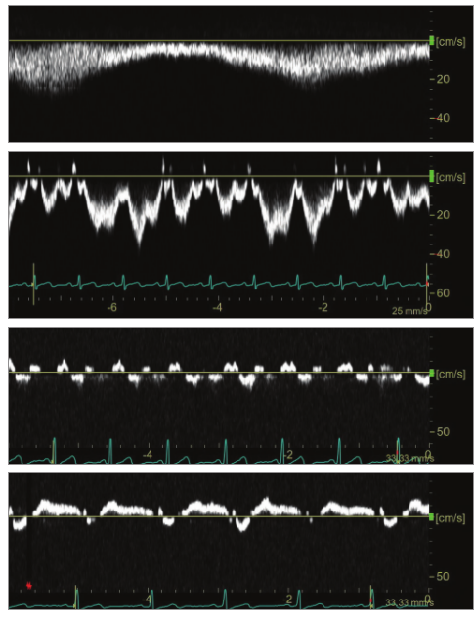
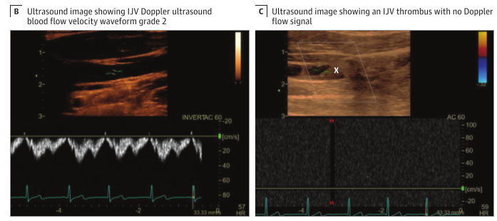
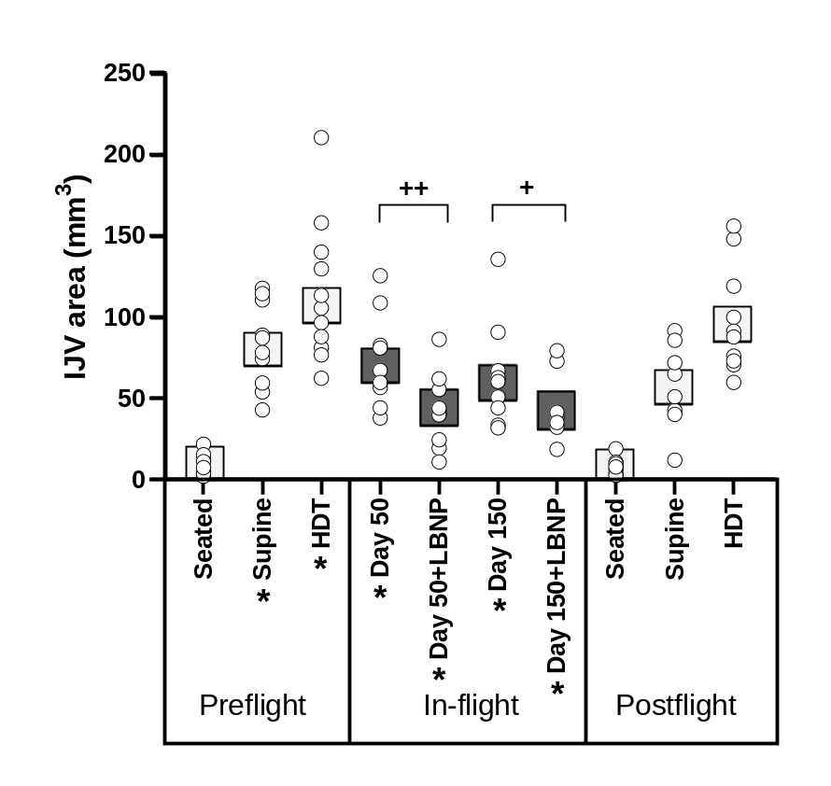
Characterize the Fluid Shift
Venous Flow Waveform Score
Identification of Venous Thrombus in Internal Jugular Vein (IJV)
1
2
Normal Grade 2 Flow
3
4
Thrombus filling IJV, no flow present
(Marshall-Goebel et al, JAMA Network Open 2019)

Slide 6
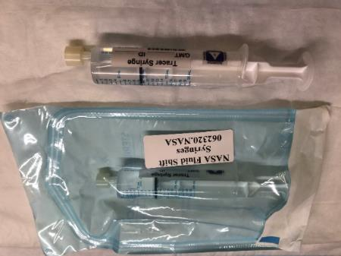

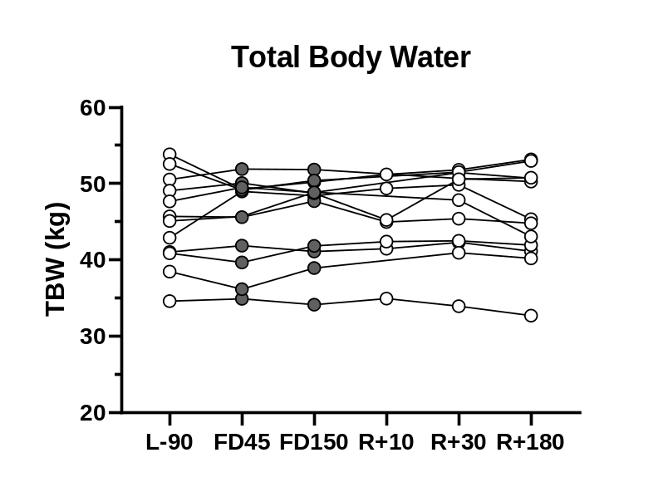
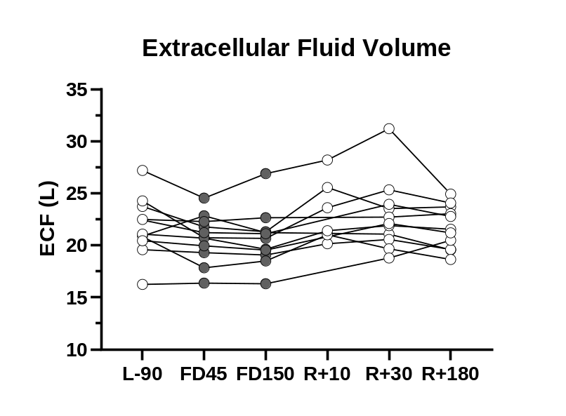
Characterize the Fluid Shift
Approach:
Ingest known volume of Sodium Bromide and heavy water
Quantify:
Total Body Water (TBW)
Extracellular Volume (ECF)
(Lytle, et al., Preliminary Data)
During spaceflight: No change in TBW or ECF
Possible interpretation: If plasma volume is decreased, interstitial fluid must increase

Slide 7
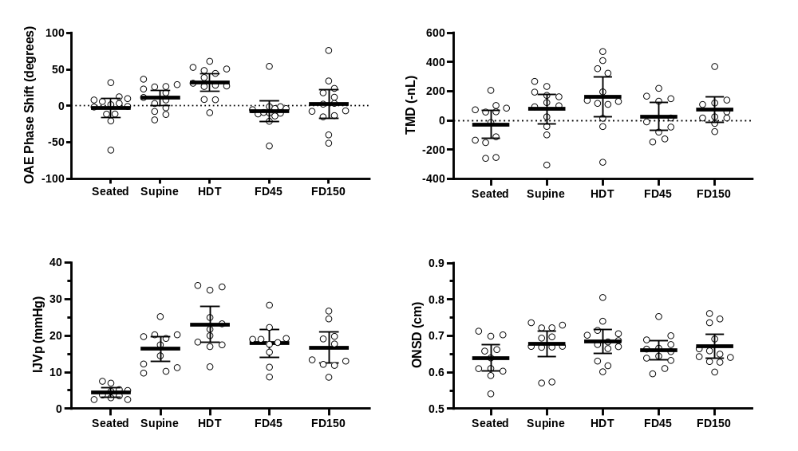
Intracranial Pressure (ICP)
Is ICP pathologically elevated during spaceflight?
(Petersen, et.al. J Physiol. 2018)
-0.3 ± 4.8
cmH₂O
20.7 ± 3.4
cmH₂O
35.5 ± 5.7
cmH₂O
Intracranial Hypertension: ICP > 30 cmH₂O
Approach:
Use multiple noninvasive techniques to assess ICP during spaceflight
(Jasien, et al., J Appl Physiol, In Preparation)
ICP does not appear to be pathologically elevated during spaceflight
Gold-standard, invasive measures are needed to confirm these findings

Slide 8
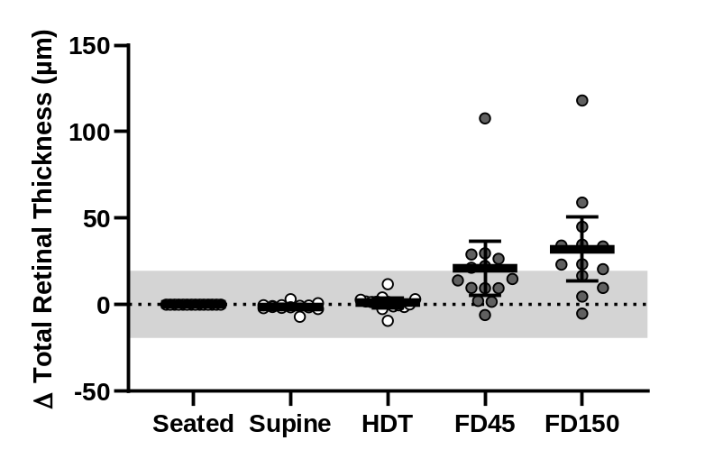
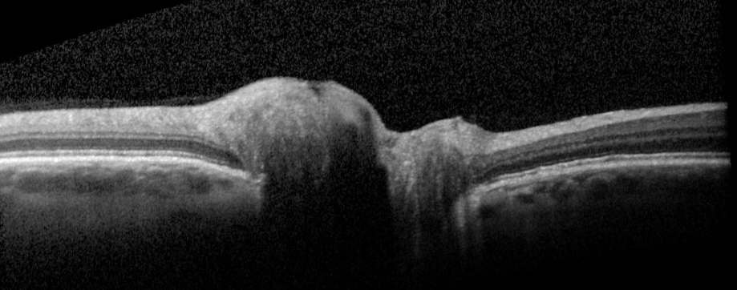
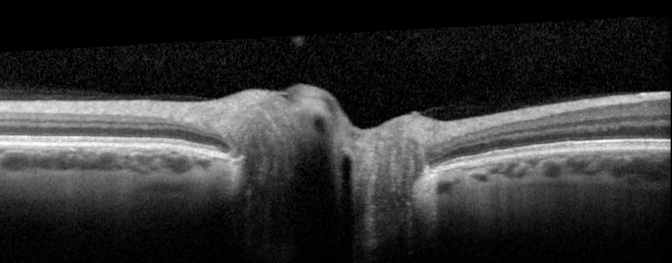
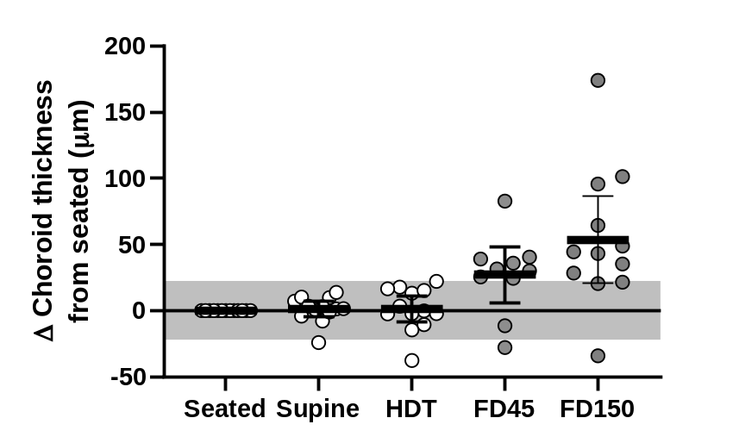
Ocular Structural Changes
(Unpublished data, Fluid Shifts Study)
(Pardon, et al., In Preparation)
Preflight Seated
FD150 Spaceflight
(Greenwald, et al., J Appl Physiol, In Review)

Slide 9

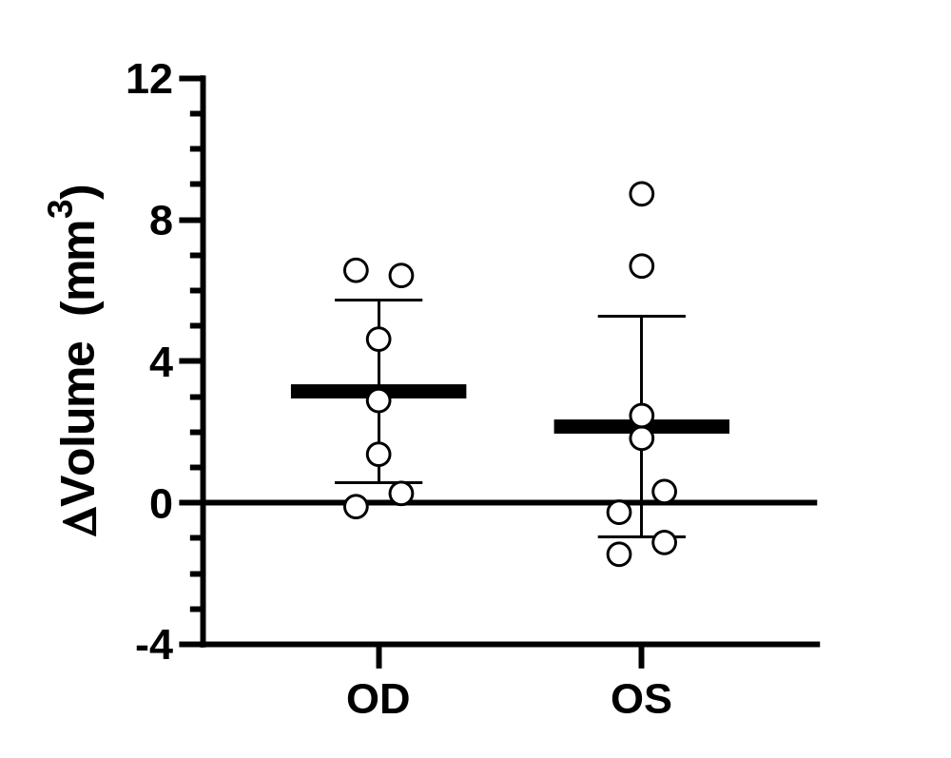
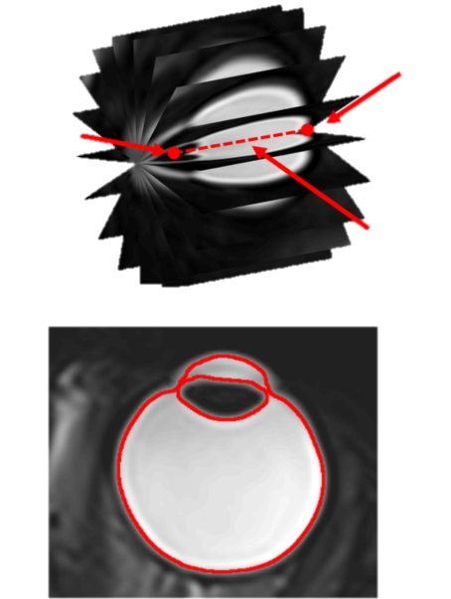
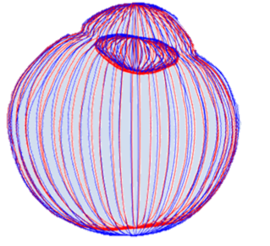
Ocular Structural Changes
Ocular MRI to Quantify Globe Flattening
ONH
Lens
Axis of Rotation
Mean ± 95% Confidence Interval
Preliminary Data: Dr. Bryn Martin

Slide 10
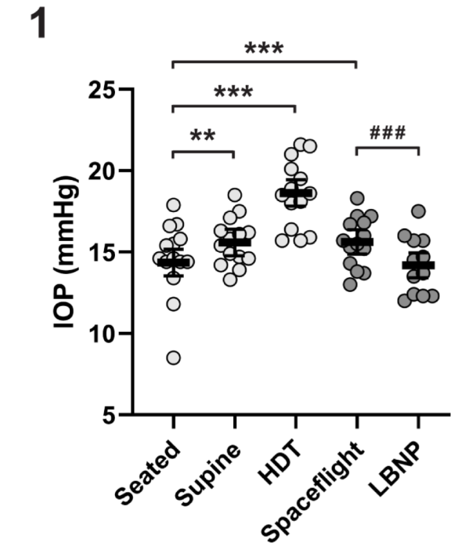
Lower Body Negative Pressure
Countermeasure
Lower Body Negative Pressure (LBNP) shifts fluids towards to the lower body.
Does LBNP affect the veins draining the eye?
IOP = F/C – EVP
… If LBNP reduces venous pressure, IOP will be lowered
USOS
Chibis
(Greenwald et al, J Appl Physiol. In Review)
LBNP effect reaches the venous drainage of the eye

Slide 11
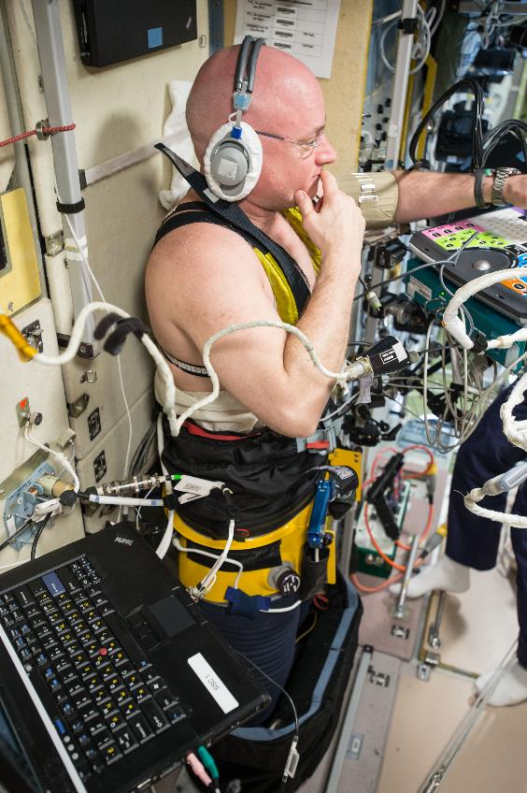
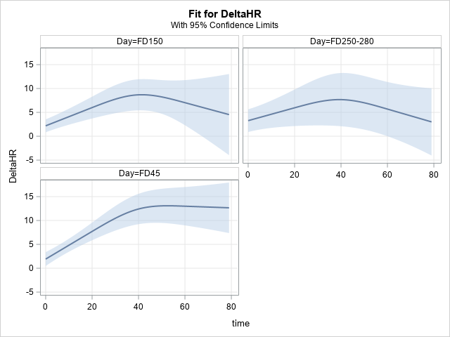
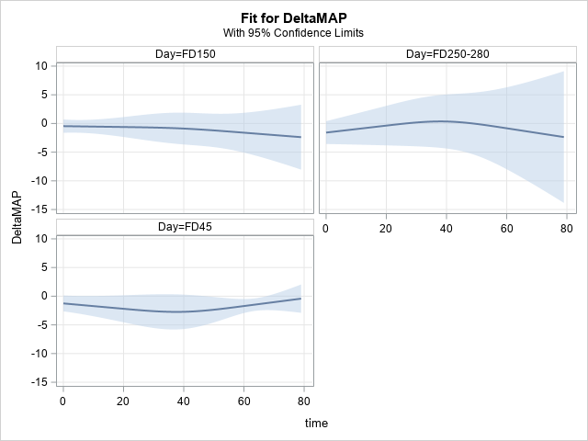
Blood Pressure & Heart Rate During LBNP
ΔHR (beats/minute)
ΔMAP (mmHg)
LBNP Exposure Time (minutes)
(Preliminary Data, Millennia Young, Ph.D.)
All subjects completed all test sessions (n=52)

Slide 12
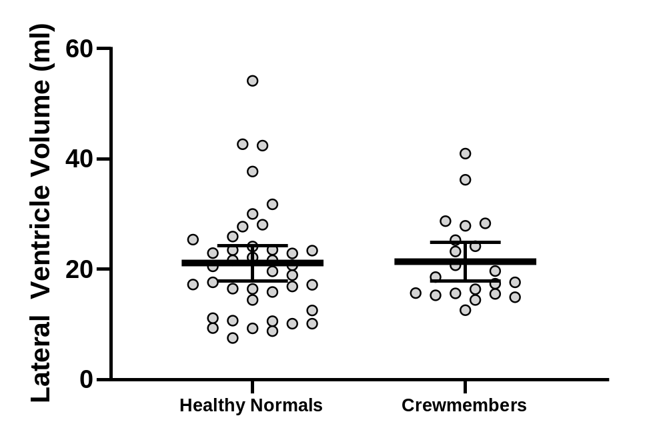
Fluid Shift Effect on Brain
Brain MRI: Ventricular enlargement after spaceflight has been demonstrated by multiple groups
  10.7% to 23.5% increase; ~1-3 ml increase
n=19
Δ 2.2 ± 1.3 ml (11.6 ± 6.5%)
Astronauts
Cosmonauts
Roberts (n=12)
Alperin (n=10)
Kramer (n=10)
Hupfeld
(n=12)
Van Ombergen
(n=11)
1
3
2
(Roberts, NEJM, 2017)
(Van Ombergen, PNAS, 2019)
(Alperin, Neurol, 2017)
(Kramer, Radiol, 2020)
(Hupfeld, Cereb Cortex Commun., 2020)
(Marshall-Goebel, JAMA Ophthalmology, In Review)
Post-flight ventricular volume is not different from Healthy Population (36-57 years old)

Slide 13
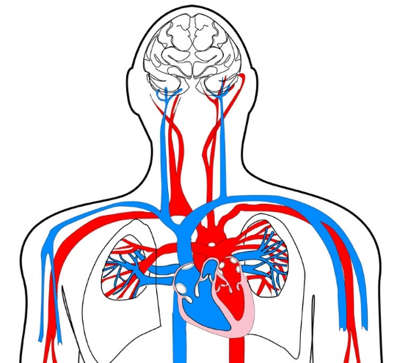
Summary
Intravascular venous fluid shift during spaceflight is similar to supine posture on Earth.
Total body water is unchanged, but appears to be increase in interstitial fluid.
Noninvasive techniques suggest ICP is not pathologically elevated during spaceflight.
Ocular structural changes include edema at the optic nerve head and thickening of vascular layer behind the eye. No edema observed at the macula.
Globe flattening occurs at the optic nerve head is small in magnitude.
LBNP countermeasure is effective at reaching the veins draining the eye.
Cardiovascular system accommodates 60 minutes of 25 mmHg LBNP. No test were terminated early.
Brain ventricular volume increases do not exceed values in a healthy population.
Lots of ongoing work by the team …
Cerebral Vasculature
Jugular Veins
Arterial Flow into the Head
Stroke Volume, Heart Rate, & Cardiac Output
Blood Flow through Heart
>20,000 ultrasound images have been analyzed and passed QC by 2 readers
Analysis of cerebral vasculature from MRI are on going
Investigating preflight metrics for predicting who is at higher risk for developing SANS
6 manuscripts are actively being drafted

Slide 14


