Slide 1
How Safety Thinking Impacts Safety Learning:
Creating Opportunities to Learn
Jon Holbrook, PhD
NASA Langley Research Center
1 February, 2021

Slide 2
The importance of thinking about safety thinking
Decision makers in organizations want to make data-informed decisions about safety management and system design.
Safety Thinking
Safety Policies & Decision Making
Affects
Affects
Affects
Data Collection & Analysis
Learning
Affects

Slide 3
Impacts of systematically limiting data
Human performance includes both desired and undesired actions – actions that promote safety, as well as actions that can reduce safety
When our safety thinking systematically restricts the data we collect and analyze, this
  Restricts our opportunities to learn
  Affects our safety policies and decision making

Slide 4
Opportunities for Learning
Learning is a consequence of interactions between people and their environment
People are learning (almost) all the time
Learning can be structured and deliberate, but also unstructured and implicit
Organizations don’t learn, but they influence people’s learning
Creating
Knowledge
Retaining
Knowledge
Transferring
Knowledge

Slide 5
Some Factors that Improve Learning and Memory
Motivation (Weiner, 1966)
Prior knowledge (Cohen, 1981)
Rehearsal and practice (Craik & Lockhart, 1972))
Elaboration (e.g., Yogo & Fujihara, 2008; McLeod et al., 2010)
Spacing out your practice (e.g., Ebbinghaus, 1885)
Organizing information (e.g., Bellezza, 1981)
Sleep (e.g., Abel & Bauml, 2013)

Slide 6
Data-Informed Decision Making
Goal: Study a sample from a population such that conclusions from a sample can be generalized to the population
Risk: Non-random samples are often subject to bias
  Sample systematically over-represents some segments of the population, and under-represents others
Consequence: Results can be erroneously attributed to the phenomenon under study rather than to the method of sampling

Slide 7
Example: How safety thinking affects safety policies
Safety-producing behaviors vastly outnumber human errors in aviation
Outcome
Human error has been implicated in 70% to 80% of accidents in civil and military aviation (Weigmann & Shappell, 2001).
Pilots intervene to manage aircraft malfunctions on 20% of normal flights (PARC/CAST, 2013).
World-wide jet data from 2007-2016 (Boeing, 2017)
  244 million departures
  388 accidents
Investigated
Not Accident
Accident
No
195,199,690
78
195,199,768
Attributed to
Human Intervention
Yes
48,799,922
310
48,800,232
243,999,612
388
244,000,000
Poorly Understood

Slide 8
Example: How safety thinking affects safety policies
  A Debatable Claim: “To fast-forward to the safest possible operational state for vertical takeoff and landing vehicles, network operators will be interested in the path that realizes full autonomy as quickly as possible.” (Uber, 2016)
When we characterize safety only in terms of errors and failures, we ignore the vast majority of human impacts on the system
When policy decisions are based only on failure data, they are based on a very small sample of non-representative data
  Without understanding the mechanisms by which safety is produced, any estimate or claim about the predicted safety of autonomous machine capabilities is inherently suspect
  Removing the only demonstrated reliable source of safety-producing behavior without first understanding the capability being removed introduces unknown risks

Slide 9
Identifying “Useful” Sources of Data
What data about safety-producing behaviors can we collect and analyze?
  What data do we already collect, but could analyze differently?
  What data could we collect and analyze, but do not?
  Operator-, observer-, & system-generated data
How can we measure the “productive safety” capability of a system?
  How do operators prevent, prepare for, and recover from failure?
  How do operators create and leverage safety-building opportunities?
  How does the design of the system (hardware, software, training, procedures, policies, etc.) support or hinder exercising these capabilities?

Slide 10
Identify “resilient performance” strategy framework
Anticipate
  Identify possible future changes, disturbances, or opportunities​
  Share information to fill predicted knowledge gaps​
  Identify predicted limits on current or planned procedure​
  Reprioritize and schedule current tasks to prepare for predicted resource constraints​
  Prepare response for predicted event​
  Identify cues/triggering conditions for which to monitor​
  Conduct pre-event briefing to discuss what to expect​
Monitor
  Monitor external conditions (environment, automation, other people, etc.) for cues signaling change from normal​
  Monitor external conditions (environment, automation, other people, etc.) for cues signaling need to adjust​
  Monitor own internal state for cues signaling change from normal​
  Monitor own internal state for cues signaling need to adjust​
Respond
  Adjust current plan to avoid harm or address threat​
  Adjust current plan to leverage an opportunity​
  Defer adjusting plan to gather information​
  Recruit additional resources to compensate for resource constraints​
  Reprioritize tasks to compensate for resource constraints​
  Slow operational pace/create time to compensate for resource constraints​
  Redistribute workload to compensate for resource constraints​
  Adjust plan to create or maintain required working conditions for others​
  Negotiate adjustments to plan to create or maintain required working conditions​
  Change mode of operation to create or maintain required working conditions​
Learn
  Apply what was learned to identify appropriate response​
  Apply what was learned to identify what to monitor for​
  Apply what was learned to predict what will happen​
  Leverage knowledge to understand formal expectations​
  Share information to facilitate others' learning or fill current knowledge gaps​
  Conduct after-action briefing to discuss what happened​

Slide 11

Example: Operator-generated data
Coding UNDESIRED
Behaviors/States
ASRS Report #1433006
We had 9000 ft selected on the MCP as the bottom altitude for the arrival. At some point before BURRZ the airplane began descending below FL240. We were briefing a possible runway change and did not stop the descent until FL236. At the same time ATC called and asked about our altitude. I replied that we were trying to control altitude and would call him back. The airplane was not responsive through the MCP panel at all. The controller cleared us to descend to FL230. At that time he instructed us to call Washington Center and gave us a phone number. I replied that we were busy trying to control the altitude of the aircraft and would call him back. We then received the phone number and switched to Atlanta Center and had an uneventful approach and landing. We wrote up the MCP and altitude hold in the logbook and contacted maintenance. I do not know the outcome as we had to swap airplanes for our next leg. The CHSLY arrival is all but unusable in the A320 series. There needs to be a software change and the controllers need to stick with their procedures and stop issuing so many speed and altitude restrictions in conjunction with the arrival.
…What happened …is a daily occurrence now covered in Company communications about crew actions to mitigate the deviation. In this particular case, the aircraft's descent could not be controlled.
Coding DESIRED
Behaviors/States
Loss of situation awareness
Anticipate – Conduct pre-event briefing to discuss what to expect
Distraction
Monitor – Environment for cues signaling change from normal
High workload
Monitor – Own internal state
Respond – Reprioritize tasks to compensate for resource constraints
Learn – Share information to facilitate others’ learning
Learn – Understand formal expectations

Slide 12
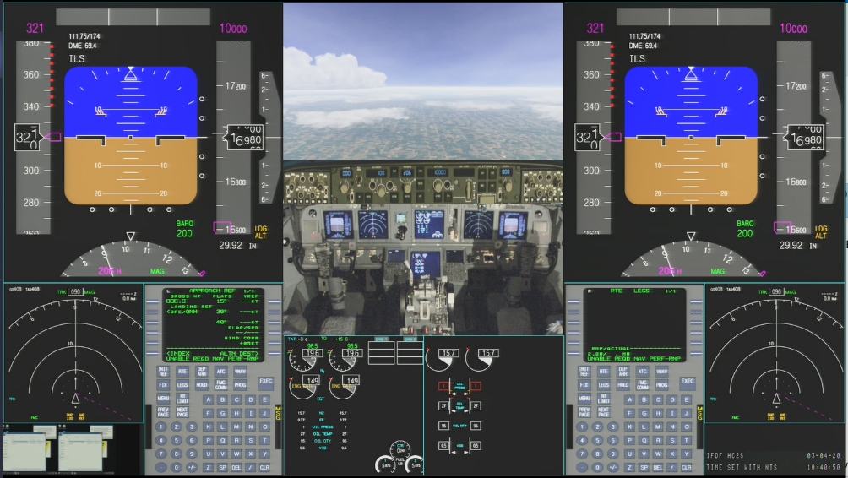
Example: Observer-generated data
What different insights about operators’ safety-related behaviors are learned from the application of different knowledge frameworks to the collection and analysis of observer-based data?
Using videos of simulated air carrier arrivals involving “routine” contingencies
Observers trained on different frameworks will collect and analyze observations
  Line Operational Safety Audit (LOSA) / Threat & Error Management Framework
  American Airlines Learning and Improvement Team / Safety-II-based Framework
Image credit: NASA

Slide 13
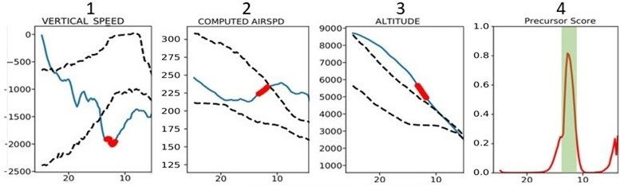
Example: System-generated data
High-speed exceedance at 1000 ft
Used sample of 1000 flights, half with adverse event and half without
Algorithm detects high-probability predictors of a pre-defined adverse event
Non-event flights examined for high precursor probabilities
Pilot transferred aircraft energy from altitude to speed, preserving capability to reduce energy further by introducing drag

Slide 14
A case study
An astronaut aboard the International Space Station (ISS) suffered a close call during an Extra-Vehicular Activity (EVA)
The subsequent mishap investigation board (MIB) identified causal factors that the ISS Program believed they were already addressing
“Why do we keep having these tragedies and not learning the lessons they are teaching us?” – Chris Hansen, MIB Chairman

Slide 15

EVA-23: What Happened?
On July 16, 2013, two crewmembers performed maintenance tasks outside of the ISS during Extravehicular Activity (EVA) 23.
Forty-three minutes into the EVA, one of the crewmembers reported water from an unidentified source inside of his helmet at the back of his head.
The amount of water increased and moved to his face, creating a potential suffocation hazard, and the EVA was terminated.
A mishap investigation board (MIB) later identified the source and cause of the water in the astronaut’s helmet.
In the course of the investigation, the MIB also noted that the presence of water in the helmet had been “normalized.“
Water entering the helmet had been observed in the past and over time, had become accepted as normal suit behavior.
This normalization resulted in missed signals of the seriousness of the event, which led to delays in recognition and response.
Astronaut Luca Parmitano. Image credit: NASA

Slide 16
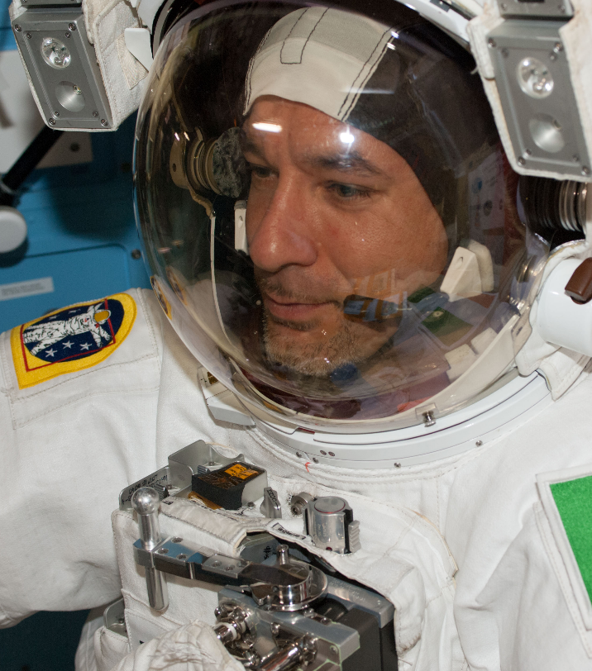
EVA-23 MIB: Selected Findings
Crew member Training did not include this failure mode.
Flight Rule to address this failure mode did not exist.
EMU Hazard Report did not identify the hazard.
ISS Community perception was that drink bags leak.
Minor amounts of water in the helmet were normalized.
Flight Control Team accepted the explanation that the water during EVA 22 was from the drink bag.
Ground Team allowed time pressures of impending EVA to influence actions.
The ISS Program conducted EVA 23 without recognizing the EMU failure that occurred on EVA 22.
Flight Control Team’s perception of the anomaly report process as being resource intensive made them reluctant to invoke it.
Astronaut Luca Parmitano. Image credit: NASA
NASA. (2013). Mishap Investigation Report: International Space Station (ISS) EVA Suit Water Intrusion High Visibility Close Call, IRIS Case Number: S–2013– 199–00005, Redacted copy available at: http://www.nasa.gov/sites/default/files/files/Suit_Water_ Intrusion_Mishap_Investigation_Report.pdf.

Slide 17
EVA-23 MIB: Selected Findings
Missed opportunities to…
Anticipate
Monitor
Respond
Learn
Crew member Training did not include this failure mode.
Flight Rule to address this failure mode did not exist.
EMU Hazard Report did not identify the hazard.
ISS Community perception was that drink bags leak.
Minor amounts of water in the helmet were normalized.
Flight Control Team accepted the explanation that the water during EVA 22 was from the drink bag.
Ground Team allowed time pressures of impending EVA to influence actions.
The ISS Program conducted EVA 23 without recognizing the EMU failure that occurred on EVA 22.
Flight Control Team’s perception of the anomaly report process as being resource intensive made them reluctant to invoke it.

Slide 18
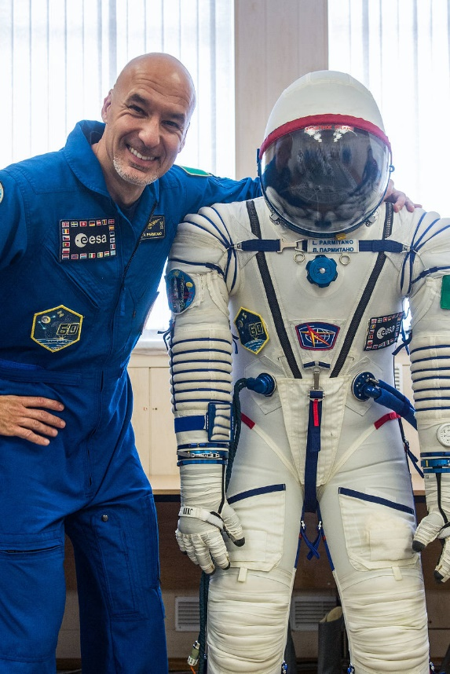
EVA-23: What (Else) Can We Learn?
Focus on “error chains” in mishap investigation limited learning
Reliance on prediction and prevention left ISS vulnerable when responding to unexpected events
“Weak signals” of impending problem were present during everyday work, but were insufficiently understood
No training focused on recognition and dealing with uncertainty
Unintended/unrecognized pressures led to reluctance to speak up
Numerous desired behaviors occurred throughout the “mishap”
Astronaut Luca Parmitano. Image credit: NASA

Slide 19
Create Opportunities by Identifying Different Ways to Learn
“Safety Policy” posted at a NASA field center
Safety-II Focus
Systems are complex and will degrade; there will always be flaws and glitches
Variability is normal—manage it
Procedures are always under-specified and must be interpreted and adapted
Focus on learning
People are an asset—learn, adapt
Focus on what we want: how safety is created
Image credit: Jon Holbrook

Slide 20
Key Take-Aways
Individuals are (almost) always learning
Organizations can affect the creation, retention, and transfer of knowledge
When we characterize safety only in terms of errors and failures, we ignore the vast majority of human impacts on the system
When we systematically restrict opportunities to learn, not only do we learn less and less often, but we can draw misleading conclusions
Many opportunities exist to collect and analyze largely unexploited operator-, observer-, and system-generated data on desired behaviors
Identifying, collecting, and interpreting data on operators’ everyday safety-producing behaviors is critical for developing an integrated safety picture

Slide 21
Thank you!

Slide 22
References
Abel, M., & Bäuml, K.-H. T. (2013). Adaptive memory: The influence of sleep and wake delay on the survival-processing effect. European Journal of Cognitive Psychology, 25, 917–924.
Bellezza, F. (1981). Mnemonic devices classification, characteristics and criteria. Review of Education Research, 51(2), 247-275.
Boeing. (2017). Statistical Summary of Commercial Jet Airplane Accidents: Worldwide Operations 1959 – 2016. Seattle, WA: Aviation Safety, Boeing Commercial Airplanes.
Cohen, C. E. (1981). Person categories and social perception: Testing some boundaries of the processing effect of prior knowledge. Journal of Personality and Social Psychology, 40(3), 441–452.
Craik, F. I. M., & Lockhart, R. S. (1972). Levels of processing: A framework for memory research. Journal of Verbal Learning and Verbal Behavior, 11(6), 671-684.
Ebbinghaus H (1885). On memory: A contribution to experimental psychology. New York: Teachers College, Columbia University.
MacLeod, C. M., Gopie, N.,Hourihan, K. L., Neary, K. R., & Ozubko, J. D. (2010). The production effect: Delineation of a phenomenon. Journal of Experimental Psychology: Learning, Memory, Cognition, 36, 671-685.
PARC/CAST Flight Deck Automation Working Group. (2013). Operational use of flight path management systems. Final Report of the Performance-based operations Aviation Rulemaking Committee/Commercial Aviation Safety Team Flight Deck Automation Working Group. Washington, DC: Federal Aviation Administration.
Uber Technologies, Inc. (2016). Fast-forwarding to the future of urban on-demand air transportation. www.uber.com/elevate.pdf.
Weigman, D. A., & Shappell, S. A. (2001). Applying the human factors analysis and classification system (HFACS) to the analysis of commercial aviation accident data. Proceedings of the 11th International Symposium on Aviation Psychology. Columbus, OH: The Ohio State University.
Weiner, B. (1966). Motivation and memory. Psychological Monographs: General and Applied, 80(18), 1–22.
Yogo, M. & Fujihara, S. (2008). Working memory capacity can be improved by expressive writing: A randomized experiment in a Japanese sample. British Journal of Health Psychology, 13(1), 77-80.

Slide 23
Back-Up
Slides

Slide 24
Responding to Mishap Findings
Finding from Mishap Analysis | Traditional Risk Mgmt. Response (Safety-I) | Safety-II Response
People had concerns but did not speak up. | Encourage workers to speak up (e.g., "if you see something, say something"). | Change meeting format: ask open-ended questions, leader speaks last. Encourage cross-checks and promote cross-role understanding.
No one noticed the emerging problem. | Attribute to complacency or loss of situation awareness. Encourage workers to be careful and pay attention. | Look for evidence of dismissing problems, prioritizing authority over expertise, simplified root-cause analyses. Implement structured pre-mission briefs focused on reinforcing awareness of risks and contingencies.
There was a failure in responding to the unexpected. | Create rules that specify what the correct response should be. | Build tangible experience with uncertain and unpredicted events. Develop drills and simulations to practice noticing subtle cues and responding to surprise.
Mishap was a recurring anomaly. | Create more documentation of incidents and lessons learned. Require workers to review and study them. | Expand analysis methods and breadth of learning opportunities. Identify similar events in which things went well, and ask, “What can we learn from our success?”

