Slide 1
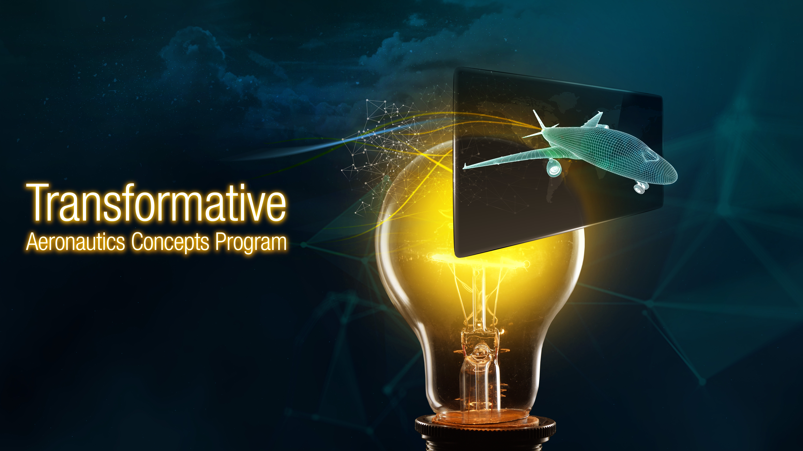
Developing an Innovation Strategy
NASA TACP Innovation Strategy Development Team
Vanessa Aubuchon
Mark Ballin
David Cannon
Steven Crimaldi
Justin Gray
Kelley Hashemi
Parimal Kopardekar
Debbie Martinez
Kenny McCombs
Anna McGowan
Joseph Morrison
Vikram Shyam
David Voracek
Marty Waszak
Gerard Welch
February 3, 2020
The Tech7 Company
Radius Capital
Integr8 Engineering Consulting

Slide 2
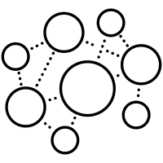



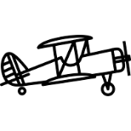





Aeronautics Transformation: Enabling Aviation’s Third Wave
The Third Wave
Convergence of many innovative technologies and practices in aviation, spanning full system life cycles
Driven by the intersection of multiple:
  Industries
  Communities
  Technologies
Cutting edge R&D easily accessible to many
Aviation 3.0
Cyber-physical aviation
Aviation 2.0
Viable transportation
Aviation 1.0
Early adoption
Connecting the World
Ubiquitous Aviation
Data Fabrics, Electrification, Sustainability, Machine Intelligence, Adaptability, Resilience
  Disciplines
  Innovation cultures
Mastery of Flight
Industry 4.0
Industry 3.0
Cyber-physical systems
Internet of things
Networks
Industry 2.0
Industry 1.0
Automation
Computers
Electronics
  Sustainable
  Zero Emissions
  Completely Digital
  Extremely Connected
  Massively Scaled
  Completely Safe
  Completely Quiet
Mass production
Assembly line
Electricity
  Instantly Available
  Available Everywhere
  Fast Production
  Inexpensive
  Autonomous
  Secure
Mechanization
Steam power
Weaving loom
1900
2000
We know how to advance Aviation 2.0. We need a step change to lead Aviation 3.0.

Slide 3
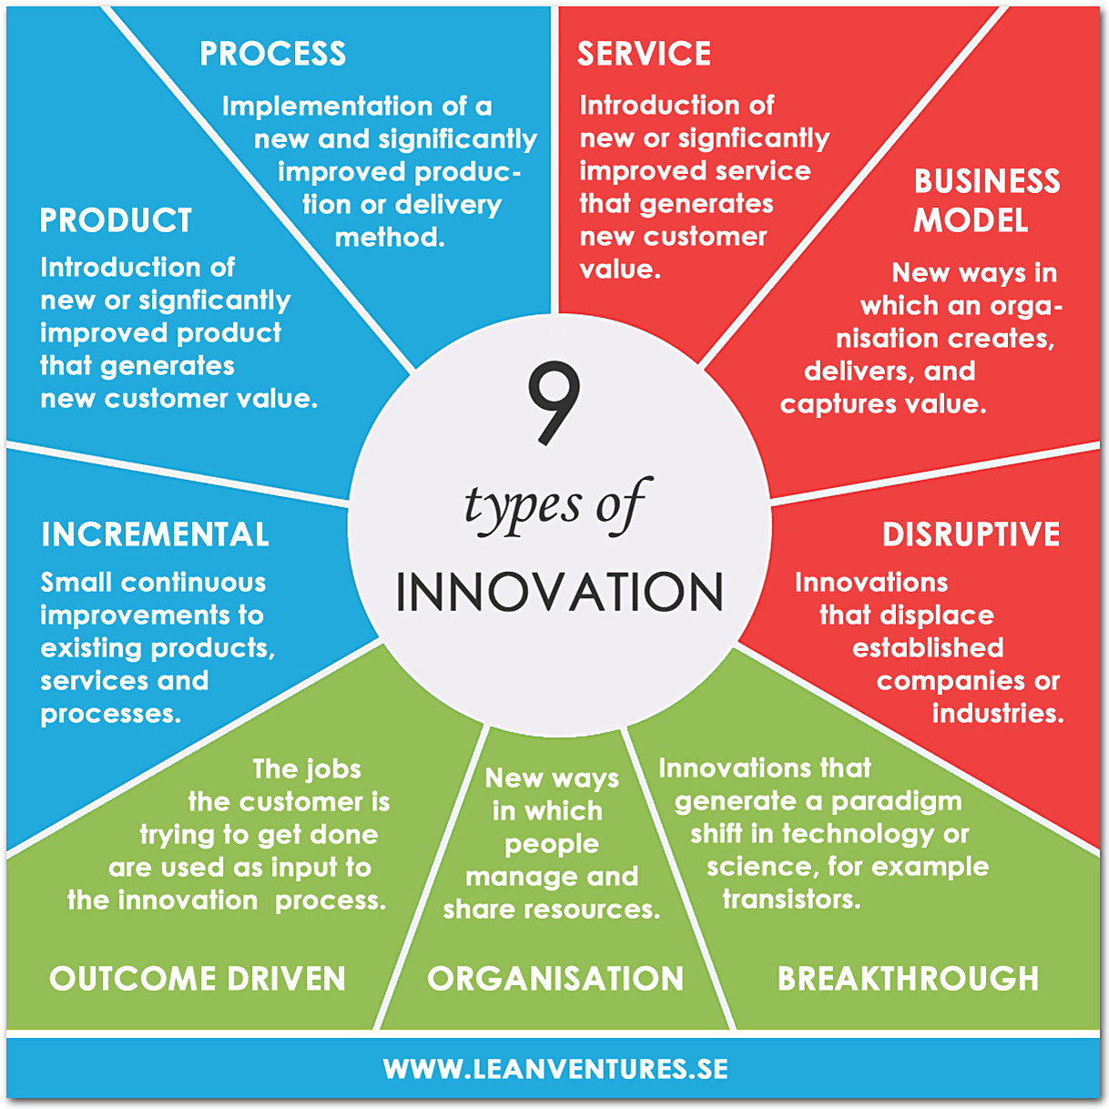
Innovation: Critical to Transformation
What innovation characteristics are important to NASA’s mission?
Innovative markets?
Technical breakthroughs?
High impact potential?
System scale: large or small?
Market demand or societal need?
Direct need/demand or anticipated future need/demand?
NASA-unique topics or broad topics?
Almost all are important for NASA Aeronautics, but some are more appropriate for TACP. Understanding this is at the heart of the TACP innovation strategy development.

Slide 4
How can NASA Facilitate Transformation?
  Strategies for Consideration
  Transformation Leader: Lead and coordinate the broad aeronautics community by fulfilling unmet needs for aviation transformation
  Strategic Thrust Generator: Define and establish foundations for new NASA Aeronautics strategic thrusts and new mission programs
  Idea Incubator: Provide early innovation and transformative advancements to support the aviation community and the other ARMD programs
  People Incubator: Create an organizational and cultural environment that actively seeks innovators, teaches innovation skills, and incentivizes innovative behaviors in the NASA workforce

Slide 5
An Ecosystem for Collaboration
  Transformation Leadership relies on establishment of an innovation ecosystem with the stakeholder community
A wide range of partnerships with traditional and nontraditional organizations
All partners are peers
NASA can provide
  Full system perspective and oversight
  Alignment and coordination
  Gap-bridging, as needed
Energy
Manufacturing
Materials
Aviation
Industry
Communications
Startup and Venture Communities
NASA Aeronautics
AAVP
AOSP
IASP
Mission Offices
PAMO
NASA Centers
TACP
Service Providers
Non-Traditional Aviation Stakeholders
Big Data
Academic
Institutions
Aviation Applications
Machine Learning
Other Government Agencies
Transportation
Sector
Software
Sensing
Transportation Planners

Slide 6

Potential Transformation Life Cycle
(NASA as Transformation Leader)
FUTURECASTING
State of the art understanding
Situational awareness
Map of big picture
ROADMAPPING
Technology/capability gaps
Analysis/synthesis
Paths forward
PLANNING INTEGRATED SOLUTIONS
Selection and incorporation of concepts and research products into capability roadmap
EXECUTING
Systems engineering and cross-disciplinary development and integration
Production-ready capability
Industry, Academia, and Other Government Agencies
Many Stakeholders ♦ Multi-disciplinary ♦ Multi-Industry
Visions and Ideas Beyond the Horizon
Community Coordination and Ideas Proof-of-Concept
Tech Break-throughs, System-of-Systems Innovations
Prototyping, Evaluation, System-of-Systems Analysis
Industry Needs and
Intent
Predictions of Capability
Capabilities, Standards, Regulations
Developed Systems
Aviation 3.0

Slide 7
TACP’s Role: NASA Aeronautics’ Transformation Catalyst
Envision: Establish, coordinate, and sustain aviation transformation visions
Discover: Provide agile exploration and proof-of-concept for bleeding edge concepts and technologies.
Advance: Perform long lead time research of transformative concepts and technologies
Ignite: Foster an agile innovation culture for NASA and the stakeholder community

Slide 8
Collaborative Innovation
TACP
Discovery
Create new system concepts and technologies based on nascent NASA/industry capabilities. Establish value.
Advancement
Provide foundational technical advances that support aviation vision and satisfy unmet needs of new concepts, including those created in Discovery
Agility
Organization and process for creating, assessing, and adapting extremely rapidly
Discovery
Discover new aeronautics S-curves based on nascent NASA and industry capabilities
Agility
Ideate, create, assess, and adapt extremely rapidly
Advancement
Provide foundational technical advances that fulfil needs of aviation vision and satisfy unmet needs of new concepts

Slide 9
Technical Innovation Landscape
Disruptive
Using known ideas to solve an uncharacterized problem
The domain of entrepreneurs
Wicked
Seeking novel ideas to solve an uncharacterized problem
The neglected domain
Uncharacterized
CAS and UI
CAS and UI
Problems That Need Solutions
Routine
Novel combination of known ideas to solve a characterized problem
The domain of business
Research
Developing novel ideas to solve a characterized problem
The domain of research
Characterized
Mission Programs
TTT and UI
Known
Novel
Source: Ulf Ehlert, Understanding Innovation Blog
Ideas for Potential Solutions

Slide 10
What We’ve Learned So Far
NASA is uniquely positioned to establish and maintain Transformation Visions for the aviation community, based on a big picture situational awareness.
An open innovation ecosystem is needed to facilitate collaboration across the Stakeholder community.
We all need to actively manage innovation. Management strategies need to be tailored to each innovation type.
Innovation is a critical element of transformation. TACP can be the transformation catalyst within NASA Aeronautics.

