Slide 1


KSC Research and Technology Portfolio
Kathleen B. Loftin, Ph.D.
Deputy Center Chief Technologist
NASA Kennedy Space Center
Kathleen.loftin@nasa.gov

Slide 2
KSC Research and Technology Guiding Principles
KSC Research and Technology is mission driven and technology focused
Focused on filling specific technology gaps
Applied research with a broad team of both scientists and engineers
Our Researchers:
  Flexible to meet NASA’s mission priorities and resources
  Work across many disciplines collaboratively
  Partner with other Centers, commercial entities, and academia

Slide 3
R&T Portfolio – NASA CCT
Coordinated R&T Portfolio Alignment to “Primary” and “Supporting” Center Roles
(Per NPD 1000.3, v3.1 “The NASA Organization”, August 2020)
HUMAN EXPLORATION & SPACE OPERATIONS
SPACE & EARTH SCIENCE
Research
Ground Operations and Services
Flight Missions
Plant research and production
Designing, developing, operating, sustaining flight and ground systems and support infrastructure, including integration and testing
Expendable Launch Vehicles for small, medium and large class missions
Technology and Development
Launch processing for launch vehicle and spacecraft: Processing, servicing, maintenance, command, control, telemetry, launch, landing and recovery operations; also includes support for processing crew (work to maximize shared equipment, resources, processes, and systems with GSFC/WFF)
*
Biological sciences
(plant research and production)
Launch range: Orbital (work to maximize shared
equipment with GSFC/WFF)
Space Systems Development & Operations
ISS
Payload and flight science experiments: process, assembly, integration, test
Commercial crew systems development, including Commercial Crew Systems Program
Program/Project Management
Certification of new commercial launch vehicles to launch high-value civil sector payloads
Commercial Crew Program
Launch Service Program
*
Exploration Ground Systems Program
Acquisition of commercial services for launch services
Deep Space Logistics Project
Bolded text denotes new content
3

Slide 4
R&T Portfolio – NASA CCT
Coordinated R&T Portfolio Alignment to “Primary” and “Supporting” Center Roles
(Per NPD 1000.3, v3.1 “The NASA Organization”, August 2020)
HUMAN EXPLORATION & SPACE OPERATIONS
SPACE TECHNOLOGY
CROSSCUTTING TECHNICAL CAPABILITIES
Space Systems Development & Operations
Discipline Capabilities
Habitation (support to specific roles in NextSTEP-2, Appendix A BAA)
ISRU propellant and consumables production
Propulsion: Chemical propulsion
flight integration (LSP); nuclear (launch support/approval)
Destination systems (specifically In Situ Resource Utilization (ISRU), surface construction, dust mitigation)
Materials: Polymer matrix composites (PMC) processing for center mission needs only
Surface systems and operations
Technology Development
Propulsion: Chemical propulsion flight integration (human transportation)
Water resource utilization technologies development (e.g., water filtering and CO₂ capture and reduction in breathing air)
Service Capabilities
Logistics reduction technologies (e.g., “trash to gas”)
Space environments test Right/West altitude chamber
Lander technology
Ground Operations and Services
Lander ground operations
Bolded text denotes new content
4

Slide 5
KSC R&T Portfolio Alignment to “Primary” Center Roles
(Center Roles Per NPD 1003.E, “The NASA Organization”, Section 6.2 – June 2019)
HUMAN EXPLORATION & SPACE OPERATIONS
SPACE & EARTH SCIENCE
CROSSCUTTING TECHNICAL CAPABILITIES
Space Systems Development & Operations
Flight Missions
Discipline Capabilities
Commercial crew systems development, including Commercial Crew Systems Program
Expendable Launch Vehicles for small, medium and large class missions
Propulsion: Chemical propulsion
flight integration
Ground Operations and Services
Storage, distribution, and conservation of cryogenic fluids and commodities
Acquisition of launch services, and commercial crew when development complete, including Launch Services Program
Tools and techniques for control, operation, inspection, analysis and repair
Designing, developing, operating, sustaining flight and ground systems and support infrastructure, including Ground Systems Development and Operations Program
Environmental and Green Technologies
Health and Safety Systems for Operations
Launch processing for launch vehicle and spacecraft: Processing, servicing, maintenance, command, control, telemetry, launch, landing, recovery; also includes support for processing crew (work to maximize shared equipment with GSFC/WFF)
Communications and Tracking Technologies
Robotic, automated and
autonomous systems and operations
Launch range: Orbital (work to maximize shared
equipment with GSFC/WFF)
Operations Support and Advanced Studies leveraging Primary Center Role expertise
ISS
Payload Processing & Integration Technologies (all class payloads)
Payload and flight science experiments: process, integration, test
R&T Technologies on In-Space Platforms (e.g., ISS, Gateway, Human Habitats)
Gateway
Logistics
Logistics Element Management,
including cislunar logistic systems development and services
Damage-resistant and self-healing materials
Notes:
Human Exploration and Space Operations
Space systems development & operations:
§ Commercial crew systems development, including Commercial Crew Systems Program
Ground operations and services:
§ Acquisition of launch services, and commercial crew when development complete, including Launch Services Program
§ Designing, developing, operating, sustaining flight and ground systems and support infrastructure, including Ground Systems Development and Operations Program
§ Launch processing for launch vehicle and spacecraft: Processing, servicing, maintenance, command, control, telemetry, launch, landing, recovery; also includes support for processing crew (work to maximize shared equipment with GSFC/WFF)
§ Launch range: Orbital (work to maximize shared equipment with GSFC/WFF)
International Space Station:
§ Payload and flight science experiments: processing, integration test
Space and Earth Science
Flight missions:
§ Expendable launch vehicles for small, medium and large class missions
CROSSCUTTING TECHNICAL CAPABILITIES
Discipline capabilities:
§ Propulsion: Chemical propulsion flight integration (LSP) (c.f. EC 2015-11-18, APMC 2016-09-14); nuclear (launch support/approval)
Added missing alignment of robotics/autonomous systems to launch vehicle and payload and flight science experiment processing, Farmbot, hazardous ops.??

Slide 6
R&T Portfolio Alignment to “Primary (Green)” & “Supporting (yellow)” Center Roles (Center Roles Per NPD 1003.E, “The NASA Organization”, Section 6.2 – June 2019)
HUMAN EXPLORATION & SPACE OPERATIONS
SPACE TECHNOLOGY
CROSSCUTTING TECHNICAL CAPABILITIES
Research
Technology and Development
Discipline Capabilities
Plant Research and Production
Biological Sciences
(Plant Research and Production)
Materials: Polymer matrix composites processing for center mission needs only
Water/nutrient recovery and management
Food production and waste management
Damage-resistant and self-healing materials
Automated and autonomous detection and repair
Plant habitats and Flight Systems
Robotic, automated and autonomous food production
Space Systems Development & Operations
Propulsion: Chemical Propulsion flight integration (human transportation)
Habitation
Service Capabilities
Plant habitats: manual and autonomous
Robotic, automated and autonomous food production
Space Environments Test: Right/West Altitude Chamber
In Situ Resource Utilization (ISRU)
Development Planning/Strategy to fit into Architecture
Resource Acquisition – Regolith/Trash & Gases Liquids
Distribution and Storage of In Situ Resources
Resource Assessment/Prospecting
Research and Technology Program/Project Management
Consumable Production – Extract/Produce Fuel
In Situ Construction such as Landing pads, Roads and Berms
Scientific Instruments
Notes:
Human Exploration and Space Operations
Research:
§ Plant research and production
Space systems development & operations:
§ Habitation (support to specific roles in BAA)
§ ISRU (limited to completion of Resource Prospector work only; allow new Systems Capability Leadership Team to identify any future KSC role
Space Technology:
§ ISRU (allow new Systems Capability Leadership Team to identify any future KSC role)
CROSSCUTTING TECHNICAL CAPABILITIES:
Discipline capabilities:
§ Materials: Polymer matrix composites (PMC) processing for Center mission needs only (c.f. APMC 2016-09-14; APMC 2017-03-15)
§ Propulsion: Chemical propulsion flight integration (human transportation) (c.f. APMC 2016-09-14)
Service capabilities:
§ Space environments test: Right/West altitude chamber 130 (c.f.

Slide 7
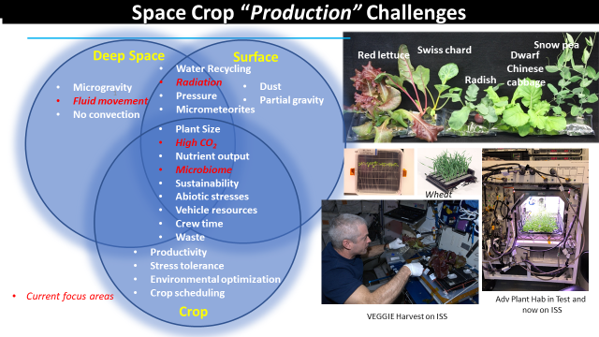
Plant Research and Production

Slide 8
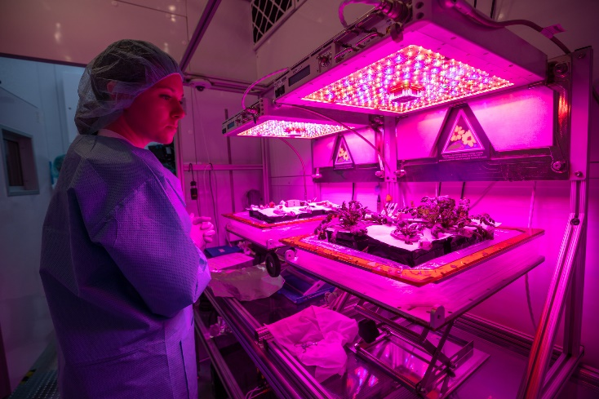
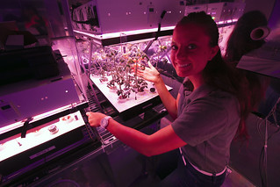
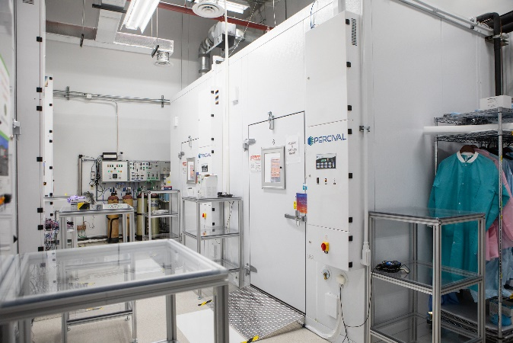
Plant Research and Production
KSC Specialized Facilities and Resources:
Plant Growth Chambers with adjustable environmental parameters
  Lighting
  Atmospheric pressure and gas mixtures
  Temperature
  Zero gravity Lab
Analog Facilities that match the ISS Plant experiments
State of the Art analytical instrumentation and DNA sequencers
In-house Prototype Labs

Slide 9
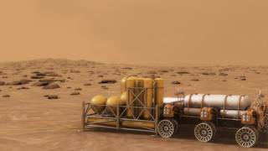
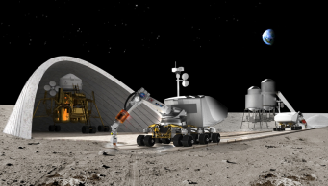
ISRU- In-Situ Resource Utilization
Living off The Land
There is a great expense required to lift mass into orbit and beyond; how can we explore with less launched-mass?
The solar system contains abundant resources; the atmosphere and soils of Planetary bodies. And sunlight!
ISRU will mine these resources and convert them to mass saving commodities.
We also look at converting wastes to useful commodities.
If we want to pioneer in the solar system, we must use the resources that are in abundance!

Slide 10
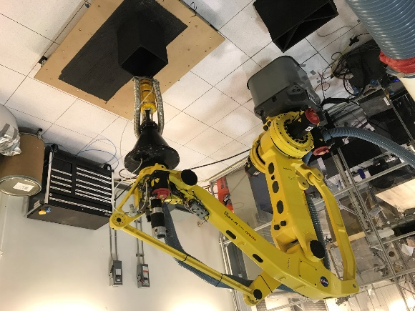
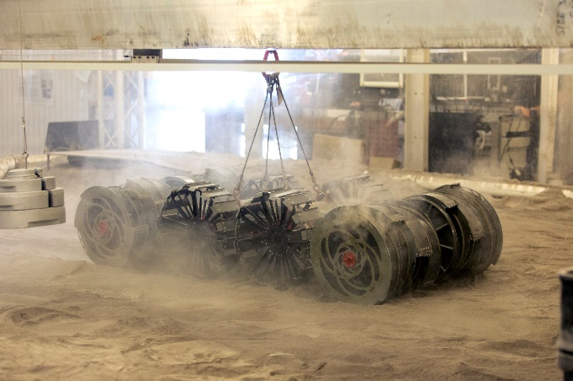
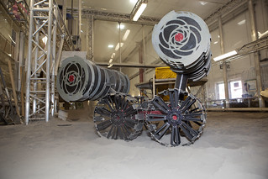
ISRU- Additive Construction
KSC specializes in excavation of regolith and using it to make structures
KSC research addresses the challenges of working with regolith in reduced gravity including mining and dust mitigation

Slide 11
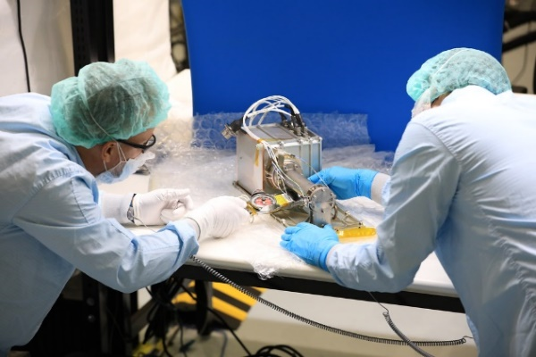
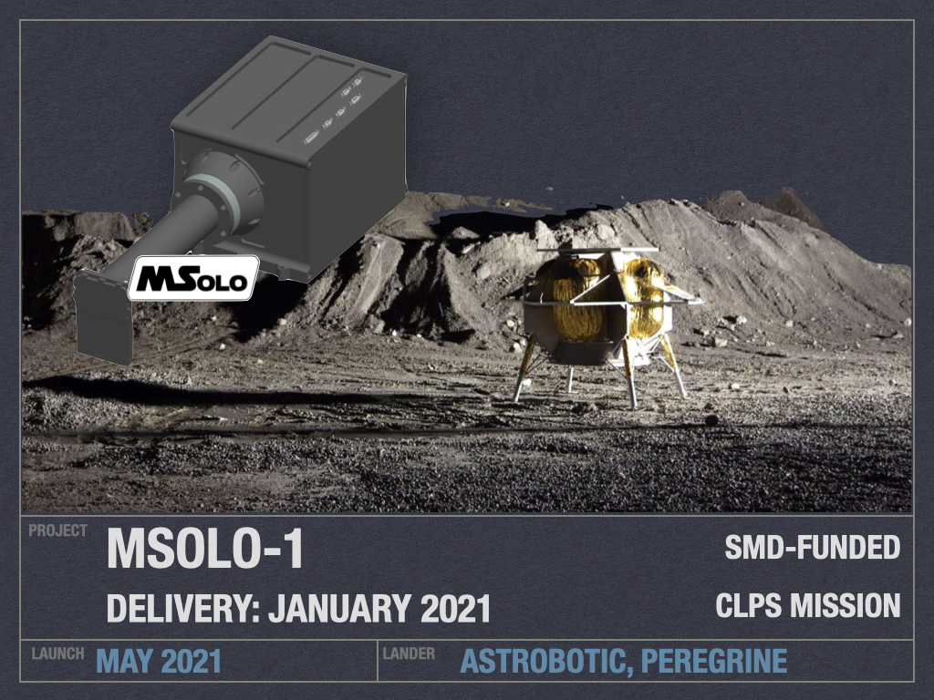
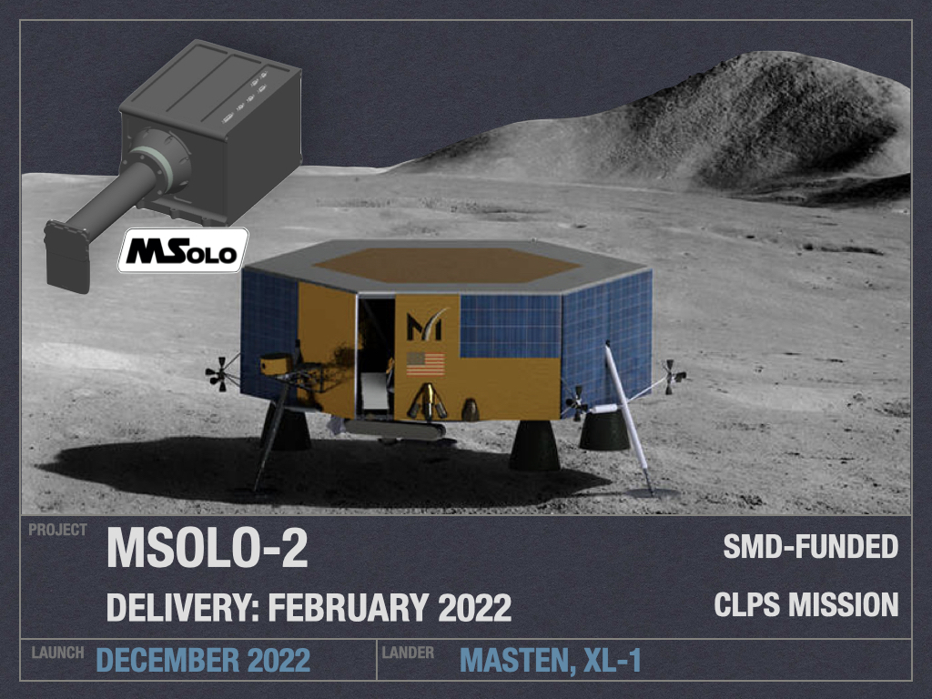
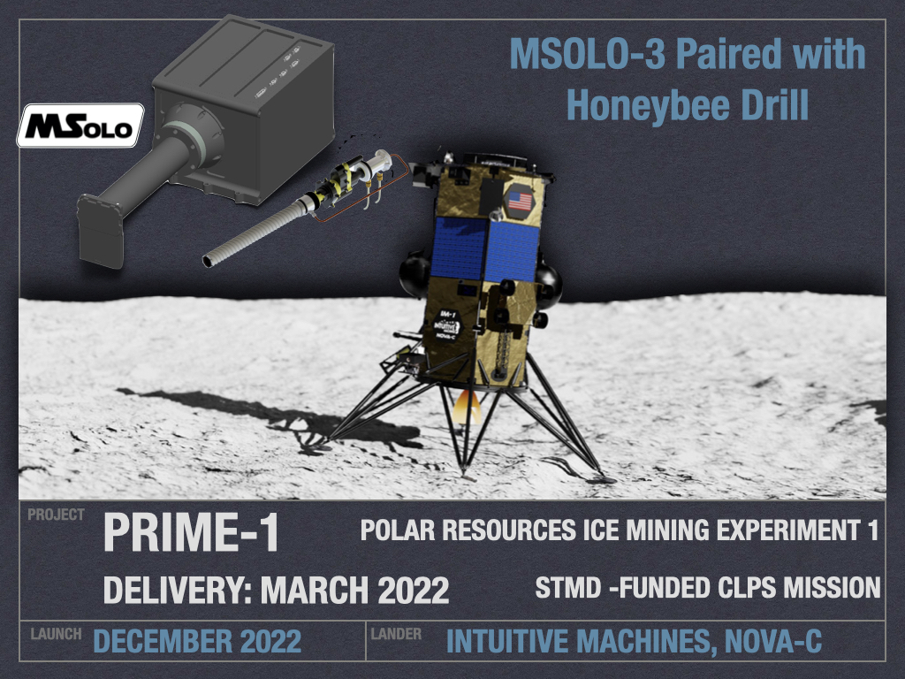
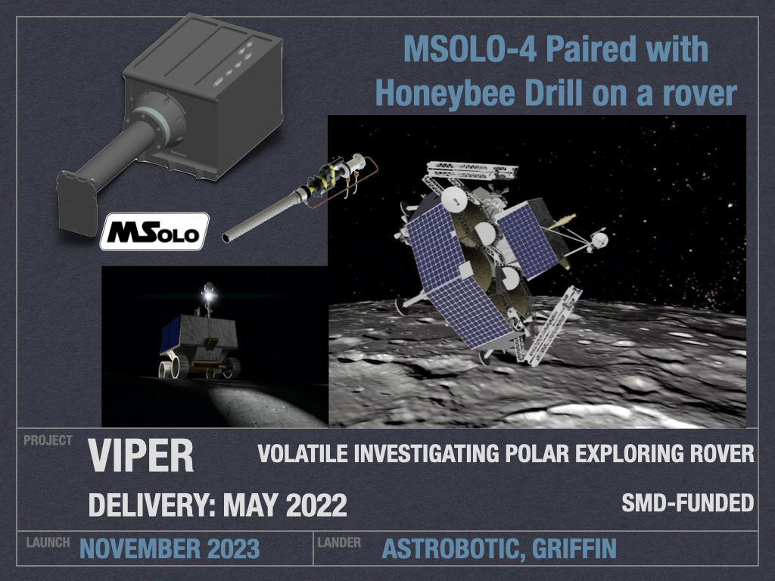
ISRU- VIPER MSOLO
MSolo is a commercial off-the-shelf mass spectrometer
modified to work in space. NASA will use MSolo
to identify molecules on the surface of the Moon.
Have four lunar missions planned
Overarching goal of ground proving the presence of water
Determining whether mining is viable
Determine best mining sites

Slide 12
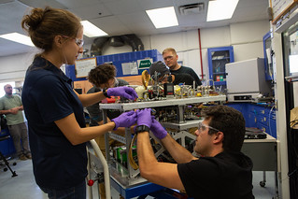
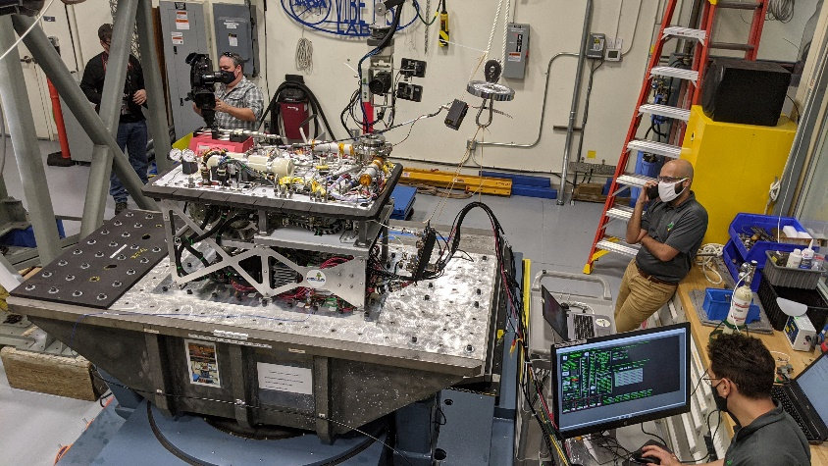
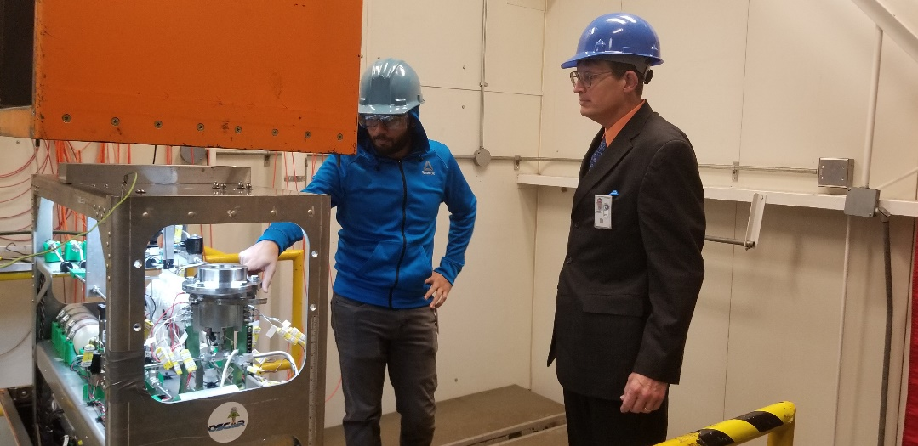
Trash to Gas – Logistics Reduction
Study ways to reuse waste into valuable commodities
Reduces launch mass
Earth-friendly applications

Slide 13

We Want YOU
To get Involved!

Slide 14
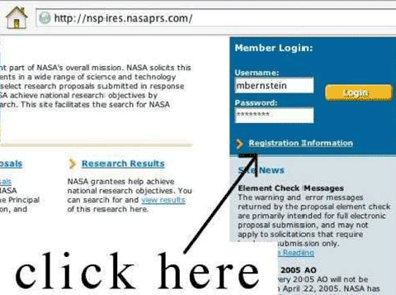
NSPIRES
NASA solicits research through the release of various research announcements in a wide range of science and technology disciplines
All research solicitations advertise and receive proposals through NSPIRES, although other solicitations do go thru: https://beta.sam.gov (e.g. CSLI) and others thru Small Business Innovative Research (SBIR) https://sbir.nasa.gov
Subscribe to NSPIRES to stay up-to-date on current and future opportunities
  Learn about previous awardees and read successful abstracts
Register and access NSPIRES here: http://nspires.nasaprs.com/
Additional information here: https://science.nasa.gov/researchers/sara/how-to-guide/nspires-registration

Slide 15
ROSES
Research Opportunities in Space and Earth Science (ROSES), an omnibus solicitation for proposals
Typically released on Valentine’s Day, February 14
Includes opportunities for Basic and Applied Research, Technology Development, Guest Investigator Programs, and Early Career Programs in support of NASA Science
Contains many individual program elements, each with its own due date and topics
Subscribe to NSPIRES RSS feed and mailing lists for updates, amendments, and clarifications to program elements
ROSES How To Guide can be found at https://science.nasa.gov/researchers/sara/how-to-guide

Slide 16
Peer Review Panels
NASA Science makes decisions based on competition and peer review
Volunteering on a review panel is highly encouraged
  Opportunity to learn how to write successful proposals
  NASA provides honorarium for participants
More information on how to volunteer here: https://science.nasa.gov/researchers/volunteer-review-panels

Slide 17
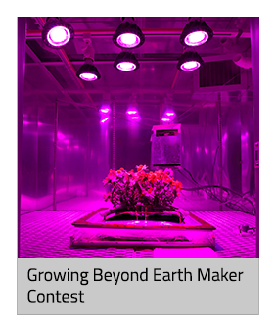
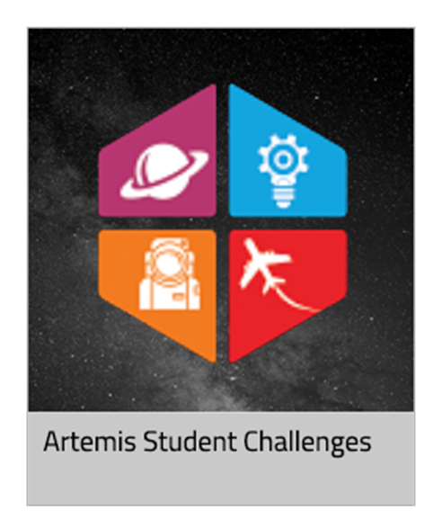
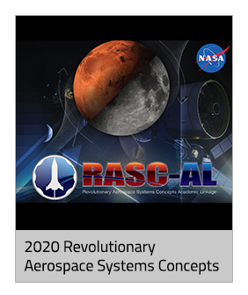
Crowd Sourcing
https://www.nasa.gov/solve/index.html
NASA Solve
One-stop-shop website is where you’ll find opportunities to participate
in challenges, prize competitions, and citizen science activities that develop
solutions for problems related to NASA’s mission

Slide 18
Thank you for you Attention

