Slide 1

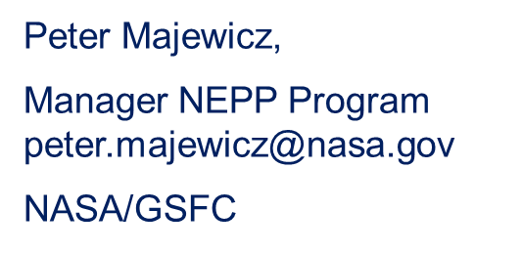

Recent NEPP Program Accomplishments
and Fiscal Year 2021 Plans
Jonny Pellish,
Dep Manager, NEPP Program jonathan.pellish@nasa.gov
NASA/GSFC

Slide 2


Agenda
NEPP Mission
Focus Areas
FY20 Highlights
FY21 Plans
NASA NEWS

Slide 3
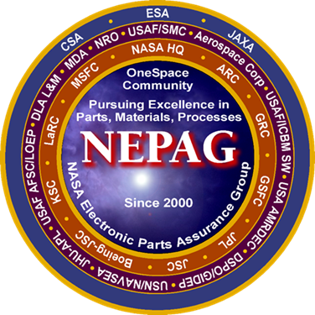
NEPP – Mission Statement
Provide NASA’s leadership for developing and maintaining guidance for the screening, qualification, test, and reliable use of EEEE parts by NASA, in collaboration with other government agencies and industry.
NASA Electronic Parts Assurance Group (NEPAG) is a core portion of NEPP

Slide 4
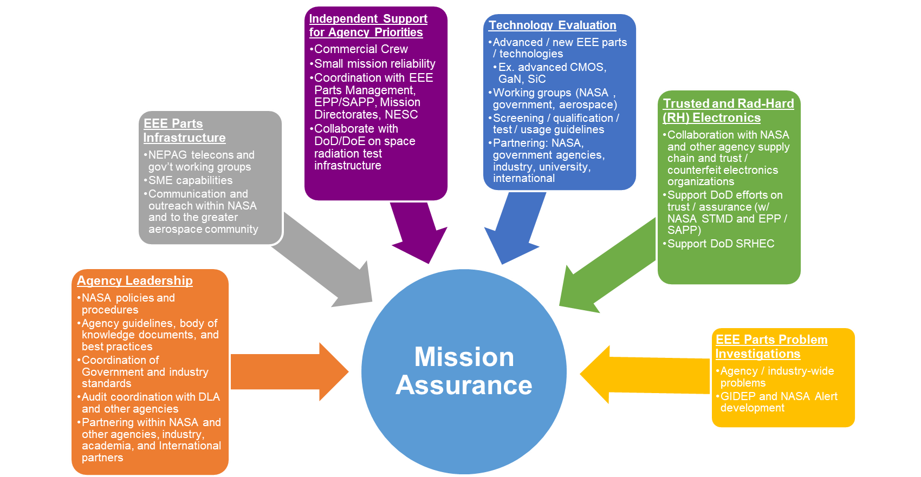
NEPP Charter

Slide 5








Standards & Policy and Guideline Development
CLASS D CLASS C CLASS B CLASS A
Updating NPR-8705.4, Risk Classification for NASA Payloads
  Appendix D – Recommended SMA-Related Program Requirements for NASA Class A-D Payloads
  Contains a mapping for EEEE Parts that recommends parts with respect to payload class (A-D), mission criticality (critical/noncritical) to part assurance level (screening and lot qualification testing)
Participated in the Development of a NASA Engineering and Safety Center (NESC) Technical Assessment Report
Title: Recommendations on Use of Commercial-Off-The-Shelf (COTS) Electrical, Electronic, and Electromechanical (EEE) Parts for NASA Missions
Available for public download at NASA Technical Reports Server https://ntrs.nasa.gov/

Slide 6
Standards & Policy and Guideline
Development
Development of the NASA EEEE Parts Selection, Testing and Derating
Standard (NASA-STD-8739.11)
Original (based on EEE-INST-002) :
  GSFC document (used by other Centers)
  3 Screening and Qualification Levels
  18 Device Specific Sections
  Last update 2003
Update:
  4 Screening and Lot Acceptance Testing Levels
  Plan is 27 Device Specific Sections
  Status: In Approval Process
Capacitor
Connectors
Crystal
Crystal Oscillator
Detectors
Fiber Optics
Filter
Fuse
Heaters
Laser Devices
Magnetics
Microcircuit Hybrid
Microcircuit Monolithic
Microcircuit PEM
Microcircuit RF /
Microwave Devices
Microcircuit Hybrid PEM
Motors
Optoelectronics
Printed Circuit Boards
Relays
Resistors
Semiconductor Devices
- Discrete
Semiconductor Devices
- PES
Switch
Thermister RTD
Wire and Cable
Red: New sections

Slide 7
Working Groups / Collaborations

Slide 8

Government Working Group (GWG)
NASA Electronic Parts Assurance Group (NEPAG)
Purpose – To discuss in detail, topics from NEPAG that require additional in-depth technical solutions
Objective – To establish a single government position applicable to both terrestrial and space programs
Attendees – 7 Government User Agencies and DLA
Air Force – SMC/The Aerospace Corporation; Air Force – Wright-Patterson; Army; MDA; NASA Centers; Navy – NSWC Crane Division; NRO/The Aerospace Corporation; DLA

Slide 9
FY20 Highlights

Slide 10
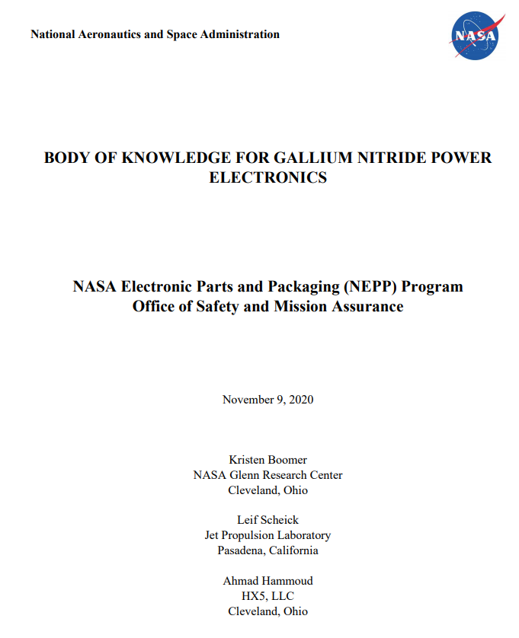
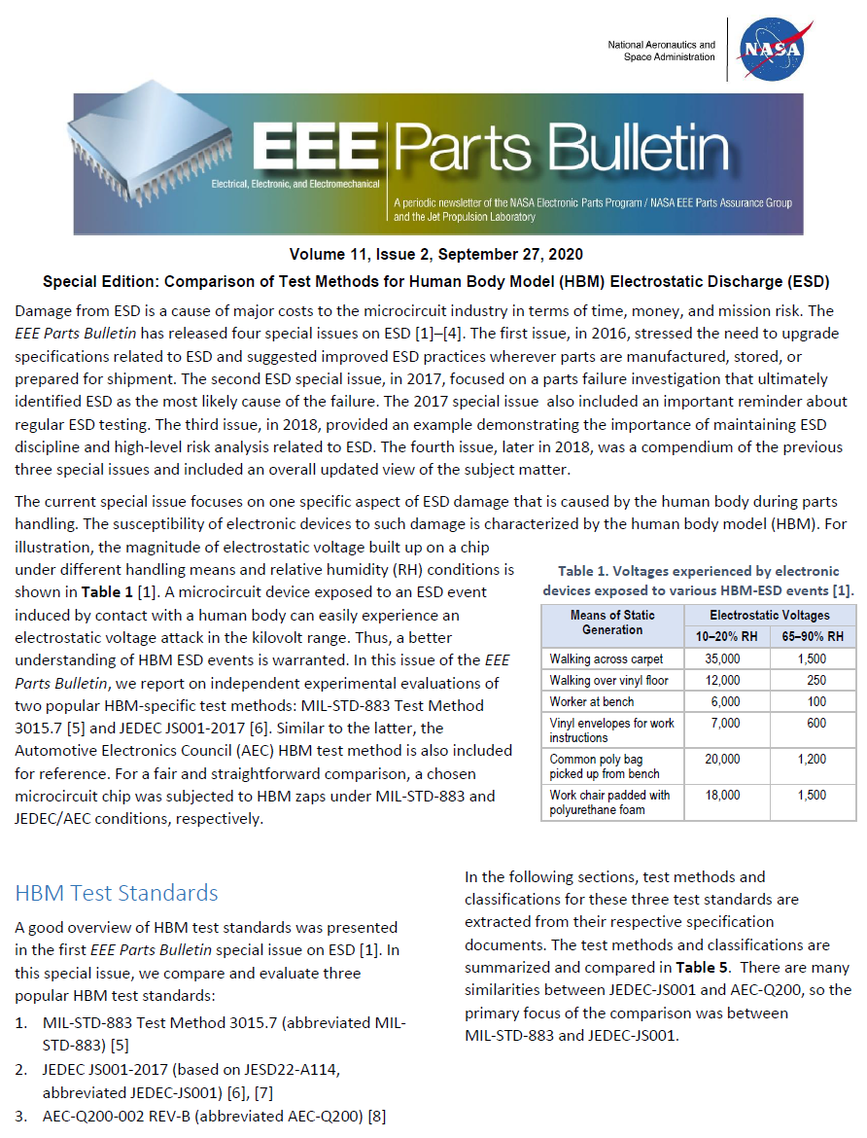
Body of Knowledge Document for
Gallium Nitride Power Electronics
EEE Parts Bulletin
- PEMS
- ESD

Slide 11
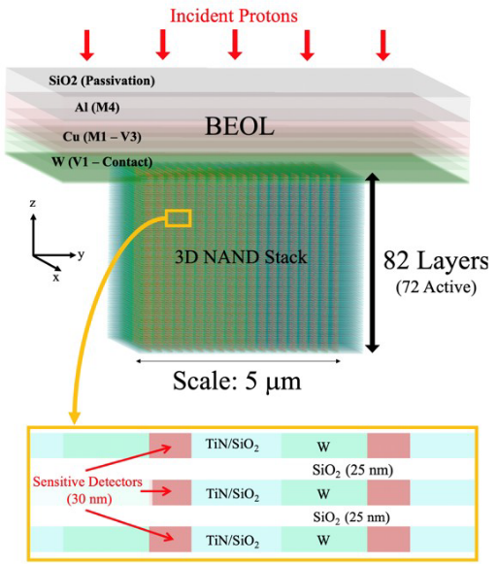
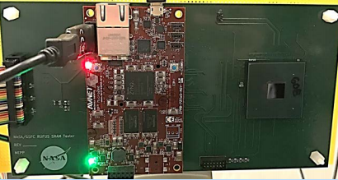
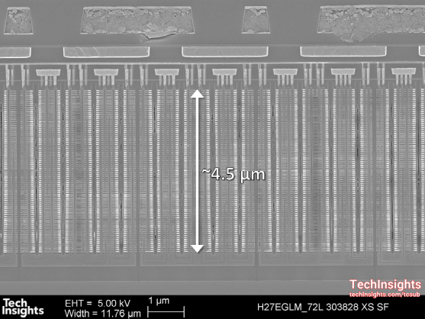
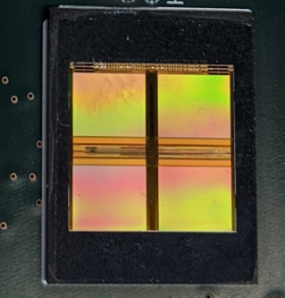
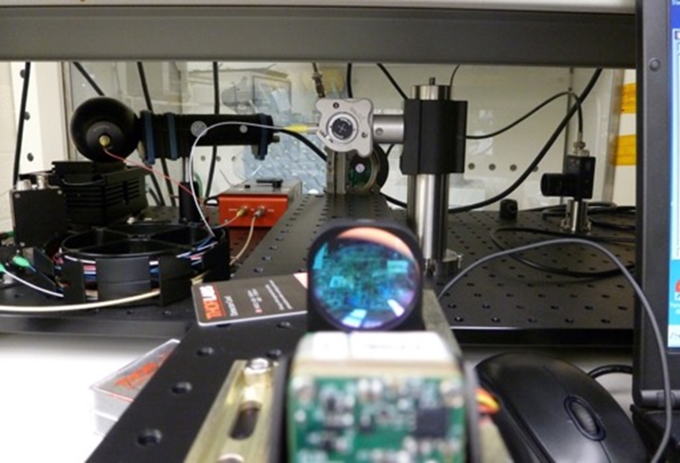

Select FY2020 NEPP Accomplishments
Extensive radiation testing of 3D NAND Flash Memory
Radiation testing of 22FDX FDSOI CMOS
Evaluation of COTS LiDAR
“Evaluation of
Polymer Tantalum Capacitors for
Space Applications”
Alexander Teverovsky (GSFC/SSAI)
Concluded NSWC/SRHEC Industrial
Base Assessments
- Major support from AF/SMC
- Components and systems;
- Production and procurement
- Passive & Semiconductor Devices
  Performing characterization over relevant simulated space conditions and environments

Slide 12
2020 NEPP Electronic Technology Workshop
MILSPECs – Incorporation of Plastics (4)
Processors, FPGAs & Memories (6)
Photonics (2)
Collaborations/Working Groups (4)
GaN & Sic (3)
Advanced Packaging (2.5/3D, etc.) (6)
Passives: Capacitors and Resistors (5)
Training / Tutorials (2)
Small Sats & COTS Utilization (7)
Model Based Mission Assurance (MBMA)
All NETW presentations for 2020 and past years are at https://nepp.nasa.gov/

Slide 13
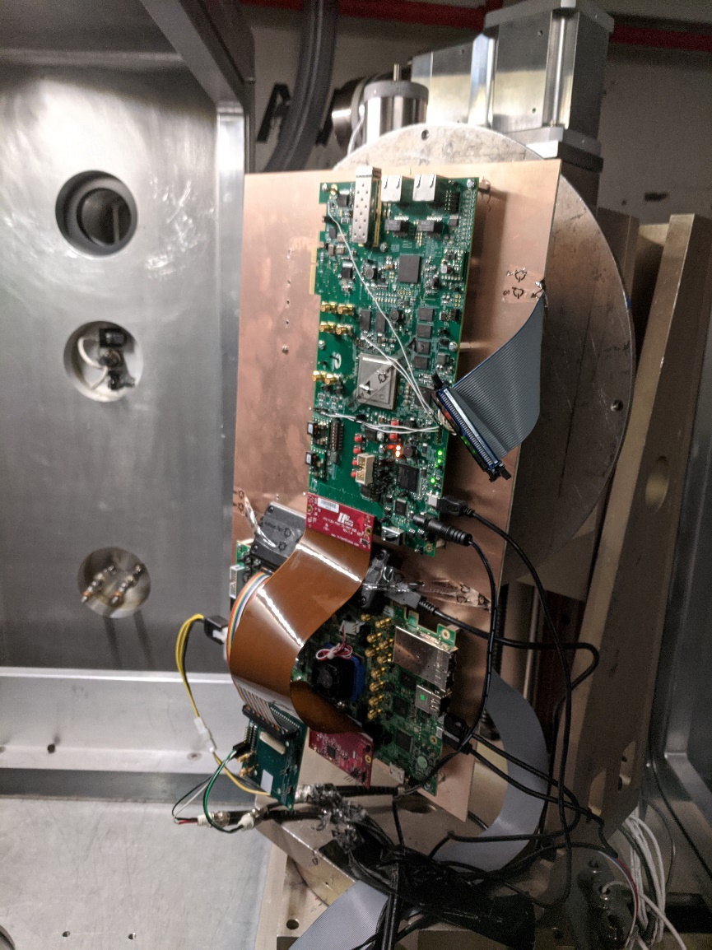
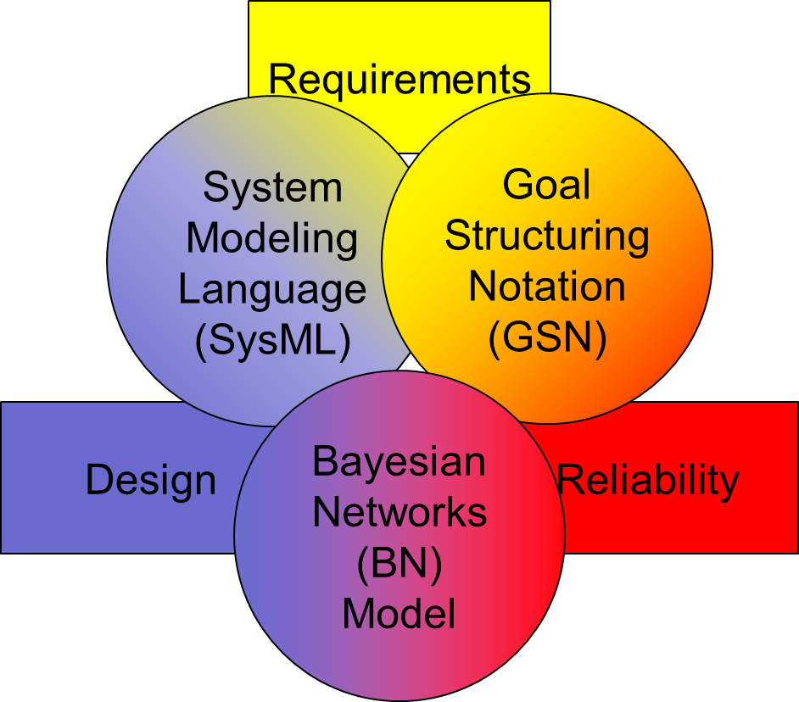
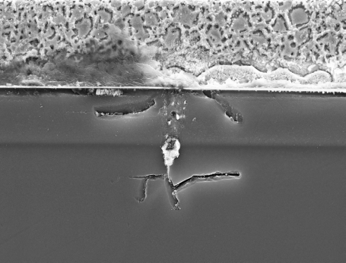
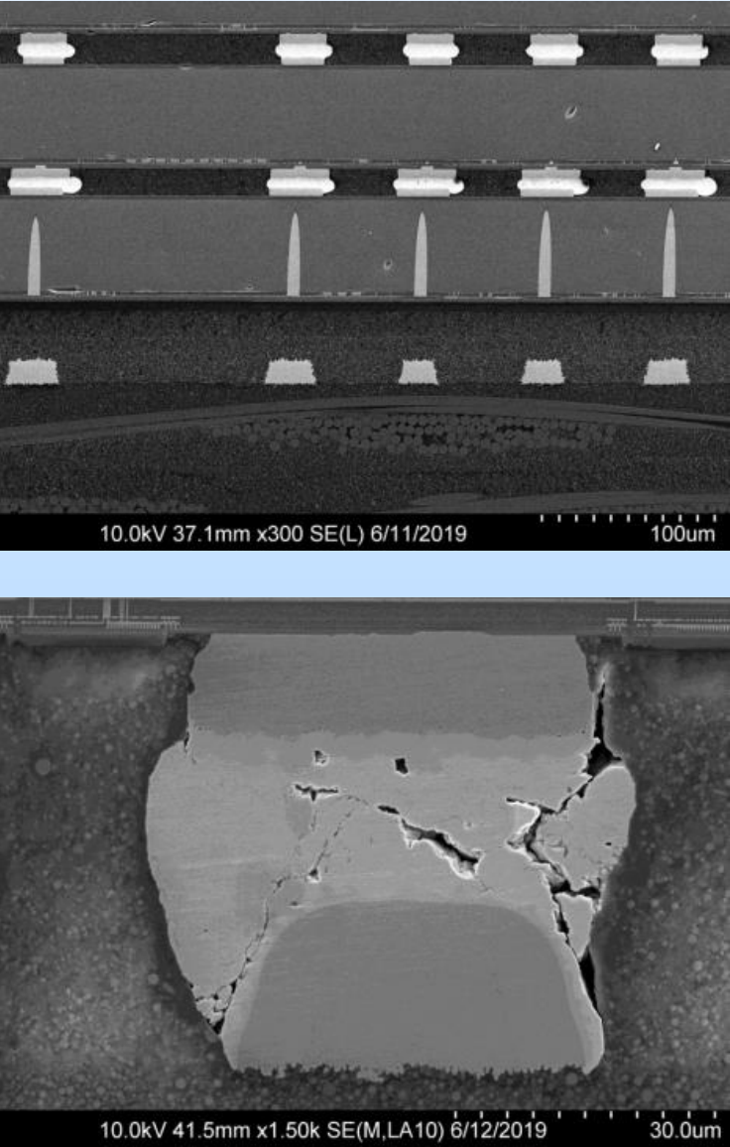
12th Annual NEPP
Electronics Technology Workshop (ETW)
Emerging Assurance Methods
Image Credit: Vanderbilt University
Radiation Testing & Analysis
Image Credit: NASA
Scheduled dates:
June 14-17, 2021
https://nepp.nasa.gov/
Advanced Technology Reliability
Image Credit: NASA
Advanced Microelectronics Packaging
Image Credit: NASA

Slide 14
FY21 Plans

Slide 15
Integrated Photonics for Next Generation Optical Communication Links
Radiation Effects Testing
- Scaled CMOS
- NVM (3D NAND Flash)
Ultrascale and Ultrascale+ FPGA Radiation Effects Testing
Commercial Surface Mount Ceramic Feedthrough Capacitors for Space Applications
Evaluation of multi-anode polymer and MnO2 capacitors
MILSPEC System Support
- PEMS
- Developing “Remote Auditing” Process with DLA

Slide 16
NASA News

Slide 17
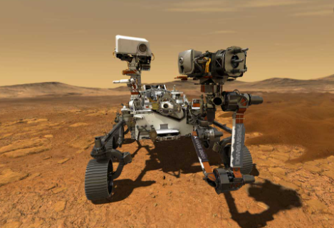
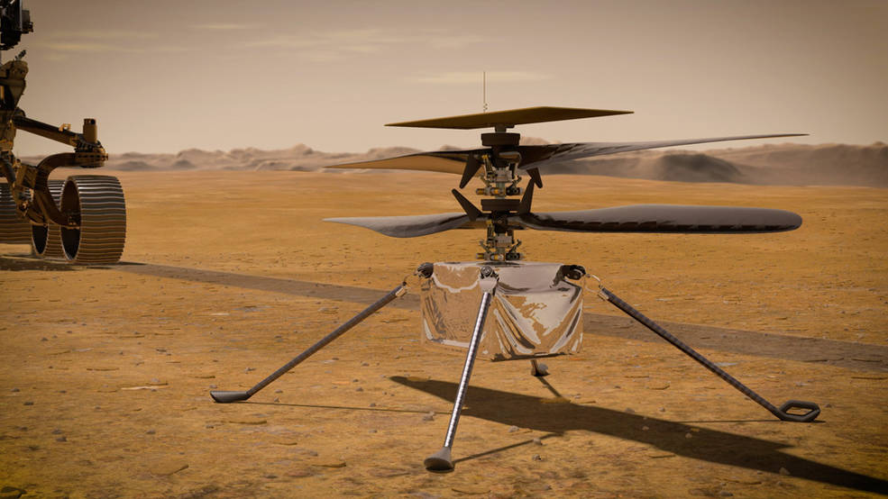
Perseverance & Ingenuity Landing date: Feb. 18, 2021
Entry, Descent & Landing Process: Seven Minutes of Terror
https://www.jpl.nasa.gov/video/details.php?id=1090
Photo credit: NASA/Bill Ingalls
Credits: NASA/JPL-Caltech

Slide 18
The End

Slide 19
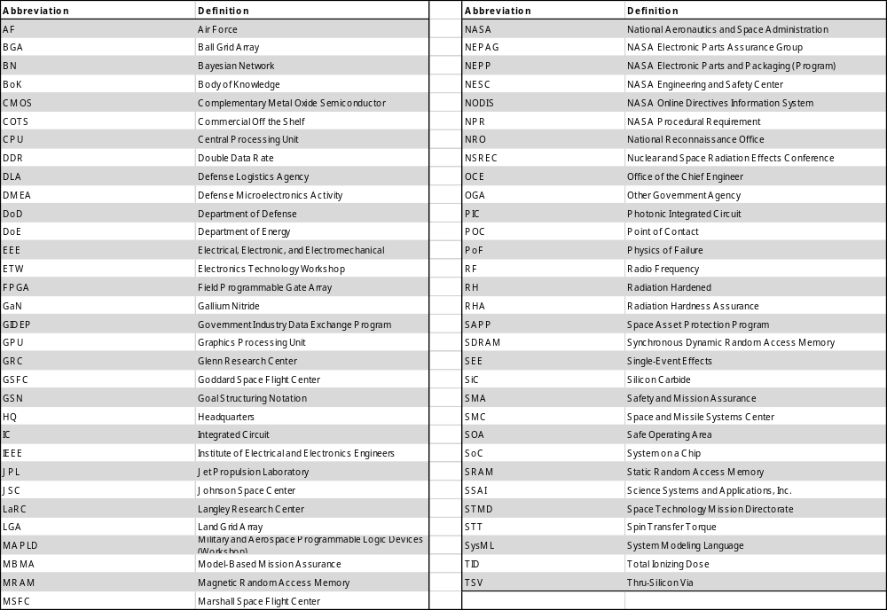
Acronyms

