Slide 1
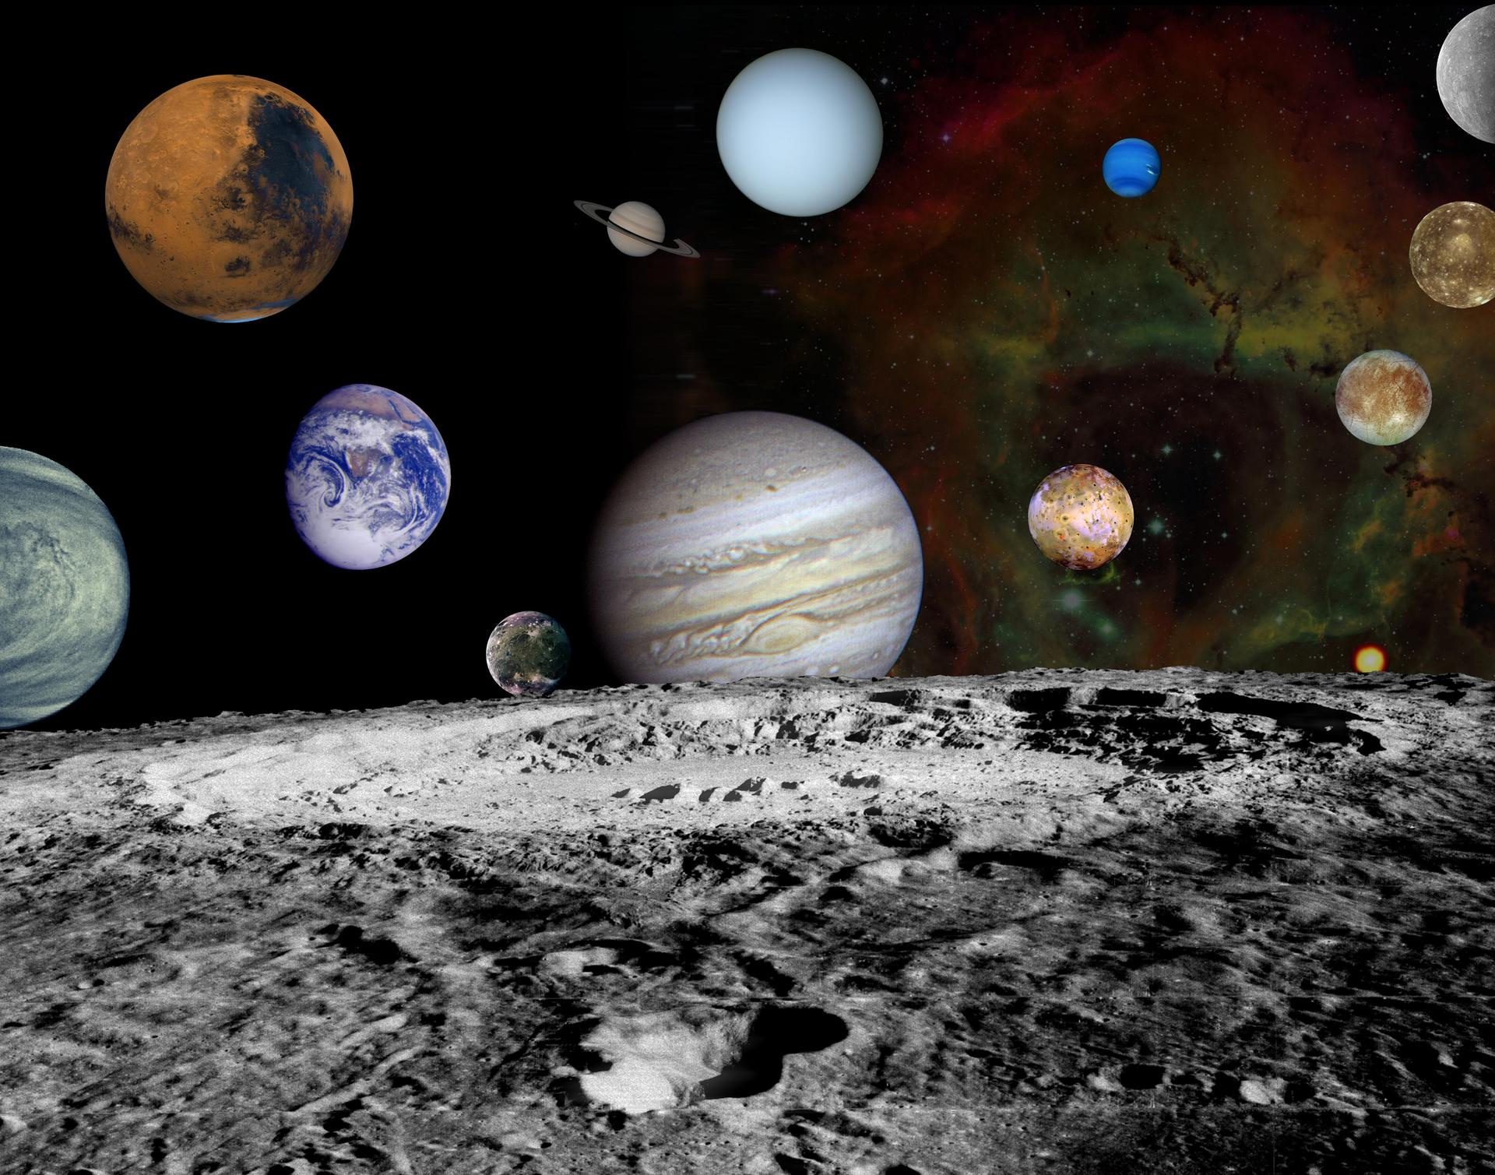
NASA Software Tech Fellow Overview
2021 Flight Software Workshop
Lorraine E. Prokop, Ph.D. / NASA-LaRC
February 8-11, 2021

Slide 2
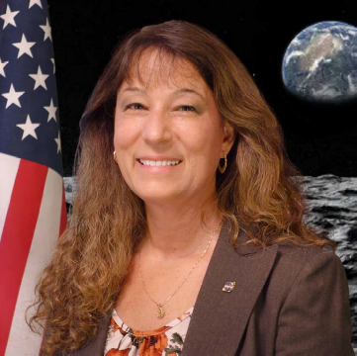
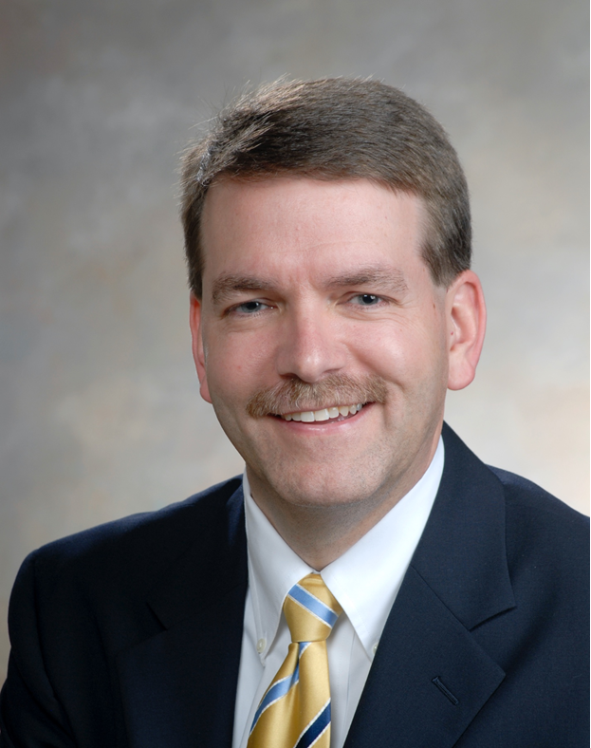
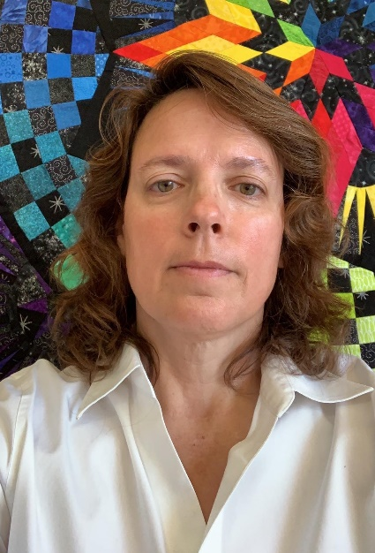
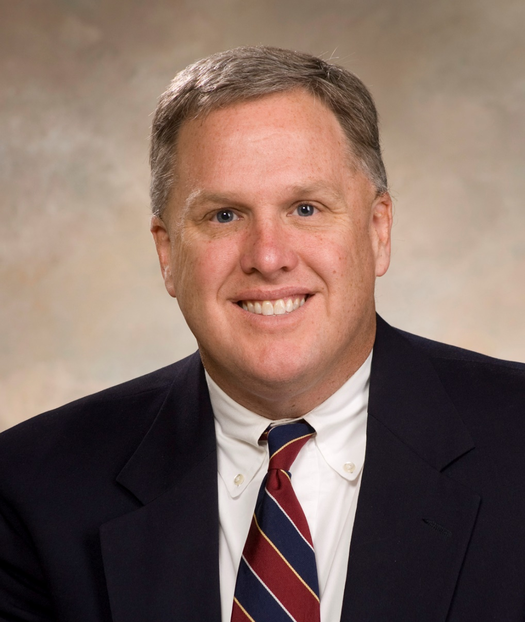
NASA Software Tech Fellow Team
Dr. Lore Prokop
Terry Brown
Laura Maynard-nelson
Tim Crumbley
lorraine.e.prokop@nasa.gov
terry.a.brown@nasa.gov
laura.a.maynard-nelson@nasa.gov
tim.crumbley@nasa.gov
Tech Fellow
Software
Langley Research Center
Deputy Tech Fellow
Software
Marshall Space Flight Center
Deputy Tech Fellow
Software
Glenn Research Center
Tech Fellow
Software Assurance
Marshall Space Flight Center
The Software Tech Fellow is a member of the NASA Engineering and Safety Center (NESC)
The Software Assurance Tech Fellow is a member of the Office of Safety and Mission Assurance (OSMA)

Slide 3
Outline
Purpose
What is the NESC?
What is the role of the Software Tech Fellow?
Recent Activities
Conclusions

Slide 4
Purpose of Presentation
Raise awareness of NASA tech fellow team, their organizations, purpose, and activities
Connect with fellow software community members for future collaboration

Slide 5
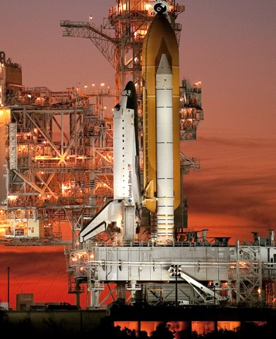
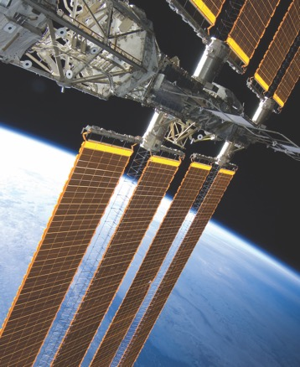
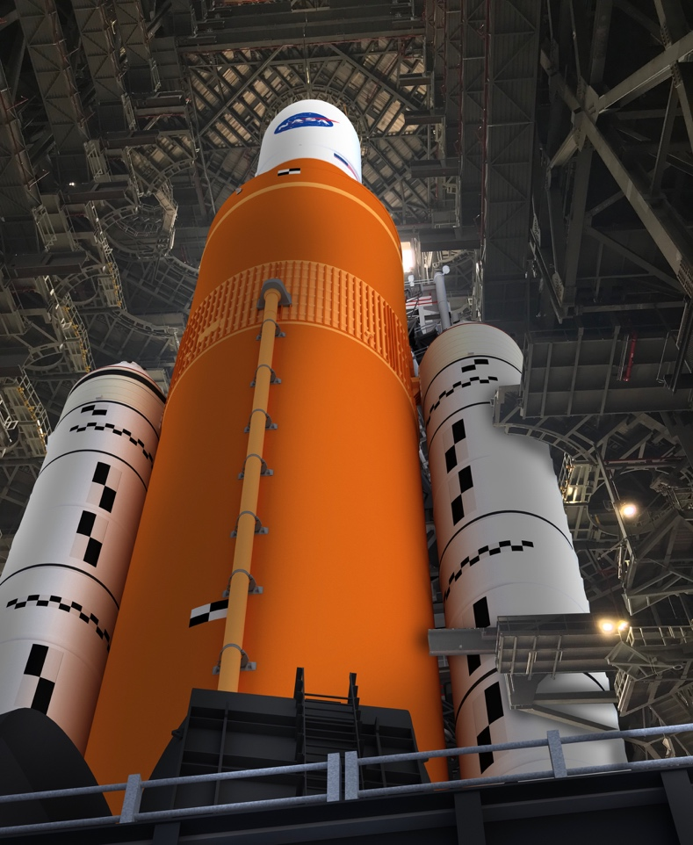
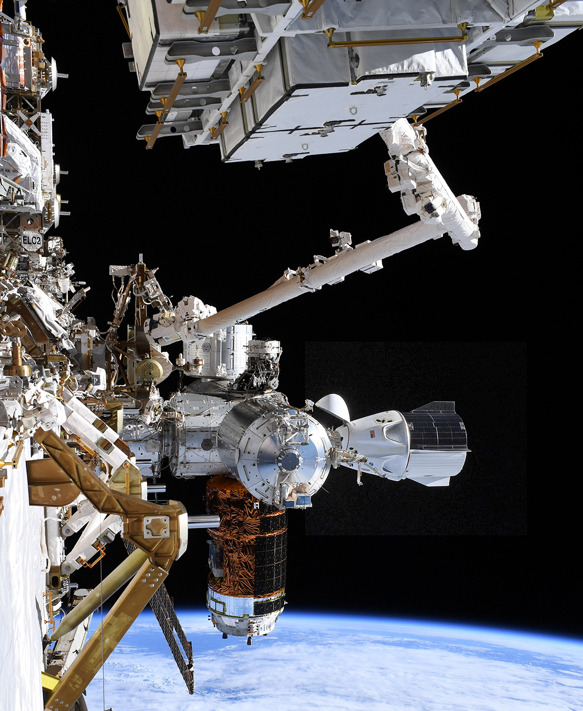
About the NESC
Established in July 2003 in response to the Columbia accident.
NESC highlights NASA’s traditional safety philosophy.
Strong In-Line Checks & Balances • Healthy Tension Between Organizational Elements • Value-Added Independent Assessment
Provides independent assessment of technical issues for NASA programs/projects, and addresses national needs.
Space Shuttle
International
Space Station
Exploration
Commercial
Crew
The NESC is cultivating a safety culture focused on engineering and technical excellence, while fostering an open environment and attacking challenges with unequalled tenacity.

Slide 6
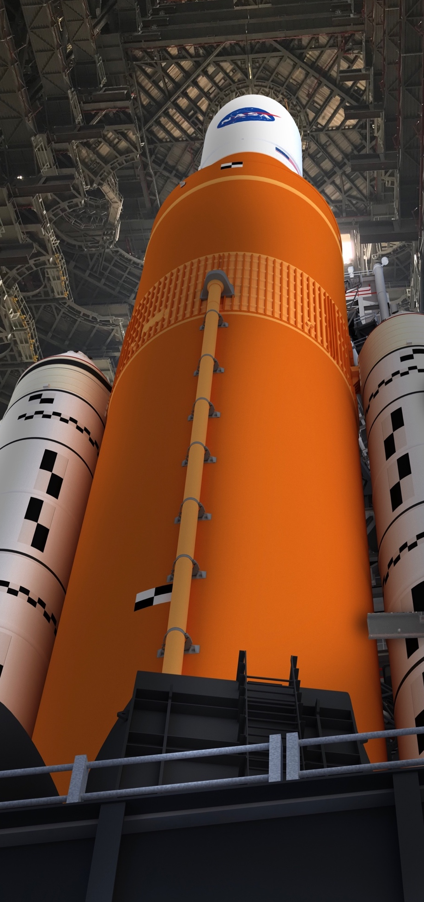
NESC Model
Institutionalized “Tiger Team” approach to solving problems
Agency-recognized NASA Technical Fellows lead Technical Discipline Teams (TDT)
  Experts from across NASA, industry, academia and other agencies
  Diverse, expert technical teams provide robust technical solutions
Assemble independent, diverse, expert technical teams that provide robust technical solutions to the Agency’s highest-risk and most complex issues
  NESC involvement ranges from supporting reviews, augmenting project teams, and solving problems through independent test and analysis, to exploring alternate designs
Strong Systems Engineering and Integration function for proactive trending and identification of problem areas before failures occur
Focusing on technical rigor and engineering excellence

Slide 7

NESC Organization
Distributed Team
NESC has 63 full-time employees from across the Agency.
NESC Chief Engineers at each Center provide technical insight and liaison roles.
19 NASA Technical Fellows are recognized experts in their respective engineering fields.
20 Technical Discipline Teams comprised of 19 engineering and 1 operations disciplines create a network of more than 900 engineers available for matrix support.
More than 270 TDT members are intentionally drawn from industry, academia and other government agencies to prevent insularity.
Participation on NESC teams provides value to home organizations.
  Valuable problem-solving experience
  Broad Agency-wide perspective
  Engage next generation of engineers
NASA OFFICE OF THE CHIEF ENGINEER
NASA ENGINEERING & SAFETY CENTER CORE TEAM
Office of the Director
NASA Technical Fellows
NESC Principal Engineers (PE)
NASA OFFICE OF SAFETY AND MISSION ASSURANCE
Technical Leadership & Management
Management & Technical Support Office (MTSO)
NESC Chief Engineers (NCE)
NESC Integration Office (NIO)
NESC REVIEW BOARD
TECHNICAL DISCIPLINE TEAMS
Aerosciences
Avionics
Cryogenics
Electrical Power
Environmental
Control & Life Support
Flight Mechanics
Guidance, Navigation,
& Control
Human Factors
Loads & Dynamics
Materials
Mechanical Systems
Nondestructive
Evaluation
Nuclear Power
& Propulsion
Passive Thermal
Propulsion
Sensors &
Instrumentation
Software
Space Environments
Structures
Systems Engineering
Technical Workforce
MORE THAN 995 TDT MEMBERS
External Partners
NASA
73%
Industry
22%
Academia
3%
Other Gov.
1%
Consultants
1%
Data as of December 31, 2020

Slide 8


NASA Technical Fellows
NASA’s Senior Technical Experts
Technical Fellows actively support NASA’s safety and mission success goals by providing a resource for independent test, analysis and evaluation of the Agency’s most difficult technical problems
Technical Fellows create Technical Discipline Teams (TDTs) to provide a “technical backbone” of experts
Technical Fellows are the Agency-wide stewards of and advocates for their individual disciplines
Technical Fellows provide unique overarching NASA-wide technical perspectives for their discipline
Provide discipline specific consistency across NASA’s Agency-level specifications, standards and tailoring
Ensure lessons learned are identified, widely shared across engineering organizations, and incorporated into Agency processes
Assess and advance the state of their disciplines for readiness to execute current and future missions
NASA Technical
Fellows
NASA's senior technical experts. They assemble and provide leadership for the Technical Discipline Teams as such they sponsor discipline-enhancing activities and educate the Agency.

Slide 9
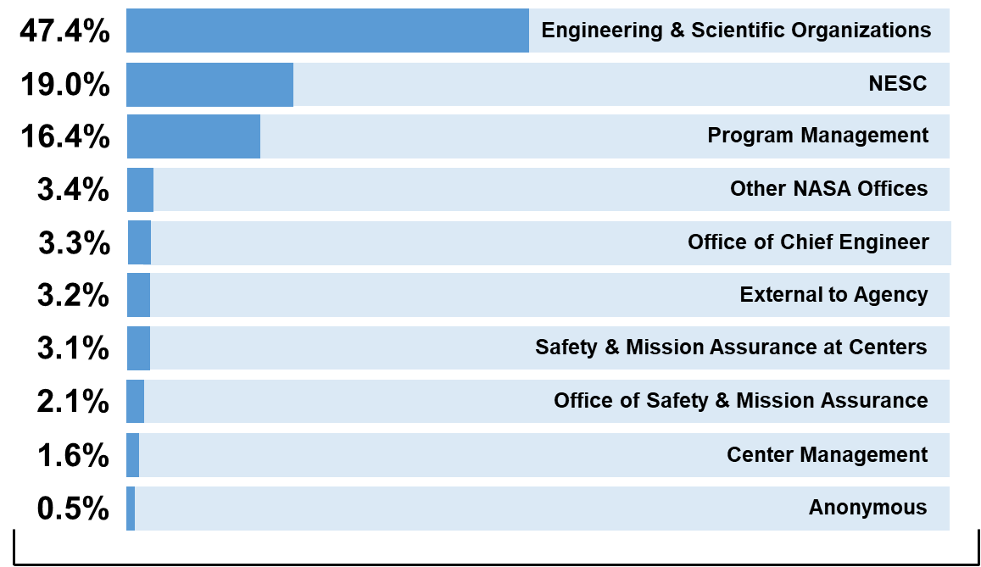
Sources of Accepted Requests
1027 Total Accepted Requests since 2003
86 Accepted Requests in FY20
59 Accepted Requests Yearly Average for 2004-2020
78 Completed Requests in FY20
142 In-Progress Requests
21 Accepted Requests so far in FY21
Sources of Accepted Requests (FY04-FY21)
Data as of December 31, 2020

Slide 10
What is a Software Tech Fellow?
Perform Software-related Technical Assessments to Assist NASA programs and projects
Provide Stewardship for the software discipline across NASA centers
  Advance the State of the Discipline
  Advocate for the discipline
Keeper of Software Standards & Practices
  NPR 7150.2C – NASA Software Engineering Requirements Standard
  CMMI appraisals, training

Slide 11
Recent Activities (2020) - Assessments
Assessments / Reviews
  Boeing Orbital Flight Test (OFT)-1 Investigation & Lessons Learned
  SpaceX Software Common Cause Assessment
  Artemis Program Software Hazards Assessment
  Software Cyclomatic Complexity Assessment
  Automated Flight Termination System Software (AFTS) Evaluation
  Software Architecture Review Board (SARB) Review of Gateway Software
    Service to NASA Projects in early phase of formulation to reduce software cost/complexity and improve reliability through better software architecture
Studies / Research / Papers
  Ethical Use of Artificial Intelligence
  Agile Software Development Methodology Across NASA
  Case Studies in Verifying Spacecraft Autonomy – IEEE Aerospace Conference
  Assuring Spacecraft Autonomy – Springer Book

Slide 12
Discipline Advancement Activities
Technically Support the Present
  Build and cultivate a Technical Discipline Team (TDT) of software experts to call on for assessment support
  Operate through the NASA Software Working Group (SWWG)
Prepare for the future
  Evolve processes, standards, and practices for increasing software autonomy, size, complexity
  Emphasize software architecture
  Emphasize reuse
  Increase organizational awareness of software
  Increase awareness and ownership of software across other disciplines
  Provide rotational mentorship opportunities
Communicate Challenges in the software community
  Software workforce issues
  Institutional reuse funding
Cultivate Existing Software Subdiscipline Expert Areas
  Software Assurance Community
  Architecture
Form new software subdiscipline expert focus groups
  Security, project management, requirements, testing
Perform in-house CMMI assessments

Slide 13
Conclusions
We welcome potential “TDT” members from both inside and outside of NASA to serve as potential experts in future assessments
We Invite NASA participation in software “subteam” focus areas
We welcome collaboration with experts in the software community, industry/academia on a broad range of software topics

Slide 14
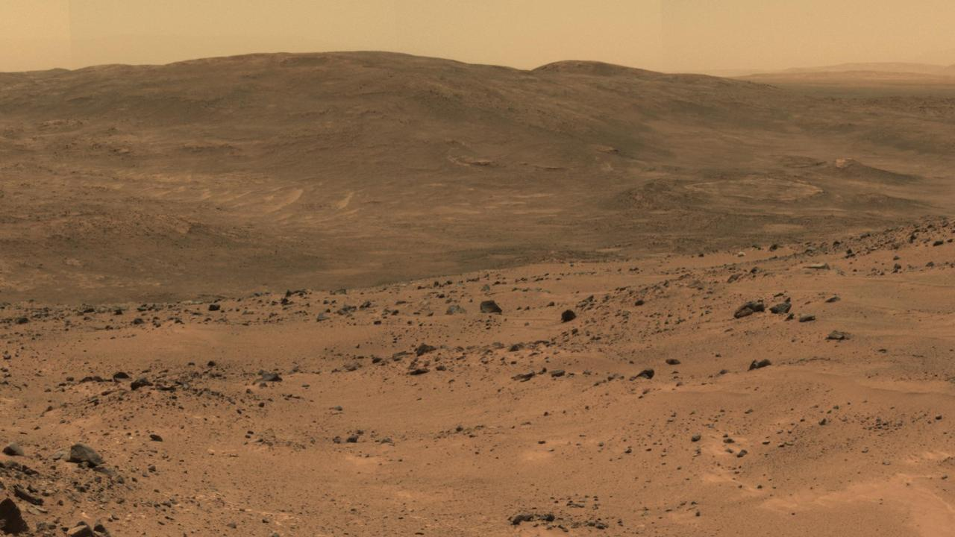
Thank you for your attention

