Slide 1
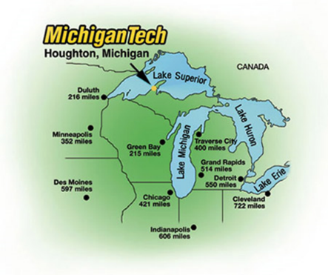
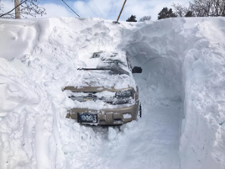
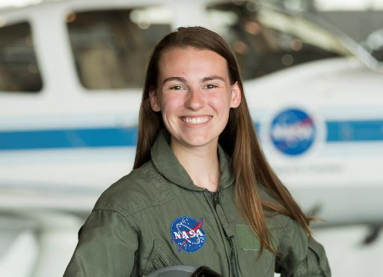

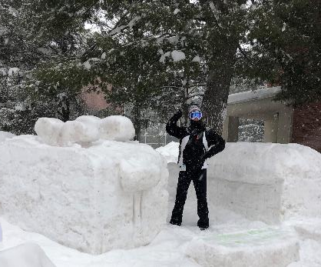
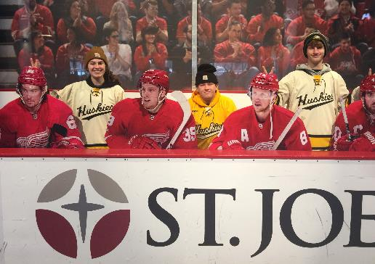
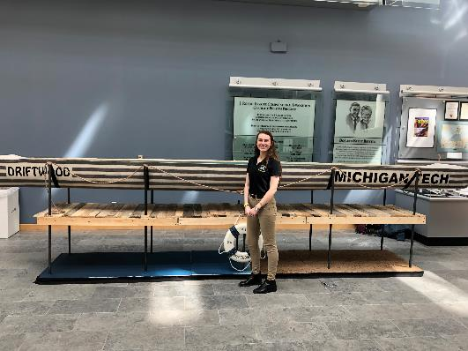

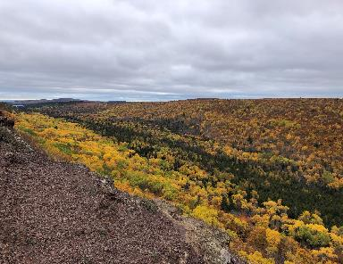
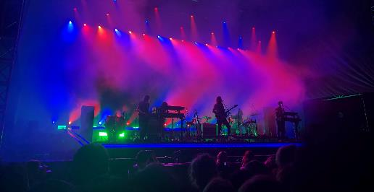

Slide 2
Advanced Structures and Materials Technology Integration for a Lunar Habitat
Lauren S. Bowling – Michigan Technological University
Bryce L. Horvath – NASA Langley Research Center
Christopher J. Wohl* – NASA Langley Research Center
2021 IEEE Aerospace Conference
*Corresponding author: c.j.wohl@nasa.gov

Slide 3
Outline
Project Description
“Bowling Habitat”
Conclusions
1
2
3
4
5
Background
Summary of Technologies

Slide 4
Project Description and Approach
10-week summer internship
Identify active NASA research that could be used in an inflatable
habitat
  Intensive literature study on inflatable habitats
      Key features, timeline, and transportation constraints
  Interviewed research groups at NASA Langley
      Performed a technology gap analysis
  Compiled technologies into the “Bowling Habitat” architecture

Slide 5
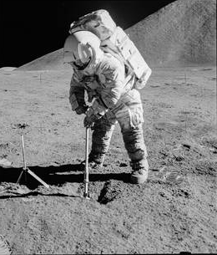
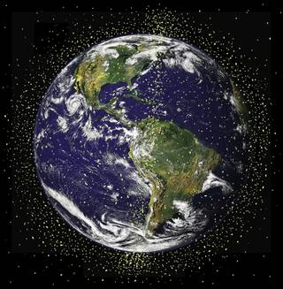
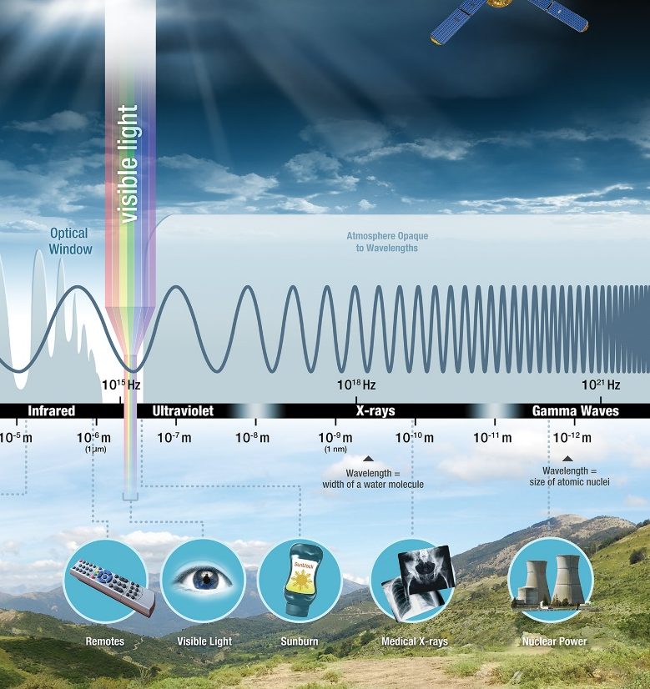
Lunar Environment
Lunar Dust
Charged
Abrasive
Toxic
Micrometeoroid Orbital Debris (MMOD)
Radiation
Galactic Cosmic Rays
Solar Proton Events
Neutron Radiation
Image Credit: NASA

Slide 6
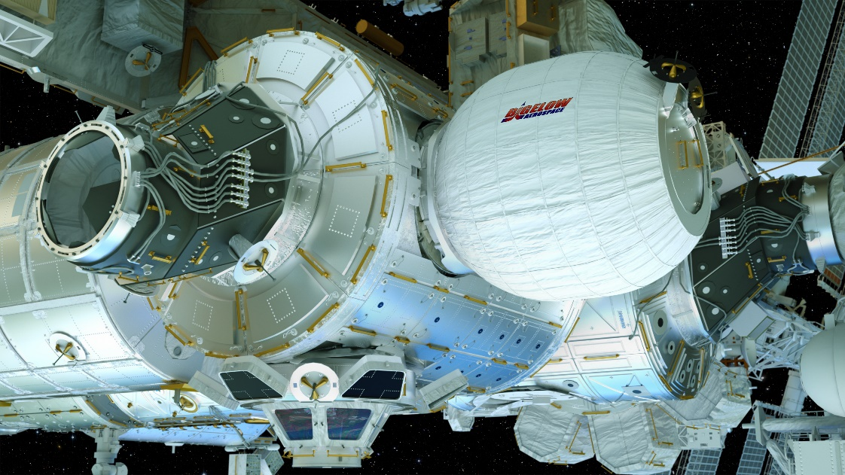
History of Inflatable Structures
Inflatable structures offer efficient mass to volume ratios
Two inflatables have been in space
  Volga Airlock on Russian Voskhod 2
  (1964)
  Bigelow Expandable Activity Module (BEAM) on ISS since 2016
Many architectures have been designed for both lunar and Martian surfaces that include inflatables
Image Credit: NASA

Slide 7
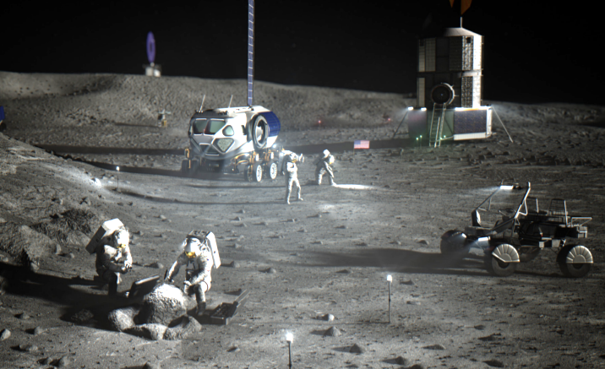
Artemis Base Camp Calls for a Lunar Habitat
Foundation Surface Habitat (FSH)
  Crewed mission in 2028
Habitable Mobility Platform
  Large, pressurized rover that supports long extra-vehicular activities (EVA)s
Lunar Terrain Vehicle
To be delivered via commercial lunar payload services (CLPS) or human landing system (HLS)
Image Credit: NASA

Slide 8
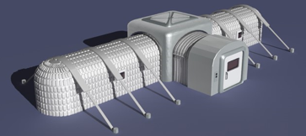
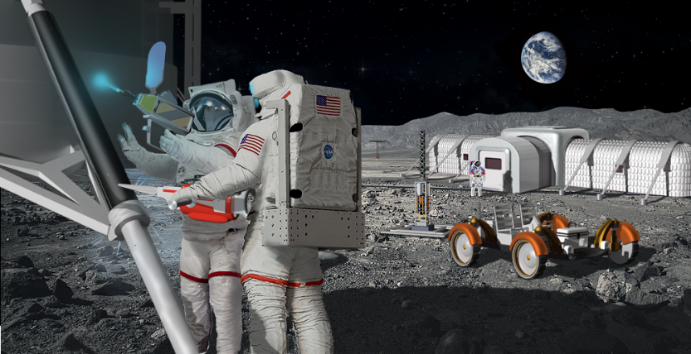
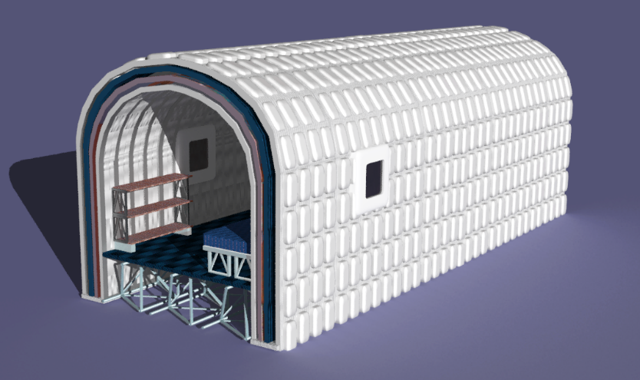
Technology Categorization
Critical
  Necessary for mission completion
Enhancing
  Significantly improves mission
Transformational
  Revolutionary to mission
“Bowling Habitat” provides a concept of how these technologies can be combined
Image Credit: Ronald Neale, NASA LaRC

Slide 9
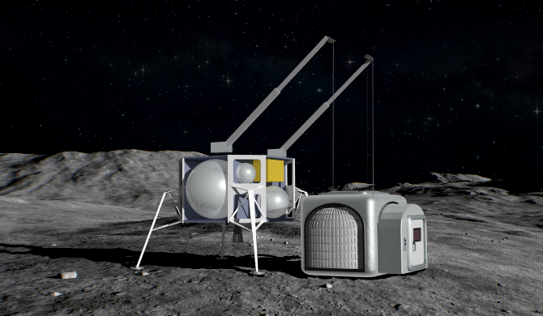
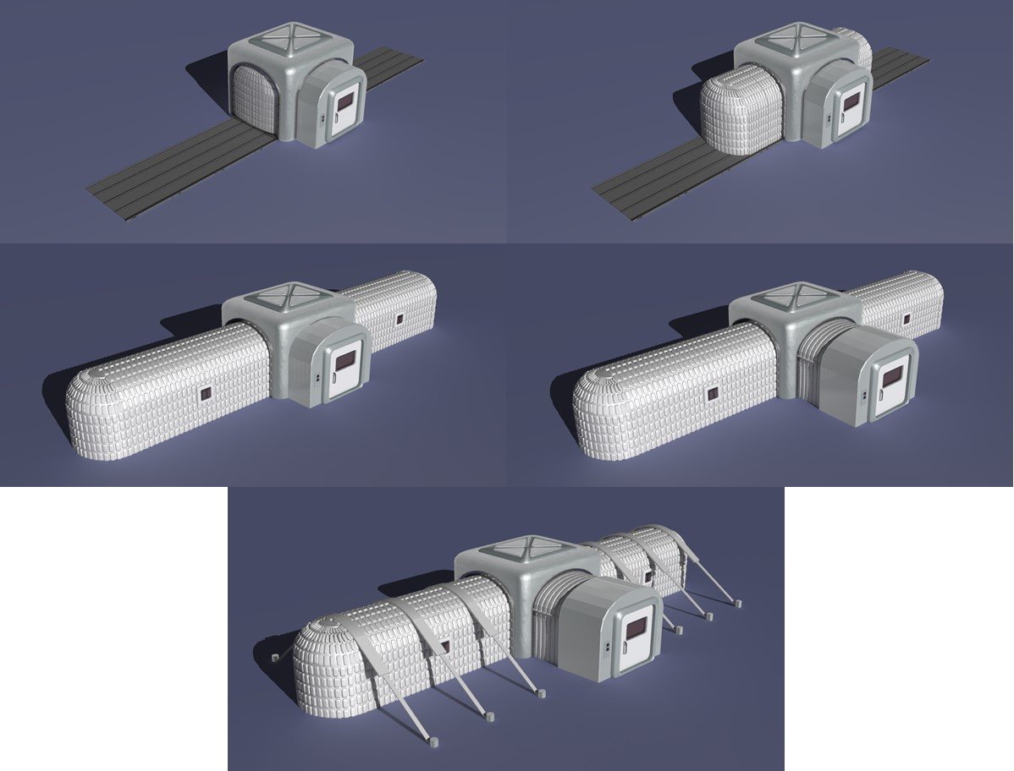
“Bowling Habitat” Deployment
Intelligent Flexible Materials (InFLEX) Fabric
Critical – TRL 3
Deployable Friction Barrier
Critical – TRL 3
Lightweight External Inflatable Airlock (LEIA)
Critical – TRL 2
Boron nitride nanotube (BNNT) Guy Lines
Critical – TRL 2
Image Credit: Ronald Neale, NASA LaRC

Slide 10

“Bowling Habitat” Landing Site
Kilopower Reactor Using Stirling Technology (KRUSTY)
Enhancing – TRL 5
Electron
Beam Gun
Enhancing – TRL 4
Re-Purposable
Composites
Enhancing – TRL 2
Trusselator
Enhancing – TRL 4
Image Credit: Ronald Neale, NASA LaRC

Slide 11

“Bowling Habitat” Interior
InFLEX Layering Scheme
Habitat Health Sensors
Critical – TRL 9
Ceramic Lunar Dust Coating
Enhancing – TRL 2
Electron Beam-Generated Floorboards
Trusselator Floor Joists
Image Credit: Ronald Neale, NASA LaRC

Slide 12
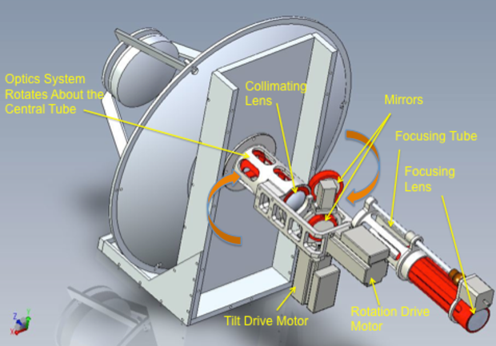
Summary of 13 Technologies Evaluated
Technology | Classification | TRL
Deployable Friction Barrier | Critical | 3
InFLEX Fabric | Critical | 3
LEIA Airlock | Critical | 2
BNNT Guy Lines | Critical | 2
Habitat Health Sensors | Critical | 9
KRUSTY | Enhancing | 5
Electron Beam Gun | Enhancing | 4
Re-Purposable Composites | Enhancing | 2
Trusselator | Enhancing | 4
Ceramic Lunar Dust Coating | Enhancing | 2
Cassegrain Reflector | Transformational | 3
Assemblers | Transformational | 3
Robot Swarms | Transformational | 3
Image Credit: NASA

Slide 13
Conclusions
13 technologies were evaluated for use on a lunar habitat
  5 critical
  5 enhancing
  3 transformational
“Bowling Habitat” is a modern suggestion for the FSH that showcases these technologies
This project only addressed a sub-set of the systems involved in habitat design
    Future work needs to include other technologies to complete the habitat design, e.g., life support, habitation considerations, etc.

Slide 14
Acknowledgements
Thank You:
  Ronald Neale
  NASA Intern, Fellowship, Scholarship (NIFS) Program Coordinators
  Michigan Space Grant Consortium
Please contact me with any questions!
  Lauren Bowling, lsbowlin@mtu.edu
  Chris Wohl, c.j.wohl@nasa.gov

