Slide 1
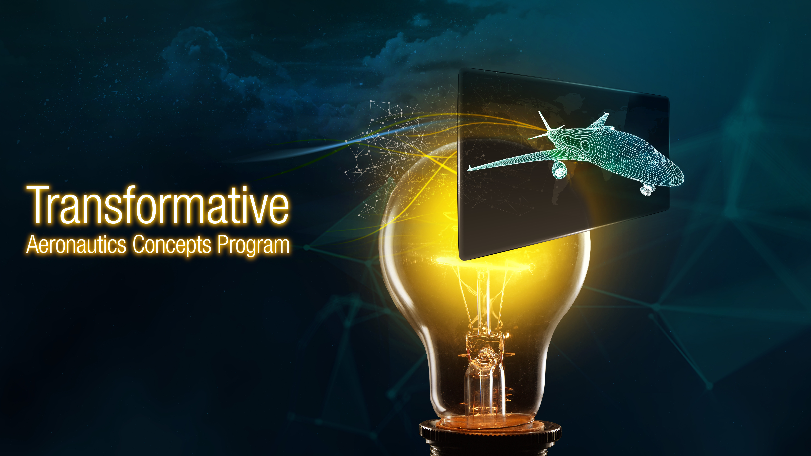







National Aeronautics and Space Administration
Dr. Sharon Monica Jones
Deputy Director (Acting),
Transformative Aeronautics Concepts Program
Aeronautics Research Mission Directorate (ARMD)
www.nasa.gov

Slide 2
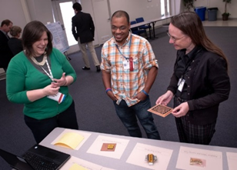
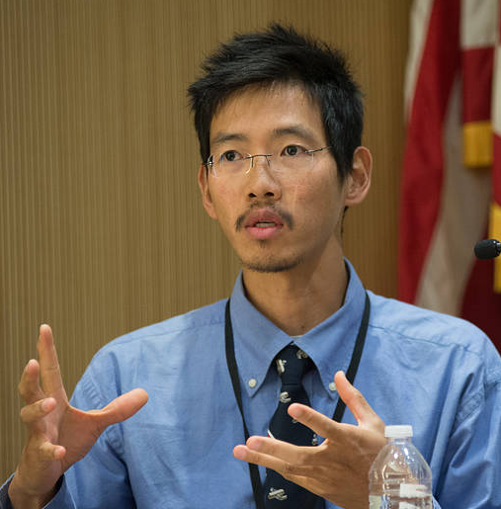
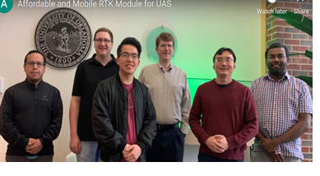
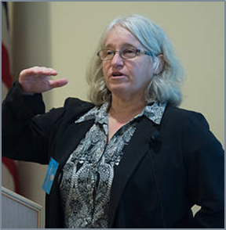
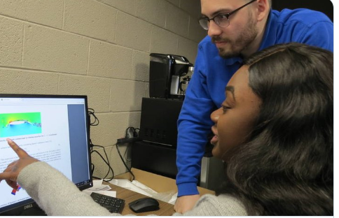
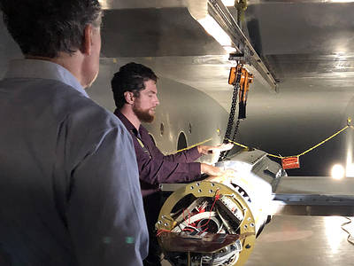
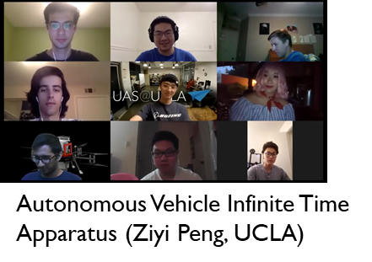
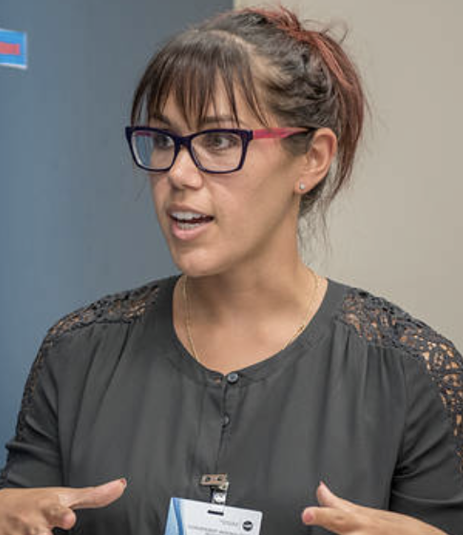
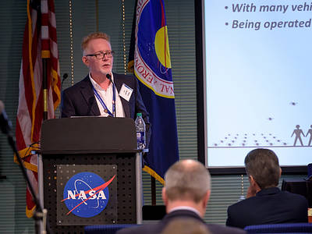
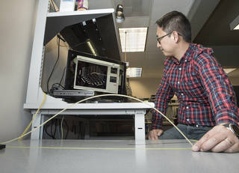

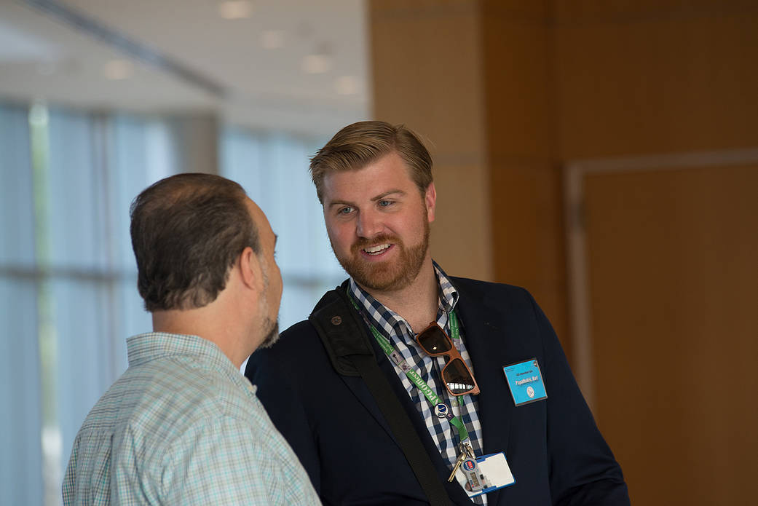
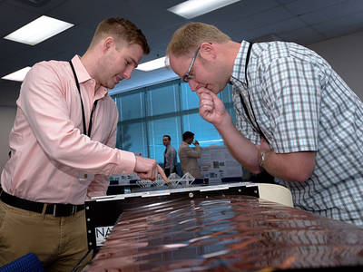
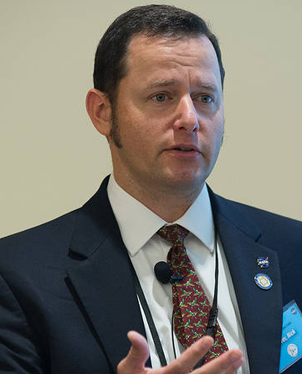
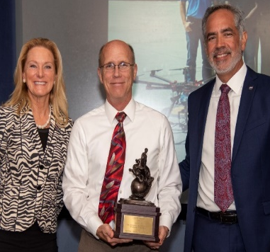
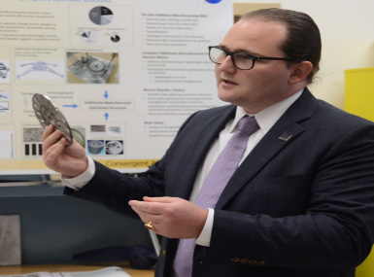
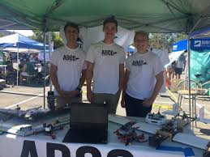
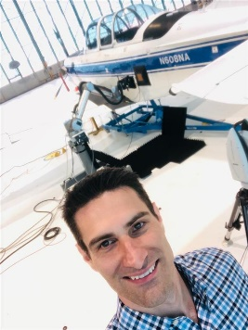
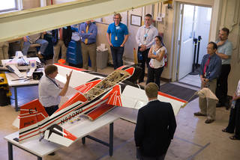
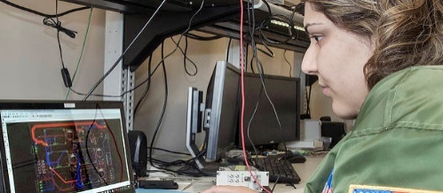
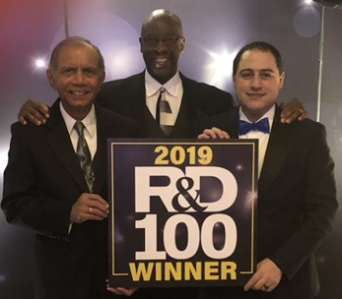

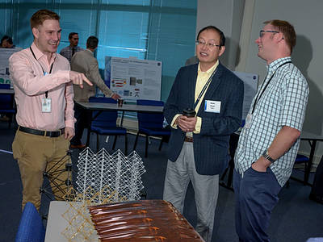
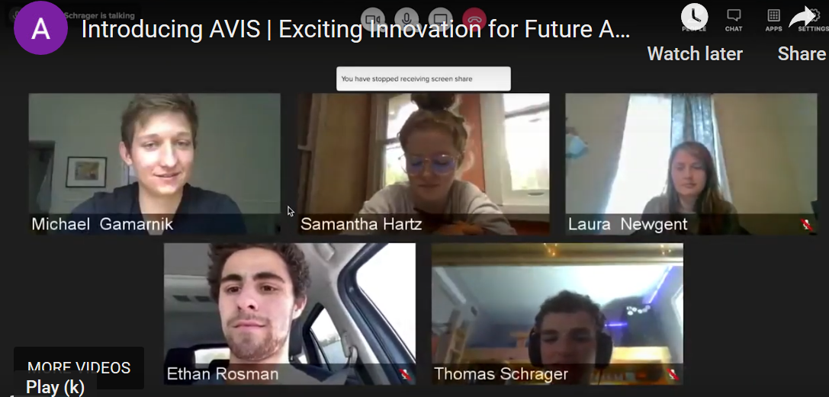

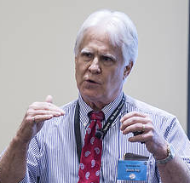
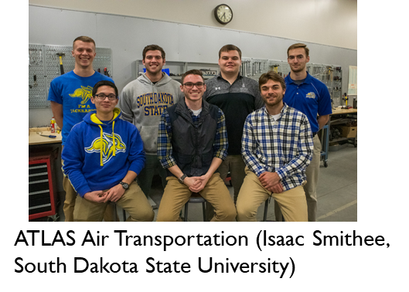
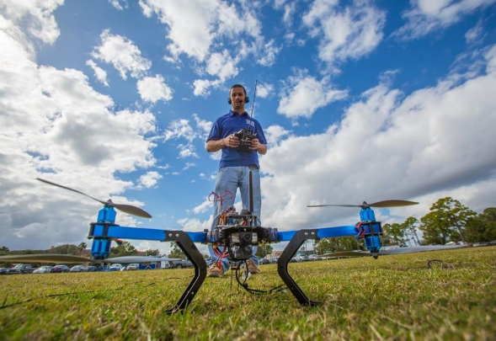
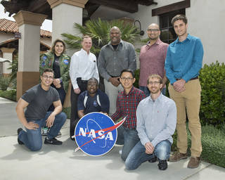
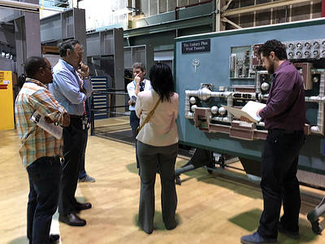

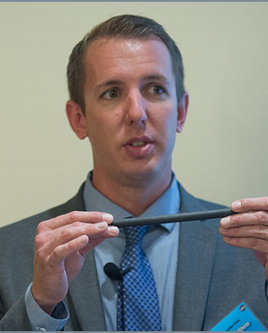
Our amazing team met the challenges of 2020

Slide 3
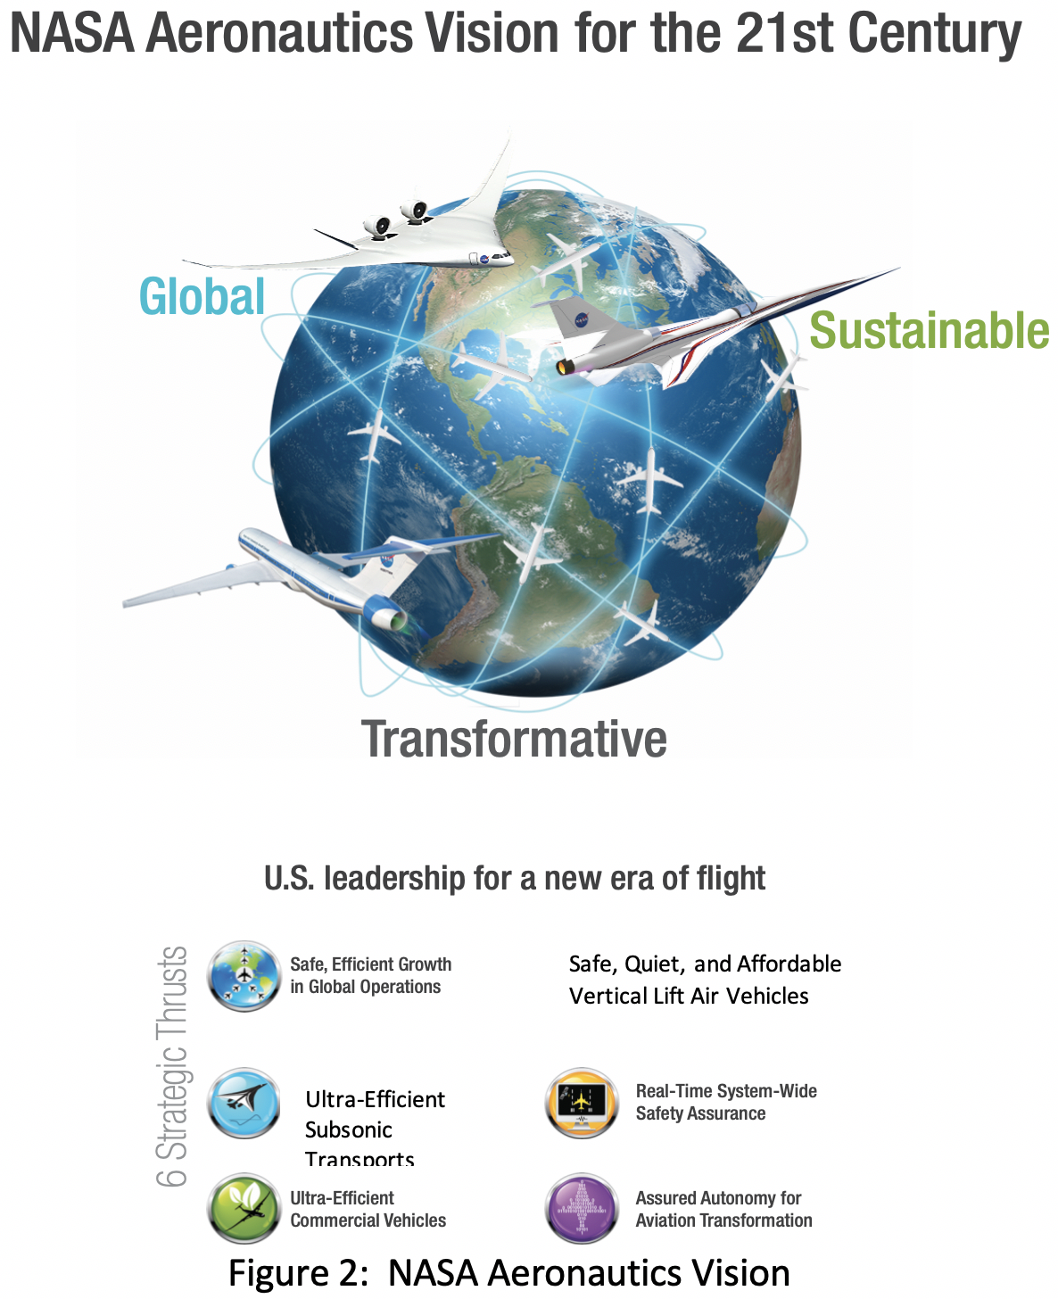
Rapid growth in traditional measures of global demand for mobility as well as new modes of transportation
An environmentally sustainable global aviation system
Convergence of multiple industry sectors that will transform aeronautical capabilities and air transportation

Slide 4
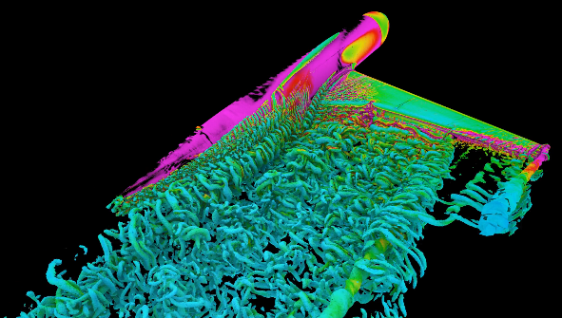
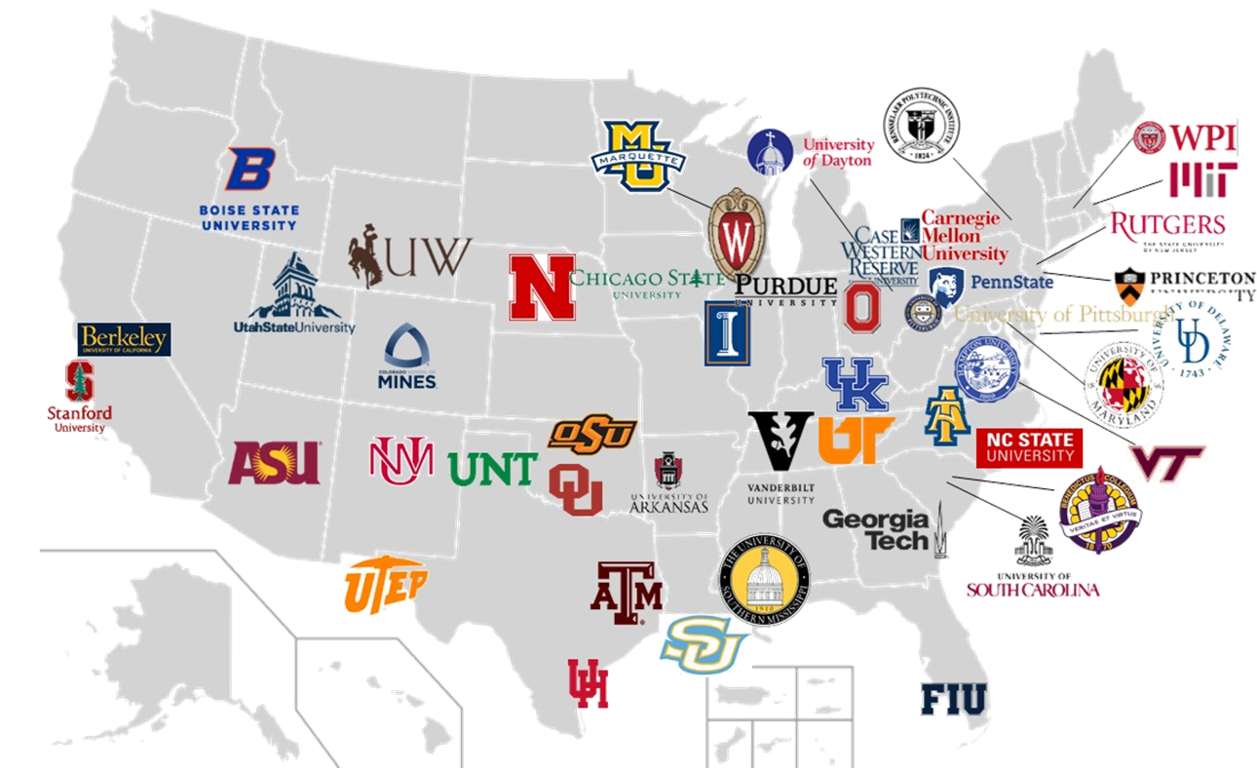
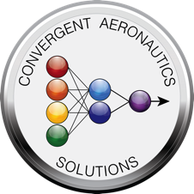

Transformative Aeronautics Concepts Program
convergence of traditional aeronautics disciplines with other emerging technologies
multidisciplinary, revolutionary concepts that transform aviation
Enduring Disciplines
ARMD Research Priority Areas
Investing in game changing concepts to transform aeronautics research
UI
University Innovation
University Leadership Initiative
University Student Research Challenge

Slide 5
Transformative Aeronautics Concepts Program
ARMD Strategy
Transformation
Agility
Culture of Innovation
Aviation Outcomes
UI
University Innovation

Slide 6









ARMD Strategy
To discover aviation concepts and solutions that support
NASA ARMD’s strategy
Mega Drivers
Strategic Thrusts
Examples of TACP research
Safe, Efficient Growth in Global Operations
Next generation airspace system communications
Innovation in Commercial Supersonic Aircraft
Supersonic noise reduction research
Ultra-Efficient Subsonic Transports
Materials research for foundational electrified aircraft propulsion
Safe, Quiet, and Affordable Vertical Lift Air Vehicles
Next generation batteries
In-Time System-Wide Safety Assurance
Technologies for weather tolerant operations
Assured Autonomy for Aviation Transformation
Artificial intelligence methods for autonomous systems
TACP projects support all six of ARMD’s strategic thrusts

Slide 7
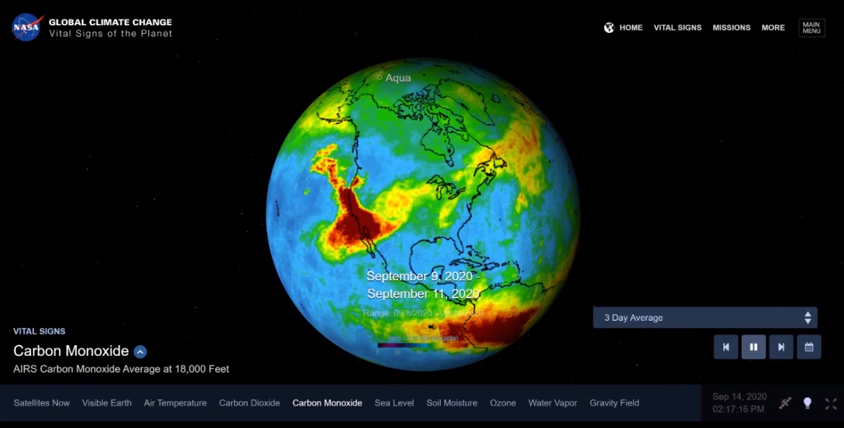
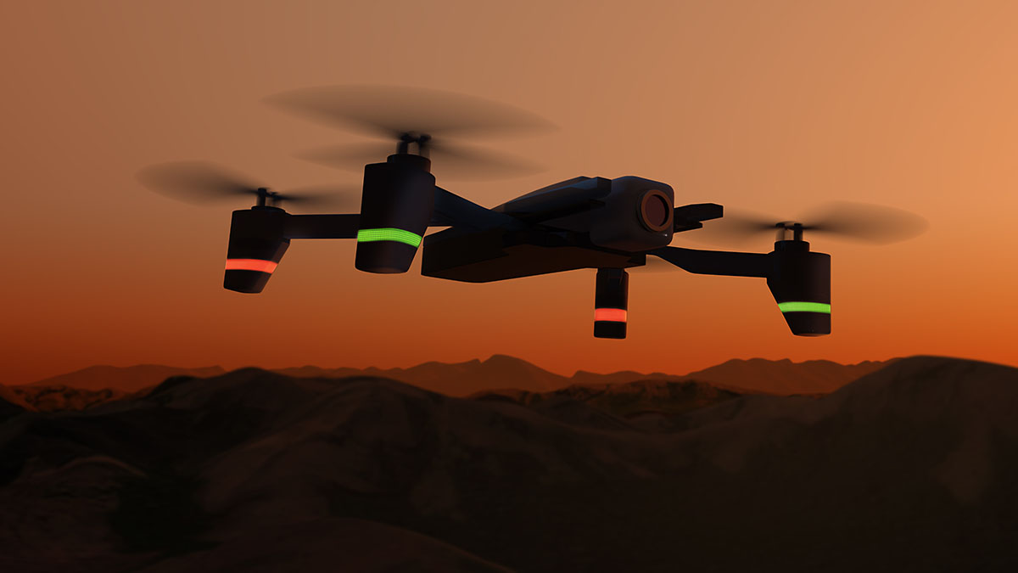
Transformation
To advance complex, breakthrough aviation concepts and solutions
High risk research
Foundational/ Seedling
Transdisciplinary
Establishing new s-curves
Scalable Traffic Management for Emergency Response Operations (STEReO)
Prototype air traffic management system to reduce emergency response time during natural disasters
Requires integration of several technologies
  Unmanned Aircraft System Traffic Management (UTM)
  Automation
  Human Machine Integration
Wildfires affect climate and air quality
Notes:
This visualization shows a three-day average of carbon monoxide concentration, from Sept 6 to 14. in the atmosphere over California due to wildfires. Higher concentrations of the gas appear as red and orange regions

Slide 8

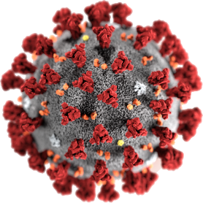


Agility
To quickly investigate and enable innovative, breakthrough aviation concepts and solutions
COVID Challenges to the Air Travel Industry
Aircraft Cabin Flow Modeling and COVID Dispersion Workshops (August 2020)
Proof of concepts
Rapid risk reduction
Flexible, asynchronous
Seamless exchange of technical personnel, ideas, and work efforts
Does not rely on a formal project formulation process when content changes are considered
Permits an agile, dynamic organization
Aero Support for Wildfire Mitigations
STEReO collaboration with US Forest Service and CalFire

Slide 9
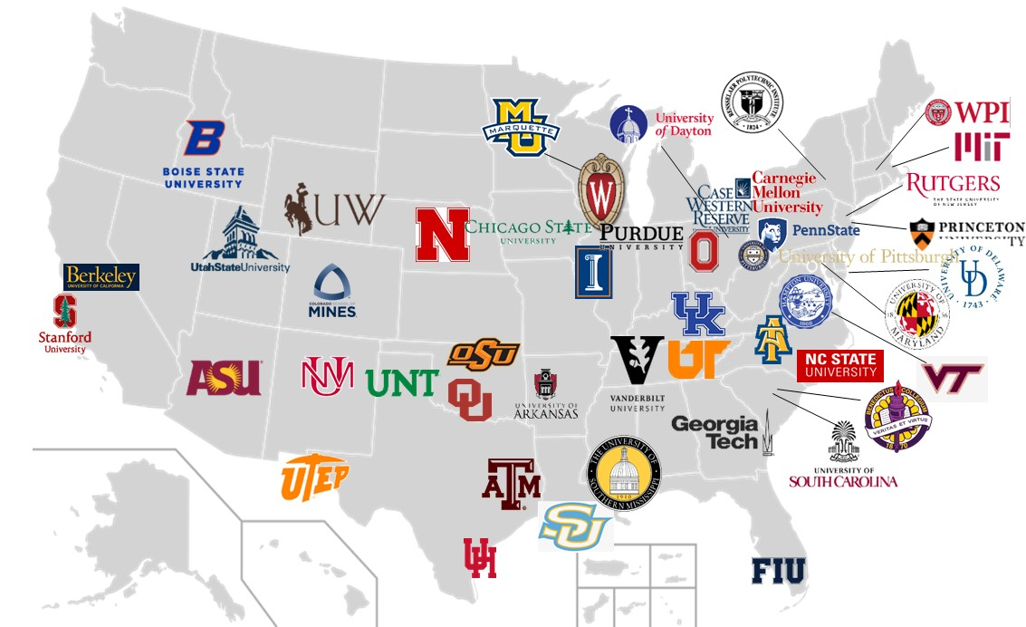

Culture of Innovation
To catalyze an innovative aerospace research culture
Unique operations and processes
Next Gen workforce
Diversity (workforce and partnerships)
Creative partnerships and engagements
5 MSIs:
Oklahoma State University (Lead), Florida International University , University of Houston,
University of New Mexico, University of Texas at El Paso
5 HBCUs:
North Carolina A&T (Lead),
Benedict College,
Chicago State University, Hampton University, Southern University
7 of 13 Principal Investigators in the University Leadership Initiative are first time NASA Grantees

Slide 10
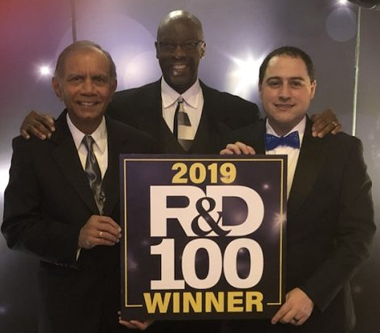

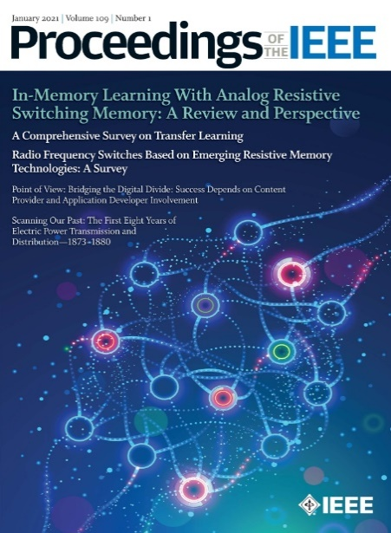
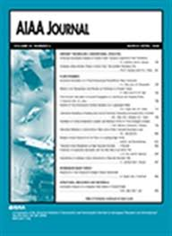
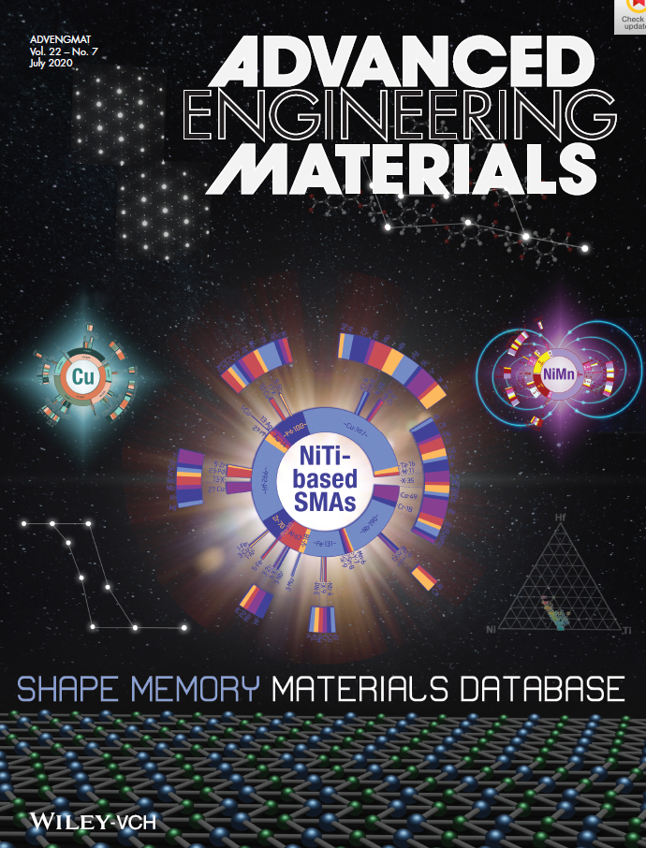
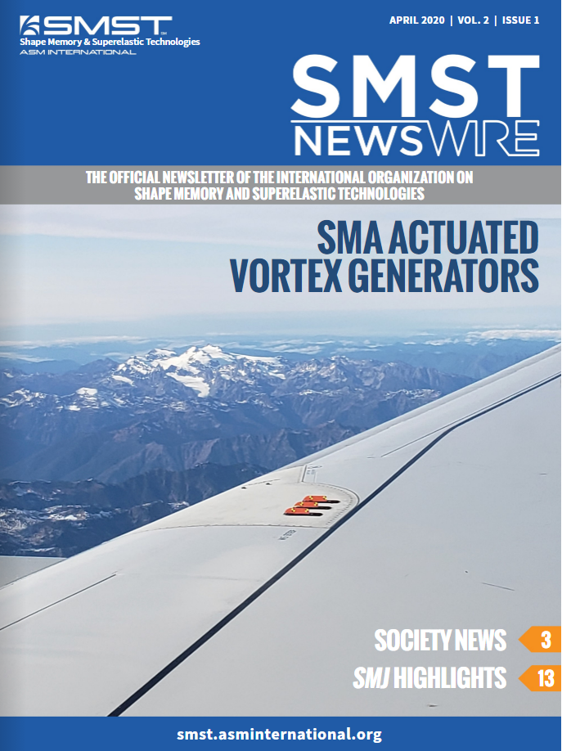
Aviation Outcomes
To deliver aviation concepts and solutions for NASA ARMD and the aeronautics community
Globally recognized research in computational tools, materials research, autonomous capability…
Transferring our research outcomes to government and industry stakeholders
FISCAL YEAR 2020 RESULTS
125 conference papers, 125 peer reviewed publications, 20 patents…
Contributions to the body of knowledge

Slide 11
Transformative Aeronautics Concepts Program
Re-imagining Efforts Toward Transformative Innovation
T
Transformation
A
ARMD Strategy
Agility
Aviation Outcomes
Developing Cutting-Edge Tools
C
Culture of Innovation
Expanding Network of University Leaders
UI
University Innovation

