Slide 1
CISTO Data Science Group
Innovation Lab
Mark Carroll

Slide 2
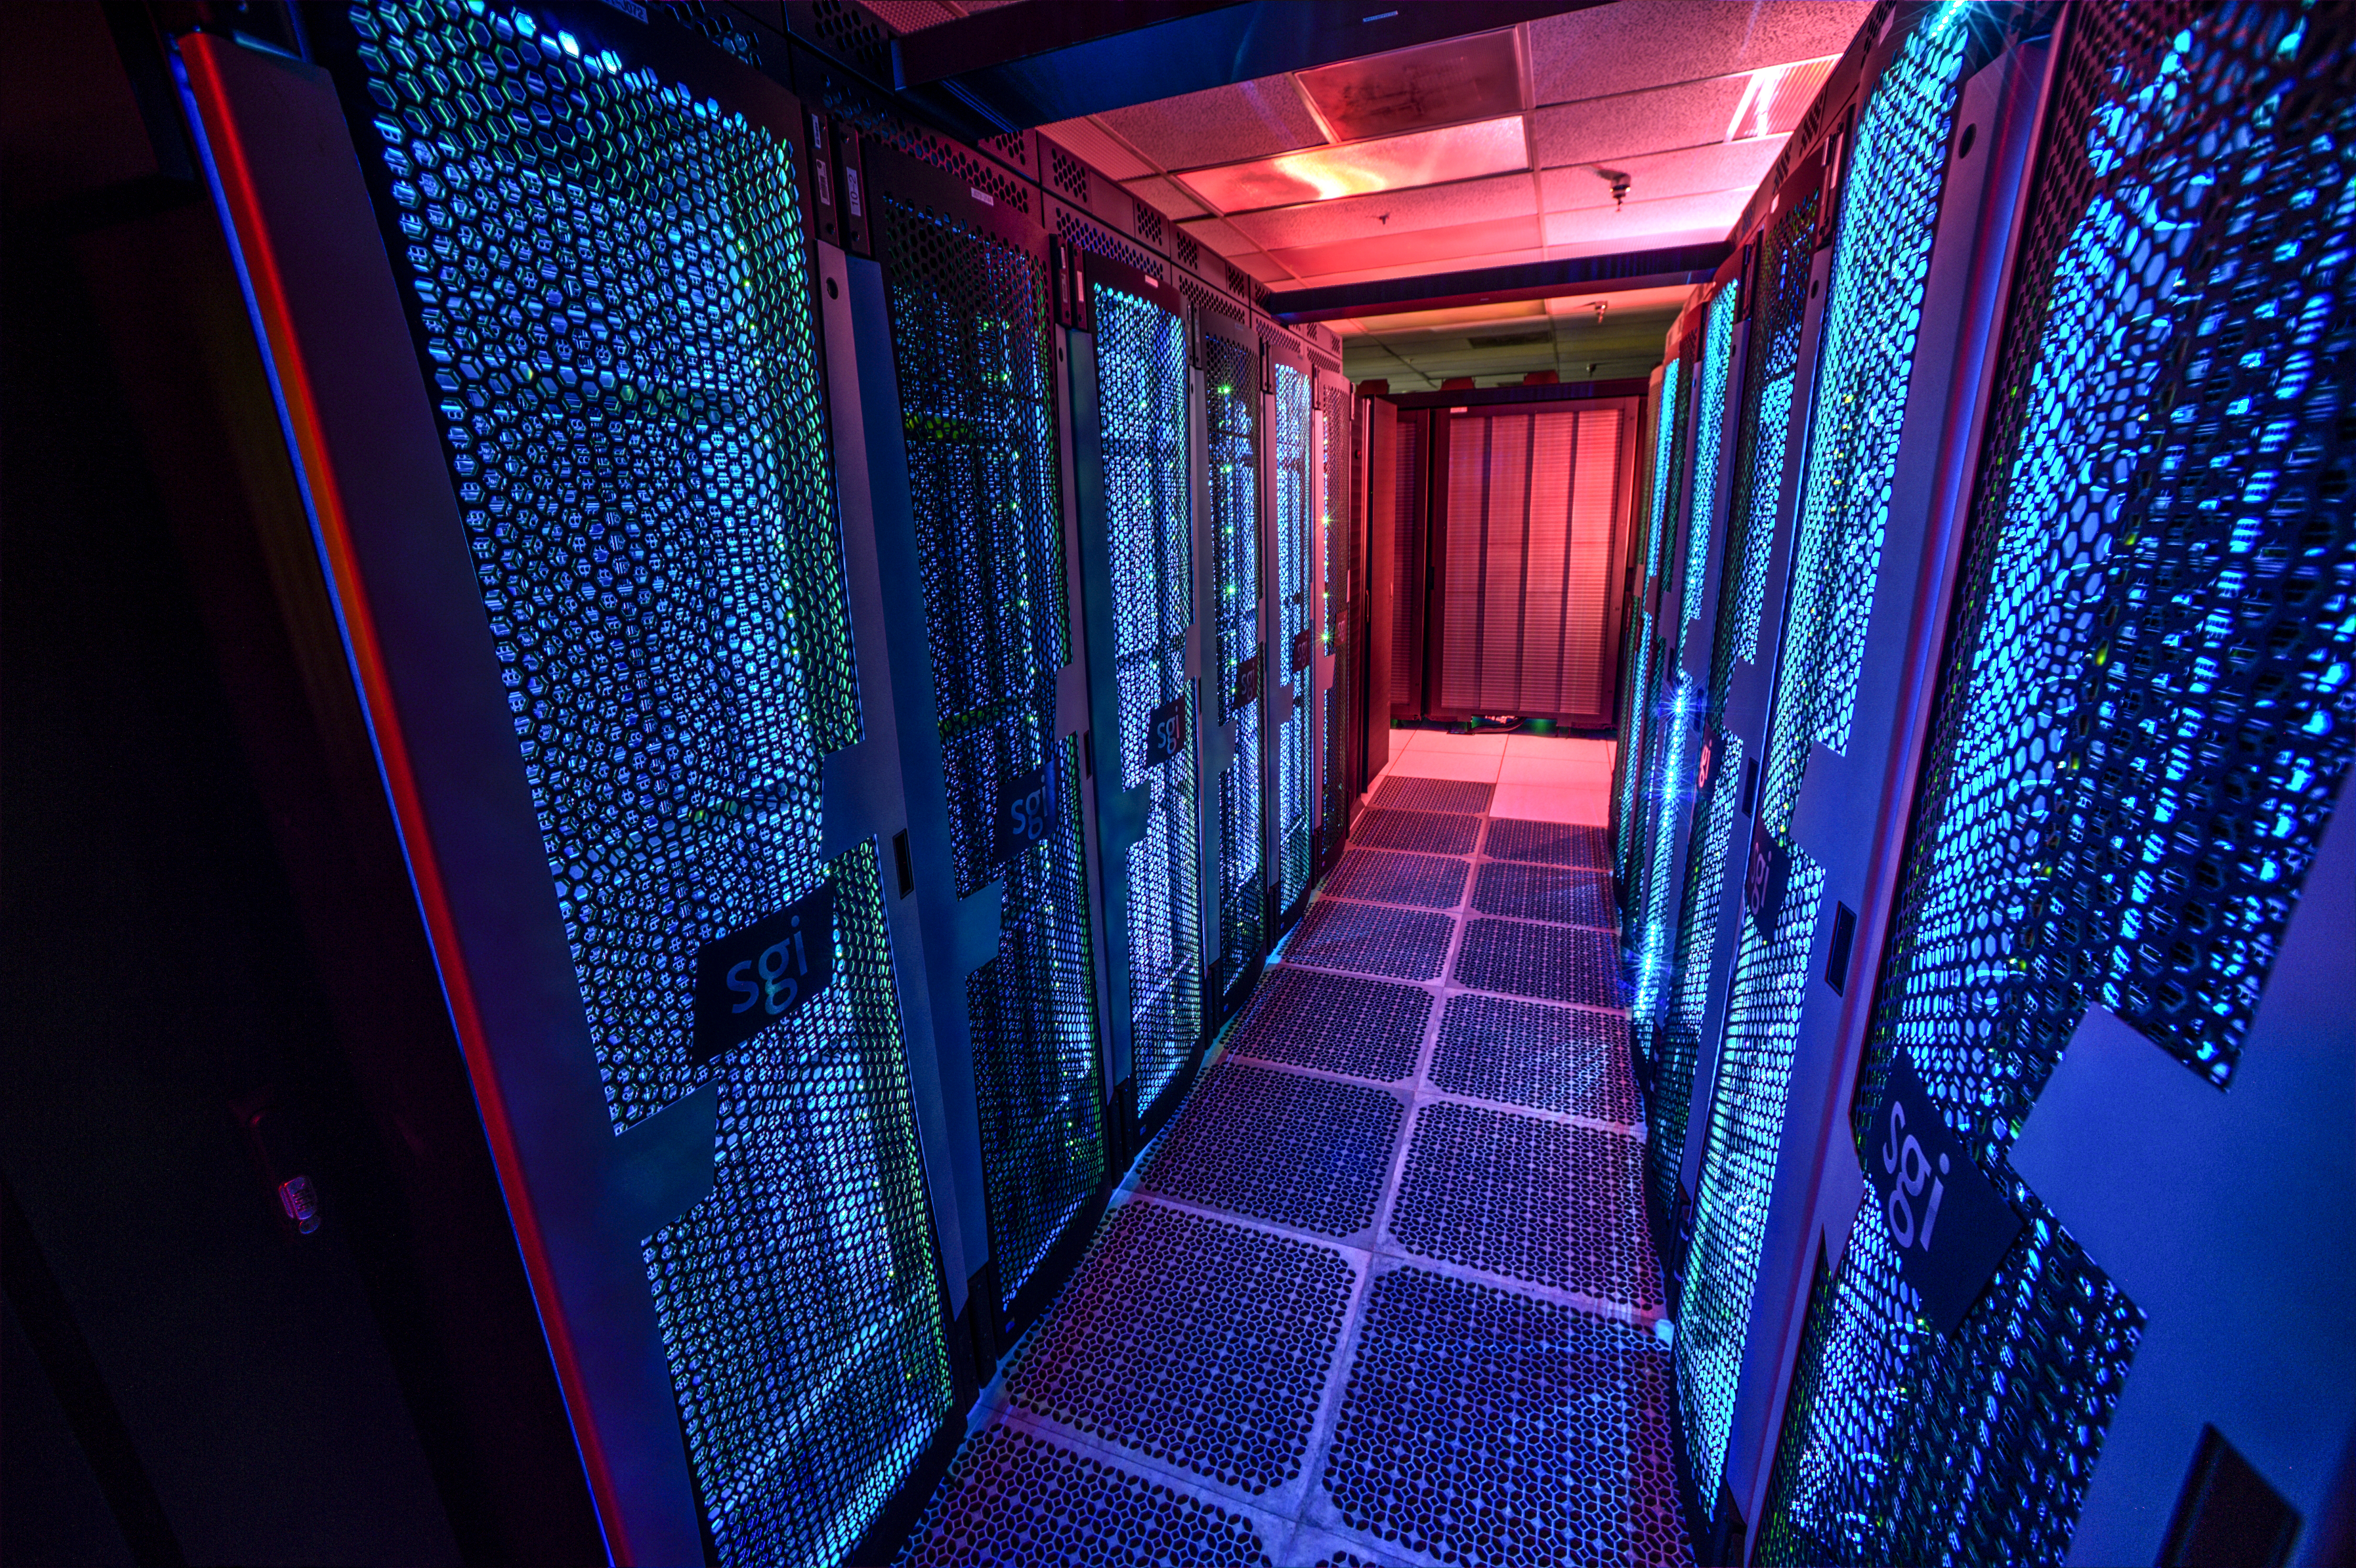
CISTO
Notes:
Computational & Information Science and Technology Office at GSFC is probably best known for super computing, particularly the Discover supercomputer shown here. We also support the ADAPT science cloud, networks and IT security, science visualization studio, and the newly formed innovation lab. ADAPT is a managed virtual machine environment borne out of a need for science compute capabilities that exceeded local workstations but didn’t necessarily need supercomputing capabilities. This system currently supports scientists from the TE funded ABoVE field campaign and the cryospheric sciences HiMAT as well as individual projects that have requested access. CISTO and NCCS support the GMAO by running the GEOS-5 climate model and generating the MERRA data. These climate datasets are large and multi-faceted which led users to demand informational products to be derived from them rather than requiring the user to download hundreds of TBs of data. Several “data analytics” services were built on top of the data to support this need. In the past year several data analytics efforts in CISTO have been coalesced into what we call the Innovation Lab. I am leading this group to provide solutions to big data problems that will accelerate science using AI/ML/DL and HPC which is the heart of data science.

Slide 3
CISTO organization
  CISTO has four main groups
    Networks and IT Security
    High Performance Computing (aka NCCS)
      All of the computing systems
    Science Visualization Studio
      All of the really interesting hyperwall work and lots of movies/visualizations in HQ presentations
    Data Science Group
      Innovation Lab
        Work directly with research scientists to accelerate their processes in HPC
        Programming support and containerization
      Data acquisitions
      Workforce Engagement

Slide 4
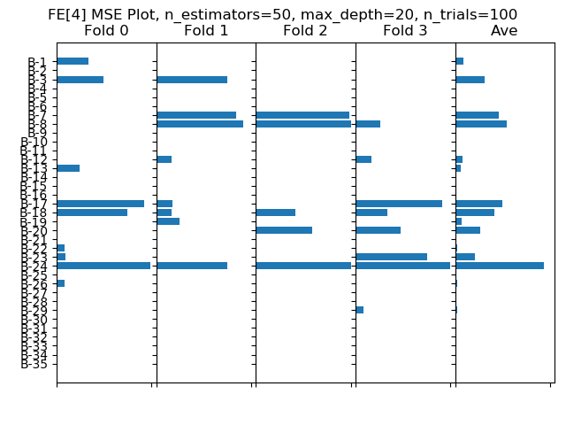
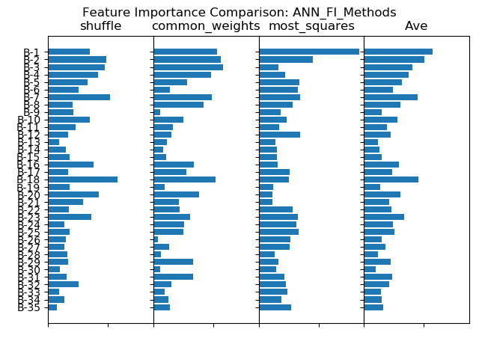
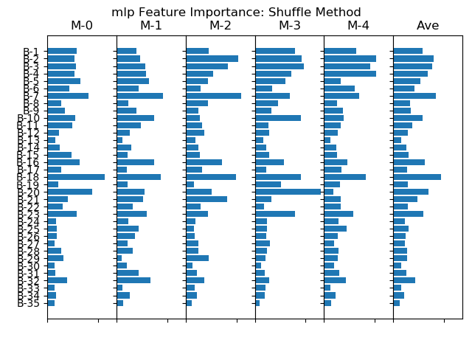
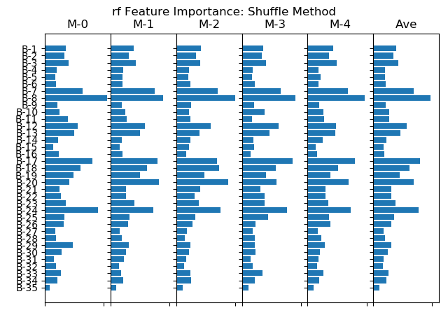
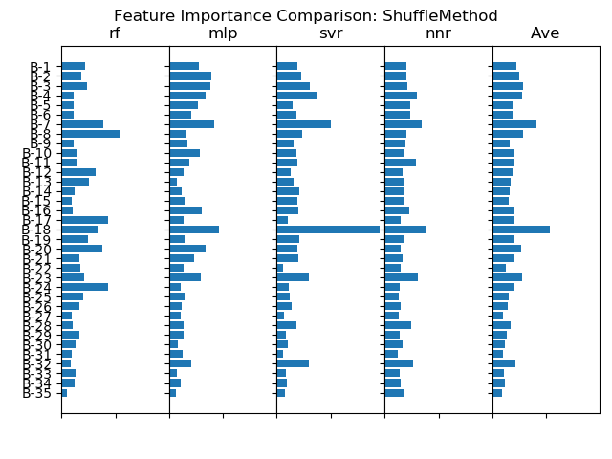
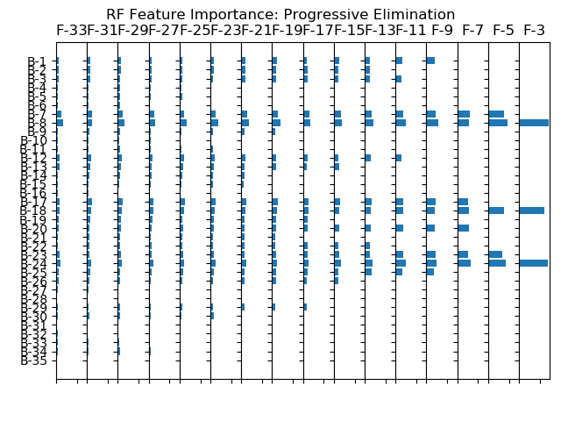
Feature Importance (FI) Investigation
Use a common training dataset in a machine learning (ML) project to investigate FI measures.
Questions: how do FI measures vary across the following dimensions:
    Across training instances?
    Across FI algorithms?
    Across ML methods?
  Result summary: Found significant FI variability across all three dimensions.

Slide 5
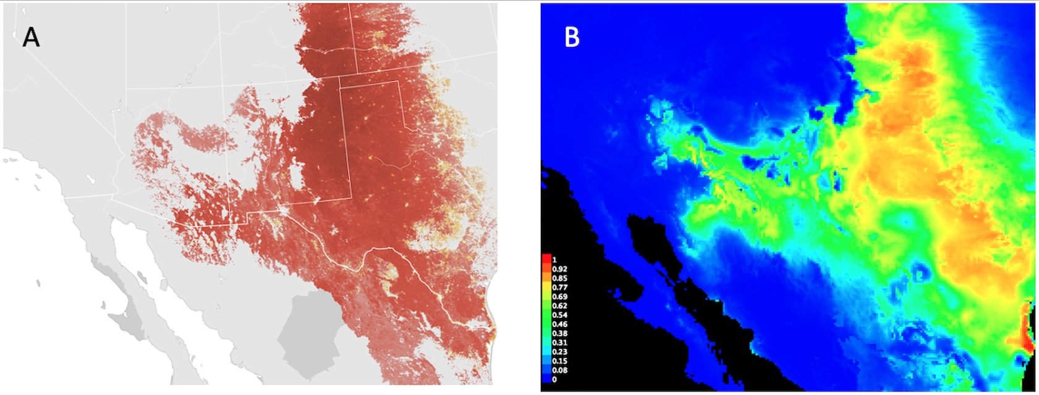
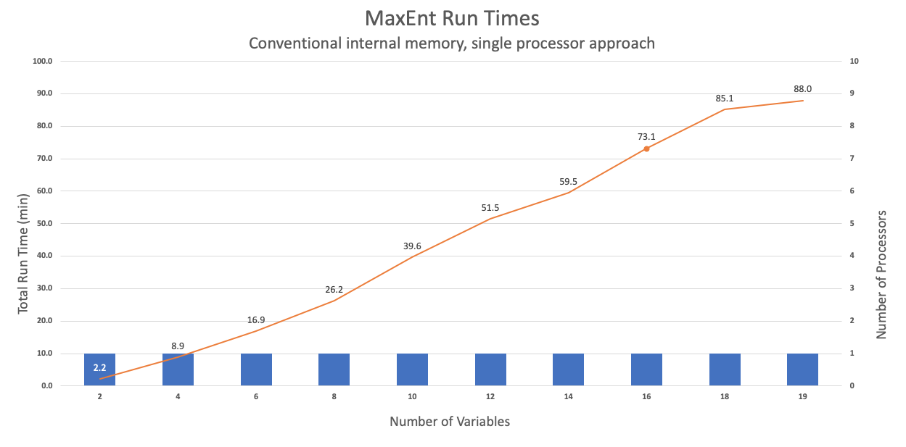
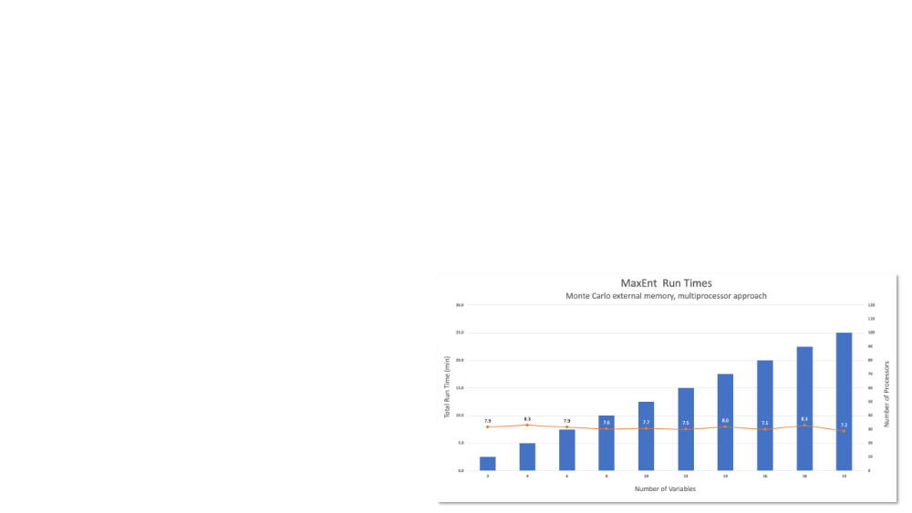
MERRA/Max (MMX) Project
Challenge
Research on ecosystem response to climate change often relies on data produced by IPCC-class climate models
Climate model outputs have hundreds of variables and large complex (Petabyte-scale) collections (MERRA, for example)
Proposed Solution
MMX is a parallel, external memory Monte Carlo optimization that selects a useful subset of predictors in a reasonable amount of time
- Uses many independent MaxEnt runs, each drawing on a small set of random variables read from a larger set stored in the file system
- MMX converges on a global estimate of the top contributing variables from the larger set
Cassin’s Sparrow observed range
“Standard” MaxEnt bioclimatic niche model
Notes:
Commonly-used ML modeling software generally works on data stored in main memory
- For example, MaxEnt widely used for species distribution modeling
- Has linear time-scaling properties wrt number of variables used
- Model runs can take impractical amounts of time (1.5 hrs with the “standard” 19 bioclim vars)
MMX’s Monte Carlo method can select “Top Six” variables (>90% importance) in <500 model runs
- Scales linearly wrt number of variables, but it’s “embarrassingly parallel” and can achieve near real-time performance in ADAPT (<8 min)
- Can scale to very large climate data collections

Slide 6
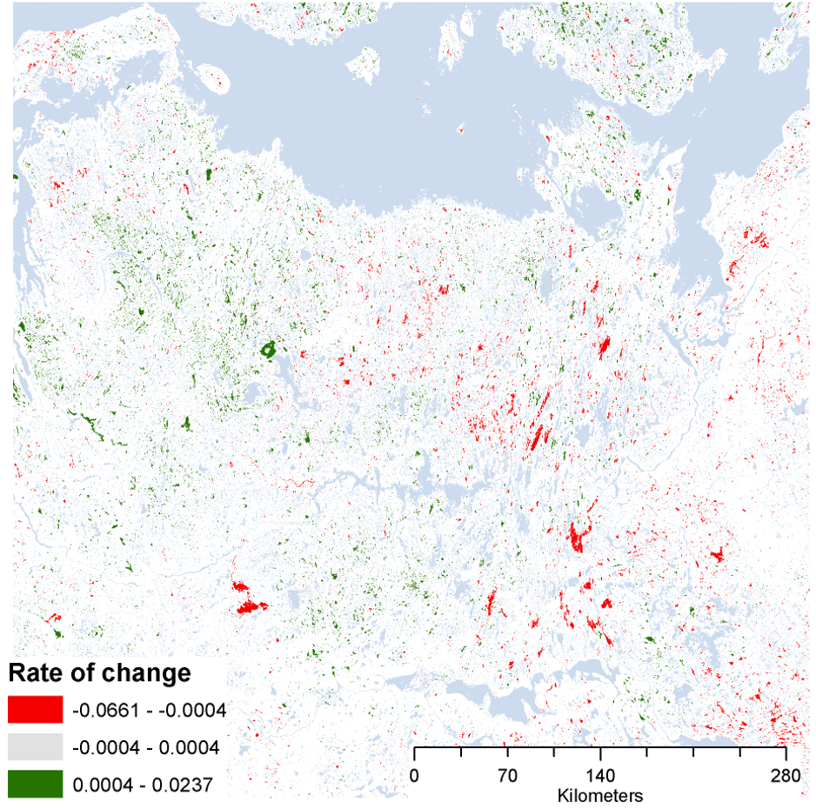
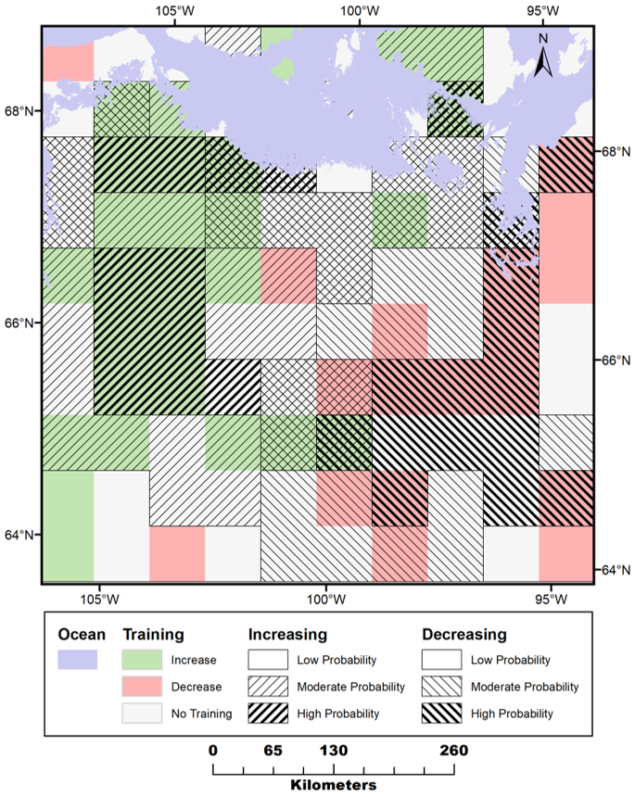
MMX – Feature Selection
Simulated co-occurring “species”
  Increasing and decreasing lakes
Selected ~60 MERRA variables
Generated weekly and monthly trends – yields ~600 input variables
Process through MMX ~80,000 runs
Resulting map simulates pattern
Key features identified make logical sense
Predictor | Time Frame | Permutation importance
Surface temperature | Week 17 (late April) | 71%
Surface temperature | Week 26 (early July) | 11%
Downward ground heating | Week 36 (mid-September) | 7%
Latent heat | Week 38 (late September) | 5%
Surface temperature | Month 7 (July) | 2%
Lake type (increasing/decreasing) = species
MMX result simulates pattern of wetting and drying with only MERRA variables
Ranked listing of input variables from final model

Slide 7
Hyperclass:
A Framework for Hyperspectral Data Visualization and Analysis
Interactive Semi-supervised learning
    Classification of landscape types/features
Manifold visualization with dimension reduction
    Projects 400D space of hyperspectral bands -> 3D point cloud
    Autoencoder reduction + UMAP embedding
    Embedding space interaction for visual exploration of data manifold
Manifold-aware training point generalization
    Builds a training set from manually selected samples

Slide 8
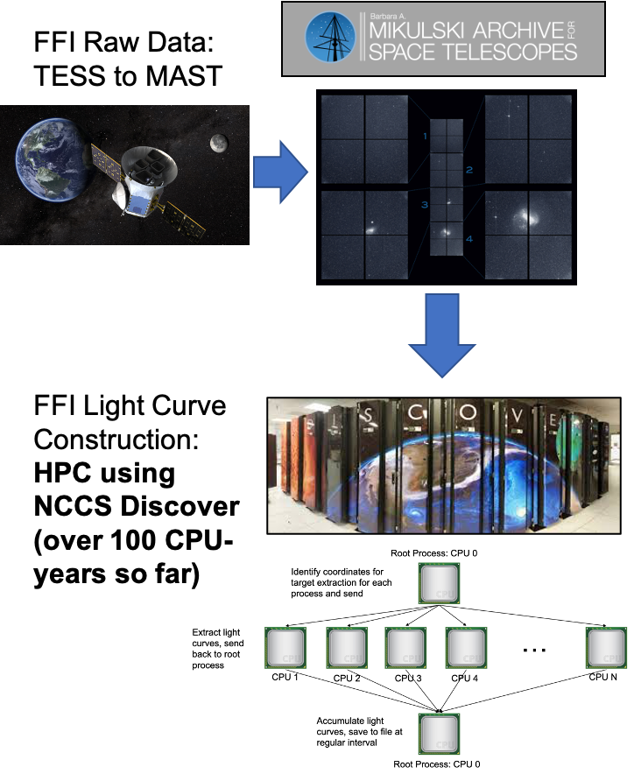

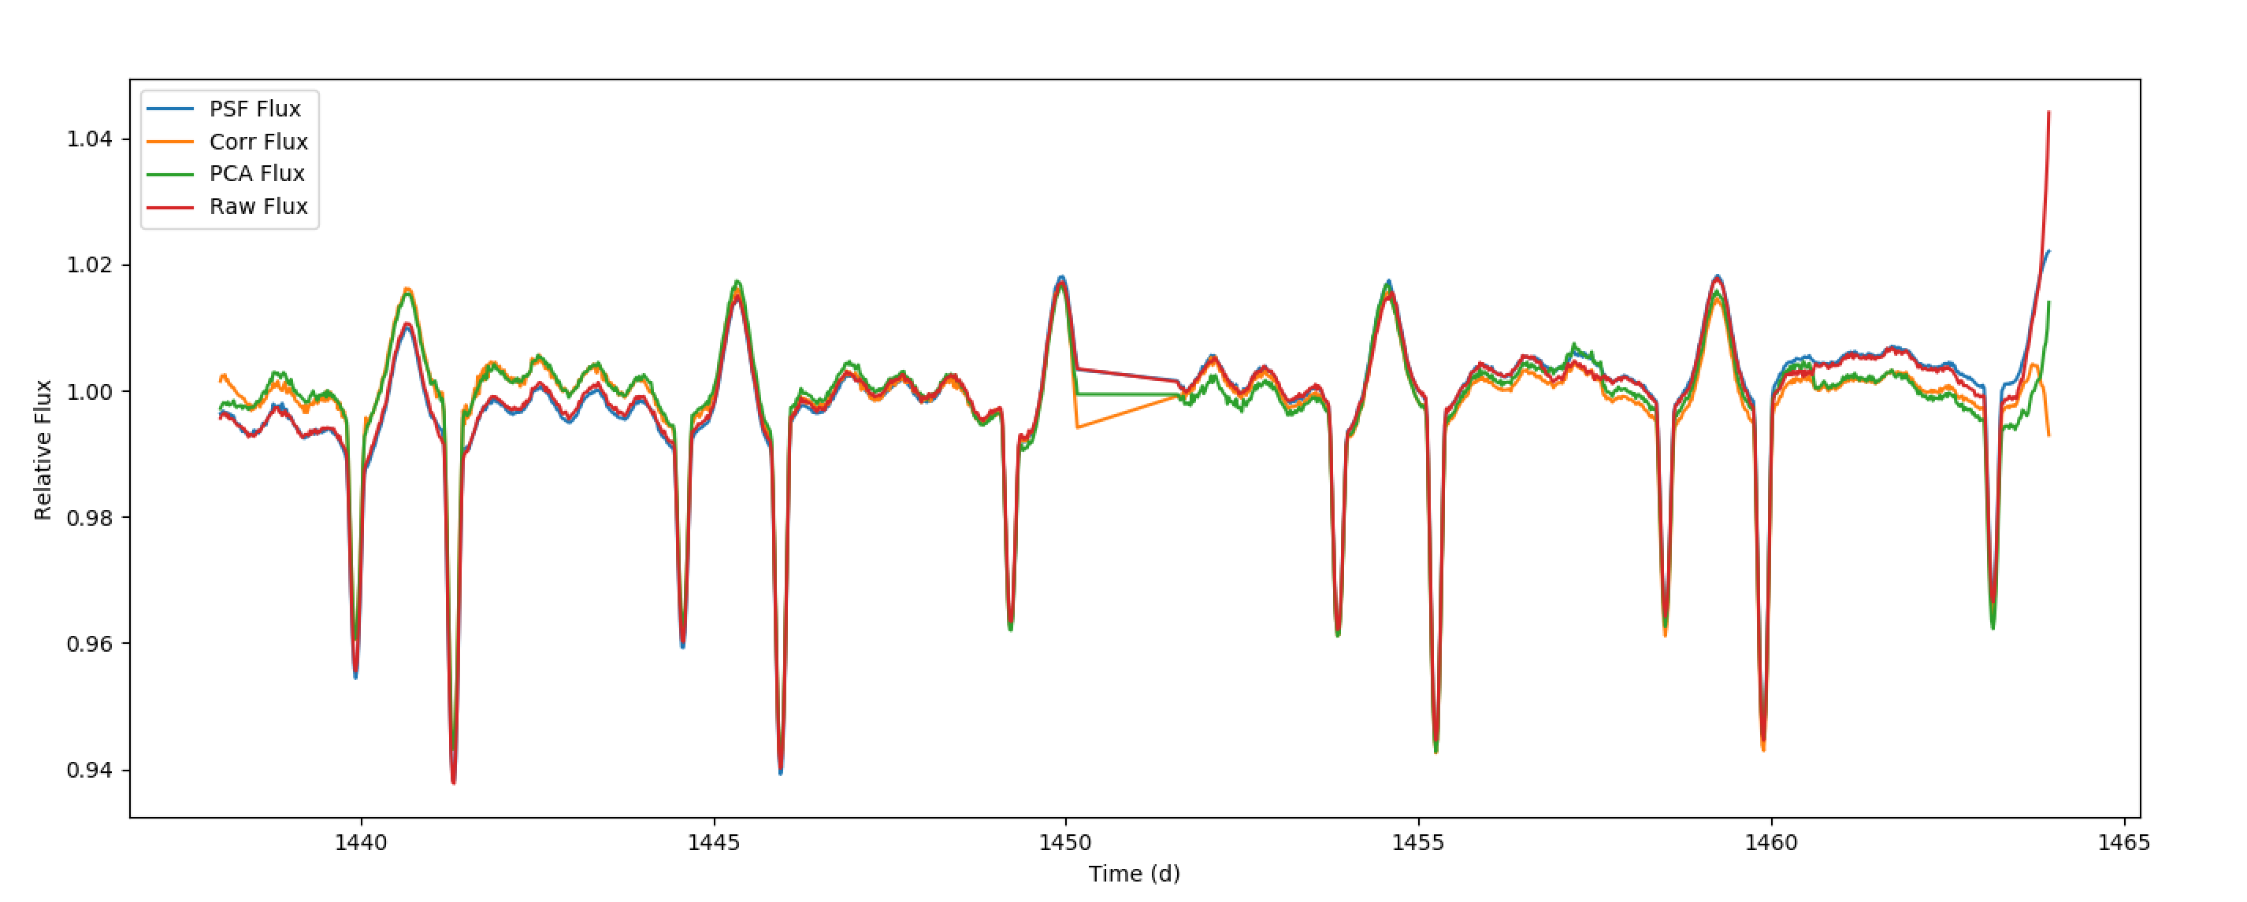

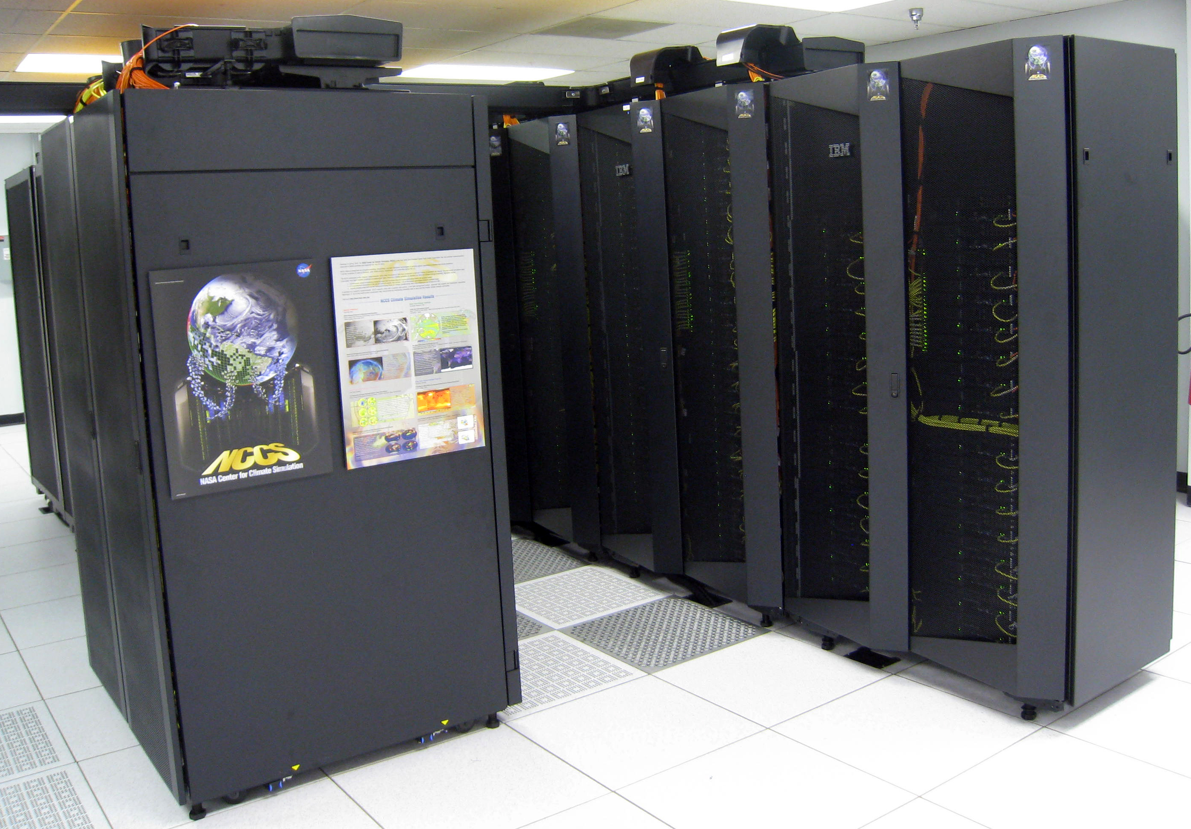
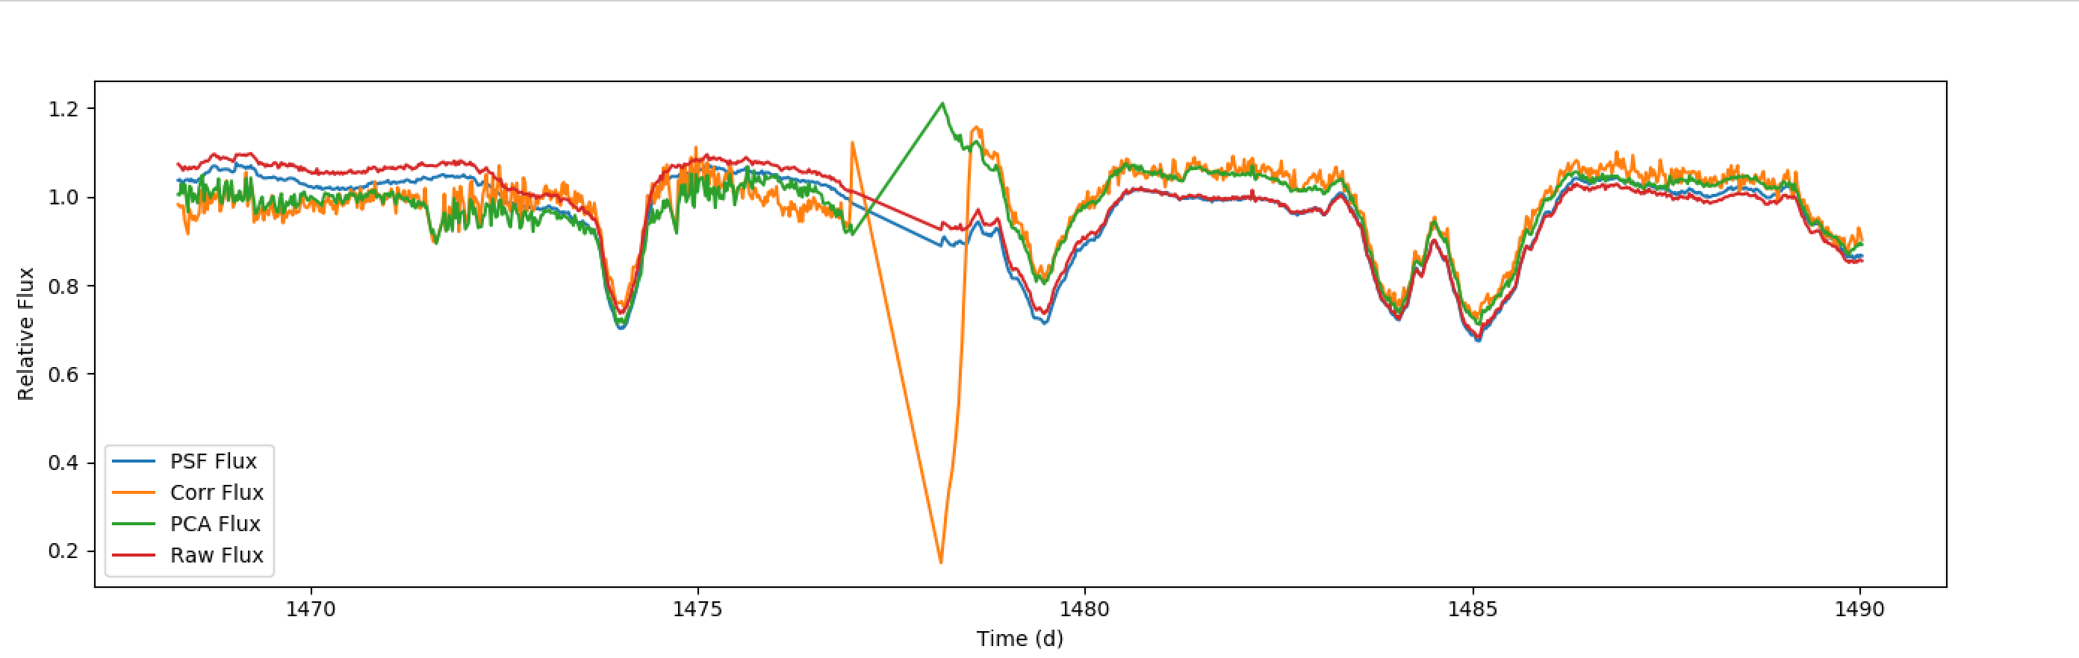
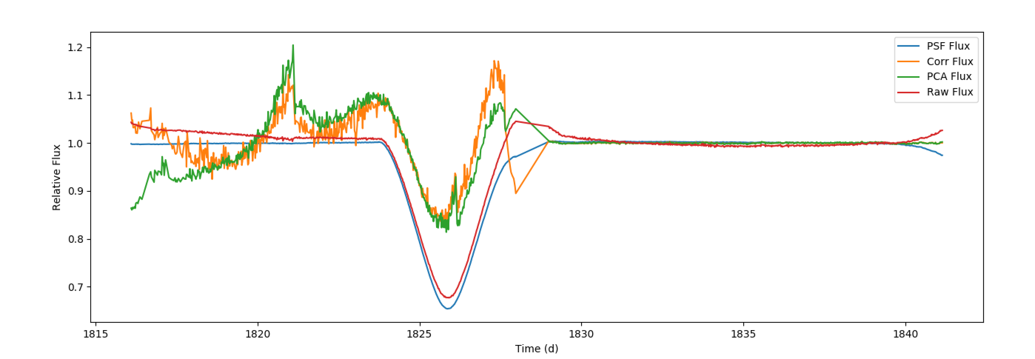
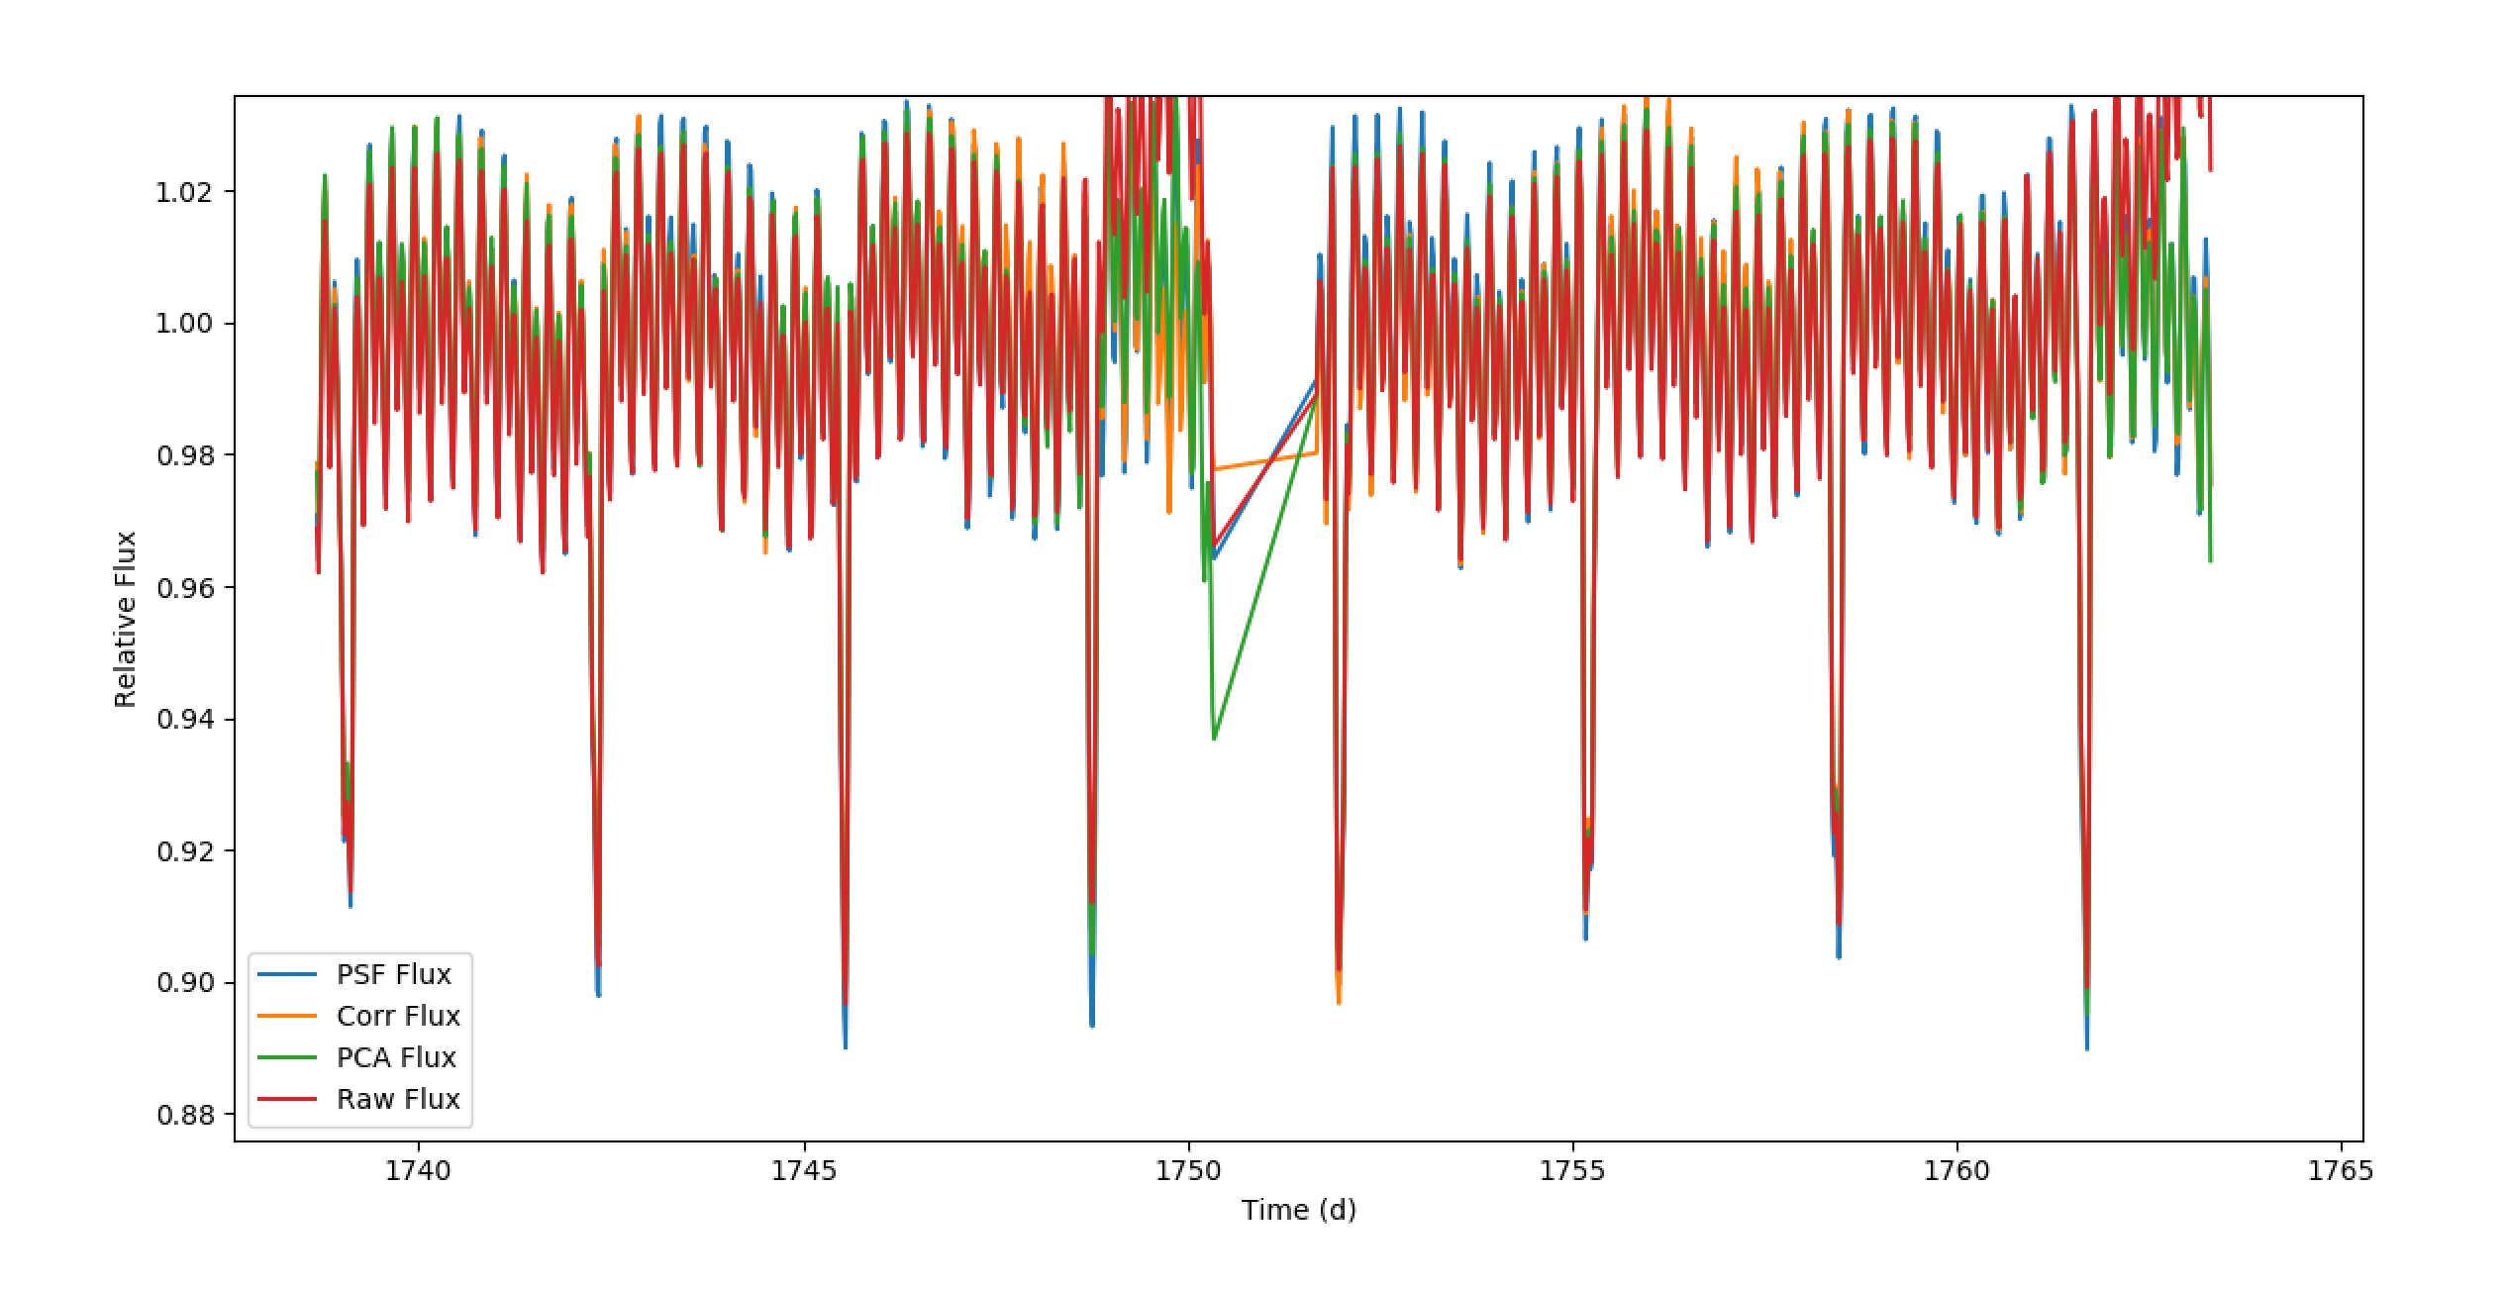
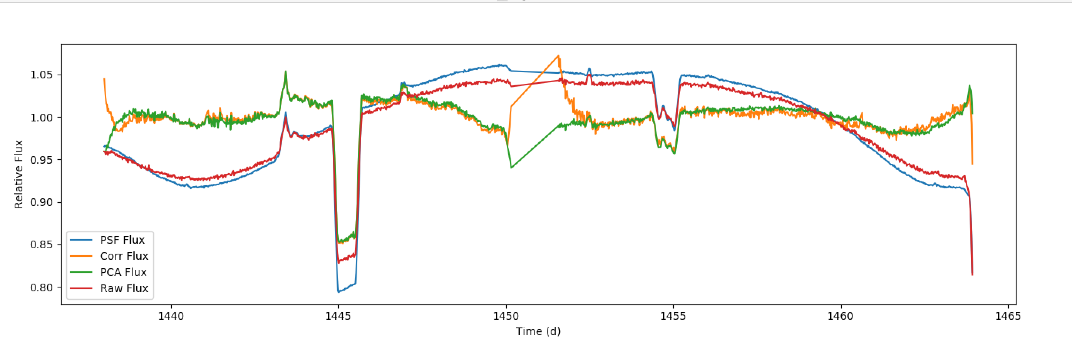
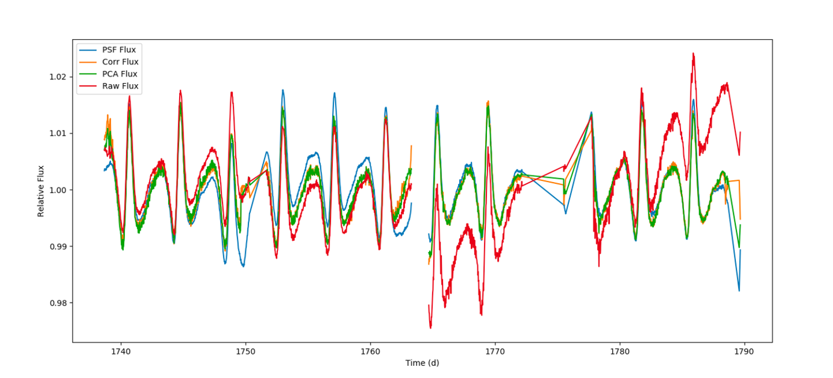
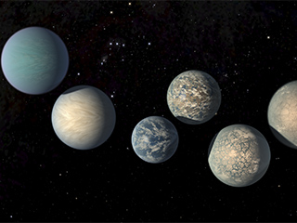
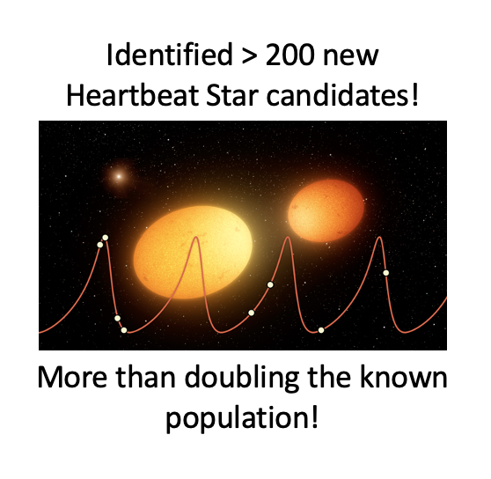
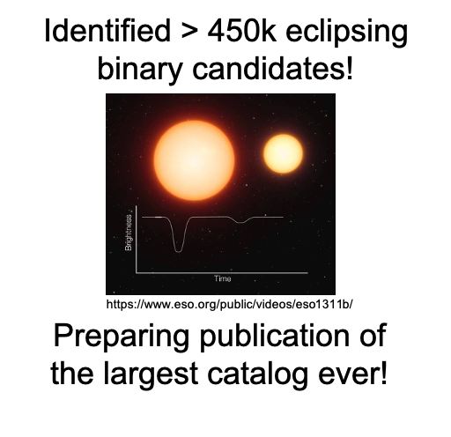
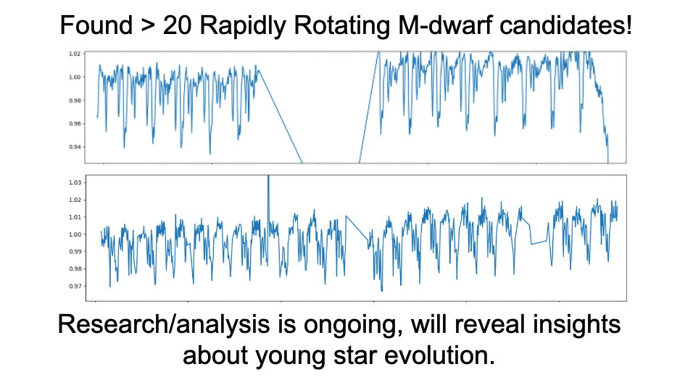
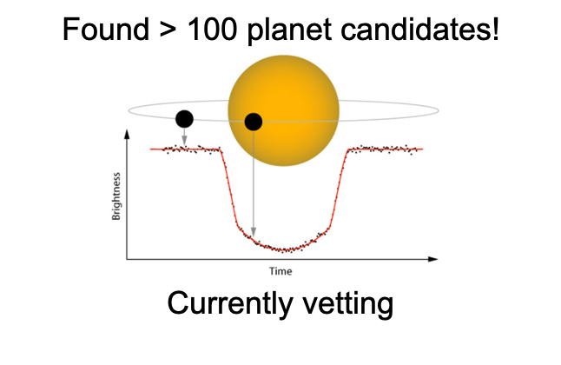
ASD is leading the way in HPC and AI/ML for Astrophysics
Classification
Representation
Applications:
1. Find specific star types
2. “Filter” systematics
3. Reduce search size
Applications:
1. Clustering
2. Anomaly detection
3. Novelty detection
AI/ML using NCCS ADAPT GPU Cluster
From HPC-created light curves (No AI/ML):
83 exoplanet candidates!
26 TESS Objects of Interest !
3 confirmed planets!
-- effort is only beginning --
3 XRP Proposals and 1 ADAP proposal submitted based on these light curves

Slide 9
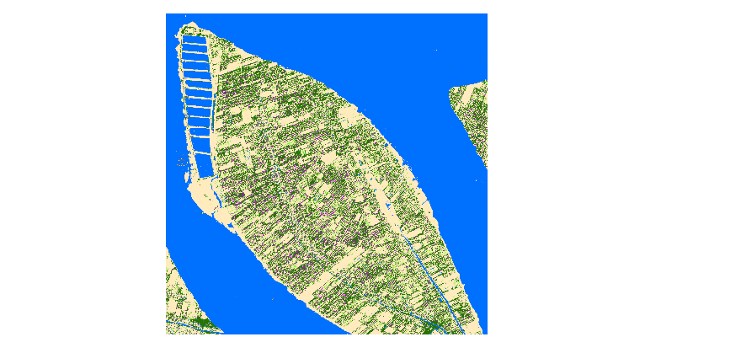
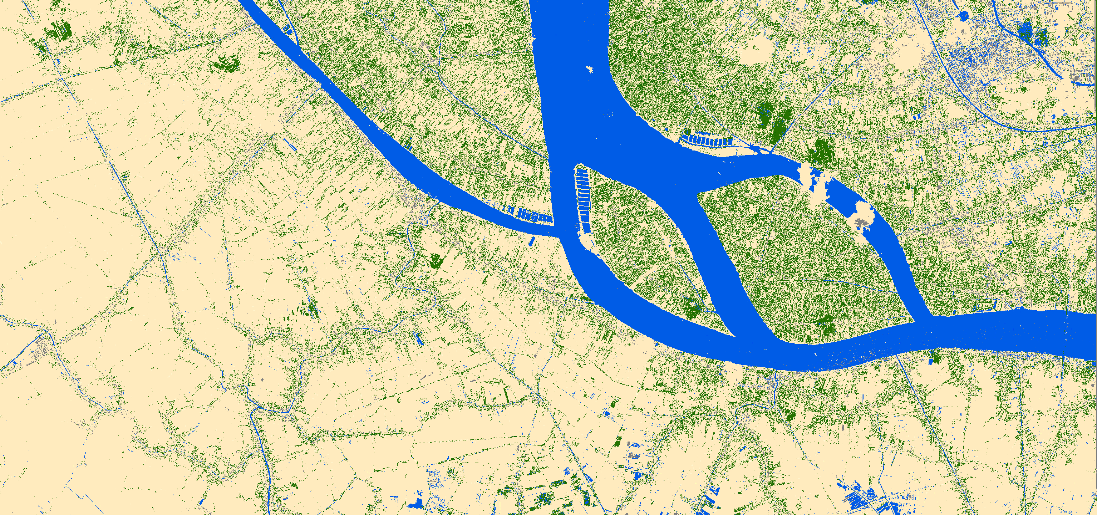
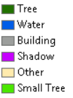
Deep Learning and GPU Image Classification
With the proliferation of Very High Resolution (VHR) imagery it is possible to map objects as small as individual trees. In this example Deep Learning has been implemented in the GPU environment to identify agro-forestry in Vietnam

Slide 10
Links and Info
  CISTO supported HPC systems (access via NAMS)
    ADAPT https://www.nccs.nasa.gov/systems/ADAPT
    Discover https://www.nccs.nasa.gov/systems/discover
    GPU cluster (part of ADAPT, no specific URL yet)
      22 systems each with 4 NVIDIA V100 systems (88 GPU in total)
        Additional systems are on order to be added to the Discover system in early 2021
      Jupyter Hub front end
    Data storage capacity for over 30 PB
      Current holdings
        Over 5 PB of commercial high resolution data (including Maxar, Ikonos, etc.)
        Over half PB of ICESat2 data (ATL03, ATL04, ATL06, ATL07, ATL08, ATL09, ATL10, ATL13)
        GLiHT data for some regions
        GEDI data incoming
    AWS Science Managed Cloud Environment https://www.nccs.nasa.gov/systems/SMCE
      Commercial cloud access
  AI Center of Excellence
    https://ai.gsfc.nasa.gov
  Any NASA funded scientist can request access to NASA HPC resources including Discover, ADAPT, and Pleiades

Slide 11
Questions?

