Slide 1
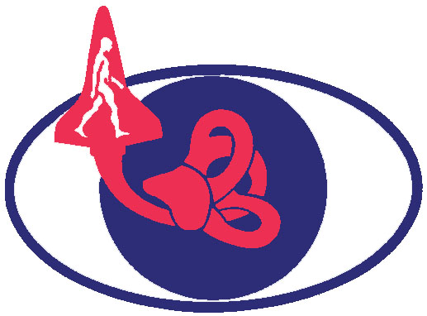

FUNCTIONAL TASK TESTS IN PARTIAL GRAVITY DURING PARABOLIC FLIGHT
Gilles R. Clément¹, Marissa J. Rosenberg¹, Scott. J. Wood², Millard F. Reschke²
¹KBR, Houston, TX, ²NASA Johnson Space Center, Houston, TX
Human Research Program Investigators’ Workshop 2021
February 1-4, 2021

Slide 2
Background
Critical mission tasks that are required by crews immediately after landing on a planetary surface are seat egress, jump, and walk.
To be able to define an effective and comprehensive countermeasure strategy for preserving crew performance during exploration-class missions, there is a need to understand how these functional tasks are actually performed in partial gravity such as on the Moon or Mars.
We propose to study the performance of the execution of these tasks during partial gravity phases (0.25g, 0.5g, 0.75g) of parabolic flight.

Slide 3
Hypothesis
We hypothesize that partial gravity during parabolic flight will cause acute changes in vestibular, proprioceptive, and sensorimotor functions, and these changes will impact the performance of mission critical tasks such as standing, walking, and jumping.
The largest changes in performance are expected at the lowest gravity level (0.25g) because subjects will no longer be able to use the gravitational reference for the perception of vertical.

Slide 4
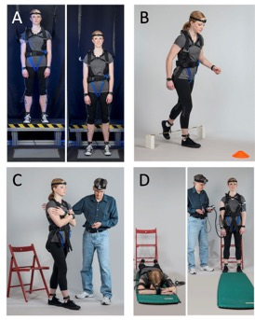
Methods
Functional task tests:
  Jump Down (A)
  Sit-to-Stand and Obstacle Walk (B)
  Tandem Walk with Eye Open/Closed (C)
  Recovery from Fall (D)
Recordings:
  Time to complete the task
  Head and body motion
  Body sway
  Heart rate; blood pressure
  Motion sickness symptoms

Slide 5
Relevance
Although gravitational dose-response curves have been obtained for some biochemical systems in animals, these dose-responses are unknown for most human physiological systems.
This study will compare the outcomes of 4 functional task tests in 0.25g, 0.5g, 0.75g, and 1.0g with those previously obtained in astronauts immediately after spaceflight.
This comparison will help understanding the true extent of functional task performance deficits in partial gravity.
The dose-response relationship will also help determining the gravity threshold for these functional tasks.
Acknowledgement: This work is supported by the NASA’s Human Research Program Human Health Countermeasures Element.

