Slide 1
Risk Reduction through Early Software Prototyping for the
Mars Ascent Vehicle
Stefanie Justice
Mars Ascent Vehicle, Flight Software Lead
NASA Marshall Space Flight Center
February 9, 2021

Slide 2
Agenda
Mission Overview
Project Lifecycle Context
Software Development Approach
Prototyping Status
Risk Reduction through Testing
Outcomes and Conclusion

Slide 3
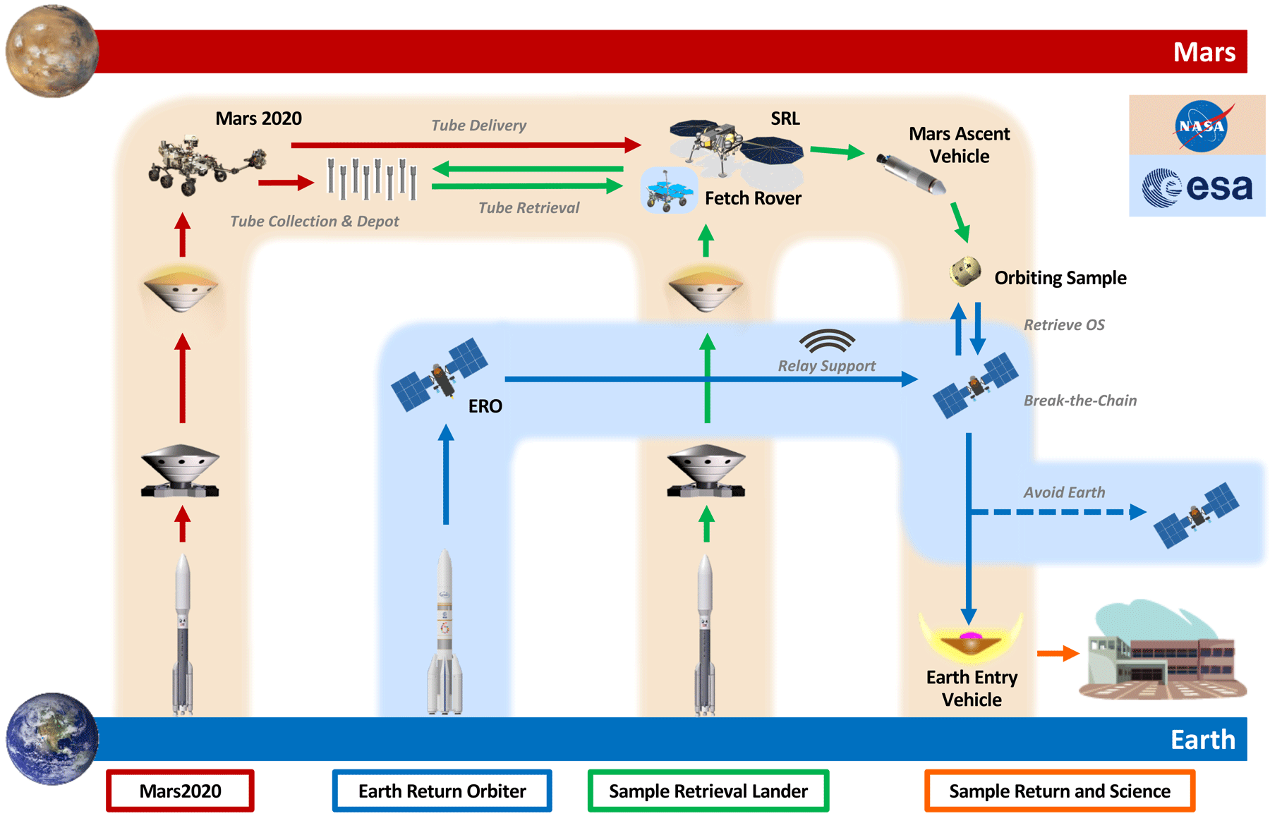
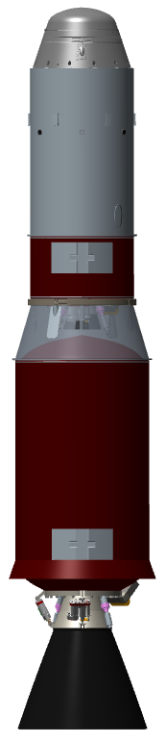
Mars Sample Return Mission Overview
MAV
Pre-decisional. Subject to change. For planning and discussion purposes only.

Slide 4
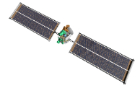







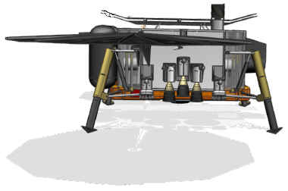

MAV Ascent Mission Operations Overview
4
2nd Stage Burn to Burnout and Spin-Down
2nd stage SRM 2 burn to burnout
Post-2nd burnout transients wait
De-spin motor burn
5
OS Payload Delivery
MAV 2nd stage-commanded OS release
Enable beacon (baseline)
3
Staging and Spin-Up
Separate 1st stage
Hi-speed spin motor burn
Enable beacon (earliest opportunity)
2
Coast and MPA Fairing Separation
Depart sensible atmosphere
Orient vehicle for MPA fairing separation
Separate MPA fairing
Reorient vehicle back to flight vector
1
Launch and 1st Stage Burn to Burnout
VECTOR launch
1st stage SRM 1 burn
Max Q
SRM 1 burnout
*Conceptual elements shown. Not to scale.
1st Burn
Coast, Staging and Spin-Up
2nd Burn and Spin-Down
OS Release
Loiter
~78s
~374s
~22s and ~Minutes
~Minutes
~Days

Slide 5
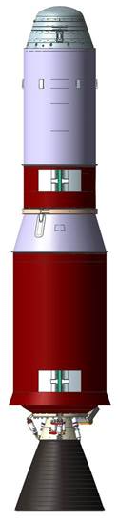

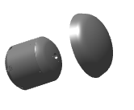
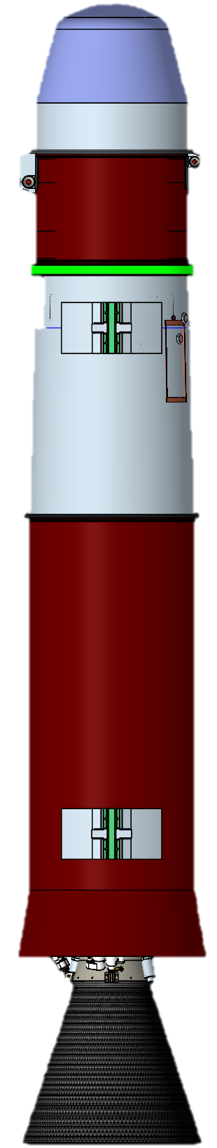
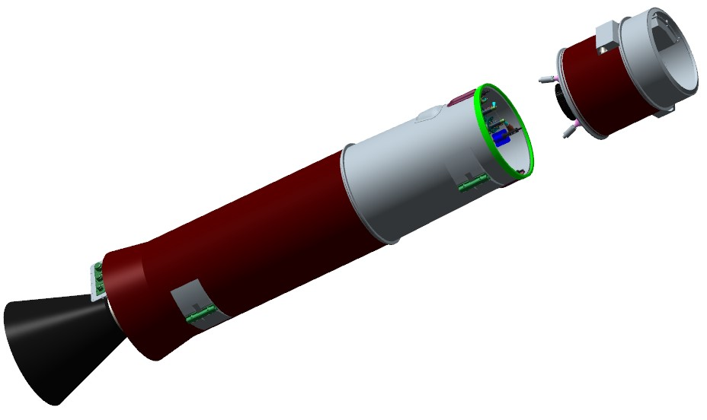
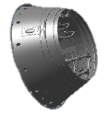
Preliminary MAV Architecture
Mars Ascent System (MAS) consists of:
Mars Ascent Vehicle (MAV)
  Two-stage (guided, unguided) solid motor vehicle
  Pyrotechnic stage separation
  Electrical-mechanical Thrust Vector Control (TVC) on 1st stage
  2x Spin Motors and 2x De-spin motors on 2nd stage, enabling spin stabilization
  Monopropellant Reaction Control System (RCS)
MAV Payload Assembly (MPA)
  Ejectable fairing
  Orbital Sample (OS)
Approximately 2.8m long, 50cm wide
MPA
Fairing
OS
MPA
2nd Stage
1st Stage
Pre-decisional. Subject to change. For planning and discussion purposes only.

Slide 6
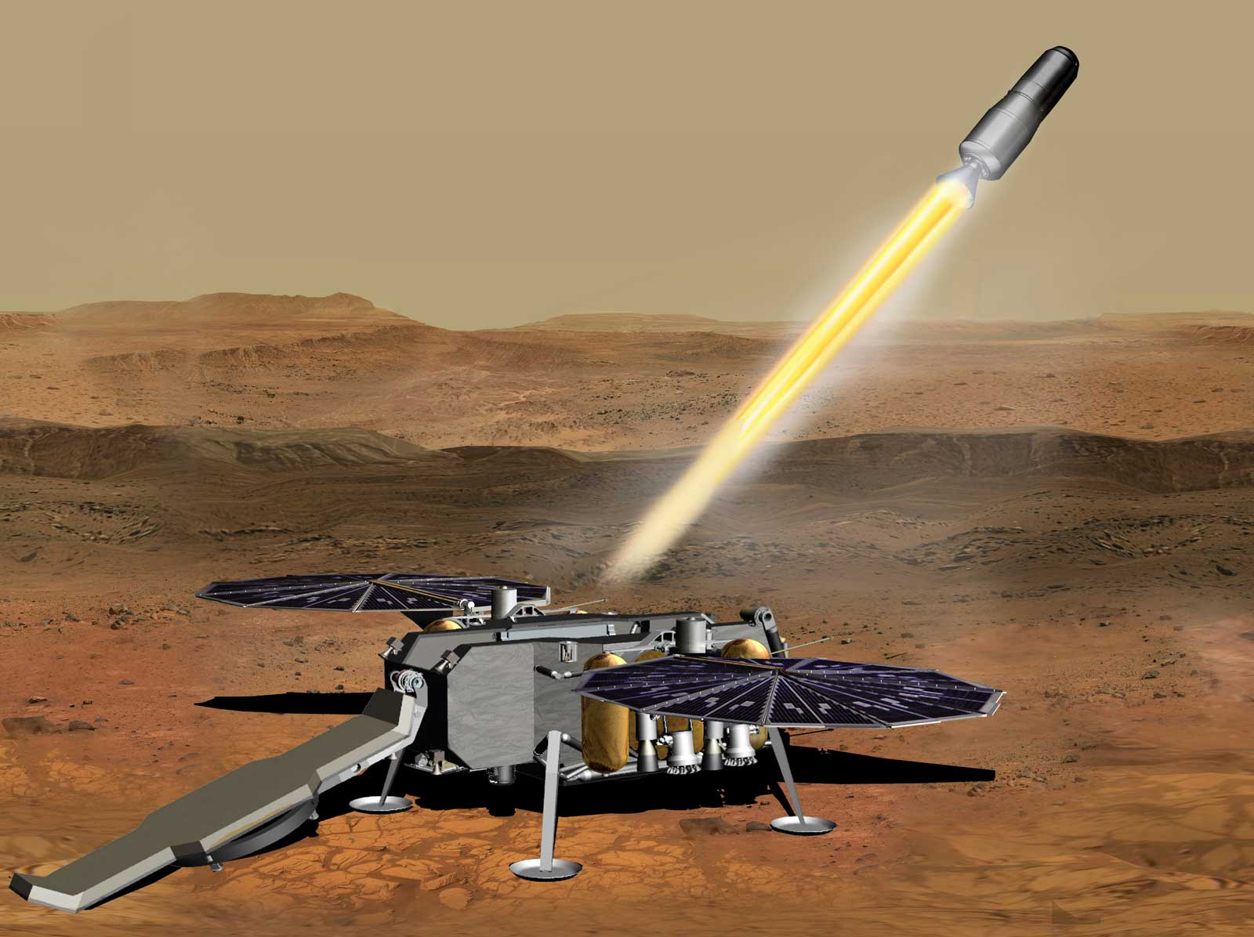
MAV Mission Design Constraints
Unique, first of its kind mission presents unique challenges
Mass and power constrained, which also constrains computing power and resources
Planetary missions present strict development schedules
MAV operates as a payload to the Sample Return Lander
Balance technical capability with meeting schedule – good enough, not perfect!
Tailoring and efficient engineering approaches are necessary
Collaboration and Risk Reduction are Keys to Success

Slide 7
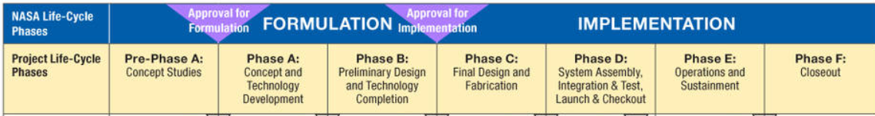
NASA Typical Project Lifecycle
Software Dev Started
Where We Are Now
Software Dev Typically Starts
Early software development efforts occurred under MSFC Technology Innovation Program during Pre-Pre-Phase A
  Assessed cFS framework for feasibility of use on mission
  Allowed team to come up to speed on mission and cFS framework
Provided software-focused considerations and notional architecture definition for multi-disciplinary design and feasibility studies during Preliminary Architecture Assessment
Transition to Phase A in December 2020 with a working prototype
MAV Software Development began during Conceptual Design

Slide 8
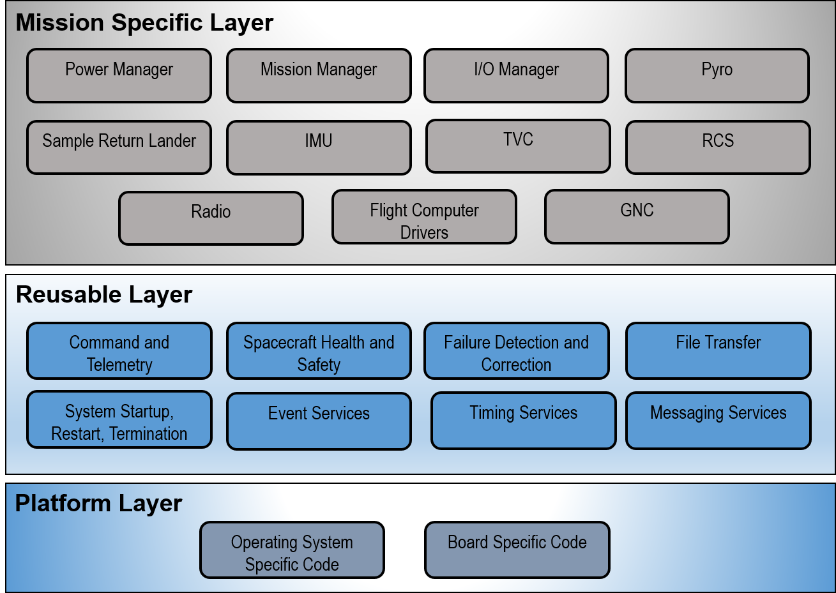
MAV First Stage Flight Software Notional Architecture
Pre-decisional. Subject to change. For planning and discussion purposes only.

Slide 9
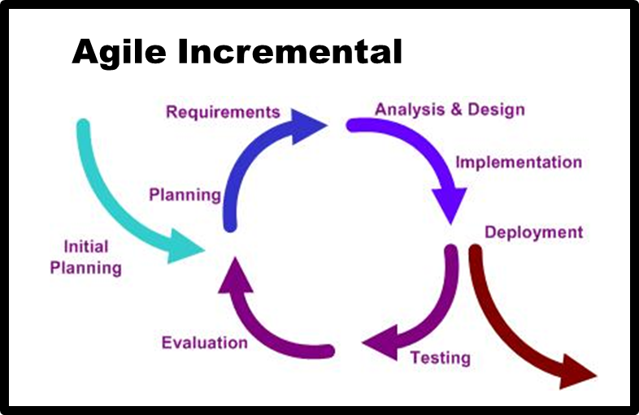
MAV Software Development Approach
Early prototyping and planning efforts
Adopted a modified Agile Scrum process from day 1:
  2-4 week sprints
  Tag ups 4 days / week, with one via email on Fridays
  Bi-weekly retrospectives and planning
  Monthly sprint reviews
Integrated Requirements, Design, and Test team
Regular interface with Mission and Fault Management and Guidance, Navigation, and Control teams
Review and implement lessons learned from previous projects
Leverage the work that team members working other projects are doing if there is overlap (i.e. tool assessments)
Continuous Process Improvement since Day One
Notes:
Peer reviews

Slide 10
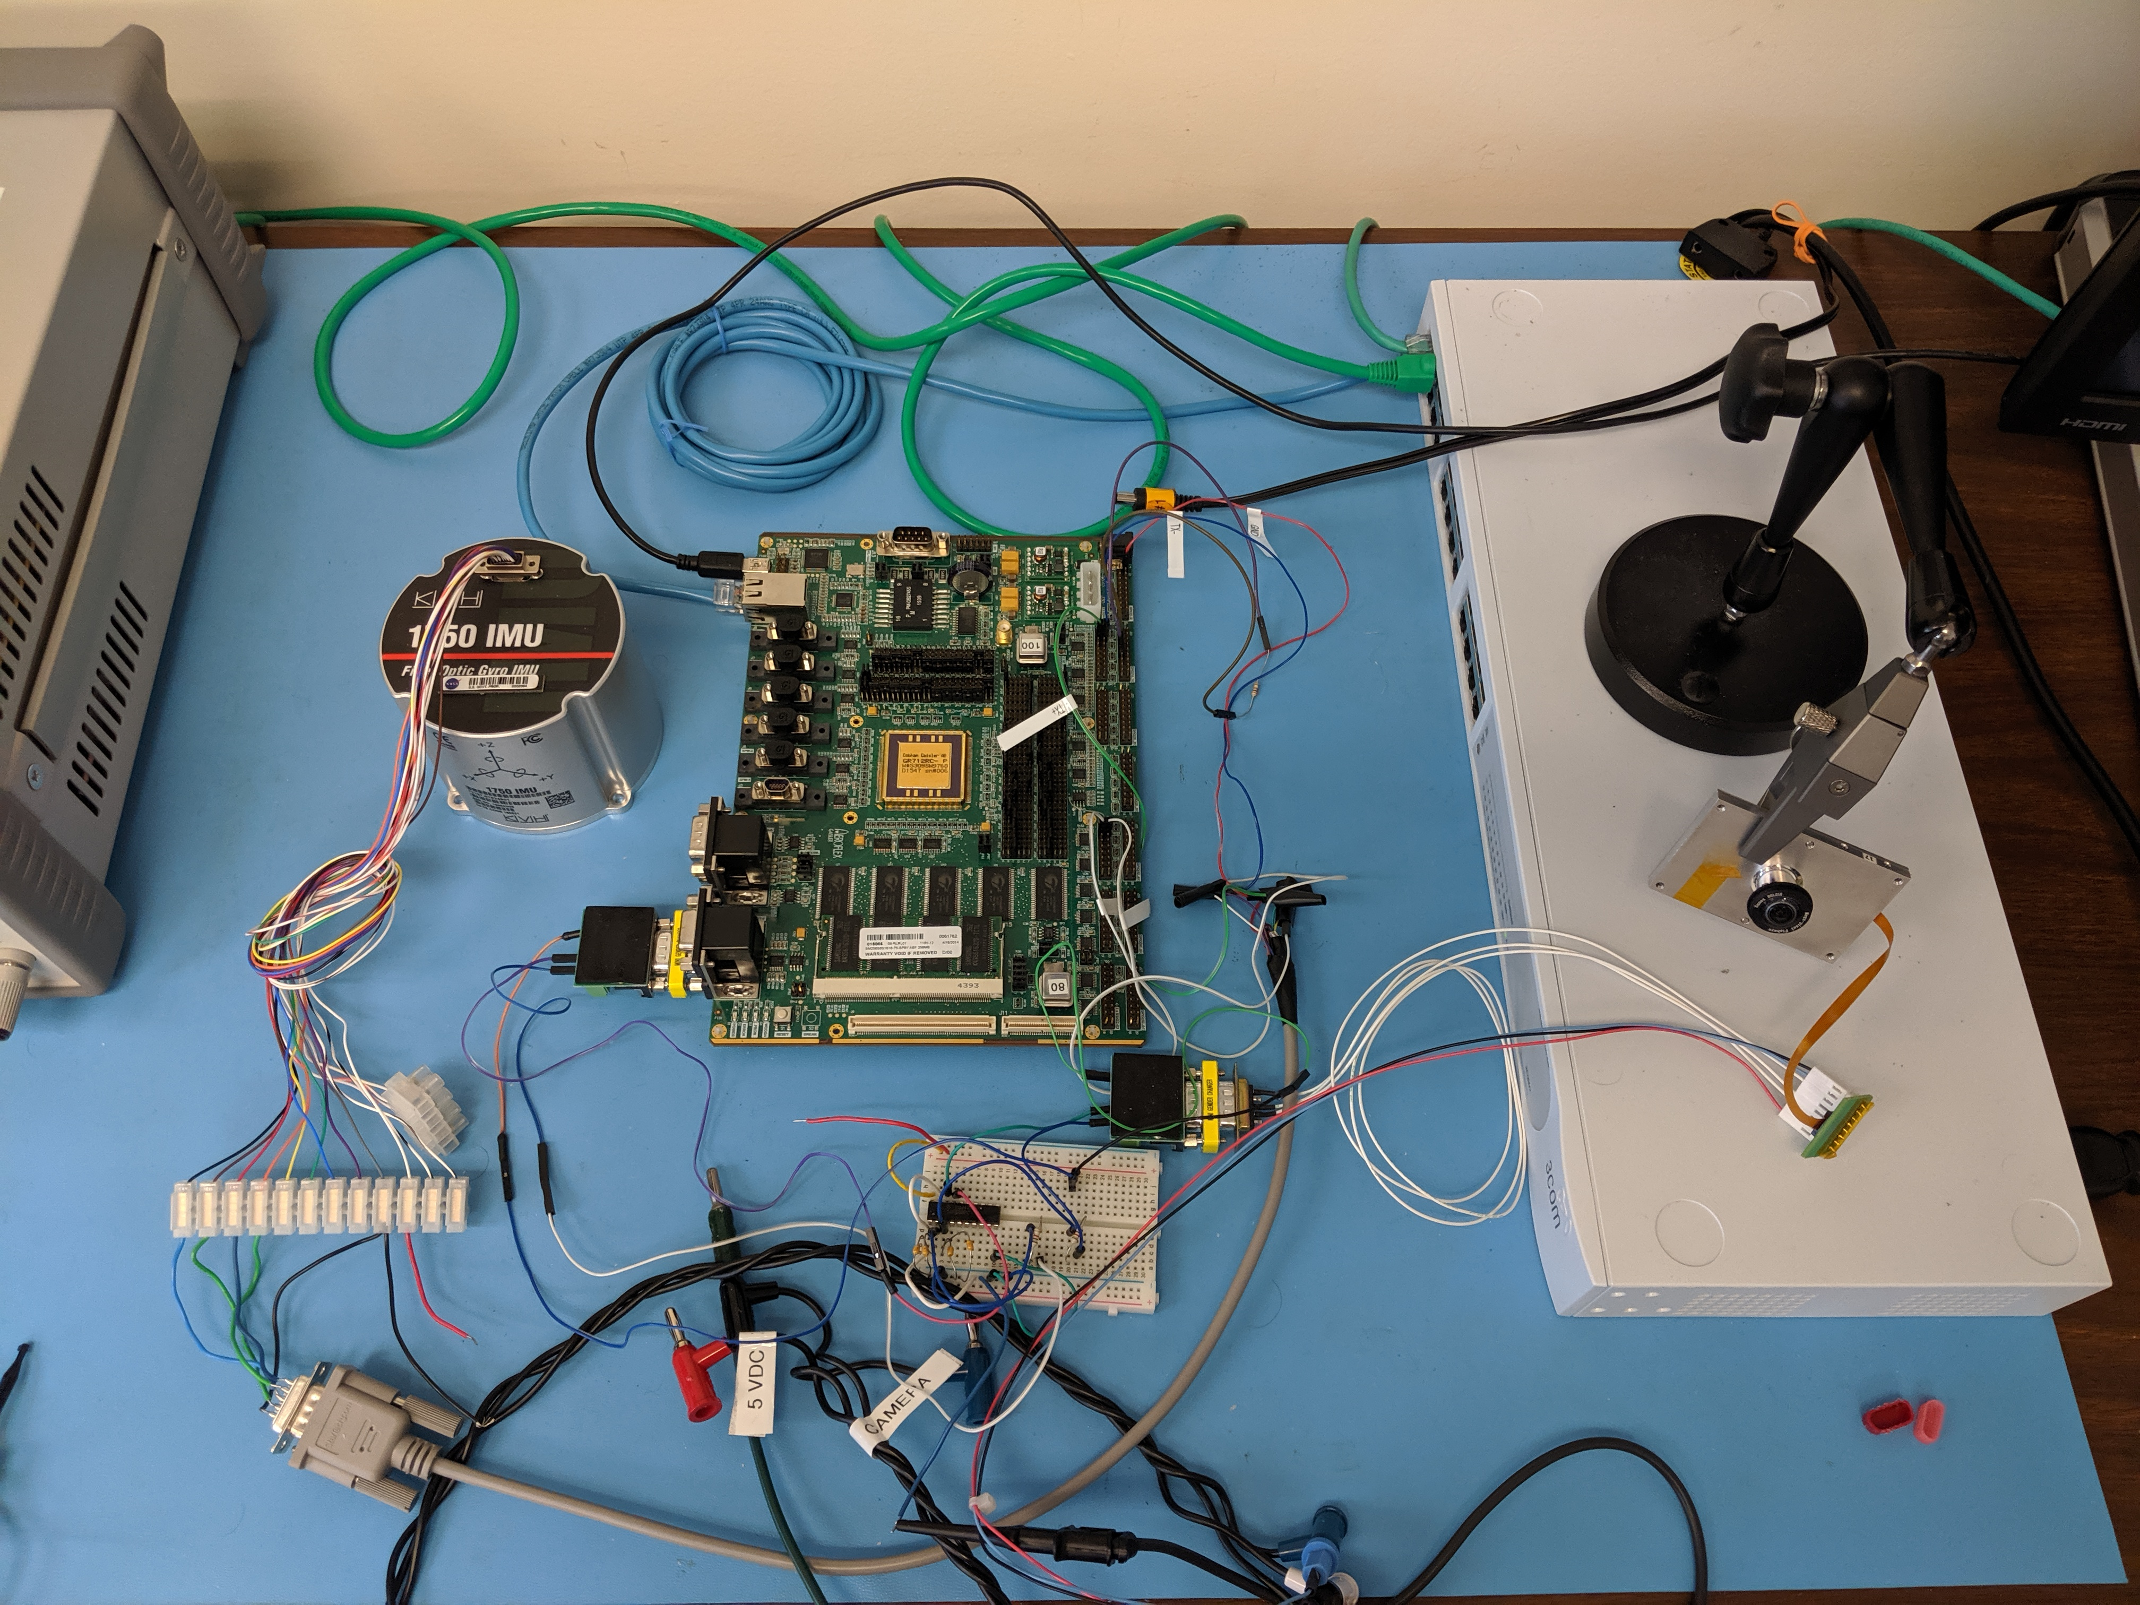
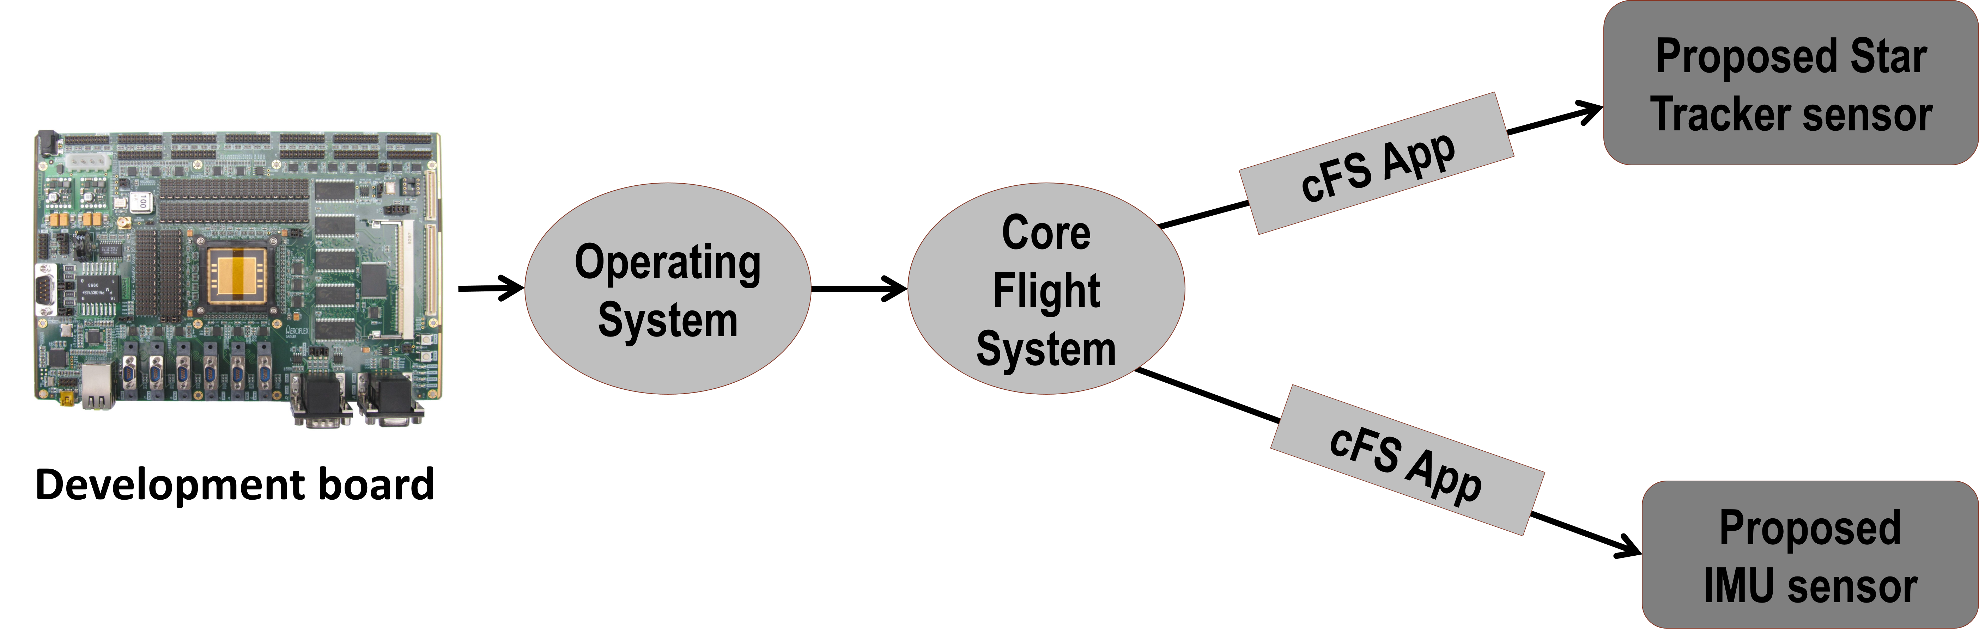
Preliminary Lab Setup
GR712RC LEON3 Development Board running:
  Real-time Executive for Multi-processor Systems operating system (RTEMS)
  Core Flight System (CFS)
  cFS applications developed for Lunar CATALYST partners and in-house cFS Software Testbed projects
Gained familiarity with platform, OS, and framework
Leaning forward with Development Hardware

Slide 11
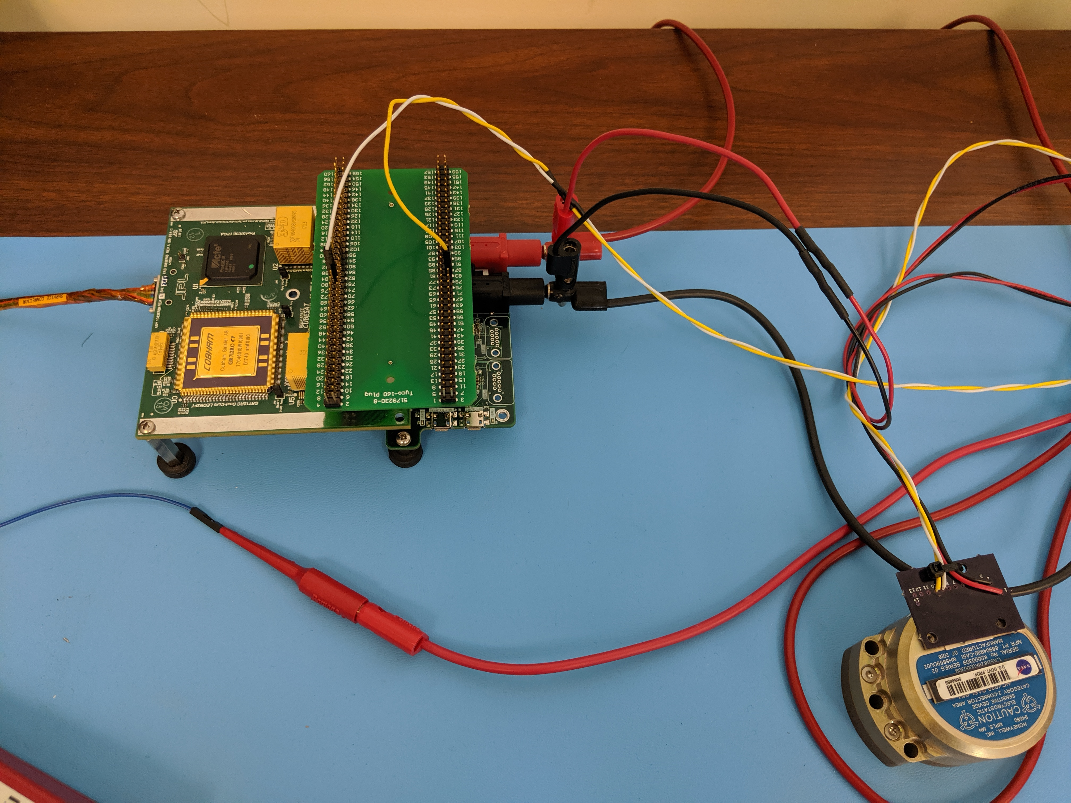
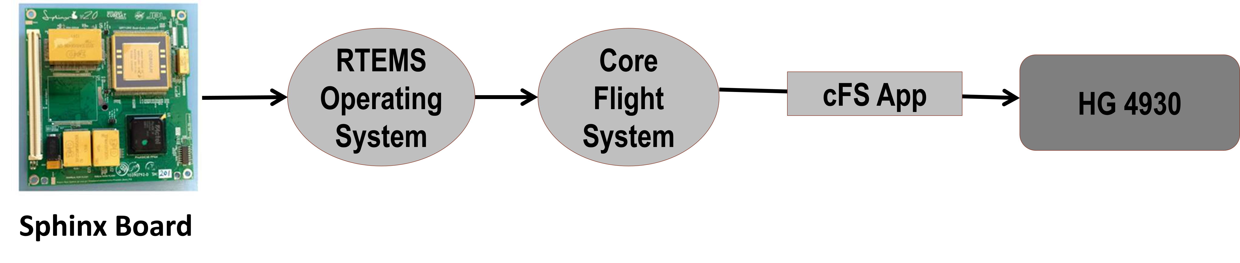

Current Lab Configuration
Sphinx prototype board running:
  Real-time Executive for Multi-processor Systems operating system (RTEMS)
  Core Flight System (CFS)
  Notional MAV IMU and NAV applications
  MAV prototype GNC code
Performance testing of prototype code helping to drive hardware requirements and focus GNC algorithm optimizations
Identifying hardware and algorithm constraints through early testing

Slide 12
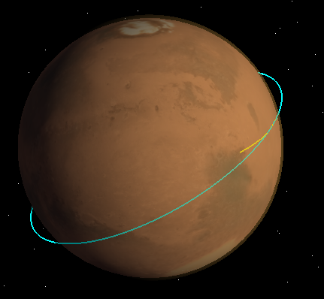
Current Flight Software Prototype
RTEMS/Linux
SCH
CI/TO
CFDP
NAV
Mantis G&C
CSV File
MAVVis3D
Newtonian
Physics
Simulation
Core Flight System (cFS)
cFS Message Bus
IMU
Serial
Ground Station
Serial/UDP
IMU (hardware)
IMU (emulator)
Significant Flight Software Capability by Phase A
Pre-decisional. Subject to change. For planning and discussion purposes only.

Slide 13
Risk Reduction through Testing
MAV Flight Test
ATLO Testing
Validation Confidence
SIL Integration Testing
SIL / JPL/KSC
FSW FQT Testing
Comprehensive
Requirements Verification on EM quality Test Line
Program Cost/Schedule
FSW Test and Verification Team
Informal testing / dry runs
Integration Testing
FSW on EM quality Flight Computers
FSW Design Team
Code Coverage Testing and Static Analysis on Brassboards
Functional Unit Testing on Brassboards
We can drive out many problems here, with less impact to cost and schedule
Test Venue Fidelity

Slide 14
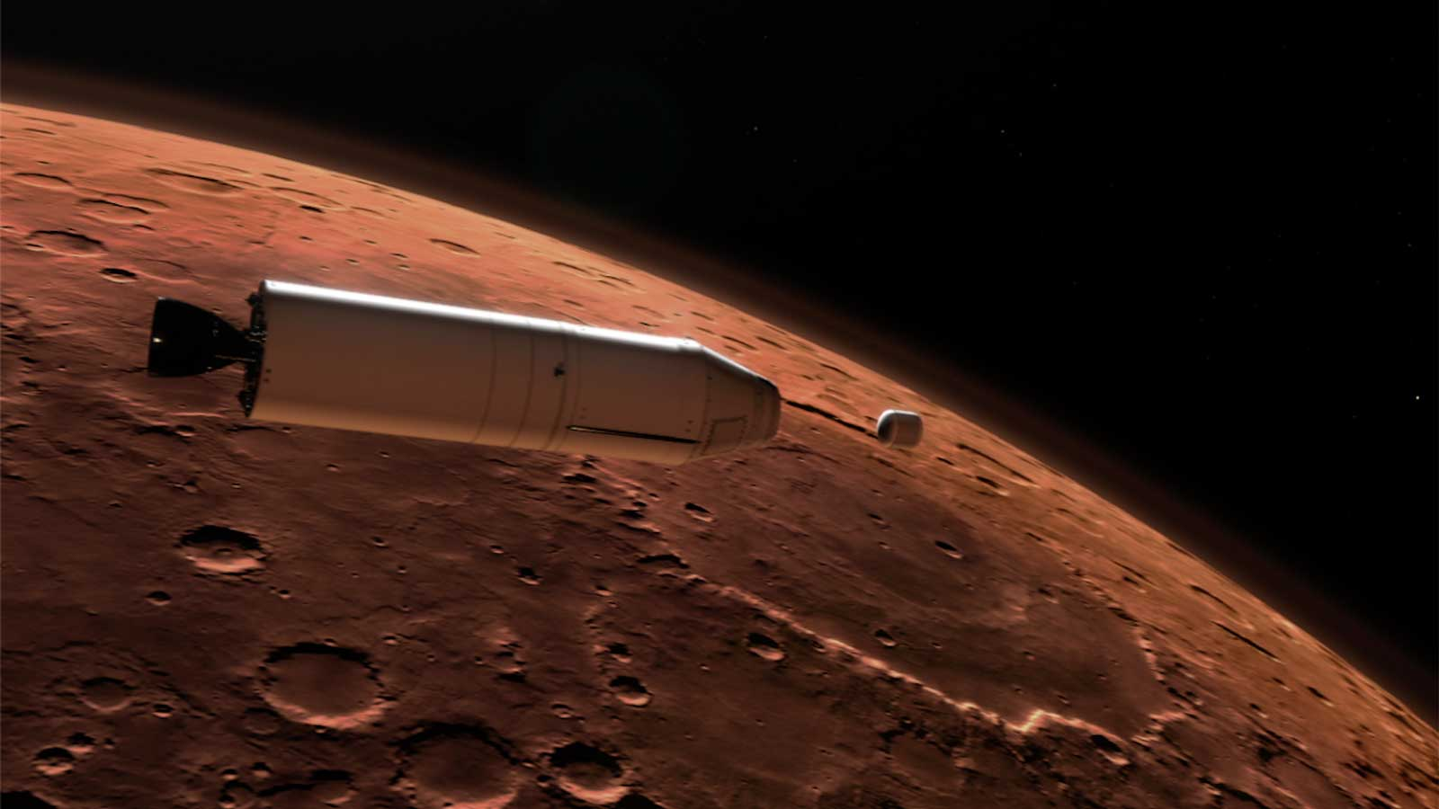
Outcomes and Conclusion
Through early involvement in the MAV project, the MSFC software development team was able to:
  Participate in conceptual design studies and early trade studies
  Experience Project Formulation and understand multi-disciplinary considerations during Pre-Phase A
  Assess software impacts of various architecture changes
  Use Agile scrum process to support incremental build up of capability to address immediate concerns
  Identify potential hardware constraints
  Assist with hardware requirement definition
  Perform early performance testing of software on hardware under consideration for mission
  Identify necessary areas of optimization for flight software
  Collaborate early and effectively with the GN&C and M&FM teams
  Support hardware procurement need dates and decisions
Early Software involvement has allowed both process and technical improvements going into MAV Phase A

