Slide 1
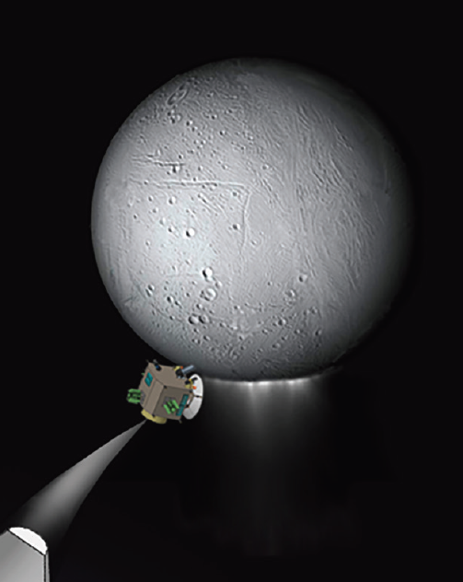
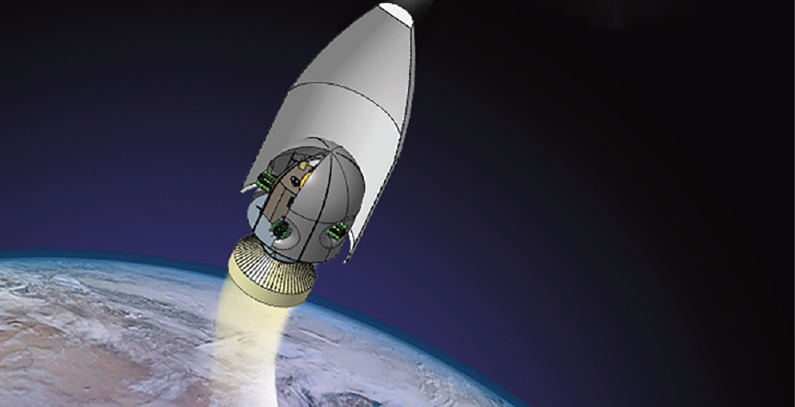






Contamination Control for Ultra-Sensitive
Life-Detection Missions
Jennifer Eigenbrode
NASA Goddard Space Flight Center, Planetary Environments Laboratory
(jennifer.eigenbrode@nasa.gov)
Robert E. Gold
Johns Hopkins University, Applied Physics Laboratory
robert.gold@jhuapl.edu
Contamination Control for Life Detection Team:
Antonios Seas, John Canham, Erich Schulze, Chris Lorentson, Therese Errigo, David Kusnierkiewicz, Faith Kujawa, Alfonso Davila, Chris McKay, Anthony Dazzo, Michael Swift, Andrew, Santo, Charles Sandy, Tony Asti, John Lin
ELSAH Technology Study Team, funded by NASA’s New Frontiers Program, 2018-2020
COSPAR 2021

Slide 2
Questions
What mitigations reduce the risk of terrestrial contamination compromising our measurements conducted afar?
              In such cases, contaminants may be viable cells (bioburden), dead and partial cells, biomolecules, other interferences
Can we reduce molecular contamination down to femtomole levels?
COSPAR 2021

Slide 3
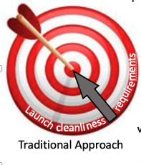
Traditional Contamination Control Engineering
Work from a viewpoint of:
Launch cleanliness (outside ring) to End of Mission (center)
  Determine requirements
  Protect the sample path
  Verify hardware cleanliness
  Account for possible contaminant transfer using bulk transfer physics
COSPAR 2021

Slide 4
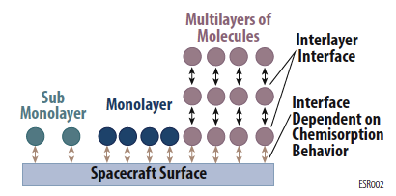
Traditional, well proven techniques and operations
→ Not adequate for Ultra-Sensitive Life Detection Missions
  Verification techniques - inadequate
  Standard Contamination Transfer Models - unrealistic
  Need new analysis techniques are required to demonstrate contamination transfer at less than a monolayer levels
  New forms of hardware protection/cleaning must be used to meet these stringent levels
Ultra-clean surfaces: Molecular interaction with surfaces is governed by the chemistry and physics of each molecule (circles) and the material it is adjacent to (spacecraft surface or other molecule).
COSPAR 2021

Slide 5
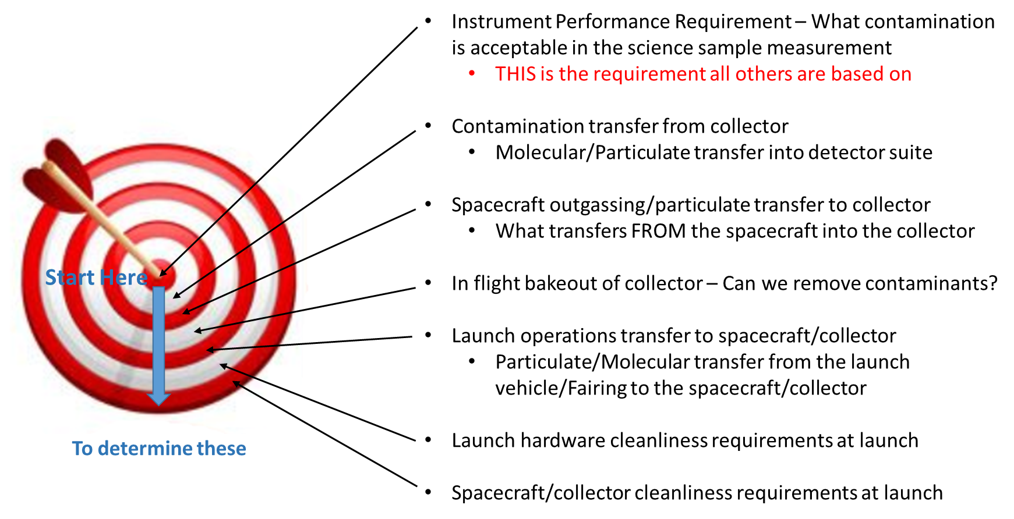
Changing the Perspective for Contamination Control Engineering specifically for Ultra-Sensitive Life-Detection Missions
– demonstrated here using a Design Reference Mission (Enceladus plume flythrough)
COSPAR 2021

Slide 6
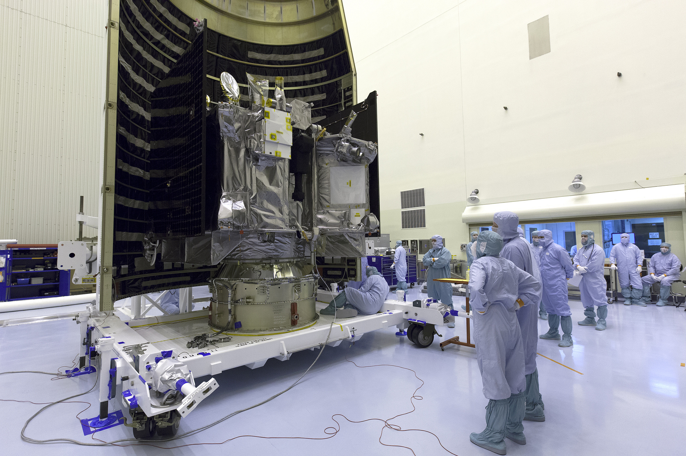
Example point of concern:
Transport of fairing contaminants onto spacecraft is poorly constrained. Will such contaminants that reach the spacecraft compromise mission results?
OSIRIS-Rex being encapsulated in its fairing before launch
(Image: NASA)

Slide 7
Changing the Perspective for Contamination Control Engineering specifically for Ultra-Sensitive Life-Detection Missions
– demonstrated here using a Design Reference Mission (Enceladus plume flythrough)
COSPAR 2021

Slide 8
Changing the Perspective for Contamination Control Engineering specifically for Ultra-Sensitive Life-Detection Missions
– demonstrated here using a Design Reference Mission (Enceladus plume flythrough)
MUST BE PART OF THE MISSION DESIGN
COSPAR 2021

Slide 9
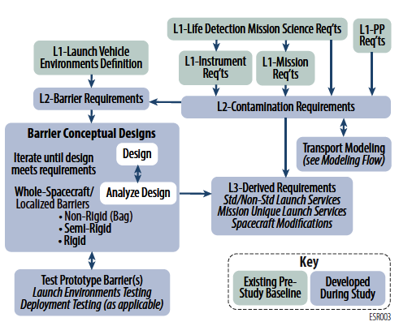
New Perspective Mapped to Requirements Flow
– demonstrated here using a Design Reference Mission (Enceladus plume flythrough)
COSPAR 2021

Slide 10
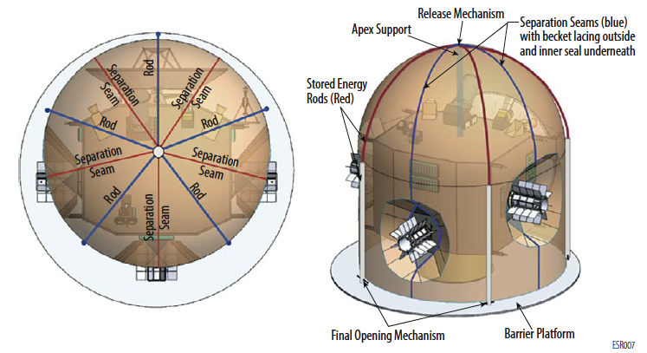
Full-Spacecraft Barrier:
Soft-sided Barrier with Skeletal Support (Semi-rigid)
Mechanical and contamination control engineers merged efforts to design a suitable barrier that served a multitude of requirements.
Barrier is dual skin fabric with a cleanable inner layer and a structurally supportive outer layer (possibly Kevlar) .
Seams are supported by lancing that is released upon opening.
RTGs are accommodated where seams meet.
RTG
COSPAR 2021

Slide 11
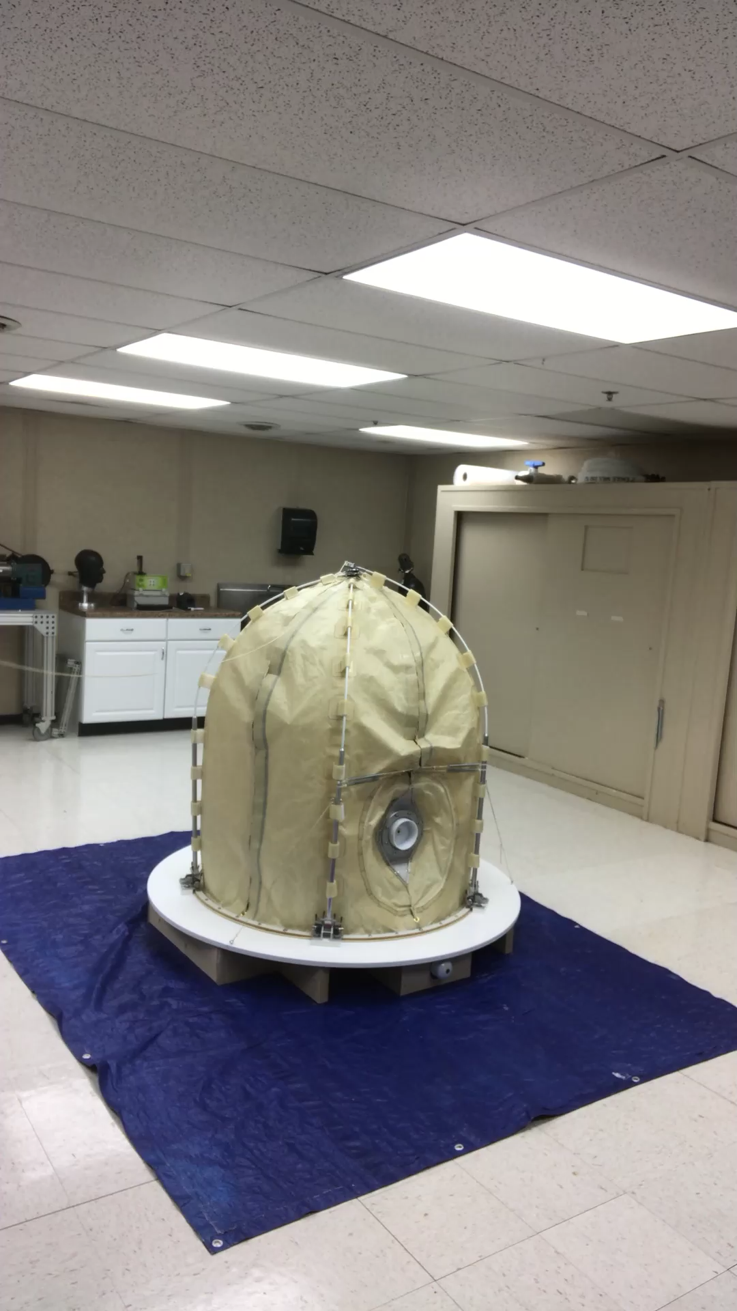
Full-Spacecraft Barrier:
1/3 Scale Demonstration Barrier
The barrier would open after the fairing is jettisoned and at an altitude necessary to avoid new terrestrial contamination.
Conclusions: We have validated a full-spacecraft, deployable barrier design as an effective strategy to isolate the spacecraft from the pre-launch processing and launch environment
Cleanable and repairable
Applicable to wide range of missions
Accommodates late mounting of RTGs and other required prelaunch activities
COSPAR 2021

Slide 12
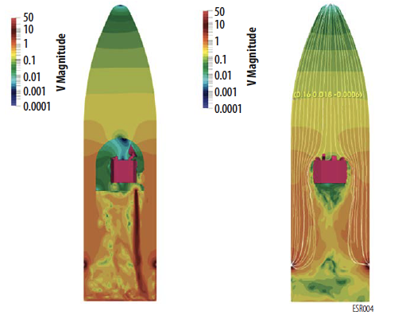
A new contamination-transport model for particles
using high-fidelity physics:
Direct comparison of the launch particle redistribution on spacecraft surfaces
No Barrier
With Barrier
Colors represent the flow velocity magnitude in m/s
The new, high-fidelity model that takes into consideration computational fluid dynamics of the launch and the physics of monolayer and less molecules.
COSPAR 2021

Slide 13
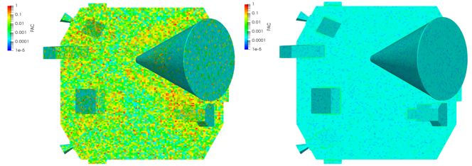
A new contamination-transport model for particles:
Direct comparison of the launch particle redistribution on spacecraft surfaces
No Barrier
With Barrier
Colors represent the percent area of the surface covered by particles.
Conclusion: The barrier effectively isolates most of the spacecraft from fairing and launch pad environments. For particles, the barrier provided isolation is greater than one in ten million. For molecular contaminants of concern, no molecular intrusion was predicted under very conservative conditions.
COSPAR 2021

Slide 14
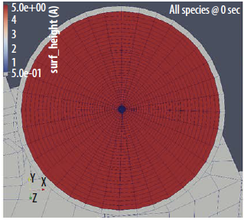
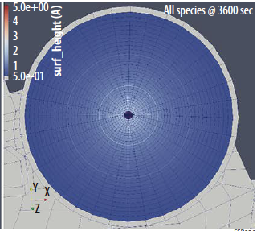
A new contamination-transport model includes
high-fidelity molecular interactions:
Analysis of an in-cruise cleaning step: Bake out of the sample collector
Time 0 = one monolayer
After 1 hr heating
(mostly n-pentacosane remains)
Colors represent the linear scale of 0.5 to 5 Angstroms
Molecules used in model:
n-dioctyl phthalate
n-hexadecane
n-eicosane
n-pentacosane
Results: 1) New model indicates 87.1% reduction of molecules, 2) the traditional “bulk” transport model, which greatly diverges from reality, indicated a 10⁻¹² reduction.
Conclusion: Bake out was remarkably effective at accomplishing further reduction in molecular levels on the
sample collector surfaces. Comparable in-flight decontamination steps should be considered for other mission scenarios.
COSPAR 2021

Slide 15
Conclusions
Both the full-spacecraft barrier that protects an ultra-clean spacecraft from the launch environment and fairing AND secondary cleaning steps (collector bake out) are effective contamination control techniques consistent with traditional engineering approaches.
With the new, high-fidelity physics model we now know that
      when starting with an attainable cleanliness levels for the spacecraft,
      adding the barrier and bake-out step,
      the cleanliness levels required to meet the Level 1-Science Requirements are both practical and reasonably cost effective.
The mitigation steps studied here are applicable to other life detection missions. However, in each case, high-fidelity physics modeling will be needed for determining mission design.
COSPAR 2021

Slide 16
Conclusions
Future work: Barrier engineering tests and verification of the model to understand errors.
The techniques developed in this study will enable future life detection missions to provide scientific results with higher confidence in their validity.
COSPAR 2021

