Slide 1

High-Performance Spaceflight Computing (HPSC)
Middleware Release 4 update
2021 Flight Software Workshop
February 8-11, 2021
Jet Propulsion Laboratory, California Institute of Technology
NASA Goddard Space Flight Center

Slide 2
Agenda
Middleware Overview
Middleware Release 4 Features and Plan
Middleware Release 4 Hardware Environment
Post Release 4 Research Topics

Slide 3
Middleware Overview

Slide 4
Middleware Team
NASA Jet Propulsion Laboratory
NASA Goddard Space Flight Center
J. Lai (Lead)
D. Kou (Developer)
R. Bocchino (Developer)
B. Morin (Systems Engineer)
J. Kochocki (Systems Engineer)
A. Cudmore (Lead)
S. Maldonado (Developer)
J. Wilmot (Systems Engineer)

Slide 5
Middleware Overview
Middleware (MW) Project Information
  A joint project between NASA Jet Propulsion Lab (JPL) and NASA Goddard Space Flight Center (GSFC)
  Funded by the Air Force Research Lab (AFRL)
  Middleware was originally targeted to run on the High-Performance Spaceflight Computing (HPSC) Chiplet
  Given delays in HPSC Chiplet hardware, the Middleware is targeting more generic multicore System on Chip (SoC) systems such as the Xilinx UltraScale+ Multiprocessor System on Chip (MPSoC)
Middleware Objectives
  Provide applications with an efficient and consistent functions to utilize features of the Chiplet multicore platform for
    Resource allocation and management (e.g., cores, memories, peripheral devices)
    Configuration management
    Power and Performance management
    Fault tolerance and redundancy management
    Sharing hardware resources using a common middleware library and services
    Messaging Services
  Facilitate deployment of applications for execution with different characteristics and resource needs (e.g., computational needs, mission criticality, timing criticality, …)

Slide 6
Middleware Design Concepts
Middleware supports fault tolerance by:
  Not using globally writable shared memory in any library implementation
  Providing options to secure system state in process restricted memory, where supported by the operating system
  Providing an inter-process messaging Application Programming Interface (API)
Middleware supports determinism by:
  Not using locks in any library implementations
  Providing a timing API to separate and synchronize application execution to specific intervals
  Employing a single thread of execution for runtime service
  Not creating additional threads of execution, unless required to support isolation
Middleware supports performance by:
  Not using locks in any library implementation
  Supporting application parallelism in multi-core deployment - pin process execution to a processor core

Slide 7
Middleware Release And Review History
Milestone | Date
Software Management Plan | 4/4/2017
Middleware Requirements Review | 5/2/2018
Middleware Release 1 (R1) | 2/5/2019
Middleware Release 2 (R2) | 10/17/2019
Middleware Architecture Review | 12/5/2019
Middleware Release 2.5 (R2.5) | 4/23/2020
Middleware Release 3 (R3) | 8/6/2020
Middleware Release 4 Workshop | 11/10/2020
Middleware Release 4 (R4) | 4/2021 (planned)

Slide 8
Middleware Architecture Overview
Layered Architecture – provides separation of concerns with well-defined interfaces
  Provides application developers with tools, abstractions and methodologies to make use of lower level SoC system software services and hardware in a consistent manner
Middleware Layer
  Allocate and manage processor cores, devices and resources to dynamically trade computational performance, energy management and fault tolerance objectives of the mission
  Provides for mission and platform configurability
  Allows Mission Integration Engineers (MIE) to reason about interactions between applications and the system
System Software Layer
  Real Time Operating System, hypervisor and low-level device drivers for the SoC are generally provided by a vendor
Application Software
Middleware Software
System Software
SoC Hardware

Slide 9
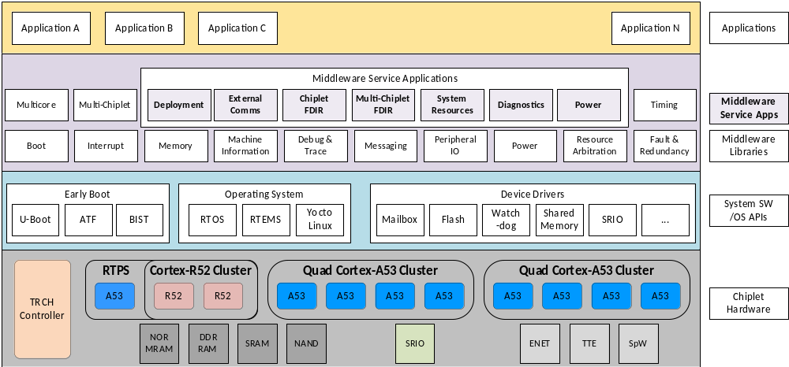
Middleware Software Architecture
Middleware Service Application
Middleware
Service App
Quad Core CPU Cluster
Optional Real Time CPU
System
Controller
A53
A53
A53
A53
R5
Representative
SoC Hardware
DDR
RAM
SRAM
NAND
SRIO
ENET
SPE
TTE

Slide 10
Middleware Service Libraries
Service Name | Service Function
Boot and Load Process | Provide an Initial Program Loader (IPL) and support various boot types/processes
Messaging | Send/receive messages between tasks on the same or different cores and Chiplets
Machine Information | Get information about cores, clusters, Chiplets, and system
Memory Management | MMU configuration, memory allocation to applications
Timing | Establish, synchronize, and distribute time
Power Management | Power on/off setting for cores/clusters/Chiplets, and set clock rates
Interrupt | Configure Interrupt controller to route interrupts to specific cores at runtime
Resource Management | Manage configuration files and assign available resources to software clients
Debug and Trace | Support software debugging and performance metrics
Deployment and Multicore Programming | Support different deployment configurations on multi-core systems
Multi-Chiplet Management | Configure and manage Inter-Chiplet interfaces (e.g., boot, messaging, resources)
Fault and Redundancy Management | Fault detection (HW/SW faults) and recovery

Slide 11
Middleware Service Application
MW Service Application Feature | System-Level Function
Deployment | Set up the system and start applications
Hardware Resource | Arbitrate access to common pool of hardware
Power | Apply power management policy
Communications | Share access to external communications device
Diagnostics | Centralize information available in system
Single SoC FDIR | Coordinate Failure Detection, Isolation, and Recovery (FDIR) activity within a single SoC
Multi-SoC FDIR | Coordinate FDIR activity across multiple SoCs

Slide 12
Middleware Service Application Architecture
Application 1
I/O
Queues
Dispatch
Check Params
Hardware Event Handler
Event
Message
Event
Message
Event
Message
Check Policy
Application 2
Check Params
Check Policy
Event
Message
Event
Message
Event
Message
System State
(OS or App Context)
Check Params
Power Event Handler
Check Policy
MW Service Application
Event Loop
(Single Thread)
. . .
. . .
. . .

Slide 13
Middleware Release 4 Features and Plan

Slide 14
Completion of Middleware Service Libraries
One of the goals of Middleware Release 4 is to complete middleware service libraries
  Some service libraries were updated to reflect the Middleware Design Concepts
  Some libraries could not be completed as originally defined because of the change in focus from the specific HPSC Chiplet target to a more generic Multicore SoC target
Requirements Status
  Original Requirements Defined: 196
  Requirements completed in Releases 1 - 3: 119
  Requirements completed in Release 4: 34
  Requirements deferred: 39
  Requirements deleted: 4

Slide 15
New Service Application Features (1 of 3)
Multi-SoC Failure Detection Isolation, and Recovery (FDIR)
  Objectives
    To accommodate multi-SoC topology including “N” Modular Redundancy (NMR) for application deployment
    To provide coordination of fault management activities between multiple SoCs
    For NMR, Middleware will provide
      Boot/load capability to support identical copies of the same application running on different SoCs
      Distribution of non-identical input to all application deployments (using 2 rounds of exchange), this will be used to form a distributed consensus among multiple SoCs
      Voting of output by a centralized entity, this will prevent having a single point of failure within the SoC network
      Execute recovery action upon detection of failure
  Design Description
    See diagram in next slide

Slide 16
Multi-SOC FDIR
New Service Application Features (2 of 3)
Legend
Sensor (Input) Flow
SOC 1
Command (Output) Flow
Sensor 1
Final Command
Fault Monitor
Output Voter
Time Master
Redundant Processing
Centralized Coordination
SOC 2
Execution Schedule
time 0 | Collect local set of sensor data
time 1 | Broadcast local set of sensor data to peers
time 2 | Broadcast full set of sensor data to peers
time 3 | Perform compute with full set of sensor data
time 4 | Send command to Output Voter
time 5 | Output Voter sends final command to Actuator
Sensor 2
SOC 3
Sensor 3
Actuator
Less reliable parts
High performance compute
Redundant hardware
Highly reliable parts
Extra radiation hardening
Centralized coordination

Slide 17
New Service Application Features (3 of 3)
Hardware Resource Management
  Objectives
    To service requests from user applications for hardware resource info and access
    To support exclusive access to hardware resources by a user application
    To arbitrate hardware resource access in a trusted execution environment
  Design Description
    User requests reservation of a hardware resource using service application message queues
    If resource is available, a unique key is immediately returned to the user
    User may wait for resource to become available using service application message queues
    With key, user has exclusive access to the hardware resource
    When resource access is complete, user releases reservation by returning key using service application message queues

Slide 18
Policy Implementation
Objectives
  To provide the capability to specify policy setting via configuration file
  To provide functions/API for validating against policy specifications
  To integrate with MW service application for policy setting and validation
Policy Requirements
  Middleware shall provide the capability to establish policy for managing resource usage by user applications
    SoC devices (core, peripheral I/O, system interconnect)
    Memory
    Power
    Performance
    Fault Tolerance
    Redundancy
  Policy shall be specified in the Configuration Files for each MW service application handlers
  Policy shall be validated at boot time and during program execution by the MW service application

Slide 19
Policy Specification Attributes
Resource
  Defined in the Device Tree listing consisting of all the SoC devices
  Single or multiple devices can be referenced in the policy
Resource Availability
  Available to specific single or multiple user applications
  Not available to specific single or multiple user applications
  Only specific quantitative value of a resource is available
Requester
  Single user application
  Multiple user applications
Duration
  Specified in mission phase
  Specified in absolute time window (tstart -> tend)
Two types of policy specification are defined
  Type 1 for discrete resources
  Type 2 for quantitative resources

Slide 20
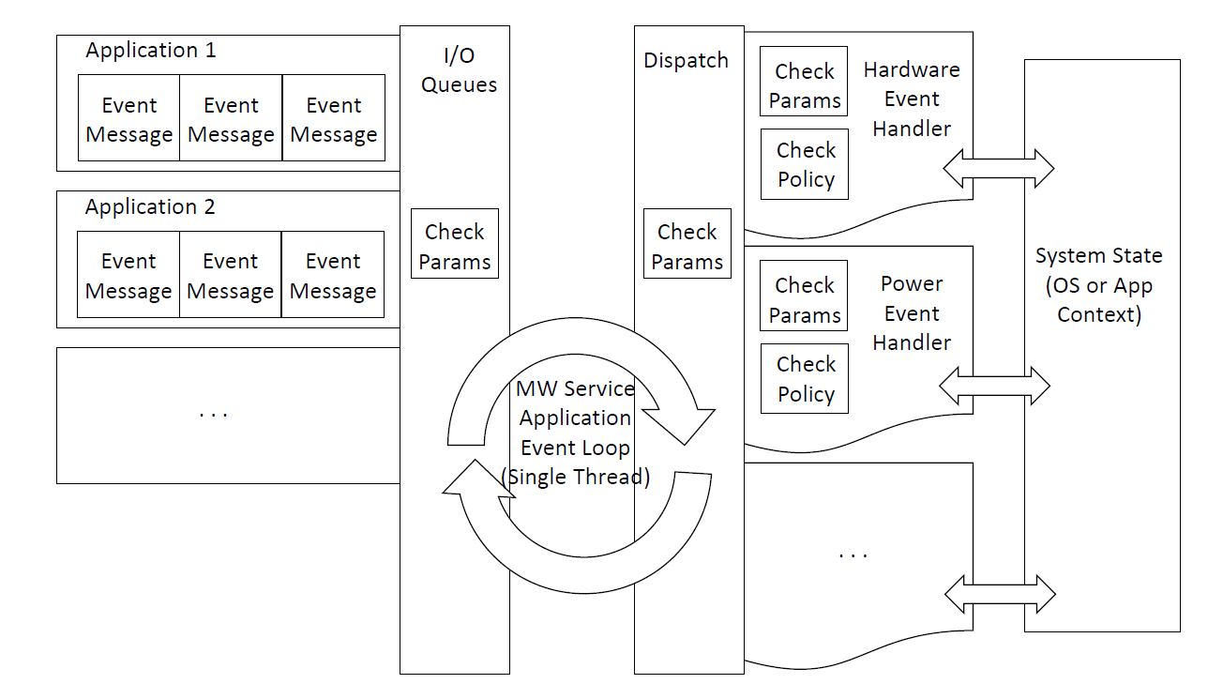
Policy Checking Integration
Policy to be defined & checked

Slide 21
Middleware Maturation
Objectives
  Identify and document requirements gap and technical debt for future implementation
  Conduct documentation review and update for clarity and completeness
  Conduct design and code reviews on selected key modules and functions
  Perform more in-depth system level testing, stress testing, performance testing, etc.

Slide 22
Middleware Release 4 Hardware Environment

Slide 23
Networking multiple ZCU102 boards
Objectives
  Establish connection of three ZCU102 boards via 2 different types of I/O, ethernet and Serial Rapid Input/Output (SRIO)
    Acquire a third ZCU102 board to establish a Triple Modular Redundant (TMR) configuration
  Establish ethernet connection between the zcu102 boards
    Use the existing ethernet driver and protocol software stack provided by the Linux OS to establish communication
  (Establish SRIO connection will need Field Programmable Gate Array (FPGA) firmware from Praesum to be loaded to the ZCU102 board
    Device driver will be provided by Praesum
    Contingent on getting the firmware/drivers in time for R4 development)
Design
  See picture in next slide
Use cases
  This environment will be used to demonstrate Multi-SOC FDIR

Slide 24
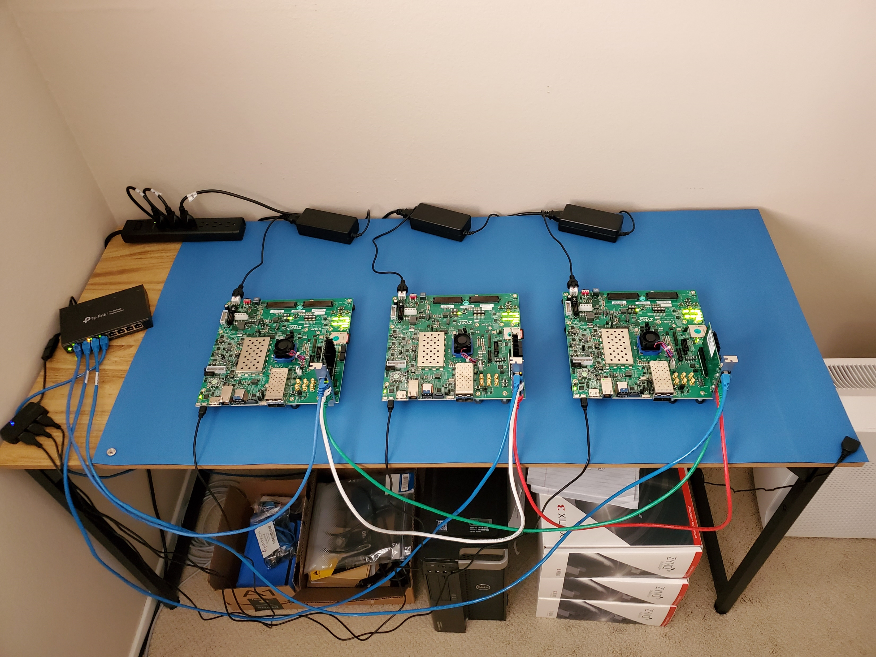
Xilinx ZCU102 in Triplex Environment

Slide 25
Middleware Post Release 4 Research

Slide 26
Middleware Post Release 4 Research
In addition to completing the Release 4 features and requirements, the Middleware project proposed a set of topics for post-R4 research
  To further enhance the usability and capability of the Middleware
The Middleware project solicits recommendations and suggestions from stakeholders on what MW should focus on
  Provide relative priority for the list of topics (in the following slides)
  Provide additional ideas to enhance the usability of MW
  Provide any topics important to stakeholders
  Inputs, suggestions and recommendations can be provided via email to the MW team
    jlai@jpl.nasa.gov (John Lai)
    alan.p.cudmore@nasa.gov (Alan Cudmore)

Slide 27
Middleware Post R4 Research (1 of 8)
FSW framework interface consideration
  MW was not designed with existing FSW frameworks in mind (e.g., NASA core Flight System (cFS), NASA F-Prime)
    There are overlaps in functionality and some incompatible design between MW and existing FSW frameworks
    Due to the focus on multi-core, Middleware has a different set of design principles and than legacy FSW frameworks that were designed for use on single core systems
      This is the source of some of the inherent incompatibility
  Investigate and establish design approach to interface with the existing various frameworks
    Expect interface approach will vary between different frameworks
    Options include interface bridges or higher-level compatibility layers

Slide 28
Middleware Post R4 Research (2 of 8)
Investigate how the Middleware can be applied in different architectures with various RTOS and OS
  For use in various process models
    Single process, multi-threaded applications
      RTEMS, FreeRTOS
    Multi-process, multi-threaded applications
      Linux, Integrity, VxWorks
    Space partitioned and/or Time partitioned applications
      Integrity, VxWorks
    ARINC 653

Slide 29
Middleware Post R4 Research (3 of 8)
Investigate the usage of hypervisor for different RTOS(s) and OS(s)
  Investigate different hypervisors and RTOS(s)
    Integrity and native hypervisor
    Xen hypervisor
    Linux/KVM
  Demonstrate the usage of hypervisor to provide isolation for process execution and SoC device usage

Slide 30
Middleware Post R4 Research (4 of 8)
Partitioning of high-performance computing resources (multiple cores) to provide secured and robust isolation between flight critical applications and high-performance applications
  Specify architectural guidelines when deploying applications with different criticalities in the high-performance computing subsystem of an SoC
  Use real world examples for demonstration
    Demonstrate faults in science application does not impact GNC application
  Perform test cases and bench marking

Slide 31
Middleware Post R4 Research (5 of 8)
Middleware in Symmetric Multiprocessing (SMP) and Asynchronous Multiprocessing (AMP) mode
  Investigate and demonstrate using Middleware in SMP mode
    This is the default implementation of Middleware
  Investigate and demonstrate using Middleware in AMP mode
  Show that the configuration file can be switched to use in different modes Example
    AMP provides isolation for critical landing phase
    SMP provides performance for science data processing on the surface

Slide 32
Middleware Post R4 Research (6 of 8)
MW in a heterogeneous environment (combination of different types of compute platforms)
  Investigate communication and interface between CPU, GPU, TPU
  Investigate fault detection and isolation
Planning on using the following development boards
  NVIDIA Nano Development Board
  Google Coral AI Development Board

Slide 33
Middleware Post R4 Research (7 of 8)
Investigate MW capability to support application deployment in a secure environment
  Role and functionality of MW in a secured execution environment
  Secure boot process
  Data encryption and authentication
  Private and Public key management

Slide 34
Middleware Post R4 Research (8 of 8)
Application of Middleware for alternate SoC hardware architecture
Given the Middleware Projects focus on High Performance Multi-core architectures, investigate the application of Middleware on current and upcoming high performance flight architectures such as:
  BAE Systems RAD5545
  Upcoming Multicore RISC V systems such as the Gaisler Noel-V
  Upcoming Multicore LEON5
  Future HPSC architectures

Slide 35
Acronyms (1)
Acronym | Meaning | Acronym | Meaning
AFRL | Air Force Research Laboratory | DRAM | Dynamic Random Access Memory
AMP | Asynchronous Multiprocessing | FCR | Fault Containment Region
API | Application Programmer Interface | FDIR | Fault Detection, Isolation, and Recovery
ARM | Advanced RISC Machines | FPGA | Field programmable Gate Array
ATF | Arm Trusted Firmware | FPU | Floating Point Unit
BIST | Built In Self Test | GNC | Guidance Navigation and Control
BSP | Board Support Package | GOPS | Giga Operations Per Second
C&DH | Command and Data Handling | GPIO | General Purpose Input Output
cFS | core Flight System | GPU | Graphics Processing Unit
CPU | Central Processing Unit | GSFC | Goddard Space Flight Center
DDR | Double Data Rate | HEO | Human Exploration and Operations
DMIPS | Dhrystone Millions of Instructions per Second | HPFEC | High Performance Fault-tolerant Embedded Computing
DMR | Dual Modular Redundancy | HPPS | High Performance Processing Subsystem
35

Slide 36
Acronyms (2)
Acronym | Meaning | Acronym | Meaning
HPSC | High Performance Spaceflight Computing | MIE | Mission Integration Engineer
HW | Hardware | MIPS | Millions of Instructions per Second
I/O | Input / Output | MMU | Memory Management Unit
I2C | Inter-Integrated Circuit | MPSoC | Multiprocessor System on Chip
IDE | Integrated Development Environment | MRAM | Magnetoresistive Random Access Memory
IPL | Initial Program Loader | MW | Middleware
ISA | Instruction Set Architecture | NAND | NOT-AND logic
ISI | Information Sciences Institute | NASA | National Aeronautics and Space Administration
ITAR | International Traffic In Arms Regulations | NEON | Single Instruction Multiple Data architecture
JPL | Jet Propulsion Laboratory | NVRAM | Non Volatile Random Access Memory
JTAG | Joint Test Action Group (Debug interface) | PCIe | Peripheral Component Interconnect express
KVM | Kernel Based Virtual Machine | QEMU | Quick Emulator
MB | Megabyte | R1, R2, R3, R4 | Release 1, Release 2, Release 3, Release 4
36

Slide 37
Acronyms (3)
Acronym | Meaning | Acronym | Meaning
RTEMS | Real Time Executive for Multiprocessor Systems | STMD | Space Technology Mission Directorate
RTOS | Real Time Operating System | SW | Software
RTPS | Real Time Processing Subsystem | TBD | To Be Determined
SCP | Self Checking Pair | TPU | Tensor Processing Unit
SIMD | Single Instruction Multiple Data | TMR | Triple Modular Redundancy
SMD | Science Mission Directorate | TRCH | Timing, Reset, Configuration, and Health
SoC | System on Chip | TTE | Time Triggered Ethernet
SPI | Serial Peripheral Interface | UART | Universal Asynchronous Receiver Transmitter
SPW | Spacewire | USC | University of Southern California
SRAM | Static Random Access Memory | VMC | Vehicle Management Computer
SRIO | Serial Rapid Input Output
SSR | Solid State Recorder
SSW | System Software
37

