Slide 1
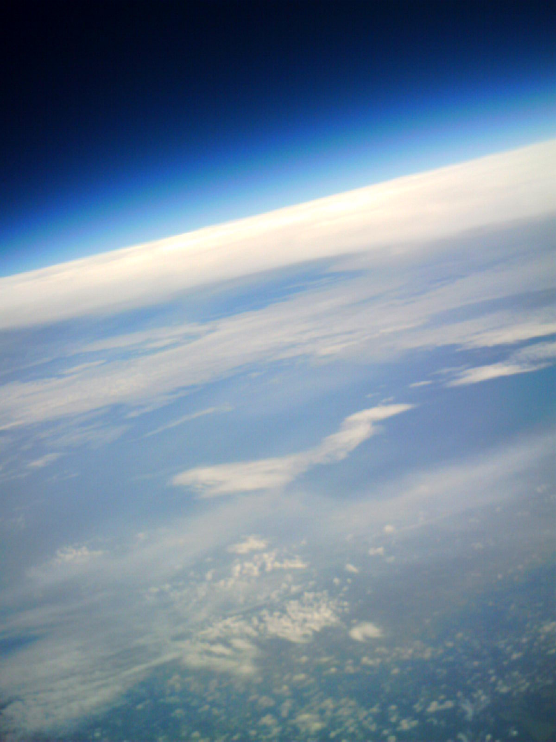



Leading University Students to the Edge of Space
T.G. Guzik, D. Granger, Louisiana Space Grant Consortium
Louisiana State University, Baton Rouge, LA, U.S.A.
Debora Fairbrother, Amy Canfield, NASA Balloon Program Office
NASA Wallops Flight Facility, Wallops Island, VA, U.S.A.
Hugo Franco, Robert Slater, Jack R. Hays,
NASA Columbia Scientific Balloon Facility, Palestine, TX, U.S.A.

Slide 2
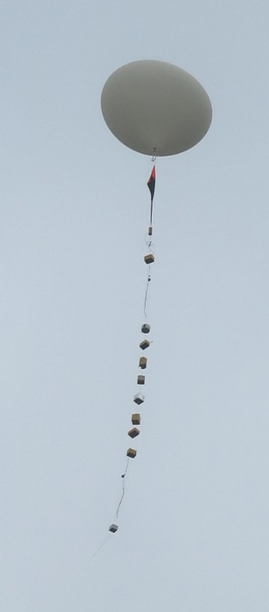
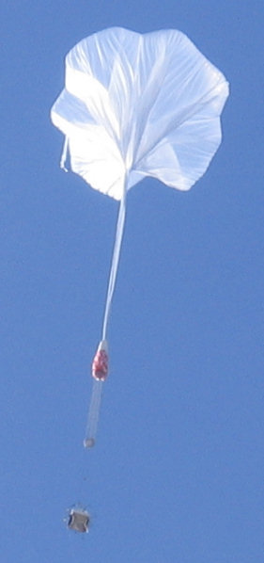
Presentation Summary
Motivation for student ballooning programs
Overview and goals of the Louisiana Aerospace Catalyst Experiences for Students (LaACES)
The Student Ballooning Course (SBC) for entry level students
A typical LaACES sounding balloon flight
Progressing to the next level - the High Altitude Student Platform (HASP)
The history of HASP flights
Outcomes for the HASP student payloads
Conclusions
An entry level sounding balloon launch including multiple student payload, tracking radio beacon, and a parachute for recovery. The total suspended weight is less that 5.5 kg. Flight time is about 2 hours and peak altitude is about 30 km.
The advanced High Altitude Student Platform on climb out. HASP can carry over 100 kg of student payloads, with power and telemetry support, to an altitude in excess of 36 km, for an average of 13 hours at float.

Slide 3
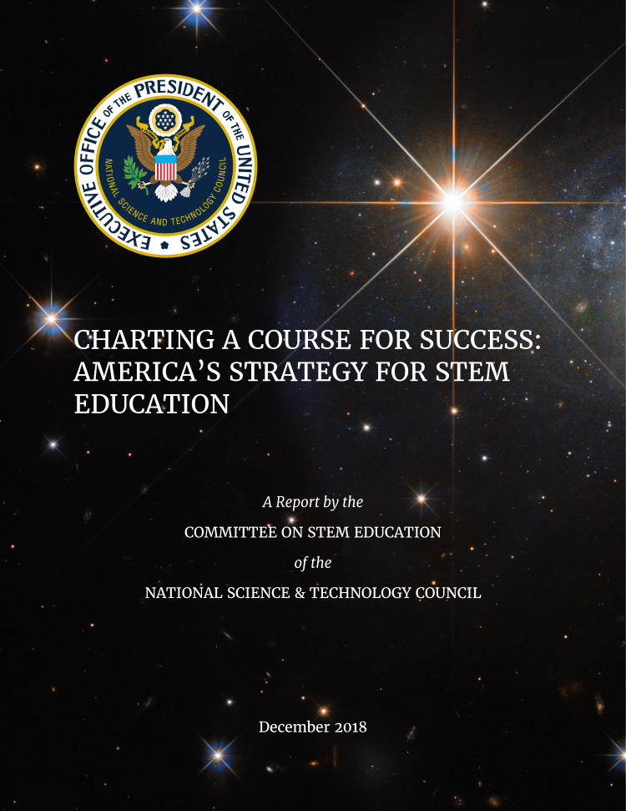
Motivation and Approach
There is a declining number of students entering the workforce as engineers and scientists and there is a need for STEM literacy and experiential activities to prepare the next generation technology workforce
The U.S. National Science & Technology Council Committee on STEM Education in 2018 identified encouraging transdisciplinary learning as a major NASA objective
The 2020-2024 NASA Science Mission Directorate strategic plan includes developing students and early career faculty using hands-on training
Balloon programs designed for university students provide a mechanism for addressing these issues
We have developed a two phase student ballooning program
  Entry level teaches basic technical, management, and communication skills
  Advanced level adds complexity and simulates a space flight mission

Slide 4
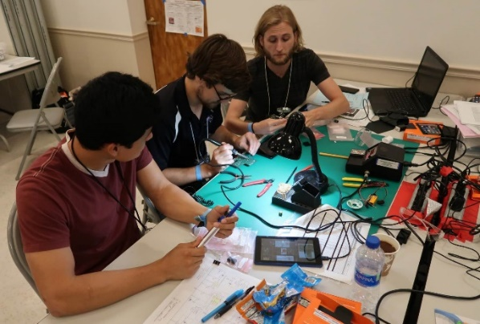
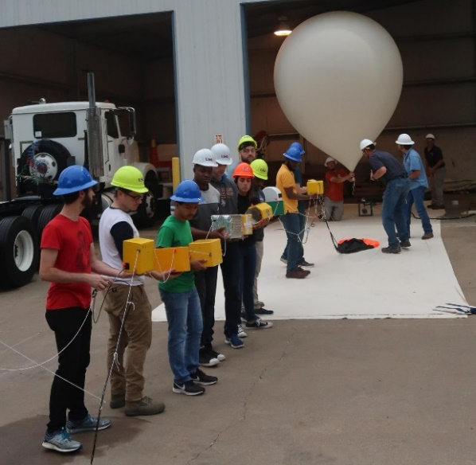
The Entry Level LaACES Program
Louisiana Aerospace Catalyst Experiences for Students (LaACES) primary objectives
Provide university students with an authentic flight project experience not normally available through the classroom
Develop student skills in electronics, real-time programming, communication, and project management
Guide students to work in teams and to use acquired knowledge to create a science payload for balloon flight
Students communicate their progress through required documents and presentations on a milestone schedule
Conduct annual flight operations where approved student team payloads are flown on a latex sounding balloon to an altitude of ~30 km or the very “edge of space”

Slide 5
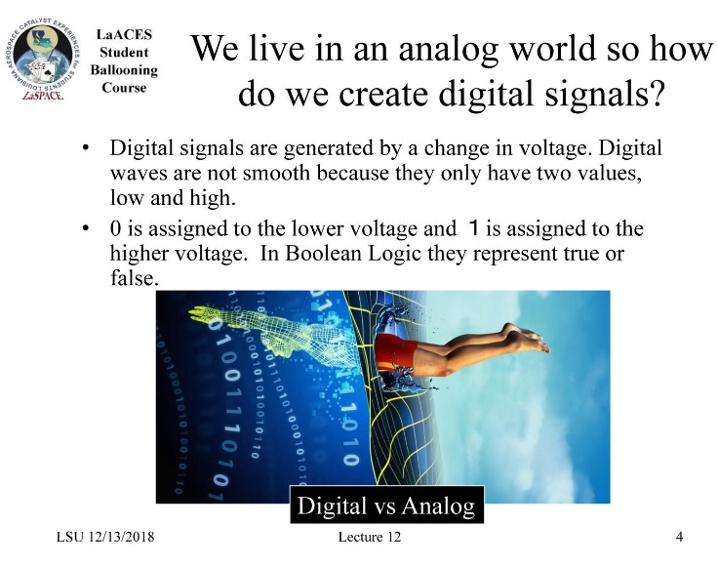
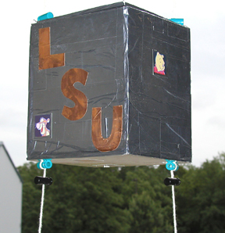
The LaACES Academic Year
Sample page from SBC lecture
Developed the Student Ballooning Course (SBC) to guide training throughout the year
First half year provides training in basic electronics, programming, and communication
  ~35 PowerPoint lectures covering the primary topics relevant to the program and ~30 hands-on activities that complement the lectures
Second half of year provides training in project management, team work, and payload development
End of year flight is supported by the NASA Columbia Scientific Balloon Facility in Palestine, Texas
Example 500 gm LaACES student payload

Slide 6
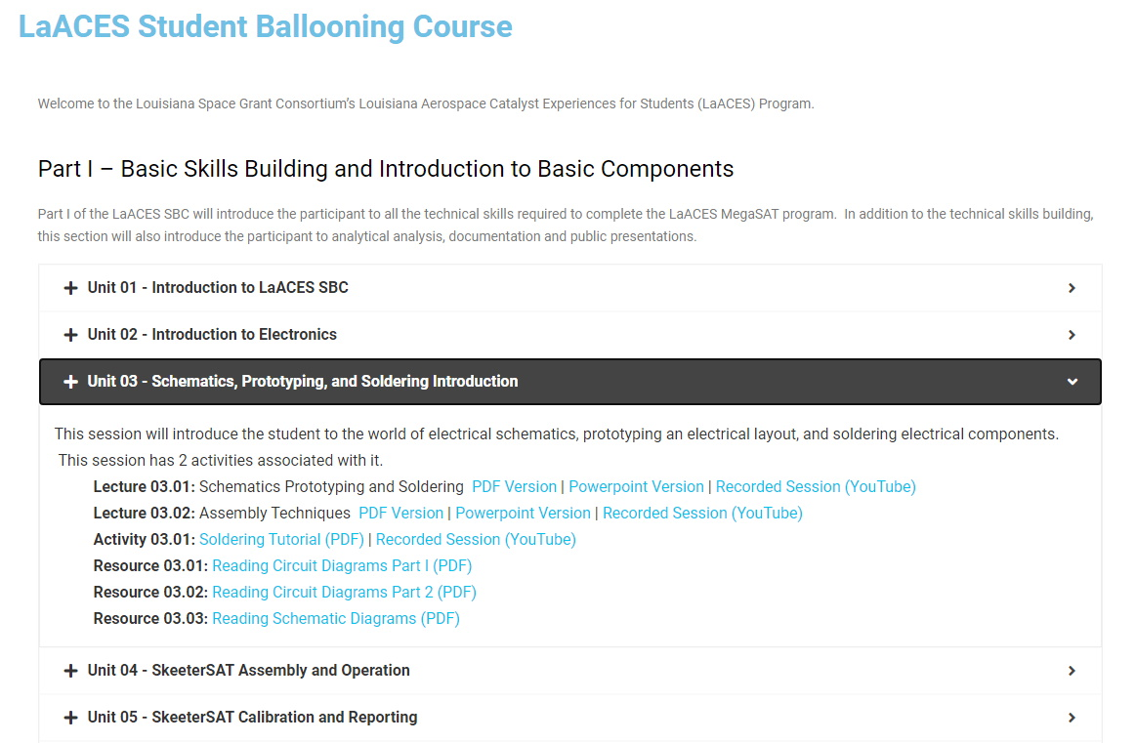
Student Ballooning Course Materials
The complete SBC is online at https://laspace.lsu.edu/laaces/student-balloon-course/

Slide 7
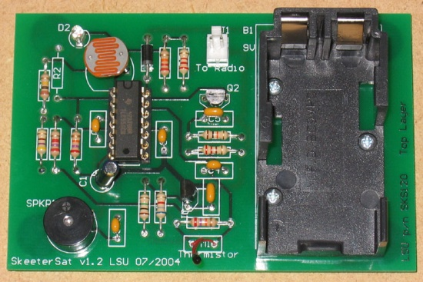
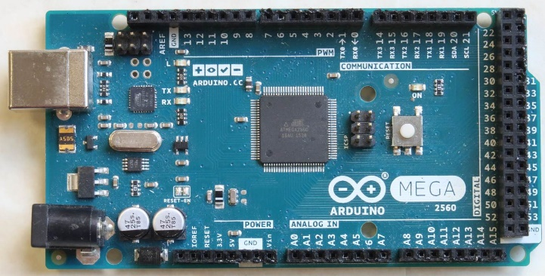
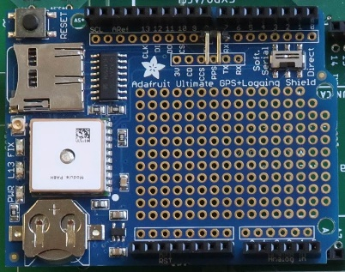
SBC Hardware Components
SkeeterSat is an introductory circuit assembly activity where the output beep frequency is temperature dependent and the interval between beeps is light intensity dependent. Used to learn basic electronics, assembly, troubleshooting, calibration, and documentation.
Arduino Mega2560 is a powerful microcontroller with 54 digital I/O lines, 16 channels of 10-bit ADC, and plenty of memory for complex programs. Used for learning programming and as a payload controller.
Adafruit Ultimate GPS Logger includes a GPS receiver (validated to at least 30 km), internal GPS antenna, external antenna socket, a battery backup coin cell holder, and a prototyping area. It interfaces with the Arduino Mega and is used for time stamping data and data logging.

Slide 8
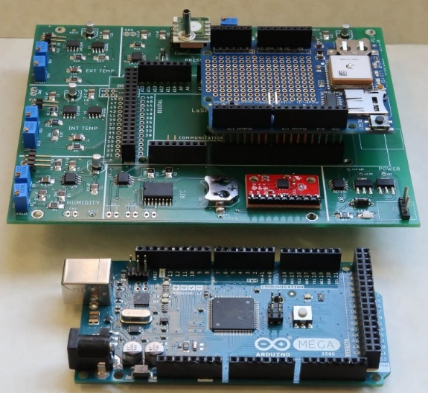
MegaSat Provides Core of Payload
MegaSat is a custom board developed at Louisiana State University to provide training in surface mount components. The MegaSat interfaces with a Arduino Mega includes two temperature sensors, one humidity sensor, one pressure sensor, a 3-axis accelerometer, a 3-axis gyroscope, and a real-time clock with backup battery
The students assemble the MegaSat in the second half of the year and use it as the core of their payload
LaACES MegaSat payload stack
Payload controller is the Arduino Mega
The Adafruit Ultimate GPS Logger shield provides GPS data throughout the flight and enables recording data on a SD card
The prototype area on the Adafruit GPS shield or a separate proto-shield board can be used to interface with other sensors

Slide 9
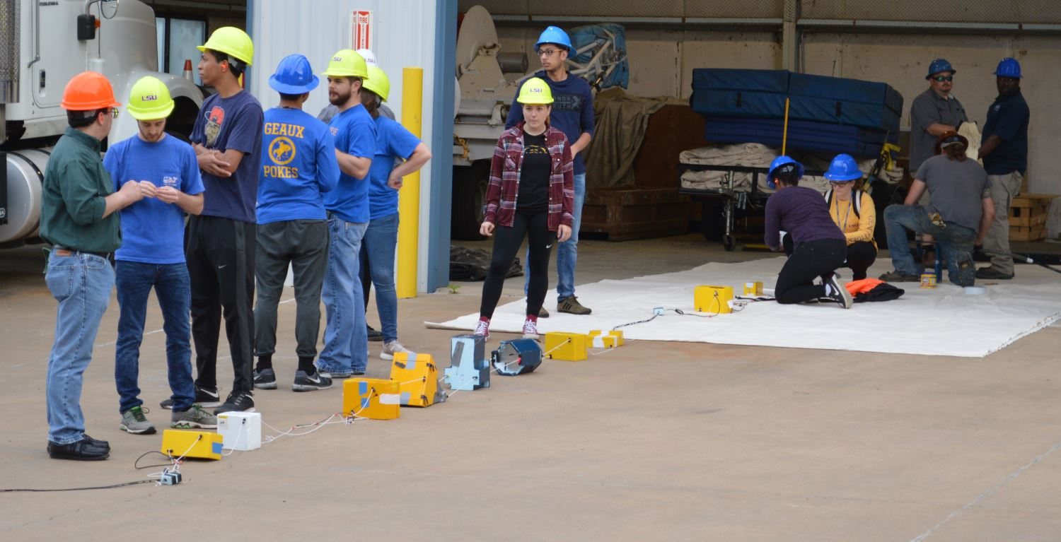
A Typical Flight String
“Tracker” radio beacon
Primary radio beacon
MSU UFO
Xavier
Balloon attach, cut, parachute
Iridium beacon
MSU Radio
Video camera
Test Arduino Beacon
MSU Tachyos
Typical total suspended weight is 4.960 kg or 10.9 pounds

Slide 10
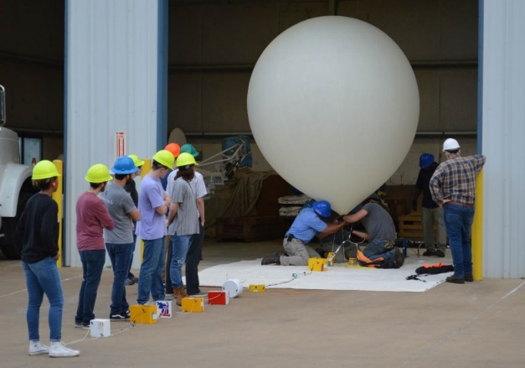
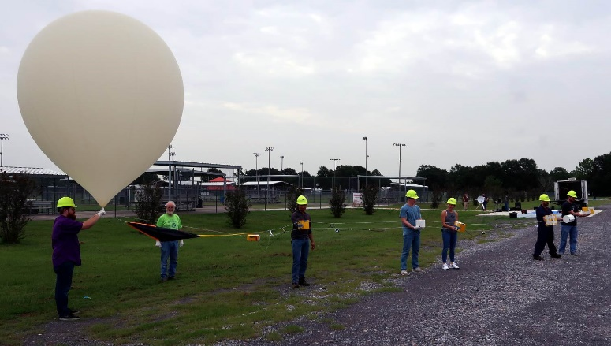
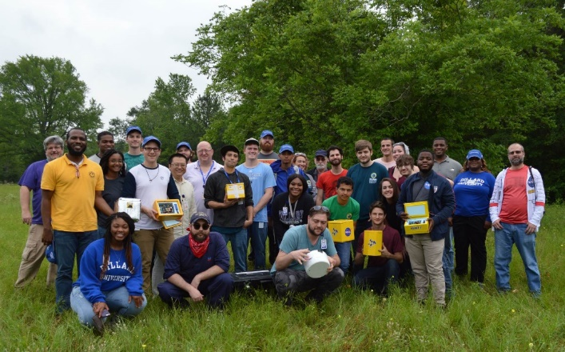
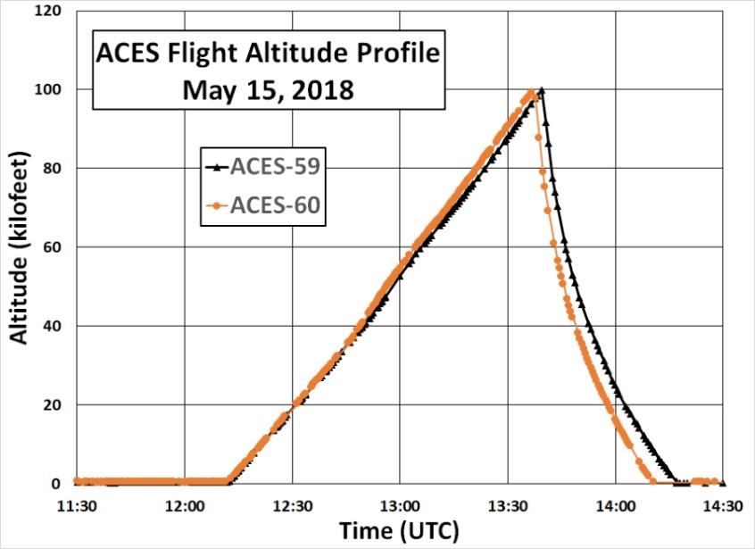
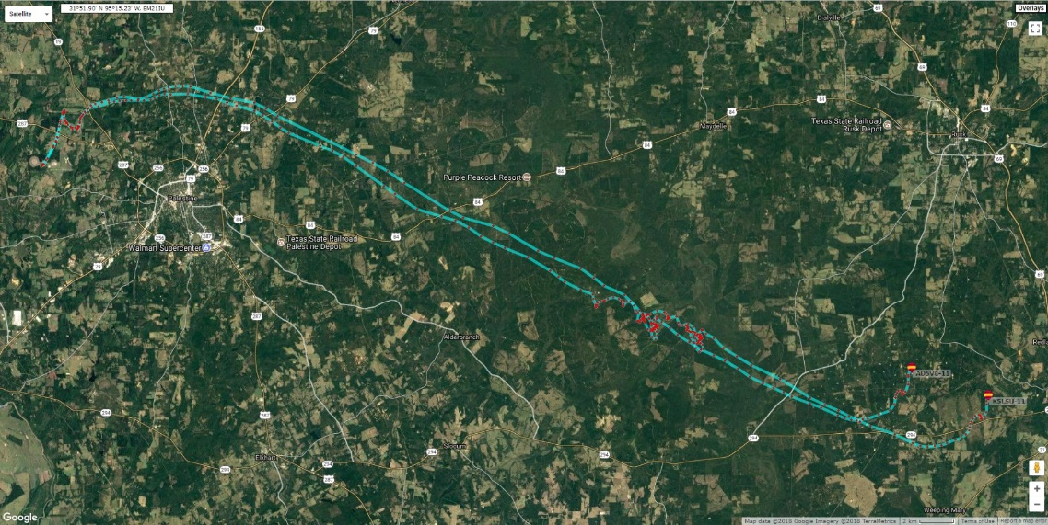
Typical LaACES Flight
LaACES flights use a 2 to 3 kg latex sounding balloon, last 2 to 3 hours, and reach a peak altitude of about 30 kilometers

Slide 11
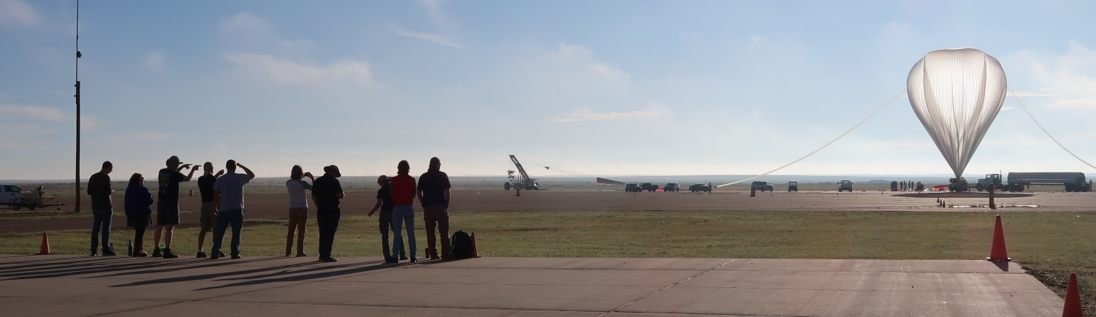
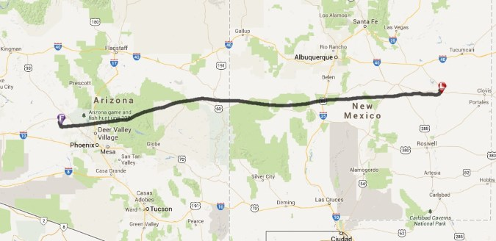
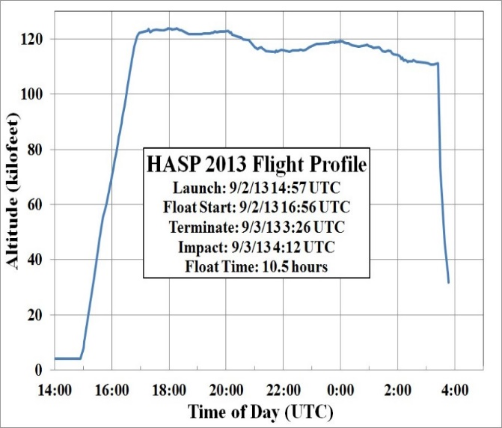
HASP for Advanced Students
Uses a ~311,000 cubic meter zero pressure balloon to carry ~725 kg total suspended weight to an altitude in excess of 36 km for an average of 13 hours

Slide 12
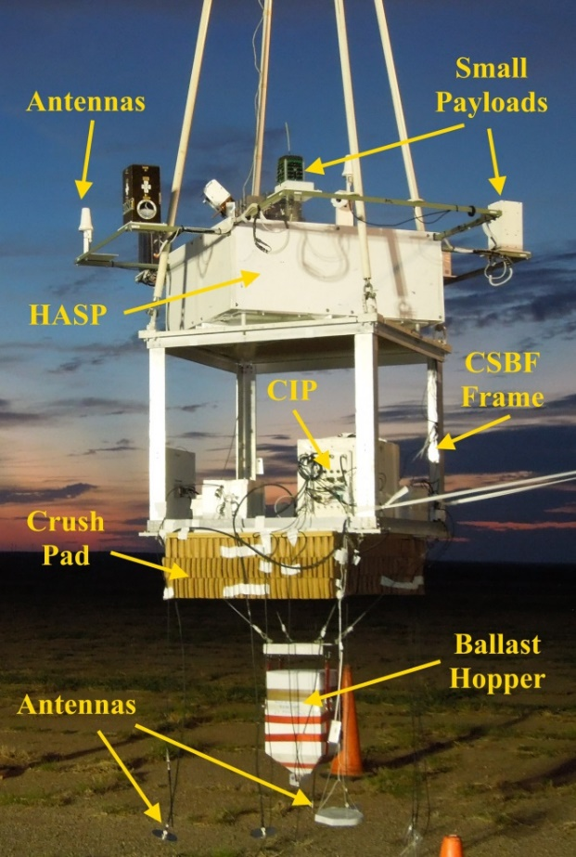
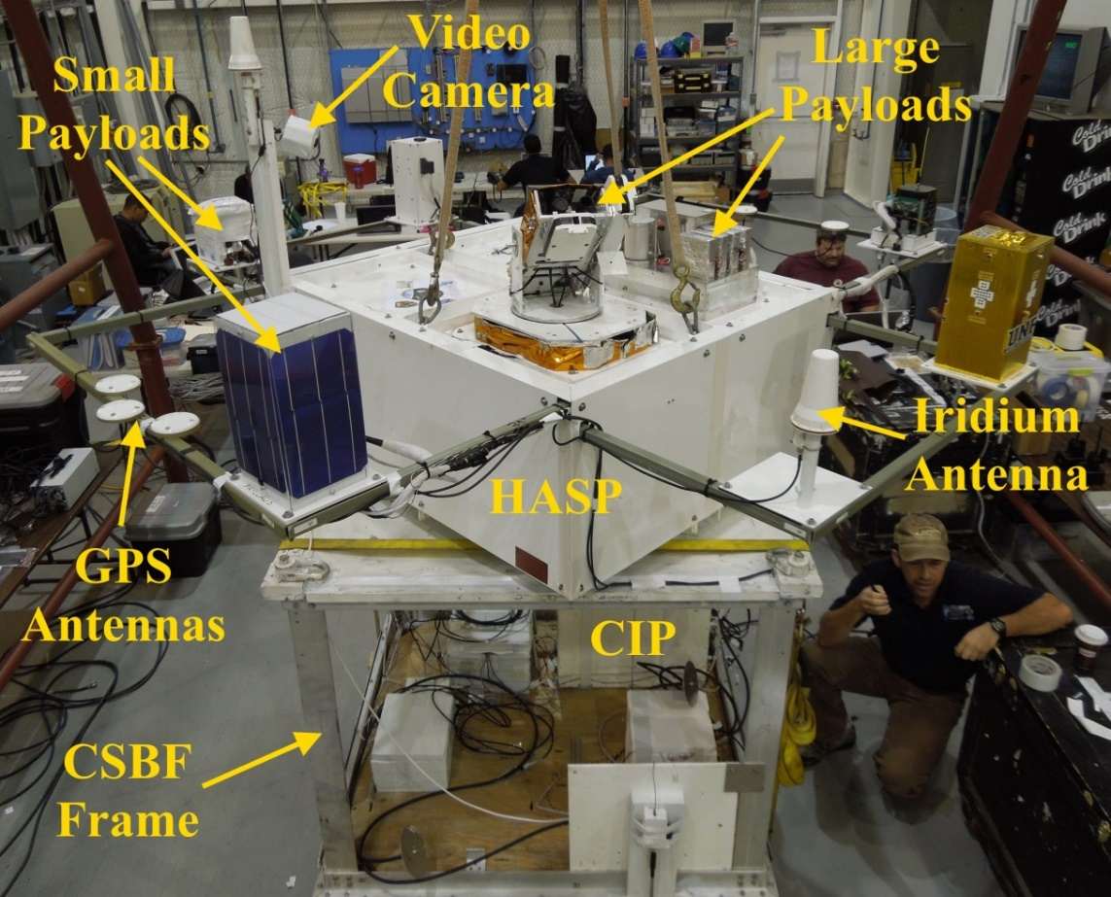
HASP Supports Multiple Payloads
Support up to eight payloads < 3 kg and four payloads < 20 kg per flight
HASP supplies payloads with serial downlink & uplink in near real-time, 32 VDC @ 2.5 A power, discrete commands, analog downlink.
Video cameras provide real-time imaging of payloads and environment

Slide 13
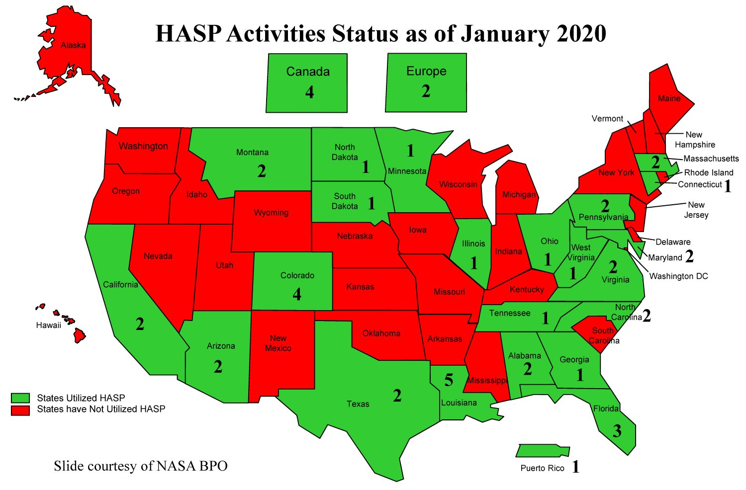
Many experiments have flown on HASP
HASP has flown fourteen (14) missions from 2006 through 2019.
Accumulated close to 8 days of flight time at altitudes in excess of 36 km (~120,000 feet) (i.e. at the very edge of space).
48 institutions, including universities, community colleges, and high schools, from 23 states plus Canada, Puerto Rico, and Europe have participated in HASP.
More than 1400 students have flown more than 130 payloads on HASP.
Success rate of 89% over 13 years
LaSPACE and NASA BPO / CSBF are planning to continue flying HASP well into the near future.

Slide 14
Outcomes from the HASP Program
Student payload investigations cover a diverse range of topics relevant to each NASA Mission Directorate
 | ARMD | HEOMD |  |  | SMD |  |  |  | STMD
 | Aeronautics | Space Life | Physical Science | Engineering | Astrophysics | Earth Science | Planetary Science | Heliophysics | Technology
2006 - 2019 | 6 | 15 | 6 | 23 | 39 | 57 | 14 | 8 | 34
Demographics of HASP participants from 2012 to 2019, with the exception of the Grade 9-12 participant data which has only been collected since 2017
 | Total | Male | Female | Hispannic | Minority | Grade 9-12* | Undergrad | Graduate | Disabled
2012 - 2019 | 969 | 746 | 223 | 141 | 48 | 27 | 816 | 126 | 4
Number of students taking their next step after participating in HASP
 | Total | STEM degree | Advanced STEM degree | Industry | Unknown
2017 - 2019 | 444 | 186 | 30 | 28 | 200

Slide 15
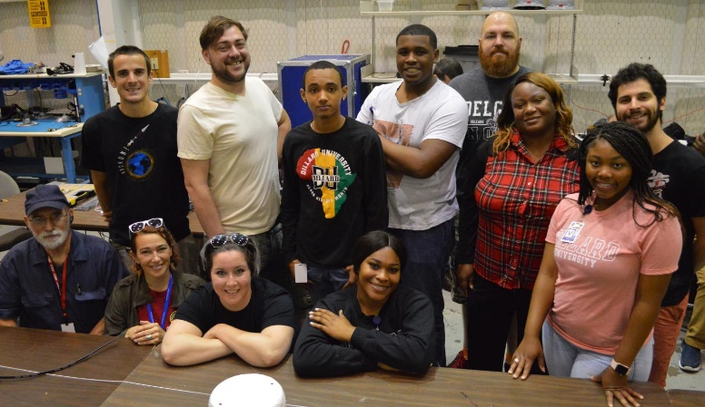
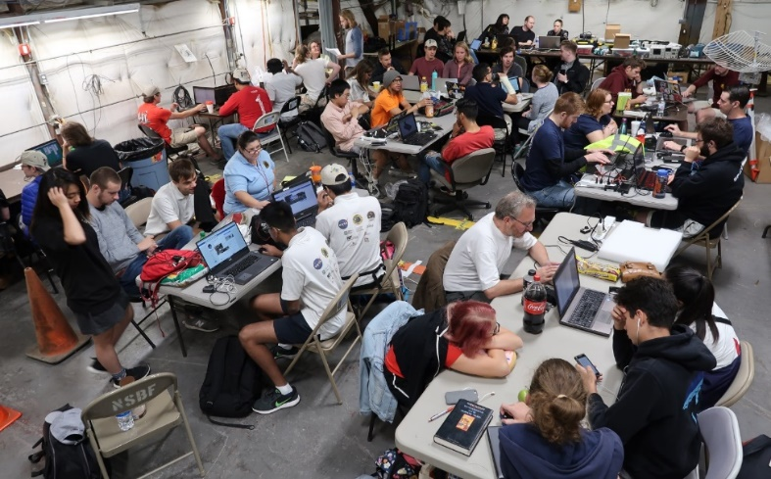
Conclusions
There has been a decline in students entering the workforce as engineers and scientists over the last several decades
Student ballooning programs can be used to motivate, engage, and train students beyond what is available in a normal classroom
Louisiana Space Grant, NASA Balloon Program Office, and Columbia Scientific Balloon Facility have developed a two phased student balloon programs
The LaACES entry level program includes the formalized Student Ballooning Course to build student skills in electronics, programming, and team work while developing a simple flight payload
The HASP program for advanced students has engaged over 1,400 students from around the world to fly more than 130 payloads to an altitude >36 km for about 13 hours @ float
Questions can be emailed to me at tgguzik@lsu.edu

Slide 16
Backup slides follow

Slide 17
Characteristics of each HASP Flight
HASP was flown 14 missions from 2006 through 2019
Over 1400 students from 48 institutions across 22 states plus Puerto Rico, Canada, and Europe have been involved in developing a HASP experiment.
Payloads Involved with HASP Since 2006
Year | Launch Date | Float Duration (hours) | Students | Payloads
 |  |  |  | Accepted | Flown | Success
2006 | 9/4/06 | 15.0 | 25 | 8 | 8 | 6
2007 | 9/2/07 | 16.5 | 70 | 11 | 10 | 8
2008 | 9/15/08 | 31.8 | 96 | 13 | 12 | 6
2009 | 9/11/09 | 12.0 | 50 | 10 | 6 | 6
2010 | 8/31/11 | 8.0 | 78 | 11 | 8 | 8
2011 | 9/8/11 | 15.7 | 117 | 11 | 5 | 5
2012 | 9/1/12 | 8.8 | 93 | 14 | 11 | 10
2013 | 9/2/13 | 10.5 | 101 | 12 | 10 | 10
2014 | 8/9/14 | 5.6 | 103 | 10 | 7 | 7
2015 | 9/7/15 | 23.1 | 107 | 12 | 10 | 9
2016 | 9/1/16 | 15.2 | 121 | 12 | 12 | 12
2017 | 9/4/17 | 10.6 | 131 | 12 | 12 | 12
2018 | 9/4/18 | 9.0 | 163 | 13 | 13 | 11
2019 | 9/5/19 | 7.6 | 131 | 12 | 10 | 8
Total 06 to 19 |  | 189.4 | 1405 | 161 | 134 | 118

Slide 18
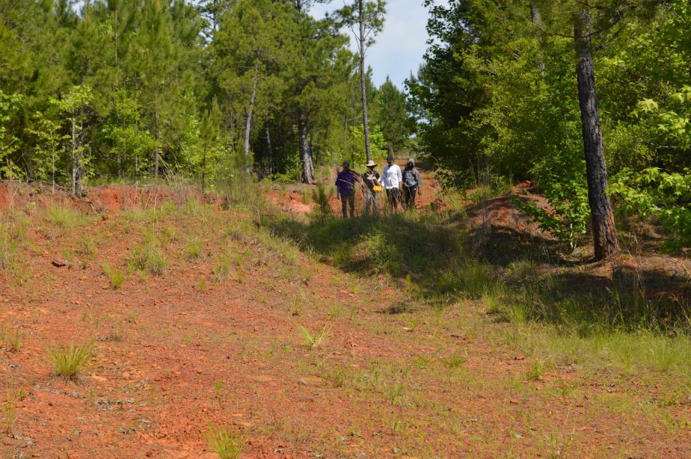
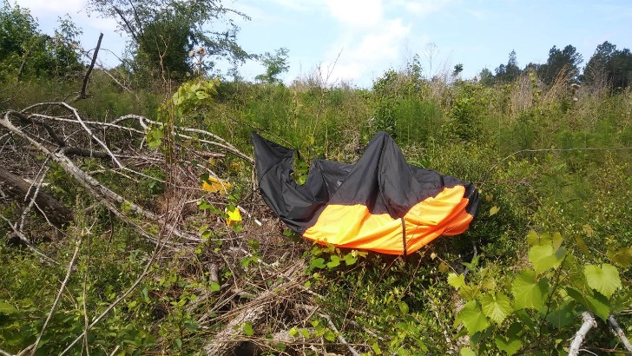
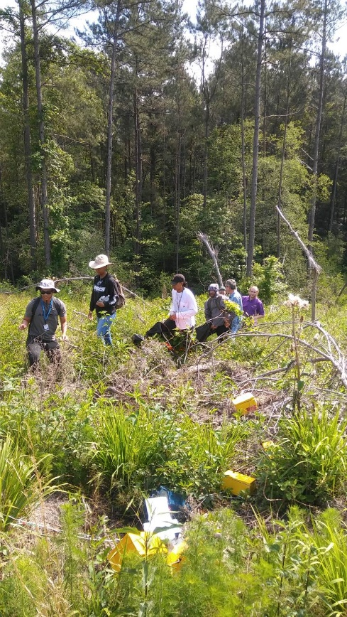
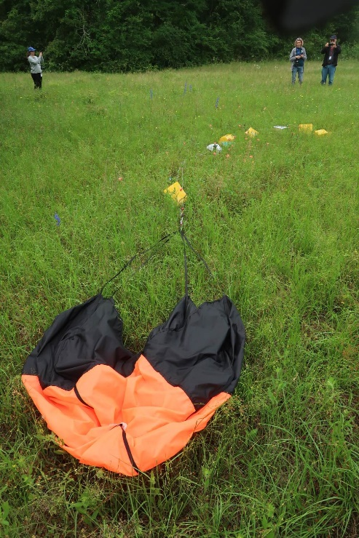
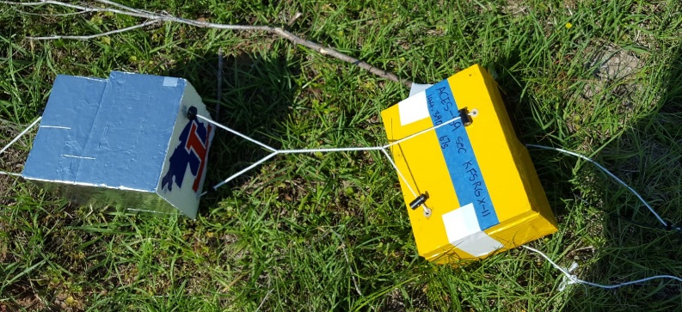
Sometimes recovery is easy

Slide 19
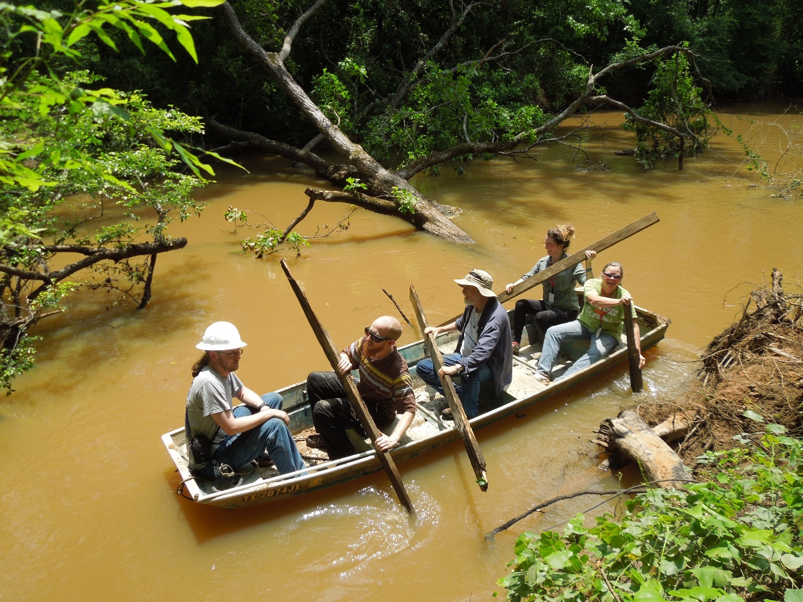
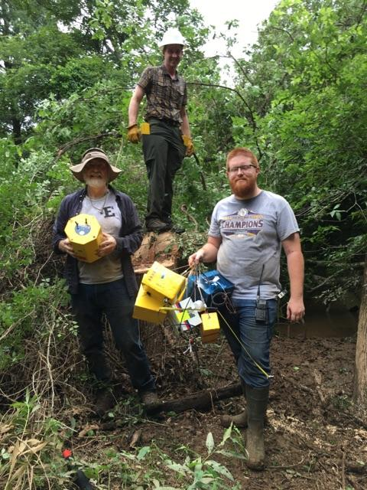
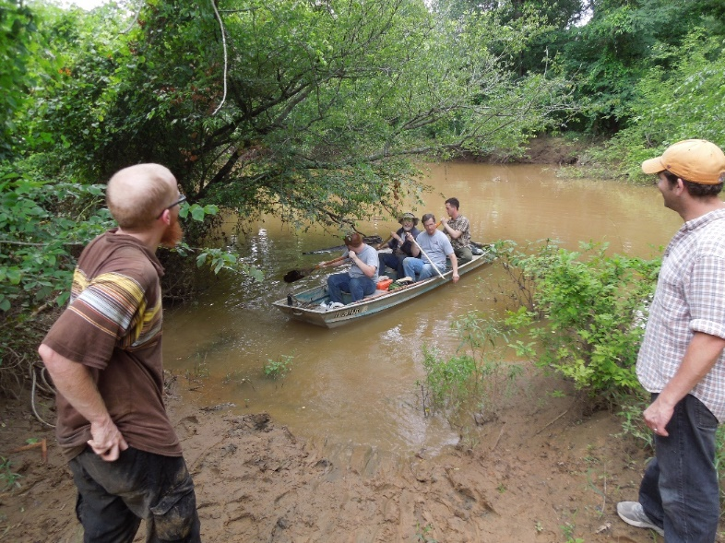
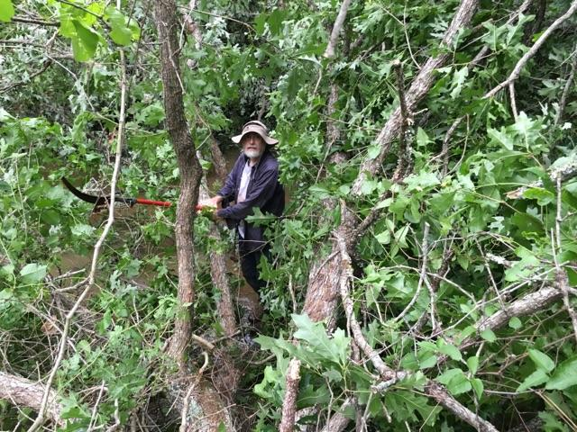
Sometimes not so easy

Slide 20
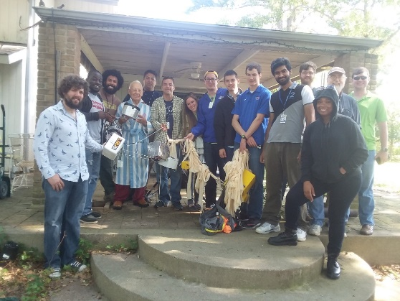
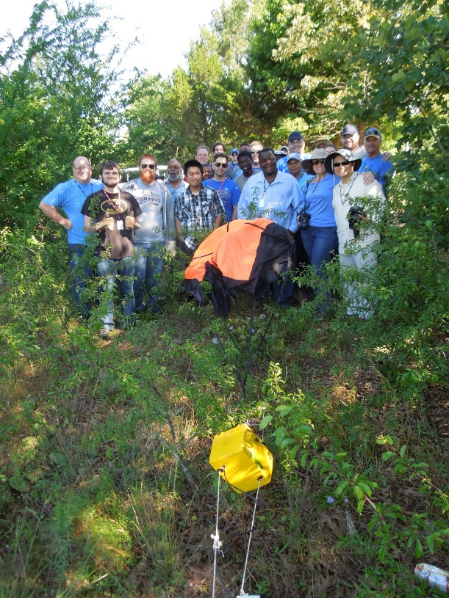

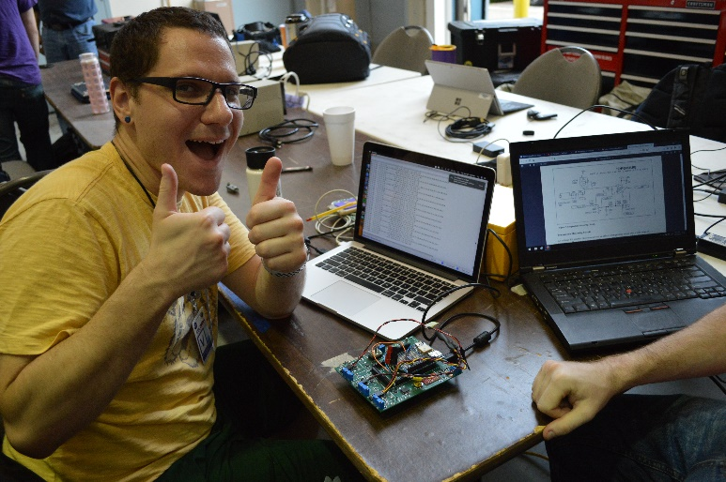
LaACES is always fun plus you end up learning something

Slide 21
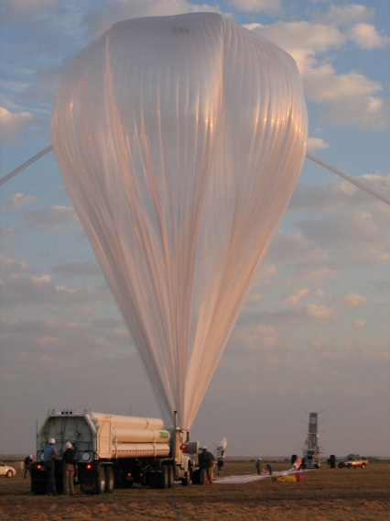
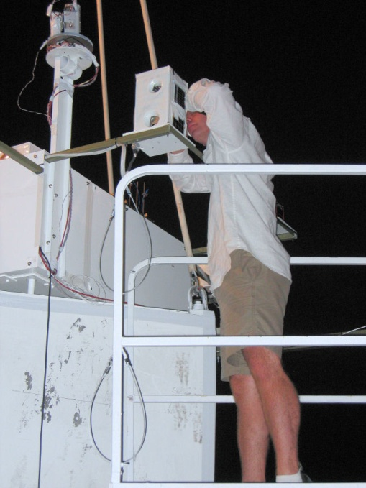
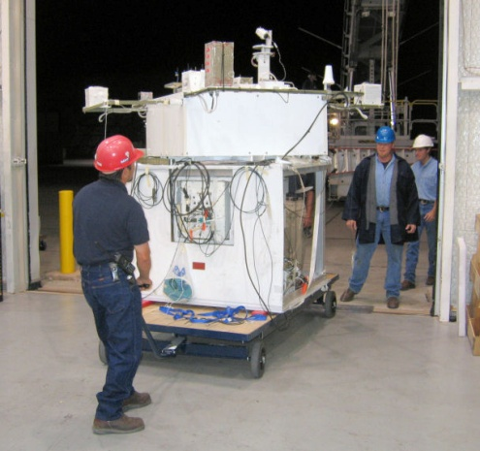
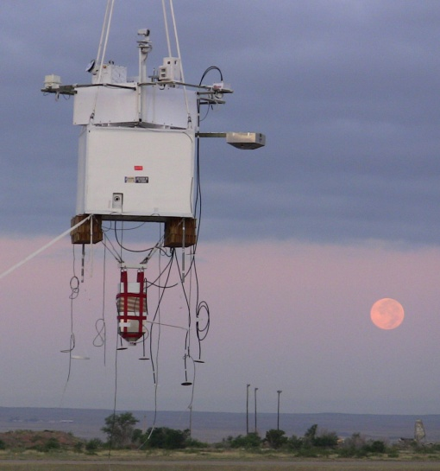
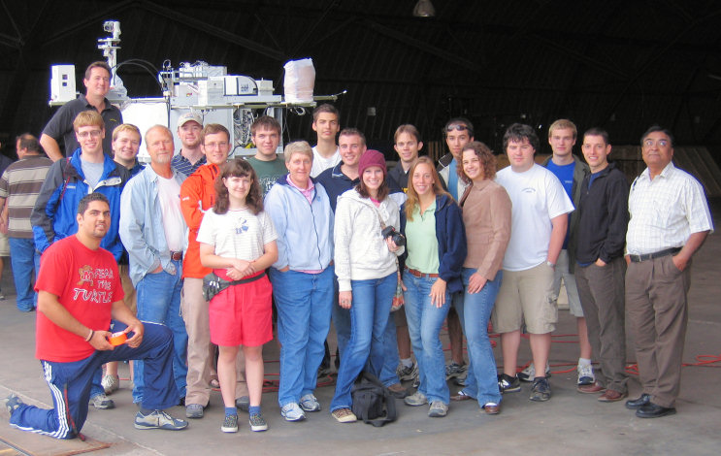
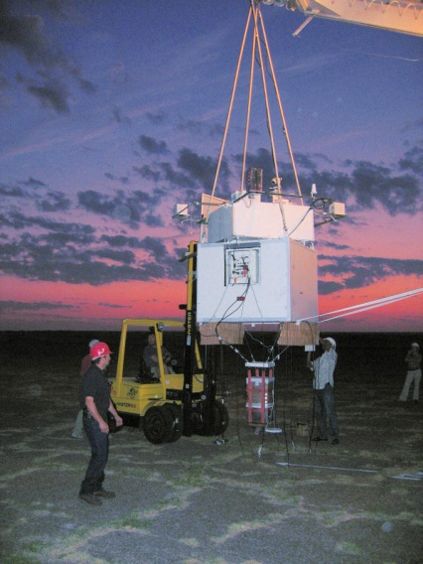
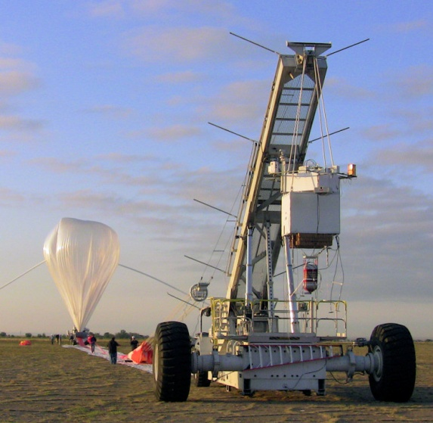
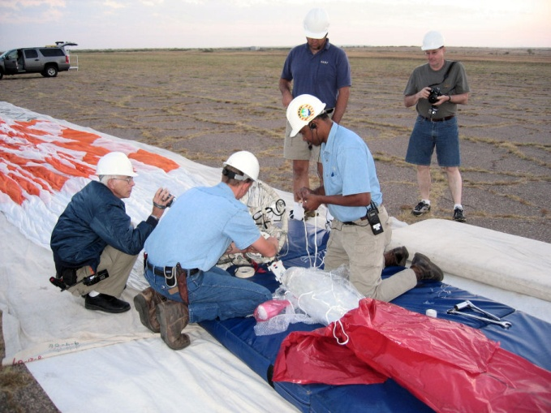
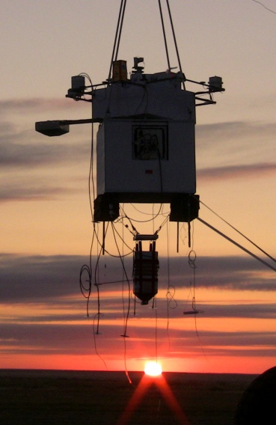
HASP Launch Preparation

Slide 22
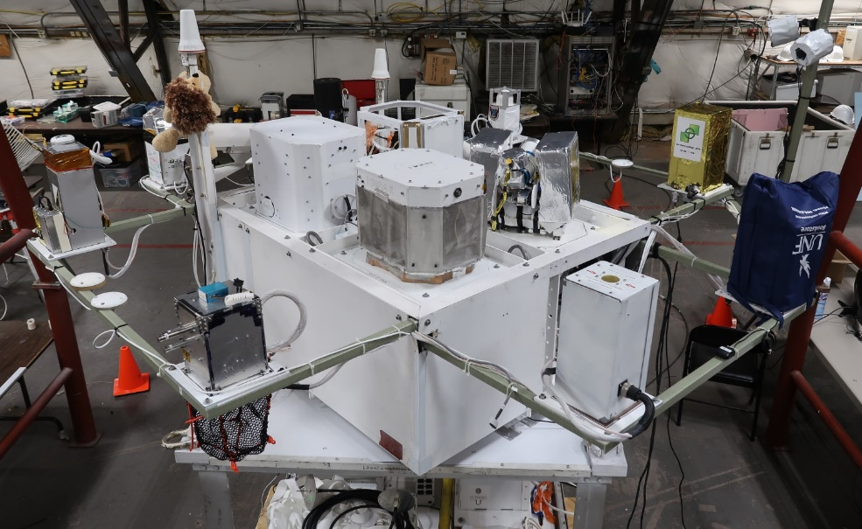

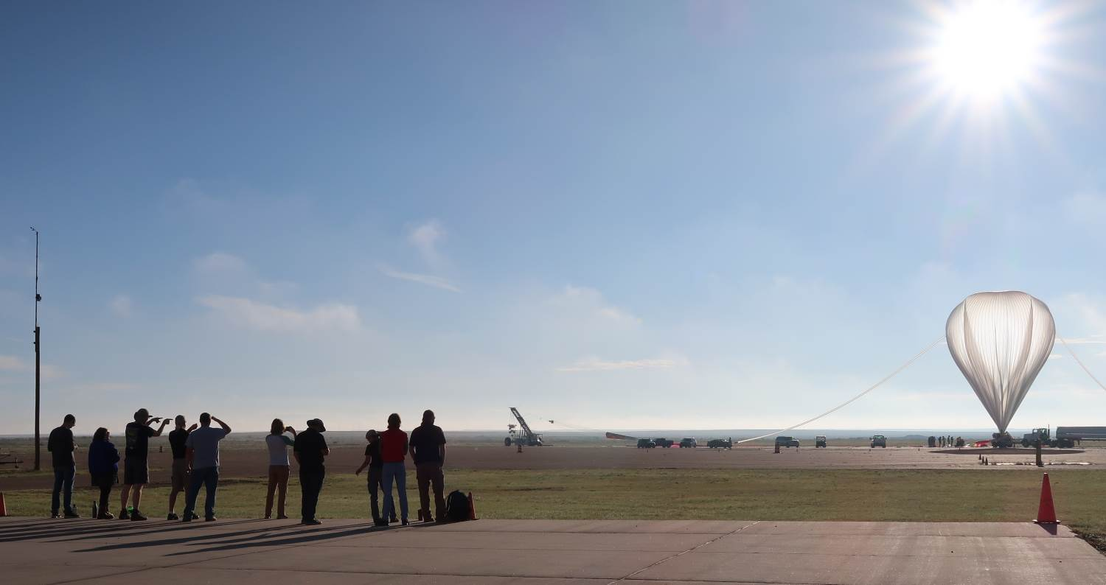

HASP 2018 Payloads and Student Teams

Slide 23


Total Eclipse April 8, 2024
LaSPACE will be leading a group of student teams during the national balloon flight for the April 8, 2024 total solar eclipse
Our effort will include a “practice flight” during the October 14, 2023 annular solar eclipse
As we did for the 2017 solar eclipse, we will hold a competition during LaACES 2022-2023 for “solar eclipse” student payloads

