Slide 1
Apophis Hypothetical Impact Exercise Risk Assessment:
Epoch 2
Jessie Dotson, Lorien Wheeler
NASA Ames Research Center
Asteroid Threat Assessment Project
Apophis Close-Approach Observing Campaign
Presentation to the International Asteroid Warning Network
4 February 2021

Slide 2
Epoch 2:
Taxonomy from spectroscopy
6% impact probability, narrower impact swath
Former Epoch 1 NEOWISE size refinements
22 January 2021

Slide 3
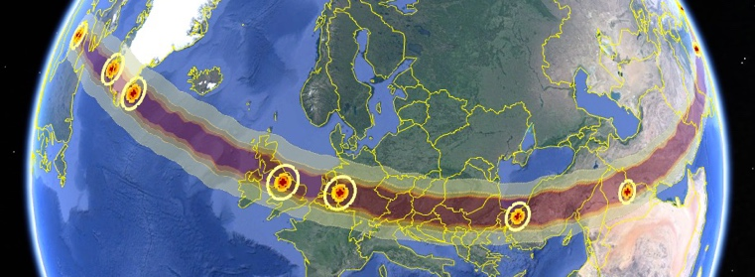
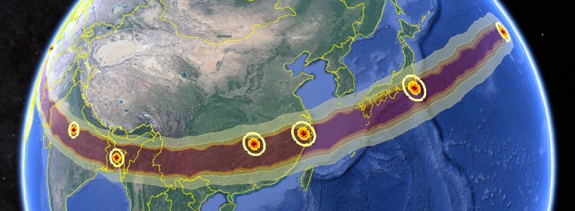

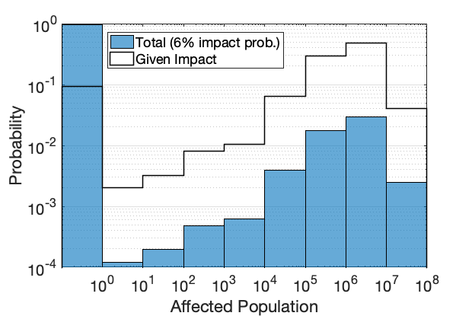
Impact Risk Summary
(Epoch 2: NEOWISE & taxonomy, 6% impact probability)
Characterization Summary & Updates
Assessment date: 22 Jan. 2021
Earth impact probability: 6%
Taxonomy: Sq determination from IRTF
Size: NEOWISE size refinement from Dec. 23
Diameter 300 m ± 75 m, full range 44 – 550 m
Energy: mean 670 Mt, full range 2 – 3770 Mt
Entry: 12.2-12.8 km/s, at entry angles up to 50°
Potential Risk Regions
Hazard Summary
Affected population: 0-54M, 138k average total risk with 6% impact prob., 2.3M average among impacting cases.
No population damage for ~9% of impact cases.
Blast overpressure is primary hazard for ~90% of impact cases.
Local blast damage radii: 0-370 km, 150 km avg.
Potential tsunami damage for ~2% of impact cases (primary hazard for <0.4%)
No major global effects expected
Affected Population Risk Probabilities
Notes:
jld: removed LL meteorite analog. That’s not from the observers, but in the behind the scenes inference engine. I’ll put it in later.
Average total risk (0.6% impact prob): 12k
Average for impacting cases: 2M
Range: 0-61M
Local max 61M
Tsu max 3M

Slide 4
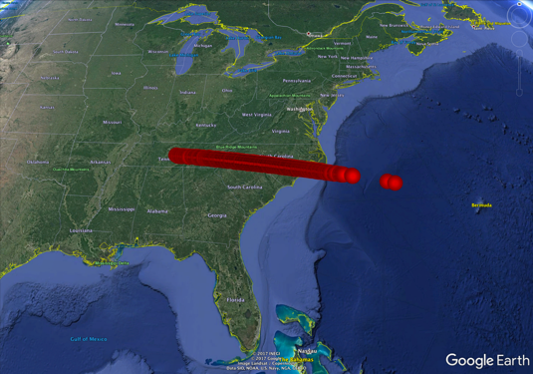
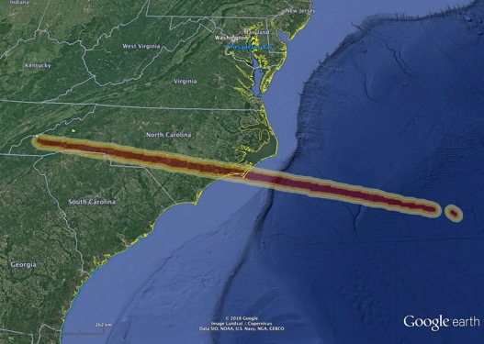
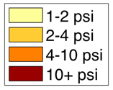
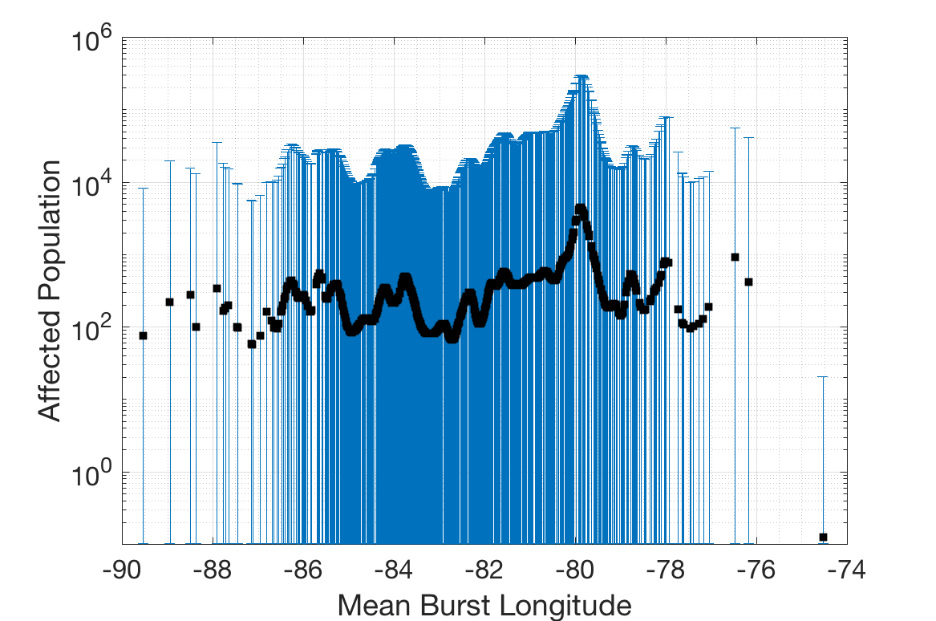
Probabilistic Asteroid Impact Risk in Apophis Exercise
Hypothetical Entry points
Damage Map
Updated by Davide as
Astrometry improves
New Damage Maps
PAIR
Physical Property Distributions
Damage Range
Updated by Jessie based on
characterization observations
New Damage Metrics

Slide 5
Asteroid Property Inference Network
Used spectroscopy results
Used NEOWise measurements
PAIR input node
Inference network node
H
diameter
albedo
taxonomy
base density
density
porosity
strength

Slide 6
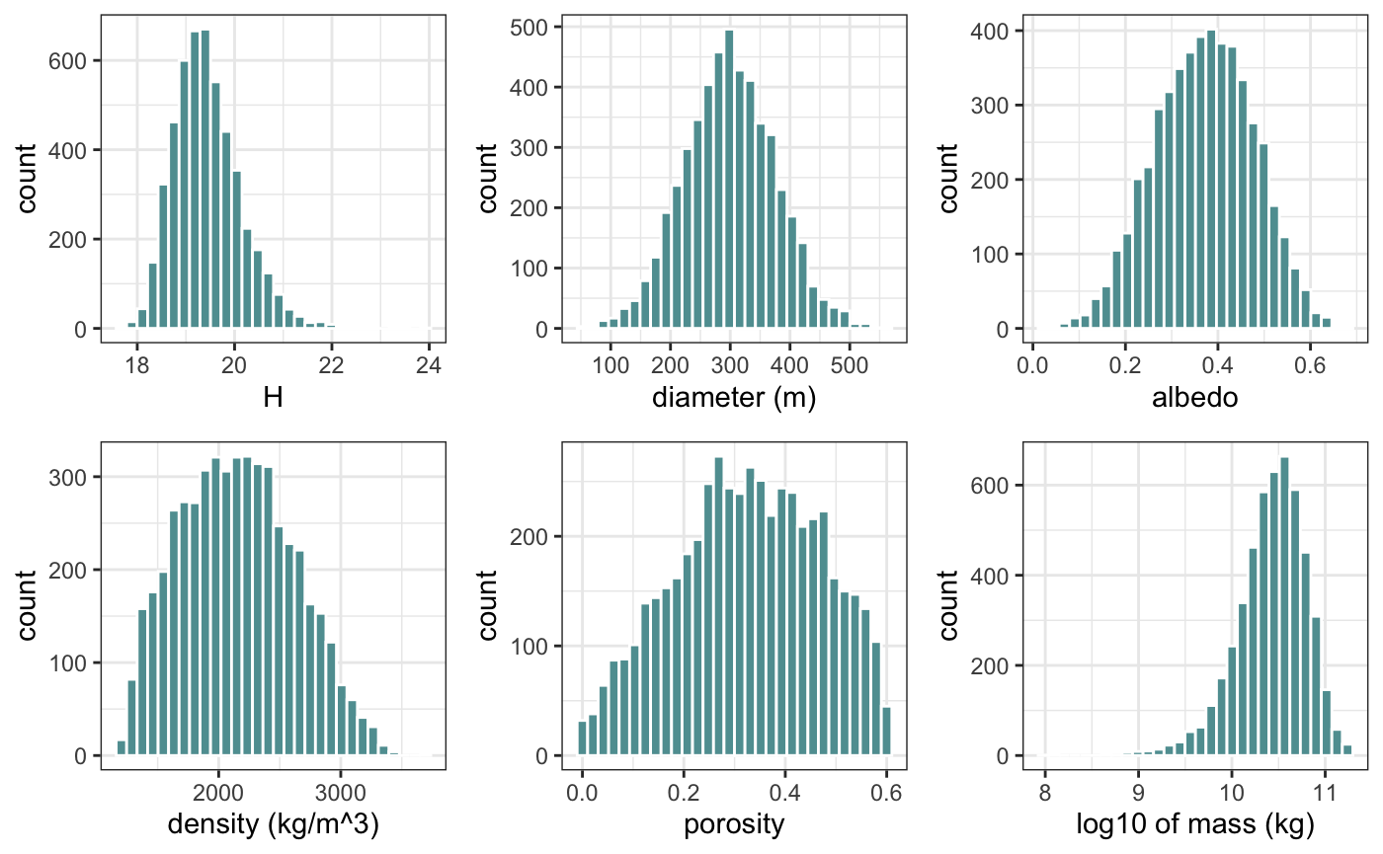
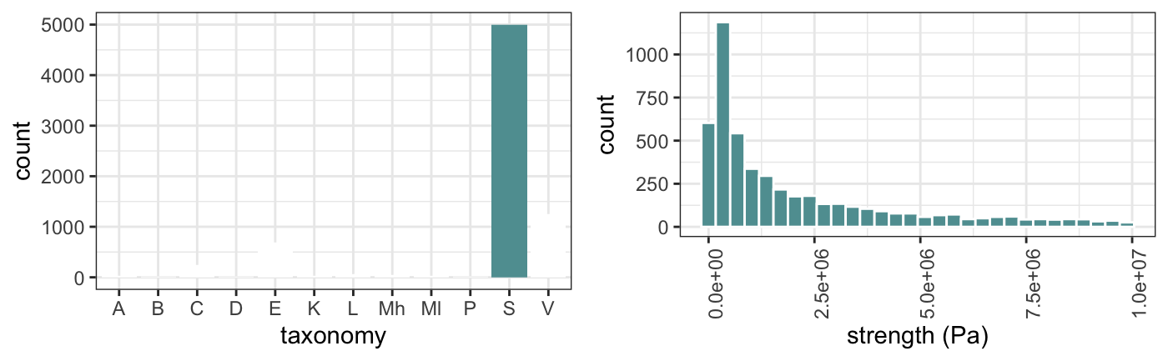
Asteroid Properties
(Epoch 2: NEOWISE & Taxonomy)
Determined by observations:
  Diameter
  Albedo
  Taxonomy
From population statistics:
  Porosity
Inferred:
  H
  Density
  Strength
Calculated:
  Mass
Notes:
Add stair overplots of generic NEA distributions for astrometry only set

Slide 7
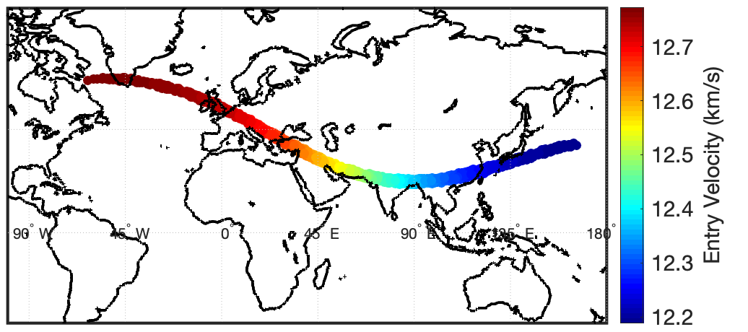
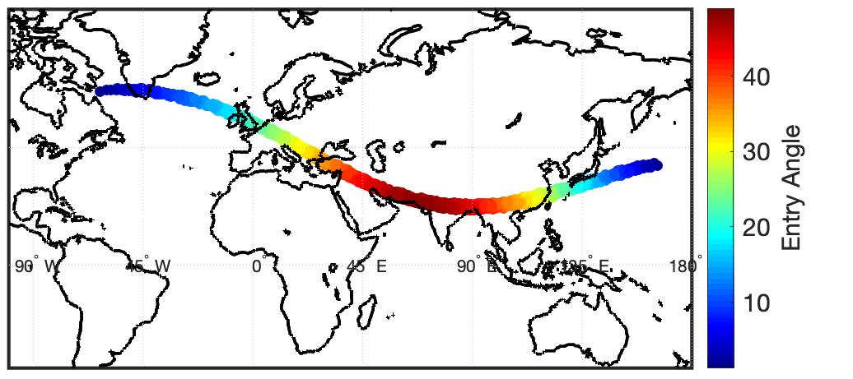
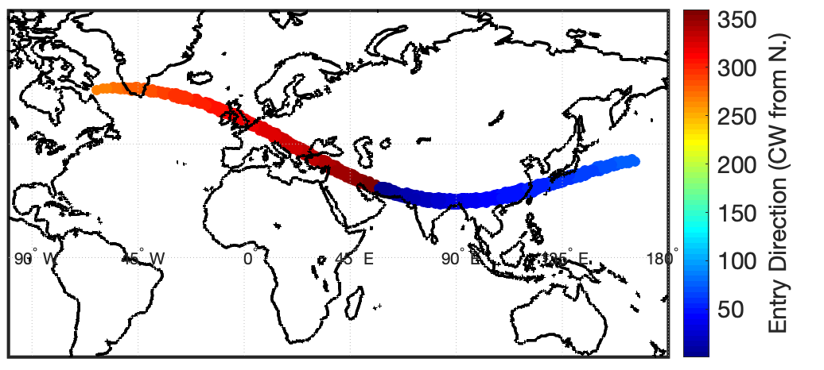
Entry Parameter Maps
(Epoch 2 impact swath, 6% impact probability)
Initial entry parameters at 100-km-altitude atmospheric entry points
Entry Velocity
Entry Angle (deg. from horizontal)
Entry Velocity: 12.2 – 12.8 km/s
Entry Angle: up to 50° from horizontal
Flight Direction (deg clockwise from N):
  ~Westward (266°) at west end of swath
  Northward mid-swath (Middle East)
  ~East-northeast (78°) at east end of swath
Entry Flight Direction
Notes:
There are skimming shallow entries down to fractions of a degree that should maybe be thrown out.

Slide 8
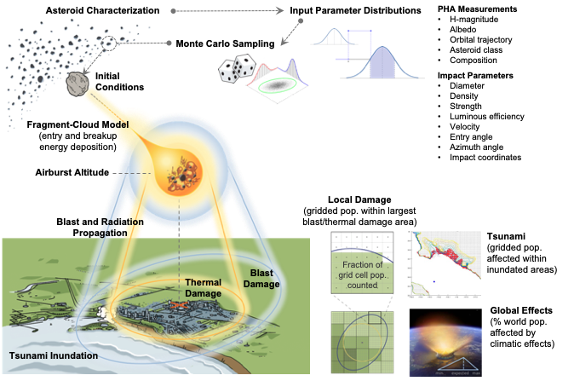
Probabilistic Asteroid Impact Risk
(PAIR) Model
Notes:
There are skimming shallow entries down to fractions of a degree that should maybe be thrown out.

Slide 9
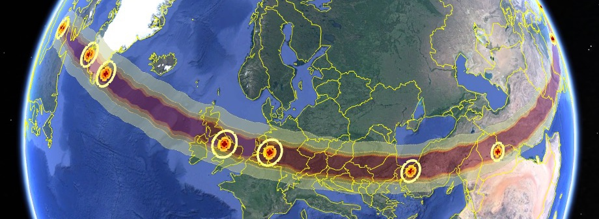
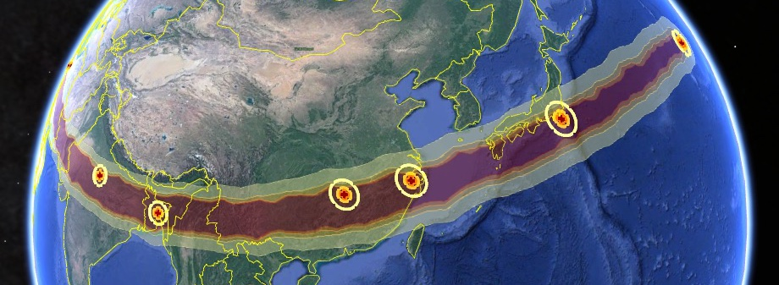
Local Damage Swath
(Epoch 2: NEOWISE & taxonomy, 6% impact probability)
Damage swath:
Full range of regions potentially at risk to local ground damage, from all modeled cases (including unlikely worst-case objects and all sampled impact locations).
Sample average damage areas: Average blast damage areas at several high-population locations across the swath.
Cologne
Istanbul
Manchester
Baghdad
Hangzhou
Gwalior
Dhaka
Hunan
Tokyo
Map image/data credit: Google Earth, © 2020 Google. Data SIO, NOAA, U.S. Navy, NGA, GEBCO. Image Landsat / Copernicus. © 2020 GeoBasis-DE/BKG.

Slide 10
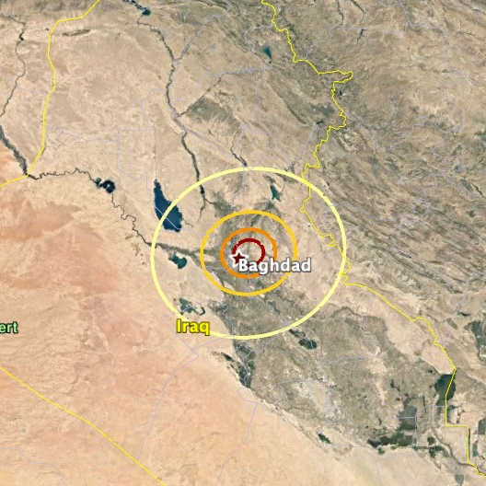
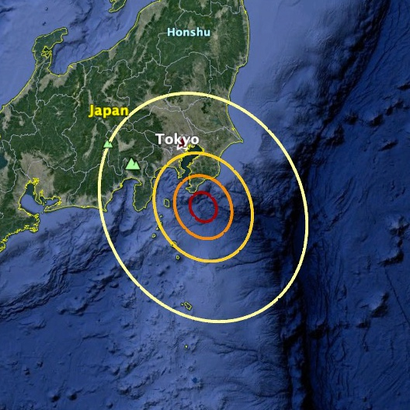
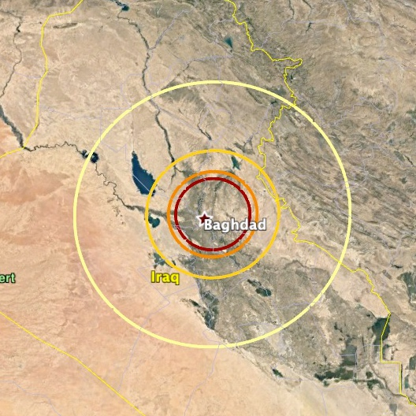
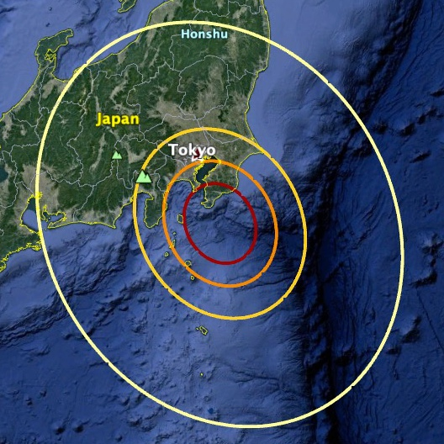
Sample Damage Areas Across Swath
(Epoch 2: NEOWISE & taxonomy, 6% impact probability)
Manchester
Western swath, shallow ~20° entry
Baghdad
Mid swath, steepest ~50° entry
Tokyo Coast
Eastern swath, shallow ~16° entry
Average Damage
Avg radius: ~180 km
Avg. affected pop.: 8.8M
Avg radius: ~130 km
Avg. affected pop.: 6.1M
Avg radius: ~190 km
Avg. affected pop.: 5.4M
Max radius: ~300 km
Max affected pop.: 10.6M
Max radius: ~240 km
Max affected pop.: 10.6M
Max radius: ~310 km
Max affected pop.: 14.7M
Max Damage
Map image/data credit: Google Earth, © 2020 Google. Data SIO, NOAA, U.S. Navy, NGA, GEBCO. Image Landsat / Copernicus. © 2020 GeoBasis-DE/BKG.
Notes:
Images are all on same scale for comparison
Manchester:
Western swath, shallow ~20° entry
Blast radii: 182 km mean, 304 km max
Affected pop.: 8.8 M mean cas, 16.8M max
Baghdad:
6.1 M mean cas, 10.6M max
134 km rad mean, 236 km max
Mid-swath, steepest ~50° entry
Tokyo Coast:
5.4 M mean cas, 14.7M max
188 km rad mean, 313 km max
Tsu cas 1.1k mean, 45k max
Eastern swath, steepest ~16° entry

Slide 11
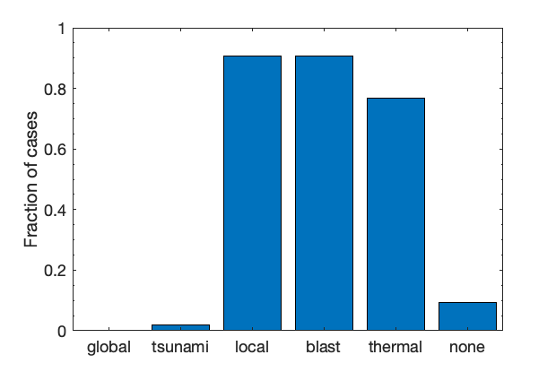
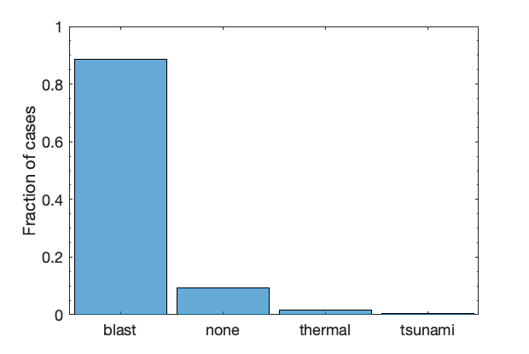
Hazard Sources
(Epoch 2: NEOWISE & taxonomy, 6% impact probability)
Occurrence of hazard sources
Fraction of Earth-impacting cases for which damage from each hazard occurs
Risk-driving hazard sources
Fraction of cases for which each hazard is the primary source of population damage
91%
91%
89%
77%
9.2%
9.2%
1.9%
1.7%
0.4%
Total affected population risk is driven primarily by local blast overpressure damage
Blast damage occurs and is primary hazard source for ~90% of cases
Thermal damage also occurs in 77% of cases but is smaller or less severe than the blast damage in nearly all cases.
Tsunami inundation potentially occurs for ~2% of cases, but is primary hazard source for 0.4%
No major global climatic effects are expected
~9% of cases cause no affected population damage from any hazard source
Notes:
However, the maximum worst-case thermal damage slightly exceeds the maximum worst-case blast damage.

Slide 12
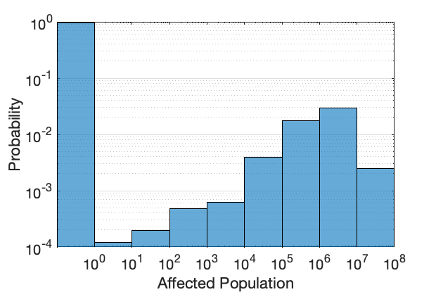
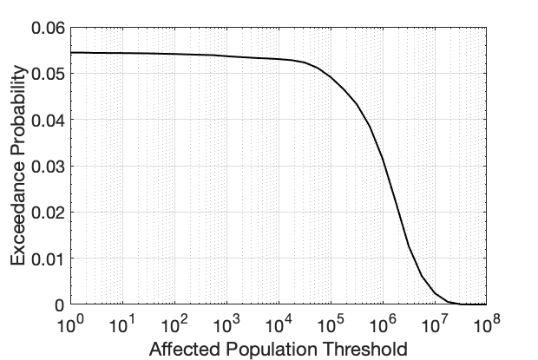
Affected Population Probabilities
(Epoch 2: NEOWISE & taxonomy, 6% impact probability)
Population risk histogram: probabilities of different population ranges being affected
Damage exceedance probabilities: Likelihood of a certain number of people or more being affected
94.6%
5.3% chance of >10k ppl
1.8%
2.9%
3.1% chance of >1M ppl
0.4%
0.25%
0.06%
No damage most likely (due to low impact probability), followed by 1M–10M people
Maximum affected population: 64M people, due to local blast damage
Average total risk (with 6% impact probability): 138k people
Average among impacting cases: 2.3M people
Tsunami affected pop: 670k max, <140 avg. among impacting cases

Slide 13
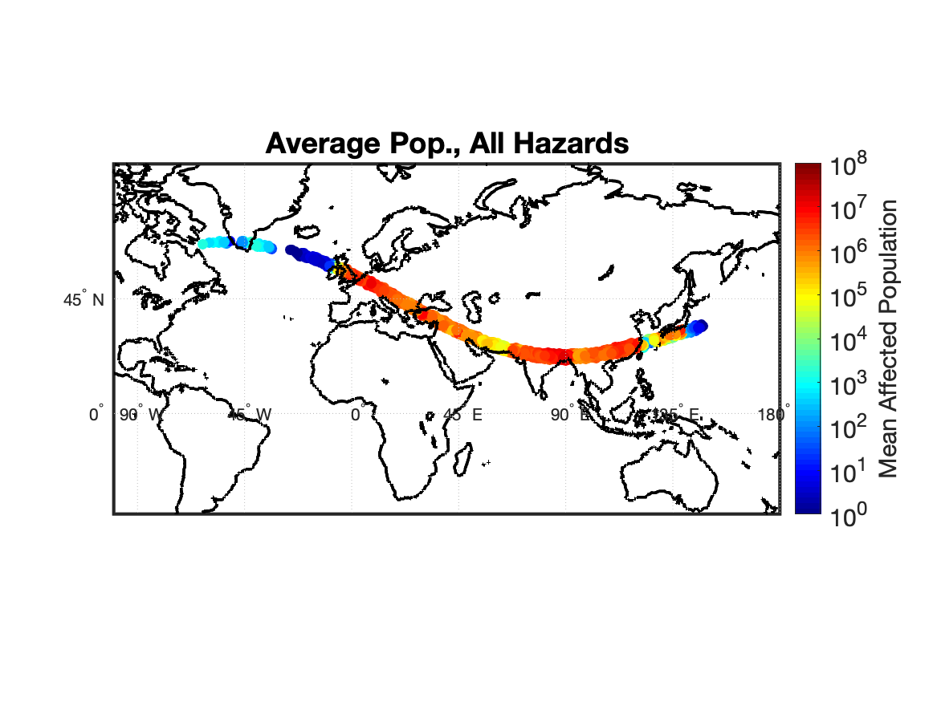
Affected Population Map
(Epoch 2: NEOWISE & taxonomy, 6% impact probability)
Average Affected Population for Sampled Impacting Entry Points Along Swath
Average affected population among potential asteroid property cases
Plotted at 100-km-altitude atmospheric entry points for each orbital sample.
Damage locations for each individual case vary depending on entry parameters, asteroid properties, and resulting airburst or impact point.

Slide 14
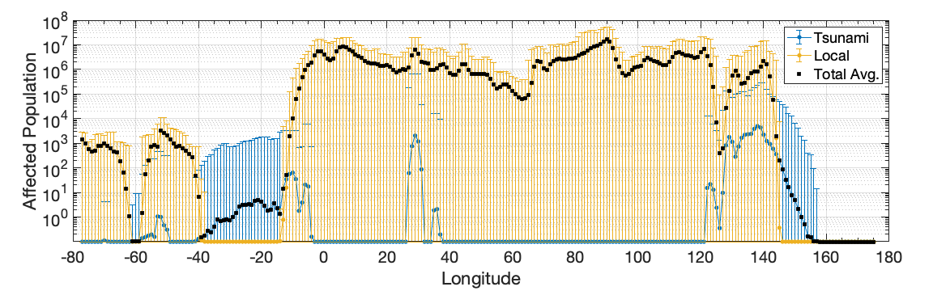
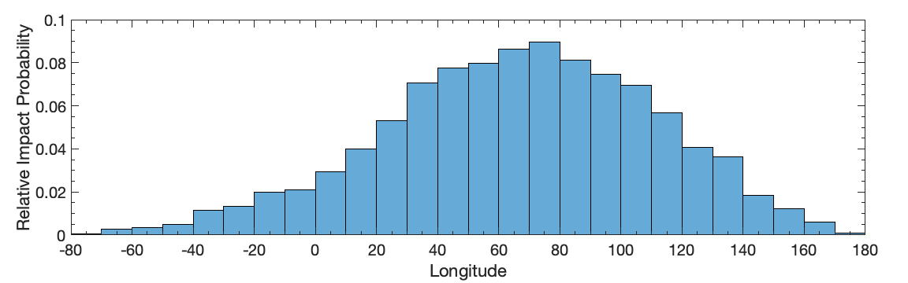
Affected Population Ranges Along Swath
(Epoch 2: NEOWISE & taxonomy, 6% impact probability)
Min/Mean/Max Affected Population
Europe
India
China
Greenland
Canada
Japan

Slide 15
Epoch 2 Observational Refinement Comparisons

Slide 16
Comparing Epochs & Observations
As the exercise evolves, we can combine different combinations of entry swath and observational results to assess what information is changing our understanding of the risk.
Comparisons executed:
  Entry estimates from 12/23/2020 (Epoch 1) and 1/21/2021 (Epoch 2)
    Epoch 1: Earth Impact Probability of 0.6% and wide impact swath
    Epoch 2: Earth Impact Probability of 6% and narrower impact swath
  Physical parameters with NEOWise and without NEOWise
    NEOWise provides diameter 300m +/- 75m and albedo of 0.44 +/- 0.19
    Photometry provides H = 19.17 +/- 0.2
    Spectroscopy provides Sq taxonomy

Slide 17
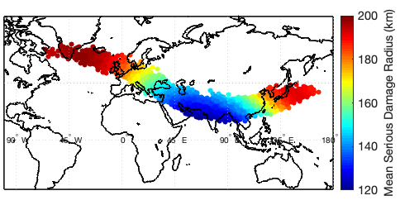
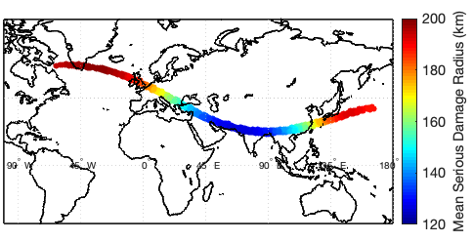
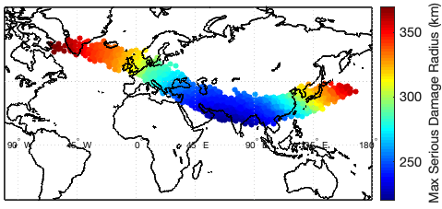
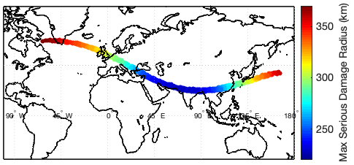
Epoch 1 vs 2 Damage Radii
(Epoch 2 vs Epoch 1 with all information)
Similar average damage radius ranges (~120-200km) and maximum damage radius ranges (~220/230-370km) along swath for both epochs
Epoch 1
Epoch 2

Slide 18
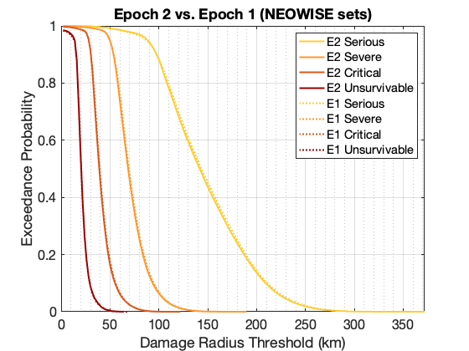
Local Damage Region Sizes
(Epoch 2 vs Epoch 1 with all information)
Relative damage radius exceedance probabilities among Earth-impacting cases
Damage radii ranges and probabilities among impacting cases very similar between epoch 1 and epoch 2, since size and entry parameters have not changed significantly
Notes:
Damage radius ranges and distributions pretty similar to Epoch 1 since these are impact-conditional probabilities and the size and entry hasn’t really changed

Slide 19
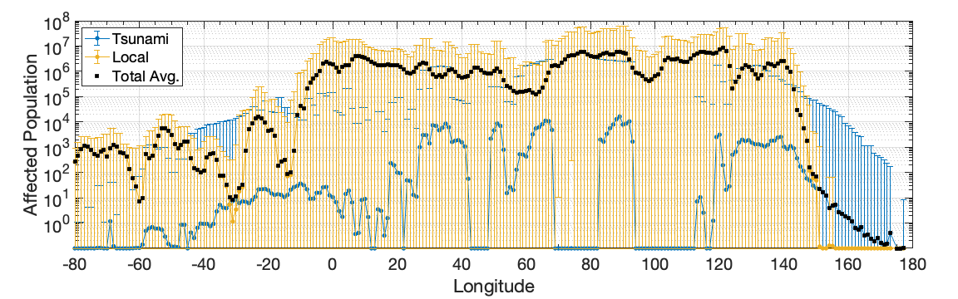
Affected Population Ranges Along Swath
(Epoch 2 vs Epoch 1 with all information)
Differences in Min/Mean/Max Affected Population ranges along swath due to narrowed swath width
Greenland
Europe
India
China
Canada
Japan
Epoch 2
Epoch 1

Slide 20
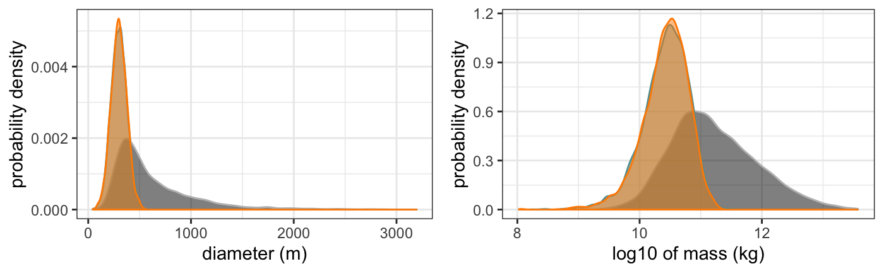
Compare Property Sets:
All available information
Considered three different physical property sets:
  Initial Astrometry (12/23/2020: H = 19.3 +/- 0.5)
  NEOWise (12/23/2020: d = 300 +/- 75m; p_{v} = 0.44 +/- 0.19)
  NEOWise + Taxonomy (1/20/2021: type = Sq)
neowise
neowise
neowise
+ taxonomy
neowise + taxonomy
initial
initial

Slide 21
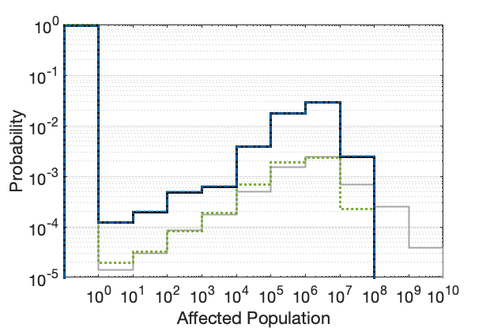
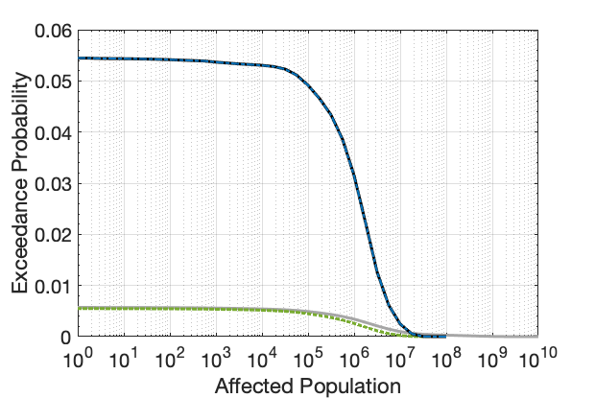
Risk Comparisons: all available info
(Total risks, including impact probabilities)
Population Risk Histogram
Population Exceedance Risks
Risk increase driven by 10x increase in Earth-impact probability from 0.6% to 6%
Taxonomic refinement makes negligeable difference compared to impact probability given the prior NEOWISE size measurement

Slide 22
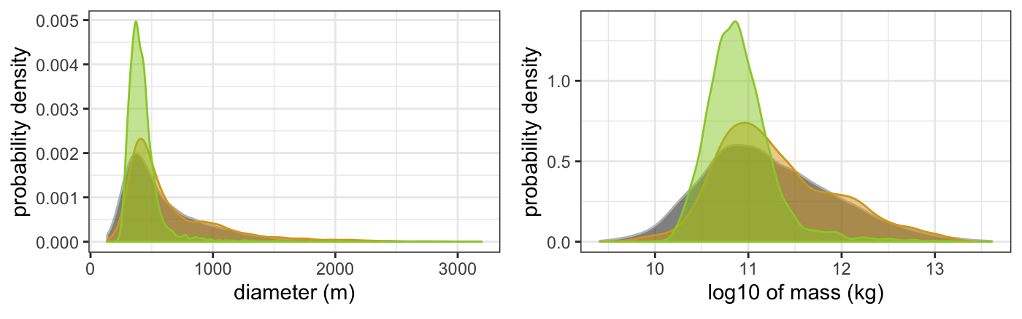
Compare Property Sets:
No NEOWise
Considered three different physical property sets:
  Initial Astrometry (12/23/2020: H = 19.3 +/- 0.5)
  Photometry (12/27/2020: H = 19.17 +/- 0.2)
  Photometry + Taxonomy (1/20/2021: type = Sq)
photometry
+ taxonomy
photometry + taxonomy
photometry
photometry
initial
initial

Slide 23
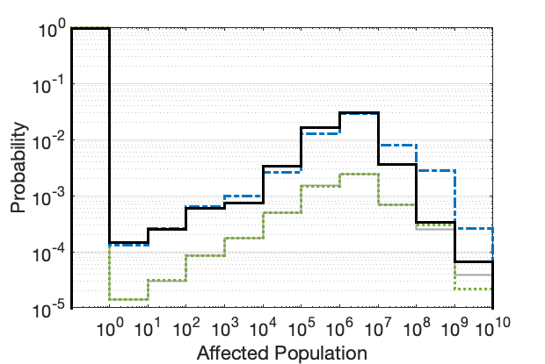
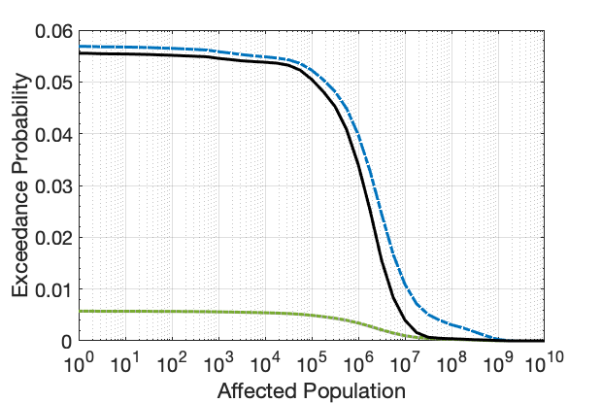
Risk Comparisons: Photometry Sets
(Total risks, including impact probabilities)
Population Risk Histogram
Population Exceedance Risks
Taxonomic refinement decreases risk more notably for cases with larger size uncertainties, (especially for the largest affected population ranges >10M people)
For the Epoch 2 swath with initial Epoch 1 photometry sizing, the additional taxonomic refinement reduces chance of affecting >10M people by ~63% (1.1% to 0.4%),
>1M people by ~15% (4% to 3.4%), or >1k people by ~2.3% (5.58% to 5.45%)

Slide 24
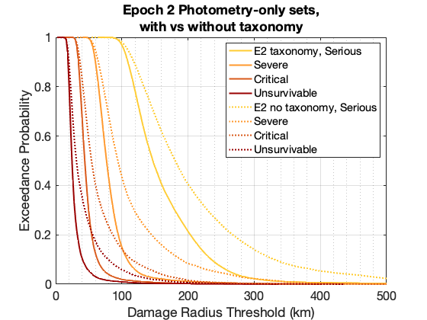
Local Damage Region Sizes
(Epoch 2: Photometry set comparisons with/without taxonomy)
Relative damage radius exceedance probabilities among Earth-impacting cases
Comparing effect of taxonomy information on damage probabilities without NEOWISE size refinement or impact swath changes.
Taxonomy information can make notable difference in the absence of major refinements to primary risk-driving size or impact parameters.
Chance of damage radii >200 km decreases from 40% to 20% with taxonomic characterization (among impacting cases).
Chance of damage radius >200 km reduced 40% → 20%

Slide 25
backup

Slide 26
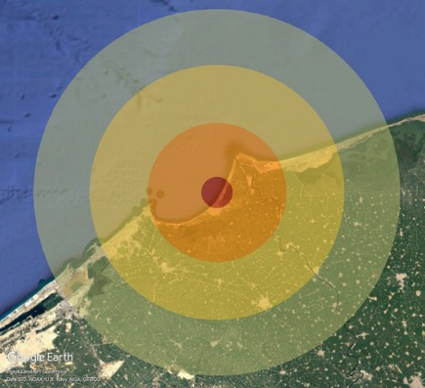
Local Damage Level Definitions
PAIR models local ground damage due to both blast overpressure and thermal radiation hazards.
Ground damage is assessed at four severity levels, with each level affecting different fractions of the population within that region
For each damage level, the larger of the blast or thermal radius is used to determine the area and population for that level.
Damage Level | Population fraction | Blast Threshold (psi) | Thermal Exposure Threshold
Serious | 10% | 1 psi – window breakage and some structural damage | 2nd degree burns
Severe | 30% | 2 psi – doors and windows blown out, widespread structural damage | 3rd degree burns
Critical | 60% | 4 psi – most residential structures collapse | cotton/denim clothing ignites
Unsurvivable | 100% | 10 psi – complete devastation | sand explodes, roll roofing ignites

Slide 27
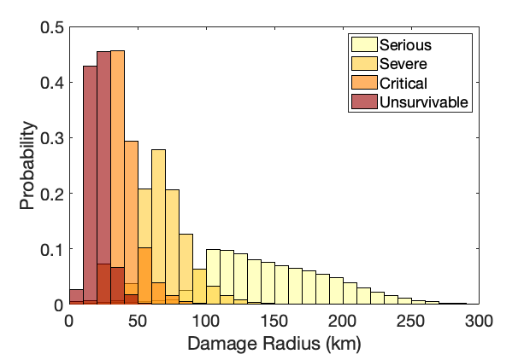
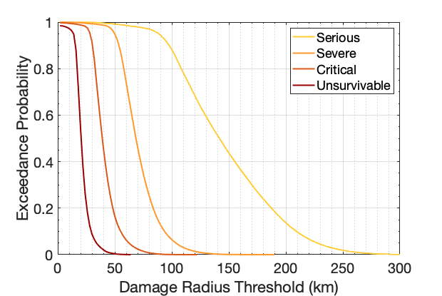
Local Damage Region Sizes
(Epoch 2: NEOWISE sizing with taxonomy, 6% Impact Prob)
Relative damage radius probabilities among Earth-impacting cases
Damage Radius Histogram
Damage Radius Exceedance
Damage Radius Stats (km)
Damage Level | Min | Max | Mean | Median | 5th % | 25th % | 75th % | 95th %
Serious | 0 | 370 | 148 | 142 | 89 | 228 | 113 | 178
Severe | 0 | 190 | 71 | 69 | 50 | 104 | 60 | 80
Critical | 0 | 121 | 41 | 39 | 28 | 62 | 34 | 46
Unsurvivable | 0 | 64 | 21 | 21 | 14 | 34 | 18 | 24
Notes:
Damage radius ranges and distributions pretty similar to Epoch 1 since these are impact-conditional probabilities and the size and entry hasn’t really changed

Slide 28
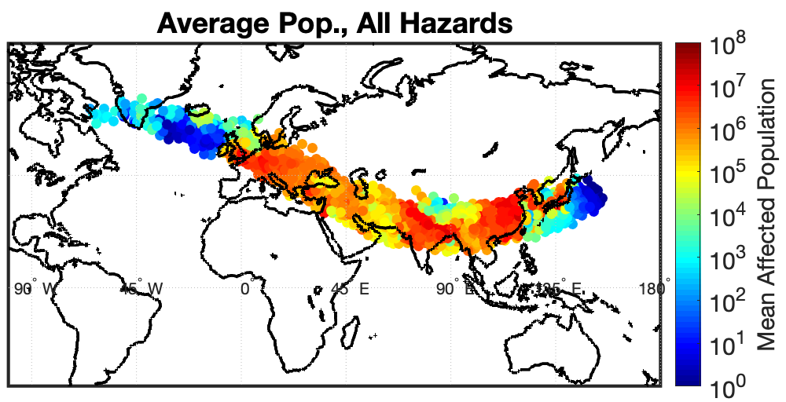
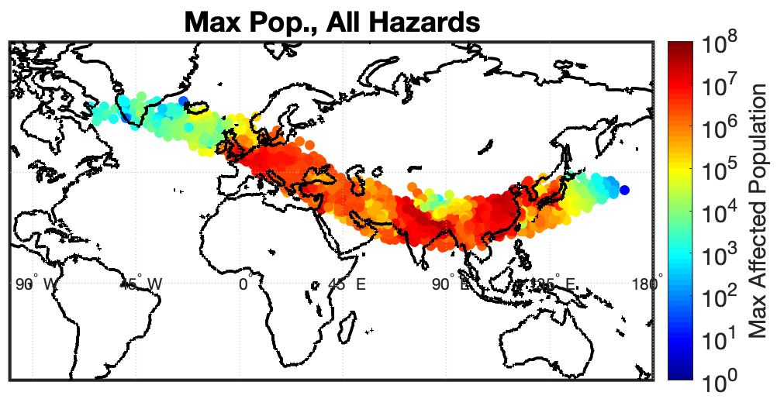
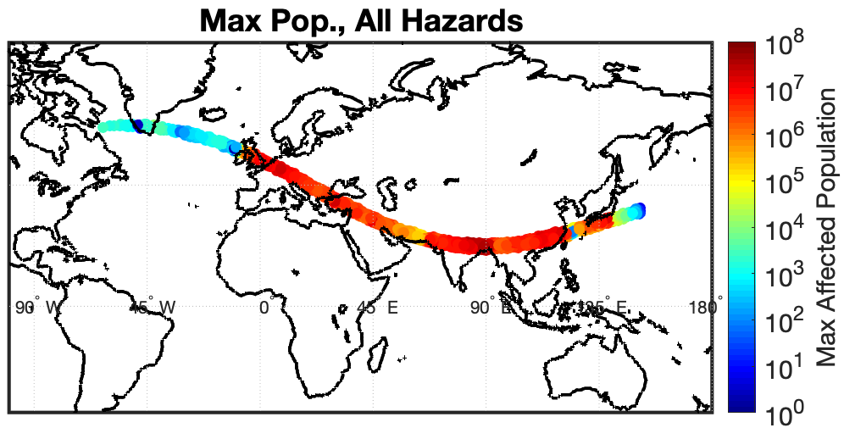
Epoch 1 vs 2 Affected Pop.
Epoch 2 swath now misses some high-population areas around northern India and China
Fewer large tsunami inundation cases affecting ~10k
Epoch 1
Epoch 2

Slide 29
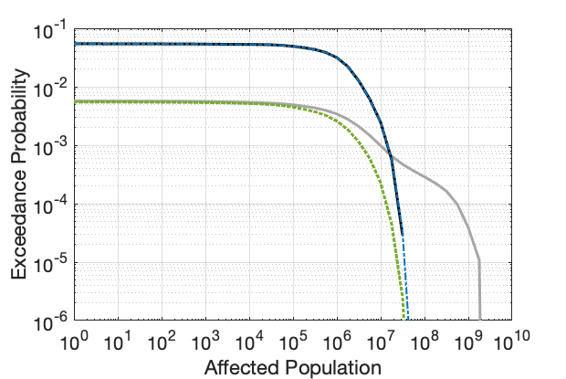
Risk Comparisons: NEOWISE sets
(Total risks, including impact probabilities)
Population Risk Histogram
Population Exceedance Risks
Risk increase driven by 10x increase in Earth-impact probability from 0.6% to 6%
Taxonomic refinement makes negligeable difference compared to impact probability and prior NEOWISE size refinement
Add some numbers… mean risk, percentiles

Slide 30
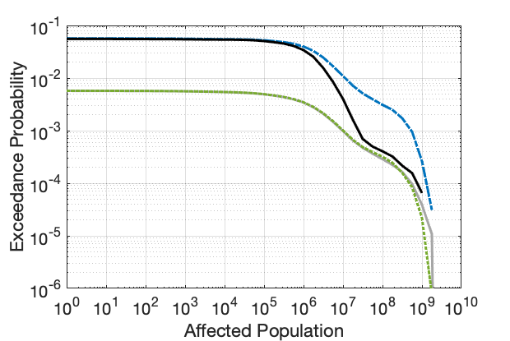
Risk Comparisons: Photometry Sets
(Total risks, including impact probabilities)
Population Risk Histogram
Population Exceedance Risks
Taxonomic refinement decreases risk more notably for cases with larger size uncertainties, (especially for the largest affected population ranges >10M people)
For the Epoch 2 swath with initial Epoch 1 photometry sizing, the additional taxonomic refinement reduces chance of affecting >10M people by ~63% (1.1% to 0.4%),
>1M people by ~15% (4% to 3.4%), or >1k people by ~2.3% (5.58% to 5.45%)
Need to look at the taxonomy property refinements to say if this primarily driven by size refinement, density/mass refinement or what…

Slide 31
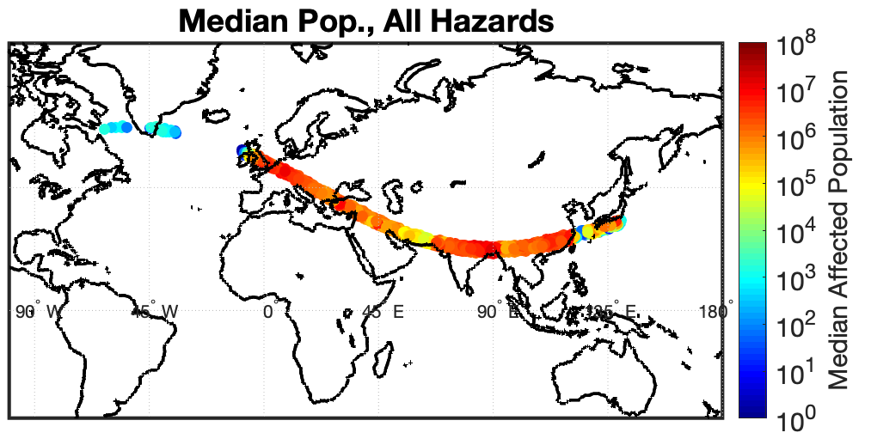
Affected Population Maps
(Epoch 2: NEOWISE sizing with taxonomy, 6% Impact Prob)
Plotted at 100-km-altitude atmospheric entry points for each orbital sample.
Damage locations for each case vary depending on entry parameters, asteroid properties, and resulting airburst or impact point.

Slide 32

Serious Damage Radius Maps
Average Serious (>1 psi) Damage Radii Along Swath
Plotted at 100-km-altitude atmospheric entry points for each orbital sample.
Damage locations for each case vary depending on entry parameters, asteroid properties, and resulting airburst or impact point.

Slide 33

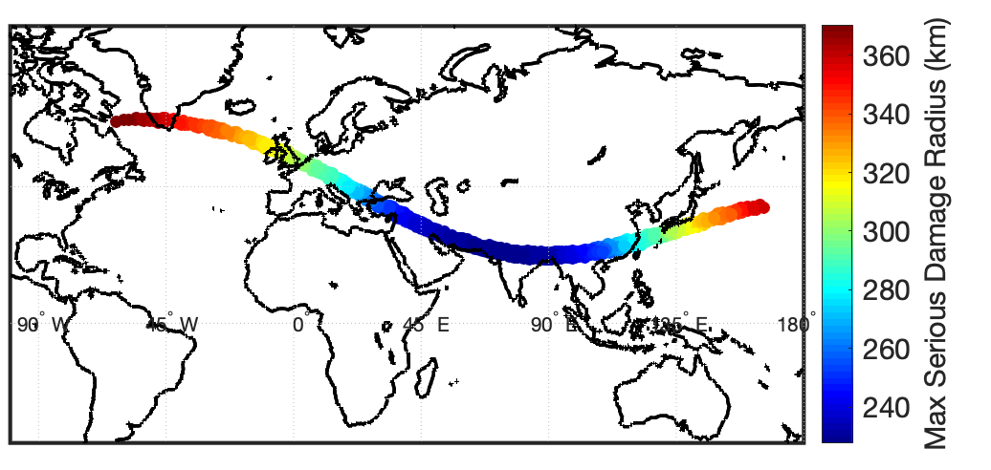
Serious Damage Radius Maps
Mean Damage Radii
Median Damage Radii
Max Damage Radii
Ranges across swath:
  Means: 125 – 198 km
  Medians: 119 – 228 km
  Maximums: 228 – 370 km
Color scales differ between plots
Notes:
Should put on same colorscale and see if ranges still discernable
Replace text with summary of ranges
Maybe re-arrange pics among slides to group all damage levels together with separate slides for Mean, Median, Max (though that might be worse for same colorscale)

Slide 34



Severe Damage Radius Maps
Mean Damage Radii
Median Damage Radii
Max Damage Radii
Ranges across swath:
  Means: 62 – 105 km
  Medians: 60 – 107 km
  Maximums: 110 – 190 km
Color scales differ between plots

Slide 35



Critical Damage Radius Maps
Mean Damage Radii
Median Damage Radii
Max Damage Radii
Ranges across swath:
  Means: 36 – 63 km
  Medians: 34 – 63 km
  Maximums: 74 – 121 km
Color scales differ between plots

Slide 36
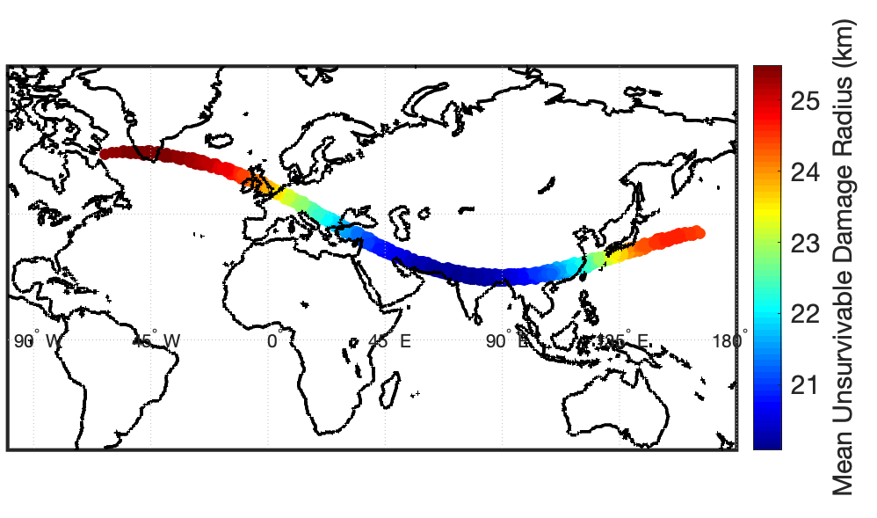


Unsurvivable Damage Radius Maps
Mean Damage Radii
Median Damage Radii
Max Damage Radii
Ranges across swath:
  Means: 20 – 25 km
  Medians: 19 – 28 km
  Maximums: 60 – 64 km
Color scales differ between plots

