Slide 1
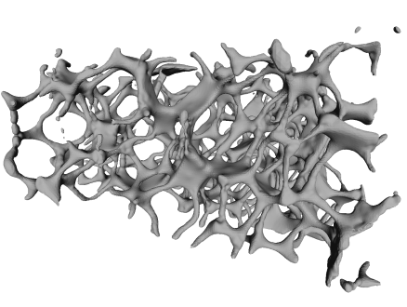
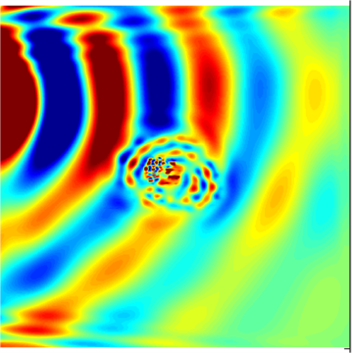
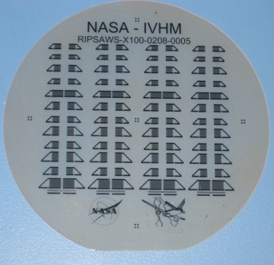
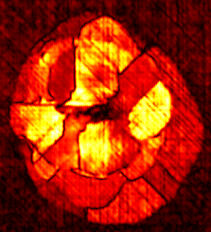
Modeling of Guided Waves for Aerospace Applications
Cara Leckey, Erik Frankforter, William Schneck
NASA Langley Research Center
Michael Horne, National Institute of Aerospace

Slide 2
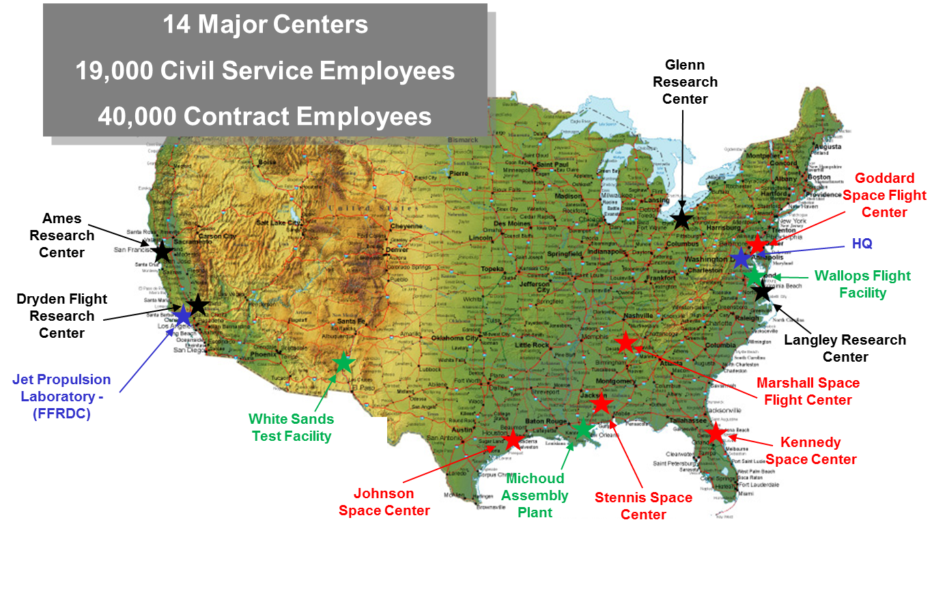
National Aeronautics & Space Administration
14 Major Centers/Facilities
~17,000 Civil Service Employees
~40,000 Contract Employees
Centers & Facilities:
Ames Research Center
Armstrong Flight Research Center
Glenn Research Center
Goddard Space Flight Center
Jet Propulsion Laboratory
Johnson Space Center
Kennedy Space Center
Langley Research Center
Marshall Space Flight Center
Michoud Assembly Plant
NASA Headquarters
Stennis Space Center
Wallops Flight Facility
White Sands Test Facility
Armstrong Flight Research Center
Research Center
Spaceflight center
Test Facility/plan
Other
NASA Langley was the first center, established 1917!

Slide 3
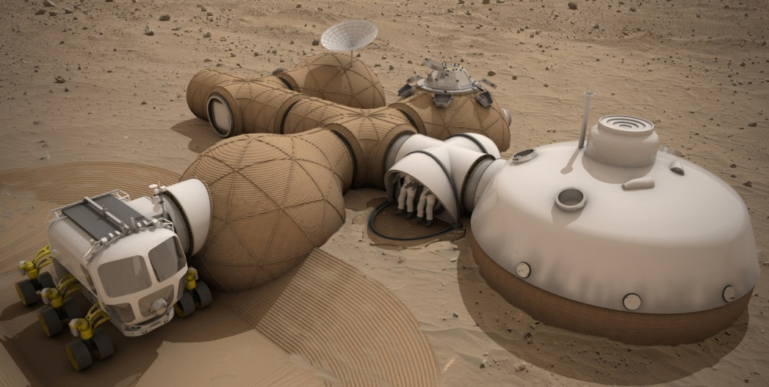


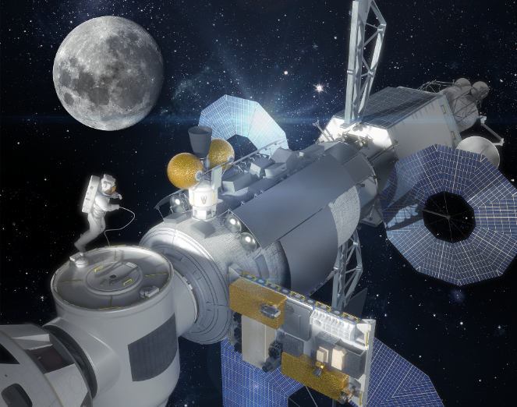
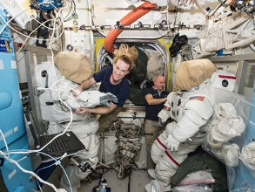
National Aeronautics & Space Administration
Commercial Crew to ISS
Space Launch System (SLS)
Beyond LEO
Asteroid, Mars
Human Habitation of Mars
International Space Station
Human Exploration
Long-Duration Space Habits

Slide 4
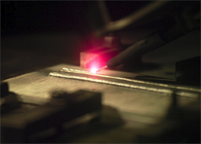
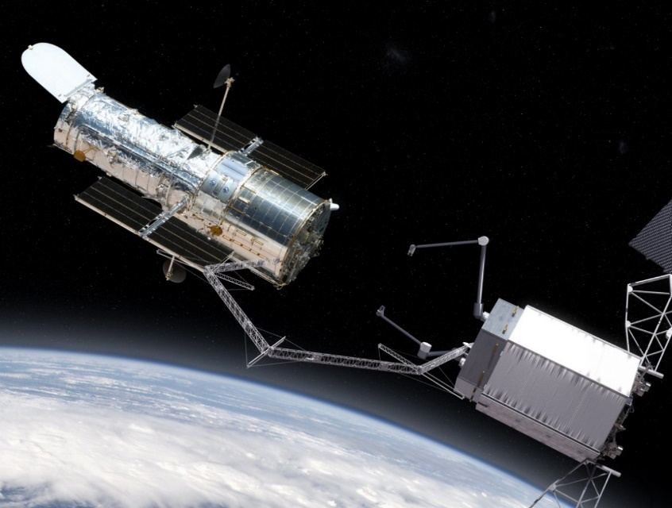
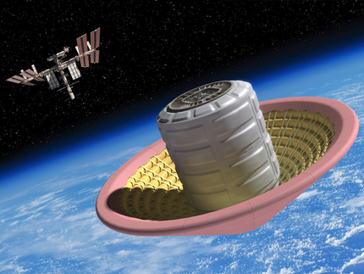
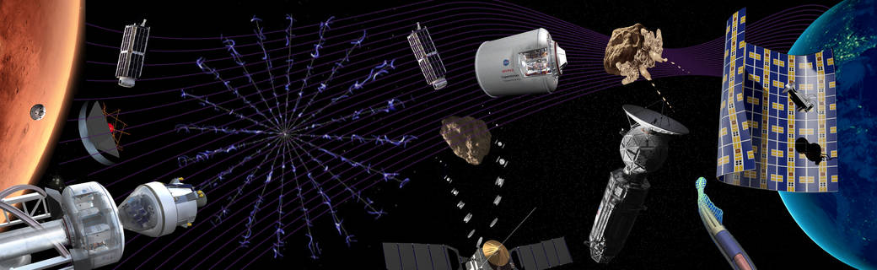
National Aeronautics and Space Administration
In-space Fabrication
Inflatable Re-entry
In-space Assembly
Space Technology

Slide 5
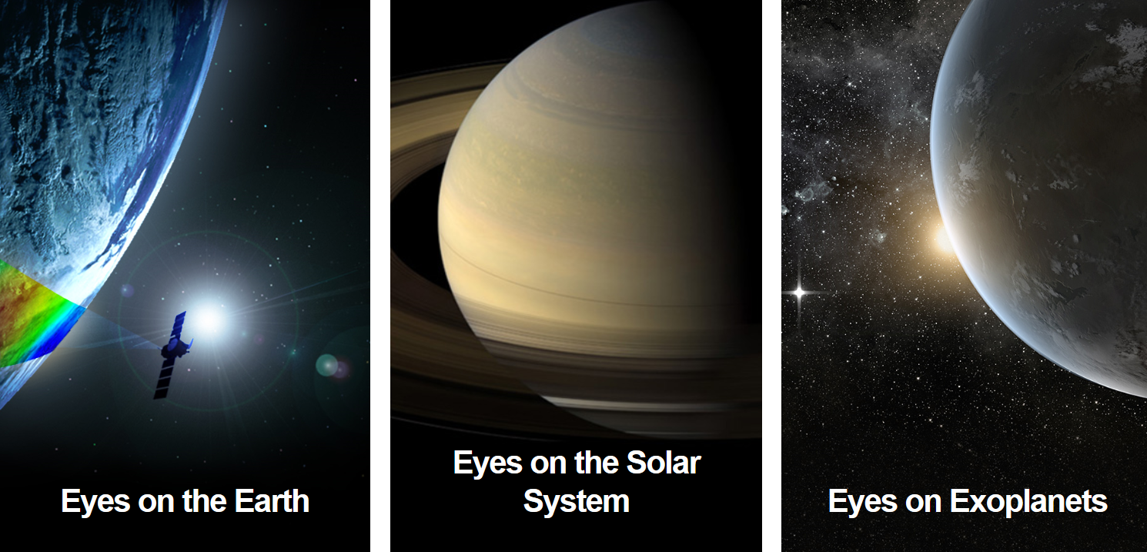
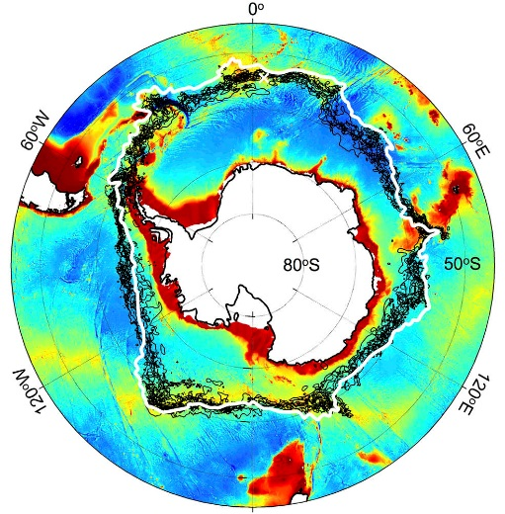
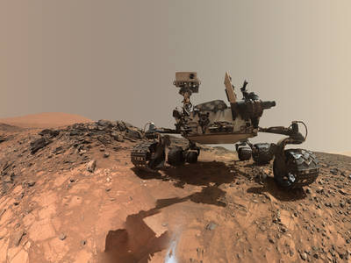
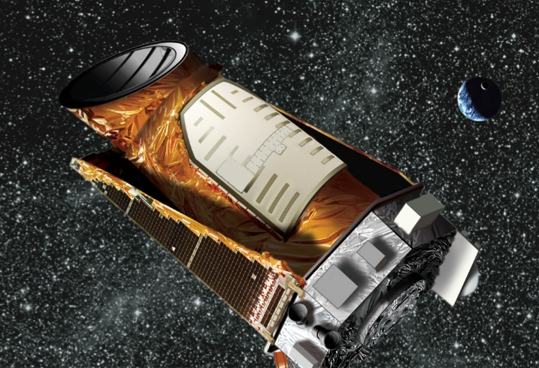
National Aeronautics & Space Administration
Science
Robotic Exploration of Mars
Artic Ozone Hole
Kepler Spacecraft
more than 2,600 planet discoveries from outside our solar

Slide 6
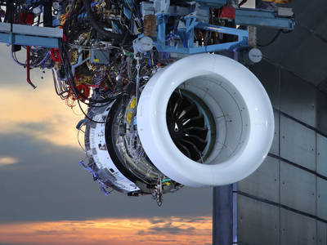
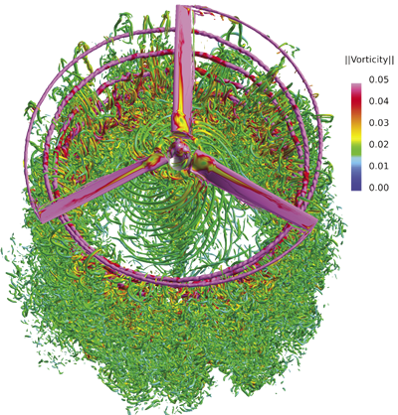

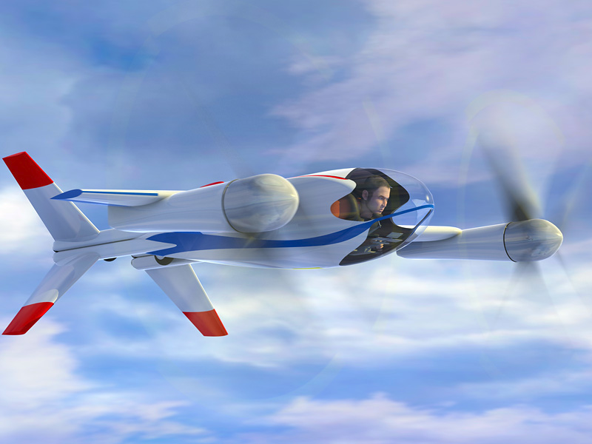
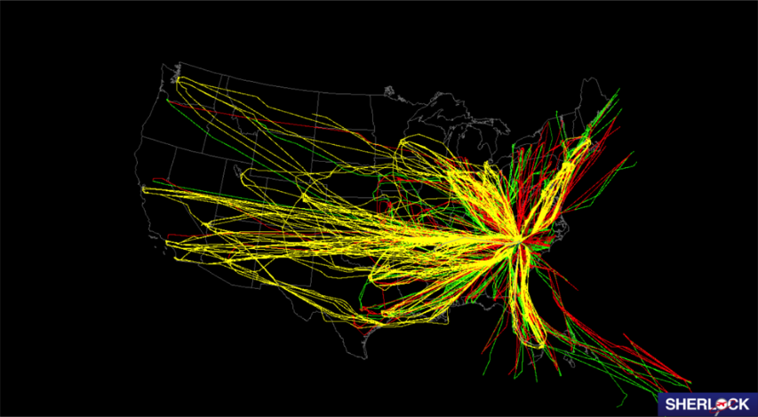
National Aeronautics & Space Administration
Ultra-efficient commercial vehicles
Transition to low-carbon
propulsion
Personal Air Vehicles
Safe, efficient growth in global operations

Slide 7
Nondestructive Evaluation Sciences Branch
NESB
Advanced NDE Solutions
Emerging NDE Technologies
Physics-Based Models
Advanced Data Analysis and Interpretation
SHM Sensor Implementation and Interrogation
Advanced Nondestructive Evaluation (NDE) Solutions
  Development of unique solutions using state-of-the-art NDE technologies such as Eddy Current, Ultrasound, Thermography and X-ray CT
Emerging NDE Technologies
  Development of unique NDE technologies such as Terahertz, wavefield imaging, nonlinear ultrasound, Raman spectroscopy
Physics-Based Modeling
  Development of both computational and analytic models
Advanced Data Analysis and Interpretation
  Development of advanced analytic methods to interpret large complex data sets and machine learning algorithms
SHM Sensor Implementation and Interrogation
  Development of advanced methods of applying and interrogating sensors for structural health monitoring

Slide 8
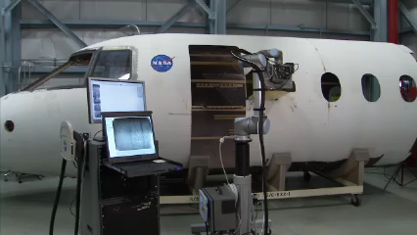
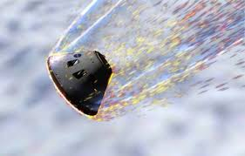
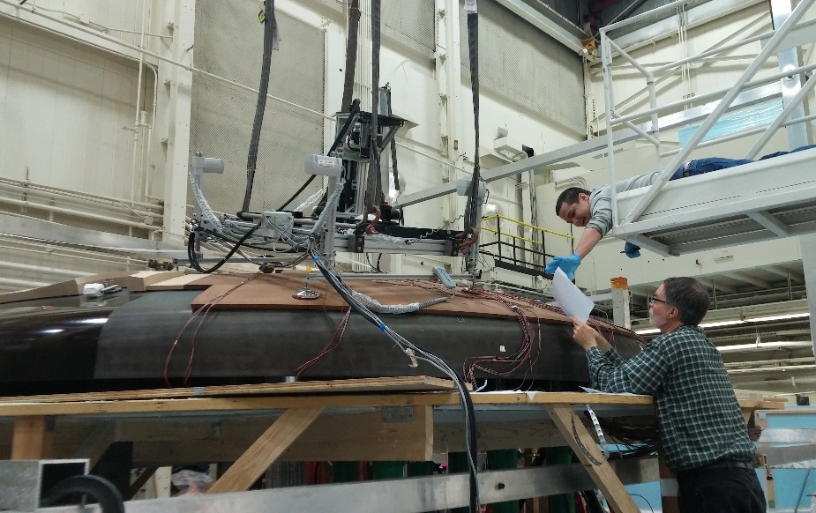
NDE for Aerospace
Inspection goals for aeronautics and spaceflight
  Ensure safety for crewed missions
  Ensure reliability for all missions
Challenges/Needs:
  Rapid, large area inspection
    Advanced materials
    Composites
    Additive manufactured metals
    High temperature materials
  Complex geometry parts
  Unique and high-cost parts
  Large data sets = need for reliable, accurate automated analysis

Slide 9
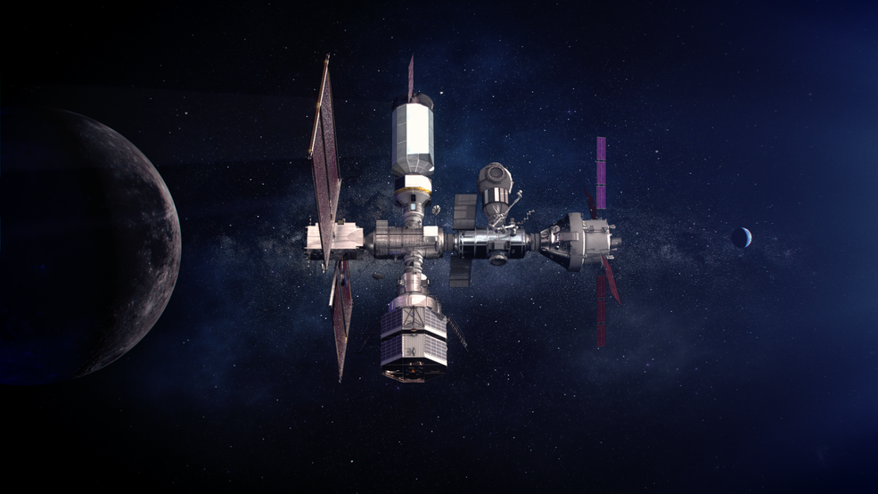
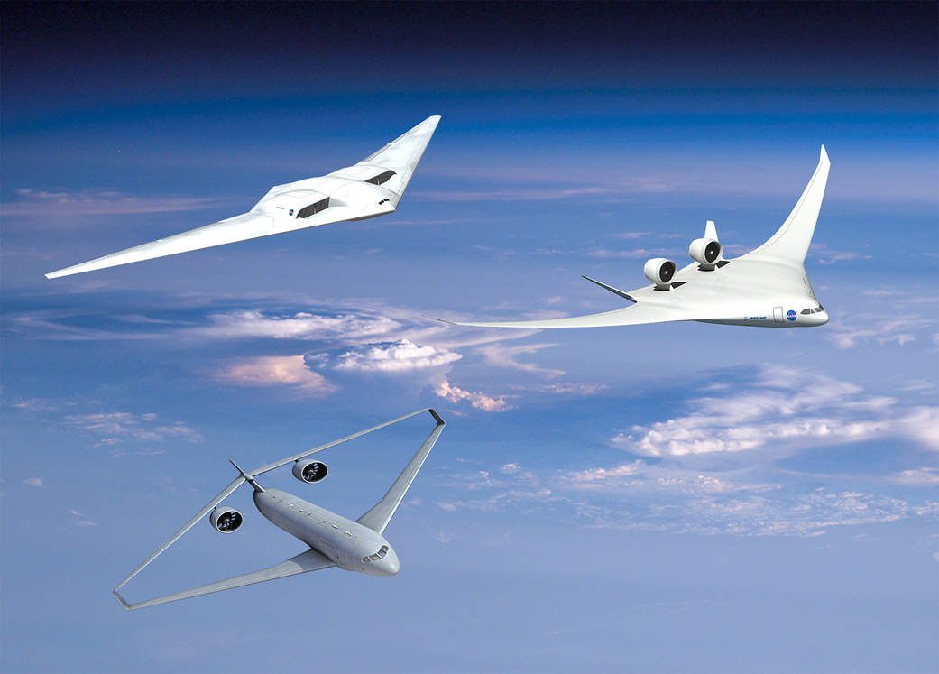
Guided Wave (GW) Applications
Inspection of large areas
Health monitoring (in-situ sensing)
Hot spot monitoring
Monitoring of inaccessible locations

Slide 10
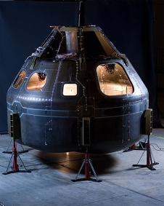
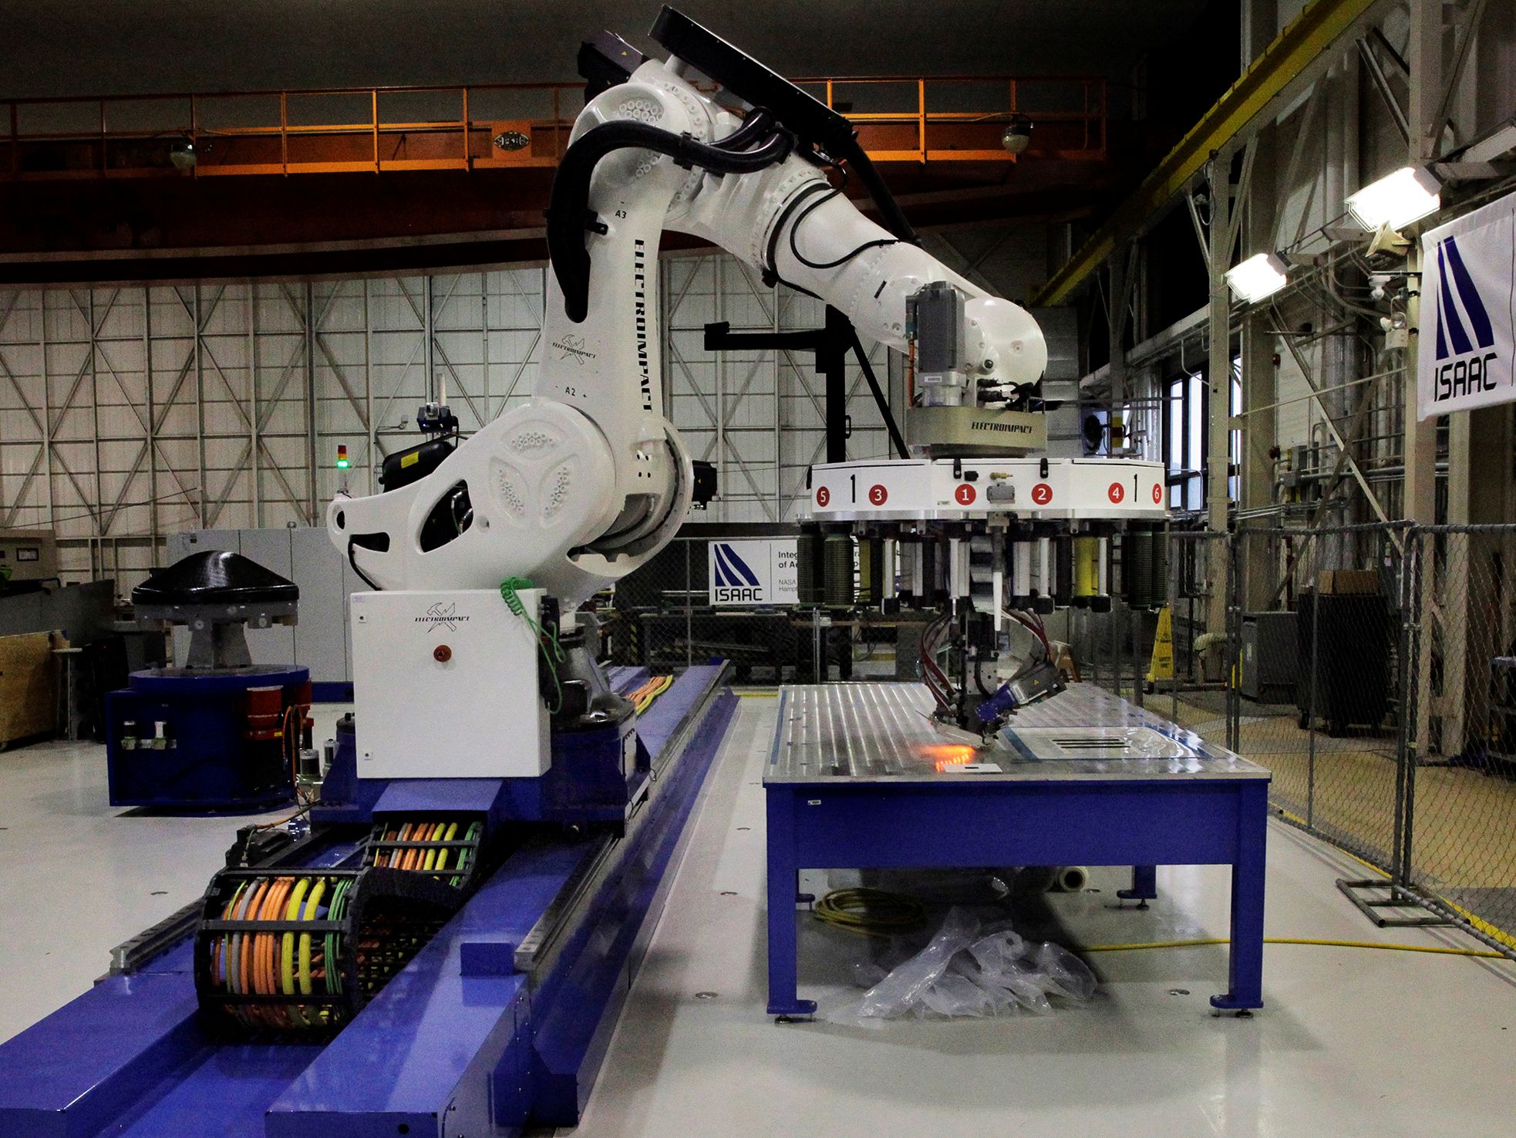
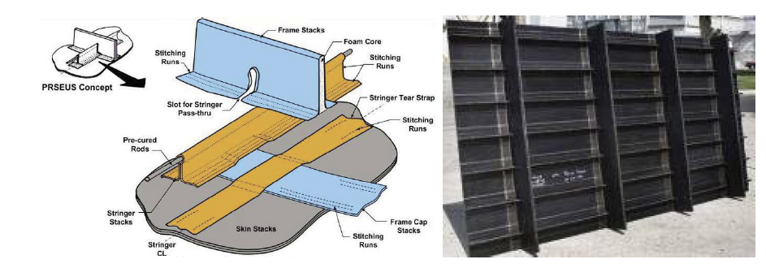
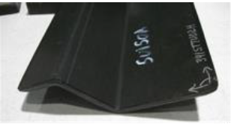
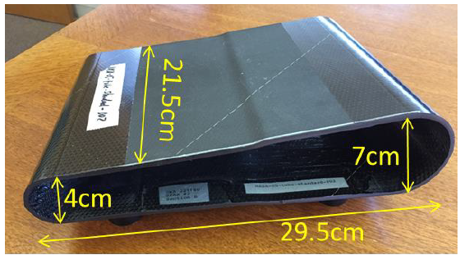
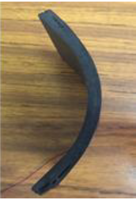
Aerospace Composites
Advanced manufacturing: Automated fiber placement machine
Orion Composite Crew Module
Composite Standards Library: https://nde.larc.nasa.gov/ndestandslib.shtml
Nondestructive Evaluation (NDE) Methods and Capabilities Handbook: https://ntrs.nasa.gov/citations/20200002023
S-curve panel
Rotocraft blade spar
Radius corner

Slide 11
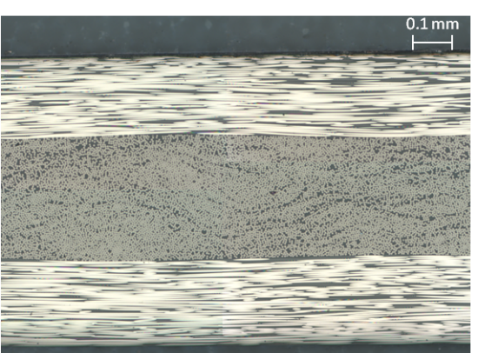
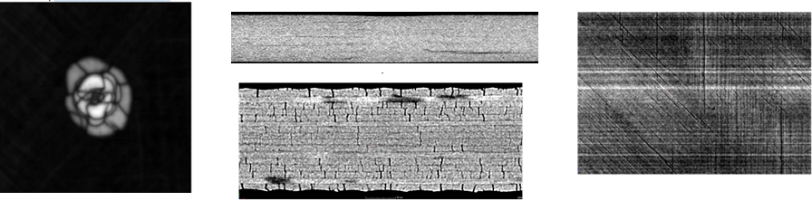
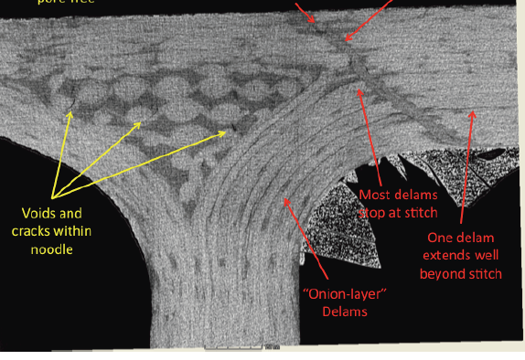
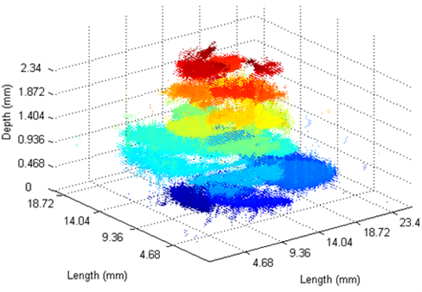
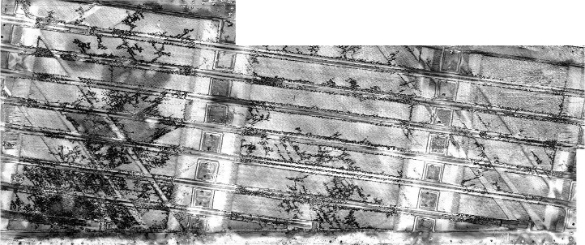
Aerospace Composites
Micrograph showing resin rich regions and fiber misalignment
X-ray CT data of microcrack damage
X-ray data for composite joint
Voids
Delamination
X-ray CT data of delamination damage
UT data of delamination damage
UT data of extensive microcracking

Slide 12
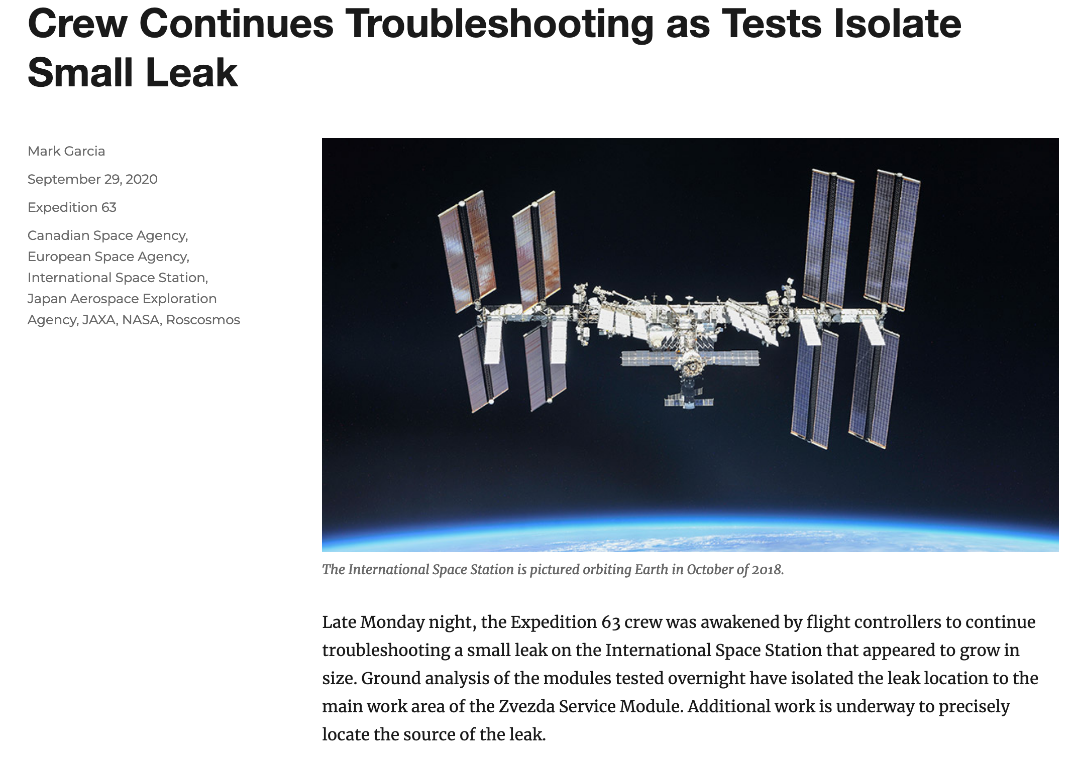
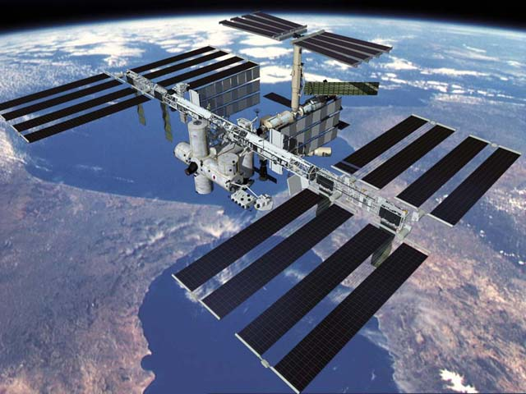
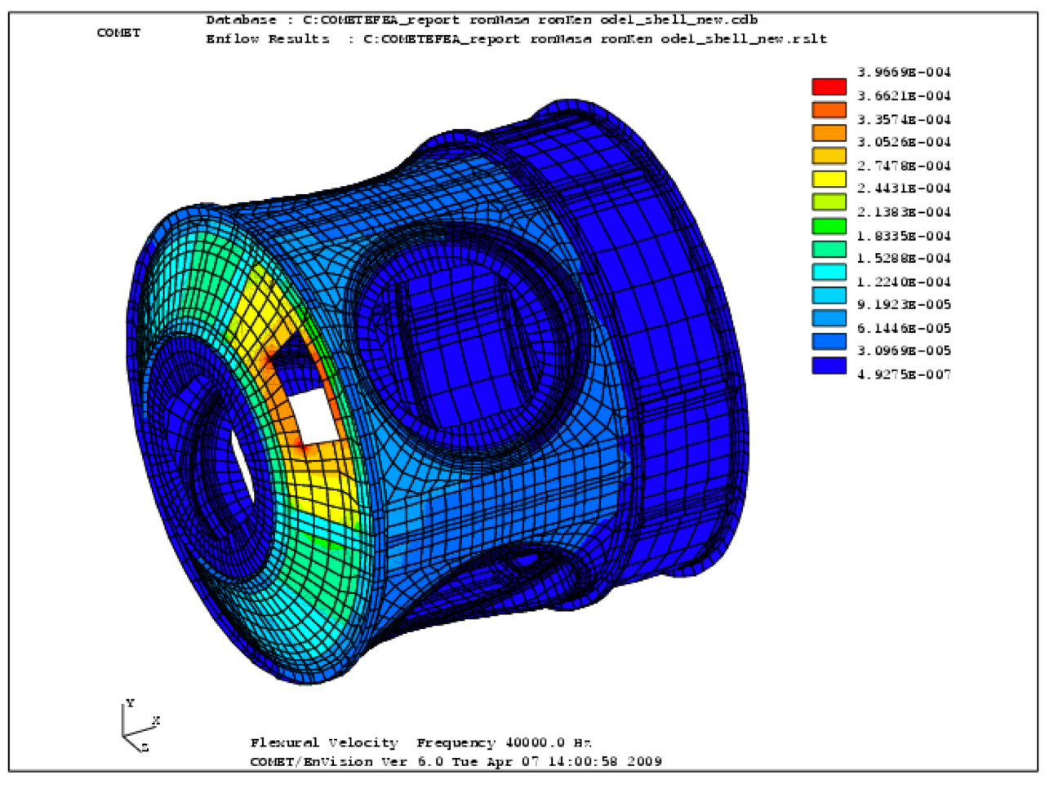
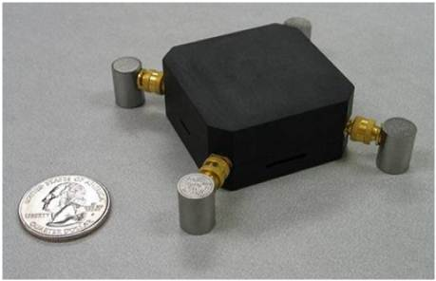
Spaceflight
https://blogs.nasa.gov/spacestation/2020/09/29/crew-continues-troubleshooting-as-tests-isolate-small-leak/

Slide 13
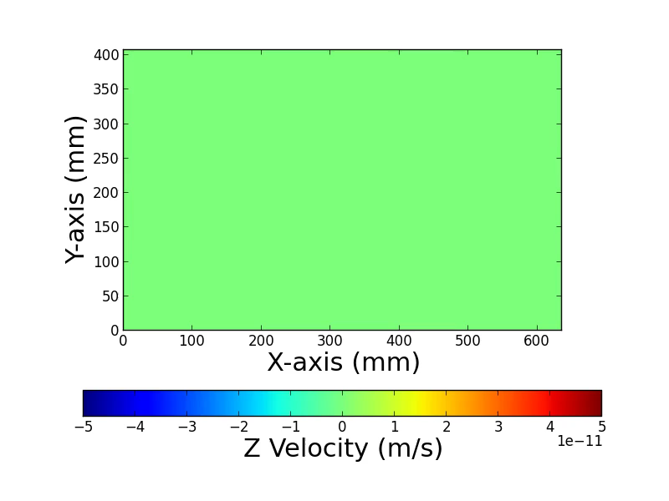
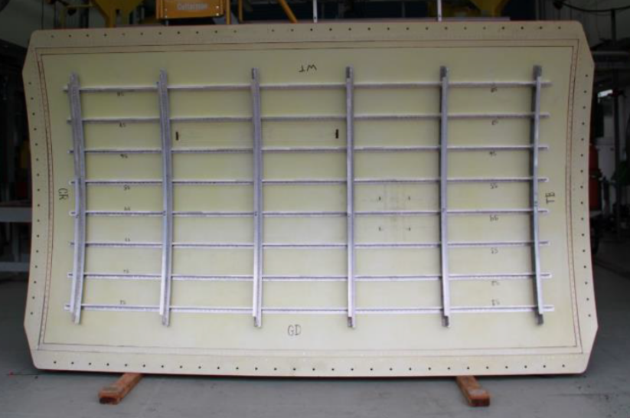
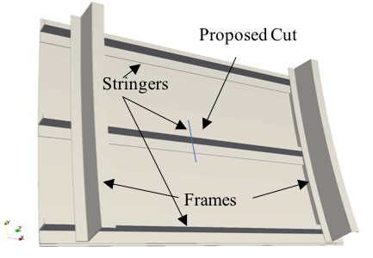
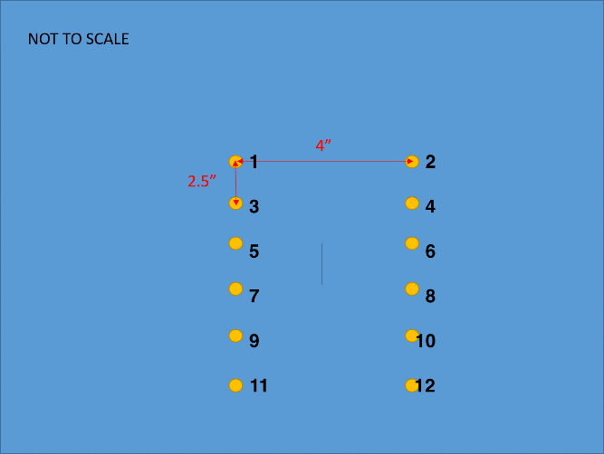
Aeronautics
FAA AL 2024-T3 panel
Gregory, Elizabeth D., William C. Schneck III, Cara AC Leckey, and Paul Swindell. "Simulation assisted guided wave structural health monitoring of aerospace structures." In AIP Conference Proceedings, vol. 2102, no. 1, p. 130006. AIP Publishing LLC, 2019.
ç
Vertical Cut = 0.1 mm wide 60 mm long
73”
Image from FAA
Notes:
Because of the internal air pressure for loading, they have to seal the saw cut and crack with a material that keeps the air from escaping. It looks like they are putting on some type of sticky tape on the stringer which was also severed with the saw cut. The clamps are used to ensure a good seal.

Slide 14
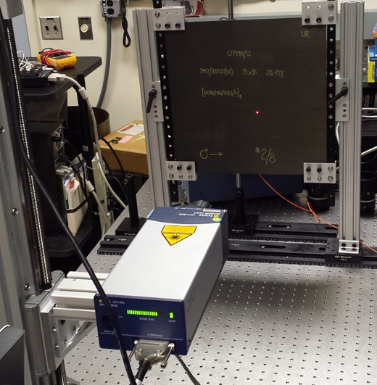
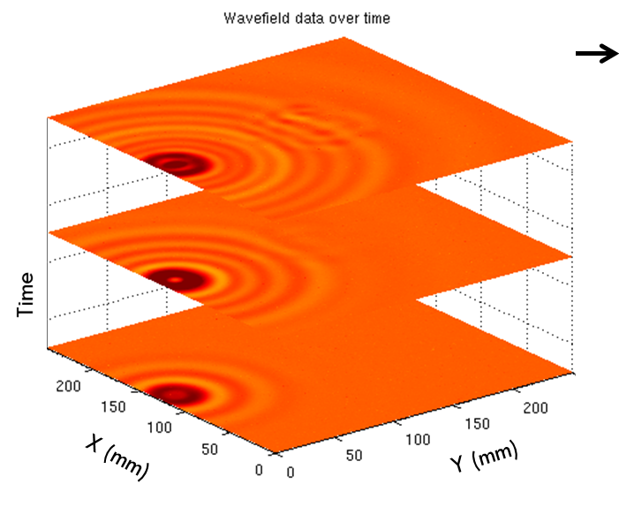
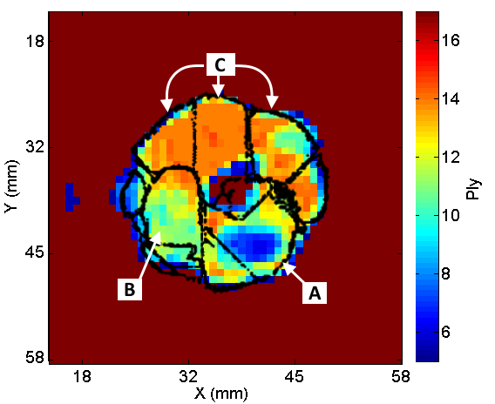
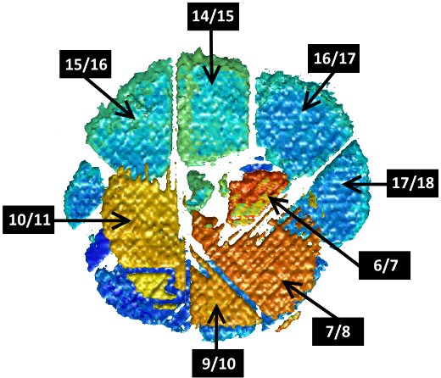
Composites
Laser Doppler
Vibrometry (LDV) Scan
Juarez, P. D., & Leckey, C. A. (2015). Multi-frequency local wavenumber analysis and ply correlation of delamination damage. Ultrasonics, 62, 56-65.
Delamination in Carbon Fiber Reinforced Polymer (CFRP) composite
Wavenumber Analysis Result
Immersion Ultrasound Result
Low velocity impact
Ply
layers
Carbon fiber composite

Slide 15
Modeling and Simulation for GW NDE/SHM
Validated modeling and simulation tools can enable:
  Consideration of NDE during design stage, leading to less conservative designs
  Feasibility to study a large number of scenarios to establish confidence in inspectability
  Cost-effective development of optimal methodologies for advanced materials and structures
  Computational NDE is likely the only cost-effective approach for structural health monitoring system validation
  Requirements for GW simulation tool:
  Ability to run large-sized simulations quickly (i.e., simulate cases representing real-world components in minutes)
  Accurately represent the physics important to the real-world monitoring scenario
  Effectively map the algorithm to leverage appropriate computer hardware (e.g., manycore and High Performance Computing (HPC) communications hardware)
  Ability to scale with the problem size and available compute resources

Slide 16
Commercial and Custom Simulation Tools
Commercial tools require less up-front investment/expertise, are more user-friendly, and may contain broader physics capabilities.
Custom simulation tools can be designed to meet requirements of a focused application and fill the gaps of commercial tools, provided sufficient resource and expertise investment.
In recent years, NASA NDE researchers have developed, applied, assessed several ultrasound simulation codes for GW propagation in composites
  Custom codes:
    EFIT
    Lebedev
    RSG
  Commercial finite element software:
    Comsol
    ANSYS
    ABAQUS
    OnScale
    Pogo
Numerical Instabilities in specific scenarios

Slide 17
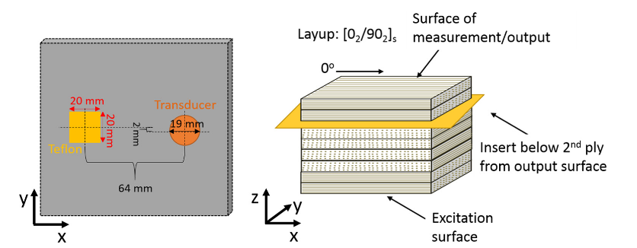
Benchmark Case
IM7/8552 8-ply CFRP laminate containing delamination below 2nd ply
300 kHz excitation, resulting in S0 and A0 modes
3D simulation, each ply layer modeled

Slide 18
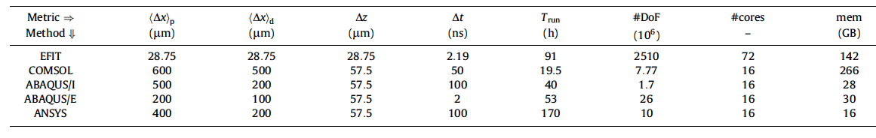
Benchmarking
*FE codes and EFIT saved data to file every ~0.1 μs
Leckey, C.A., Wheeler, K.R., Hafiychuk, V.N., Hafiychuk, H. and Timuçin, D.A., 2018. Simulation of guided-wave ultrasound propagation in composite laminates: Benchmark comparisons of numerical codes and experiment. Ultrasonics, 84, pp.187-200.

Slide 19

Rotated Staggered Grid (RSG)
3D Finite Difference method, previous use in Geophysics
Grid staggered along diagonals with spatial derivatives are evaluated along the four diagonals
Custom code version developed at LaRC
  C++ and MPI,
Tested for triclinic anisotropy with traction free boundaries
  No instabilities observed
Implemented for benchmark case, run on single compute node with 4 Ivy Bridge Intel Xeon E5-4650 v2 CPUs
9 minutes 38 second run time when saving data every 0.116 μs (12,000 output files)
Significantly faster than other commercial codes and prior custom codes tested for this case (all took 19+ hours)

Slide 20



Example RSG Results
RSG kx wavenumber:
3.6 % difference from theory
11.4 % difference from experiment

Slide 21
Pogo
Software developed out of Imperial College London*
Designed to leverage GPU hardware
Software includes:
  variety of linear elements in 2D and 3D
  multiple force or displacement sources
  selectable displacement output
  Ability to model: multiple materials, anisotropy, damping
Base package is structured as a set of command line executables and MATLAB scripts
Implemented for benchmark case, on one Nvdia Tesla V100-PCIE-16GB GPU card (contains 640 GPU cores)
  10 minute run time when saving data every 0.6 μs (100 output files)
  130 minute run time when saving data every 2 ns (30 million output files)
*http://www.pogo.software/

Slide 22



Example Pogo Results
Pogo kx wavenumber:
0.5 % difference from theory
7.0 % difference from experiment

Slide 23

Parametric Analysis
Linking of rapid NDE modeling/simulation tools with parametric analysis tools is required to:
  Thoroughly explore a problem space
  Understand the relationship between input/output parameters
    E.g., effect of sensor size, frequency, distribution; defect size, location, shape
  Perform inspection optimization for a specified problem
Software requirements: parameter sweeps, global/local sensitivity analysis, design of experiment (DOE) with response surface analysis, and optimization (response-surface based and direct optimization)
Sandia National Laboratories’ Dakota package was selected for preliminary study
https://dakota.sandia.gov/

Slide 24

Test Case
Mesh convergence was selected as an initial simple test case for linking a custom RSG code to Dakota
Implemented a mesh size sweep with automated assessment of the resulting wavenumber
For every simulation case, peak wavenumber values were calculated across an angular sweep between 0° and 90° propagation directions
Used a 200 kHz 5-cycle Hanning windowed tone burst excitation such that only A0 mode was generated
Sweep settings: dx=0.25: 0.25: 3.0 mm and dz=2:2:12 cells across the laminate thickness
  Resulting in 70 RSG model runs initiated via Dakota
Sweep took ~5 hours
Finest discretization k_{x} = 215 m⁻¹
Theory* = 222.5 m⁻ ¹
Experiment = 228.6
*Using DISPERSE
Notes:
-3.39% error compared to theory

Slide 25
Parametric Analysis
Parameter inversion for GW propagation in a unidirectional IM7/8552 CFRP composite plate is a simple next step, requiring few changes in the Dakota setup
Variations in part construction and deviation from prescribed mechanical properties can result in inaccuracies when modeling wave behavior using ‘idealized’ properties
Parameter inversion can aid with pulling simulation in-line with as-manufactured specimen parameters

Slide 26
Summary
Numerous commercial tools are available for modeling GW propagation in aerospace materials
Custom code approaches have also been implemented/assessed
The custom RSG code showed the fastest simulation speed for the benchmark case
Future work will include full material property parameter inversion based on CFRP GW propagation metrics
Further work is needed to explore the use of tools such as Dakota for pushing forward capabilities in GW modeling for NDE and SHM in aerospace applications

Slide 27
Questions?

