Slide 1
Artemis III Science Definition Team Report Briefing
LSSW: Structuring Real-Time Science Support of Artemis Crewed Operations
Renee Weber, MSFC, Committee co-chair
Feb. 24, 2021

Slide 2
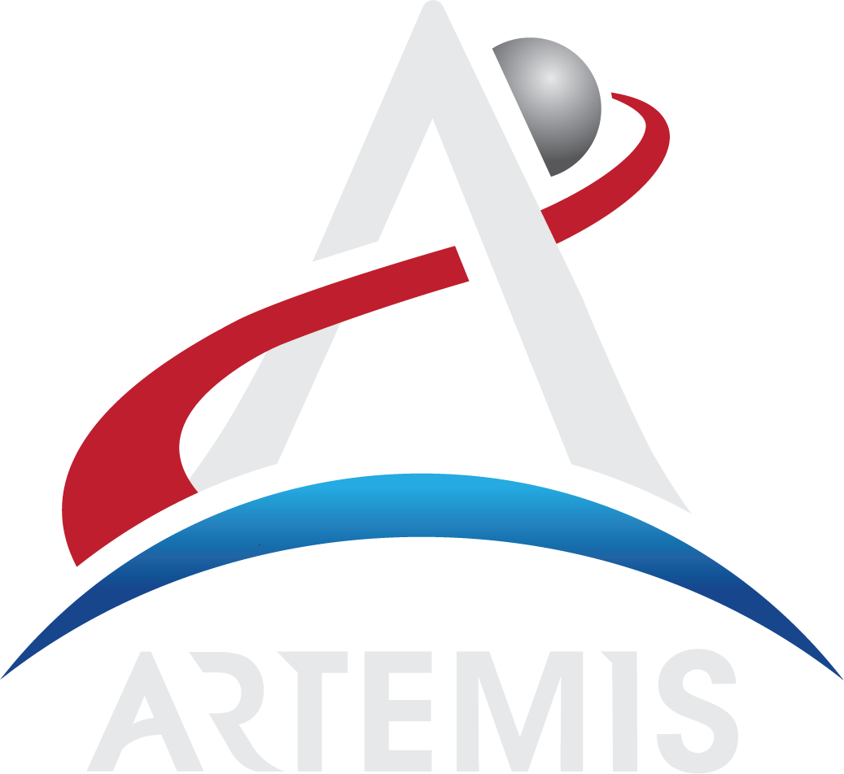
THE MOON ENABLES SCIENTIFIC EXPLORATION
A CORNERSTONE
For Solar System science and exoplanet studies
A TRAINING GROUND
To learn how to conduct scientific exploration from a planetary surface, working synergistically with crew and robotic explorers
A NATURAL LABORATORY
To study planetary processes and evolution
AN OPPORTUNITY
To use infrastructure and resources associated with human exploration to leverage support for autonomous scientific investigations

Slide 3
Charge to the Committee
The Artemis III SDT was charted by Thomas Zurbuchen for NASA SMD. The Committee was charged to:
Define compelling and executable science objectives for the Artemis III mission, the first human mission to the surface of the Moon in the 21st century.
Assess objectives for the mission to achieve the science goals articulated by NASA including investigation approaches, key surface science activities, and potential inputs into the concept of operations.
Submit a final report to the Planetary Science Division that contains prioritized science objectives for all aspects of the Artemis III mission, including sampling strategies and science goals and priorities of deployable instrument packages.
Schedule
White Papers due September 8
First meeting September 10
Town Hall #1 September 14 (LEAG meeting)
Draft report released October 14
Town Hall #2 October 22
Public comments deadline October 26
Final report submitted November 13 & released publicly on Dec. 7th

Slide 4
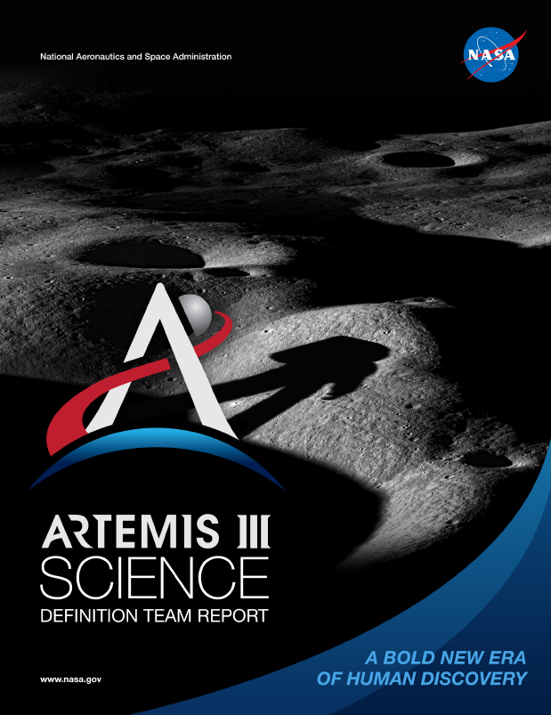
Artemis III Science Definition Team Report
(available at www.nasa.gov/reports)
Table of Contents
Executive Summary
Introduction
Overview of Guiding Community Documents
Artemis Program and Architecture Summary
Artemis Science Objectives and Traceability to Science Priorities
  Objective 1: Understanding Planetary Processes
  Objective 2: Understanding the Character and Origin of Lunar Volatiles
  Objective 3: Interpreting the Impact History of the Earth-Moon system
  Objective 4: Revealing the Record of the Ancient Sun and Our Astronomical Environment
  Objective 5: Observing the Universe and the Local Space Environment from a Unique Location
  Objective 6: Conducting Experimental Science in the Lunar Environment
  Objective 7: Investigating and Mitigating Exploration Risks
Artemis III Candidate Science Program
Enabling Capabilities
Cartographic Recommendations
Considerations for Landing Site Selection
References
Appendix 1: Terms of Reference
Appendix 2: Summary of Community Involvement
Appendix 3: Biographies of Members
Appendix 4: List of White Papers Submitted to the Panel

Slide 5

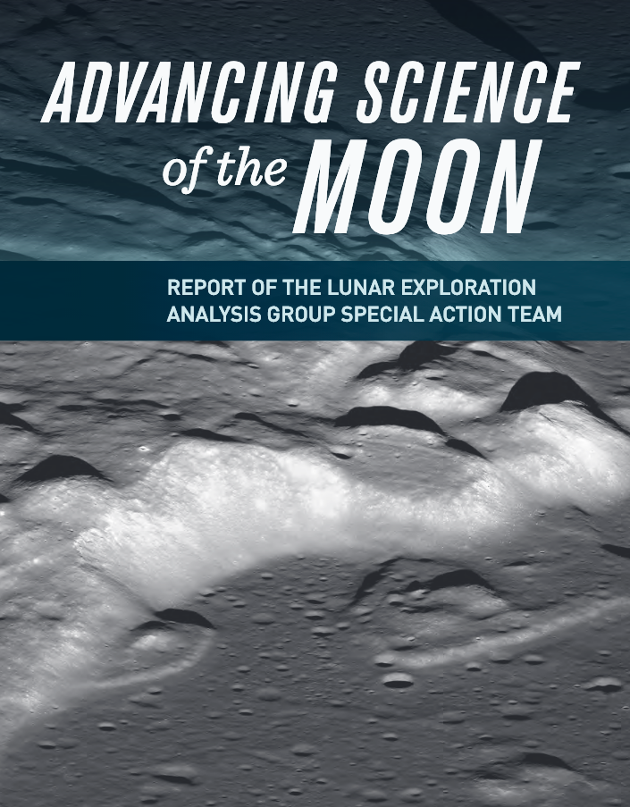
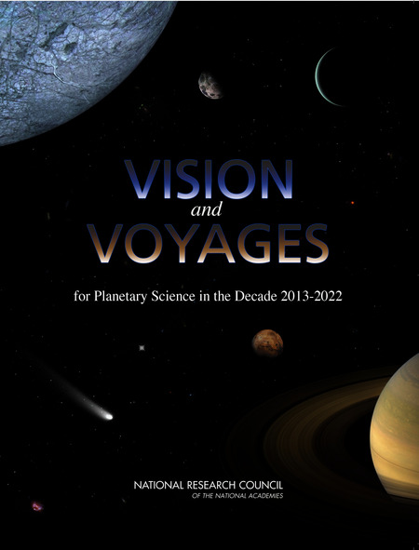
Guiding Community Documents
2016
2007
2018
2012
… as well as community-submitted white papers and draft report comments

Slide 6
Artemis Science Objectives and Traceability to Science Priorities
NASA HQ’s Artemis Plan laid out seven Science Objectives:
Objective 1: Understanding Planetary Processes
Objective 2: Understanding the Character and Origin of Lunar Volatiles
Objective 3: Interpreting the Impact History of the Earth-Moon system
Objective 4: Revealing the Record of the Ancient Sun and Our Astronomical Environment
Objective 5: Observing the Universe and the Local Space Environment from a Unique Location
Objective 6: Conducting Experimental Science in the Lunar Environment
Objective 7: Investigating and Mitigating Exploration Risks
The SDT was charged with expanding upon science these Objectives. We chose to map science Goals (areas of research) down to Investigations (specific activities undertaken to address Goals).

Slide 7
Candidate Program
We constructed a candidate program that captures the highest-priority science for Artemis III and provides the greatest feed-forward to follow-on missions and the build-up to the Artemis Base Camp
Our cohesive program contains a mix of activities encompassing
  Field geology and sample return
    Contingency sample (bulk)
    Small clast (rake)
    Large clast (hand)
    Sealed core (drill)
    Sealed surface (bulk)
    Regolith surface (CSSD)
A more detailed mission operations plan based off this program will need to be developed by NASA when HLS system capabilities, a landing site, and other architectural details come into sharper focus
  In situ measurements and long-lived experiments
    Volatile monitoring
    Environmental monitoring
    Deployed geophysics
    Geochemistry/mineralogy
    Geotechnical properties
    Traverse geophysics

Slide 8
SDT Report Recommendations
The SDT report contains 15 major findings and accompanying recommendations to NASA for actions to address each finding, encompassing:
Crew training
Coordinated sampling strategies
Enabling capabilities (e.g., needed technology development)
Artemis program architecture
Science implementation strategy
Cartographic considerations
Landing site selection criteria

Slide 9
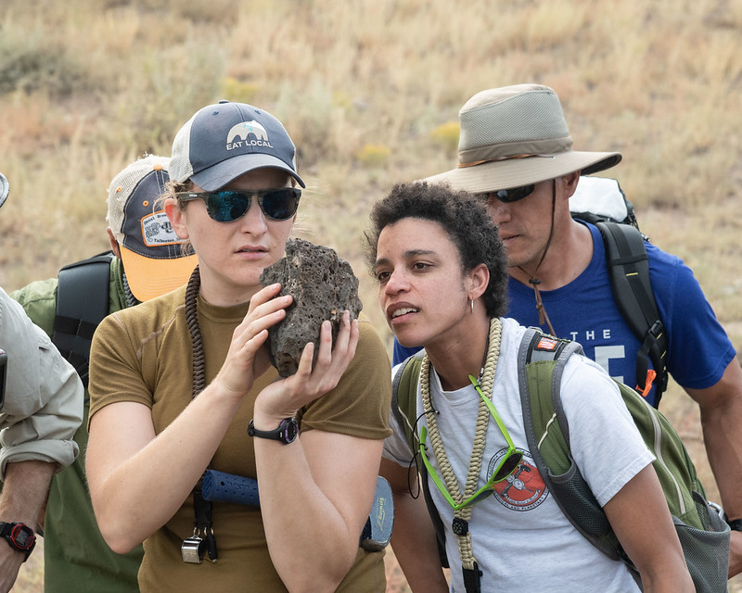
Recommendations: Crew Training
Astronauts should participate in an Apollo-style course in geology and planetary science, including both field and classroom components, in order to provide optimal in situ geologic characterization of lunar sample collection sites. A dedicated team of scientists should serve in an Earth-based Artemis III Science Mission Center with real-time two-way audio and one-way video between the crew and the Science Mission Center.
Astronauts should be trained and equipped to collect a variety of surface and sub-surface samples. NASA should plan to return total sample masses in excess of previous lunar sample return missions.

Slide 10
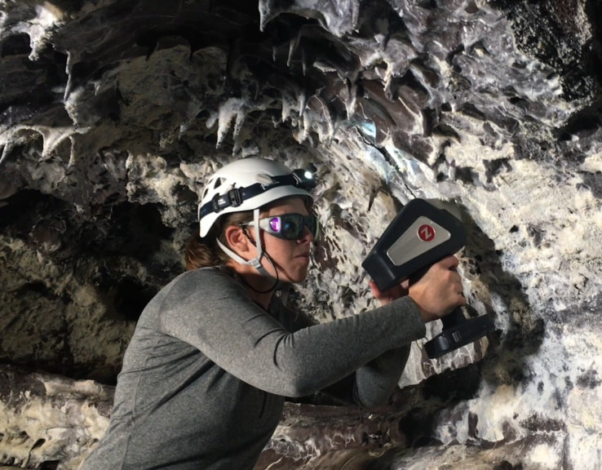
Recommendations: Coordinated sampling strategies
NASA should ensure that sample collection and in situ measurements are carefully choreographed to maximize science return. Examples of such coordination include the characterization of rock samples with in situ instrumentation to aid in prioritization of samples selected for Earth return, and in situ volatile measurements made in conjunction with sample collection to characterize volatile losses from sample collection, transport, and/or curation, and efforts to provide “ground truth” for orbital remote sensing datasets.
NASA should ensure that in situ imaging and assessment capability is available to crews during extra-vehicular activity (EVA) to document site characteristics, sampling, and instrument deployment.

Slide 11
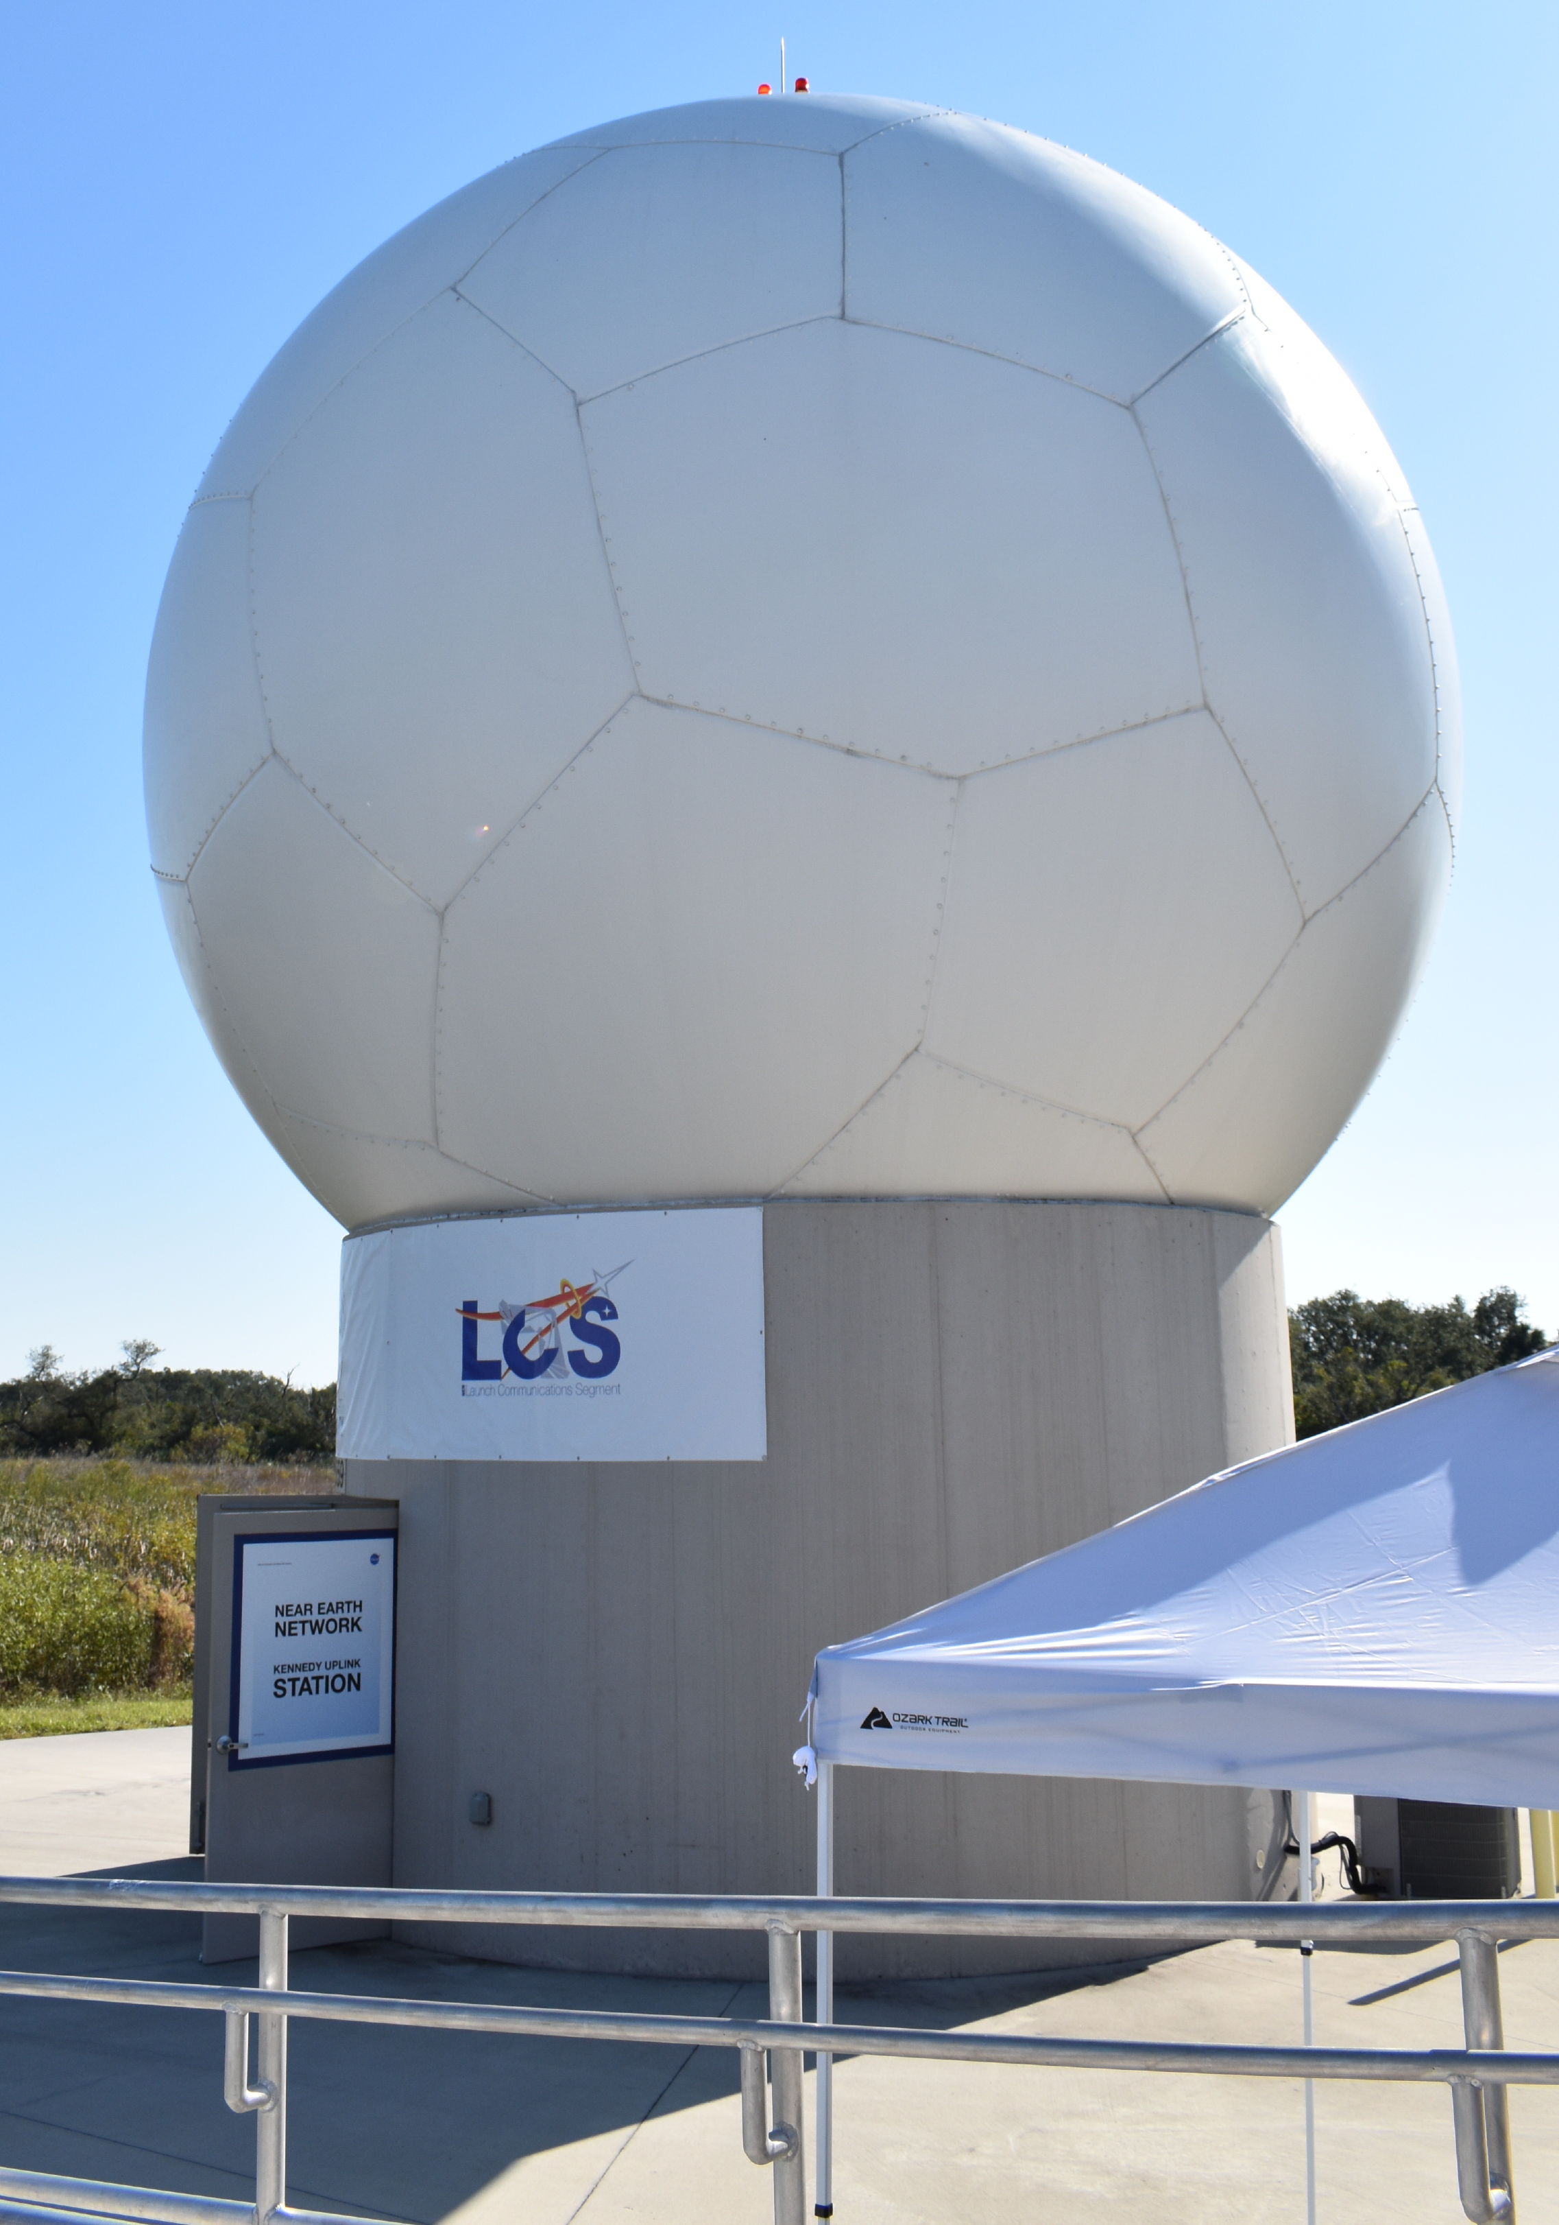
Recommendations: Enabling capabilities
We recommend NASA provides a mission capability of real-time transmission of data from in situ science instrumentation that provides documentation for site characteristics and enables a science support team (backroom, operations center, etc.) to support EVA operations with (near) real-time feedback to the crew when necessary on science decision-making, as well as provide processed data when necessary (i.e. helping convert raw data into tactical decision-making).
This requires prior establishment of high bandwidth communication that is capable of extensive real-time data transmission to accommodate use of valuable measurements from modern sensors.

Slide 12
Artemis III SDT Membership
Co-chairs
Renee Weber, NASA MSFC
Barbara Cohen, NASA GSFC
Sam Lawrence, NASA JSC
Community consultants
Amy Fagan, LEAG Chair
Carlé Pieters, SSERVI Chief Scientist
Juliane Gross, CAPTEM Lunar Sample Subcommittee Chair
Executive Secretary
Amanda Nahm, SMD PSD
Civil Servant Members
Jeremy Boyce, NASA JSC
Michael Collier, NASA GSFC
Caleb Fassett, NASA MSFC
Lisa Gaddis, USGS Astrogeology (now at LPI)
John Gruener, NASA JSC
Jennifer Heldmann, NASA ARC
Noah Petro, NASA GSFC
Kelsey Young, NASA GSFC
Ex officio observers: Sarah Noble (PSD), Debra Needham (ESSIO), James Spann (HPD), Kevin Sato (BPS), Jake Bleacher (HEOMD), Julie Mitchell/Francis McCubbin (JSC curation), David Draper (OCS)

Slide 13
BACKUP (additional report recommendations)

Slide 14
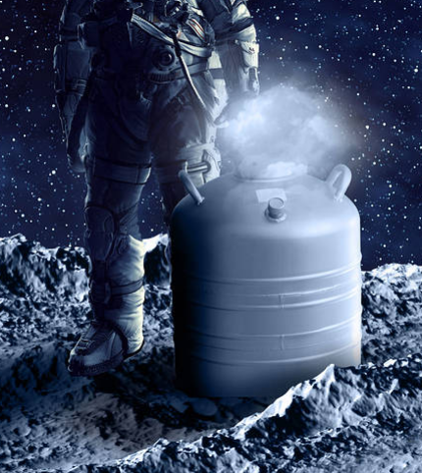
Recommendations: Enabling capabilities
NASA should develop lightweight, double-sealed vacuum containers to return volatile bearing lunar samples to Earth.
NASA should develop and implement hardware and operations to return a subset of samples at cryogenic temperatures (low enough to preserve water ice and other volatiles of interest) in the solid state throughout the journey from the lunar surface to Earth-based laboratories. Cryogenic sample return will increase the scientific fidelity of sample analyses of volatiles and ices.
Minimizing the mass penalty for both vacuum-sealed and cryogenic sample return results in increased scientific yield of the mission because more mass can be allocated to the lunar samples instead of the sampling hardware.

Slide 15
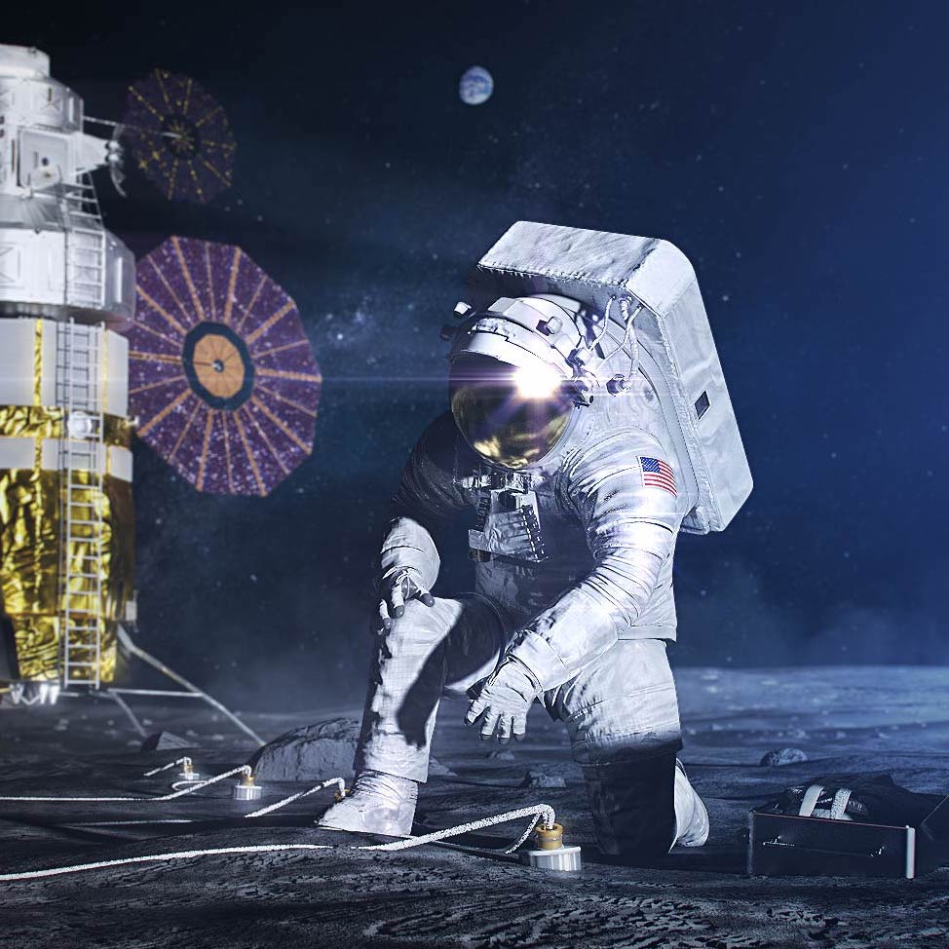
Report recommendations: Enabling capabilities
The Artemis III mission is an opportunity lost if the first of a series of geophysical and environmental network nodes is not deployed. The Artemis III node can be augmented by both robotic and human future missions, thus building towards a global network.
While incremental science can be obtained with short-lived experiments, NASA should pursue solutions for long-lived power and communications to enable networked operation of ALSEP-like packages at multiple landing sites, as needed, to enable meaningful progress on many Artemis III science goals and feeding forward to future Artemis missions.
Geodetic monitoring via Earth-based laser ranging requires no lunar surface power or communication to function and hence will provide science return even in the absence of such capabilities. We advocate for geodetic monitoring capability to be prioritized for Artemis III.

Slide 16
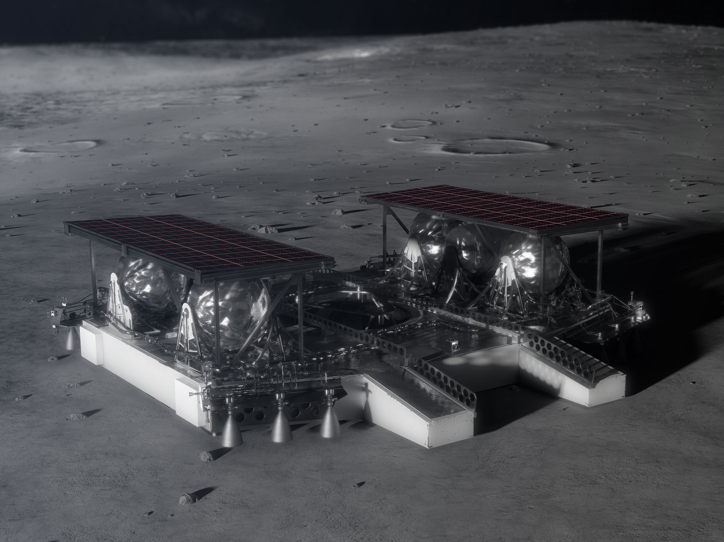
Recommendations: Artemis program architecture
NASA should solicit the development of instruments that are capable of addressing more than one measurement need and/or science Investigation.
NASA should consider pre-positioning science assets in the vicinity of the Artemis III landing site. This could consist of an inert cache of tools/instruments to be accessed by crew upon arrival, and/or one or more instrumented landers or rovers for environmental monitoring.
NASA should include a rover or other mobility solution for crew use on the lunar surface starting as early in the Artemis program as possible, ideally for Artemis III.

Slide 17
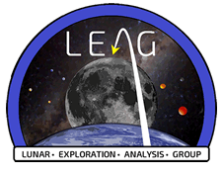
Report recommendations: Science implementation strategies
A standing working group comprising scientific leadership of the Artemis program in SMD should be established and closely coordinate with representatives of STMD and HEOMD to ensure clear lines of communication and facilitate program implementation.
NASA’s existing Program Analysis Groups, such as LEAG and CAPTEM, serve an important role synthesizing community input across diverse stakeholders in the engineering, science, and commercial communities, and should be leveraged as the Artemis program continues to promote external community engagement to the fullest practical extent.
CAPTEM
Curation and Analysis Planning Team for Extra-terrestrial Materials

Slide 18
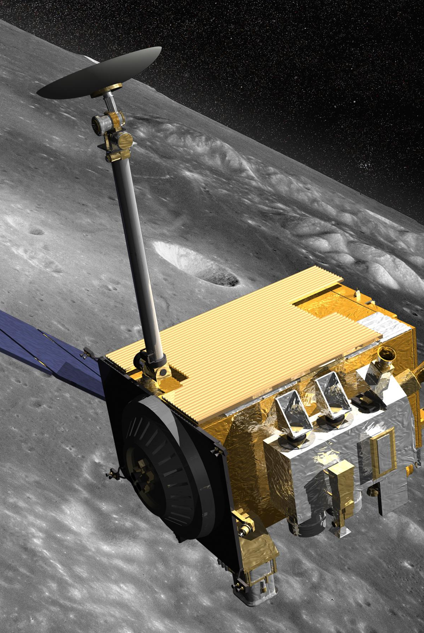
Report recommendations: Cartographic considerations
Any needed updates to the standard lunar geodetic coordinate reference frame (e.g., currently used by LRO) should be identified in 2021, and foundational products should be mapped onto it and/or developed to use it directly. Establishing a standardized coordinate reference frames can significantly improve data reliability and reduce the risk of errors.
Standards for cartographic and time controls for surface measurements (photographs, video, and surface measurements) should be defined in the near term so that those standards can be implemented in instrument development. This should also include high-fidelity time coding for all surface measurements time-synced with Earth in UTC.
We recommend maintaining sufficient funding to the Planetary Data System (PDS) to maintain the online tools needed to search, access, and use lunar data.

Slide 19
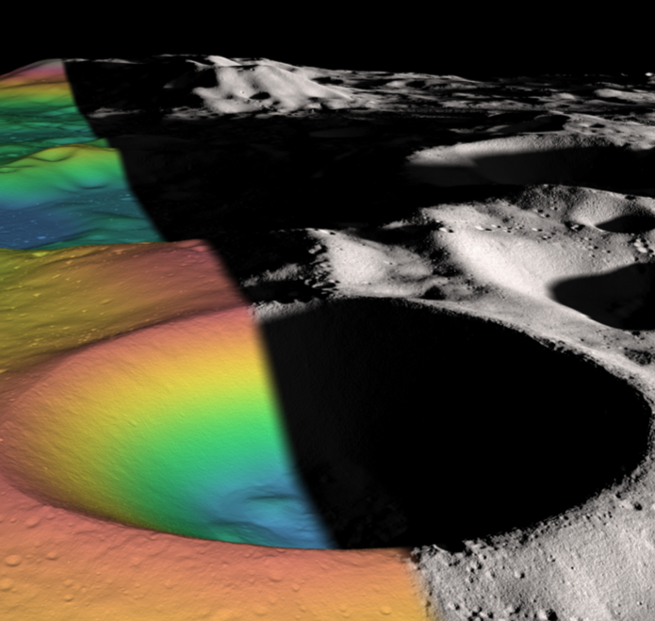
Report recommendations: Cartographic considerations
To support the level of accuracy and precision needed for landing and surface operations, new cartographic products, including mosaics and topographic models, for the south pole should be developed using the highest quality data available and using the standard (possibly updated) lunar geodetic coordinate reference frame.
New derivation of higher-order data products from existing missions should also be supported where needed for Artemis III. For example, it is vital that more detailed geologic mapping of candidate landing sites be accomplished at a scale similar to what was done in preparation for Apollo.

Slide 20
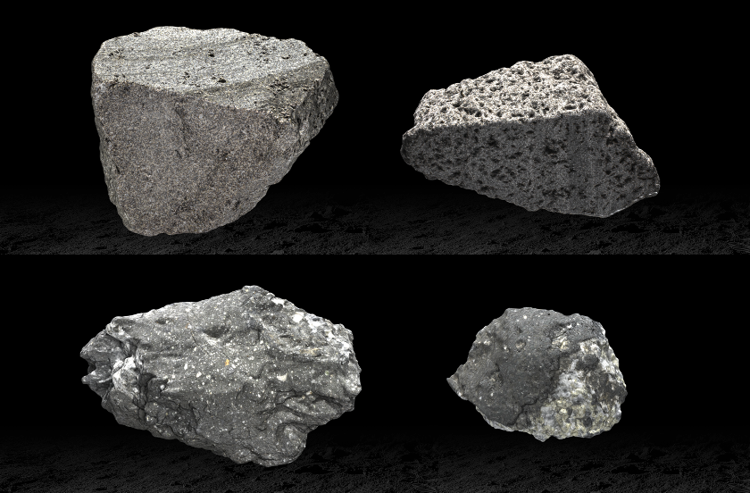
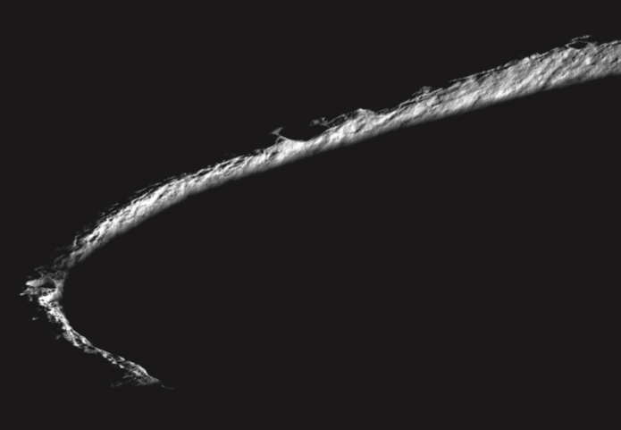
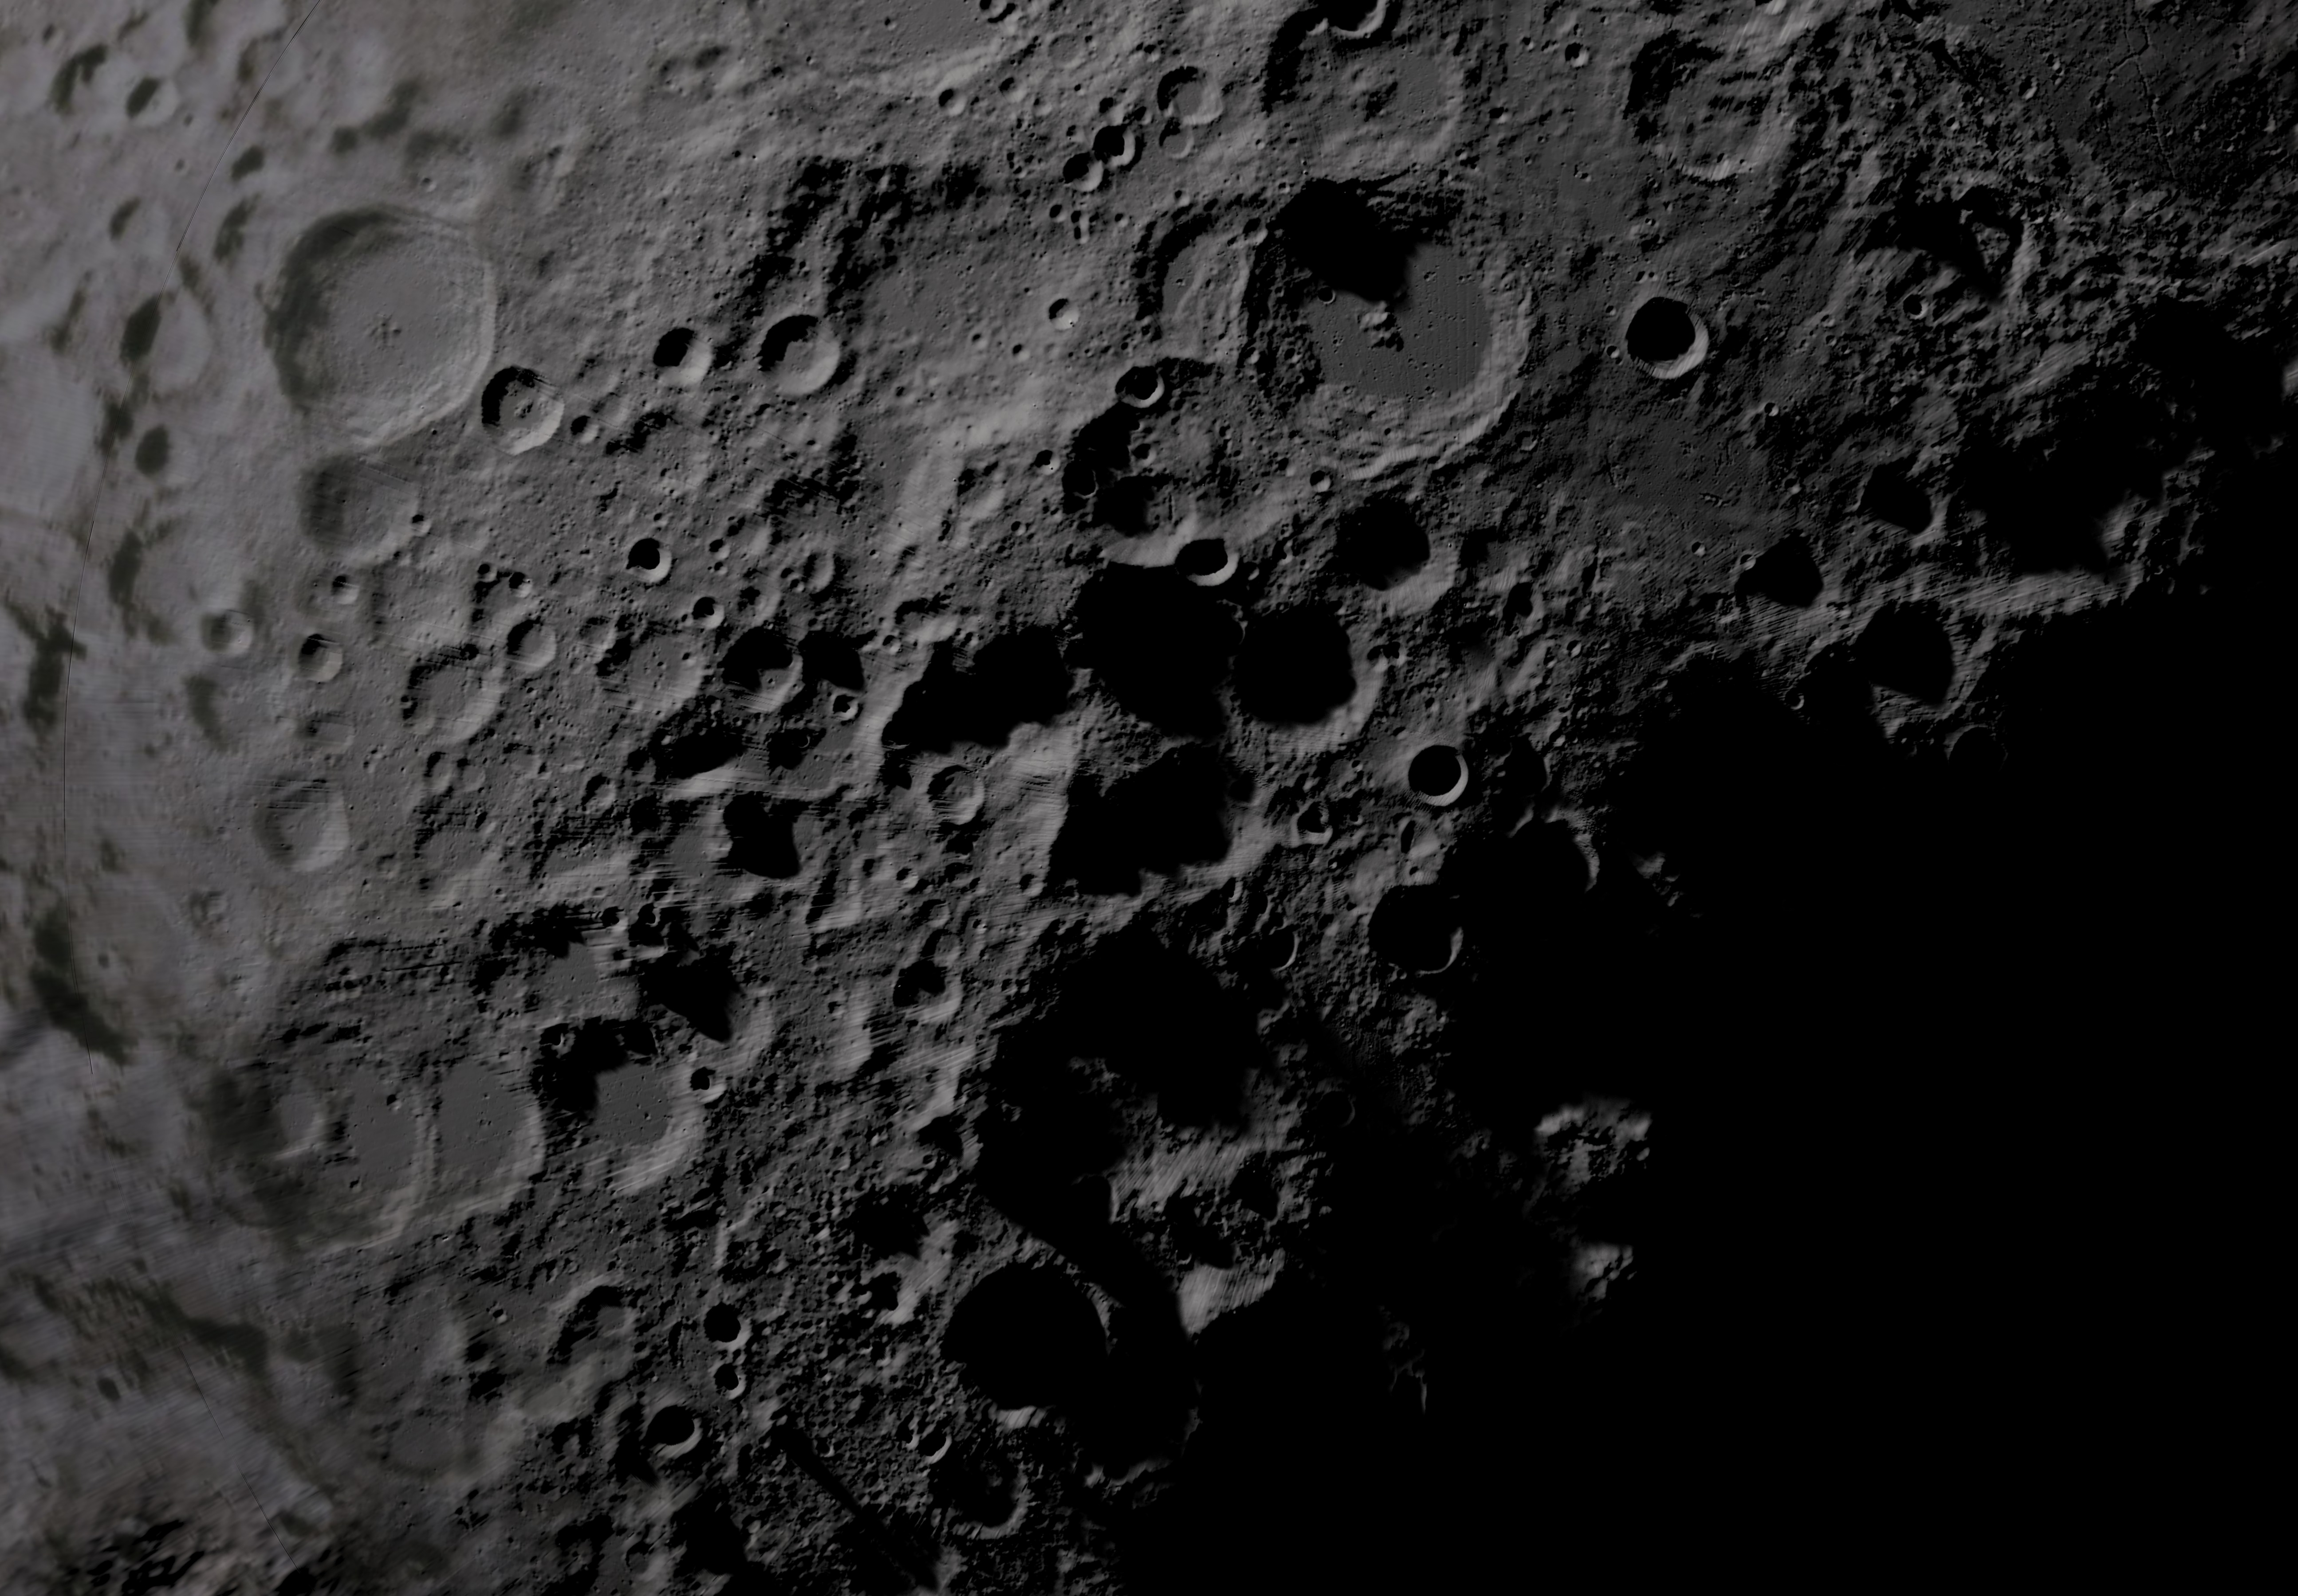
Report recommendations: Landing site considerations
The scientific return of the Artemis III mission will be intrinsically linked to the Artemis III landing site.
The SDT suggested the following factors be considered in the Artemis III site selection process in order to fully inform the ultimate selection of the Artemis III landing site, in addition to other physiographic parameters such as block abundance, crater frequency, and slope:
Sufficient illumination for long-duration solar power stations to enable long-lived surface experiments (if solar power is used);
Availability of a range of sizes of craters for radial traverses and sampling, which will inform our understanding of the impact process;
Comprehensive sampling which will inform our understanding of the complex geology of the landing site and its link to both surface and internal processes;

Slide 21
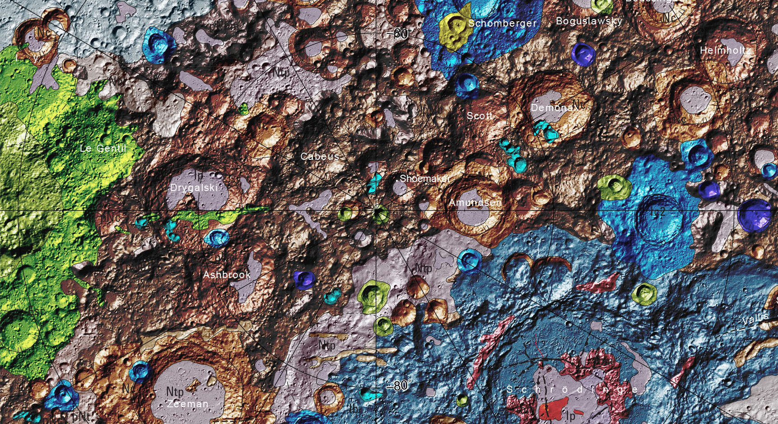
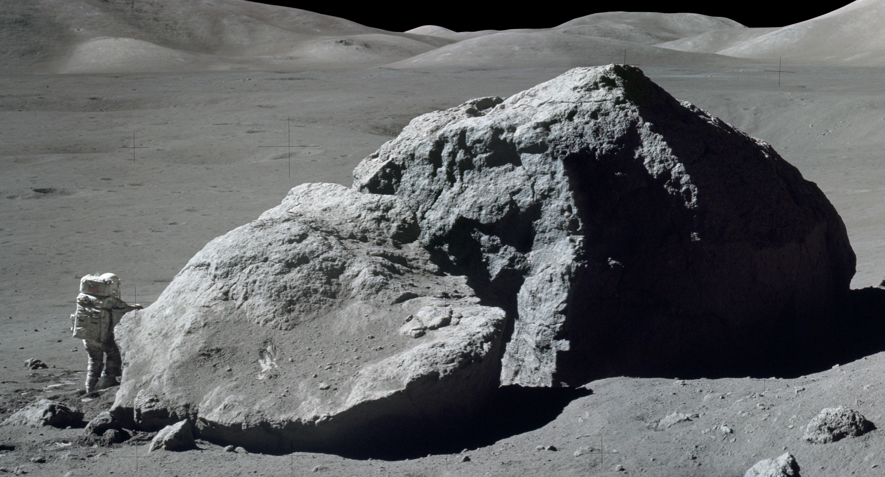
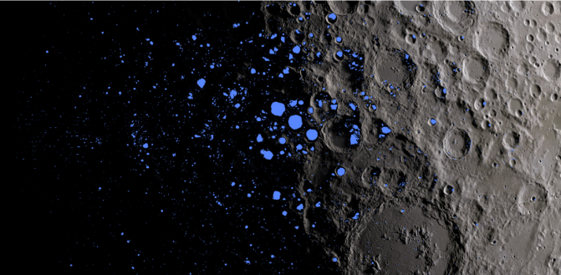
Report recommendations: Landing site considerations
The scientific return of the Artemis III mission will be intrinsically linked to the Artemis III landing site.
The SDT suggested the following factors be considered in the Artemis III site selection process in order to fully inform the ultimate selection of the Artemis III landing site, in addition to other physiographic parameters such as block abundance, crater frequency, and slope:
Accessibility of larger blocks to enable sampling of large crater ejecta;
Proximity and accessibility of mostly or permanently shadowed regions to understand volatile processes;
Proximity to multiple geologic units of differing time-stratigraphic age;
Proximity to geologic units that enable specific, high-priority investigations (SPA and PSRs)

Slide 22
Report recommendations: Landing site considerations
The scientific return of the Artemis III mission will be intrinsically linked to the Artemis III landing site.
The SDT suggested the following factors be considered in the Artemis III site selection process in order to fully inform the ultimate selection of the Artemis III landing site, in addition to other physiographic parameters such as block abundance, crater frequency, and slope:
Sufficient illumination for long-duration solar power stations to enable long-lived surface experiments (if solar power is used);
Availability of a range of sizes of craters for radial traverses and sampling, which will inform our understanding of the impact process;
Comprehensive sampling which will inform our understanding of the complex geology of the landing site and its link to both surface and internal processes;
Accessibility of larger blocks to enable sampling of large crater ejecta;
Proximity and accessibility of mostly or permanently shadowed regions to understand volatile processes;
Proximity to multiple geologic units of differing time-stratigraphic age;
Proximity to geologic units that enable specific, high-priority investigations (SPA and PSRs)

