Slide 1
Destination Space 2021
Mars 2020 Thermal Protection Systems (TPS)
Robin Beck, M2020 TPS Cognizant Engineer
NASA Ames Research Center
Feb 10, 2021

Slide 2
Outline
Mars 2020 quick overview
Mars 2020 Entry, Descent and Landing
Mars 2020 TPS
A little about me ☺

Slide 3
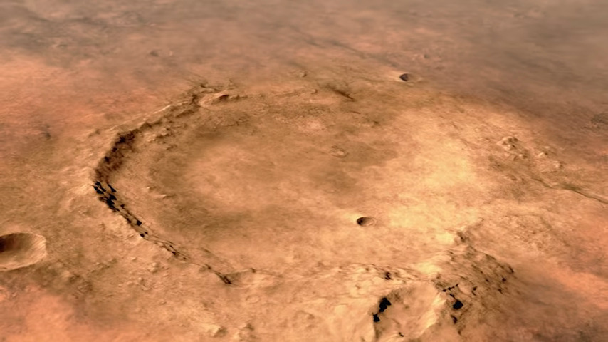
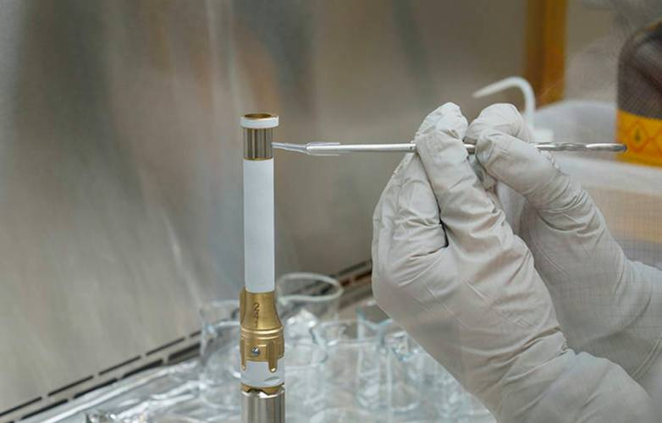
Mars 2020 Mission
The Mars 2020 Mission (launched on July 30, 2020) is the first leg of a series of missions that will eventually return samples from Mars
The Mars 2020 spacecraft will deliver the Perseverance Rover along with a small experimental helicopter named Ingenuity to the Jezero Crater (landing Feb 18, 2021)
For size perspective, Perseverance is roughly the same size as a Mini Cooper, with the wheel base of a Hummer!
Perseverance has 4 science objectives that support the Mars Exploration Program science goals at the Jezero Crater
Looking for Habitability: Identify past environments capable of supporting microbial life
Seeking Biosignatures: Seek signs of possible past microbial live in those habitable environments, particularly in special rocks known to preserve signs of life over time
Caching Samples: Collect core rock and “soil” samples and store them for future retrieval
Preparing for Humans: Test oxygen production from the Martian CO2 atmosphere
Jezero Crater
Caching Tube

Slide 4
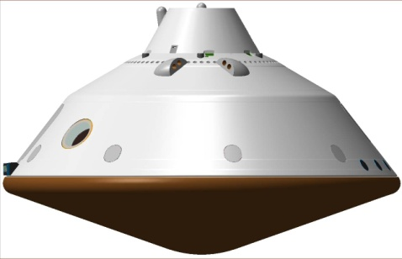
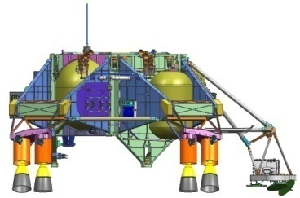
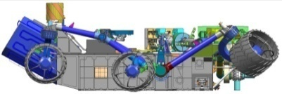
Mars 2020 Cruise Configuration
The Cruise Stage provides power and maneuvering while in space
The Entry Vehicle flies into the atmosphere at Mars
The Aeroshell carries the landed payload within it
The Aeroshell parts include the Heatshield, the Backshell, the Parachute Cone (and it’s lid)
When the Aeroshell flies through Mars’ atmosphere, the surfaces are all heated and need to protect the payload, so they have thermal protection materials on the outside of the structure to keep the inside cool
Cruise Stage
Parachute Cone
Backshell
Aeroshell
Descent
Stage
Rover & Helicopter
Heatshield
Entry Vehicle

Slide 5
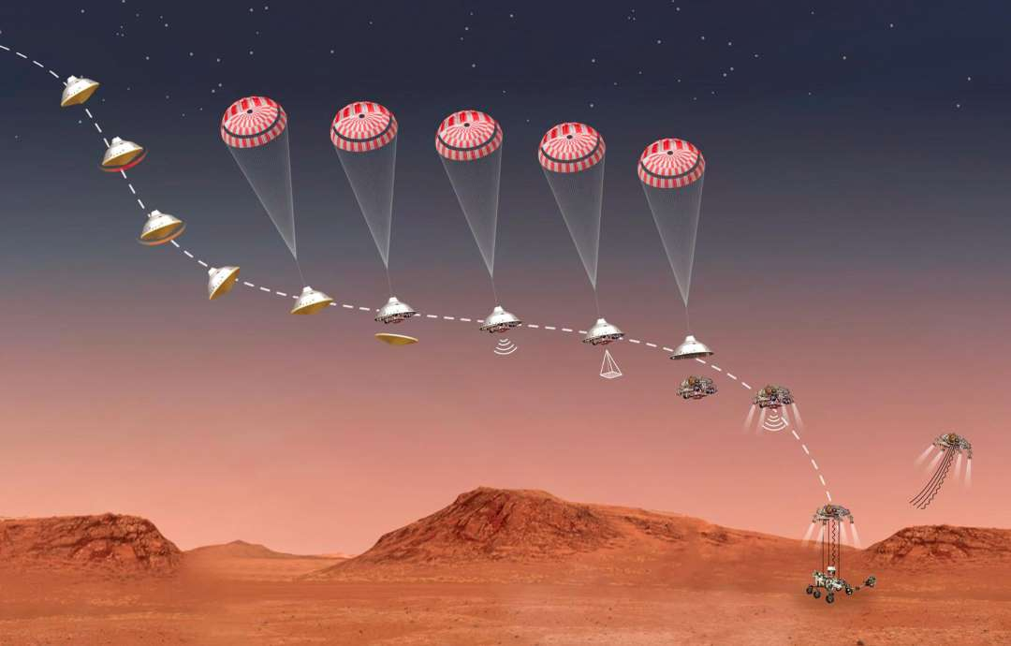
Mars 2020 Entry, Descent and Landing
In Space
Cruise Stage Separation
Peak Heating

Slide 6
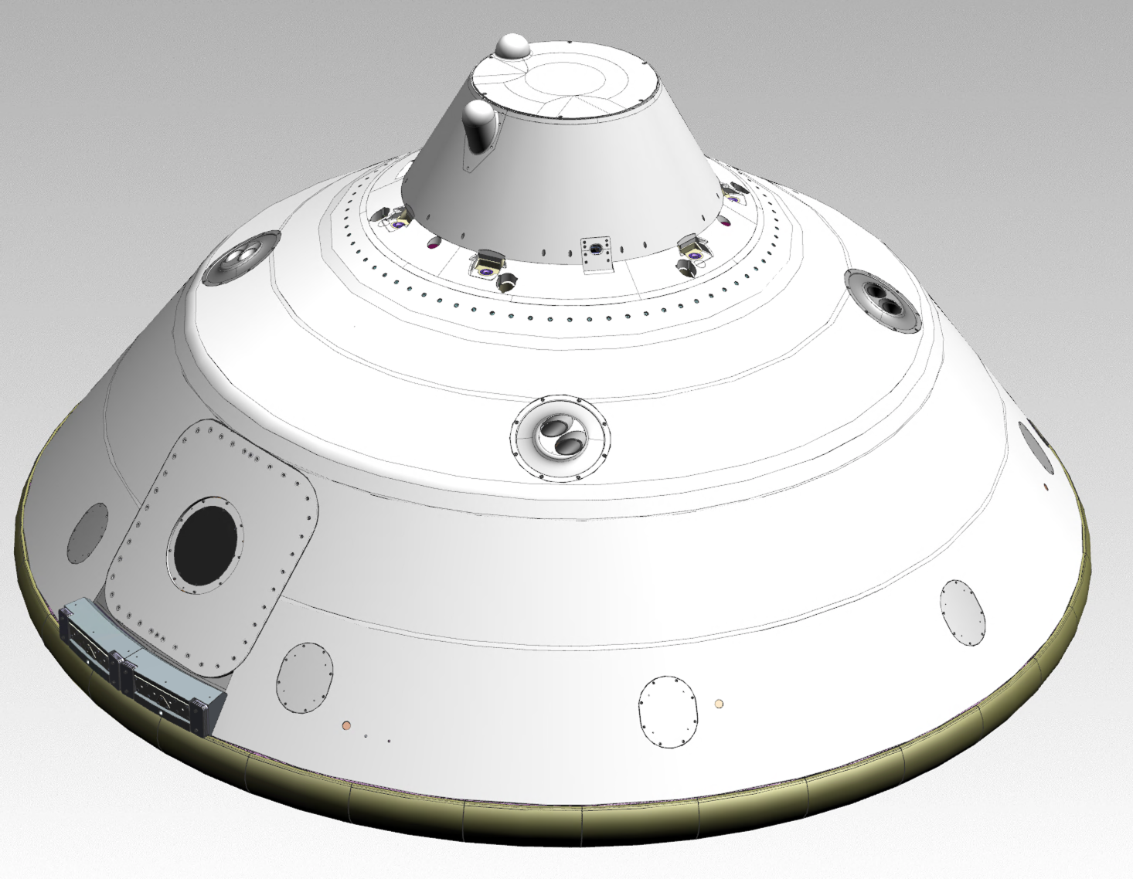
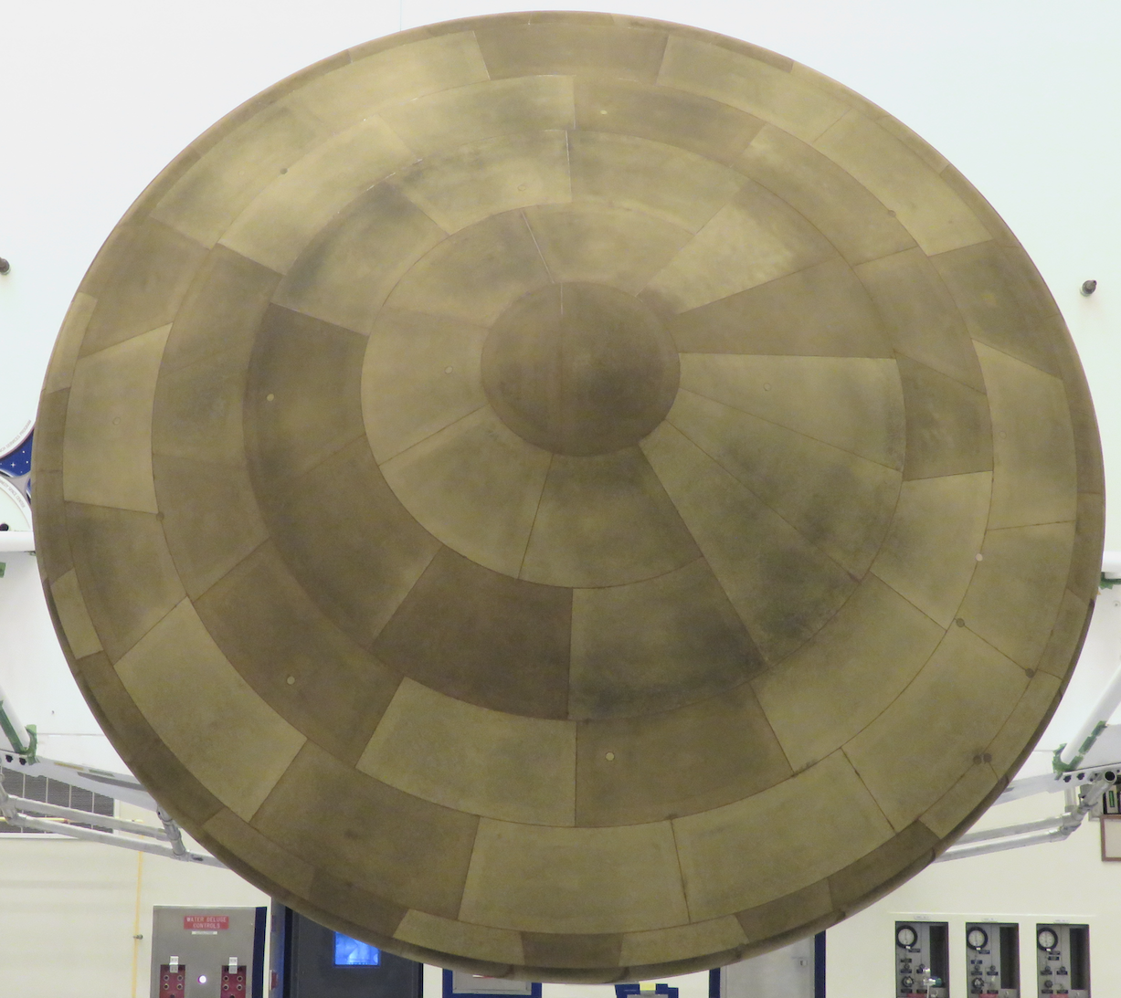
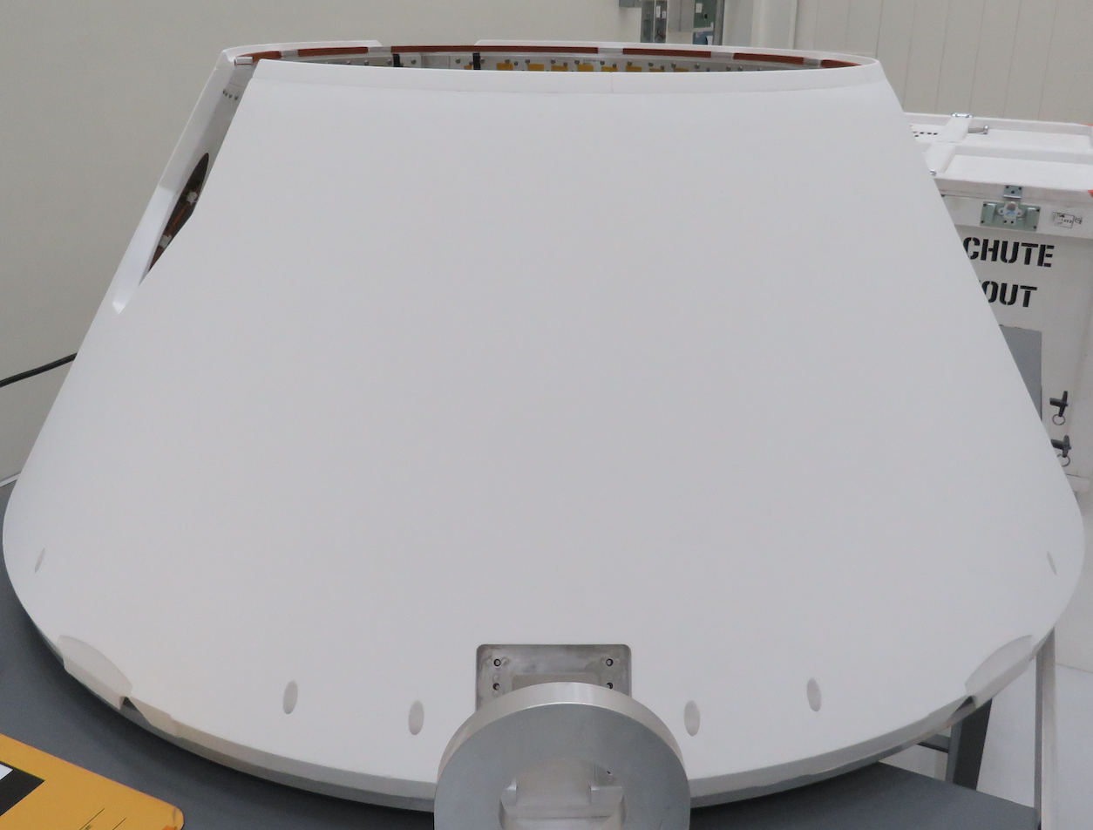
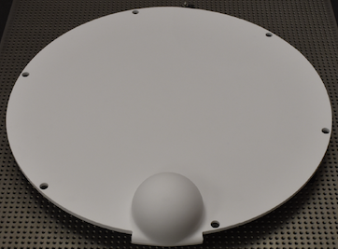
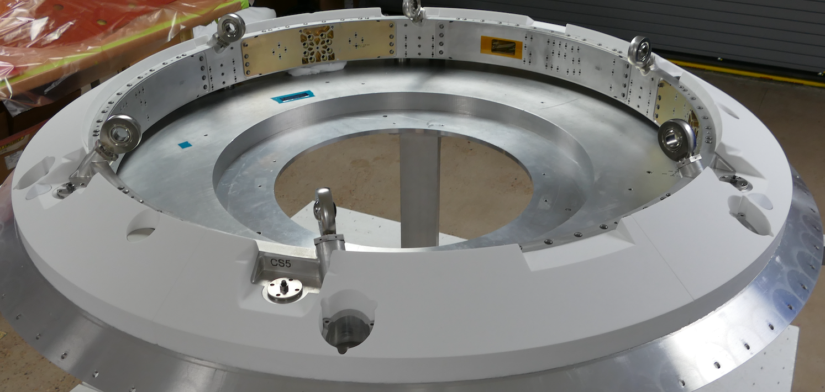
Mars 2020 Aeroshell TPS Overview
Heatshield: Phenolic Impregnated Carbon Ablator (PICA) tiles with gap filler, coated with NuSil
Backshell: Painted Super Lightweight Ablator (SLA-561V)
Acusil-II on Parachute Closeout Cone (PCC), PCC lid, and Backshell Interface Plate (BIP)
PCC/BIP TPS Acusil-II
Backshell TPS SLA-561V
Heatshield TPS PICA
Main Seal
Heatshield
Backshell
PCC
PCC Lid
BIP
Image Source: JPL

Slide 7
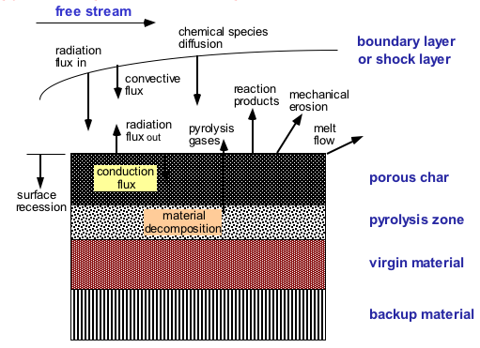
How Does the TPS Work?
Hot gases in the boundary layer convectively heat the surface
Radiant flux from the shock layer heat the surface
Heat is either re-radiated out or conducted into the surface
The polymer in the composite begins to decompose (often absorbing energy during decomposition) and pyrolysis gases are formed, and a char layer begins to form
The thermal front moves through the material, causing more decomposition
hot
cool
Temperature gradient
The pyrolysis gases, formed deeper in the composite are at a lower temperature than the near surface char, so as they flow through the char, they actually cool it
The charred surface reacts with the boundary layer (oxidation, sublimation, etc) and material may be removed, causing recession
As the pyrolysis gases and gases formed at the surface blow into the boundary layer, they thicken it and reduce the convective heating

Slide 8
About the Mars 2020 TPS
All three materials (PICA, SLA-561V, and Acusil II) are very light weight
Imagine:
Take a large paper cup and fill it with water and weigh it
Empty the cup
Now fill it with any of the 3 TPS materials and weight it
If you ignore the weight of the paper cup itself, the weight of the TPS materials is only about ¼ of the weight of the water that filled that cup!
Water boils away at 212 ⁰F, but these TPS materials can withstand much surface temperatures (> 3000 ⁰F) and keep the structure <350 ⁰F. The thickest TPS on the vehicle is only ~1.25”

Slide 9
Who am I?
Robin Beck
Born and raised in San Jose, Ca (like many of you) a long, long, long time ago (not like you)
Went to Kirk Elementary School (not around any more), John Muir Junior High, and Pioneer High School
Went away (~7 miles) to college at Santa Clara University, where I got my Bachelor’s Degree in Mechanical Engineering
Went further away (another 11 miles) to Stanford University for a Master’s Degree in Mechanical Engineering
Still live in San Jose!
Have worked in Aerospace for most of my career
Started at NASA in 2006
Planning to retire in January 2022

Slide 10
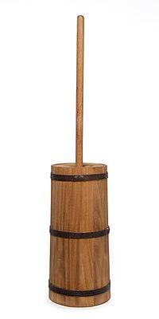
How Did I Get Here?
I always l ved Math and Science
I didn’t have any engineers in my family, so I didn’t know what engineers did
Back in the olden days, like when your Grandmothers (or even your great-grandmas) were in high school they didn’t tell girls about engineering, so because I was good in math and science, counsellors suggested that I become a Math Major in college
Luckily, a family friend, who was an engineer, asked if I wanted to teach math
I didn’t think so, because it would be hard to have students who didn’t get math when it was so crystal clear to me
The family friend got me a summer job as an Engineering Aide, and I finally got to see what engineers did, and I thought it was interesting
I started taking engineering classes in college and was so mad at my high school counsellors, because engineering is MATH and SCIENCE, which is where my strengths were
With a degree in engineering, I get to work on spacecraft that are going to Mars, and so can you

