Slide 1


Flight Director Insights
Into Human Spaceflight Operations
Semana Aeroespacial 2021
March 2021
Ed Van Cise, NASA Flight Director

Slide 2
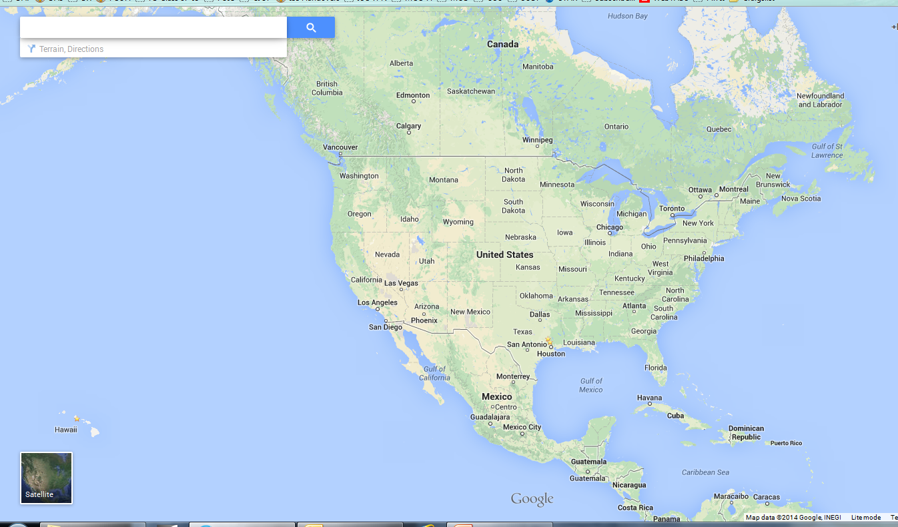
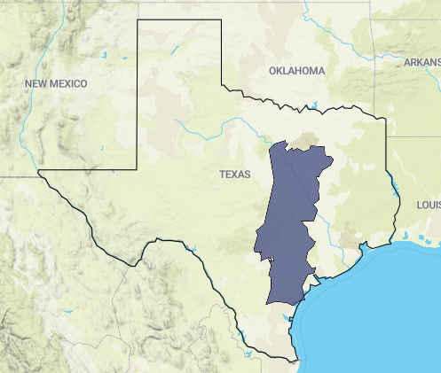
Ed is from here (Bay City, MI)
Population: 33,000
Ed works here (Houston, TX)
Population: 2,300,000
2,230 km

Slide 3
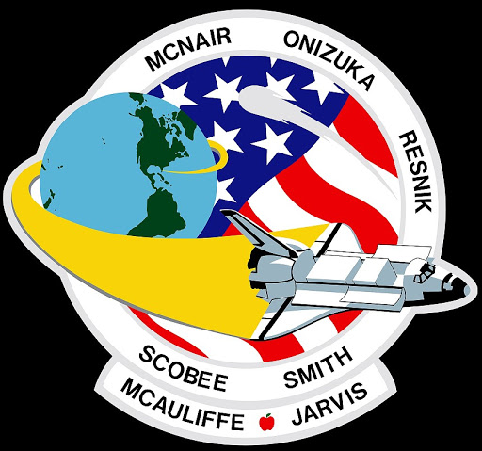
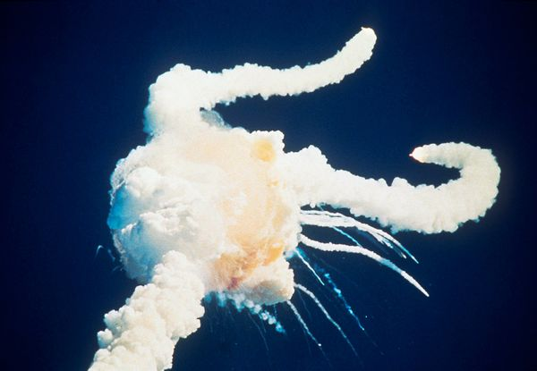
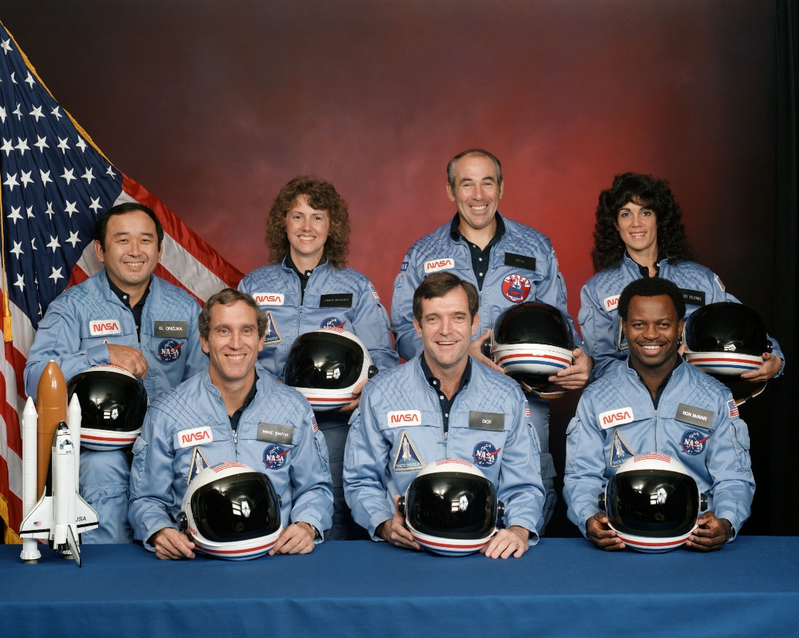
Challenger – January 28,1986

Slide 4
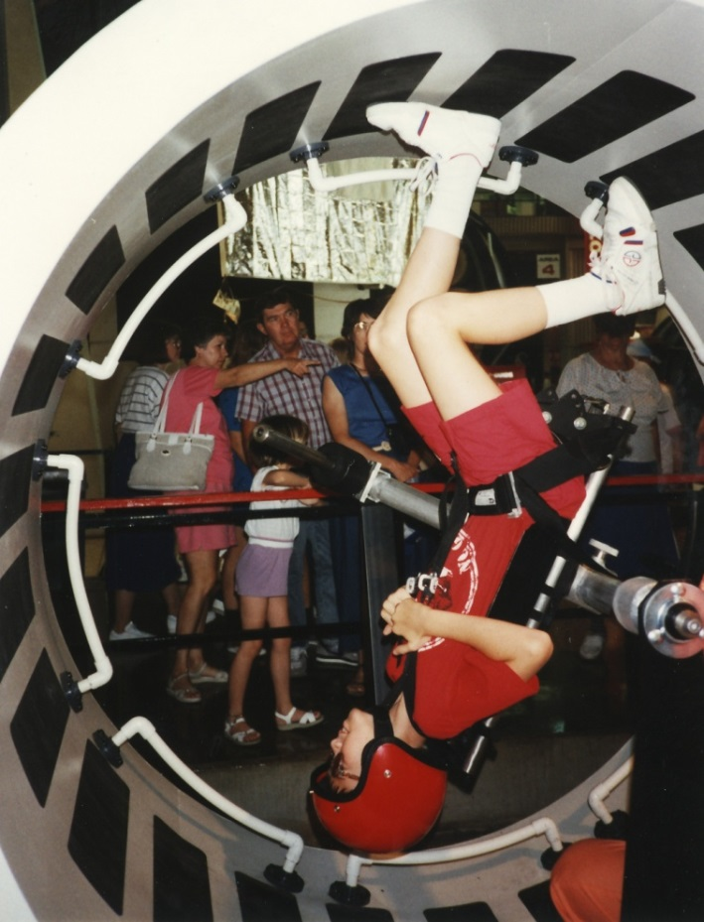
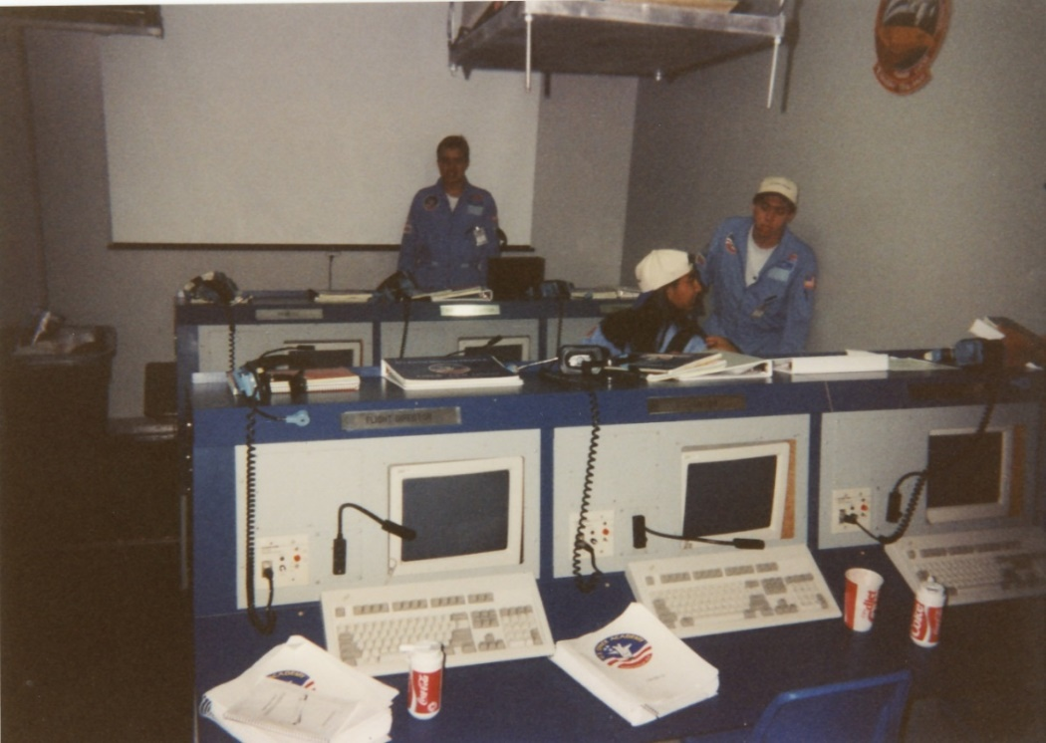
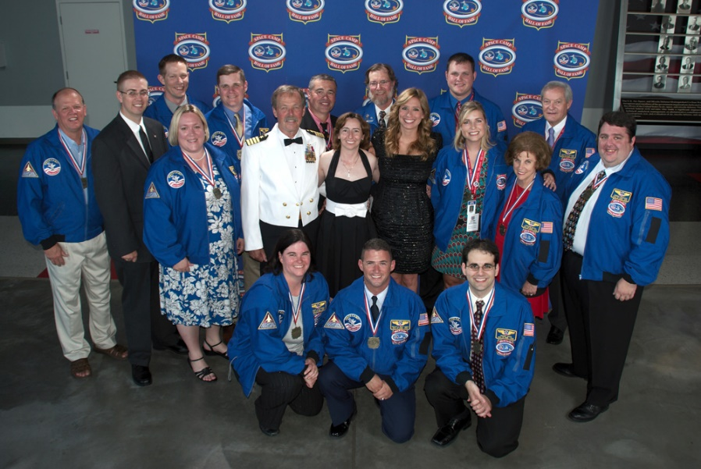


Space Camp (1990, 1993, Induction in 2012)

Slide 5
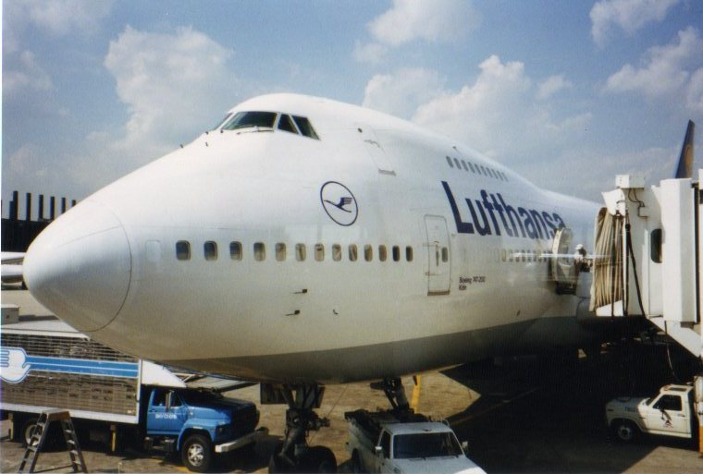
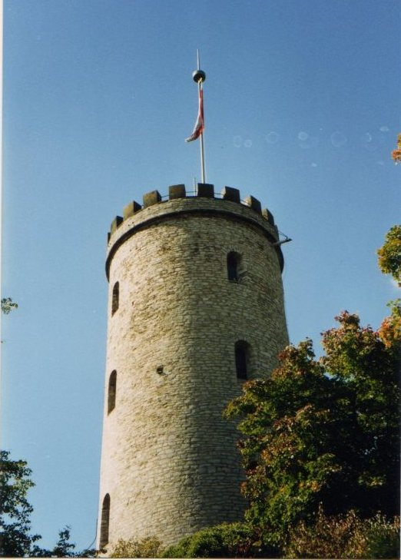
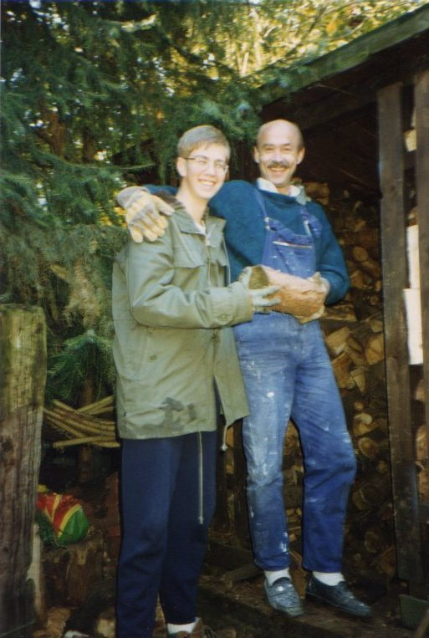
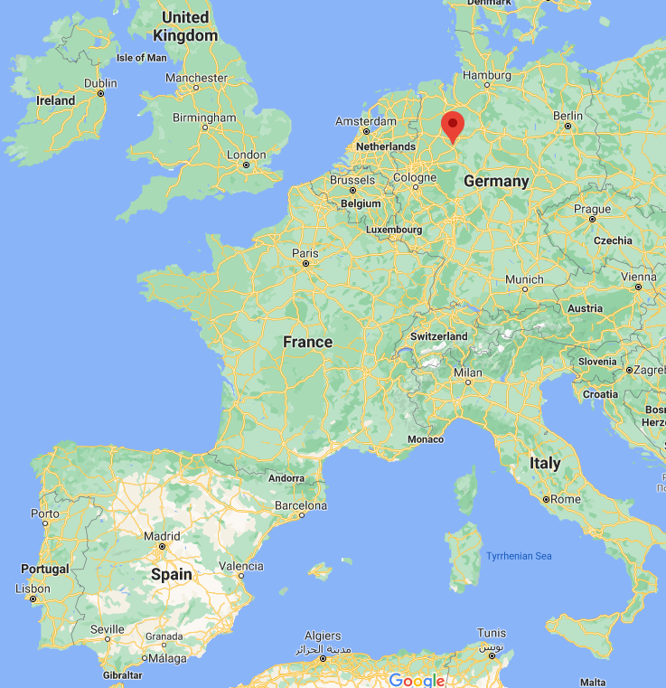
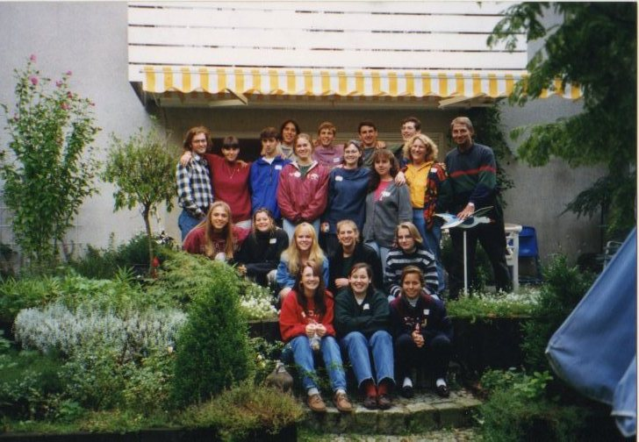
Foreign Exchange Student – 1993 to 1994
Bielefeld, Germany

Slide 6


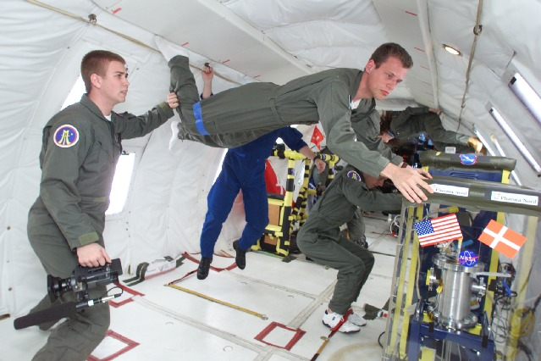
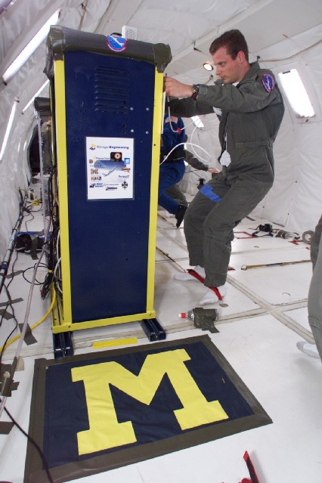
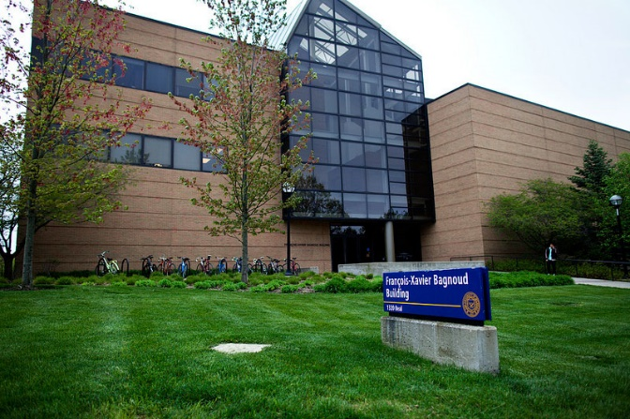
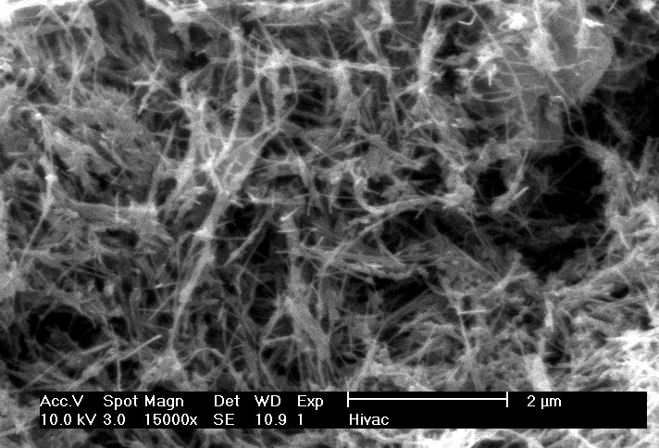
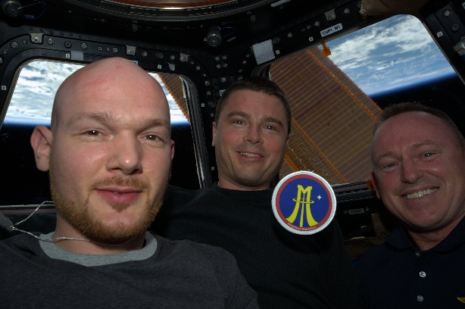
The College Years (1995 – 2000)
Bachelor’s of Science in Aerospace Engineering
Notes:
Graduated from High School in 1995, started at University of Michigan
Didn’t get to take any Engineering courses until sophomore year – took Aero 200
At that time, much of the Aero curriculum at UMich was aeronautical focused from our Aero 200 course all the way through our bachelors
Why go there, then, since it wasn’t more space-based?
I had contacted NASA JSC, the home of human spaceflight, during my high school senior year and learned they basically only hire through their co-op program. Thus I needed to attend a good school, somewhat close to home, that had Aerospace Engineering and had a good relationship with JSC’s co-op program. Michigan fit the bill – and I was already a big Wolverines fan to boot.
Knew early on that I needed to develop relationships with faculty and staff
Sought out those who could help me get into Aero co-op program, then CoE co-op program. Didn’t ‘suck up’ but sought advice and sought to become a known entity
Stayed focused on my goals
Perhaps at the determent of having more fun my first couple of years at college, but I was successfully able to get into the JSC co-op program
While co-oping, volunteered with the Reduced Gravity Student Flight Opportunities Program. Thought it would be a lot of fun to fly in zero-g. Needed an experiment though.
(nanotubes pic) Utilized what I was working on as a co-op to work with NASA Aircraft Ops and NASA Researchers to create a carbon nanotube experiment to fly in 0g
Started out really only wanting to do it as an “easy” way to fly in 0g. Turned out to be a whole lot more than that.
Program Management, Principal Investigator, team leadership, budgeting, communication, etc
Had up to 20 students “working” for me at one point
Had to find a way to make it happen – minimal faculty ‘doing it for us’
Flew in ’99 and ’00; first (and only still today, to my knowledge) to make nanotubes in 0g. Led to follow-on research in Aero dept in nanotubes, to my knowledge was CoE’s first foray into nanotubes, now a full fledged research area in Chem Eng in conjunction with Aero
Graduated with a BSAE in April 2000
Led to other opportunities to fly in 0g both for U of M and for NASA. Currently have over 600 0g parabolas or just over 1 orbit’s worth of 0g time
Got a great education at UMich and my participation in extracurriculars, especially the nanotubes project, started to teach me the important concepts of leadership, teamwork, and communication. So why take a year off of school to co-op at JSC?
Easiest answer – hiring in directly with NASA as a government employee is very competitive and due to limited funding there aren’t many job openings for college graduates. They mostly hire out of their co-op pool.

Slide 7
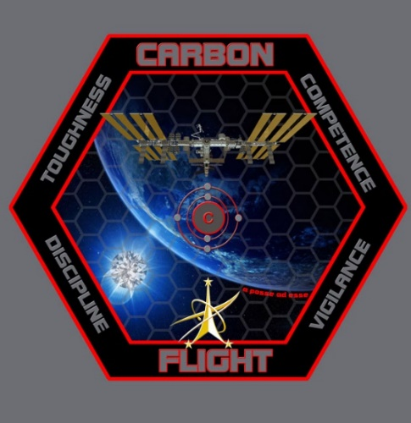
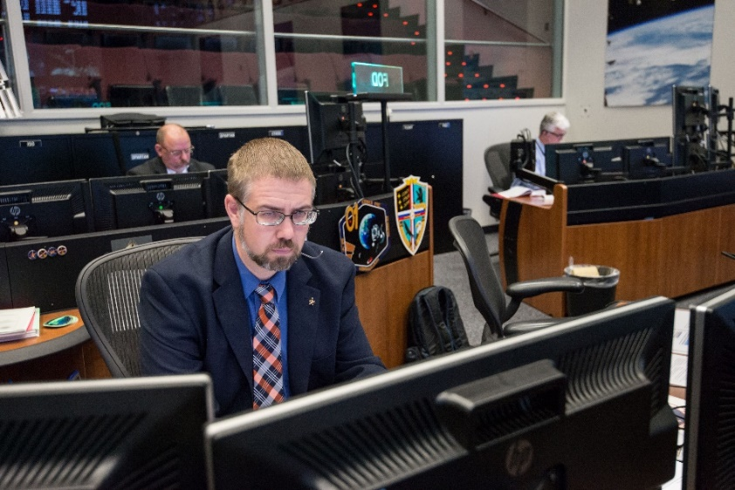
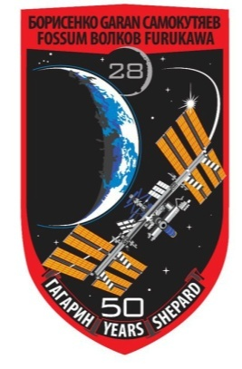


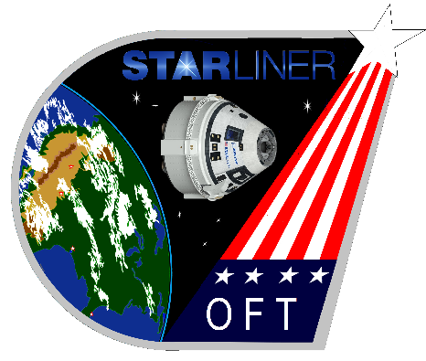
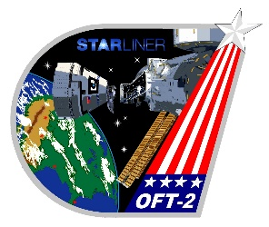

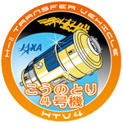
Career Progression
Worked in Mission Operations for the International Space Station since 1998
  Operations Support Officer (OSO) Flight Controller for 5 years
  TITAN Flight Controller for 3 years
  Group Lead for the ISS Mechanisms & Maintenance Training Group for 2 years
  Selected in Flight Director Class of 2009, certified January 2010, call sign “Carbon Flight”
Other
  Over 8,100 hours supporting operations from the ISS Flight Control Room since 2001
  Over 90 minutes of zero gravity experience on NASA’s reduced gravity aircraft
  Multiple SCUBA dives on the full size ISS mockups in NASA’s Neutral Buoyancy Laboratory
Notes:
Co-oping benefits NASA and the student. NASA gets to see what you might be like as a full time employee. The student gets to “sample” a couple of jobs with NASA to see if this is really what they want to do after the graduate
At JSC you get to choose where you work, treated like a regular employee, given real assignments
Might decide there are certain areas where you don’t want to work
First tour was in Engineering. Even though I learned about nanotubes, I realized Engineering orgs was not where I wanted to be.
Confirmed I wanted to be in Mission Operations – Mission Control
2nd – 4th tours were all in Mission Ops.
All with the same group (OSO). Since they treated me as a “real” employee, did real work that not only benefited them, but since I later hired into the same group full time I got to continue that work as a full time employee
Might decide NASA’s not all you thought it would be
Might decide to change your major
Excellent opportunity to experiment and make changes before you’re fully committed to a career and I highly recommend it for any career or job field, be it a year-long co-op or a summer internship.
Taught me a different way to think about/approach school/homework
OSO
Describe OSO’s job, flight control and training
Working on co-op projects full time
STS-114/ULF1 lead turning into STS-114/LF1
Talk about the human element, Columbia, loss of friends?
TITAN
While also OSO lead for STS-114
Multiple systems, gaining seniority, experience, recognition (know the politics)
DA8 Program Integration
Exposure to Flight Directors
Learn about the “world” outside of MOD
DX42 Group Lead
Form a new group
Back to my roots, but on training side
Learn to lead a team
Debrief methodology paper – set goals but get their buy-in, make it their work so it will outlive your tenure
Flight Director
Selection in June 2009, certified in January 2010, call sign “Carbon Flight”
Major assignments – all are stretch goals that seem impossibly hard but by definition we rise to the challenge
X2EXTR6 before certified, Russian EVAs, Inc 28 (talk about Fossum, class of ’80), EVAs 18, 19, 21, FRAT, HTV4, Inc 41
HTV3’s abort, redesign of entire mission profile in 10 months
Can include discussion of complications due to structural loads considerations on solar arrays
The fun of EVAs 18, 19, 21. Talk about the ‘bad day feeling’ as EVA 18 went past 8 hours, the Toothbrush Hack for EVA 19, doing EVA21 in less than 36 hours

Slide 8
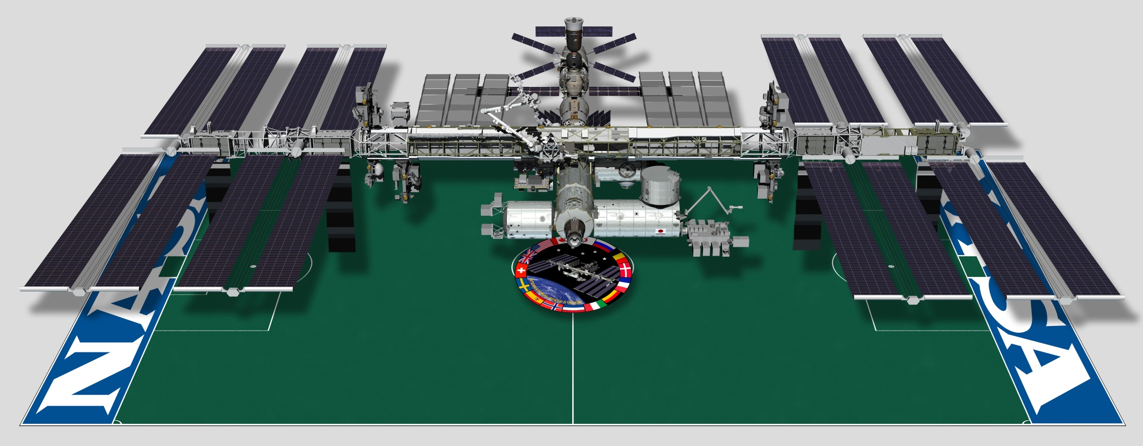
Earth’s Only Microgravity Research Laboratory
Truss: 109 m
Solar Arrays:
35 m
Modules:
51 m
Mass: 420,000 kg
Habitable Volume: 388 m³
Solar Power Generation Capability: 84 kW
Altitude: 365 km
Orbital Speed: 28,000 kph (7.8 km/sec)
Orbital Period: 90 minutes (16 sunrises/sunsets per day)
Notes:
First Elements launched in 1998, first inhabited in November 2000, currently home to a crew of 6
Assembly completed in 2011, now a fully operational one-of-a-kind laboratory
During a given 6-month period, ~200 tended and untended investigations are conducted, representing over 400 scientists on the ground.
Biology, biotechnology, Earth and space science, human research, technology development, physical science, educational & cultural activities
Human Health Research
Development of new medical technology and disease treatment
Advancement of telemedicine, nutritional health, and cell adaptation/behavior
Bone health and the prevention of bone loss due to aging
Earth Observation
Disaster Response support
Immediate input to and imagery of unexpected events and natural disasters (volcanic eruptions, earthquakes, hurricanes and tsunami flooding)
Understand & Resolve environmental issues, collecting data on global climate, environmental change
Future of Exploration
Improved processes for safe operations of long duration spaceflight
Preparedness and preventions for human health changes
Improved technologies for sustainability

Slide 9
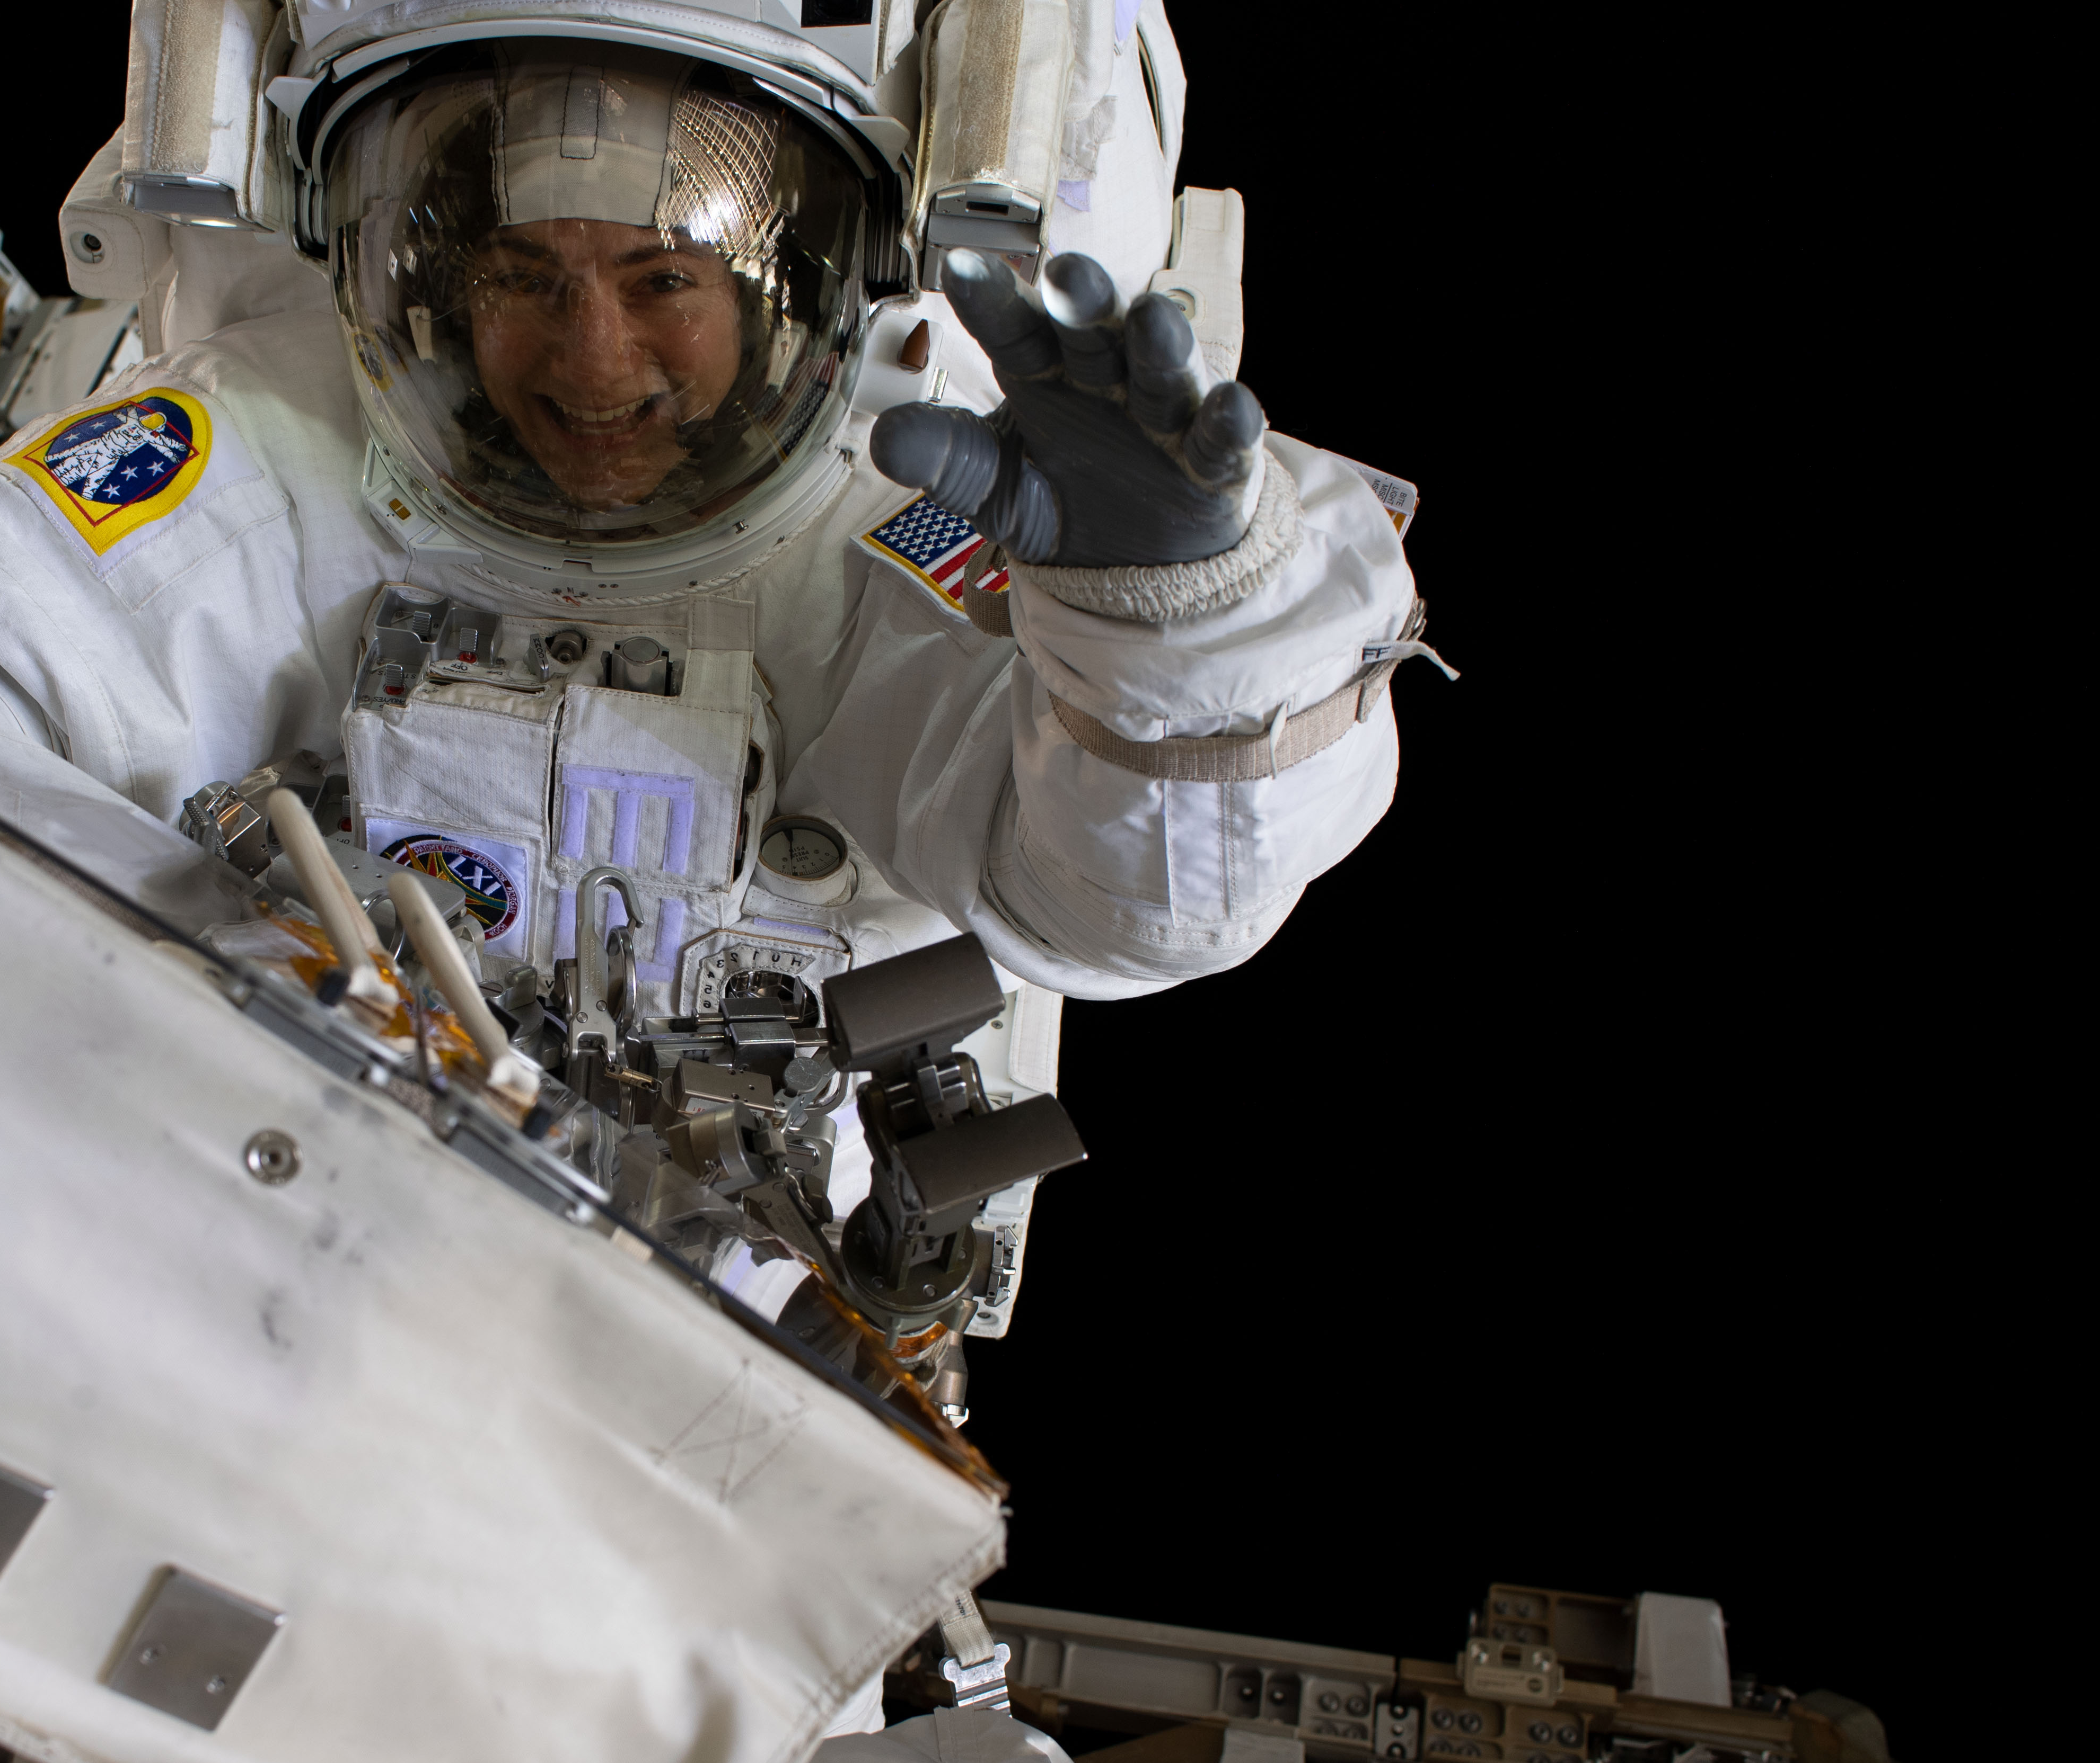
The Mission of the International Space Station
Basis for international and commercial human exploration partnerships
Enable long duration human spaceflight beyond Low-Earth Orbit (LEO)
Returning benefits to humanity through basic and applied research
Enabling the development of a commercial market in LEO

Slide 10
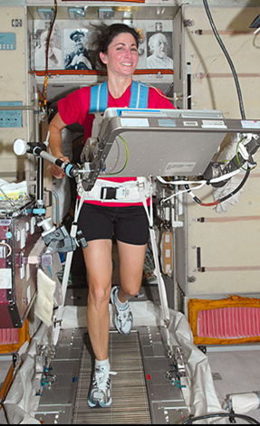
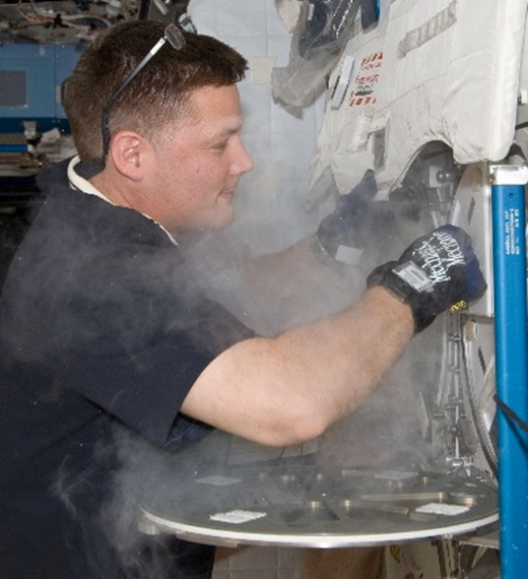
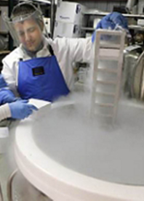
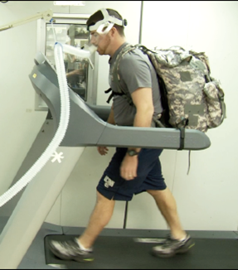
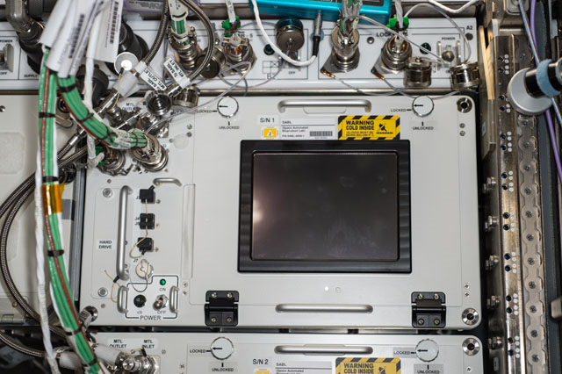
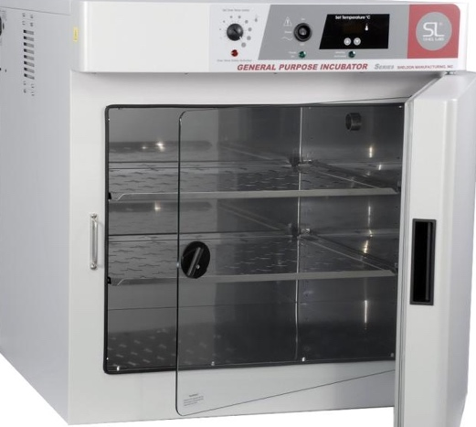
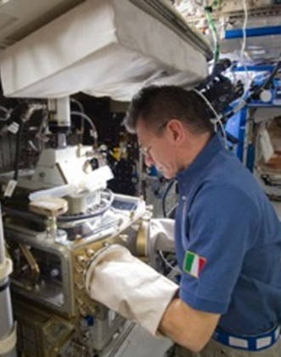
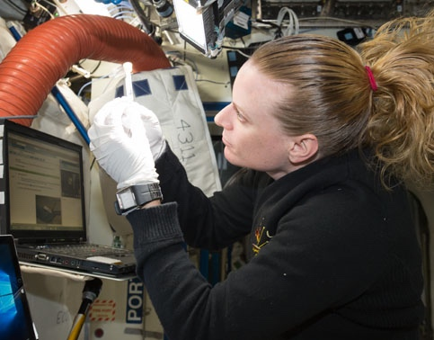
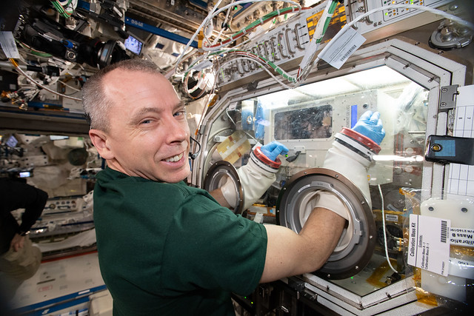

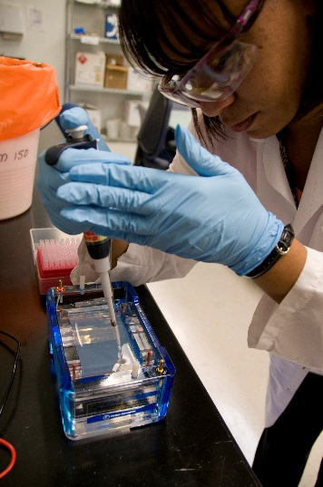
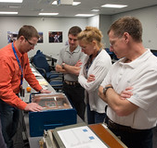
A Lab Like on Earth, Unlike Earth
Freezers
Incubators
Human Research
Microscopes
Genetic Analysis
Model Organisms

Slide 11
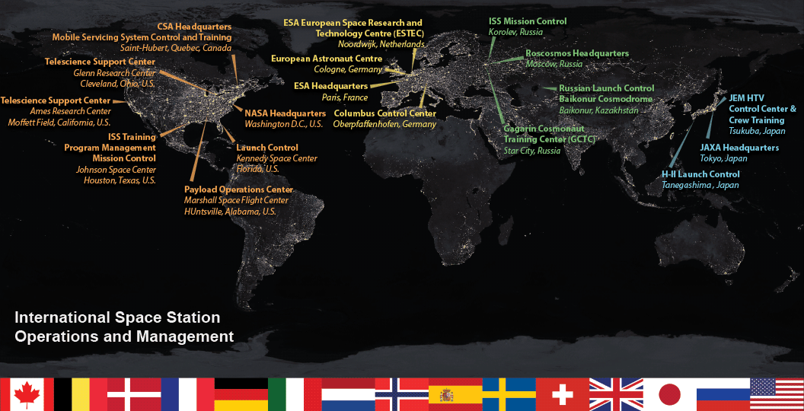

Slide 12
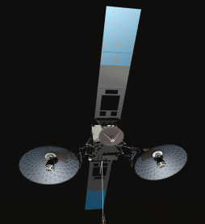
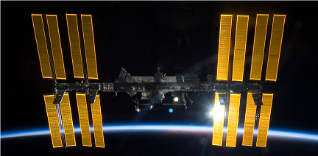
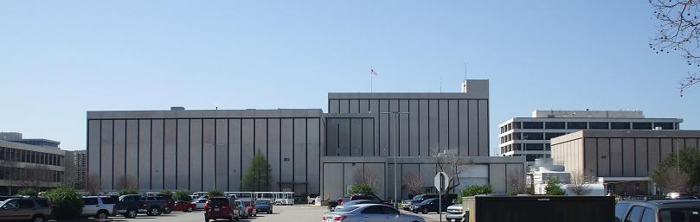




TDRS
Relay
Satellites
Mission Control Center - Houston
Space Station
Command
Telemetry
Voice Links
Tsukuba
Control Center
Japan
Columbus
Control Center
Munich
Payload
Control Center
Huntsville, AL
MCC
Moscow
Russia
Notes:
5 Control Centers support ISS; MCC-H is a primary hub with Moscow also able to directly communicate with and command to their segment of ISS. With 5 control centers, need one that is “prime.” MCC-H is the Lead control center, responsible for not only the US modules but also the entire crew and vehicle.

Slide 13
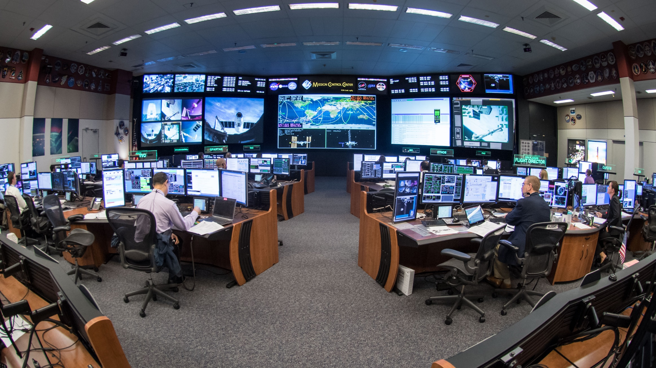
Mission Control Center – Houston
Established 1965

Slide 14
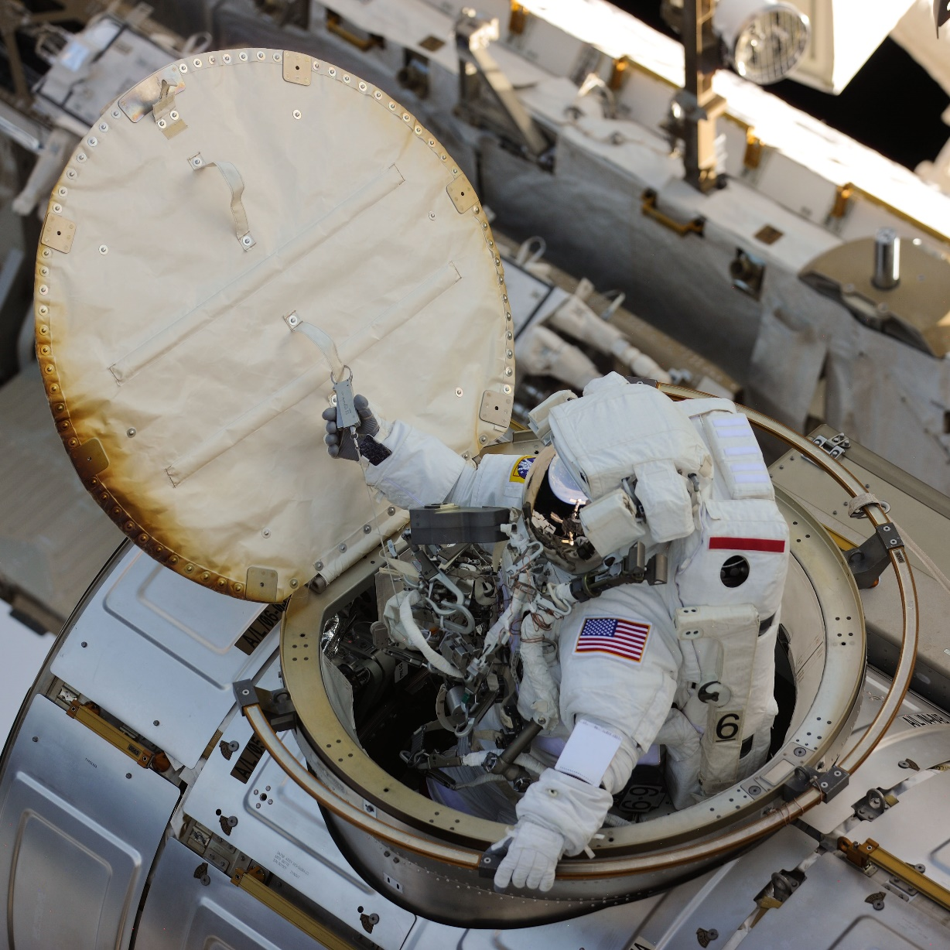
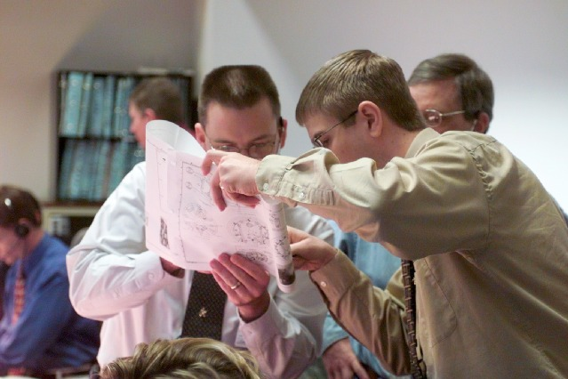
Failure Is Not An Option – January 15, 2003

Slide 15
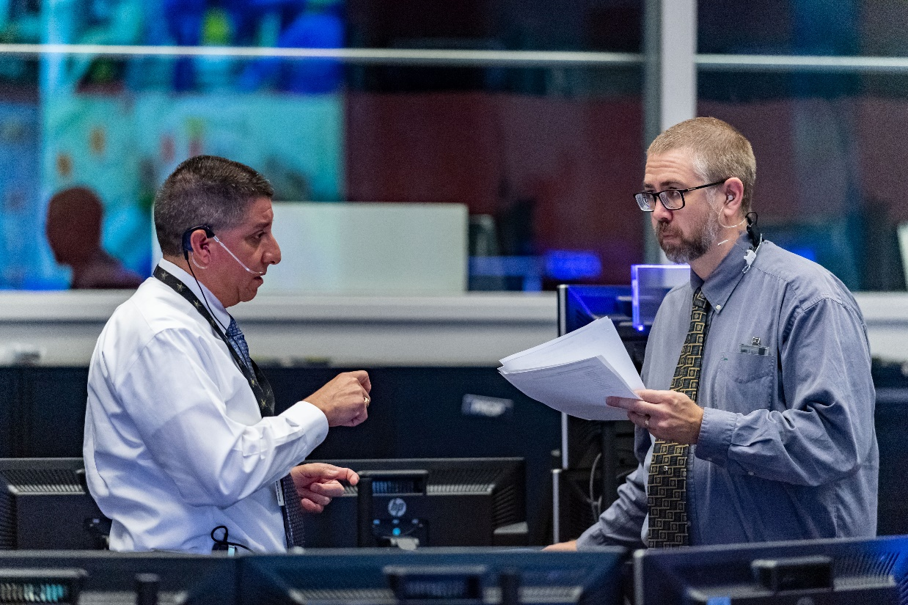
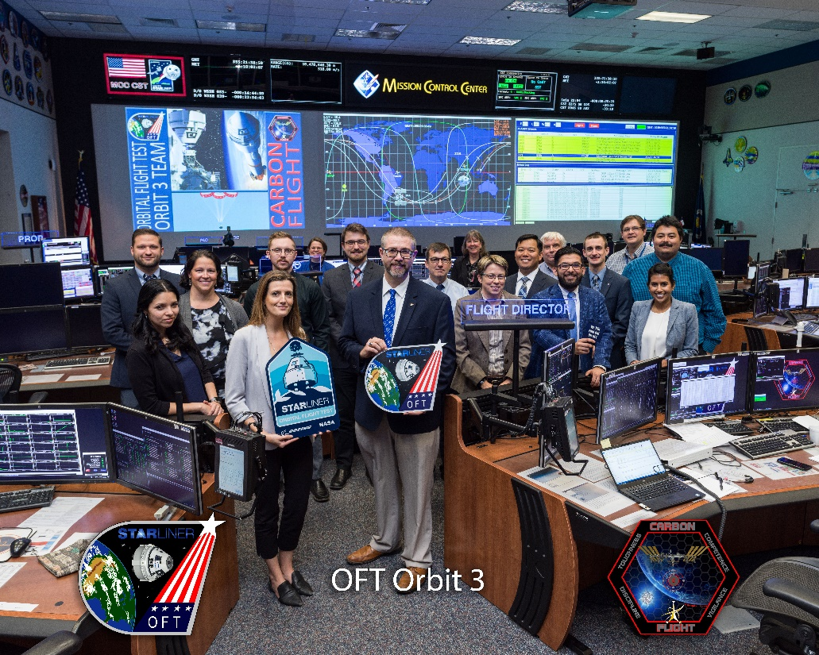
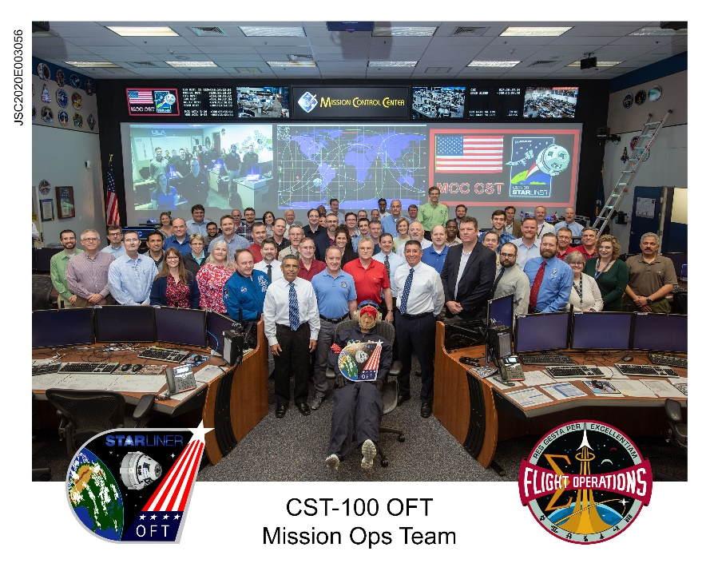
CST-100 Orbital Flight Test (OFT)
What to you mean Liftoff was 11 hours ago?!

Slide 16
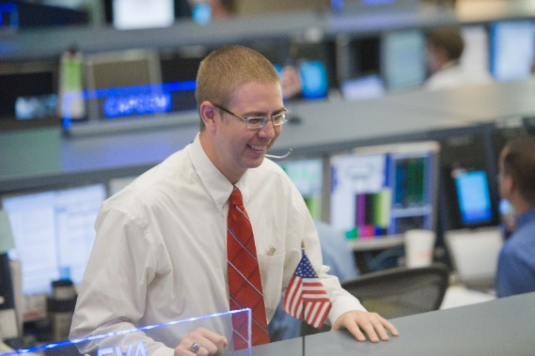
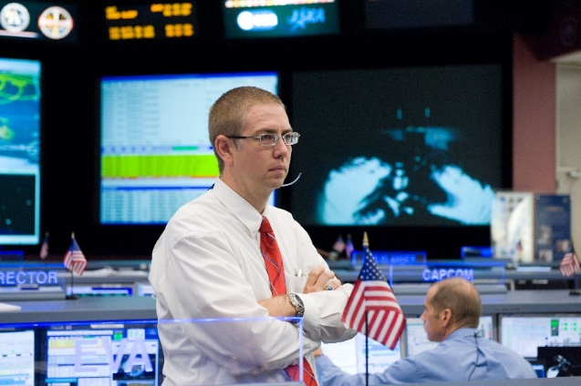
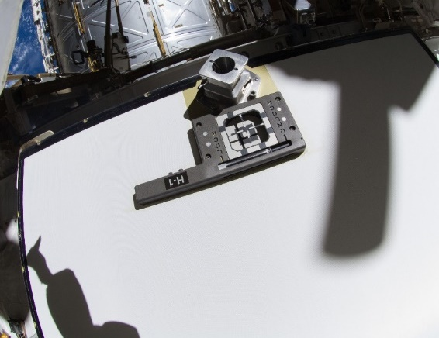


Two Bolts – How Hard Can It Be? (EVAs 18 & 19)
“The Toothbrush Hack” (August 2012)
EVA Start
8 Hours Later

Slide 17


Performing An EVA in 36 Hours (EVA 21)

Slide 18



HTV-3’s Abort
September 2012: HTV grapple fixture stuck on the ISS robot arm as the arm backed away
  Caused HTV to drift towards ISS, resulting in an unexpected automated abort
HTV-4 scheduled for August 2013, 11 months later:
  Don’t let HTV-3 happen again!
  What happened, why, how do we prevent it?
  Cannot change HTV vehicle design
ISS Program, Engineering, Flight Operations, Canada, Japan needed to fully engage
  Key to on-time success – operating as a High Performing Organization
  Assemble to agree on direction/priorities, release teams to do work, reassemble to assess/integrate results and agree on next step(s)
Direction of Initial SSRMS motion “pull”
Orbital Mechanics
Notes:
7:00
Video source: YouTube, videos edited/compiled by myself duration 4:20
August 2012: HTV grapple fixture stuck on the ISS robot arm as the arm backed away causing HTV to drift towards ISS, resulting in an unexpected automated abort
Instead of slowly drifting away, HTV accelerated quickly away from ISS
August 2013: HTV-4 mission teams needed to understand the cause of HTV-3’s abort, how to avoid this in the future, assess any impacts to proposed changes, develop new techniques and procedures, and be ready to fly in less than 1 year without changing HTV vehicle design
As a High Performing Organization, all involved parties across the ISS Program, Engineering, Canadian Space Agency, Japanese Aerospace Exploration Agency, and Flight Operations could integrate and lead their elements with only key management integration meetings required
Enabled accomplishing the aggressive mission schedule
Assemble to agree on direction/priorities, release teams to do work, reassemble to assess/integrate results and agree on next step(s)
Needed CSA to determine what happened at the LEE/FRGF interface
Needed CSA and NASA Engineering to assess the forces and loads imparted on HTV
Needed JAXA to assess those loads and confirm that those loads caused the problem.
CSA and FOD ROBO needed to develop an alternate release technique
CSA and NASA needed to model what loads and moments the new technique would put into HTV
ISS Program asked for assessment of changing the HTV orientation – required JAXA, FOD, CSA, NASA Engineering assessment
Separately, HTV3 abort caused teams to assess the impacts of the thruster loads on ISS structure. Determined that for all possible abort trajectories there were loads and heating concerns. Needed to find a way to change the HTV release so that if there was a Main Engine abort, the thruster plume would not hurt ISS
NASA Structures, GNC, Aerothermal, JAXA, FOD VVO all involved
Ultimately came up with a release technique that used the sliding carriage to ‘bump’ HTV’s grapple fixture out of the LEE if it didn’t drift out prior to starting backaway.
HTV design has it flying in a certain, fixed orientation relative to Earth. To get the thrusters pointed away from ISS structure, we also changed the ISS attitude at the time of release relative to HTV.
On release day, it all went exactly as simulated with one exception. When we got HTV to the release point, it was not where we thought it should be relative to ISS. It turns out that in some of the analysis, two numbers got transposed. Because of the type of leaders we develop in Flight Operations there as only a very brief “oh crap” moment and within 20 minutes our lead ROBO team determined the source of the problem, a means of correcting it, and developed a new procedure to move HTV to the correct position.
Best part – after we had a successful release and slow drift away, we all went for a round of beer to celebrate. ROBO stayed until he could track through the paperwork and find exactly where the error occurred and why. He joined us in about 1 hour’s time. While we celebrated together, we also took notes on what processes we could improve to make sure this didn’t happen again.

Slide 19
The Keys to Success in Human Spaceflight Operations
Mission Operations needs to be an organization that is:
  High Performance
    A high performance organization is an organization that achieves financial and non-financial results that are better than those of its peer group over a period of time of at least five to ten years.”
    Translation: High Performing Organizations (HPOs) do good stuff faster and better than its peers. For us, it means we are very, very good at human spaceflight operations.
  High Reliability
    A High Reliability Organization (HRO) is an organization that has succeeded in avoiding catastrophes in an environment where normal accidents can be expected due to risk factors and complexity.
    Translation: Being an HPO is good but being good doesn’t mean you get it right or you do it safely. HROs have a tendency to do thing safely and manage risk effectively. Typically HROs involve expensive, rare assets where their operations directly impact human lives. With lives of astronauts living in a tin can in the vacuum of space at stake, mission ops needs to be an HRO.

Slide 20
High Performance Organization
Leadership is aligned and effective deep within the organization
  Unambiguous chain of command within MCC-H and between Control Centers
  Leadership within a discipline is expected on and off console; “Lead Your Leader” reflects our goal for leadership development at all levels
Organizational Design is lean and reflects the organization’s strategic focus
  Documented processes, training flows, and certification guides establish both the ends and the means; regularly reviewed to ensure the methods align with changing strategic goals
The organization effectively translates business strategy into a powerful people strategy, attracting and retaining the most capable individuals
  Selective recruiting, Flight Controller Boot Camp, progressively complex training and simulations, regular skills assessments and pass/fail evaluations with documented pass/fail criterion
Change Management – The organization can drive and sustain large-scale change and anticipate and adapt
  Mission Control is a balance between being nimble enough to adapt to unexpected change yet knowledgeable enough to ascertain whether the change is within accepted limits; Next Worse Failure planning
Culture and Engagement – The culture is shaped to achieve strategic goals. Employees pursue corporate objectives.
  Foundations of Flight Operations, Flight Controller Manifesto, Stone Tablets of Flight Control, Plan/Train/Fly, Next Worse Failure, Lessons Learned meetings
Source: Bhalla, Vikram; Caye, Jean-Michel; Dyer, Andrew; Dymond, Lisa; Morieux, Yves; Orlander, Paul (2011). “High-Performance Organizations, The Secrets of Their Success,” Used with permission

Slide 21

High Reliability Organization
Anticipation (Prevention)
  Preoccupation with Failure
    Culture
  Reluctance to Simplify Interpretations
    Processes
  Sensitivity to Operations
    Circumstance
Containment (Reacting)
  Commitment to Resilience
    Culture
  Deference to Expertise
    Culture
Source: Weick, Karl E.; Kathleen M. Sutcliffe (2001). Managing the Unexpected - Assuring High Performance in an Age of Complexity. San Francisco, CA, USA: Jossey-Bass. pp. 10–17. ISBN 0-7879-5627-9

Slide 22




Moon to Mars
Artemis – Humans on the Moon and in Lunar orbit
  SLS
  Orion
  Gateway
  Long duration Lunar surface

Slide 23

Curiosity Rover, Mars
You are here.
On To Mars!
  56,000,000 km from Earth (Moon is 382,500 km)
    Mars is 146x farther from Earth than the Moon
Leverage Artemis experiences to learn to travel into deep space, stay there for lengths of time, explore surfaces for weeks or months, and develop technologies to live away from Earth for up to 2 years
160,000,000 kilometers

Slide 24
Links and Information
Social Media
  Twitter
    Ed: @Carbon_Flight
    NASA: @NASA
    Space Station: @Space_Station
    Astronauts: @NASA_Astronauts
    Artemis: @NASAArtemis
Inside Look at Space Station Flight Control (eBook)
  https://blogs.nasa.gov/spacestation/tag/mission-control-center/
Websites
  Spot the Space Station from nearly anywhere on Earth: https://spotthestation.nasa.gov
  More on the Space Station: http://www.nasa.gov/mission_pages/station/main/index.html
  Commercial Crew Program: https://www.nasa.gov/exploration/commercial/crew/index.html
  More on Artemis and going beyond Earth: https://www.nasa.gov/topics/moon-to-mars/
  More on our solar system: http://www.nasa.gov/topics/solarsystem/index.html
Video:
  NASA Television: www.nasa.gov/multimedia/nasatv/index.html
  NASA High Definition Earth Views from ISS: http://www.ustream.tv/channel/iss-hdev-payload
  Live video (external or internal) from ISS: http://www.ustream.tv/channel/live-iss-stream
  ISS Symphony: https://youtu.be/wgdbZhnFD5g
  Paolo Nespoli and Soyuz: https://youtu.be/-l7MM9yoxII
  Riding the Boosters: https://youtu.be/2aCOyOvOw5c
  Longer booster video: https://youtu.be/cLl7oqdm_B8
Notes:
1:00

Slide 25

Cassini Spacecraft, Saturn
Questions?
You are here.
1,440,000,000 kilometers

