Slide 1
Mission Ops and Ground Systems 101
Theresa Beech
Code 583
NASA Goddard Space Flight Center
January 29, 2021
This material is a declared work of the U.S. government and is not subject to copyright protection in the United States. Published by The Aerospace Corporation with permission.

Slide 2
AGENDA
This class is meant to be highly interactive. Please ask questions as we go along. Discussion is good.
Introductions
Satellite Mission Types
Orbital Overview
  Field of View and Swath
  GEO Belt
Mission Ops Overview
  Drivers
  How to get the data where it’s got to go
Ground Systems Overview
GMSEC Overview

Slide 3
CLASS OBJECTIVE
Provide a general overview of how satellite missions drive the mission operations concepts which in turn drive the ground system architectures that we use

Slide 4
SATELLITE MISSIONS
What do we mean by a Satellite Mission?
The Satellite Mission is our WHY, it is the REASON we are spending a lot of money to get 1+ satellites into orbit, it is WHAT we are hoping to obtain from these spacecraft
The Satellite Mission drives EVERYTHING.

Slide 5
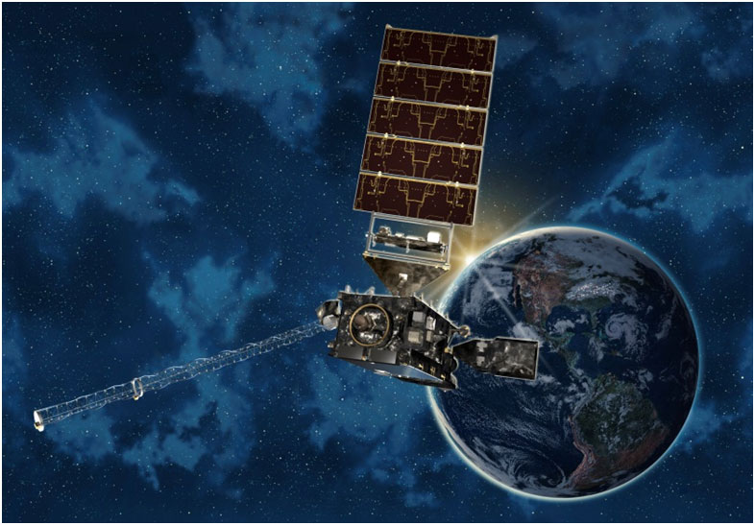
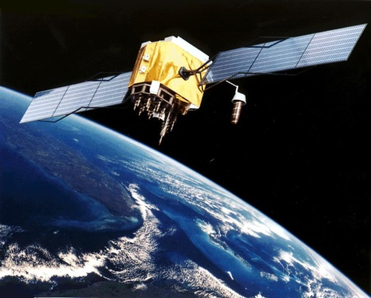
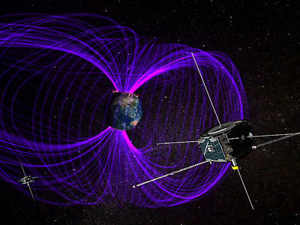
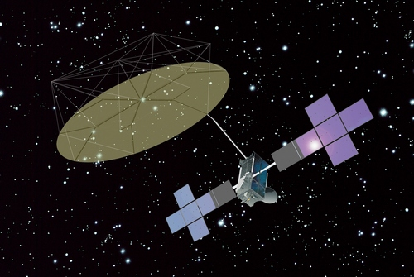
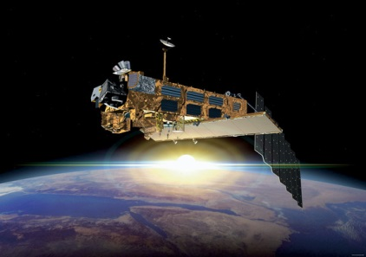
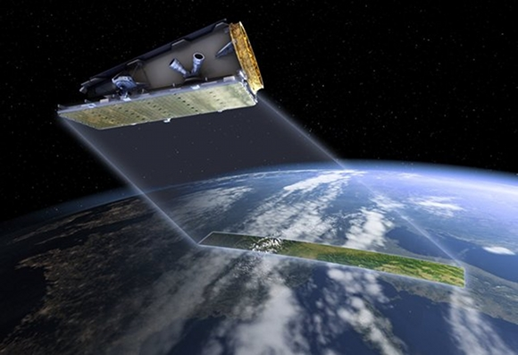
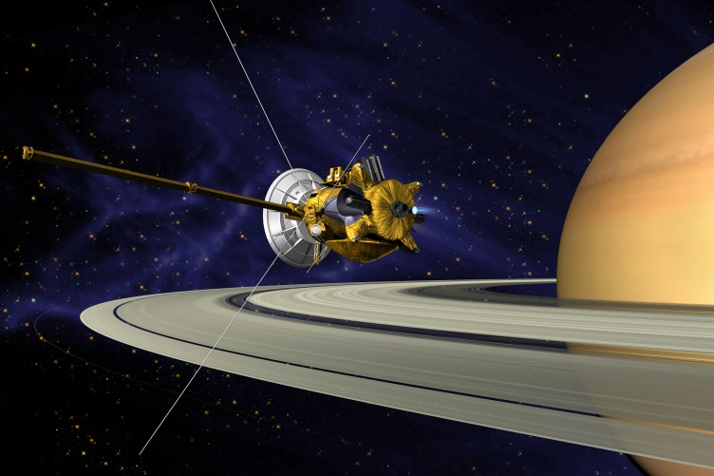
SATELLITE
MISSION TYPES
Weather
Science
Navigation
Communications
Earth Observation
Reconnaissance
Planetary Science
02/10/2021
5

Slide 6
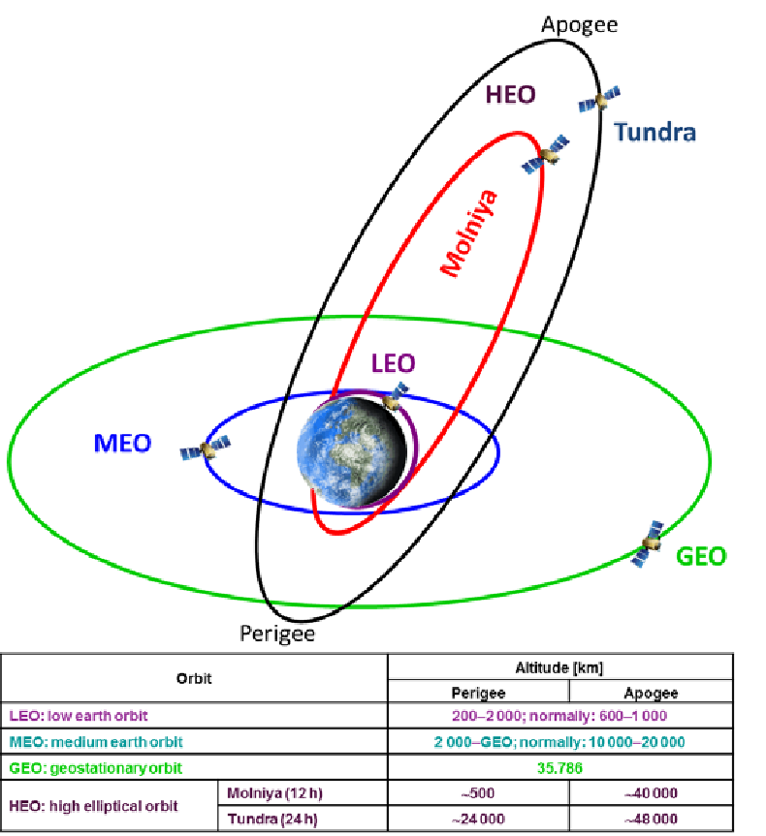
S/C ORBITAL OVERVIEW

Slide 7
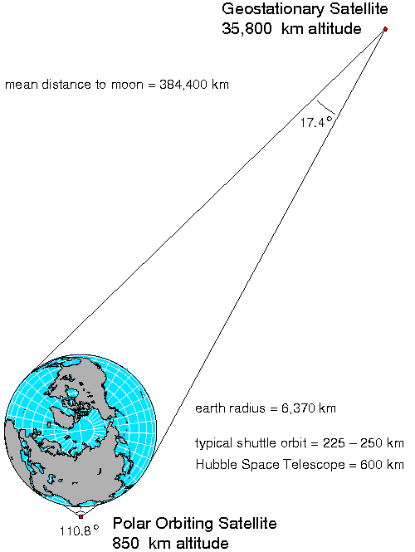
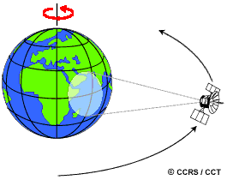
MORE ON ORBITS: FIELD OF VIEW & SWATH (1)
Notice the huge difference between GEO and LEO

Slide 8
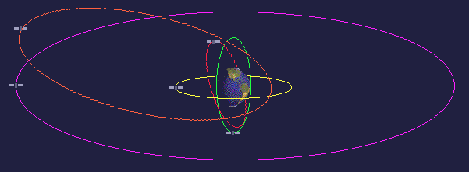
MORE ON ORBITS: FIELD OF VIEW & SWATH (2)
https://salinity.oceansciences.org/data-aq-processing-v3.htm

Slide 9
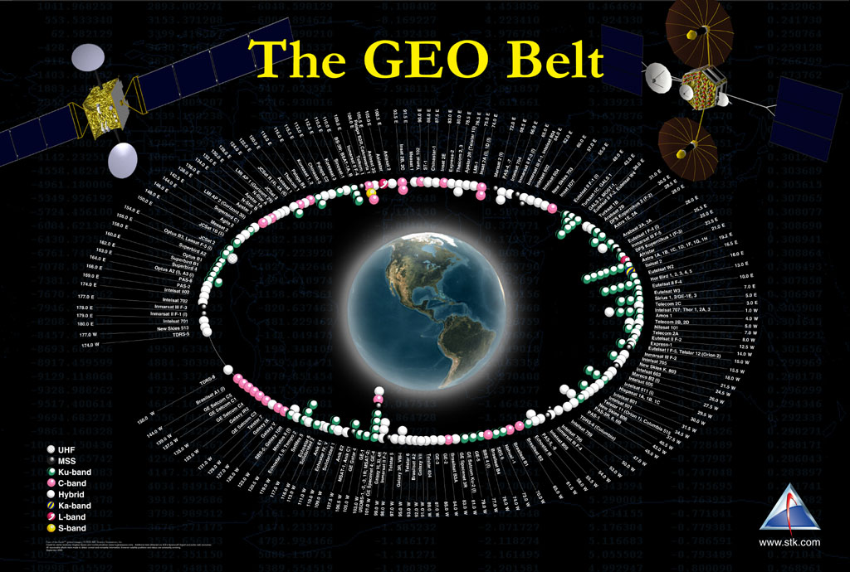
MORE ON ORBITS: THE GEO BELT
Collocated S/C

Slide 10
How do we make our Satellite Mission a reality?
(besides building and launching it…)
The ground system.
Because a satellite with no ground system is a very expensive hunk of junk

Slide 11
What drives the ground system architecture?
The mission operations concepts.

Slide 12
THE BOTTOM LINE
Satellite Mission
Mission Ops Concepts
Ground System
Whatever you do ALWAYS REMEMBER….
…the MISSION DRIVES EVERYTHING

Slide 13
WHAT ARE THE MISSION OPERATIONS DRIVERS? (1)
Keep the S/C safe and healthy
Maximize the mission
  Maximize S/C & P/L availability
Mission criticality
  How important is the mission? What happens if it fails?
  Redundancy (space & ground & people)
  Risk (inversely proportional to cost)
How to get the data where it’s got to go
  Standards (XTCE, CCSDS, SLE, CFDP, C2MS)
  Ground & space networks
Minimize cost
  Everyone wants to pay less for what they need, but…

Slide 14
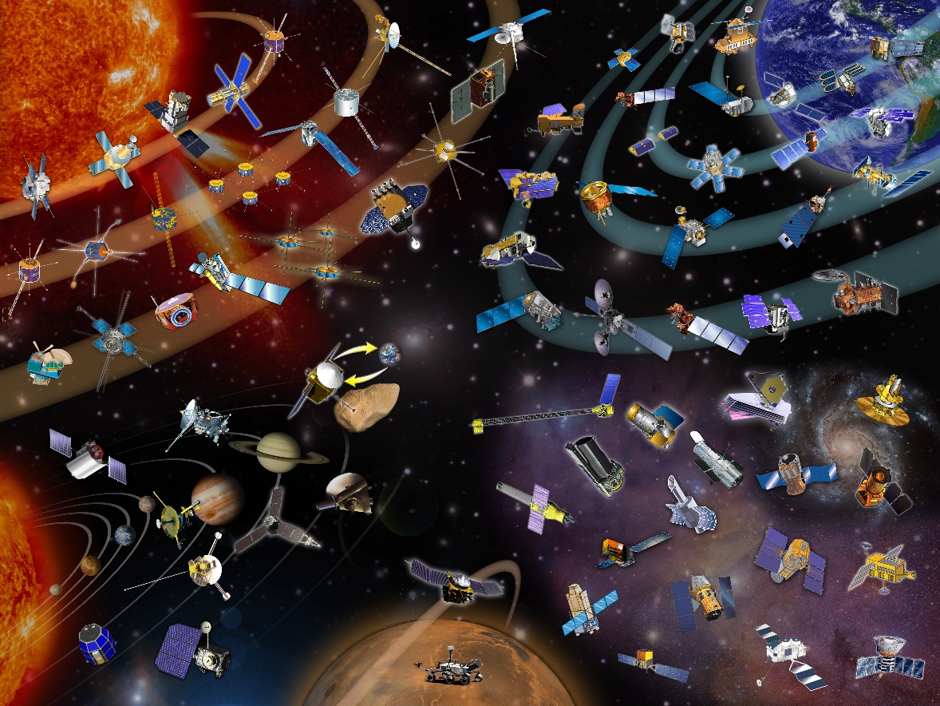
WHAT ARE THE MISSION OPERATIONS DRIVERS? (2)
Optimize anomaly detection and recovery
Heritage
  “This is how we’ve ALWAYS done things….”
  NO ONE wants to be “the first”
  “I know how to use this system, so I want it for …”

Slide 15
So what does this mean?
Mission criticality ➔ reliability reqs ➔ failover reqs ➔ back-up reqs
Orbit ➔ field of view & swath ➔ ground contacts
  Commanding
  Planning & scheduling
  Mission data dumps
  Anomaly detection/ recovery
$$ pressure ➔ AUTOMATION!!!!
  S/c ops, ground ops, mission ops, joint ops
Data transport/exchange ➔ use of standards
24x7 or 8-5 Ops
CMD load
Manual CMD
Remote/separate ops
Joint mission
Data relay

Slide 16
INTERNATIONAL SPACE DATA STANDARDS
XTCE: XML Telemetry & Command Exchange
CCSDS packets: Consultative Committee on Space Data Standards
CFDP: CCSDS File Delivery Protocol
SLE: Space Link Extension
C2MS: Command & Control Message Specification
Standards:
Make data exchange easier
Enable multi-agency missions
Make maintenance & upgrades/replacement easier

Slide 17







HOW TO GET THE DATA WHERE IT’S GOT TO GO
Relay S/C 1
Relay S/C 2
Our data: user, mission, TM & TC
Relay S/C TM & TC
Our S/C
Relay S/C TM & TC
TM & TC
Our data
Our mission & User data
Our mission & User data
Our MOC
Relay Antenna
Our Antenna
Our User
Relay S/C MOC
Relay S/C TM & TC
Our data

Slide 18
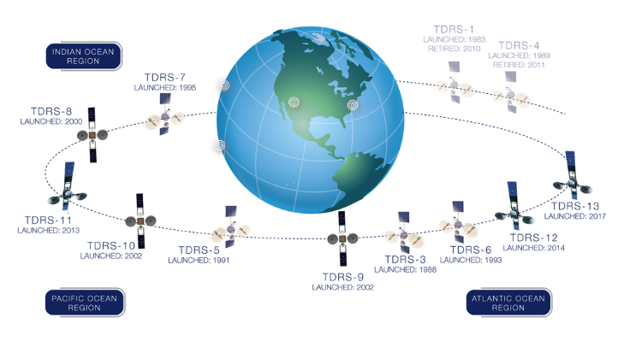
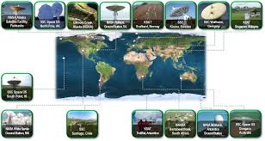
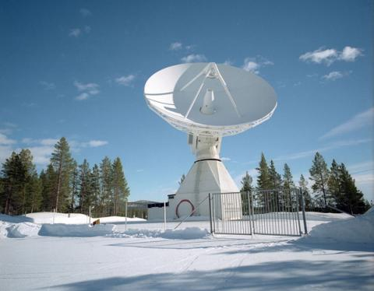
HOW TO GET THE DATA WHERE IT’S GOT TO GO
SPACE NETWORK (SN): TDRS
NEAR EARTH NETWORK (NEN)
NASA Options: dedicated G/S or networks (NEN, SN and DSN)

Slide 19
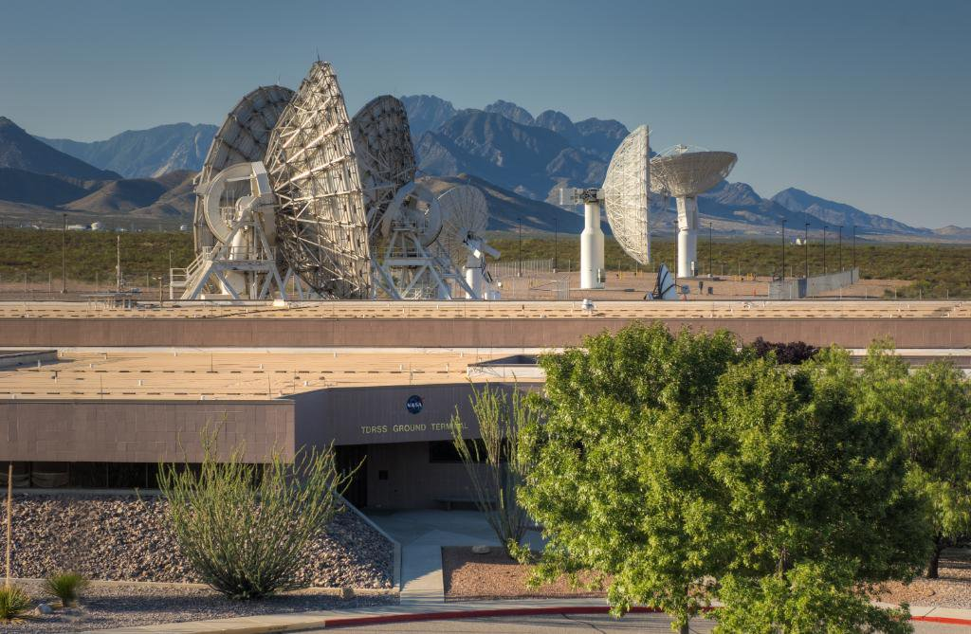
GROUND SYSTEMS OVERVIEW

Slide 20
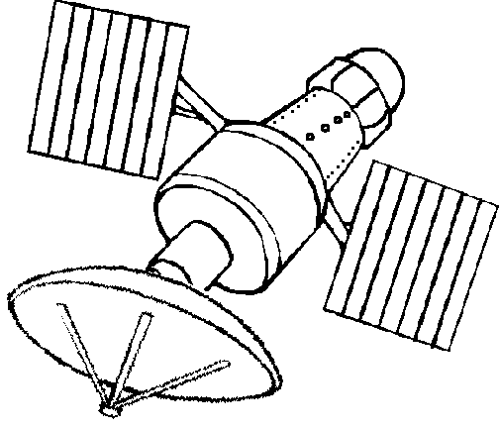
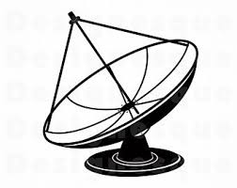
GROUND SYSTEMS OVERVIEW
XTCE
C2MS
CCSDS
Commands
Commands
CCSDS
CFDP
Prime
Back-up
Mission Control Center (MCC)
Mission Control Center (MCC)
Telemetry
(hk & mission)
SLE
XTCE
CFDP
FEP
RF/IF Equipment
RF/IF Equipment
Prime
FEP
Back-up
Ground com link for synchronization & data delivery

Slide 21


MISSION CONTROL: PRIME SITE (CLASSIC DESIGN)
Mission data routed to SOC/POC at FEP (often)
Prime
Backup
Prime
Backup
Prime
Backup
Prime
Backup
T&C
T&C
FDS
FDS
MPS
MPS
Mission Specific SW
Mission Specific SW
Prime
FEP
Critical technical path
Prime LAN
Prime
FEP
Backup
GSCE
GSCE
UTIL
UTIL
CRYPTO
CRYPTO
Communications links
Prime
Backup
Prime
Backup
Prime
Backup
FEP
Back-up LAN
Backup
Mission Specific SW
T&C
GSCE
FDS
UTIL
MPS
CRYPTO
T&C
FDS
MPS
Mission Specific SW
Often co-located with ground station, fully redundant, hot-backup with a training/development string
Training/Dev LAN
GSCE
UTIL
CRYPTO

Slide 22
MISSION CONTROL: BACK-UP SITE (CLASSIC DESIGN)
Mission Specific SW
Communications links
FEP
Back-up LAN
T&C
GSCE
FDS
UTIL
MPS
CRYPTO
May not be redundant, may be cold back-up
Geographic distance dependent upon mission criticality, $

Slide 23
MISSION CONTROL: INTERFACES
Socket interfaces
Custom code
Difficult to maintain
Difficult to replace
Interfaces are a nightmare
Coordination with 3rd parties is challenging
Situational awareness is neglected
UTIL is made up of many, many SW apps doing many tasks which help the ops team.
External I/F
UTIL
CRYPTO
FDS
T&C
FEP
TRENDING
MPS
GSCE
Mission Specific SW
Connects to many subsystems

Slide 24
WHAT ARE SOME OF THE GROUND SYSTEMS AND MISSION OPS HEADACHES?
Interfaces
  No ICD is ever completely documented or completely up-to-date. Ever.
Obsolescence
  HW & SW ages and dies
  Companies come and go and disappear
  People come and go and retire
Vendor lock-in => $$$
Different color of money
  G/S development vs. Operations
People & Training* (depends upon sector)

Slide 25
What can we do to mitigate ground system architecture risks?
A few thoughts on how interfaces, obsolescence, and vendor lock-in are inter-woven….

Slide 26
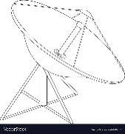
GMSEC: GROUND SYSTEM & MISSION OPS ENABLER
Communicates w/other buses
UTIL
GRASP
Triggers action based on directive
Automation & “brains”
Systems Agent
Resource msg
Installed on all hosts
Email notifications
Countdown clock
Room Alert Adapter
SNMP driver mgmt
CTS
Trending
CAT
SA
ANSR
CC
RAA
PTU
RF/IF
G/S Test Utilities
CRYPTO
FEP
T&C
Critical technical path
GMSEC API & Middleware
FDS
XTCE
GSS
NOTE
GPD
GREAT
GEDAT
MPS
XTCE s/c T&C DB read, edit, service
Webservices server & front end:
Widgets (single value, URL, chart, grid)
Message viewer
Message archive
MVAL request
NOTE, CC
Writes text msg on bus
TM table display
Event Archive
Event Analyzer
Event Report
Heartbeat monitor
Trends SA msg
GSCE
Mission Specific SW

Slide 27
C2MS: Publish/subscribe Mechanics
Communicates w/other buses
UTIL
CCSDS
CFDP
GRASP
Triggers action based on directive
Automation & “brains”
Systems Agent
Resource msg
Installed on all hosts
Email notifications
Countdown clock
Room Alert Adapter
SNMP driver mgmt
CTS
Trending
CAT
SA
ANSR
CC
RAA
PTU
RF/IF
G/S Test Utilities
CRYPTO
SLE
FEP
T&C
C2MS
XTCE
GMSEC API & Middleware
FDS
XTCE
GSS
NOTE
GPD
GREAT
GEDAT
MPS
XTCE s/c T&C DB read, edit, service
Webservices server & front end:
Widgets (single value, URL, chart, grid)
Message viewer
Message archive
MVAL request
NOTE, CC
Writes text msg on bus
TM table display
Event Archive
Event Analyzer
Event Report
Heartbeat monitor
Trends SA msg
CCSDS
CFDP
SLE
GSCE
Mission Specific SW

Slide 28
CONCLUSION
Know your Satellite Mission
  Live, sleep, eat, and breath it
Understand your Mission Ops drivers
Understand your Ground System
  Know your pain points intimately
And remember…
Satellite Mission
Mission Ops Concepts
Ground System
…the mission drives everything

Slide 29
Background Information

Slide 30
Acronyms
ANSR | Alert Notification System Router
API | Application Programming Interface
C2MS | Command & Control Message Specification
CAT | Criteria Action Tool
CC | Countdown Clock
CCSDS | Consultative Committee on Space Data Standards
CFDP | CCSDS File Data Protocol
CMD | Command
COTS | Commercial Off The Shelf
CTS | Compliance Test Suite
DoD | Department of Defense
EOS | Earth Observing System
FDS | Flight Dynamics System
FEP | Front End Processor (aka Baseband Equipment)
GEO | Geostationary Earth Orbit
GMSEC | Goddard Mission Services Evolution Center
GOTS | Government Off The Shelf
GPD | GMSEC Parameter DIsplay
GREAT | GMSEC Reusable Events Analysis Toolkit
GSCE | Ground System Control Equipment
GSFC | Goddard Space Flight Center
GSS | GMSEC Services Suite
HEEO | Highly Elliptical Earth Orbit
hk | Housekeeping telemetry
LEO | Low Earth Orbit
MEO | Medium Earth Orbit
MCC | Mission Control Center (same as MOC)
MOC | Mission Operations Center
MPS | Mission Planning System
NASA | National Aeronautics and Space Administration
NEN | Near Earth Network (of NASA)
NOAA | National Oceanic and Atmospheric Administration
OMG | Object Management Group
P/L | Payload
POC | Payload Operations Center
PTU | Performance Test Utility
RAA | Room Alert Adapter
RF/IF | Radiofrequency/Intermediate Frequency
SA | System Agent
S/C | Spacecraft
SLE | Space Link Extension
SOC | Science Operations Center
SN | Space Network (of NASA) – constellation of TDRS s/c
T&C | Telemetry & Command
TDRS | Telemetry and Data Relay Satellite
XML | eXtensible Markup Language
XRAE | XTCE Reader And Editor
XTCE | XML Telemetric & Command Exchange

