Slide 1


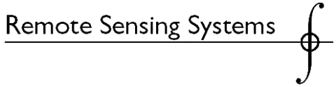
Evaluating the Detection of Mesoscale Outflow Boundaries using Scatterometer Winds at Different Spatial Resolutions
Georgios Priftis¹, Timothy J. Lang², Piyush Garg³, Richard Lindsley⁴, Stephen W. Nesbitt³, Themis Chronis¹
¹University of Alabama in Huntsville
²NASA Marshall Space Flight Center
³University of Illinois at Urbana-Champaign
⁴Remote Sensing System

Slide 2
Background
Scatterometers have been used repeatedly to examine wind signatures induced by convective systems.
Despite the effects of rain contamination on wind retrievals, real signatures have been observed by different studies [Portabella et al. 2012, Elsaesser and Kummerow 2013, Kilpatrick and Xie 2015].
Scatterometers in conjunction with ground-based weather radars can characterize low-level winds induced by mesoscale convective systems (MCSs) [Priftis et al. 2018].
A novel technique to identify cold pools in scatterometer data has been recently introduced by Garg et al. 2020.

Slide 3
Objectives
To what extend are scatterometers able to detect outflow boundaries at different resolutions?
What is the added value of an ultra-high resolution product?

Slide 4
Data
Advanced Scatterometer (ASCAT) on-board MetOp-A and –B
  Wind retrievals at 50-, 25- and 7-km spatial resolution
  Quality flags and background wind information
  Next Generation Weather Radar (NEXRAD)
    KHGX station (Houston, TX)
    Reflectivity, Doppler velocity and spectrum width
    Buoy observations (NDBC)
      Stations EINL1, AMRL1, FRWL1, CAPL1 and 42035
      Continuous (10-m) wind speed and direction every 10 minutes

Slide 5
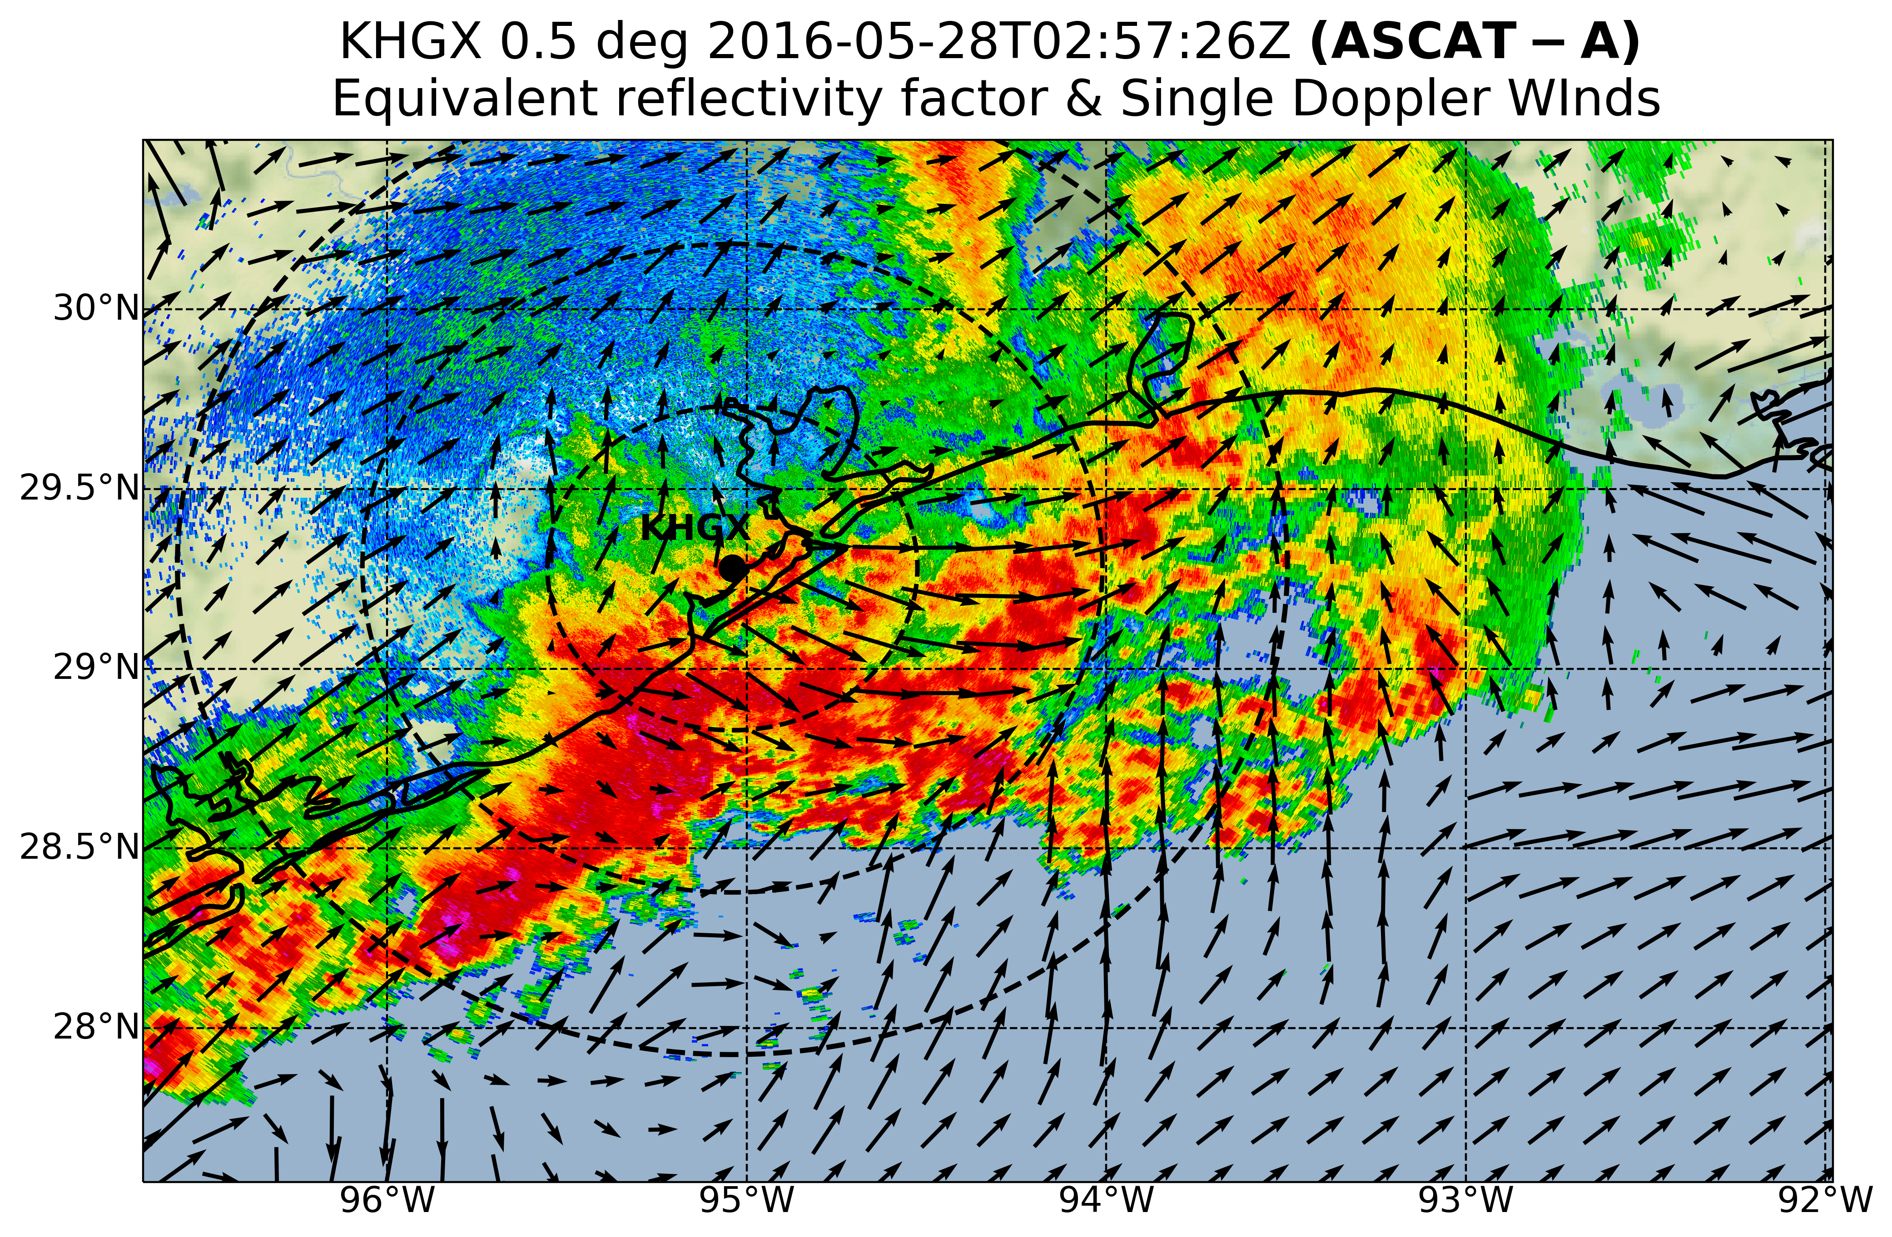
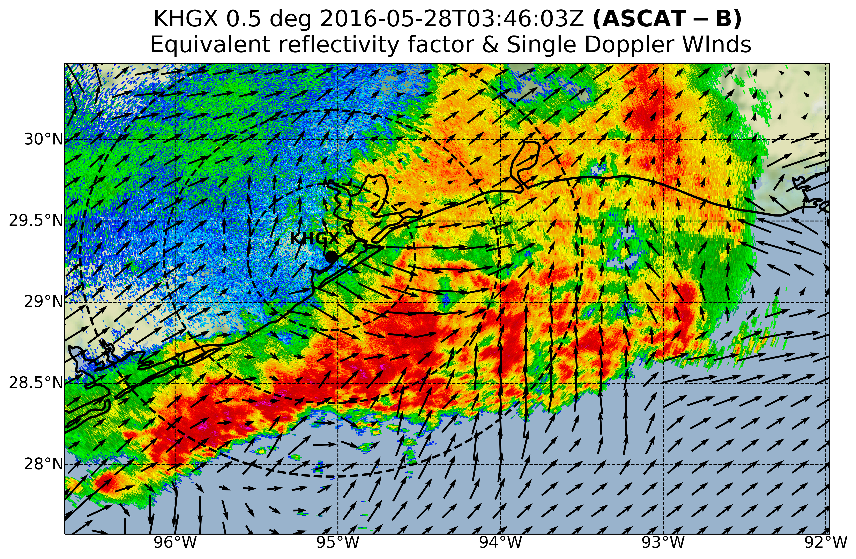
Method 1
Rear-inflow jet
Adjust ASCAT Retrievals
  Quality of retrievals degrades
  near precipitation.
  At close distances from radar Doppler winds
  can represent low-level wind.
  Leverage Single-Doppler wind analysis
  to adjust ASCAT wind retrievals.
Rear-inflow jet

Slide 6
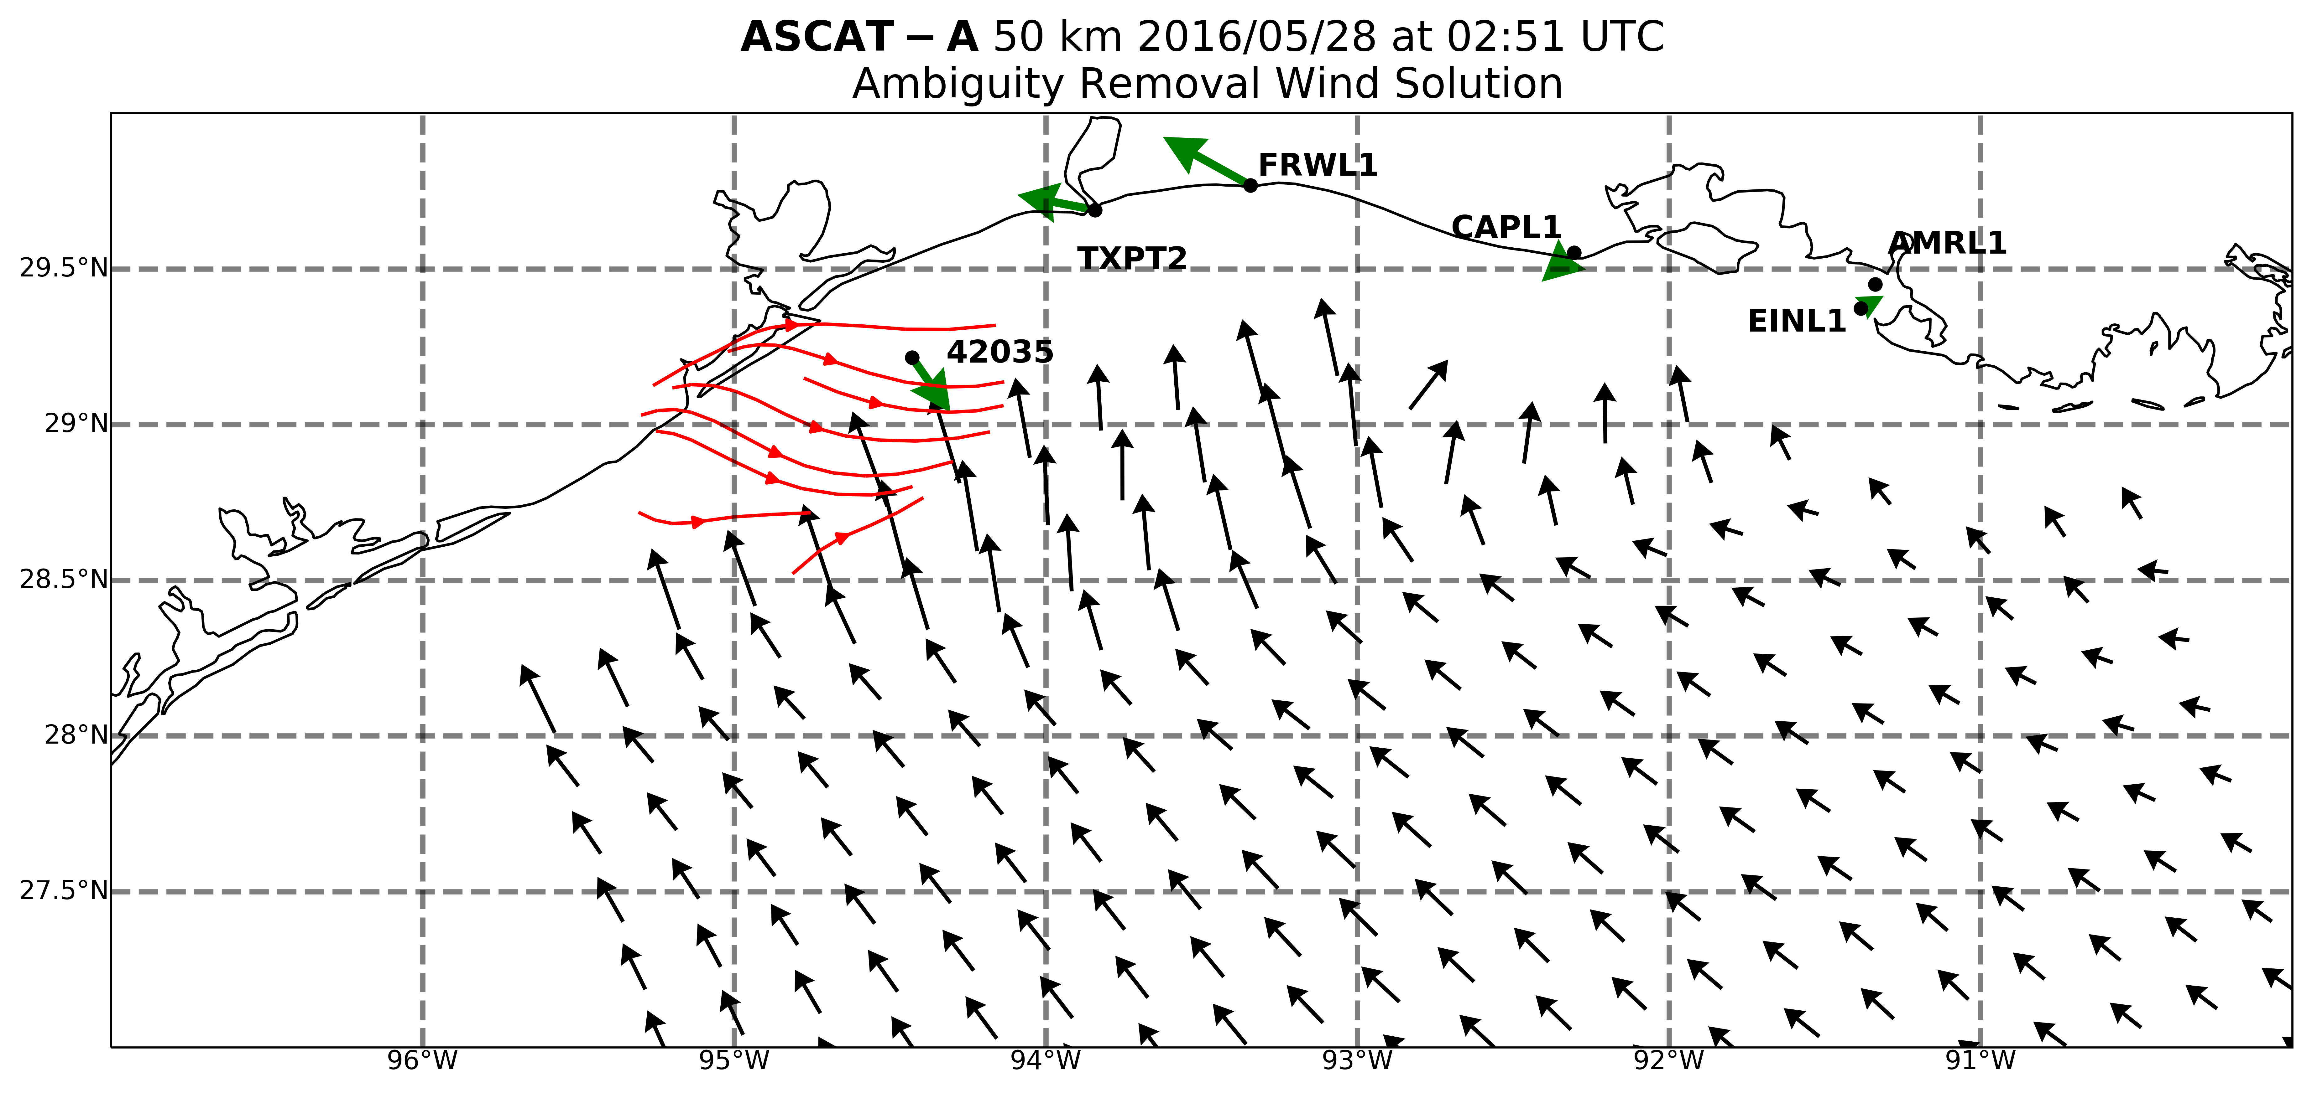
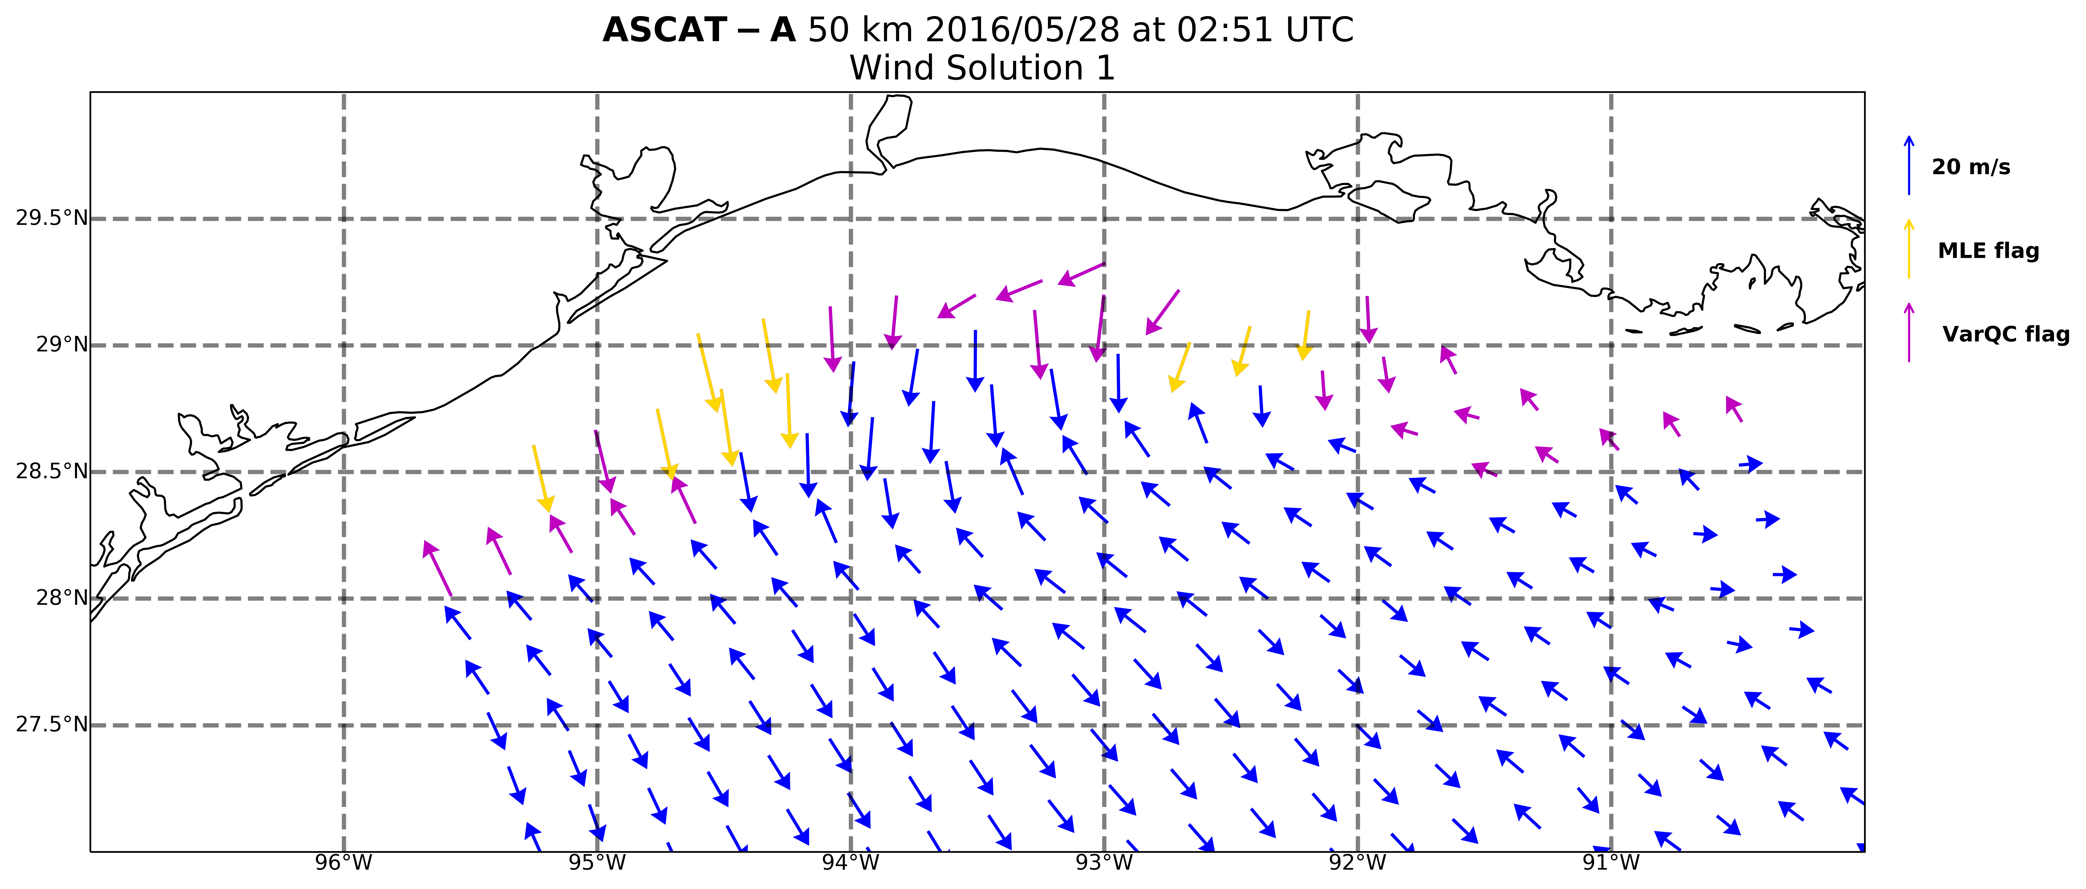
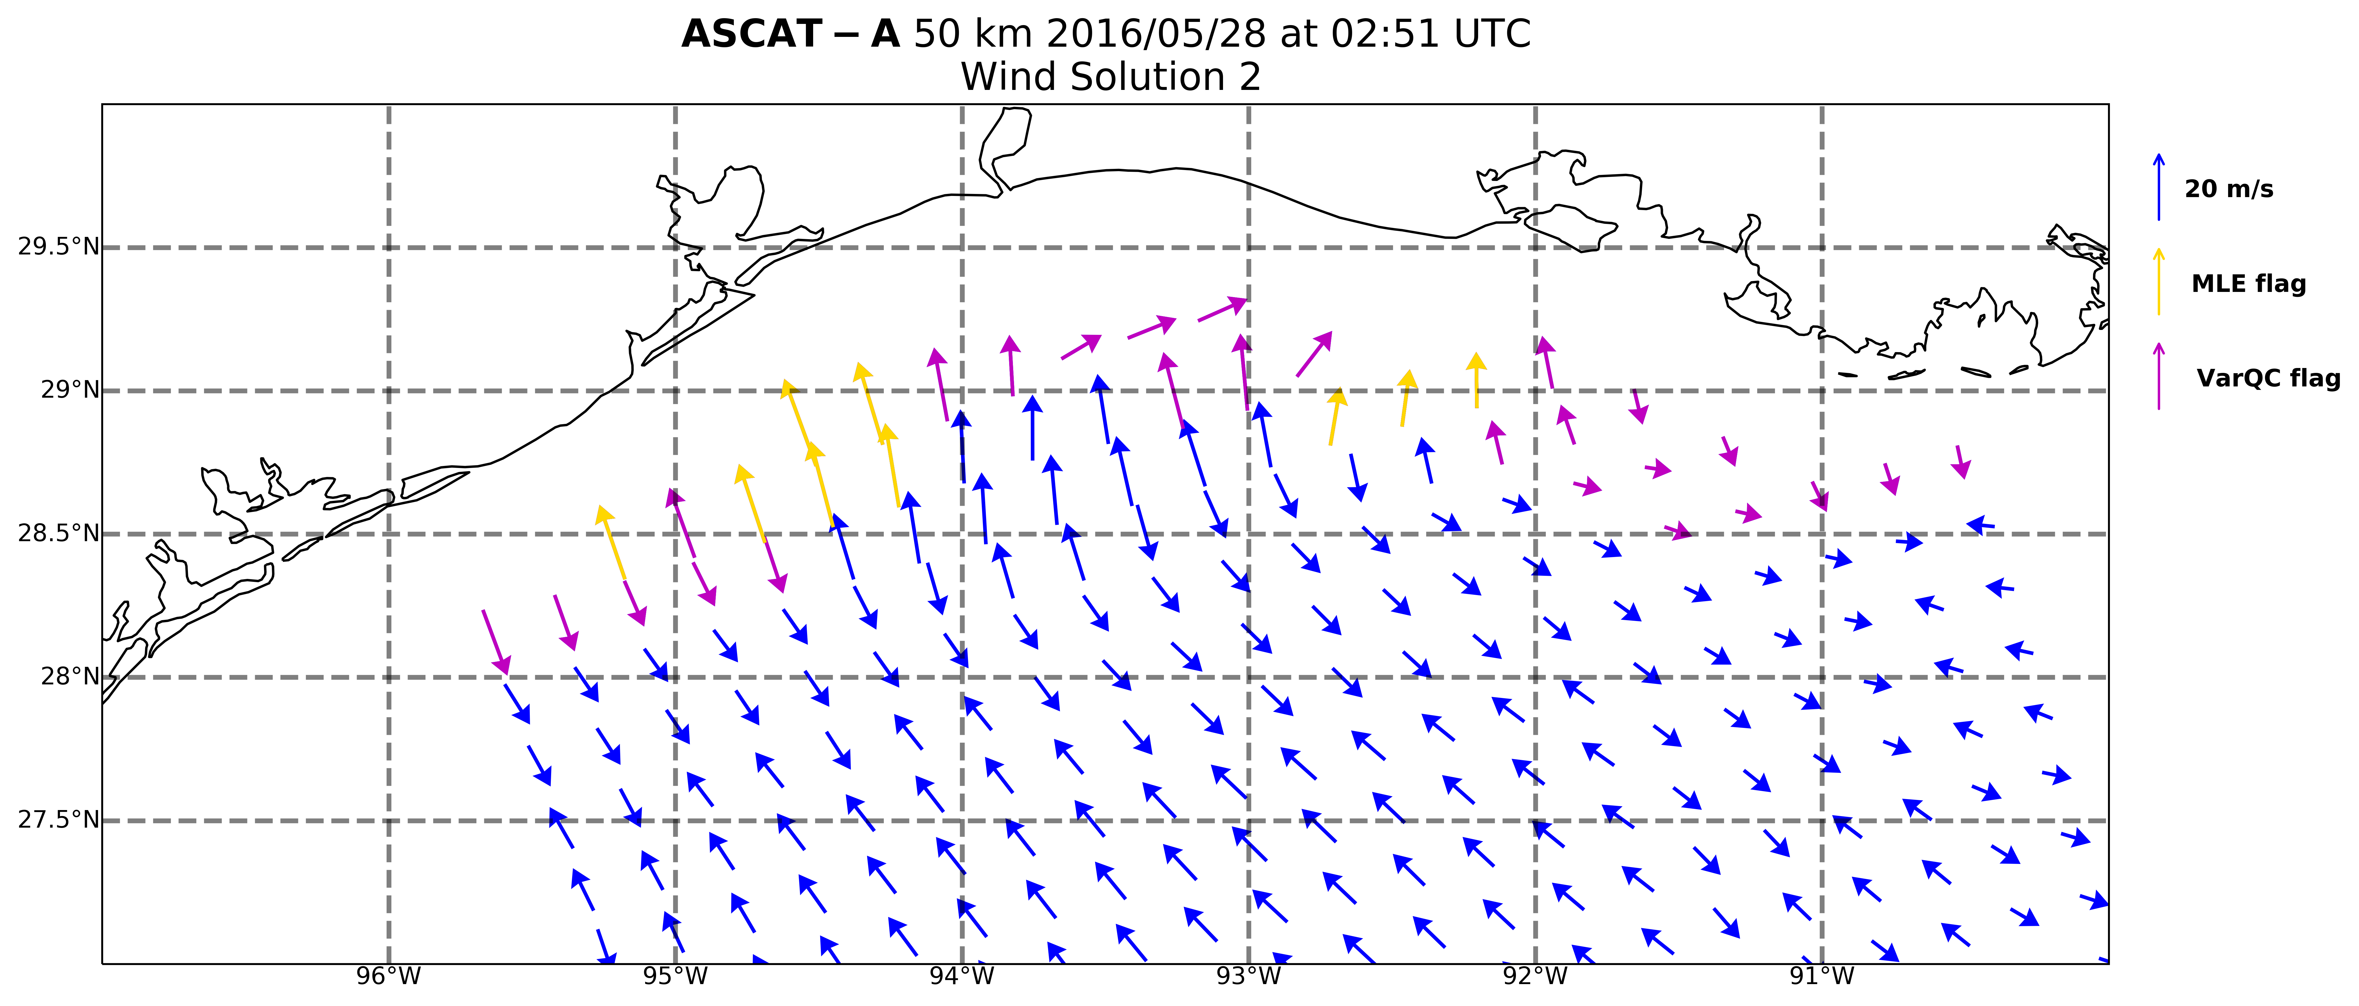
Method 1
: Single-Doppler streamlines
  Explore available unambiguous solution
  Pick solution for which the wind direction
  is closer to the single-Doppler wind direction.

Slide 7
Method 2
Gradient Feature (GF; Garg et al. 2020)
Wind gradient: $∇\vec{V} =\left[\begin{aligned}\frac{∂u}{∂x}+ \frac{∂v}{∂x} \\ \frac{∂u}{∂y}+ \frac{∂v}{∂y}\end{aligned}\right]$ , $\left|∇\vec{V}\right|$ = $\sqrt{{\left(\frac{∂u}{∂x}+\frac{∂v}{∂x}\right)}^{2}+ {\left(\frac{∂u}{∂y}+ \frac{∂v}{∂y}\right)}^{2}}$
Sobel technique for edge detection
Thresholds for GF:
  Background noise (primary)
  Bias (secondary)
  Concave hull algorithm (alpha shape)

Slide 8
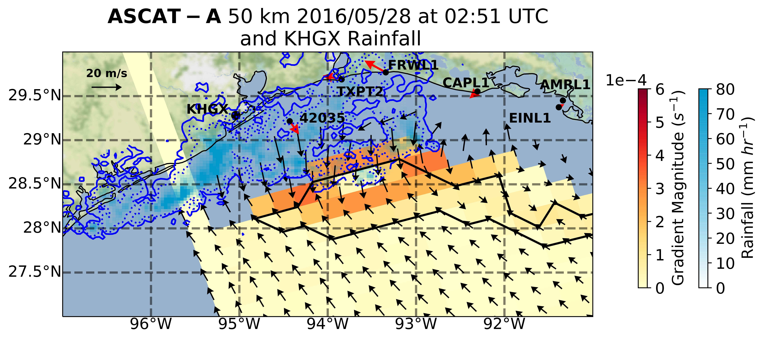
Results
Coarse resolution product (50-km)
  Winds near the coast are absent due to land contamination.
  Wind shift in front of the MCS denoted the presence of the outflow boundary.
  Elevated values of the wind gradient are enclosed by the GF polygon.
GF Thresholds (50-km)
  Primary: 6.8 x 10⁻⁵ s⁻¹
  Secondary: 1.2 x 10⁻⁴ s⁻¹
  GF not sensitive to thresholds

Slide 9
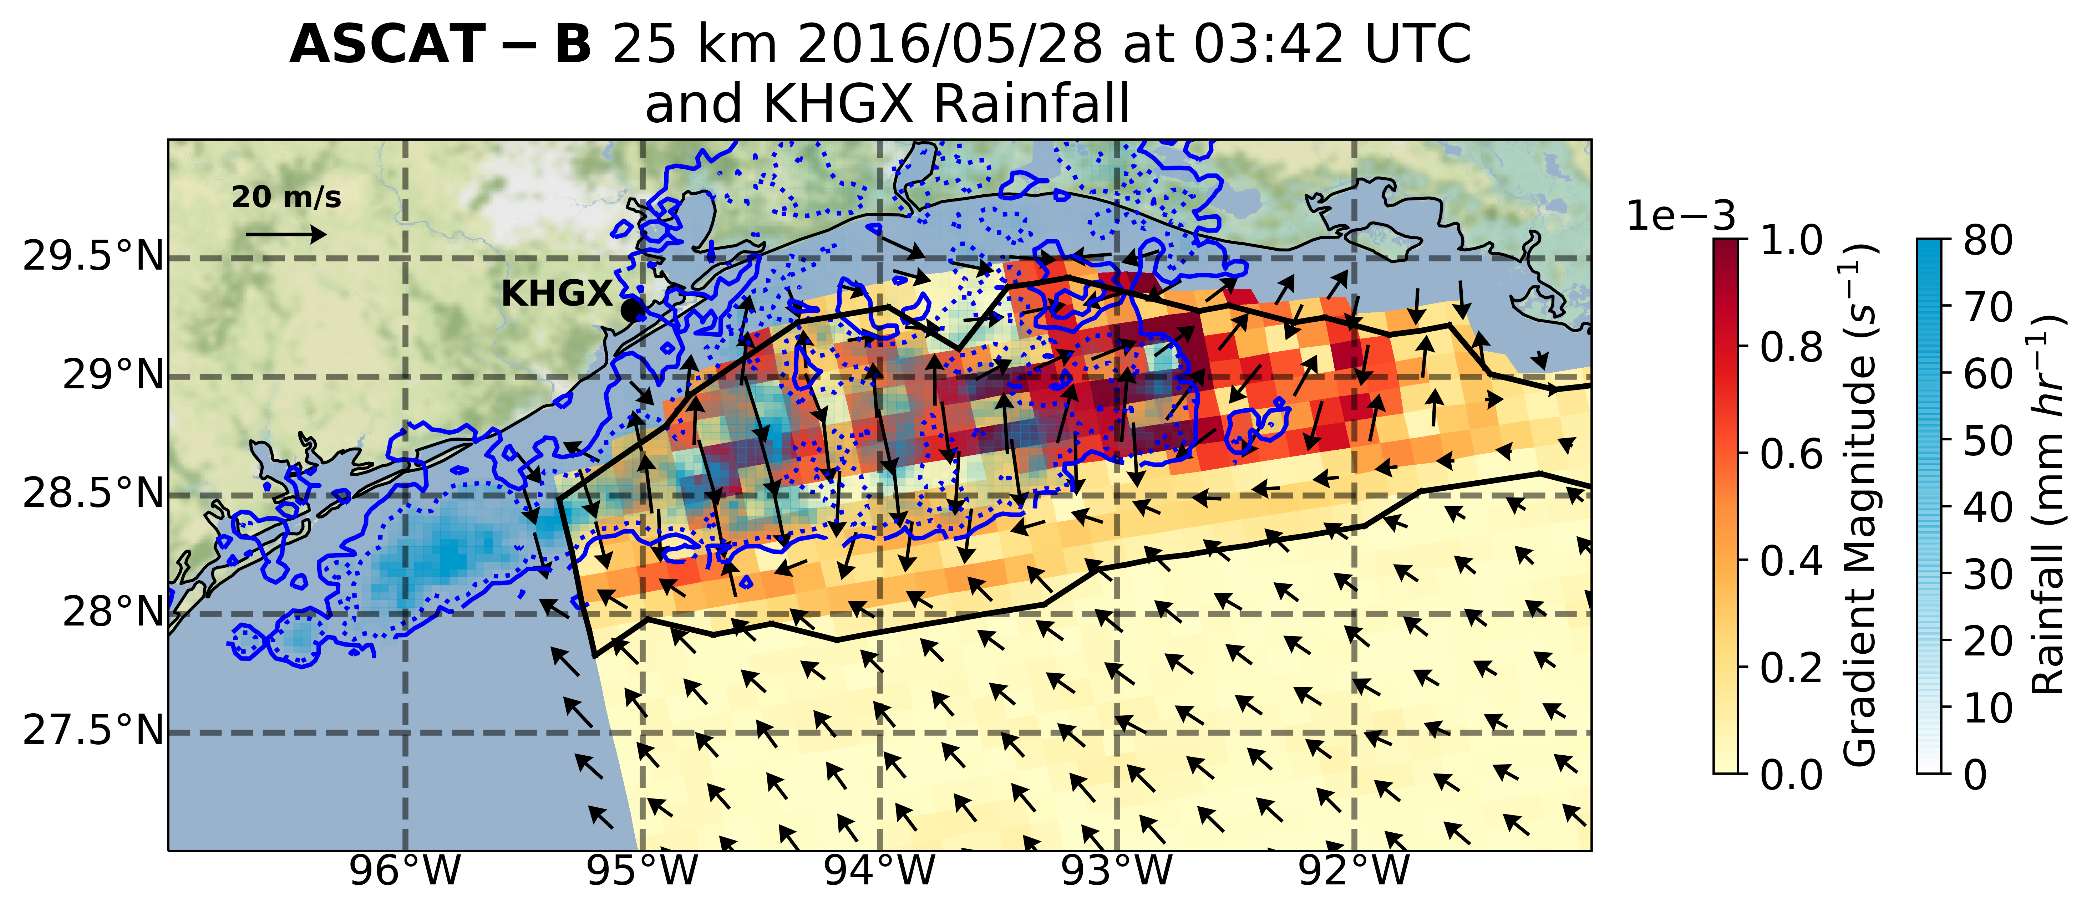
Results
Coastal product (25-km resolution)
  Low quality retrievals over precipitation -> elevated wind gradient magnitude.
  Wind shift observed near the precipitation boundary of the MCS.
  Gradient feature follows the direction of the MCS propagation.
GF Thresholds (25-km)
  Primary: 6.8 x 10⁻⁵ s⁻¹
  Secondary: 1.2 x 10⁻⁴ s⁻¹
  GF sensitive to thresholds

Slide 10
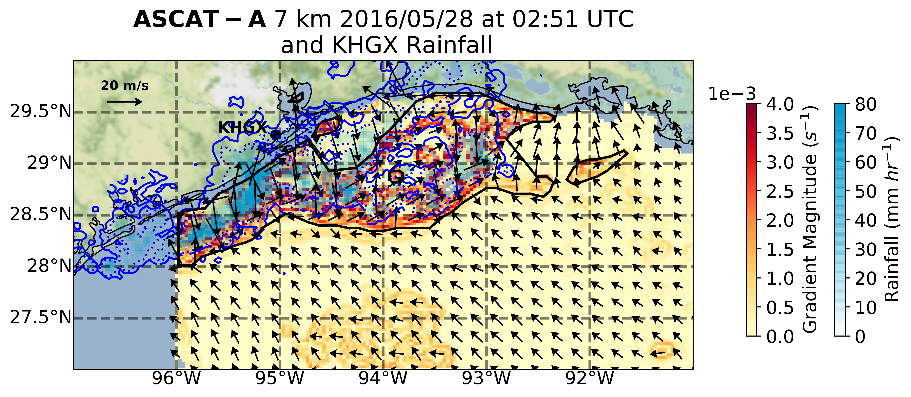
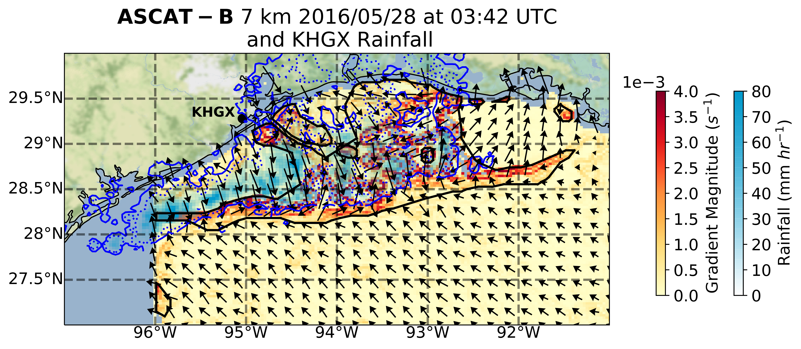
Results
Ultra High-resolution product (7-km)
  UHR can detect fine scale wind deformations.
  Wind shift induced by the gust front observed at the edge of the precipitation boundary.
  Additional gradient features were observed far from the MCS.
GF Thresholds (7-km)
  Primary: 6.8 x 10⁻⁴ s⁻¹
  Secondary: 2 x 10⁻³ s⁻¹
  GF sensitive to thresholds

Slide 11
Conclusions
A method to adjust the scatterometer retrievals near the coast ensured more accurate representation of rain-afflicted wind vector cells.
ASCAT wind product at 50-km spatial resolution is able to identify mesoscale outflow boundaries, also observed as an increase in the wind gradient within a GF feature.
Coarse resolution product is not sensitive to thresholds in the GF algorithm.
The GF feature in the ASCAT wind product at 25-km spatial resolution more accurately encapsulates the precipitating system and its gust front.
Coastal wind product is sensitive to thresholds in the GF algorithm.
The UHR product demonstrates fine-scale structure of the wind gradient associated with the outflow boundary, as well as other small-scale features.
UHR wind product is sensitive to thresholds in the GF algorithm, with an order of magnitude lower thresholds than the coarser resolutions.

