Slide 1
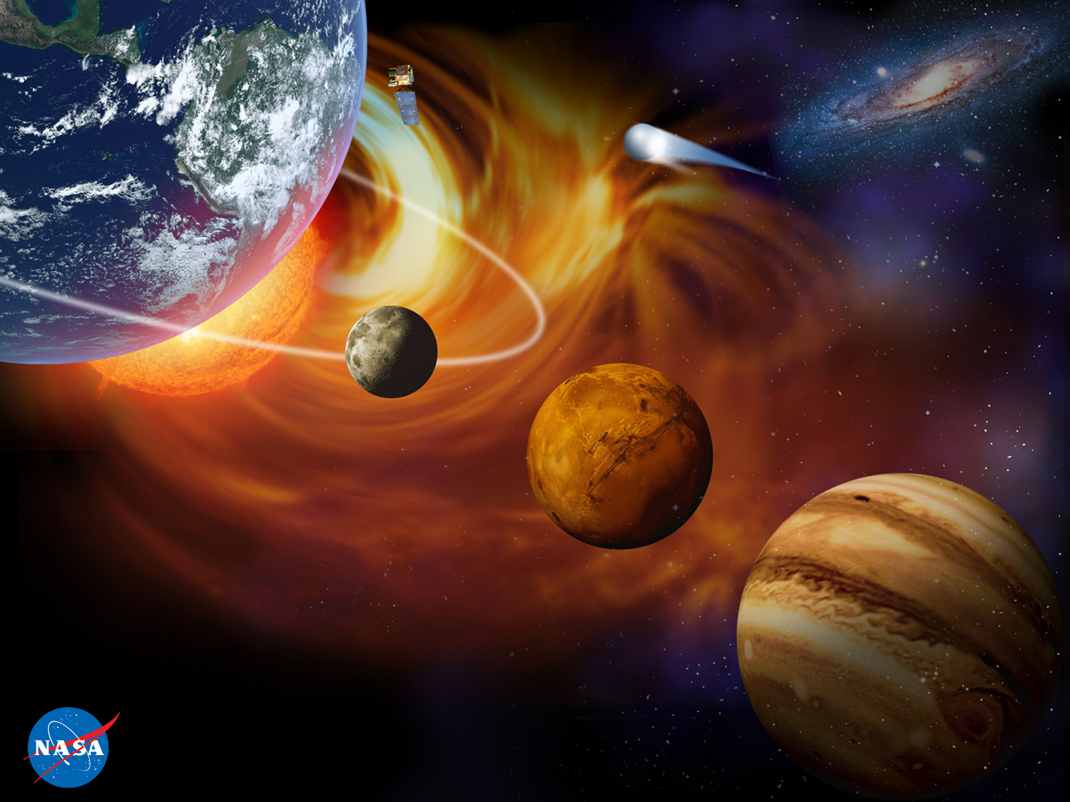
Life as a Mars Engineer
Helen Hwang
Science Missions Development Manager
NASA Ames Research Center
Entry Systems and Technology Division
KIPP San Francisco College Prep
February 10, 2021

Slide 2


A Little Bit About Me
I was born and raised in Iowa
Moved to Cincinnati, Ohio when I was in middle school
Graduated with BS, MS, and PhD in Electrical Engineering from University of Illinois at Urbana-Champaign
I moved out to the SF Bay Area right after submitting my thesis
Thought I might become a professor some day, just like my dad

Slide 3
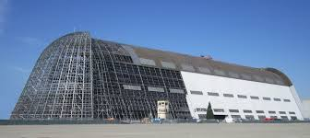
My NASA Background
I work in the South Bay at NASA Ames Research Center at Moffett Field.
I’ve been at NASA ARC for 24 years and for the past 15 years I’ve worked in Entry, Descent, and Landing (EDL) for planetary missions.
I’m an engineer and also a Project Manager
Blimp Hangar at NASA Airfield, from Highway 101

Slide 4
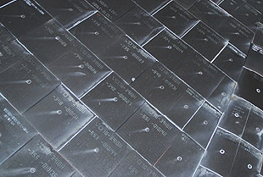
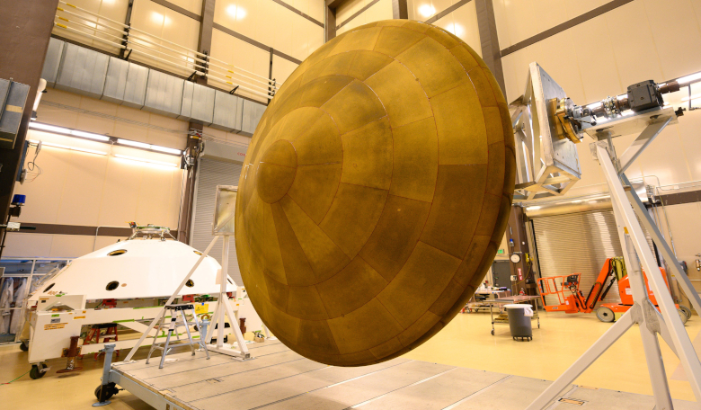
Entry Systems at NASA Ames
My group specializes in heat shields for both human and robotic missions (we invented and developed materials for the Space Shuttle, Mars missions, Pioneer Venus, Galileo…)
  We make and test heat shield materials, and help companies manufacture heat shield materials (both ours and their own)
  We also write and use simulations to predict atmospheric flow, heat shield temperature response, aerodynamic forces on spacecraft, etc.
  We develop instruments that get installed in heat shield which measure temperature and pressure, and analyze the data once we get it back (Earth, Mars, eventually Titan)
EDL Community is a relatively small one and very specialized. We get to know each other well because we work together on different missions over the years.
Images: NASA

Slide 5
About This EDL Stuff….
Entry, Descent, and Landing at Mars happens in about 7 minutes (“Seven Minutes of Terror”, https://www.youtube.com/watch?v=Ki_Af_o9Q9s)
The one-way light speed from Earth to Mars ~12 minutes
If the spacecraft encounters a problem during EDL, there is no time to communicate it back to Earth and for us to fix it
Therefore, the entire EDL sequence must be automated and the spacecraft has to have enough “smarts” built in to handle the most-likely-to-occur problems
Every aspect of EDL has to happen perfectly, no points for partial credit (gotta stick that landing)
That means landing on Mars is very difficult, so far the world’s track record is < 50% (NASA once completely missed the entire planet of Mars…true story)

Slide 6


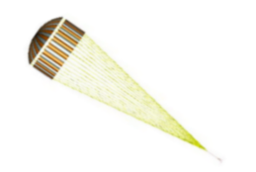
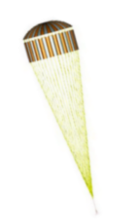









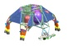


Entry Heating at Mars (Mars Science Laboratory)
Entry Interface: 13,000 mph (5.9 km/s)
The heat shield protects the rover from heating while entering the Martian atmosphere
Peak
Heating
Peak
Deceleration
Hypersonic
Aero-
maneuvering
Parachute
Deploy
Heatshield
Separation
Radar
Data
Collection
Backshell
Separation
Deceleration during the first 2 minutes of EDL reduces about 90% of the entry kinetic energy—which leads to heating on the spacecraft
Powered Descent
Sky
Crane
Flyaway

Slide 7
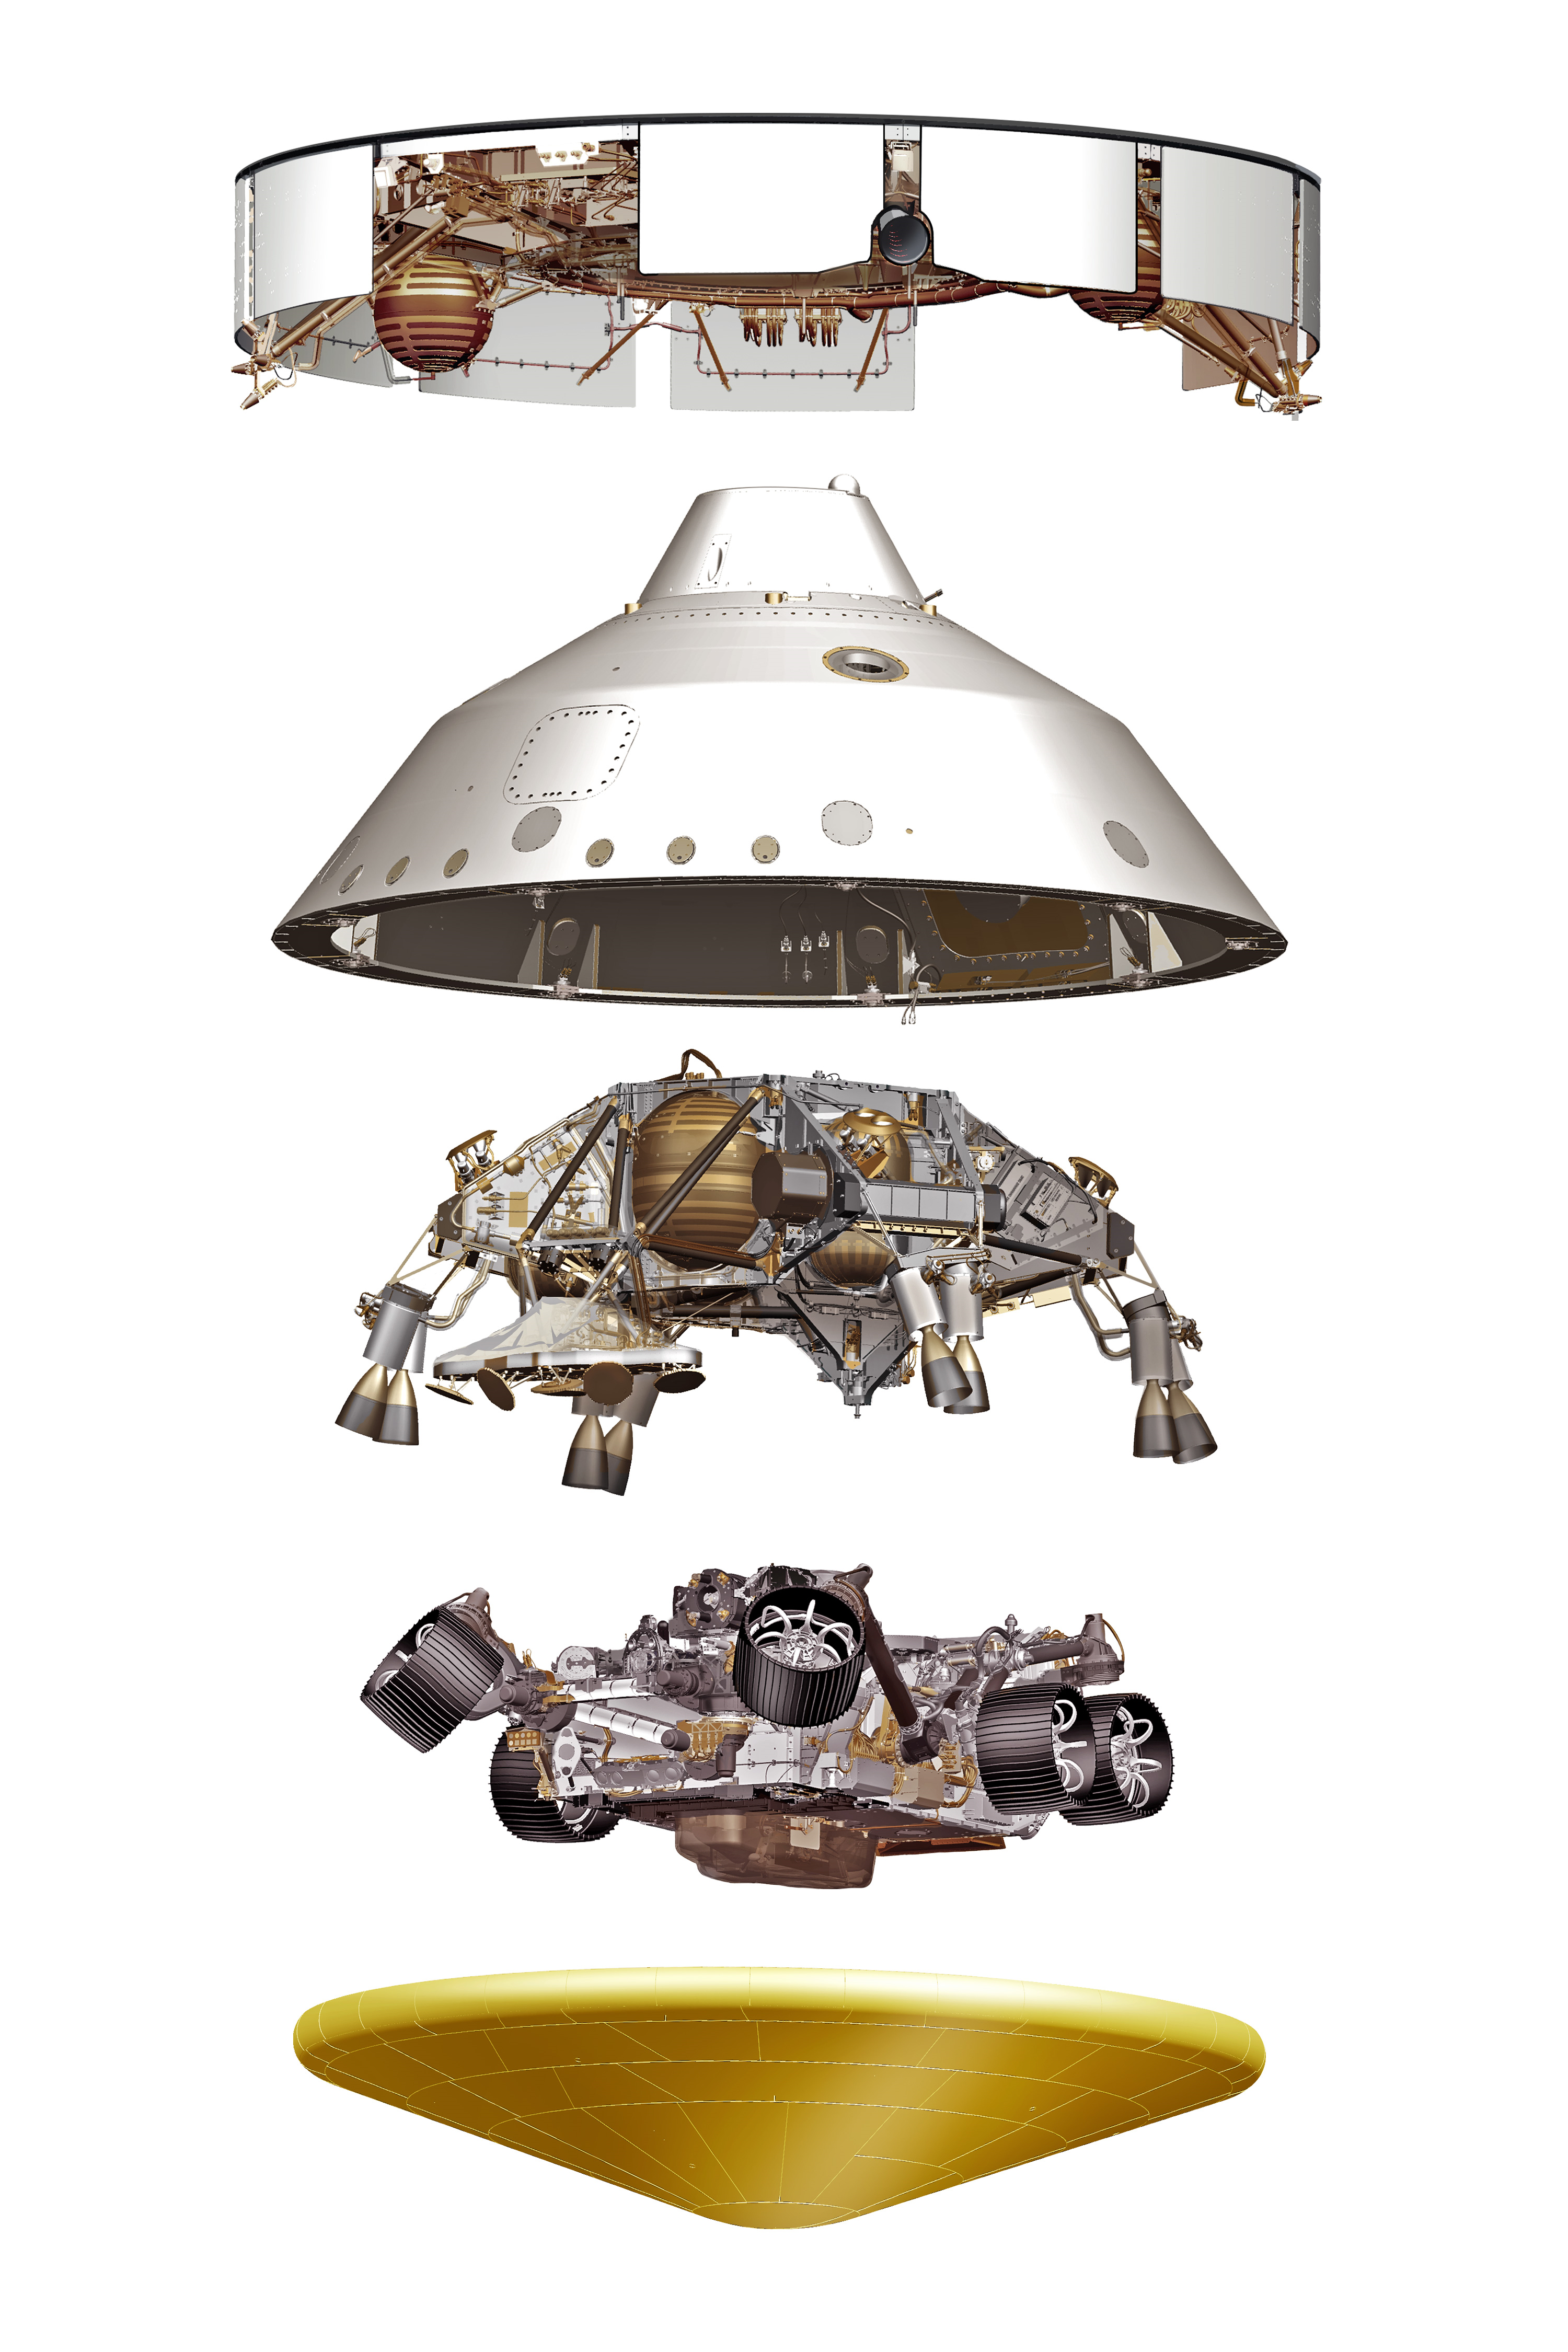
The Mars 2020 Spacecraft
Cruise stage
Backshell
Descent stage (“Sky Crane”)
Perseverance Rover
Heat Shield
Image: NASA

Slide 8
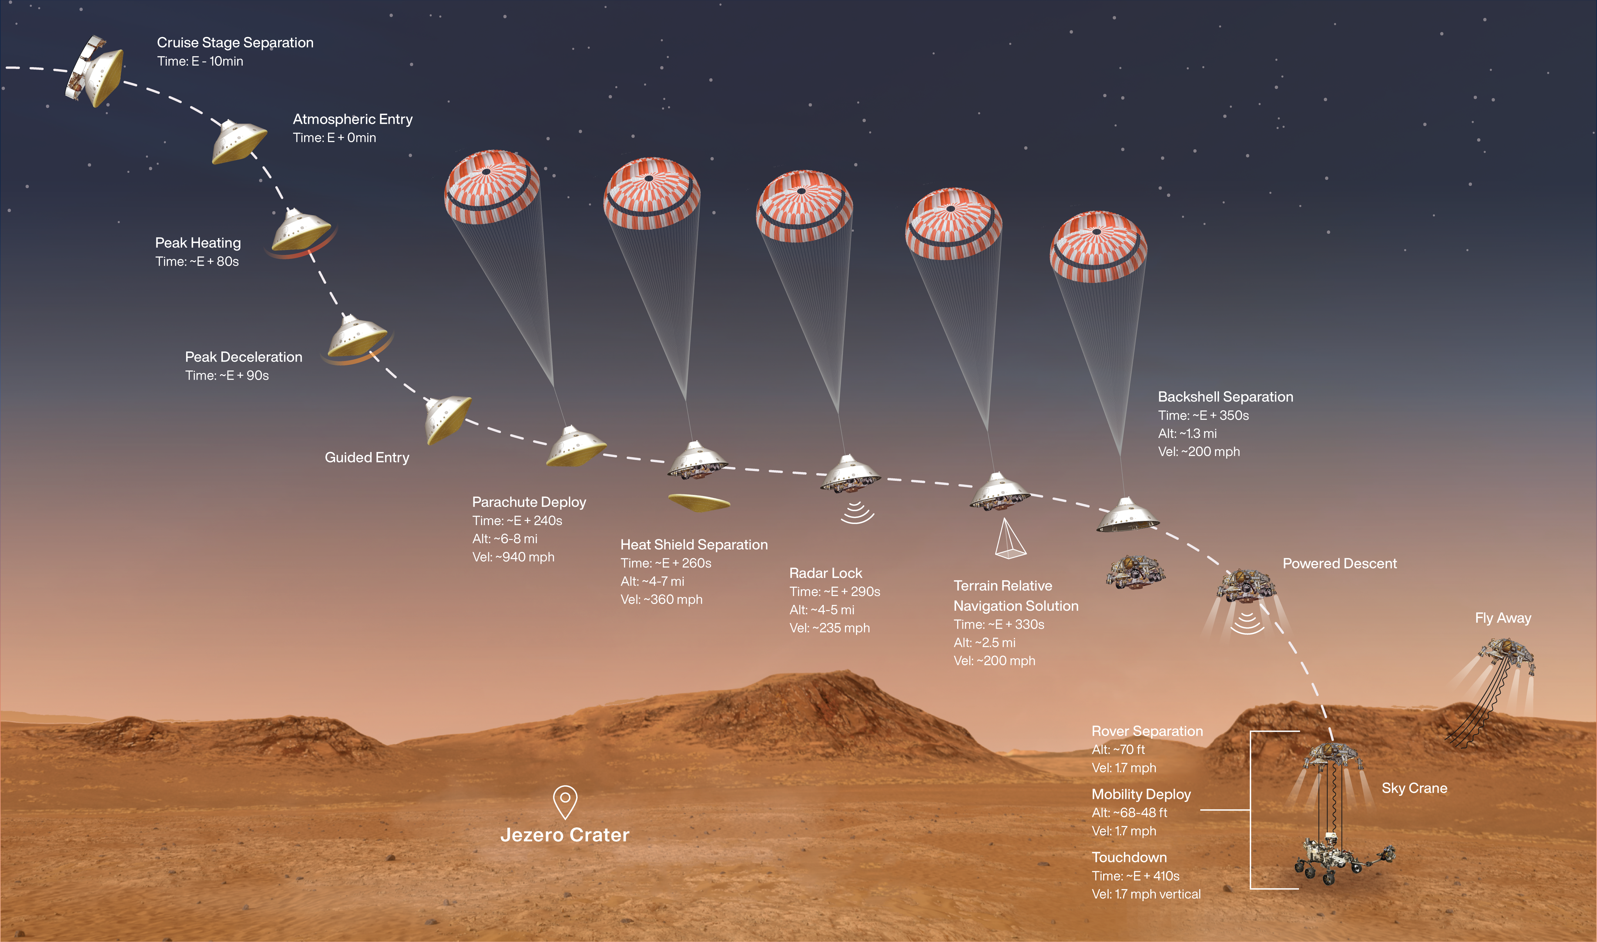
Q: How large does the parachute need to be with respect to the rover?
A: It’s complicated!
21.5 m
3 m
1025 kg
Image: NASA

Slide 9
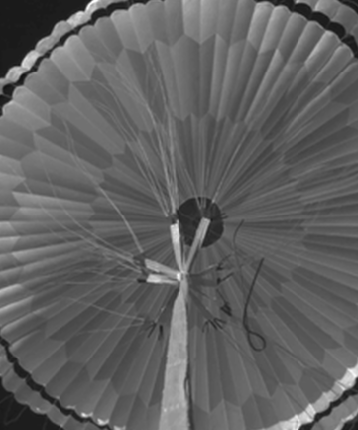
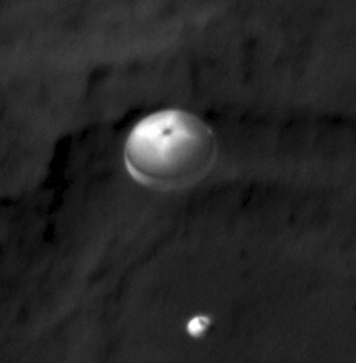
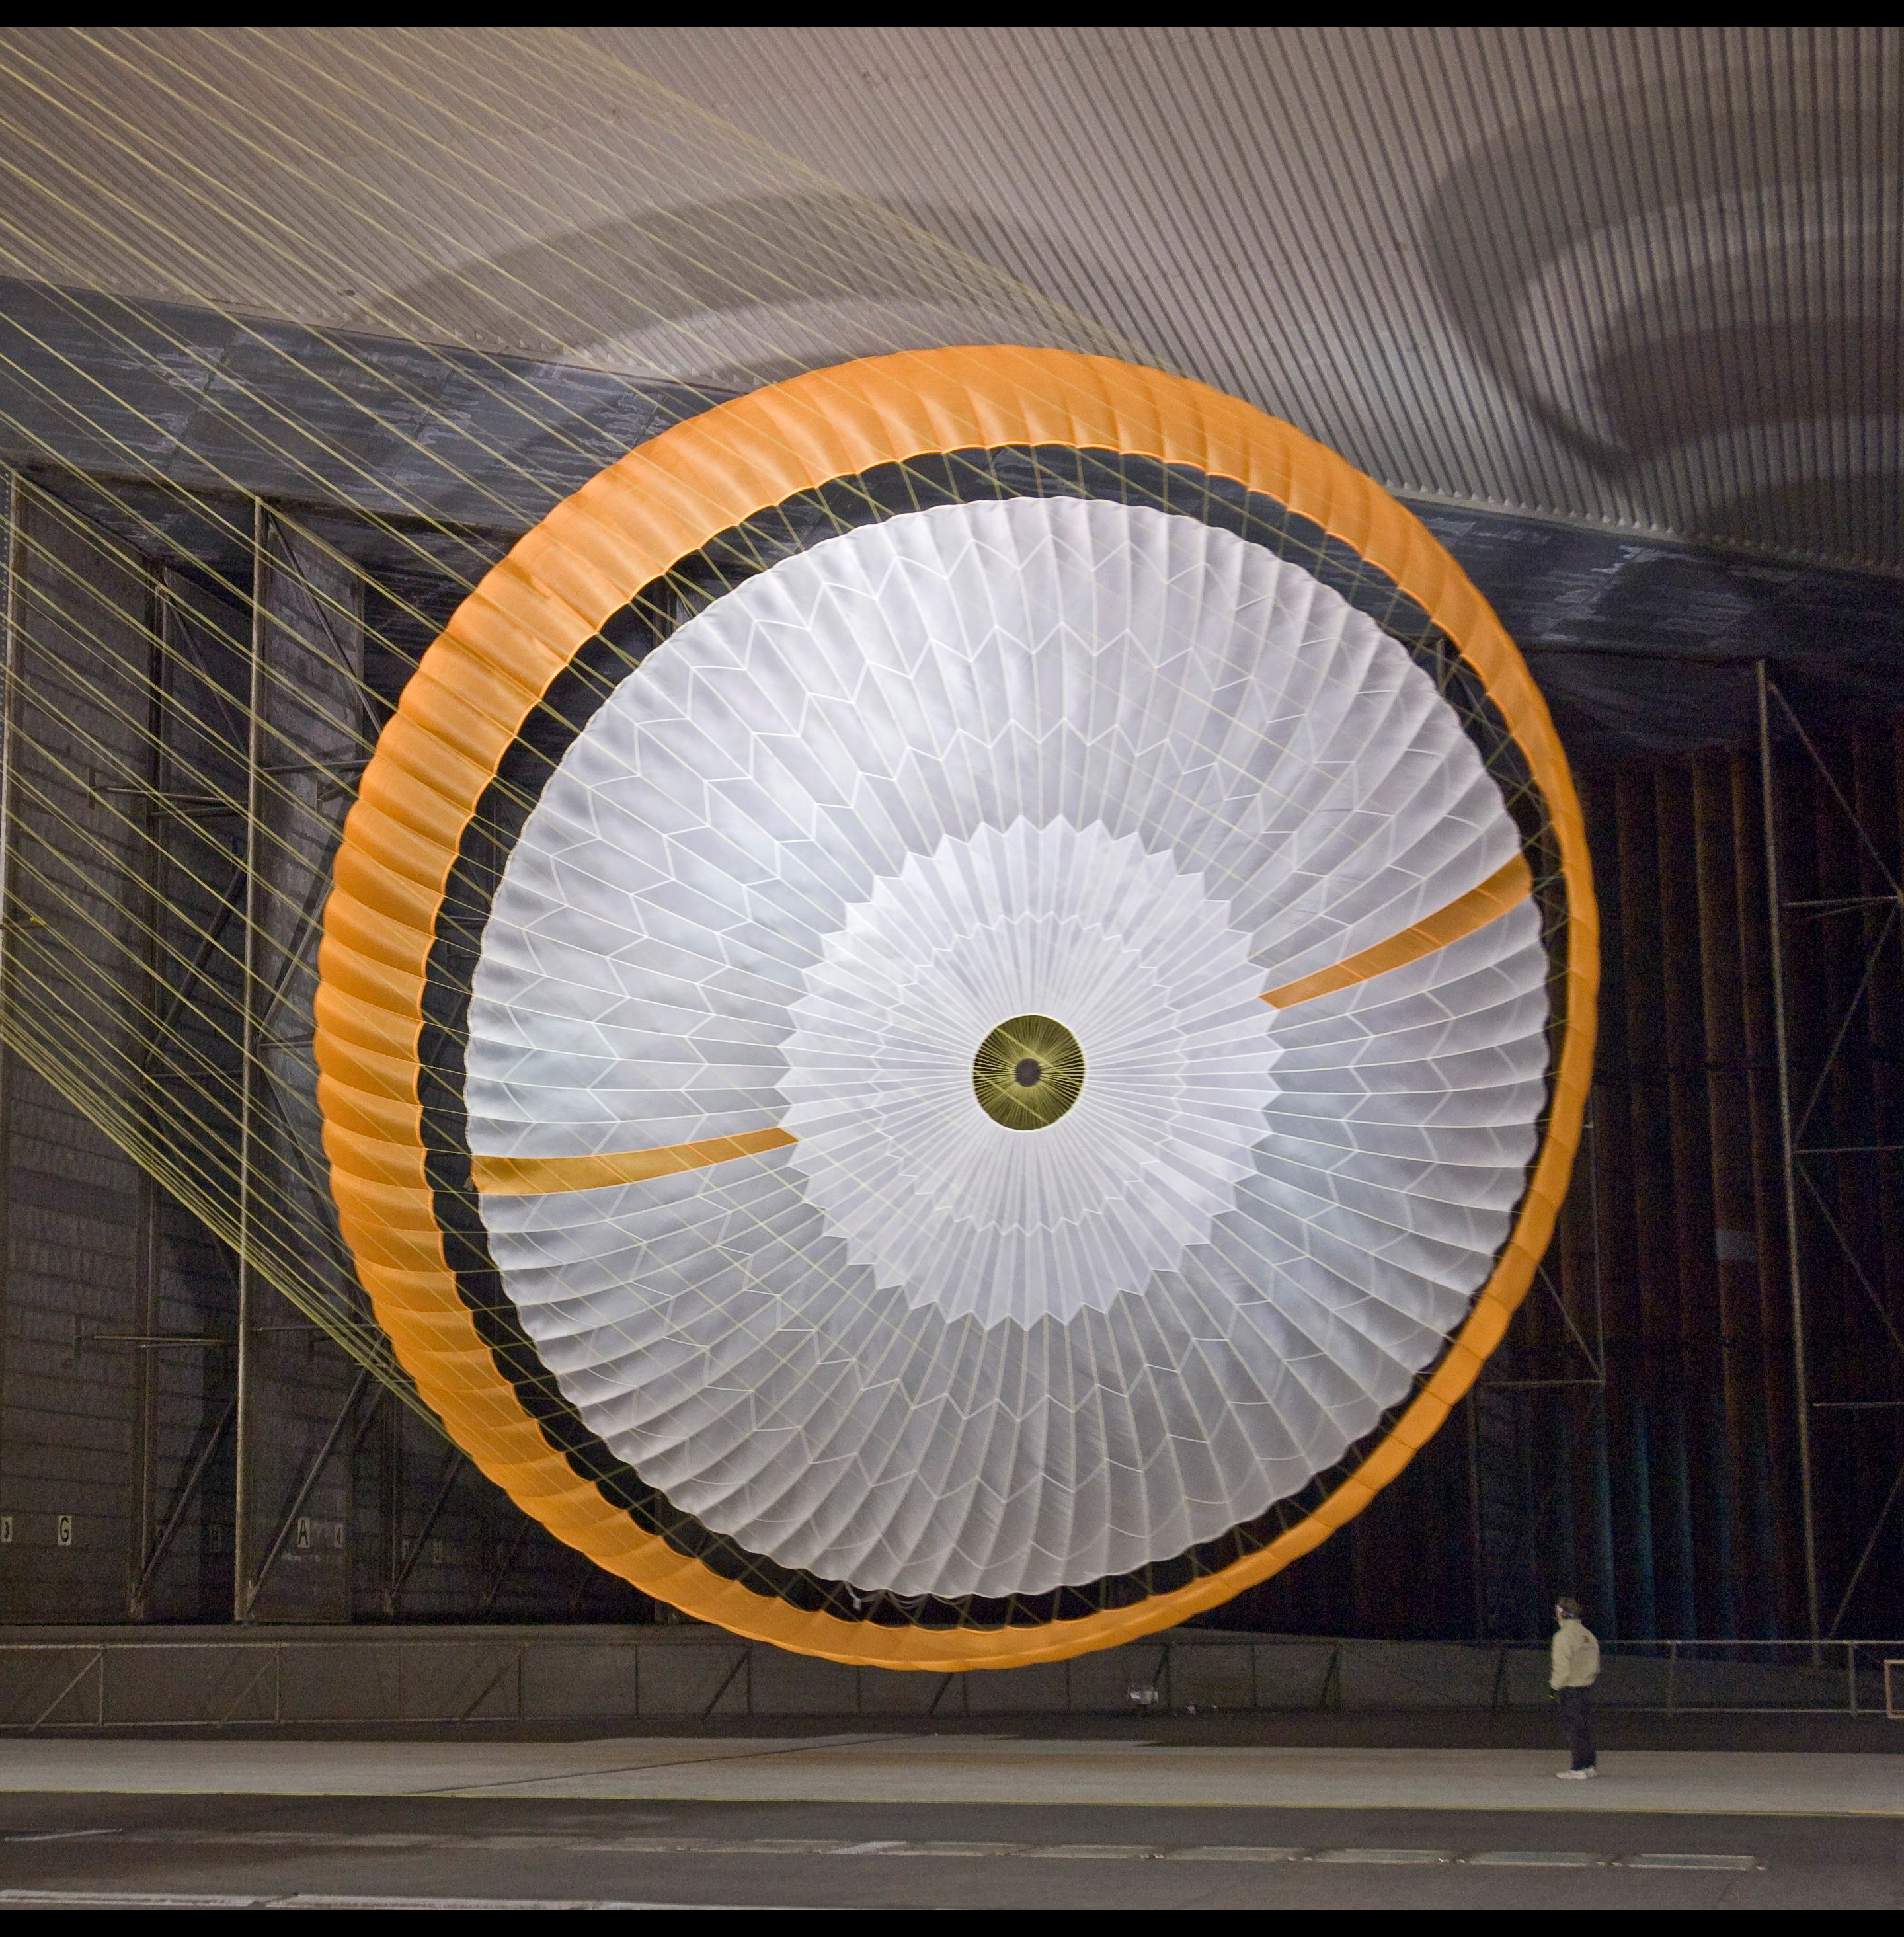
Mars Chutes
M2020 had a flight test
Mars Science Laboratory tested at Ames in a wind tunnel
HiRise camera captured chute at Mars!
Images: NASA

Slide 10
In the Beginning…

Slide 11
What inspired you to become a NASA engineer? ‒Yaneli
How did you get to work for NASA? ‒Samuel
I knew I wanted to become an engineer because I love math and science, and trying to find out answers to How? and Why?
I’ve always wanted to make “sense” of the world, using logical thinking with creative problem solving.
When I was a kid, someone visited our elementary school and talked about Space Shuttle heat shield tiles. I thought that was incredibly neat and it stuck with me. But that didn’t mean I immediately thought that was what I would do for living.
My path to becoming a NASA planetary science engineer was not very straightforward!
  Electrical engineering (most study aerospace engineering)
  Became a NASA onsite contractor studying semiconductor processing, which became nanotechnology, and then needed to find a new field
  I had friends in the same building who did Entry Systems. And lo and behold…

Slide 12
What made you want to study your profession, did you want to be someone else?
–Ariana
I’ve always been interested in many different subjects. In college, I studied both Electrical and Chemical Engineering, as well as mathematics. I wanted to find a field that was dynamic and involved a diverse group of people who had studied many different areas
  My first subject area was plasma physics, which involved applied physics, electrical engineering, chemical engineering, chemistry, … Many disciplines to study in order to attack a problem.
  At NASA, switched from plasma physics/nanotechnology into entry physics, similar subject matter but different application. Entry physics allows me to learn about different fields and interact with people who come from different backgrounds
It is definitely challenging to find a subject area that can be satisfying, particularly if you have many interests.
Matching your personality and passions with the right position and role within a technical field is also important (Technical? Managerial? Outward facing?)

Slide 13
What designs for the rover are efficient in helping it land without problems?
Perseverance (“Percy”) weighs 1.025kg (2,260 lbs), the largest we’ve ever landed anything at Mars using a direct entry. Curiosity was ~900 kg (1,982 lbs).
Ingenuity helicopter is 1.8kg (4 lbs).
We design the entire EDL sequence around a safe landing at Mars for the entire payload, landing where planetary scientists think the richest data can be obtained
  To save driving time on the surface of Mars, the spacecraft will be using Range Trigger to deploy the chute. This technology will sense where the spacecraft is, relative to the target landing spot, and fire the chute once the spacecraft is within range. This will land the rover closer to the target.
  Because Jezero Crater is filled with rock hazards, we are using a new technology called Terrain Relative Navigation (TRN) to “steer” around rocks while we descend. This way, Percy won’t land on a large rock.
The same technologies used for Curiosity, such as guided navigation and the sky crane, will also be used for Mars 2020

Slide 14
What does a regular workday look like? What do you do during work on a daily basis? ‒Edith
Lots of meetings! In a non-pandemic time:
  Discussions with the technical teams to talk about ongoing analysis, trade studies, and other engineering problems, in person, and on the phone/video
  Our teams usually span multiple organizations (many NASA centers across the US) and even internationally, so we are used to having virtual participation
  We also travel to have in-person discussions because communication is very important
Managing a project requires:
  Developing a schedule that includes milestones and due dates for tasks (“deliverables”)
  Developing a budget so that funds to buy things, pay for people’s time, etc. is given to us on time
  Tracking progress for both schedule and budget
  Checking in on team members (“How’s it going? What problems are you encountering?”)
More meetings and writing up reports, presentations:
  Presenting to supervisors and funding agents so they understand our progress and problems
  Asking for more $$
  Presenting results at scientific conferences and talking to the public
It’s a good thing that I like to talk!

Slide 15
Problems, Problems, Problems…

Slide 16
Any obstacles you face that keep coming up a lot during your test runs? If yes, how do you go about making sure they are completely taken care of?
Was there ever a thought of giving up on the whole project and throwing it out the window? –Jaime
What were your biggest struggles in this field and how did you work to overcome it? –Bianna
Yes, I’ve faced many technical obstacles there are difficult and sometimes I wondered if we would be able to launch our mission on time.
Although I don’t think I’m an optimist, I’ve always felt sure that we could develop a solution because I really believe in our abilities to solve a problem together.
Usually the path to success means:
  Asking the experts the right questions and having them on the team to solve the problem,
  Using logic to work through hypotheses and testing them one by one,
  Having a back up plan!!

Slide 17

Heat Shield Material Failures—The Struggle is Real
This material kept disappearing during test runs, which is definitely not a good thing for a heat shield.

Slide 18
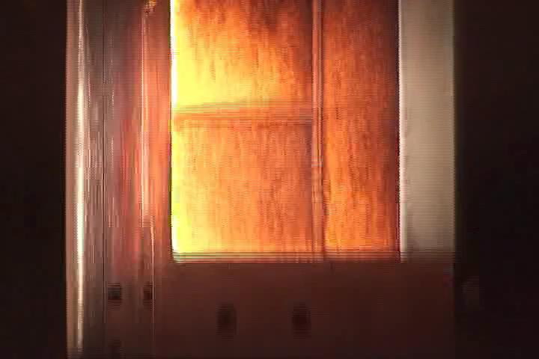
Sometimes Abandoning a Plan is the Only Answer
Switching to a different material meant lots of work in less than 2 years, but it meant we had a successful heat shield for MSL and M2020.

Slide 19
Interpersonal Problems (not as fun as technical ones)
Believe it or not, problems between people is often the most challenging part of the job.
  Learning how to communicate effectively with people is an ongoing issue (“Do I understand what she is telling me?” “Does he understand what I just said?”)
  Our different backgrounds make us view the world differently, we have different values and priorities, so we don’t always approach a problem with the same style
    This can be very good in overcoming obstacles
    This can also create obstacles!
Sometimes, the most brilliant people are the most difficult. Their unique viewpoint is valuable but can be misinterpreted by others.
Let’s face it, engineers are not in the field because they excel at human relationships… Some of us are not as developed in expressing ourselves well and dealing with our emotions effectively.
We take training classes to learn the “soft” skills. So learn how to deal with all kinds of people (including yourself!), it will be very valuable in your job and in your life.

Slide 20
Success, and Moving On

Slide 21
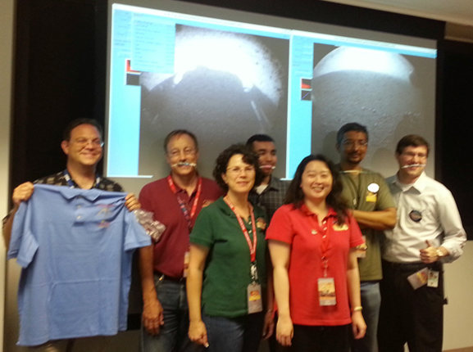
What did it feel like when finally being done with a rover? How many tries did it take? How long did it take? –Victor
Is this the most challenging thing you've done? What is the next big goal? ‒Flor
I personally feel anxious because our work is done for the entry system part of EDL. There is nothing I can do except wait, and wait, and wait…
Once the rover lands on Mars, the feeling is INCREDIBLE! Celebrating with all of my team mates was such a joy after spending many years of hard work
Mars Science Laboratory, the rover that landed in 2012, was definitely the most challenging work I’ve done to date. We had to design a new heat shields in less than 2 years.
M2020 has been in work since 2013. All of the hard work that went into MSL helped to accelerate M2020.

Slide 22
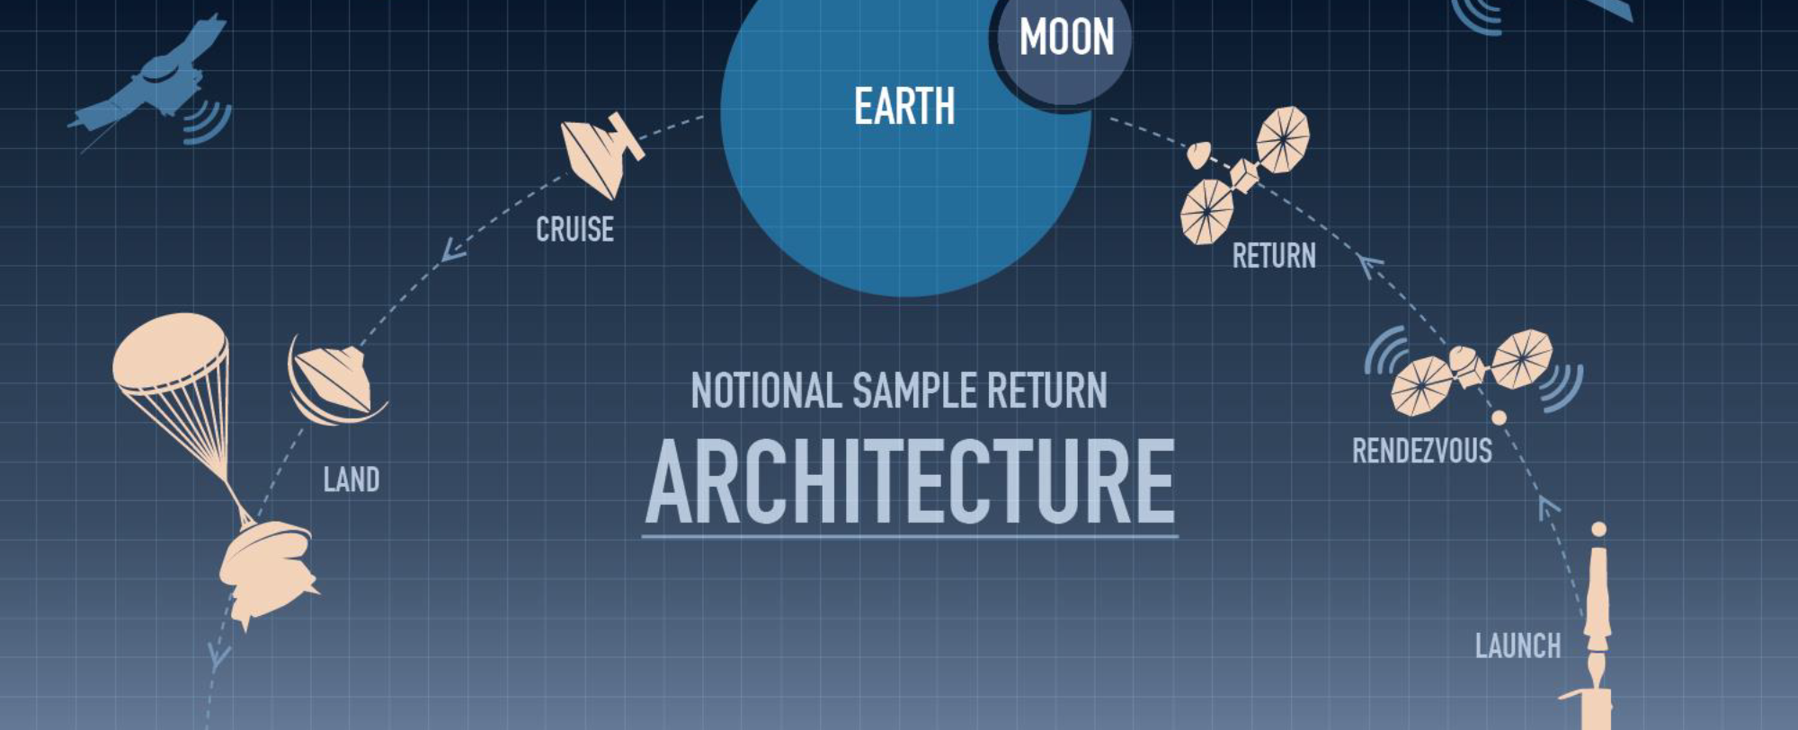
Mars Sample Return
The next set of missions for Mars is the 2nd and 3rd missions that will take the samples of Martian soil that Percy collects and bring them back to Earth
NASA will be collaborating with the European Space Agency to execute these 2 missions
Image: NASA

Slide 23
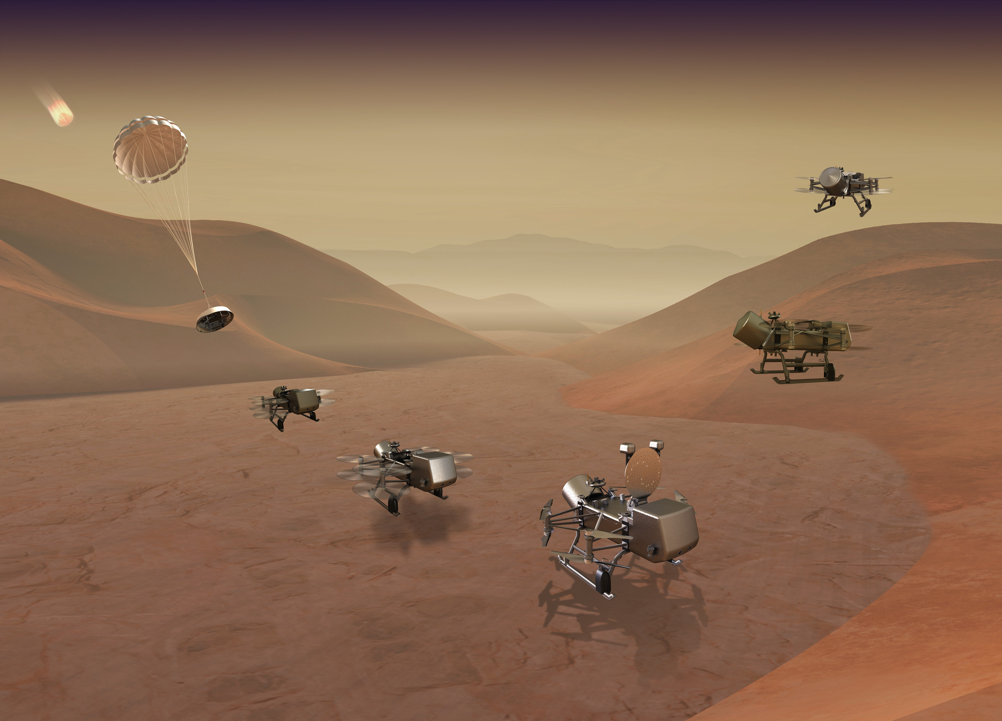
My Next Career Challenge
I will be managing the EDL portion for the Dragonfly mission, NASA’s rotorcraft mission to Titan (Saturn’s largest moon), with arrival ~2037. https://dragonfly.jhuapl.edu/What-Is-Dragonfly/
Image: Johns Hopkins APL

Slide 24
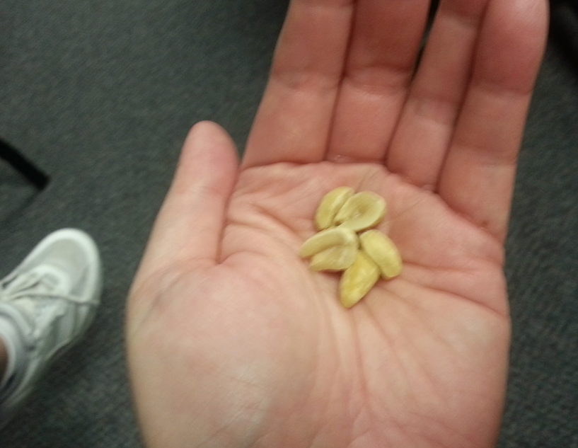
All Eyes on Mars
Watch the Mars 2020 landing event on Friday, February 18th, 11:15 am PT: https://mars.nasa.gov/mars2020/timeline/landing/watch-online/
Learn more about M2020 and Percy here: https://mars.nasa.gov/mars2020/
Don’t forget your lucky peanuts!

Slide 25

Any other questions?

