Slide 1
NASA Langley Research Center
OCIO Data Science Team
Ed McLarney
Associate CIO for Technology & Innovation
OCIO Data Science Strategic Lead
Second Artificial Intelligence and Data Science Workshop
February 9-11, 2021

Slide 2

Growing Capability through Collaboration
 | FY14 – FY16 | FY17 – FY19 | FY19-21+
Exploring Machine Learning | Knowledge Discovery Data Mining | Reinforcement Learning Deep Learning | Intelligent Systems Easy-to-Use Platforms
Applying Text Analytics & Expert Systems | Watson Content Analytics & Discovery Advisor | Watson Explorer Natural Language Processing | Cloud Applications Jargon-Enabled Systems
Providing Training, Education, & Outreach | Seminar Series Partnering across LaRC | Workshops & Tutorials Collaborations across NASA | Agency AI/ML Embedded Workforce Awareness & Facilitation
Philosophy | for all customers |  | Balanced approach:
D O
when needed
D O
T E A M
when practical
D O
T E A M
C O N S U L T
C O N S U L T
where possible

Slide 3
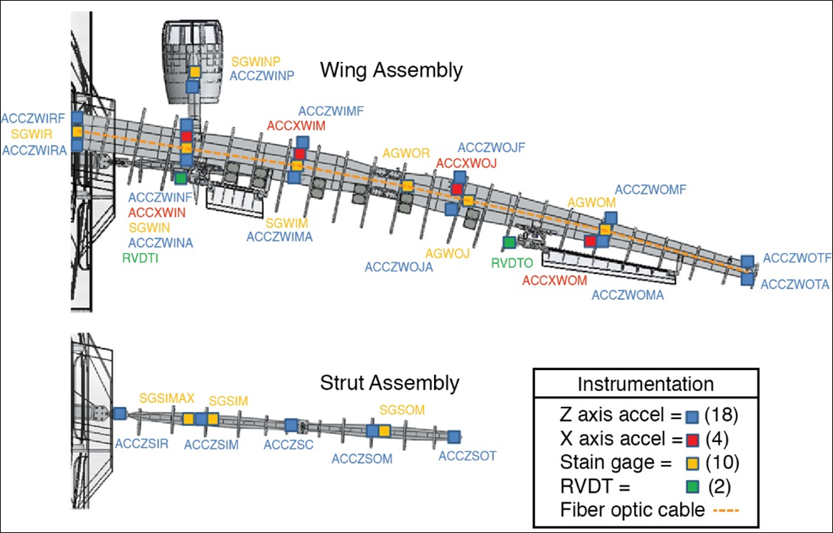
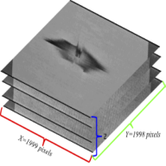

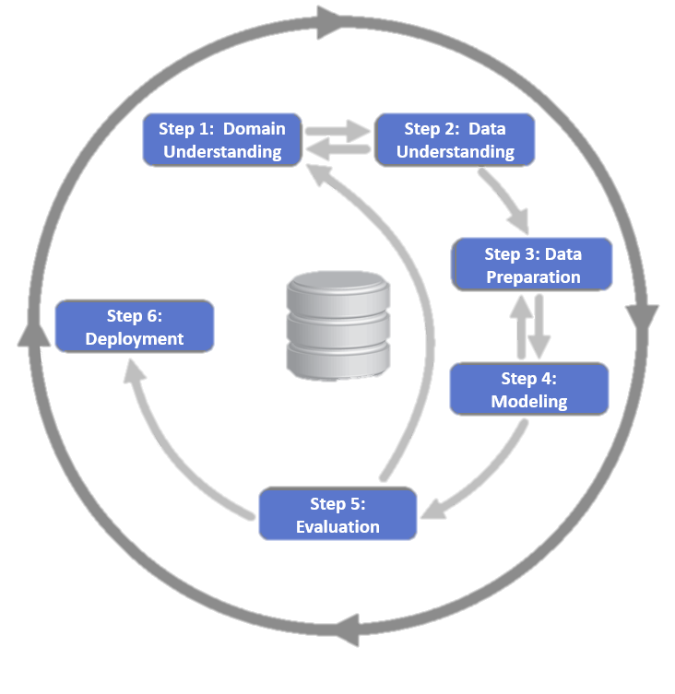
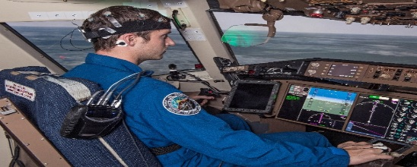
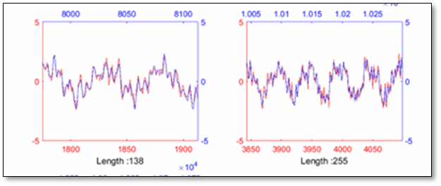
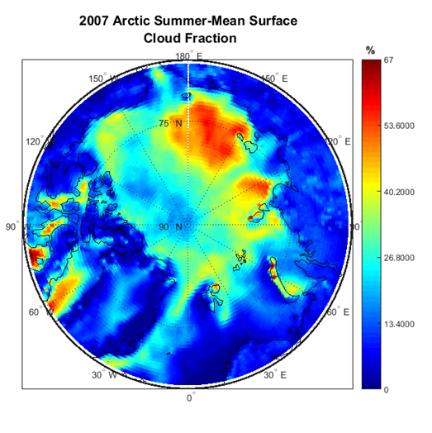
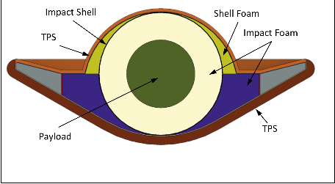
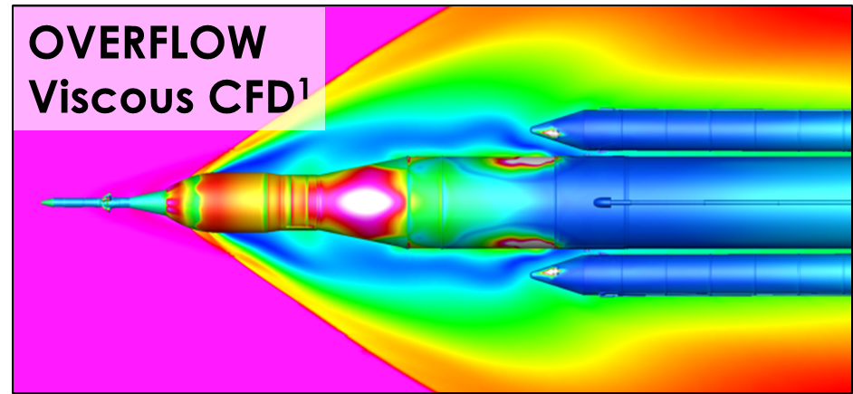
Define a Repeatable Process
Knowledge Discovery in Databases
Extracting previously unknown information
Data Mining
Detecting patterns and relationships in data
Machine Learning
Classification or prediction, based on properties learned from training data
Reinforcement Learning
Optimal choice in a given situation, based on reward
CRISP-DM

Slide 4
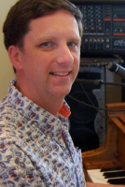

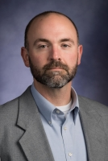
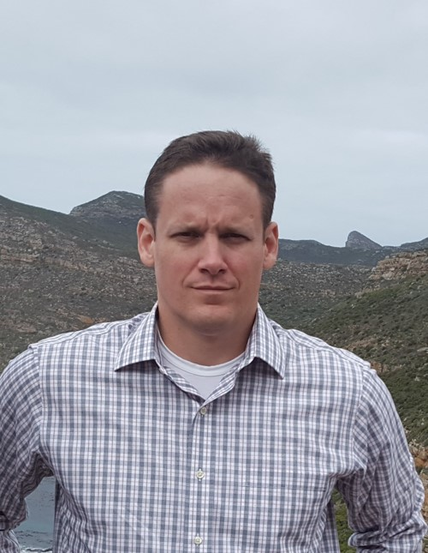
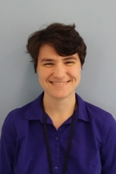

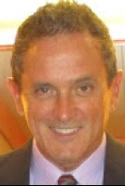
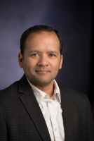
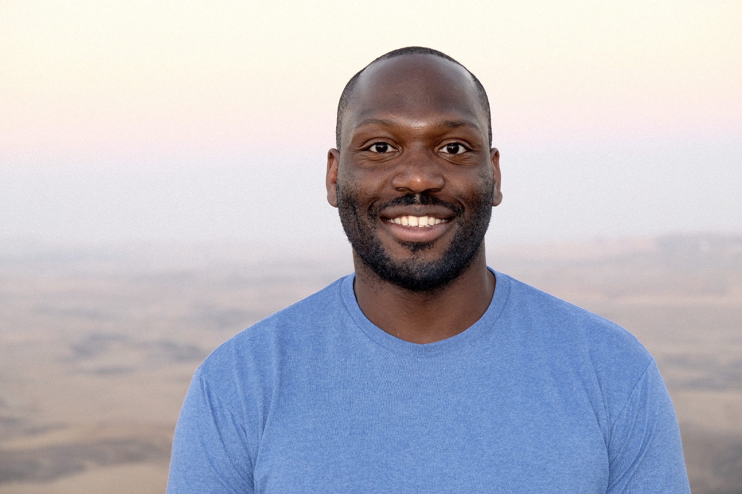
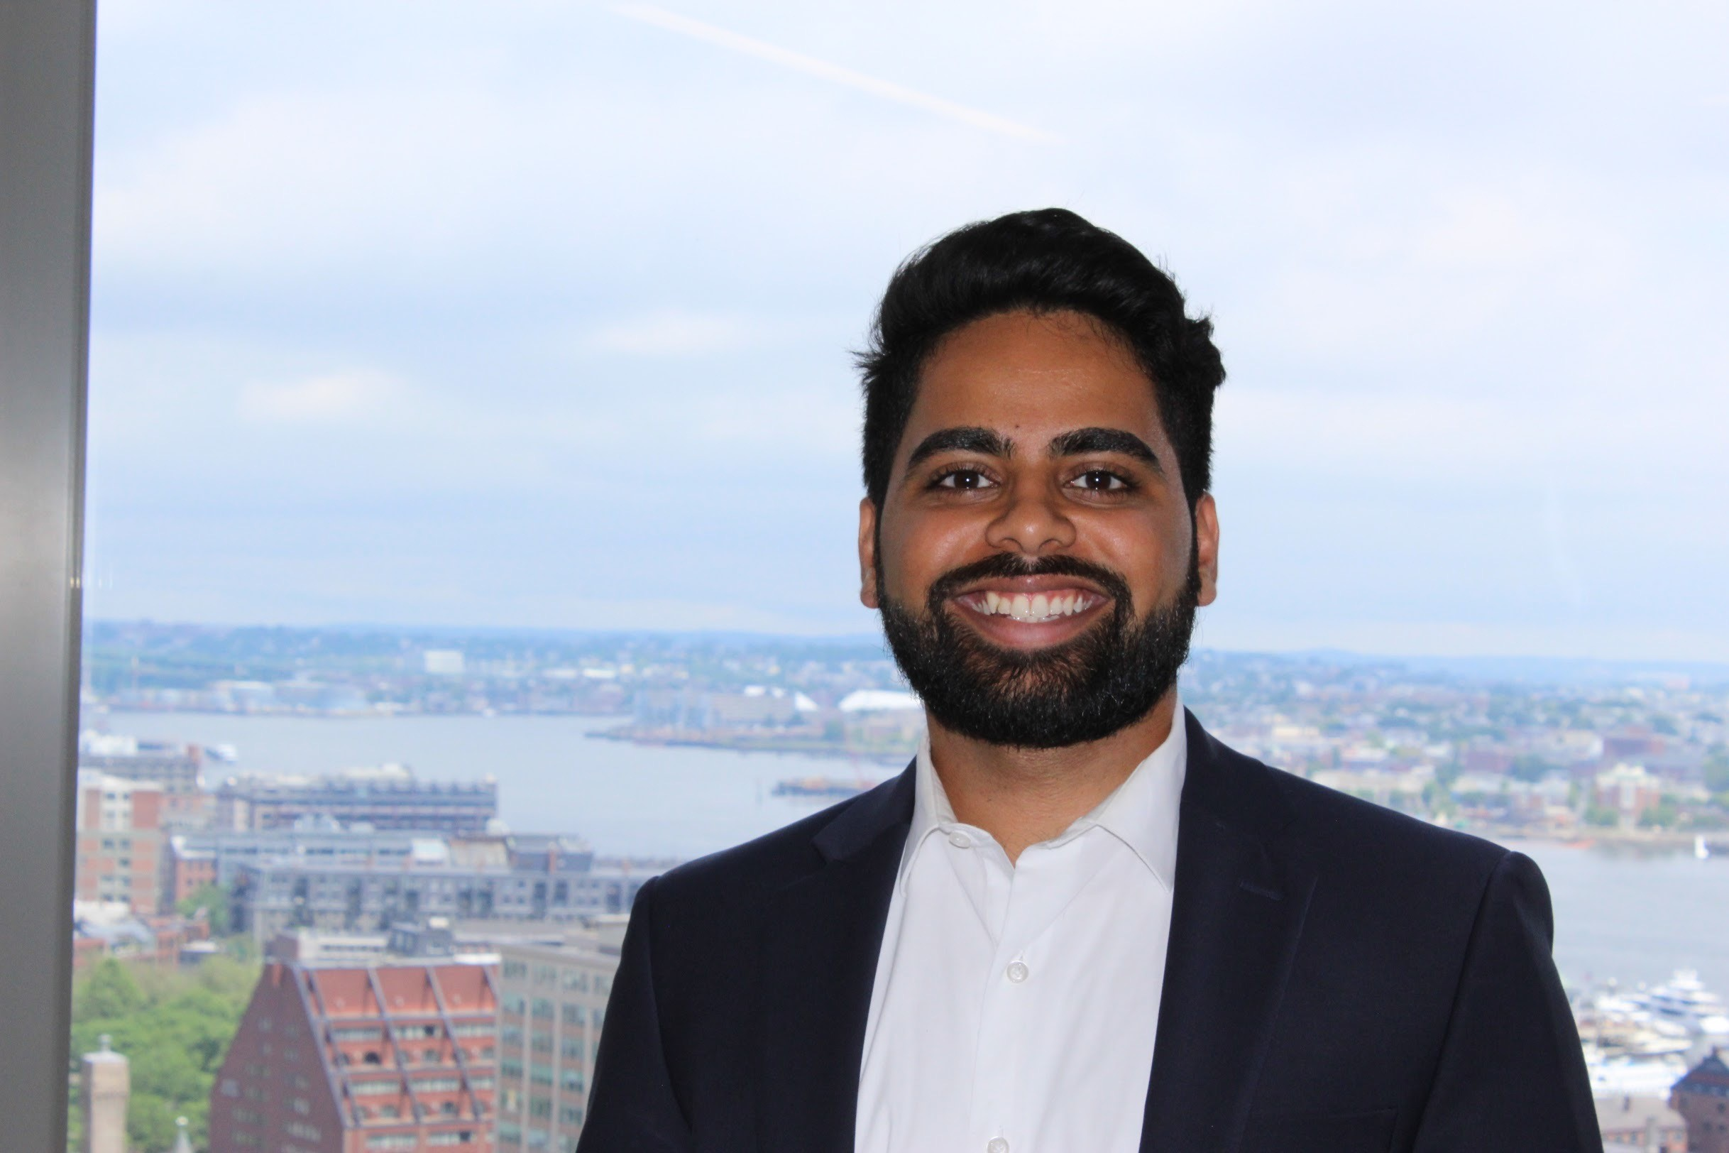
Growing Capability Through Collaboration
LaRC OCIO Data Science Team
Ed McLarney
Associate CIO for Technology & Innovation
OCIO Data Science Strategic Lead
Jeremy Yagle – (Vacant; On Detail)
Asst. Branch Head (IMB)
Technical Lead, OCIO Data Science Team
Charles Liles
Data Scientist
AI/ML/Cloud
Tina Heinich
Data Scientist
AI/ML/Visualization
D O
T E A M
Ted Sidehamer
Task Lead/NLP
Craig Technologies
Doug Trent
Data Scientist
SAIC
C O N S U L T
A balanced approach to growing a digitally-enabled workforce at Langley
Andy Ramlatchan
Data Scientist
SAIC
Dr. Newton Campbell
Data Scientist
SAIC
Hari Ilangovan
Data Scientist
SAIC

Slide 5
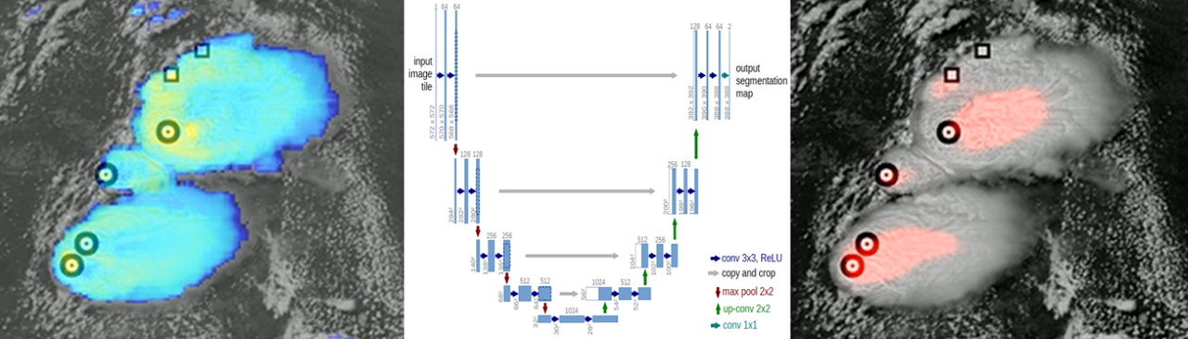
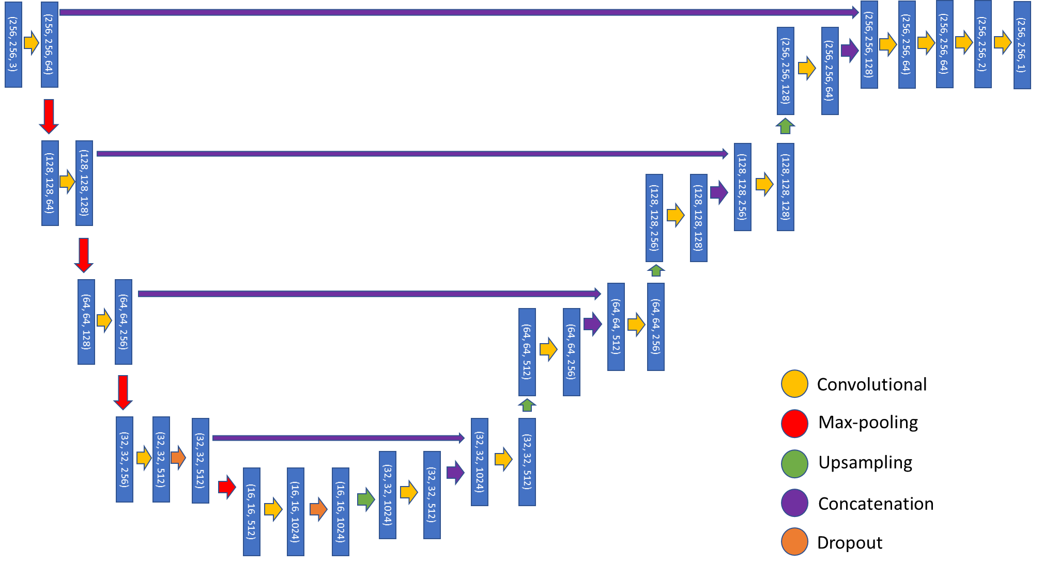
Above Anvil Cirrus Plumes (AACP) ML Project
Purpose: Identify above anvil cirrus plumes (AACP) in satellite imagery.
Problem: AACPs are typically ~31 minute precursors to severe weather such as hail, high winds, and tornadoes. They also eject water into the stratosphere which acts as a greenhouse gas.
Objective: Identify AACP occurrences in satellite imagery to assist with weather forecasting and long-term climate studies.
Customer/SME: Dr. Kristopher Bedka, Science Directorate
Data Scientist: Charles Liles
Approach: Deep learning U-net’s for semantic segmentation of AACPs.
Status: Exploring the use of LSTM layers in a U-net to account for temporal component of satellite imagery.
A
B
(A) Model input with infrared GOES 16 imagery “sandwiched” as a colormap on top of visible imagery. (B) Model output with semantic segmentation AACP probability prediction overlain in red over visible imagery. Rectangular markings represent SME-labeled non-AACP storm updrafts while circular markings represent AACP updrafts in both images.
U-Net Architecture

Slide 6
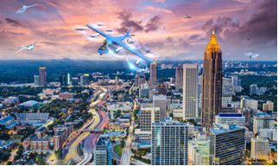
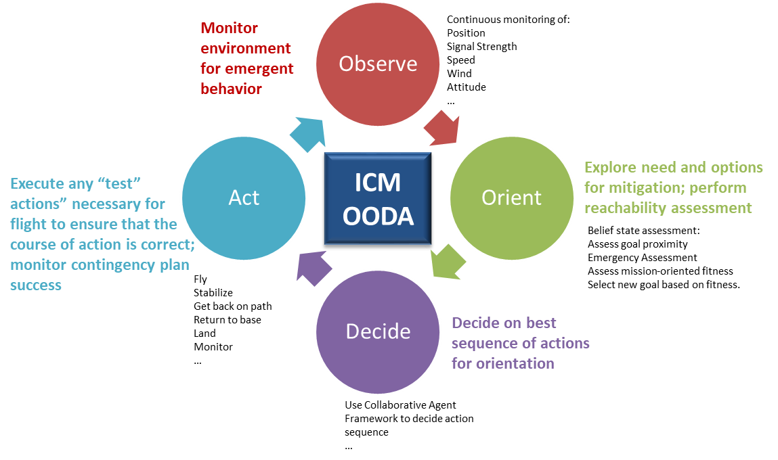
Intelligent Contingency Management
Purpose: UAM Mission - Safely fly from point A to point B under all vehicle-allowable weather conditions, in a high-density airspace complex urban environment, including off-nominal situations without direct human intervention, i.e. autonomous
Problem: For an arbitrary set of sensors and actuators, there is no robust, repeatable method of identifying the necessary data needed to train and verify that a vehicle can intelligently address an emergency.
Objective: Decision making under uncertainty and incomplete information
  1. Explore machine learning for intelligent contingency management, with a focus on assessing/projecting vehicle capability and maintaining nominal performance via reinforcement learning
  2. Develop vehicle intelligent contingency management system architecture at a functional level and validate against a specific UAM-class vehicle
  3. Incorporate (1) and (2) into an evolving toolset for an autonomous vehicle
Customer/SME: Dr. Irene Gregory (ARMD TTT-Autonomous Systems)
Data Scientist: Dr. Newton Campbell
Approach:
Develop probabilistic inference techniques to detect changes in vehicle or mission state and contextualize emergencies.
Develop reinforcement learning and knowledge reasoning techniques to create and assess the performance of contingency plans.
Status:
Completed Year 1 exploration; Preparing high-quality simulation platform for program experimentation
Publishing Problem Specification to AIAA Aviation 2020.

Slide 7
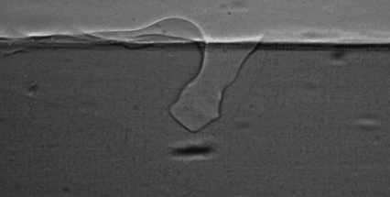
Computational Materials
Transformational Tools and Technology (T³)
Purpose: Additive manufacturing (AM) is rapidly developing for aerospace applications, yet further investigation is required to characterize these processes at microscale. Advanced imaging techniques enable unprecedented opportunities to observe builds in-situ, generating large datasets. Machine learning (ML) can then provide optimized process parameters to reduce defects and assist with process certification.
Problem: The aerospace industry currently does not have a standard for certification of builds created by AM. The process is known to create defects under certain conditions, and quantifying those defects and characterizing build conditions must first be established.
Objective: NASA Aeronautics Research Mission Directorate (ARMD), Transformational Tools and Technologies (TTT).
Customer/SME: NASA Aeronautics Research Mission Directorate (ARMD), Transformational Tools and Technologies (TTT)
Data Scientist: Andy Ramlatchan
Approach: Pattern recognition (e.g. mixture of Gaussians background reduction, adaptive thresholding). Matrix factorization with singular value decomposition for latent feature detection. Deep learning for material microstructure characterization and prediction.
Status: Work to be presented at Predictive Analytics World 2020 and Materials Science and Technology 2020. Next steps include development of generative models (variational autoencoder, generative adversarial networks) to derive artificial material microstructures computationally.
Image from ultra fast dynamic x-ray radiography captured during build
Laser beam
Gaseous vapor cavity
Liquid melt pool
Solid substrate
Melt pool boundary
100 μm

Slide 8
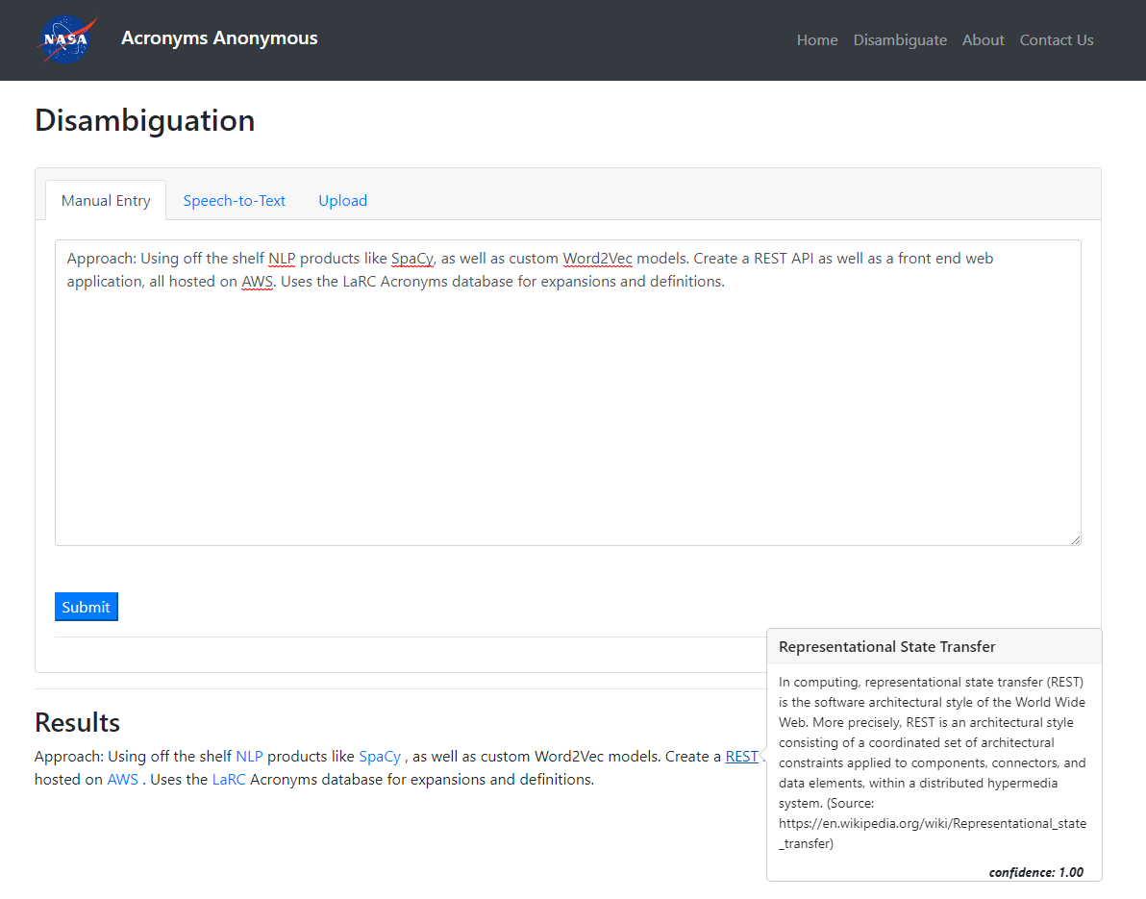
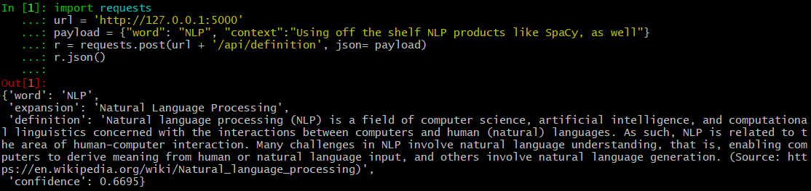
Acronyms Anonymous
Purpose: Create a programmatic and user friendly interface to help navigate the choppy acronym-laden waters of NASA.
Problem: NASA’s ecosystem is filled with acronyms, creating a huge learning curve for new employees.
Objective: Host a service that, when provided an acronym and the context around it, can return the properly expanded acronym + more information about it’s actual meaning.
Customer/SME: Joel Malissa (Kennedy), Justin Gosses (Johnson)
Data Scientist: Tina Heinich
Approach: Using off the shelf NLP products like SpaCy, as well as custom Word2Vec models. Create a REST API as well as a front end web application, all hosted on AWS. Uses the LaRC Acronyms database for expansions and definitions.
Status: Frontend + API framework stable. Working with api.nasa.gov for hosting. Improving models.
A
B

Slide 9
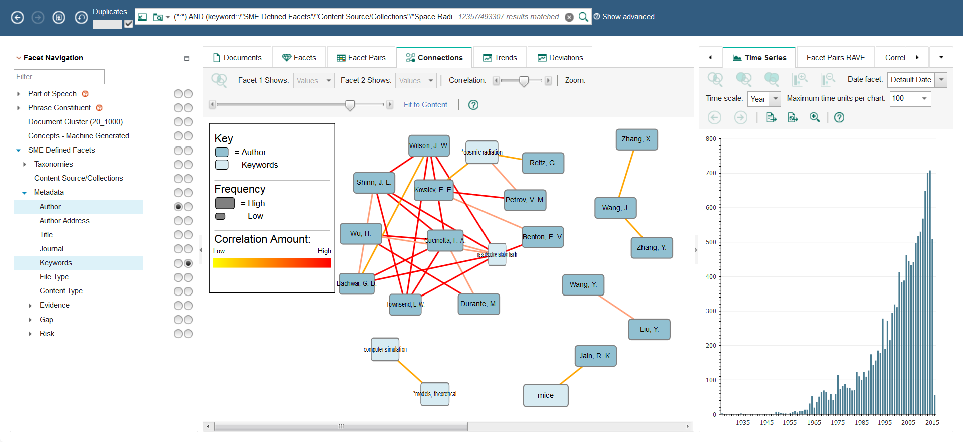
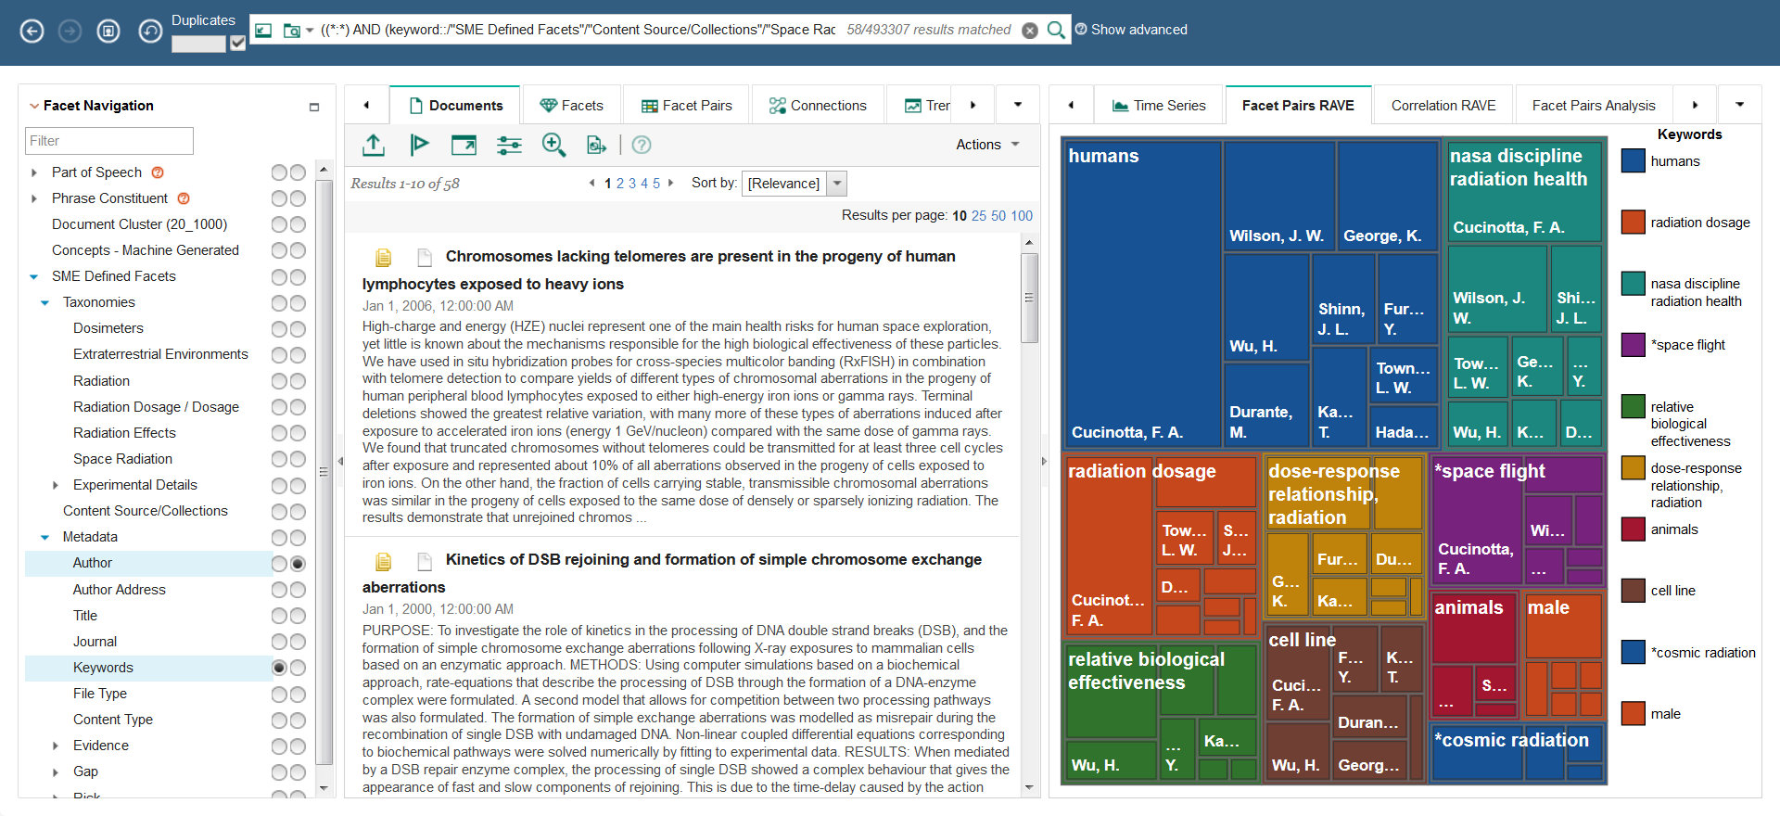
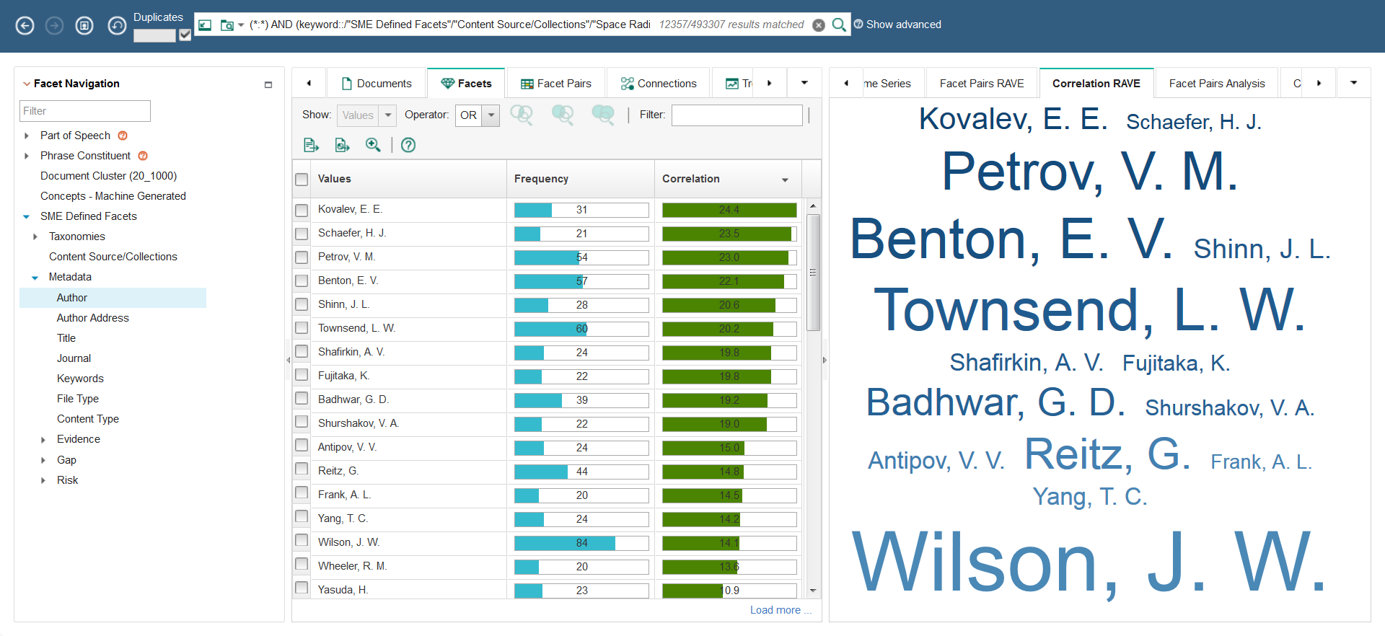
Watson Explorer
Text Analytics
Purpose: Provide users with a way to intuitively interface with their textual data.
Problem: NASA has lots of textual data in search of a visualization mechanism.
Objective: Perform cognitive search and content analysis for accessing insight from large amounts of structured and unstructured text. Rapidly identify trends, expert connections, technology gap exploration and connect cross-domain research.
Customer/SME: Bob Beil/Delmar Foster (NESC-Kennedy)
NLP Data Scientist: Ted Sidehamer
Approach: WEX is installed on a dedicated server to take advantage of its computing and visualization capabilities.
Status: Current work focused on FORs: Findings, Observations, Recommendations System attempting to identify previous FORs related to current evaluations. Largest collection - Space Radiation: 600k+ records.
Watson Explorer User Interface
Time Series
Concept Links
Heat Maps
Facet
Pairs
Faceted Search
Word
Clouds

Slide 10
Translational Radiation Research and Countermeasures (TRRaC)
Text Analytic
Purpose: Translate radiation research results to humans using bioinformatics and computational modeling to link previous data generated to new sources of space relevant radiation exposure and new animal models, including human medical radiation exposure. Identify and develop preventative and in-mission therapies and integrated countermeasures (CMs).
Problem: Abundance of data which needs to be combined and visualized for the entire Space Radiation community.
Objective: Datamining effort coupled with computation biology/modeling to translate SR effects from rodents to humans, and identify and prioritize potential therapies and countermeasures.
Customer/SME: Ryan Norman (DDTRB: LaRC) 5-year project
NLP Data Scientist: Hari Ilangovin and Newton Campbell
Approach: Define, Build, Collaborate, Visualize
Status: Developing the research questions.- Building the foundation of organizational knowledge.

Slide 11
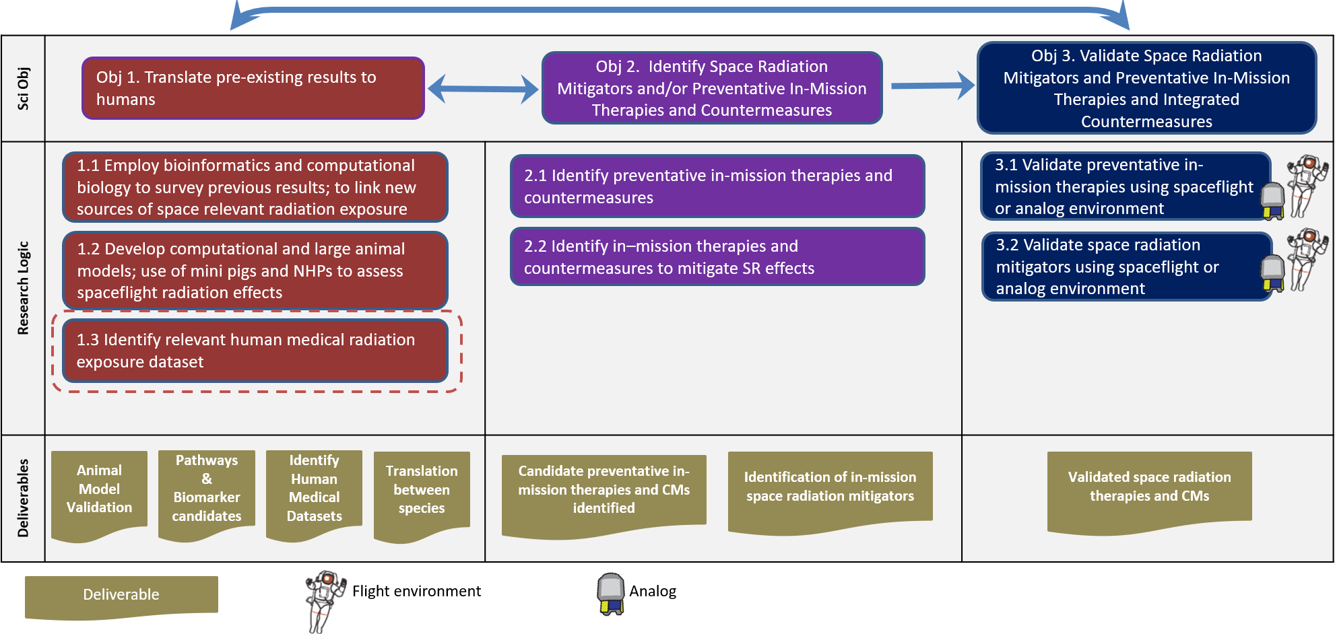
Translational Radiation Research and Countermeasures (TRRaC)
Text Analytic
Project Strategy

Slide 12

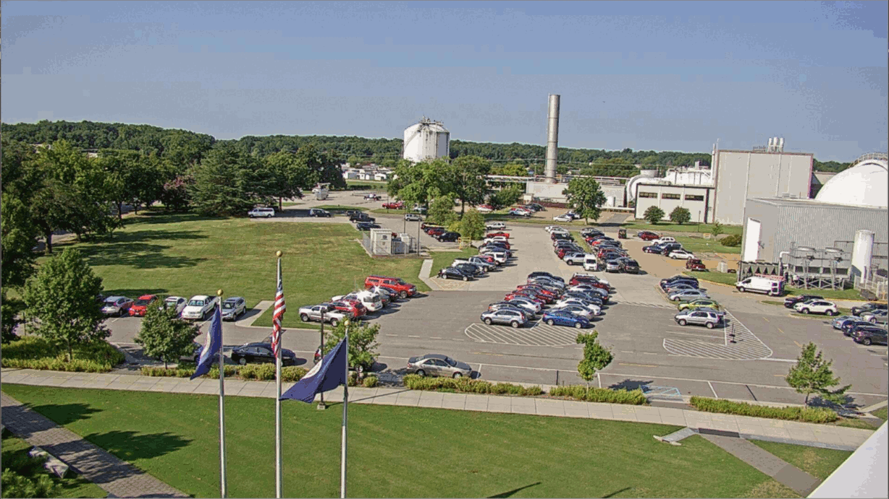
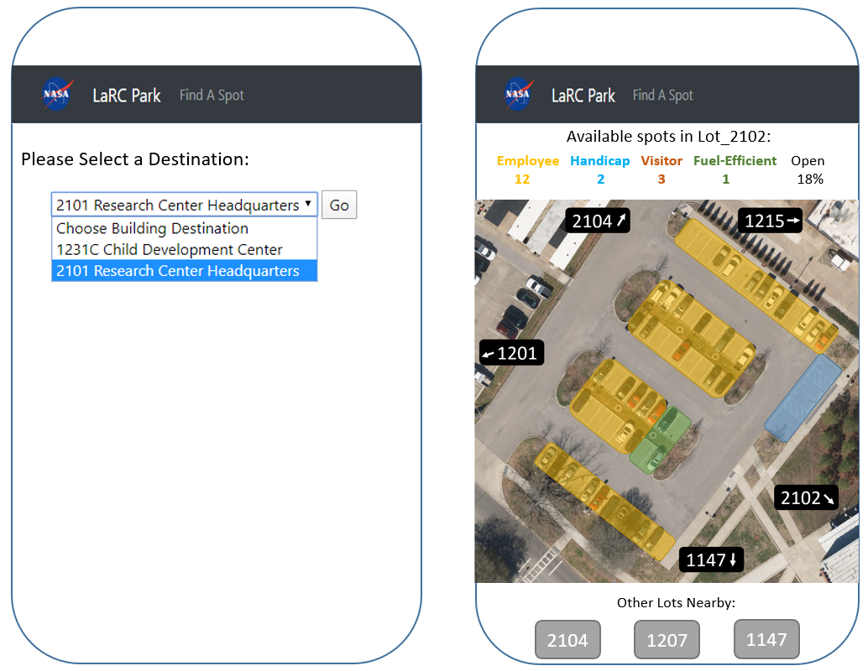
LaRC Park – Parking Mobile App
Purpose: Present a real time map of available parking in a secure mobile app to LaRC employees.
Problem: LaRC = 764 acres, 200 buildings, no parking decks. Employees drive to meetings, arriving late when they have to search for open parking spots.
Objective: Improve employee productivity/reduced frustration, increase on-time meeting starts by providing a convenient method to find parking space. Data capture for subsequent traffic analysis.
Customer/SME: Jill Marlowe (ACT2 funded)
Data Scientist: Doug Trent and Adi Chackonal. Consultation with Georgia Tech and JPL (Brent McWatters)
Approach: Place cameras on roofs of buildings with congested parking. Use R-CNN Computer Vision model to detect open spots.
Status: Deep Learning detection model is working. Installing a second camera on HQ building. Coding the mobile web app for Summer 2020 operation.

Slide 13
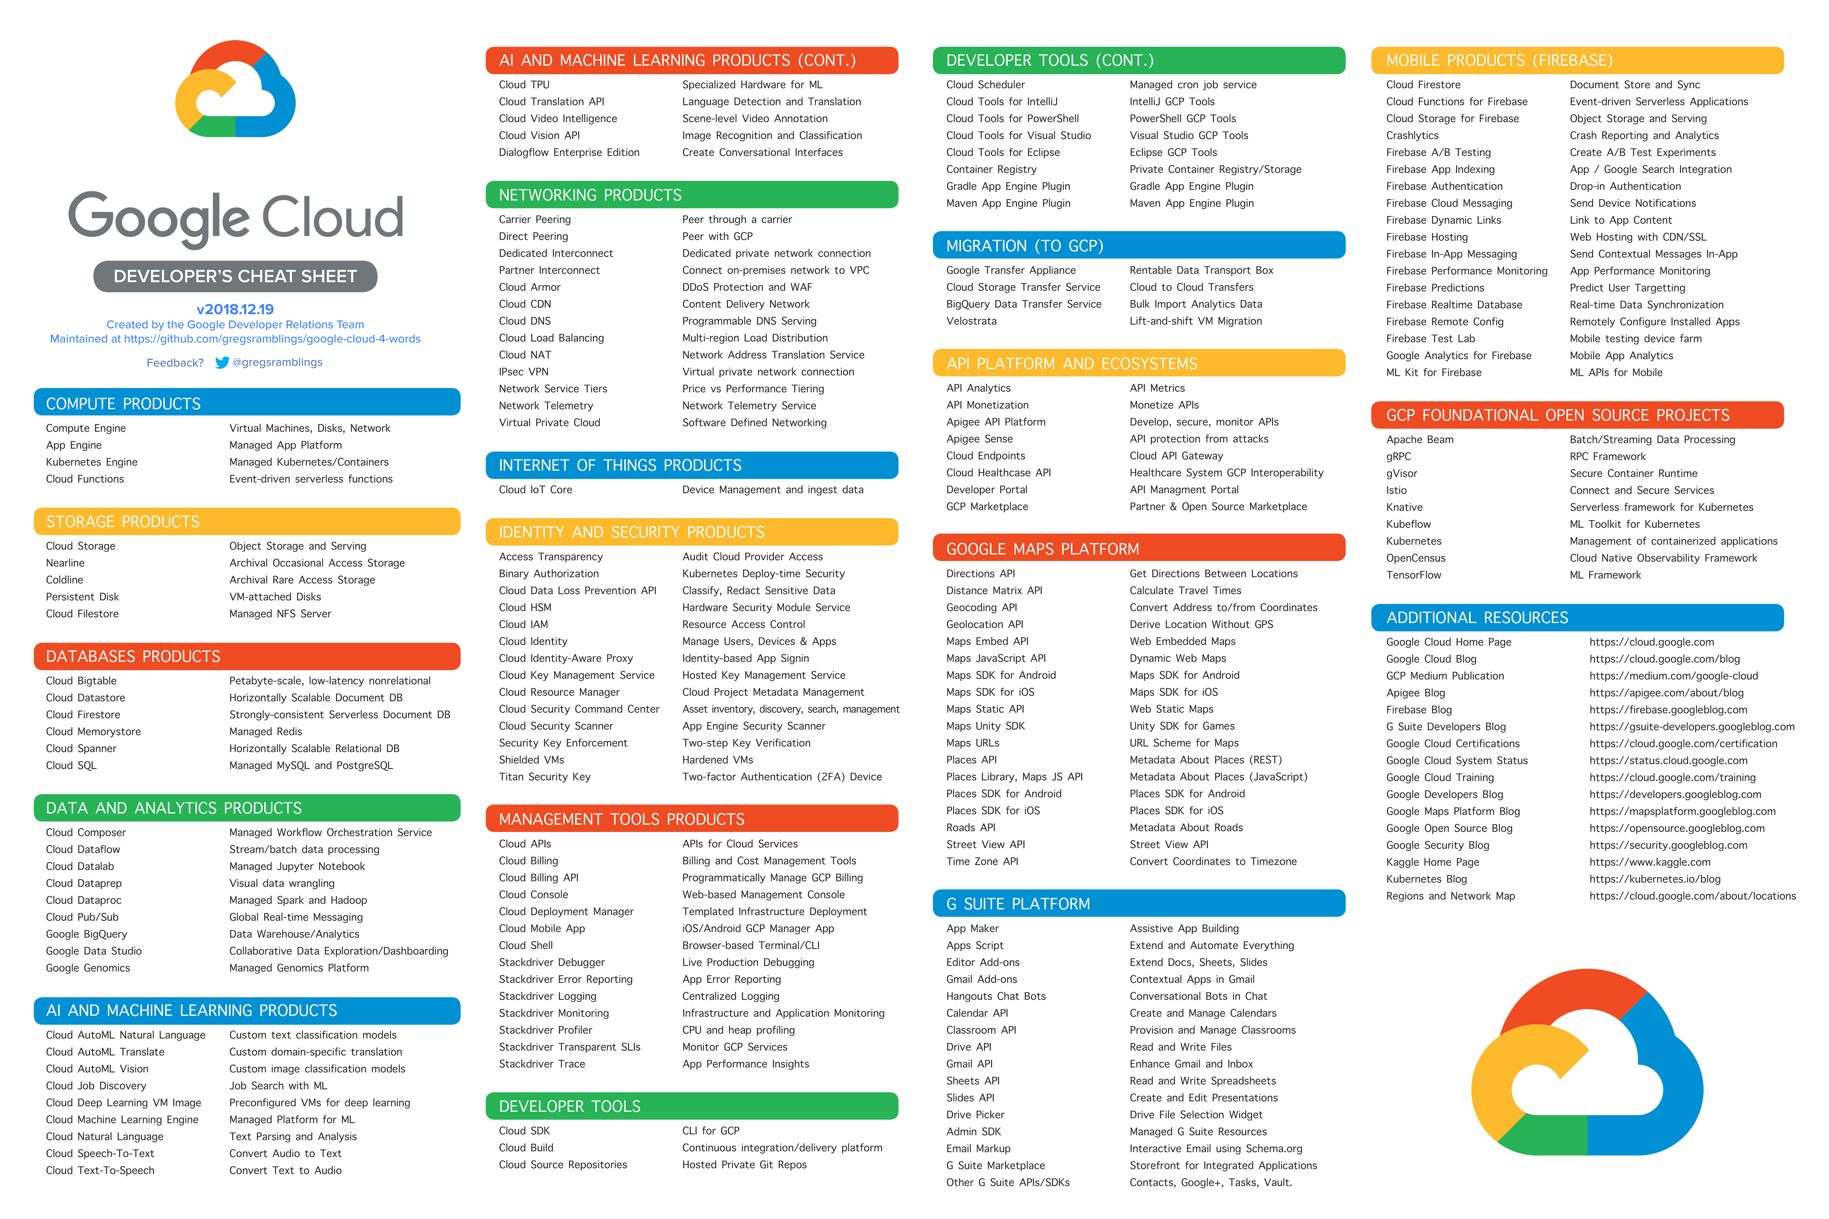
GCP AI / ML Project Description
Goal: Make Google Cloud Platform (GCP) artificial intelligence and machine learning (AI/ML) services securely available to NASA

Slide 14
LaRC Data Science Summary
Variety of work; Meet customers / cartners on their terms
Ongoing training, jam sessions to supplement projects
Recent Add: Space Radiation data mining
Supporting Agency DS planning and AIML transformation

Slide 15
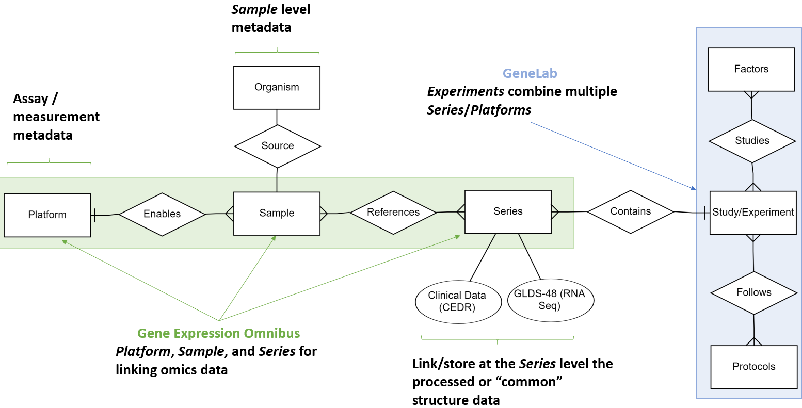
Translational Radiation Research and Countermeasures (TRRaC)
Text Analytic
Data Flow Diagram

