Slide 1
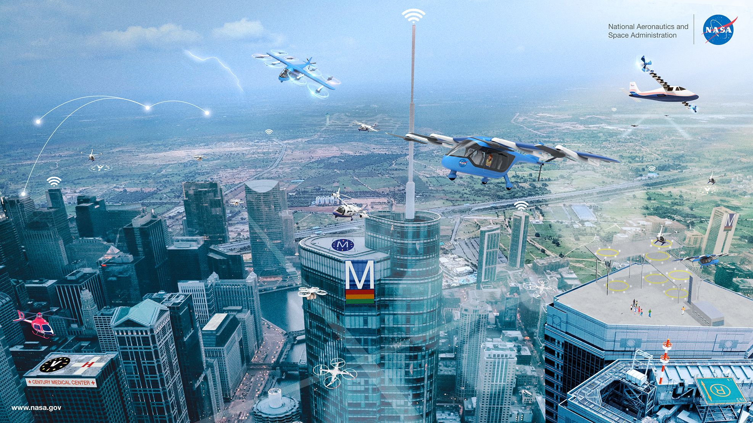
NASA Advanced Air Mobility (AAM) Project
Project Overview – AUVSI (HR) Briefing
February 17, 2021

Slide 2
Advanced Air Mobility Project Goal
Relevant Strategic Thrusts - SIP
AAM Mission Critical Commitment
6 - Assured Autonomy for Aviation Transformation
1 - Safe, Efficient Growth in Global Operations
4 - Safe, Quiet, and Affordable Vertical Lift Air Vehicles
5 - In-Time System-Wide Safety Assurance.
Based on validated operational concepts, simulations, analyses, and results from National Campaign demonstrations, the AAM Mission will deliver aircraft, airspace, and infrastructure system and architecture requirements to enable sustainable and scalable medium density advanced air mobility operations.
Project Goal
Develop and implement an environment to accelerate AAM development and operational adoption concepts, including developing and demonstrating key automation functions, and delivering validated system architectures and requirements to the benefit of the AAM ecosystem

Slide 3
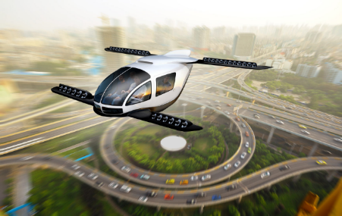
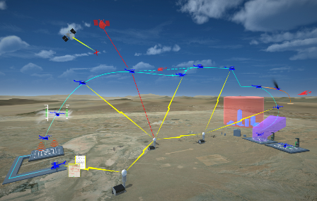
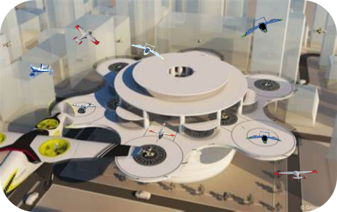
AAM Project Goal and Technical Challenges
Goal: Develop an environment to accelerate advanced air mobility concepts and
automation by delivering validated system architectures and requirements.
TC: UAM Automated Flight and Contingency Management (AFCM)
TC: High Density Vertiplex (HDV)
National Campaign (NC) Series Goal
Develop and evaluate an initial, integrated suite of key vehicle automation functions to enable simplified piloting in urban environments, and propose recommendations to enable certification and approvals for the selected concepts.
Assure AAM safety and accelerate scalability through integrated demonstrations of candidate operational concepts and scenarios.
Develop and evaluate a reference automation architecture that addresses scalable and efficient aircraft operations, flight and airspace management procedures, and vertiport operations in high density vertiplex environments
AFCM Subproject in development
HDV Subproject in development
Notes:
Bullets in italics are not covered by UAS-NAS P2 resource allocation

Slide 4
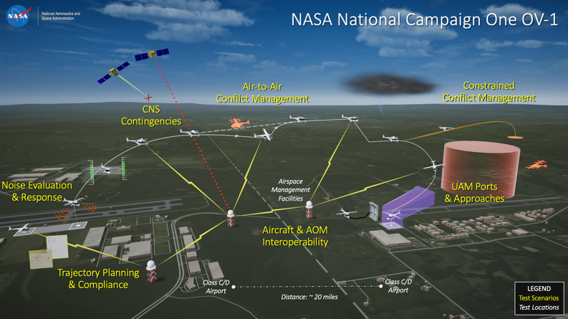
NC-1 Operational View

Slide 5
National Campaign Execution
  CY2020
  CY2021
  CY2022
  CY2023
  CY2024
  CY2025
  CY2026
  CY2027
  CY2028
  CY2029
  CY2030
NC-DT
Legend
Developmental Testing
Research and Capability Development
NC-1
Integration of Automated Systems Flight Testing
Operational Safety
NC-1
NC Series Development
NC Series Operational Demonstrations
NC-2
Complex Operations
NC-2
NC-3
High Volume Vertiports
NC-3
NC-4
Scaled Urban Demo
NC-4

Slide 6
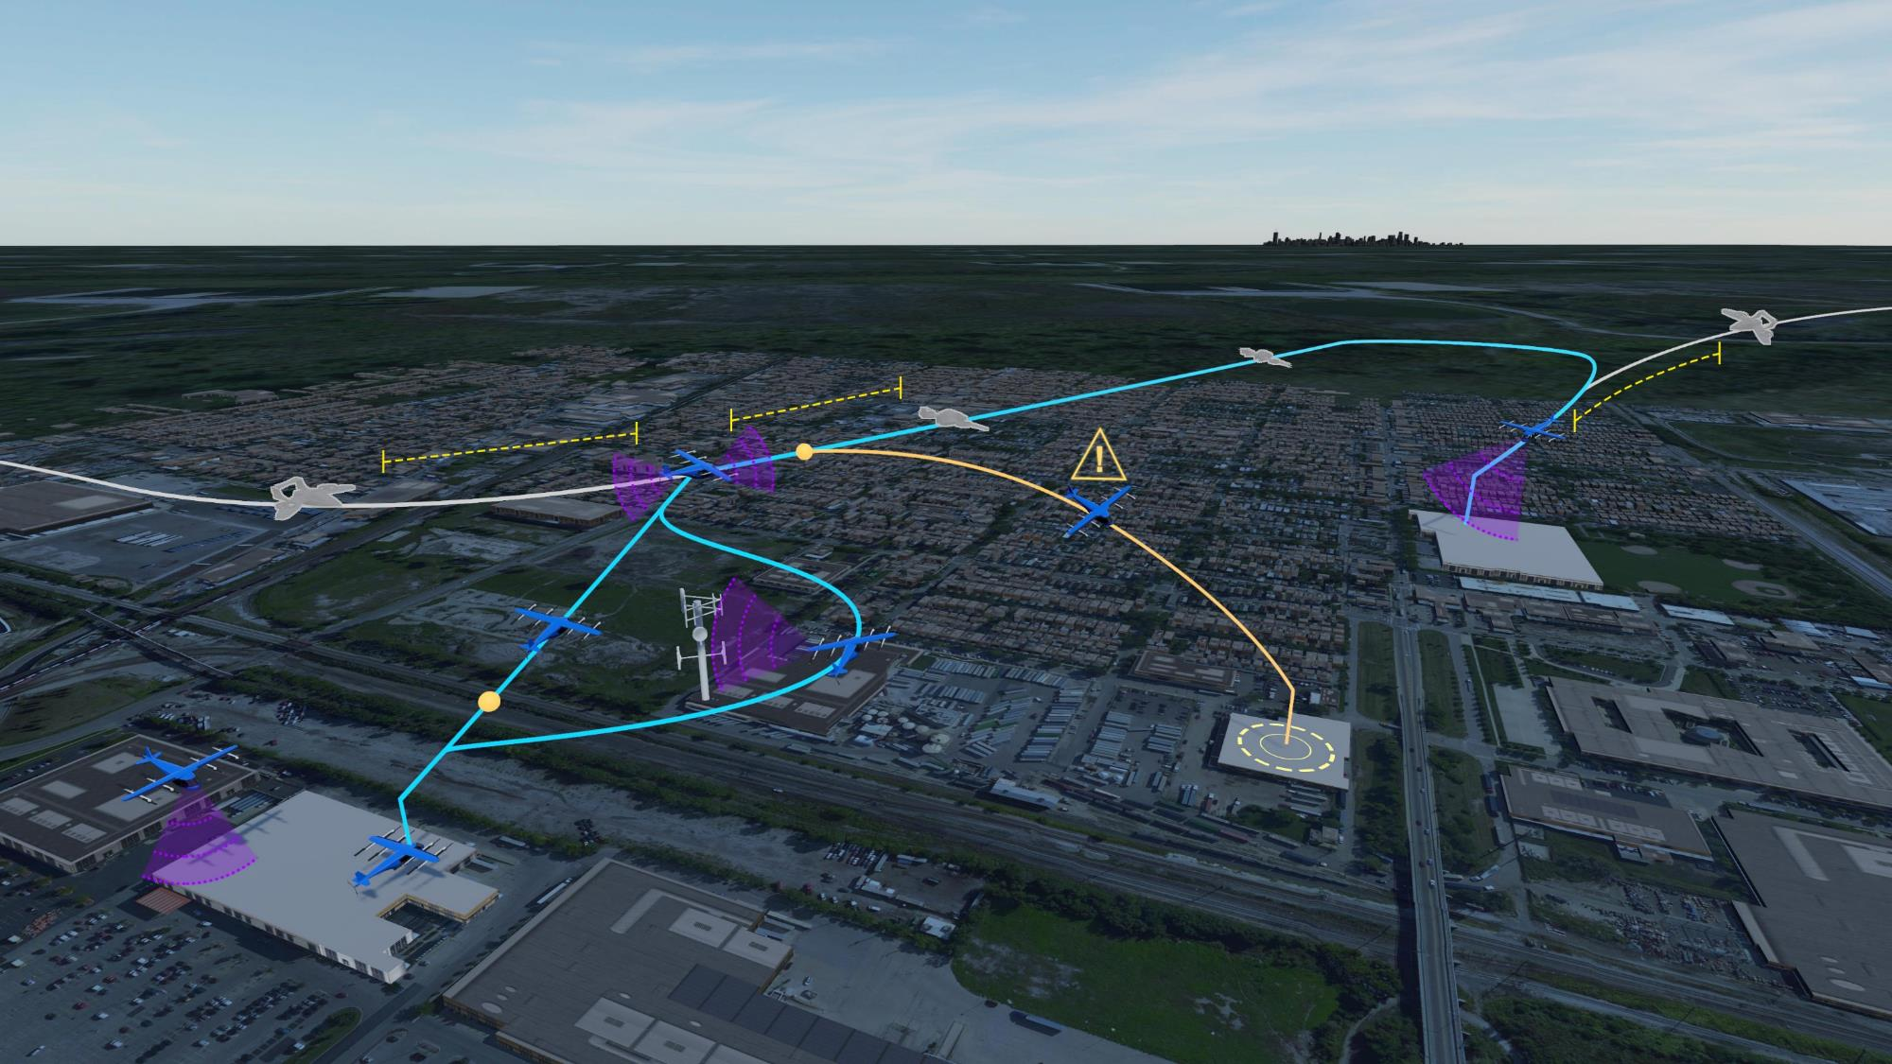

National Aeronautics and
Space Administration
AFCM Focus in the NASA NC-2 Complex Operations OV-1
✷Airspace/Operation
Data Interop
✤ Simplified Handling
Operations
✷✤ 4D TBO / DAA
Merging & Spacing
✤ Assisted Piloting Requirements
Critical Vehicle
Failure Point
Pilot-directed
Landing
✤ Contingency
Management
LVC
Traffic
✤ Nominal
Operations
✤ Hazard Perception
& Avoidance
Commit
Decision Point
✤ Assurance for
Responsible Automation
✷Demand-Capacity
Balancing
Uncharted
Obstacle
LEGEND:
Automation Scenarios and Challenges
✷ATM-X Relevant
✤ AFCM Relevant
Operational Elements
AFCM Subproject in development
Notes:
‘Airspace/Operation Data Interop’ is new airspace structures (e.g. fixed routes, volumes, corridors, etc.) + flight planning and ensuring the data is interoperable.
Leveraging our team's experience with FIXM/AIXM and using the ConOps as a guide, define these new structures.
With those defined, we now turn to figuring out how an operation shares its plan, hopefully leveraging those airspace structures. Targeting NC-2 to show how all of that should work

Slide 7
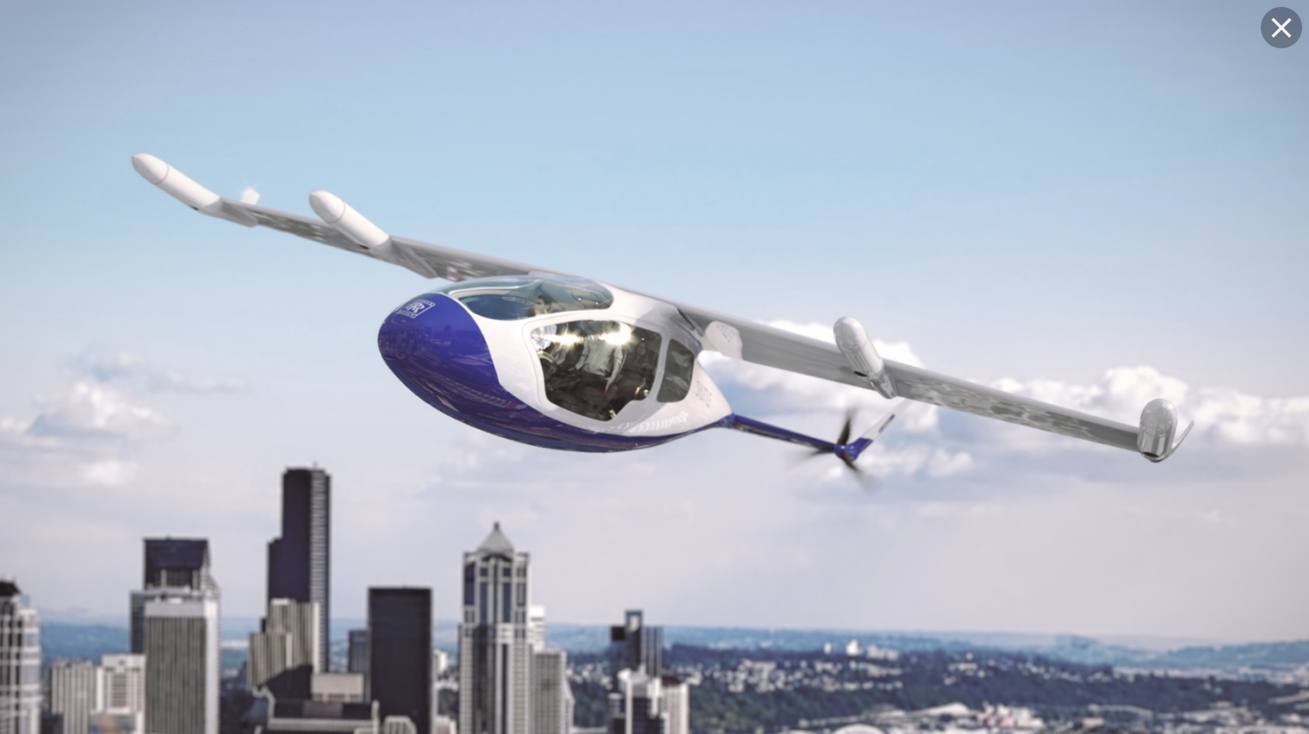
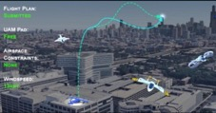





AFCM – Automation Enabled Pilots (AEP)
Operations
(e.g. Vertiport Approaches)
Pilot Requirements
(e.g. Skill, Knowledge, Proficiency)
Automation Enabled Pilots
Simplified Handling
and Operations
Assisted Piloting
Requirements
Command and Control
(e.g. Inceptors and VTOL handling)
Displays
(e.g. Integrated Guidance and Hazard Displays)
AFCM Subproject in development

Slide 8

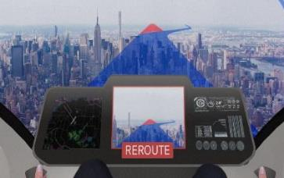
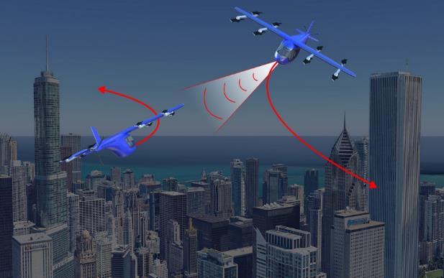
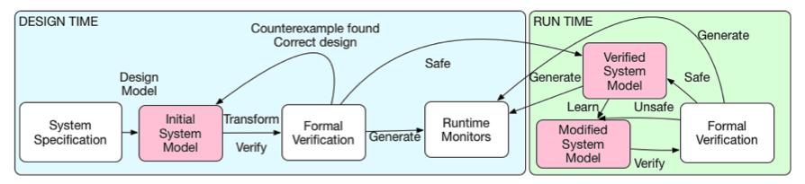
AFCM – Assured Vehicle Automation (AVA)
4D TBO
(e.g. Autonomous Operations Planner)
Contingency Management
Airborne Collision Detection and Avoidance (e.g. ACAS-Xr)
Assured Vehicle Automation
Flight Path
Management
Hazard Perception
and Avoidance
Automation Requirements Specification
Assurance for
Responsible Automation
AFCM Subproject in development

Slide 9
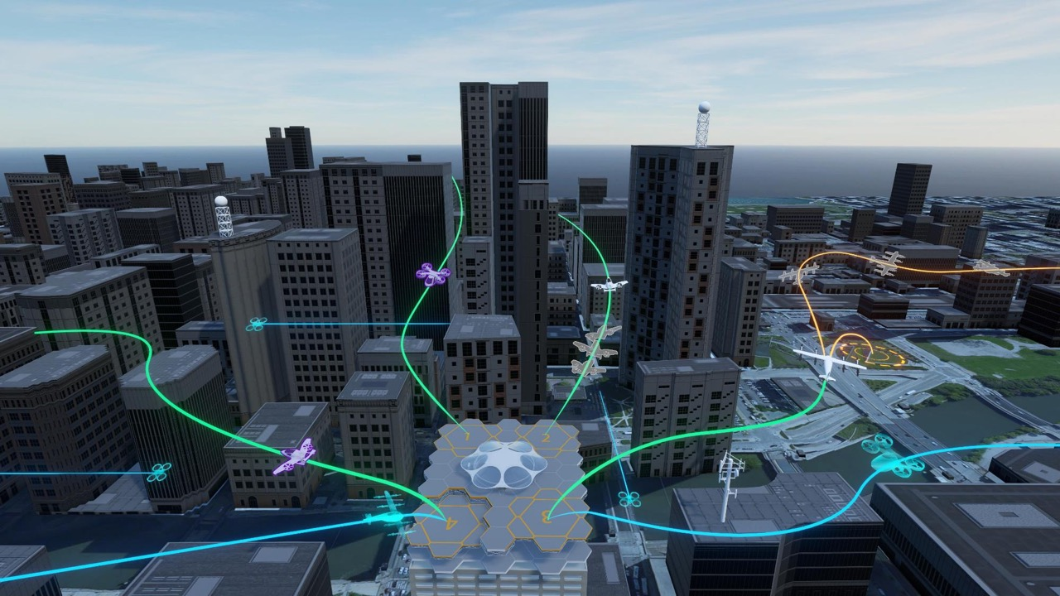




National Aeronautics and
Space Administration
NASA NC-3 High Volume Vertiports OV-1
High Density Vertiplex Contributions
Vertiport Hazard Monitoring
X
Vertiport CNSI
Auto-land
Interdependent Arrival / Departure Procedures between Vertiports
Automated Re-route
Contingency
Decision Making
Take-off / Landing Clearance
Merging and Spacing
HDV technologies address key UML-4 challenges and will enable vehicle-airspace-vertiport automation
HDV Subproject in development

Slide 10
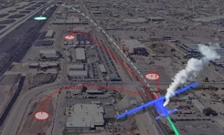
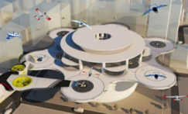


High Density Vertiplex
-- Schedule Work Packages --
  Advanced Onboard Automation (AOA)
  Goal: Develop reference system architecture, integration guidelines, and safety cases that support increasingly autonomous and resilient operations.
  Scalable Autonomous Operations (SAO)
  Goal: Develop and evaluate concepts, procedures and prototype technologies supporting operations at increased scale from a vertiport.
  Vertiplex Operations (VO)
  Goal: Develop and evaluate concepts, procedures and prototype technologies supporting high density operations in and out of multiple nearby vertiports.
  Integration of Automated Systems 2 – HDV (IAS-2.HDV)
  Goal: Develop and evaluate vertiport automation reference architecture for a representative UAM aircraft in a vertiplex environment.
HDV Subproject in development

Slide 11


High Density Vertiplex
Advanced Onboard Automation (AOA) Objectives
Development of an UAS integrated automation architecture to support terminal area operations.
Development of a BVLOS sUAS safety case for urban operations in controlled airspace.
Demonstration of automated VLOS urban operations in controlled airspace.
AOA Deliverables
Initial UAS Automation Reference Architecture
Initial BVLOS Safety Case
AOA Flight Test Report and Lessons Learned
Scalable Autonomous Operations (SAO) Objectives
Connect fleet management tools and airspace management services to UAS ground control stations.
Develop and test a vertiport automation system
Demonstration of vehicle, airspace, and vertiport automation technologies supporting dense operations at a vertiport.
SOA Deliverables
Initial Vertiport Automation Reference Architecture
Expanded BVLOS Safety Case
SAO Flight Test Report and Lessons Learned
HDV Subproject in development

Slide 12

High Density Vertiplex
Vertiplex Operations (VO) Objectives
Connect airspace management services to vertiport automation systems to support a multiple vertiport network.
Connecting vehicle automation to vertiport automation to support arrival/departure contingency management scenarios
Demonstration of dense operations within a Vertiplex to support National Campaign 3 development
VO Deliverables
Vertiport Automation Reference Architecture
UAS Automation Reference Architecture
VO Flight Test Report and Lessons Learned
Integration of Automated Systems 2 – HDV (IAS-2.HDV) Objectives
Evaluate multiple automated UAM aircraft communicating with automated vertiport environment
Demonstrate increasing density of eVTOL arrival departure operations from automated vertiport
Demonstrate off-nominal conditions due to aircraft arrival/ departure from automated vertiport
Demonstrate airspace-aircraft-vertiport interactions in off-nominal conditions on vertiport surface
IAS-2.HDV Deliverables
Vertiport Automation Range Requirements
Vertiport Automation Prototype for NC-3
Vertiplex Scenarios and Use Case
HDV Subproject in development

Slide 13
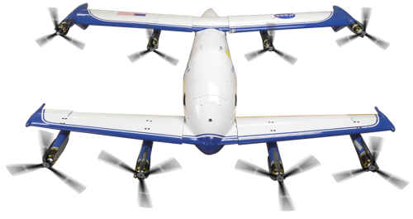

Vertiplex Automation System
Vertiplex Services
Airspace Services
Legend
Vertipad(s) Status
Strategic Deconfliction [ATM-X]
AOA
Constraint Management
SAO
Conformance Monitoring [ATM-X]
VO
Weather Conditions [SWS]
Conflict Management [ATM-X]
IAS-2.HDV
Take-off/Landing Clearance
Scheduling [ATM-X]
Vertiport Management Display
Hazard Management [SWS]
Ground Control Station / Fleet Management
Aircraft Automation
Automated Safe Landing
Operations Planning
Battery Monitoring [SWS]
Automated Re-routing
Tactical Conflict Management [ATM-X]
Risk Assessment [SWS]
Multi-aircraft control tools [TTT]
Merging and Spacing
Contingency Decision Making [SWS]
Health Monitoring [SWS]
Risk Assessment [SWS]
HDV serves as an integrator for key ARMD automation technologies to develop and test vertiplex environments.
HDV Subproject in development

Slide 14


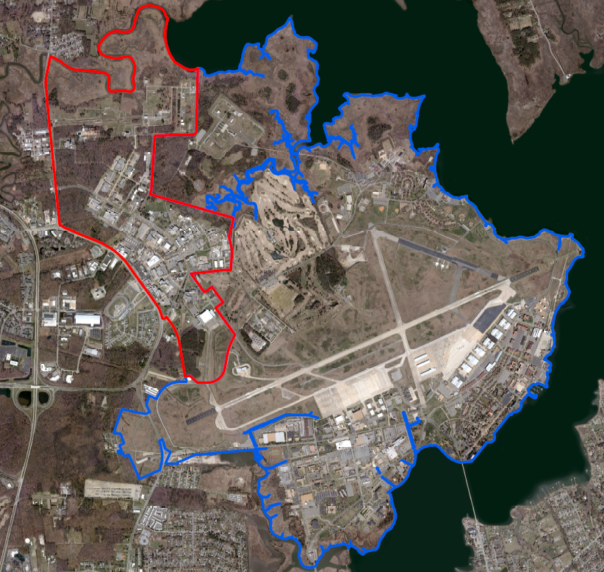
CERTAIN UAS Test Range
Operational Areas
CERTAIN I - 2015
CERTAIN II - 2017
CERTAIN III & IV - 2020
NASA LaRC
CERTAIN I
Agreement with Langley Air Force Base
Class D airspace when tower open
  Operations up to 400’
  Rural and urban areas
Class G airspace when tower closed
Risks managed via Langley Airworthiness and Safety Review board (ASRB)
Most operations in CERTAIN I and II
LaRC population varies by day and by hour
We have some means to control access on weekends
CERTAIN II
CERTAIN III
CERTAIN IV
LAFB

Slide 15
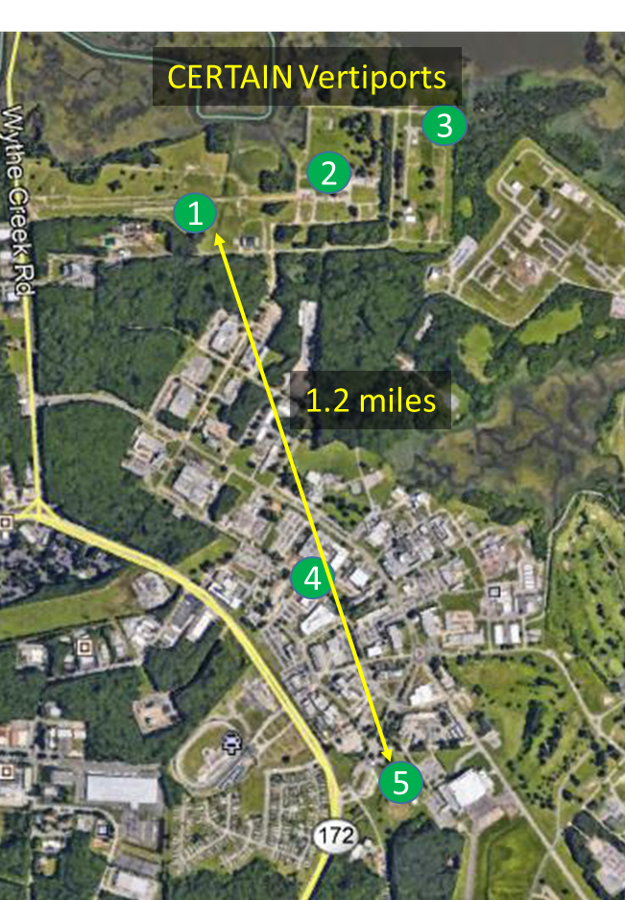
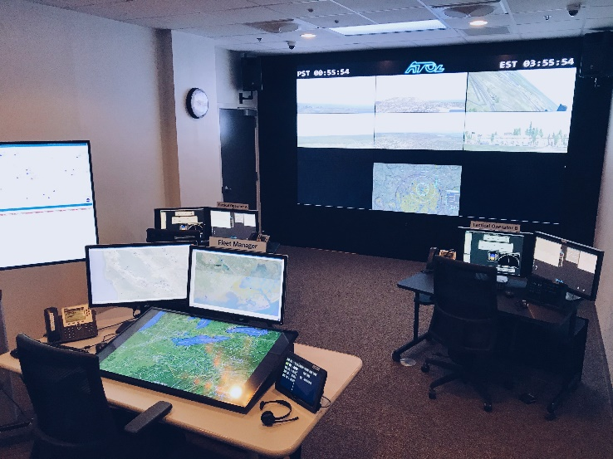
HDV Testing Overview
Initial focus on Northern CERTAIN UAS Range
  Largely rural area of NASA Langley
  Progressively extend to other areas of LaRC
Develop UAS Ops Center
  Use for both simulation and flight testing
Establish radar coverage for LaRC airspace
  Provides non-visual verification of operations area
  Supports Detect and Avoid functionality
Stand up fleet of sUAS
  Equipped with risk mitigating autonomous systems
Perform series of spiral development tests
  Crawl, walk, run
  Feedback results for subsequent spiral wraps
UAS Ops Center

Slide 16
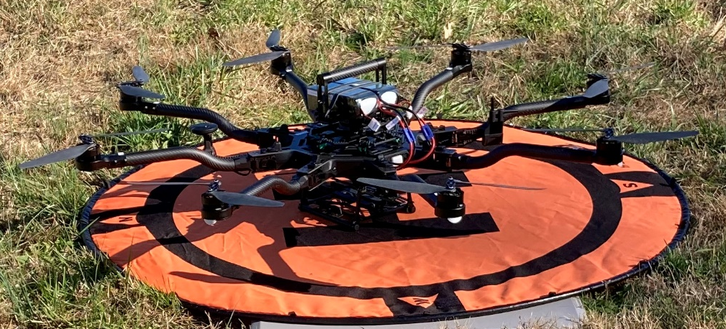
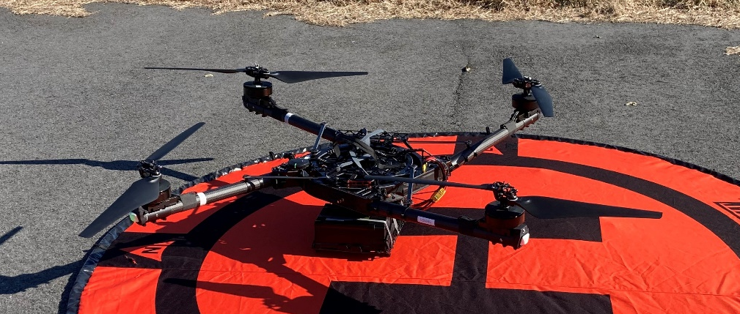
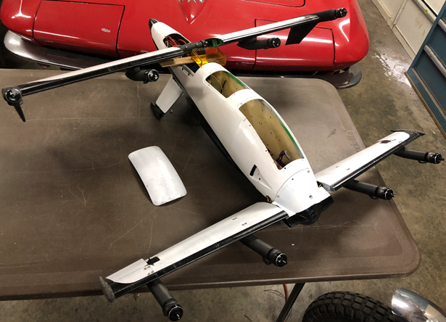
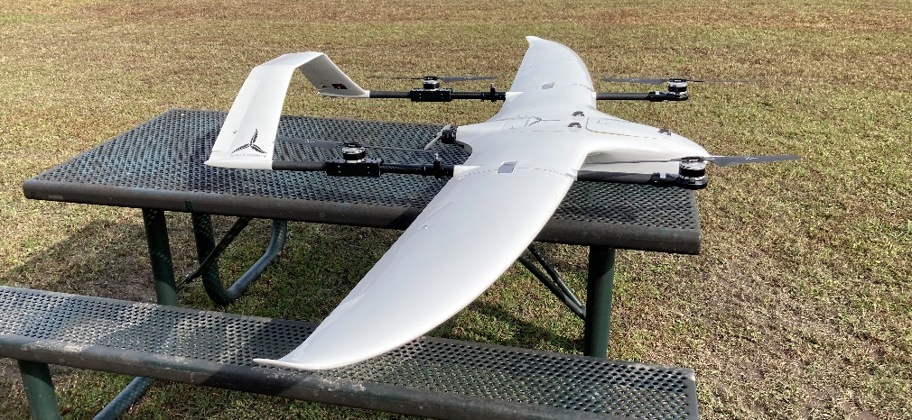
HDV Vehicles
Multi Rotors
  Alta-8
    Empty: 14 lbs
    Max: ~25 lbs (est)
    Will do most of flying
  Alta-X
    Empty: 23 lbs
    Max: ~60 lbs (est)
    Would be used for heavier payloads
  Currently supporting NASA flight operations
Hyrbid VTOL
  Hush-1
    Empty: 13 lbs
    Max: 20 lbs
  LA-7-3
    Custom built research vehicle
    Dual-tilt wing
    Empty: 13 lbs (est)
    Max: 20 lbs (est)
Alta-8
Alta-X
LA-7-3
Hush-1

Slide 17
HDV Schedule
  CY2020
  CY2021
  CY2022
  CY2023
  CY2024
  CY2025
  CY2026
  CY2027
  CY2028
  CY2029
  CY2030
HDV
Flight Activity
Simulation
Development/Prep
Multiple VLOS Autonomous UAS
AOA
BVLOS High Density Instrumented Vertiport
SAO
BVLOS High Density Autonomous Vertiplex
VO
Transition Technology for IAS Testing
IAS-2
Complex Operations
High Volume Vertiports
Scaled Urban Demo
IAS-1
IAS-2
IAS-3
NC-2
NC-2
NC-3
NC-3
NC-4
NC-4
HDV implements a “crawl, walk, run” process to mature automation technology and increase complexity of the operations
HDV Subproject in development

Slide 18
Questions

