Slide 1
Latent Cure Epoxy Matrix Resins for Reliable Assembly of Thermoset Composite Structures
Frank L. Palmieri¹, Kathryn Crossett², Tyler B. Hudson¹, Austin J. Smith¹, Roberto J. Cano¹, Jin Ho Kang³, Yi Lin³
¹NASA Langley Research Center, ²NASA NIFS Intern, ³National Institute of Aerospace
Hampton, VA
2021 Annual Meeting of the Adhesion Society
Virtual Symposium
February 22-25, 2021
All uncredited figures and images generated at NASA.
Notes:
Frank Talks
Hello and thank you for watching this presentation video. I am Frank Palmieri from NASA, Langley Research Center, and I am presenting the most recent developments at NASA on the topic of Modified Epoxy Matrix Resins for Reduced Dependence on Redundant Fasteners in Secondary-Bonded Composite Structures.

Slide 2
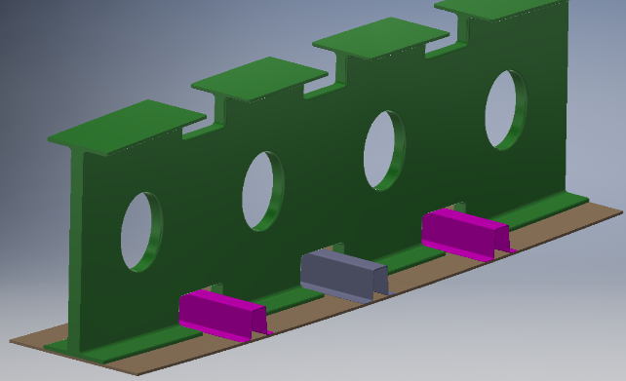
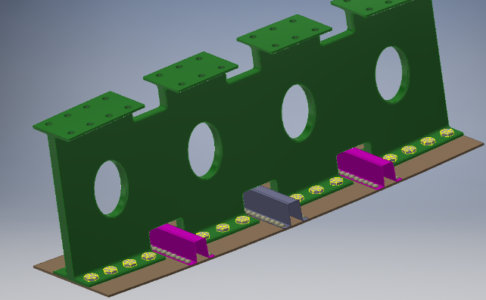
Manufacturing Challenge
Global commercial aviation market is expected to grow!
Airframes are assemblies of many parts
Composites can be assembled rapidly with adhesives
Redundant load path (bolts) is required for certification
Thousands of drilling and installation steps
Composites should be replacing metals in aircraft but…
Fastener installation is too slow causing a bottleneck
Production rates cannot meet demand
Bonded Wing
Structures
rib
skin
stiffener
Bolted Wing
Structures
rib
skin
stiffener
Notes:
Frank describes current manufacturing of aircraft and the need to install fasteners
Tyler describes the impact on rate and the images.
… but there is a manufacturing bottleneck for composite structures during the assembly process. Composite airframes are composed of many parts, which can be assembled rapidly with structural adhesive bonding. However, redundant load paths, such as bolts, are required for certification resulting in thousands of drilling and installation steps that slows down assembly. In addition to decreasing the manufacturing rate, bolts can cause stress concentrations at the drill site, add mass, and have the potential for corrosion. To the right, you see drawings of some common wing structures. The top drawing shows the simplest possible assembly of the rib with the skin and stiffeners using an adhesive or co-cure process. The bottom picture shows the many holes and fasteners that are add to bonded structures to meet certification requirements.

Slide 3

Fasteners in a Single-Aisle Composite Airframe
Wing 2
~21,000 bolts
Wing 1
~21,000 bolts
Fuselage
~70,000 bolts
Notes:
Frank describes the systems analysis and results
The impact of eliminating redundant fasteners is enormous. A systems analysis performed at NASA Langley Research Center estimated that approximately 21,000 bolts per wing could be removed from the composite wingbox of a of single-aisle, commercial transport airframe. In addition, information gathered on fuselage components indicated approximately 70,000 bolts could be removed from the fuselage.

Slide 4
Assembly of Composites
Co-Cure
uncured prepreg
Method limited by part complexity
Cure Process
Co-bond
cured
uncured
adhesive
Secondary Bond
cured
uncured
Unpredictable interfaces formed
adhesive
cured
Co-cure produces predictable components and joints but is limited to simple geometries
Bonded/Co-bonded joints are susceptible to weak bonds
Unpredictable bonds are a concern in primary structure
A redundant load path is used to ensure structural integrity
Notes:
Frank describes the methods of assembling composite parts
Tyler describes the limitations and the source of limitation
To understand the dependence on redundant fasteners, we have to look at how large scale composite structures are assembled. There are essentially three primary methods for assembling composites: co-cure, co-bond, and secondary bond. During co-cure, two or more parts are cured together in an autoclave resulting in unitized structure. In other words, co-cured joints have continuous matrix resin through the joint. In contrast, co-bonded and secondary bonded joints use adhesive to bond together one or more previously cured components. The adhesive bond results in a material discontinuity that can be observed microscopically.
Co-cured joints are inherently predictable because the joint is inherently interface-free.
First animation
However, co-cure is limited in application by part complexity and size. Quite simply, you cannot produce an entire aircraft or even an entire wing in single cure process. The tooling would be too expensive.
Bonding and co-bonding simplify the assembly of complex structures, but the resulting joints are susceptible to weak bonds leading to unpredictable performance.
Second animation
The lack of predictability in bonded interfaces is a concern in primary structure. So airframers are compelled to use redundant fasteners to ensure structural integrity.

Slide 5
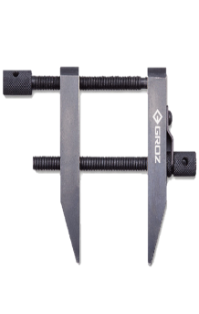
The AERoBOND Method
The reliability of co-cure in a “bonded” assembly
Joining Layer A
conventional materials (uncured)
Joining Layer A
Primary Cure
partially cured
surfaces
cured laminate
Co-cure reliability in a “bonded” assembly
partially cured interface
Assembly with
Joining Layer B
Secondary Cure
Co-cured structure
Notes:
Frank describes the AERoBOND methods
The AERoBOND process enables the reliability of a “co-cured” joint and the manufacturability of a “secondary bonding process”
Modified epoxy layers, shown here in blue as joining layer A, are applied to the bonding surfaces of conventional, epoxy matrix preforms, shown here as a green bar.
The primary cure process causes the component prefrom to fully cure, but leaves the joining surface only partially cured and able to reflow when heated.
The two partially cured surfaces are then assembled with a complimentary epoxy layer, shown here at Joining Layer B, between them, clamped in a fixture, and cured as an assembly, analogous to a secondary bonding process with adhesive.
During secondary cure, the partially cured layers reflow, allowing joining layers A and B to mix together, and fully cure forming a co-cured assembly.

Slide 6
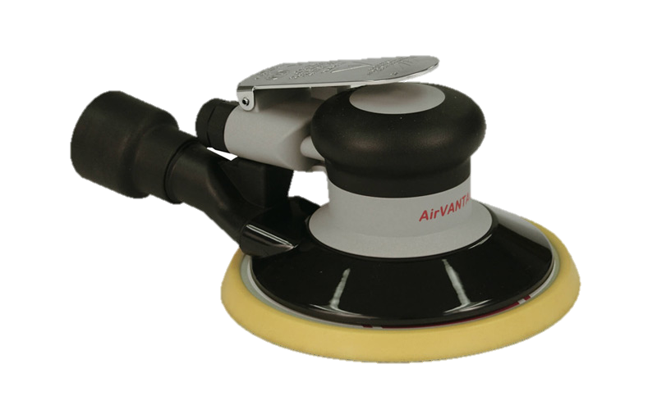
AERoBOND VS SoA
AERoBOND
State-of-the-Art (SoA)
Preform
Preform
Primary
Cure (~6 h)
Preform
Preform
Component
Component
Component
Component
Surface Treatment
(~2 h)
Joining
Layer B
Component
Assembly
(~2 h)
Adhesive
Secondary
Cure (~4 h)
Adhesive
Cure (~4 h)
Co-cured structure
Bonded structure
Total Time: ~12 h
Install bolts (~6 h)
Bonded and
Bolted
AERoBOND is ~40% Faster!
Total Time: ~20 h
Cure/assembly times are notional
Notes:
Tyler describes AERoBOND vs SoA and how AERoBOND is faster
1. I know the AERoBOND method appears complex, but its actually much simpler than the state of art?
2. The primary cure process is identical to the state of art with the exception of the modified epoxy layer shown here in blue.
3. After primary cure, the state of the art method requires surface preparation such as sanding, grit blast, peel-ply removal, or solvent wipe, NONE of which are used in the AERoBOND method.
4. The assembly and secondary cure processes are identical replacing only the adhesive layer with the AERoBOND material shown here in yellow.
5. The AERoBOND method results in co-cured structure whereas the state-of-art produces a bonded structure.
6. Even though the likelihood of a weak bond is low, the bonded structure generally requires redundant fasteners to ensure joint performance.
7. By eliminating the surface preparation and installation of bolts, the AERoBOND method is approximately 40% faster than the state-of-art. In addition, the AERoBOND method can be accomplished using existing equipment for assembly and cure, and thus requires little to no new capital expenditures to add to a production line. It drops directly into any thermoset manufacturing process.

Slide 7
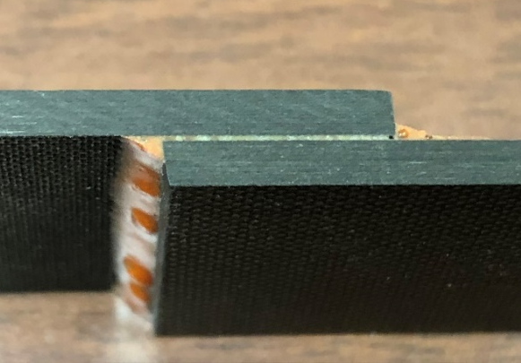
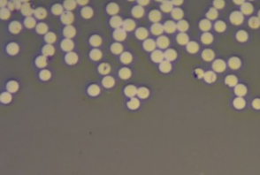
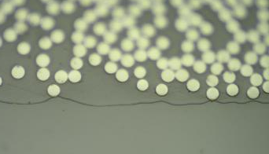
Adhesive Bondline vs. AERoBOND
AERoBOND Joint
Adhesive Bondline
Matrix Resin
AERoBOND Joint
Adhesive
The AERoBOND joint is indistinguishable from the matrix resin of adherends
Quantifiable & certifiable resin properties
Cured matrix resin cannot mix with adhesive
Potential for weak bonds
Notes:
Frank describes the graphics on the left and the uniformity of the AERoBOND joint
Tyler describes the graphics on the right and the interface between matrix and adhesive
I’m showing on the left, an AERoBOND laminate being peeled open, and a micrograph of the AERoBOND joint in cross-section before testing. The resins of the two joining layers have diffused across the interface. This results in quantifiable and certifiable resin properties. The white circles visible in both joints are polished ends of carbon fiber which are about 6 microns in diameter.
In contrast, the adhesively bonded joint on the right has a cured matrix resin, which did not mix with the adhesive during the bonding process resulting in this clearly visible interface, which you see as a line in the micrograph. This interface is susceptible to weakness.

Slide 8
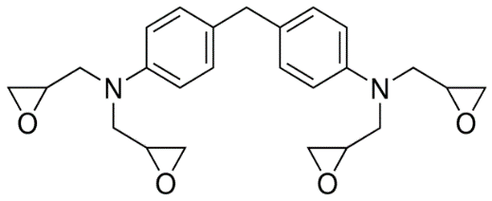
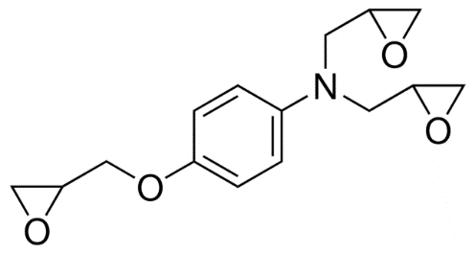
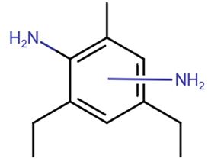
AERoBOND Precursors
Kaneka API-60 Part A
  ~65% tetrafunctional epoxy
  ~20% trifunctional epoxy
  ~15% proprietary toughener
  Epoxy equivalent weight
  (EEW) = 131 g/mol
Diethyltoluenediamine (DETDA)
  Ethacure 100 from Albemarle® Corp.
  Mixture of isomers
  Liquid at RT
  EEW = 45 g/mol
Notes:
Frank describes raw materials
To make AERoBOND bond materials we use convential tetrafunctional and trifunctional epoxy materials show here. The part A material we use was obtained from Kaneka and has a toughener mixed. The hardener we are using is probably not so common in aerospace composites, but we wanted something that was liquid at room temperature like this DETDA material.
By using commercially available precursors, the AERoBOND process is readily scalable for high-volume production of large structures. In addition, the AERoBOND method could be applied to other epoxy or thermoset chemistries.

Slide 9
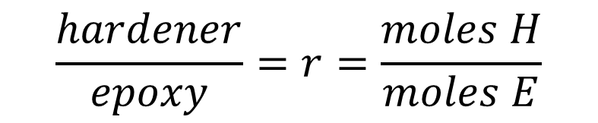
Thermoset Epoxy Basics
Hardener groups (H) react with epoxy groups (E) to form polymer
H
H
H
H
E
E
H
E
E
E
…
E
E
H
H
Molecular weight is limited by applying an offset to the stoichiometry
$$\frac{hardener}{epoxy}=r=\frac{moles H}{moles E}$$
r = 1 : Equivalent Mixture
r > 1 : Hardener Rich (HR)
r < 1 : Epoxy Rich (ER)
Notes:
Frank describes the polymerization reaction
The formation is modified by offsetting the stoichiometry of the epoxy mixture. For the AA/BB step-growth polymerization scheme, you can see that leaving out one of the two components in this system means that the reaction cant go to completion, in the ideal case. Epoxies can undergo various side reactions that generally lead to chain extension and crosslinking even without the presence of a hardener, but the epoxy homopolymerization is much slower than the epoxy-amine reaction, and is neglected analysis we used to determine degree of cure. The r-value defined here is how we describe the offset of epoxy and hardener in an AERoBOND formulation. I will refer to resins with r>1 has hardener rich and r<1 as epoxy rich.

Slide 10
AERoBOND Process Tradeoff
ER Layer Too Thin
Surface resin gelled
Primary cure
  Thick ER layer prevents surface gelation
Secondary cure
  Thinner plies equilibrate/homogenize easily
Minimize thickness of AERoBOND ply stack [ER_{n}/HR_{m}/ER_{n}]
  Prevent unmixed/heterogenous resin in the bondline
  Adds mass to the part
  Uni-directional pad-ups may have transverse weakness
Primary Cure
ER Layer
ER Layer
Conventional Material
Conventional Material
ER Layer Too Thick
Secondary Cure
Line of symmetry
HR Layer
HR Layer
HR Layer
Residual, unmixed HR and ER resins
ER Layer
ER Layer
ER Layer
Conventional Material

Slide 11
Barrier Ply (BP) Concept
Goal: Reduce resin mixing during primary cure
Approach:
  Make thin, conventional, prepreg tape
  Advance degree of cure (DoC) / B-stage matrix resin
  Place at ER/Conventional interface
Result
  Measure bond performance of joined panels
ER Ply
conventional materials (uncured)
Barrier Ply

Slide 12
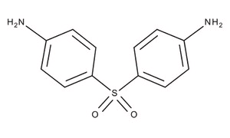
Barrier Ply Precursors
Kaneka API-60 Part A
  ~65% tetrafunctional epoxy
  ~20% trifunctional epoxy
  ~15% proprietary toughener
  Epoxy equivalent weight
  (EEW) = 131 g/mol
4,4’ Diaminophenylsulfone (DDS)
  Kaneka Corporation
  Melting Point ~170 - 175 °C
  EEW = 62.1 g/mol
Conventional formulation: r = 0.8
Notes:
Frank describes raw materials
To make AERoBOND bond materials we use convential tetrafunctional and trifunctional epoxy materials show here. The part A material we use was obtained from Kaneka and has a toughener mixed. The hardener we are using is probably not so common in aerospace composites, but we wanted something that was liquid at room temperature like this DETDA material.
By using commercially available precursors, the AERoBOND process is readily scalable for high-volume production of large structures. In addition, the AERoBOND method could be applied to other epoxy or thermoset chemistries.

Slide 13
Barrier Ply Preparation
Material: IM7G/API-60 (DDS) r = 0.8
  Initial cure state: 5% DoC
  Fiber areal weight (FAW): 45 g/m²
  Resin content: ~50 wt%
  Thickness: 75-100 µm
Advance DoC to improve barrier properties
  Heated in convection oven at 110 °C between caul plates for uniformity
  Final cure state depends on hold time:
    150 min → 15% DoC
    225 min → 25% DoC
    300 min → 35% DoC

Slide 14
Preliminary Development and Testing
Two-step fabrication process
  1. Fabricate panels with epoxy rich (ER) surfaces
  2. Join panels with hardener rich (HR) ply
Conventional material used in backer laminate
  Hexcel® IM7/8552 prepreg
  190 g/m² fiber areal weight (FAW), 35% resin content
Test parameters
  Presence of BP layer
  BP DoC
  ER layer thickness
Rapid screening with End-Notched Flexure (ENF) test
  Mode-II (Shear) Fracture Toughness
  Simple specimen fabrication and testing
Laminate Configuration
Hexcel IM7/8552 backer laminate
Epoxy Rich Ply
Hardener Rich Ply
Epoxy Rich Ply
Hexcel IM7/8552 backer laminate
End-Notched Flexure (ENF) Test
Fiber direction
Crack starter
Layup: [0]₂₄
Non-Precracked (NPC) vs Precracked (PC)
Notes:
Frank describes the fabrication of specimens
Tyler describes test parameters
Frank does the rapid screening ENF part
1. To develop the AERoBOND process, we fabricated a series of joints and mechanically tested them. As I mentioned, the AERoBOND process is two steps. First, two panels are laid up and cured with epoxy rich surfaces. These two parts are then assembled with a hardener rich ply and cured again.
2. The panel is primarily composites of a commercially available, conventional IM7/8552 material from Hexcel which is shown here as the laminate back in the laminate configuration diagram.
3. Our test parameters included the r-value of the resin, which is the ratio of epoxy to hardener in the AERoBOND ER and HR plies, as well as the initial degree of cure of the materials, ply thickness, resin content, time and temperature of curing, as well as the bagging scheme.
4. The end-notched flexure test was used to rapidly screen each configuration. The ENF test measures Mode II, shear, fracture toughness with relatively simple specimen fabrication and testing. Two types of ENF tests are run on each sample and the names are quite confusing. There is a non-precracked test that has a manufactured pre-crack created with an thin crack starter film. There is also a pre-cracked test condition that has a naturally sharp crack tip which is obtained from the previous NPC test. I will present both NPC and PC data, and there is distinct difference.

Slide 15
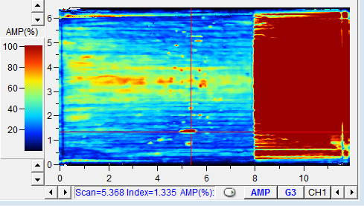
Control Experiments (No BP Layer)
Thin ER layer (212 µm) delaminated prior to testing
  C-scan indicated poor bonding
Thick ER layer (425 µm) performed well
  Shear fracture toughness 787 J/m²
  92% of baseline performance
  The indicates an invalid result
  Blue bars: crack grown towards HR ply
  Green bars: crack grown towards ER ply
G_{IIc-PC} (J/m²)

Slide 16
BP Test Results
Increasing BP DoC improves toughness
Reduced ER thickness from 425 µm to 85 µm and maintained/improved toughness
Best performance achieved with thick ER layer
Sample | %Baseline | G_{IIc-PC} (J/m²) | d_{ER} (µm) | %DoC_{BP}
Control | 92 | 787 | 425 | N/A
B | 0 | Delaminated | 115 | 15
C | 43 | 364 | 145 | 25
D | 99 | 848 | 85 | 35
E | 111 | 947 | 287 | 25
F | 101 | 863 | 127 | 35

Slide 17
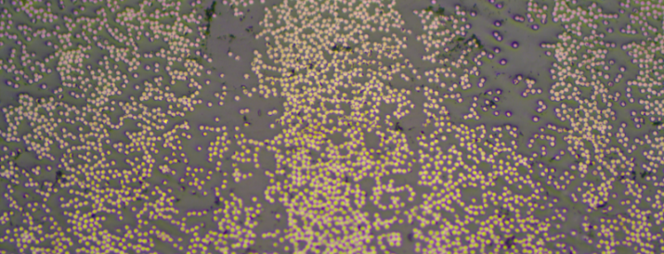
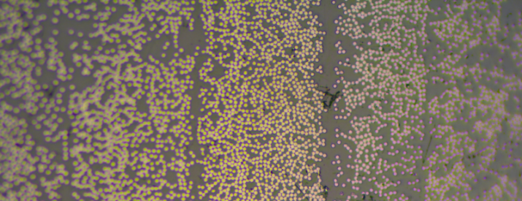
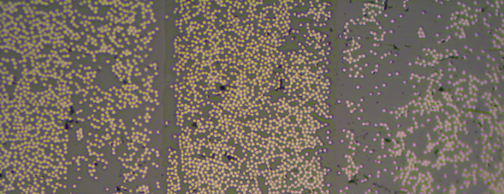
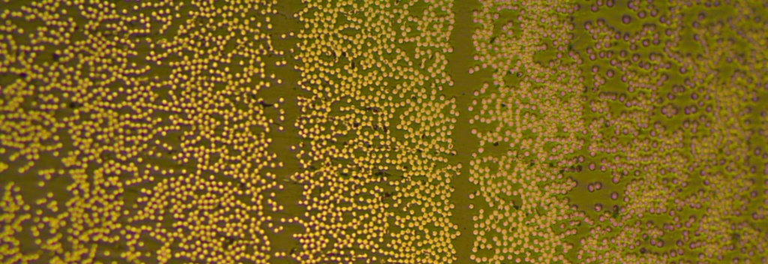
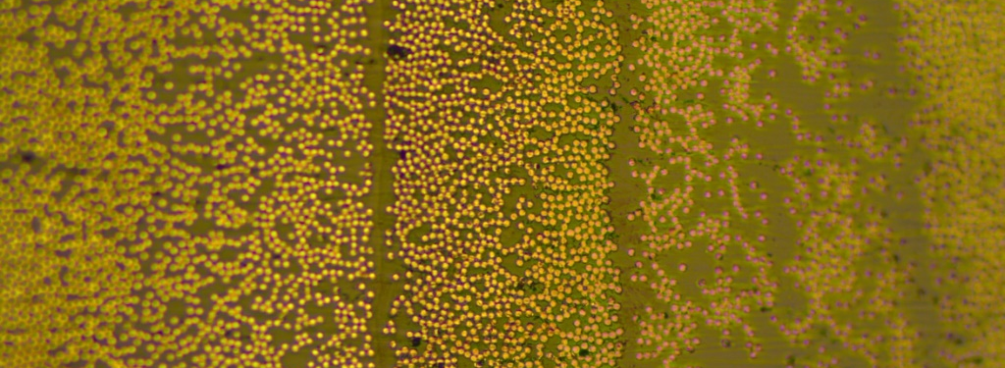
Barrier Ply Micrographs
Control
100 µm
Sample E
100 µm
BP
BP
HR
HR
ER
ER
ER
ER
Sample C
Sample F
HR
HR
BP
ER
ER
BP
ER
ER
BP
Sample D
Sample | %Baseline | G_{IIc-PC} (J/m²) | d_{ER} (µm) | %DoC_{BP}
B | 0 | Delaminated | 115 | 15
C | 43 | 364 | 145 | 25
D | 99 | 848 | 85 | 35
E | 111 | 947 | 287 | 25
F | 101 | 863 | 127 | 35
HR
ER
BP
Yellow arrows indicate visible interfaces
*No micrographs of sample B were attempted

Slide 18
Conclusions
AERoBOND Method:
  Goal: Predicable joints in composite assemblies (reduces redundant fasteners)
  Latent epoxy resins were developed using offset epoxy/hardener stoichiometry
  Thick ER layers add mass and are hard to homogenize with the HR layer
Barrier Ply was developed to reduce mixing during primary cure
  BP is a layer of prepreg with advanced cure state
  Tested 15 to 35% DoC
Reduced thickness using BP and matched or exceeded fracture toughness of samples without BP
  Measured 787 J/m² with ~400 µm ER layer,
  Measured 848 J/m² with ~100 µm BP and ~100 µm ER layers
Future Work
  FTIR Microscopy to measure polymer composition across the interface
Notes:
Frank takes the methods
Tyler takes the results
In conclusion, the AERoBOND method is a rapid, reliable assembly technique for composite structures to reduce or eliminate the need for redundant fasteners. It enables unitization without complex tooling or processing and is practical for near-to-mid-term implementation. The precursor materials are commercially available, and, in some cases, already in-use by the aerospace industry.
Microscopic inspection indicated good mixing at the AERoBOND interface is achievable, making the an AERoBOND joint indistinguishable from a co-cured interlaminar region.
Recent ENF testing that measured mode II fracture toughness showed that the AERoBOND process can match co-cure properties and I showed you three different configurations with as manufactured crack tips and naturally sharp crack tips.
Very soon we plan to measure the interlaminar tensile and shear strengths, mode I fracture toughness, and damage tolerance in a series of quasi-static coupon tests. And I also showed you some plans for a sub-element scale test that we are planning for later this year.

Slide 19
Thank You
Questions?

Slide 20
Start of Backup Slides

Slide 21
Failure Mode and Certification
AERoBOND Failure
Bond Failure
Cohesive Failure
Cohesive Failure
Adhesive Failure
AERoBOND eliminates the potential for weak bond failure mode
Goal: AERoBOND mechanical properties similar to conventional co-cured laminates.
Notes:
Tyler describes the cohesive failure
Frank describes the adhesive failure mode and reiterates that weak bonds can be eliminated with AERoBOND
AERoBOND eliminates the potential for a weak bond failure mode by eliminating the interface. The only possible failure mode in an AERoBOND joint is cohesive failure either in the joint or in the surrounding laminate. The properties of the materials can be tested and certified to meet specifications using current practices. Therefore engineers can design and certify structures based on those measurable, repeatable properties.
In bonded joints, the vast majority of failures are also cohesive in nature, but the weak, adhesive failure mode remains a possibility. It may be impossible to measure and certify the interfacial properties of a bonded joint because of the nature of the nearly two-dimensional, microscopic interface between the adhesive an substrate. So with bonded joints, the only thing that’s absolutely certain stick, are the redundant fasteners.
So the Goal of the AERoBOND project is not be stronger than SoA joints, but simply to achieve mechanical properties and reliability similar to conventional co-cured laminates.

Slide 22
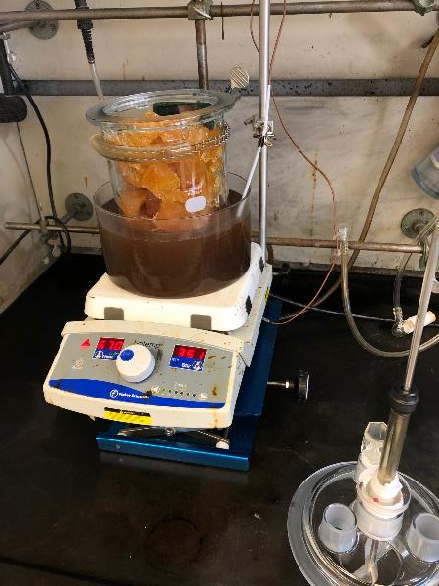
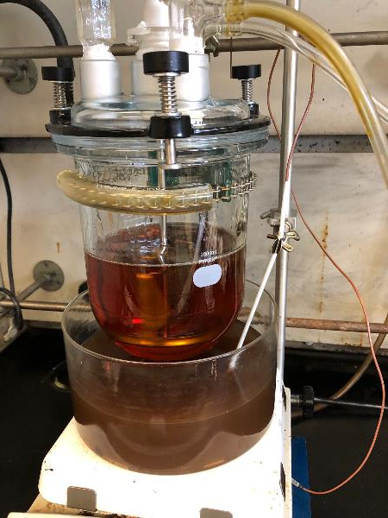
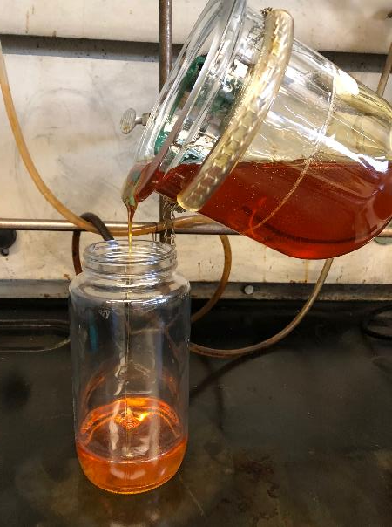
Resin Preparation
Part A and Part B stirred 1 - 1.5 h at 100 -100 °C
Prepolymer diluted with 15 wt.% methyl ethyl ketone (MEK) prior to producing prepreg
Commercially available precursor, readily scalable process
Notes:
Frank describes the resin preparation for prepregging
These pictures show how we formulate the resin in our labs. The Part A epoxy and DETDA hardener are added to a resin kettle. On the left you see the solid chunks of frozen epoxy in the flask. The materials are mixed and heated using an oil bath and a hot plate. The polymerization reaction is advanced only slightly to prevent separation of the components. The prepolymer is poured into jars and diluted with 15 wt.% MEK prior to prepregging.

Slide 23
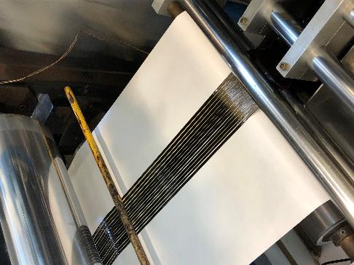
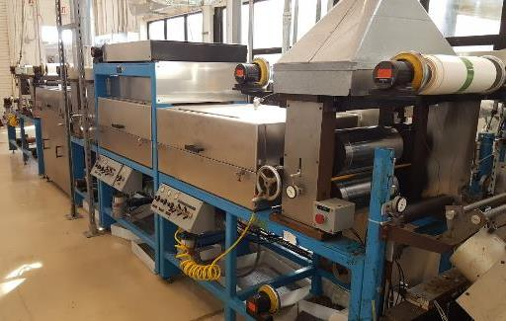
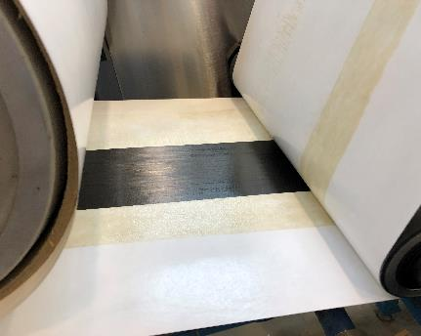
Prepreg Tape Production
Prepared prepreg tape using a custom tape machine at NASA Langley Research Center
  Fiber: IM7G, 14 to 16 tows (12k fibers/tow), 75-100 mm wide tape
  Fiber areal weight (FAW): 70-90 g/m²
  Resin Content: 45-65%
Notes:
Tyler describes the prepregging
We make prepreg tape from the resin/MEK solutions using a custom prepregger at NASA Langley Research Center. We use 14 to 16, 12k fiber tows to get a 3-4’’ wide tape. The prepegging process is critical because it determines the ply thickness, resin/fiber content, and initial DoC in the prepreg.

Slide 24
Baseline Properties
Measured baseline properties:
  Hexel IM7 carbon fiber
  AERoBOND epoxy system (API-60 Part A)
  Conventional hardener (diaminodiphenyl sulfone)
  Conventional stoichiometry (r ~ 0.8)
  Co-cure processing
Baseline properties used to set AERoBOND performance goals
Notes:
Tyler presents how we obtained baseline properties
Frank transitions from baseline to results section
Before I can show you the results of the testing, you need to know about benchmark properties against which we compare our results. We measured the fracture toughness from a set of laminates that were co-cured using the same API-60 resin system used in AERoBOND but with a conventional r-value which is probably around 0.8. I can’t tell you the exact ratio, because the baseline API-60 resin was formulate by the manufacturer. So you will see these baseline properties on the following charts which determined our goals AERoBOND materials.

Slide 25
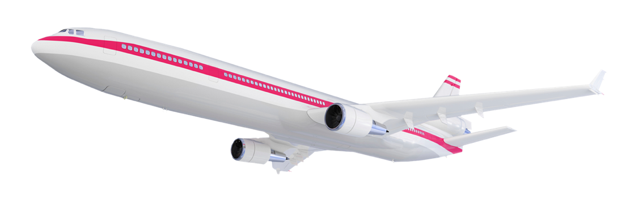

Challenge for Commercial Aircraft Industry
Global Growth in Aviation
2017
4 BILLION
PASSENGER TRIPS
2036
7.8 BILLION
PASSENGER TRIPS
Airbus / Europe
Bombardier / Canada
Irkut /
Russia
Boeing
Comac /
China
41,030
New Aircraft Deliveries
$6.1 Trillion
Market Value
78%
of New Aircraft Deliveries are
Single Aisle Class
(including Regional Jets)
Asia-Pacific
Market is Nearly
40%
of New Aircraft Deliveries
Embraer /
Brazil
Global Competitors
Notes:
Tyler describes original motivation based on IATA report
Frank reaffirms idea that demand will return to nearly predicted level by 2036 assuming pandemic is not lasting 16 years.
The international air transport association (IATA) regularly reports the air transportation outlook for the next twenty years.
They forecasted a doubling of passenger trips between 2017 and 2036, which means that aircraft manufacturers will need to respond with a proportional increase in new aircraft production.
And for sustainability of such high growth rates, there is ever increasing pressure to build sustainable, efficient aircraft, which are highly dependent on high performance composite structures.

