Slide 1
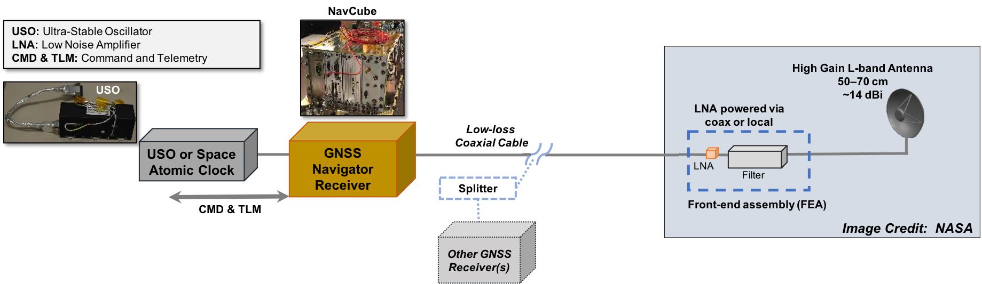
GUCP Lunar GNSS Demonstration Concept

