Slide 1
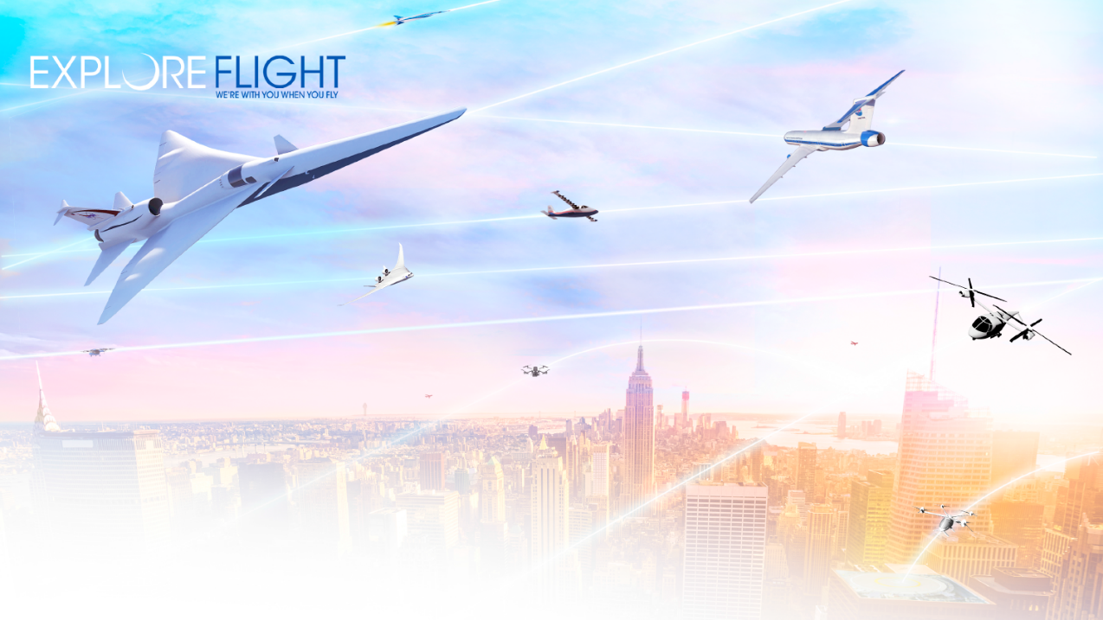

National Aeronautics and Space Administration
UAM Vision: Sky for All
Parimal Kopardekar, Director, NASA Aeronautics Research Institute
February 4, 2021
www.nasa.gov

Slide 2
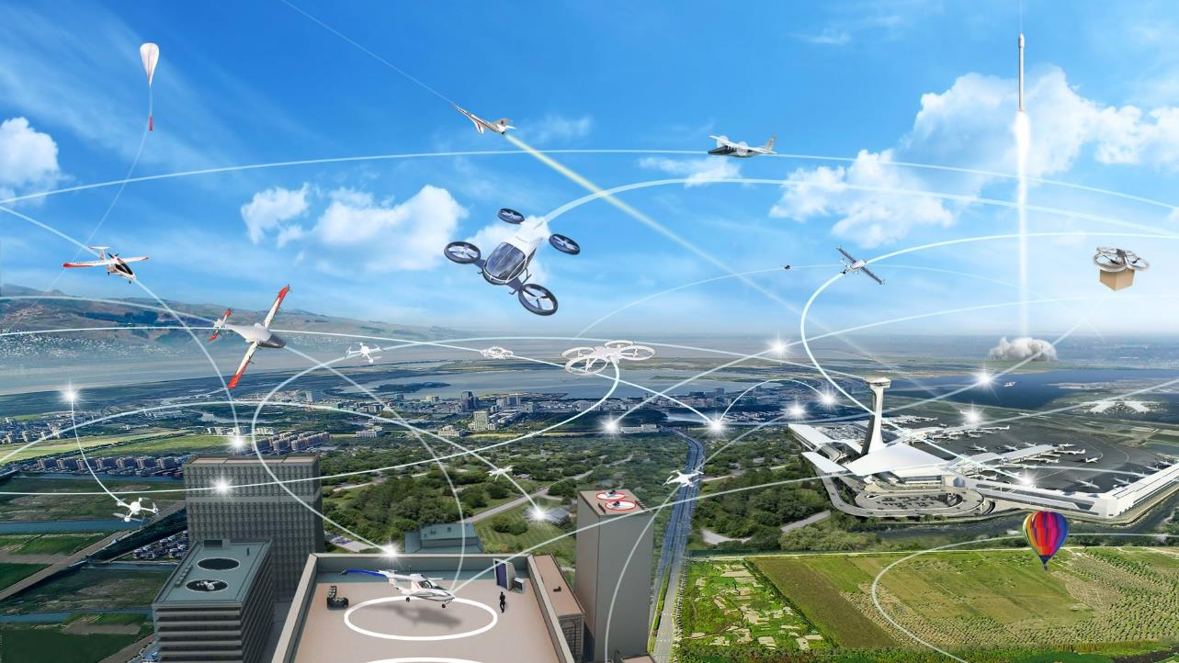
Big Picture
One mile of surface transportation takes you one mile, whereas one mile of aviation land can take you anywhere.

Slide 3
End-to-End
Air Transportation
Increased use of electric propulsion and air vehicles of all sizes are likely to impact future transportation options and society
Currently, transportation is one of the key factors for location of businesses and housing
In future, aviation can get closer to businesses and housing

Slide 4
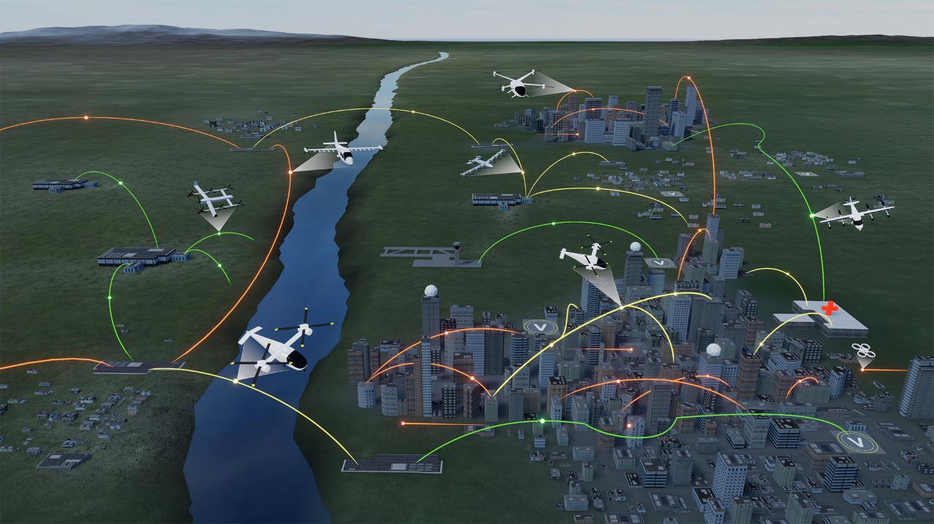



UAM Maturity Levels (UML)
Advanced Air Mobility (AAM) Mission
UML-4 Medium Density/Complexity
UML-3 Low Density,Medium Complexity
UML-2 Low Density/ Complexity
UML-1 Conforming prototypes
On Demand
Air-Taxi
Rural Operations
Urban Operations
Regional
Network
Inter-City
eVTOL
Cargo
Delivery
Cargo
Delivery
Airport
Transfer
Medical
Transfer
Distribution
Center/Warehouse
High Density
Corridor
Air
Ambulance
Fleet
Operations
Inter-city
eVTOL
Small
Package Delivery
Cross-metro
Transfer
Safe, sustainable, affordable, and accessible aviation for transformational local and intraregional missions

Slide 5
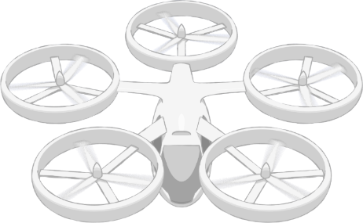
NASA AAM Mission Priorities
xTM Architectures
Operational Rules, Roles, & Procedures
Comm, Nav, Surveillance, Information
Vertiports, Localities, and National Acceptance
UAM Supplemental Data Services
In-time Aviation Safety Management System
Community Integration
Airspace System Design & Implementation
Airspace & Fleet Operations Management
5
3
4
Vehicle
Development & Production
Individual Vehicle Management & Operations
Source and Fleet Noise
Vehicle Propulsion Reliability
Environmental and Failure conditions
Automated Flight and Contingency Management
1
2
Systems and Architecture Requirements
Aircraft & Aircrew Barriers
Airspace Barriers
Community Integration Barriers
Pillar number
National Campaign
#

Slide 6
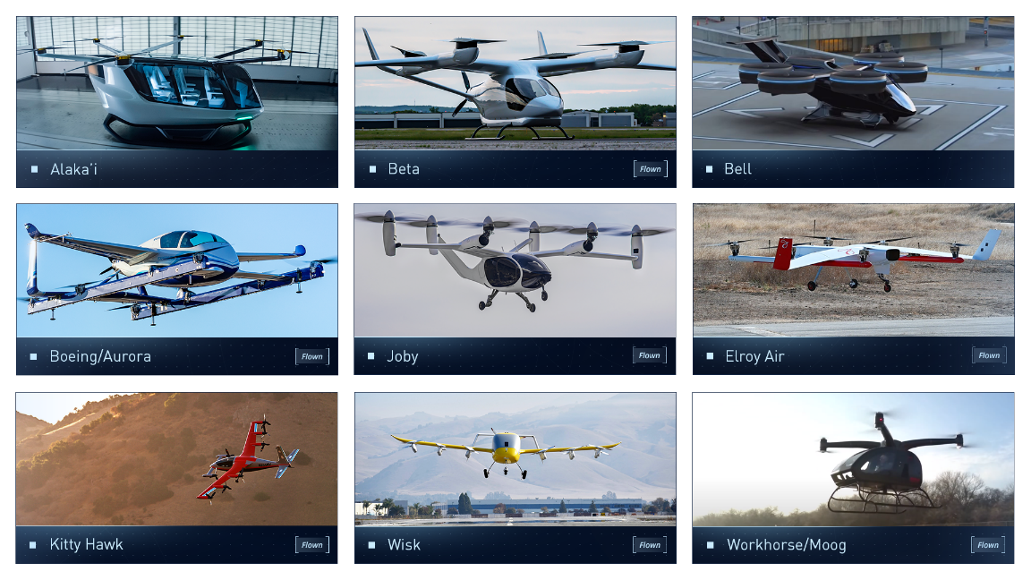
Strong Domestic (e)VTOL Industry Base

Slide 7
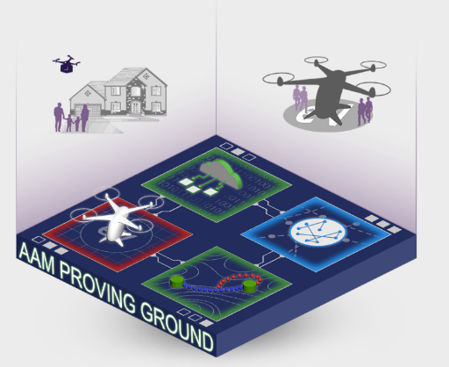
AAM National Campaign (NC) Series
Goal
Assure AAM safety and accelerate scalability through integrated demonstrations of candidate operational concepts and scenarios.
Objectives
Accelerate Certification and Approval
Develop Flight Procedure Guidelines
Evaluate the Communication Navigation and Surveillance (CNS) Trade-Space
Demonstrate an Airspace Operations Management (AOM) Architecture
Characterize Community Concerns

Slide 8
National Campaign Series Support of the Industry Timeline
  Industry proposed
  UML-1 unlock
  Industry proposed
  UML-2 unlock
  Industry proposed UML-3 unlock
  Industry proposed
  UML-4 unlock
  CY2020
  CY2021
  CY2022
  CY2023
  CY2024
  CY2025
  CY2026
  CY2027
  CY2028
  CY2029
  CY2030
NC-1 Operational Safety
Help catalyze UML 1, 2…
NC-2 Complex Operations
Key enablers to accelerate the UML 3&4 timeline…
NC-3 High Volume Vertiports
Remain Agile… Assess and align the AAM strategy with industry needs
Legend
NC Series Progression
X-Series Simulations
NC-4 Scaled Urban Demo
R&D Flight Tests
NC Series Ops Demonstrations
  UML ”unlocks” based on a range of publicly available industry projections and conversations with partners; not a consensus view

Slide 9




AAM Ecosystem Working Groups (AEWG)
  Align on a common vision for AAM
  Collectively identify and investigate key hurdles and associated needs
  Learn about NASA’s research and planned transition paths
  Develop AAM system and architecture requirements
  Adopt a strategy for engaging the public on AAM
  Support regulatory and standards development
  Form a connected stakeholder community
Accelerate the development of safe and scalable AAM flight operations by bringing together
the broad and diverse ecosystem

Slide 10

Airspace “System”
Should be Ready
when Vehicles
are Ready
Image credit: NATS

Slide 11
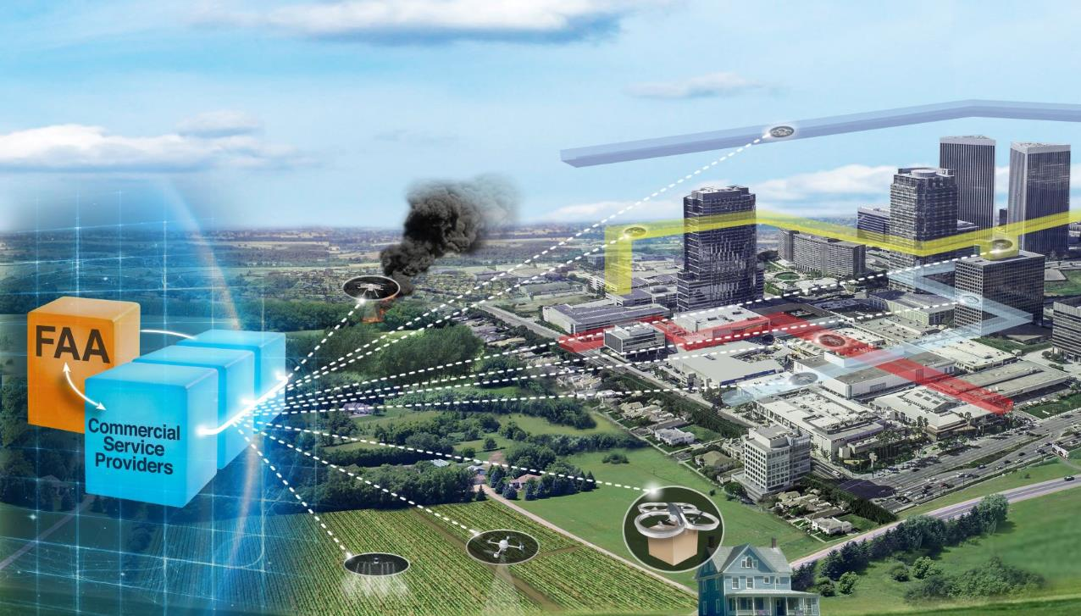
Airspace Considerations
Scaled operations without burdening current air traffic system
Building on UTM success and lessons learned

Slide 12

ATTRIBUTES
Cooperative
Intent-sharing
Digital: data exchanges among operators
Standardized application protocol interfaces
Air/ground integrated
Service-oriented architecture
Role for third-parties
UTM-like Airspace Operations
Environment
OPERATIONS
Space traffic management
Upper E operations
Conventional manned aviation (Class A, B, C, D, E)
Urban/advanced air mobility
Low-altitude small UAS
NASA AOSP focus

Slide 13
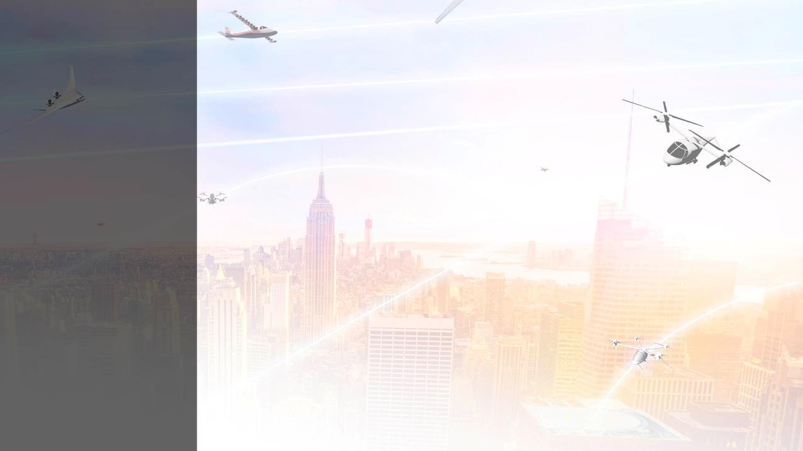




Planning for future
UTM-inspired-ATM (digital, cooperative,
intent sharing, service-oriented architecture, etc.)
Enabling
Future
Airspace
Operations
Revisiting flight rules
electronic/digital, intent sharing, CNS, etc.
Revisiting roles and responsibilities federated
Revisiting separation minima
new technology with higher precision
Kopardekar P., Spring 2020
ATCA Magazine

Slide 14




Using technologies to reduce weather induced delays
Machine learning and artificial intelligence
Enabling
Future
Airspace
Operations
Enabling increased local and regional operations
Benefits societal change
Enabling better disruption management
Primary focus on large-scale disruptions
Developing architecture, automation and R&R
Needs to hang together
Kopardekar P.,
Spring 2020 ATCA Magazine

Slide 15
Progression to Complete Transformation
Low altitude UTM
Upper E UTM-style cooperative operation
Urban/regional air mobility – increasing density and throughput
Accommodate commercial space launches and reentries through digital exchange of intent and real-time updates
Increase digitization, service-oriented architecture, machine learning based decisions, and role for third-parties for ALL airspace
Integration of increasingly autonomous cargo and reduced crew operations

