Slide 1
Artemis III Science Objectives
Renee Weber, MSFC, SDT Committee co-chair

Slide 2
Artemis III Science Definition Team Membership
Co-chairs
Renee Weber, NASA MSFC
Barbara Cohen, NASA GSFC
Sam Lawrence, NASA JSC
Community consultants
Amy Fagan, LEAG Chair
Carlé Pieters, SSERVI Chief Scientist
Juliane Gross, CAPTEM Lunar Sample Subcommittee Chair
Executive Secretary
Amanda Nahm, SMD PSD
Civil Servant Members
Jeremy Boyce, NASA JSC
Michael Collier, NASA GSFC
Caleb Fassett, NASA MSFC
Lisa Gaddis, USGS Astrogeology (now at LPI)
John Gruener, NASA JSC
Jennifer Heldmann, NASA ARC
Noah Petro, NASA GSFC
Kelsey Young, NASA GSFC
Ex officio observers: Sarah Noble (PSD), Debra Needham (ESSIO), James Spann (HPD), Kevin Sato (BPS), Jake Bleacher (HEOMD), Julie Mitchell/Francis McCubbin (JSC curation), David Draper (OCS)

Slide 3
Charge to the Committee
The Artemis III SDT was chartered by Thomas Zurbuchen for NASA SMD. The Committee was charged to:
Define compelling and executable science objectives for the Artemis III mission, the first human mission to the surface of the Moon in the 21st century.
Assess objectives for the mission to achieve the science goals articulated by NASA including investigation approaches, key surface science activities, and potential inputs into the concept of operations.
Submit a final report to the Planetary Science Division that contains prioritized science objectives for all aspects of the Artemis III mission, including sampling strategies and science goals and priorities of deployable instrument packages.

Slide 4
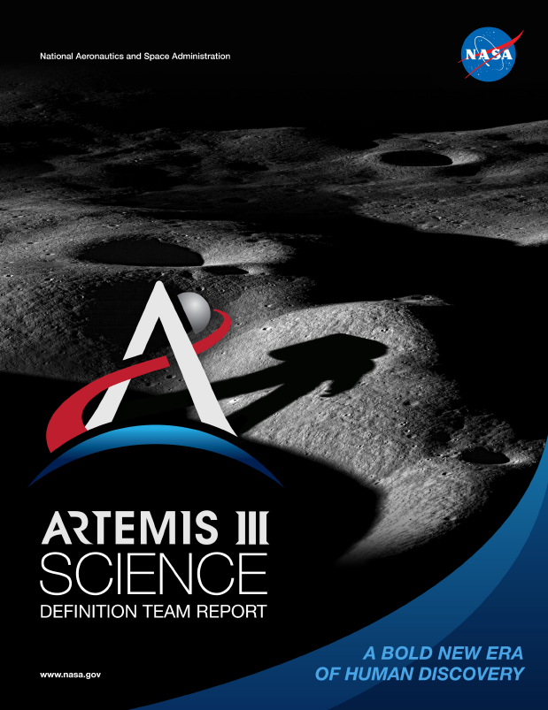
Artemis III Science Definition Team Report
(available at www.nasa.gov/reports)
Table of Contents
Executive Summary
Introduction
Overview of Guiding Community Documents
Artemis Program and Architecture Summary
Artemis Science Objectives and Traceability to Science Priorities
  Objective 1: Understanding Planetary Processes
  Objective 2: Understanding the Character and Origin of Lunar Volatiles
  Objective 3: Interpreting the Impact History of the Earth-Moon system
  Objective 4: Revealing the Record of the Ancient Sun and Our Astronomical Environment
  Objective 5: Observing the Universe and the Local Space Environment from a Unique Location
  Objective 6: Conducting Experimental Science in the Lunar Environment
  Objective 7: Investigating and Mitigating Exploration Risks
Artemis III Candidate Science Program
Enabling Capabilities
Cartographic Recommendations
Considerations for Landing Site Selection
References
Appendix 1: Terms of Reference
Appendix 2: Summary of Community Involvement
Appendix 3: Biographies of Members
Appendix 4: List of White Papers Submitted to the Panel

Slide 5
Artemis Science Objectives and Traceability to Science Priorities
NASA HQ’s Artemis Plan laid out seven Science Objectives:
Objective 1: Understanding Planetary Processes
Objective 2: Understanding the Character and Origin of Lunar Volatiles
Objective 3: Interpreting the Impact History of the Earth-Moon system
Objective 4: Revealing the Record of the Ancient Sun and Our Astronomical Environment
Objective 5: Observing the Universe and the Local Space Environment from a Unique Location
Objective 6: Conducting Experimental Science in the Lunar Environment
Objective 7: Investigating and Mitigating Exploration Risks
The SDT was charged with expanding upon science these Objectives. We chose to map science Goals (areas of research) down to Investigations (specific activities undertaken to address Goals).

Slide 6
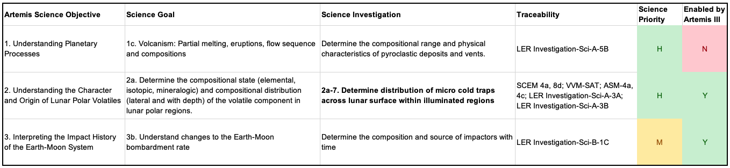
Traceability and Prioritization
Both traceability and prioritization drew on community-submitted white papers and guiding documents.
Each investigation was ranked on two independent criteria:
  Compelling science (e.g., how fundamental is the investigation to making a significant scientific advancement
  Whether Artemis III presents an enabling opportunity given the architectural constraints

Slide 7
Candidate Program
We constructed a notional program that captures the highest-priority science for Artemis III and provides the greatest feed-forward to follow-on missions and the build-up to the Artemis Base Camp. This program contains three cohesive elements:
A successful surface mission hinges on addressing all three program elements
Sample collection and return | In situ and field science | Deployed experiments
Contingency sample (bulk) Small clast (rake) Large clast (hand) Sealed core (drill) Sealed surface (bulk) Regolith surface (CSSD) | Volatile monitoring Environmental monitoring Geochemistry/mineralogy Geotechnical properties Traverse geophysics | Volatile monitoring Environmental monitoring Geophysics

Slide 8
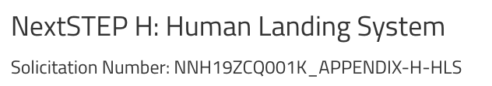
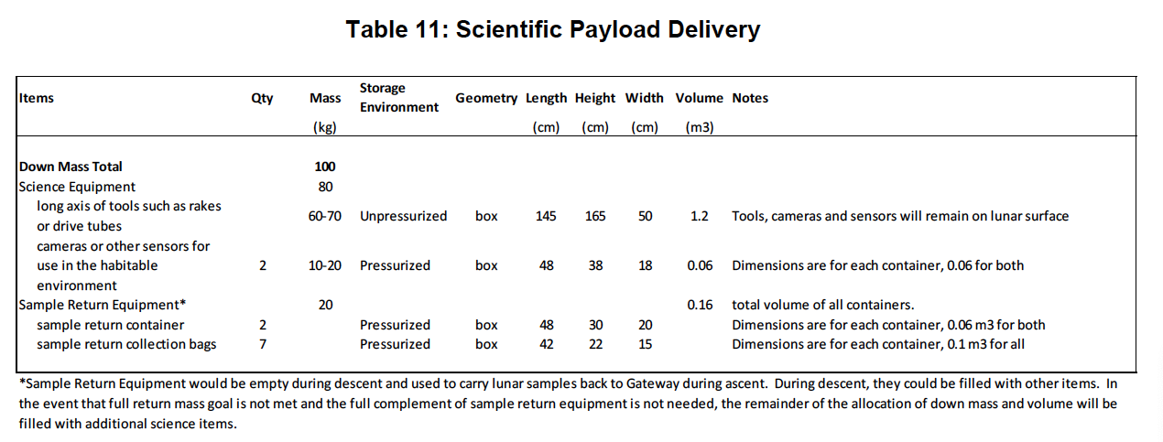
HLS Program Architecture – mass
https://www.nasa.gov/nextstep/humanlander2

Slide 9
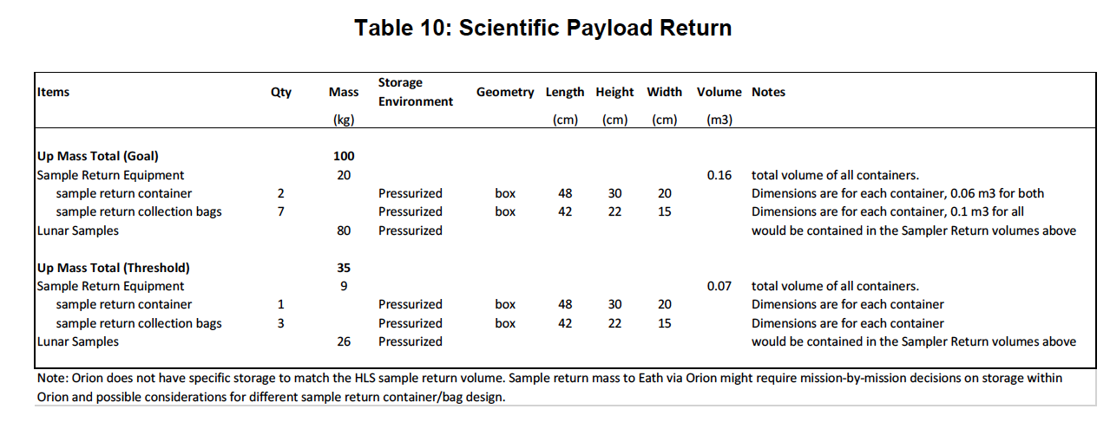
HLS Program Architecture – mass

Slide 10
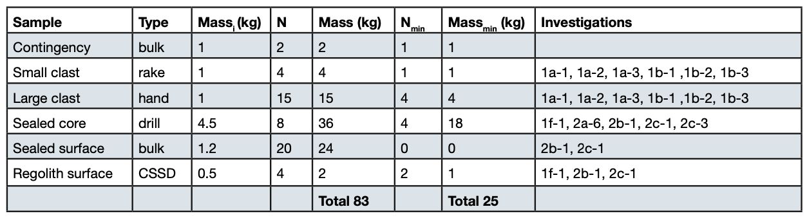
Candidate Program: Samples
The SDT developed sample suites meeting both the threshold and goal requirements. Notice that in both cases, we are still able to address the same investigations, but more samples are always better.

Slide 11
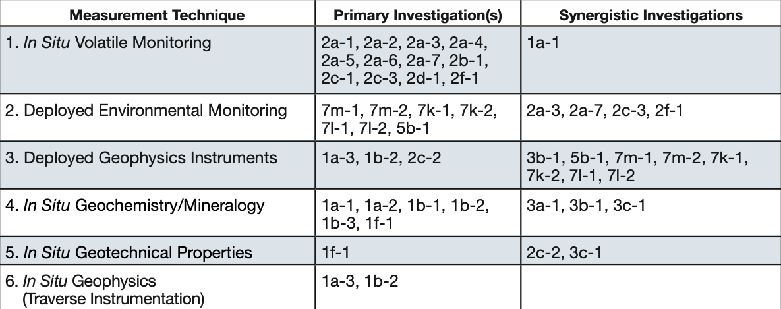
Candidate Program: In situ and Deployed Science
Assuming Goal up-mass allocation for samples, the HLS down-mass allocation for science & utilization (60-70 kg) must be first reserved for sample collection tools (rakes, core tubes, etc.) and sample return containers
Without pre-deploy, only 10-20 kg will be available for ALL Science & Utilization objectives:
  SMD: in situ tools (handheld instruments, including a camera) or crew-deployed experiments left on the surface
  Other objectives arise from HEOMD & STMD
Where to draw the line depends on both available mass AND breakdown of utilization objectives

Slide 12
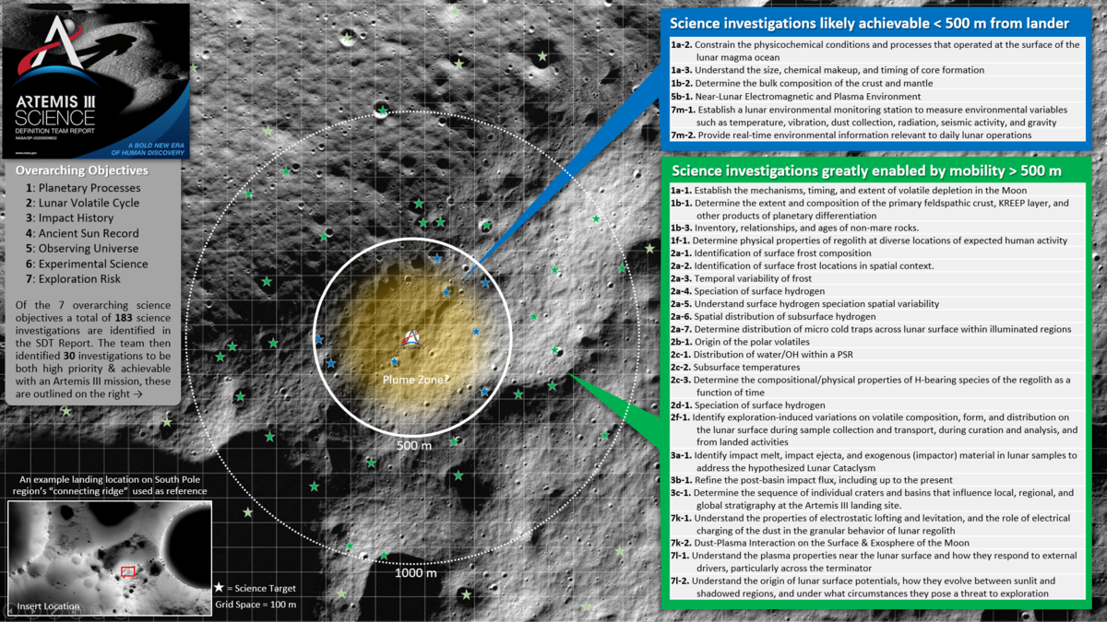
HLS Program Architecture – EVA distance

Slide 13
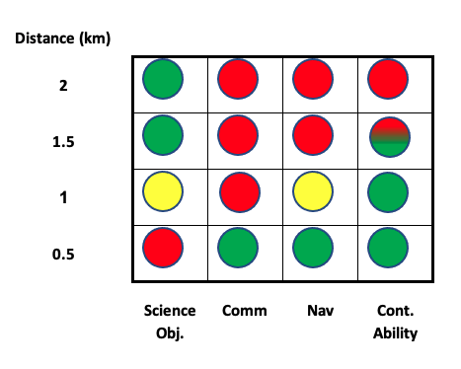
HLS Program Architecture – EVA distance
Based on EVA distance trade, radial distance desires/needs for science objectives conflict with the communications and navigation radial distance capabilities
Science/Utilization needs would ideally drive development of enhanced capabilities
Prioritization of science objectives remains the same regardless of EVA distance capability
Surface objectives cannot be further prioritized until HLS downmass, a landing site, and EVA capabilities are defined

Slide 14
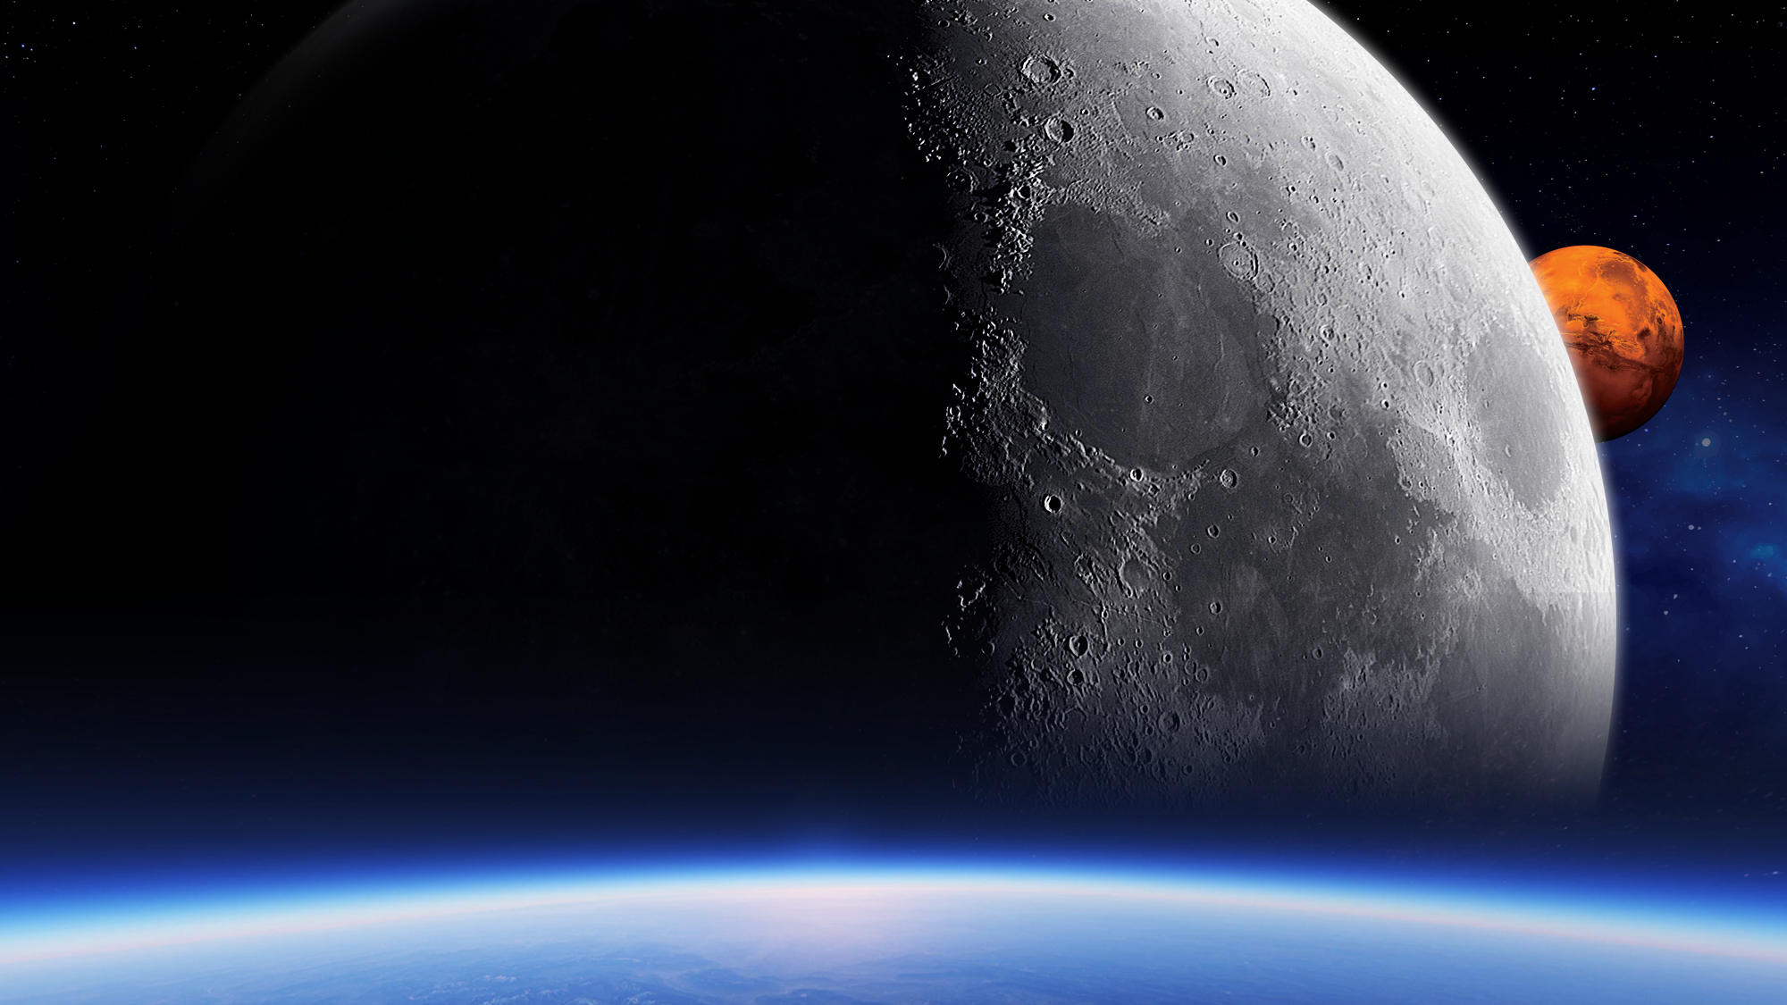

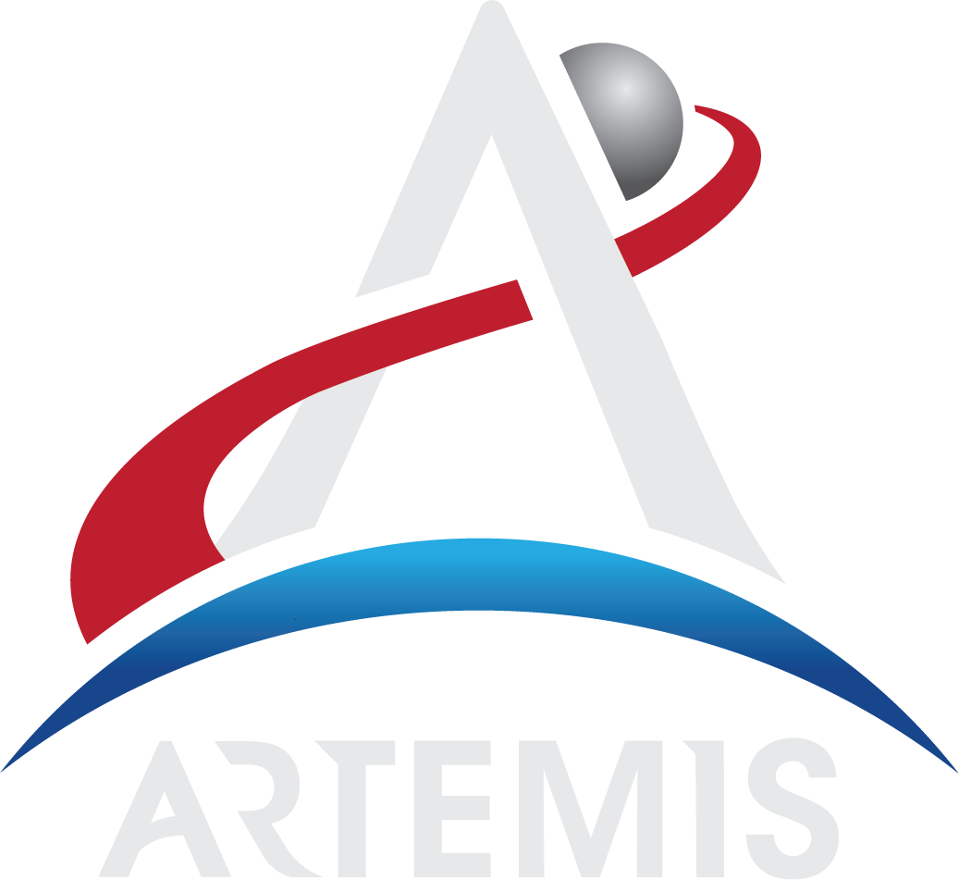
THE MOON ENABLES SCIENTIFIC EXPLORATION
A CORNERSTONE
For Solar System science and exoplanet studies
A TRAINING GROUND
To learn how to conduct scientific exploration from a planetary surface, working synergistically with crew and robotic explorers
A NATURAL LABORATORY
To study planetary processes and evolution
AN OPPORTUNITY
To use infrastructure and resources associated with human exploration to leverage support for autonomous scientific investigations

