Slide 1





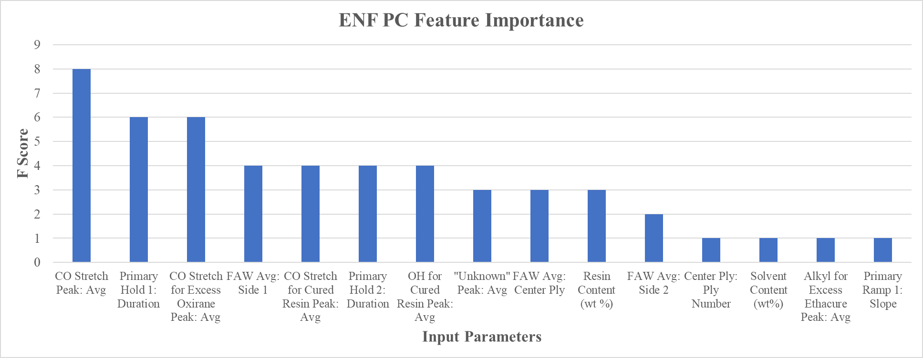
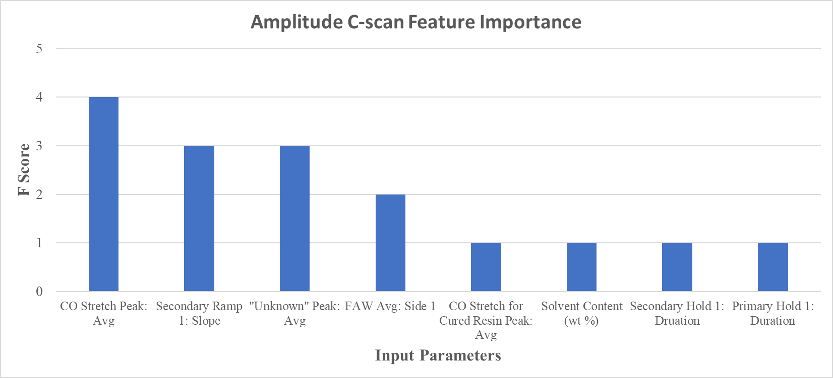
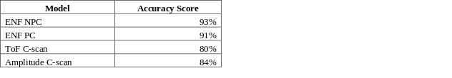
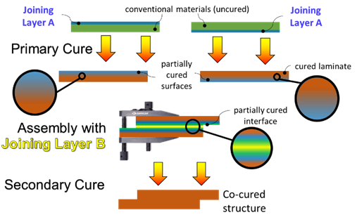




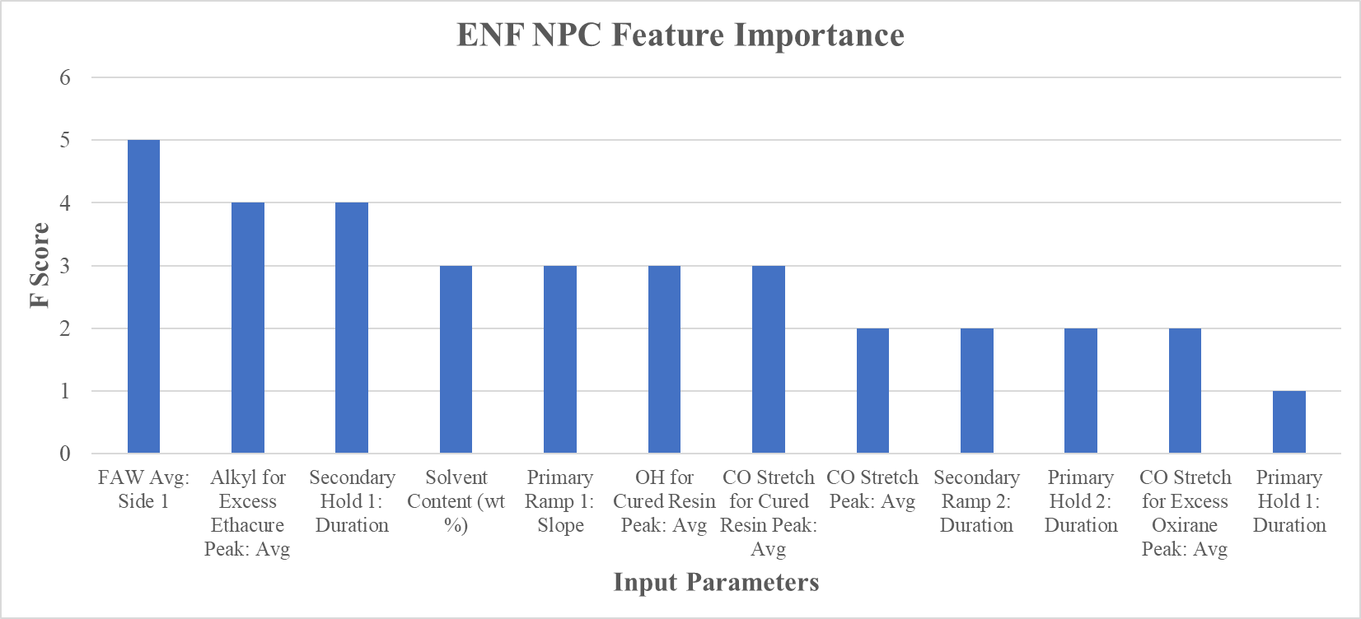
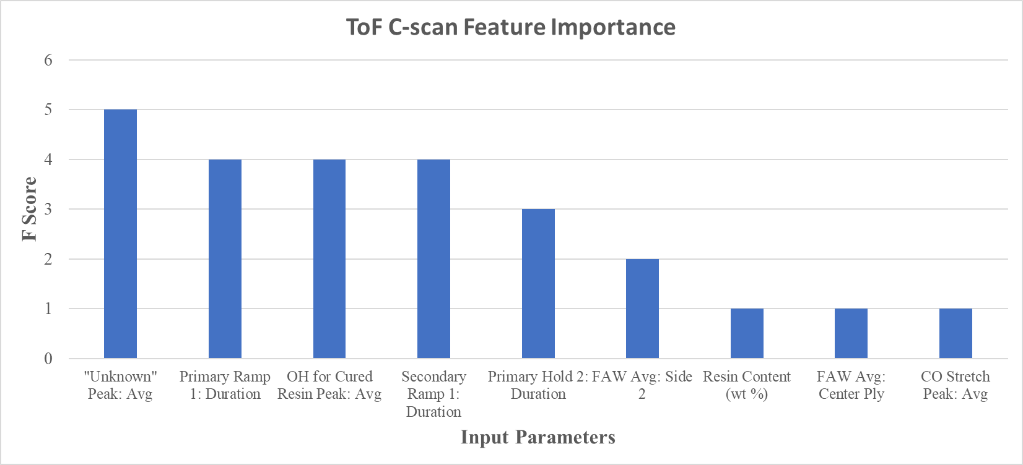
Machine Learning to Predict Joint Performance in Epoxy Composites Based on Process Parameters
Brennen M. Middleton¹, Tyler B. Hudson², Yi Lin³, Jin Ho Kang³, and Frank L. Palmieri^{2,*}
¹NASA Internships, Fellowships, and Scholarships Program, NASA Langley Research Center, Hampton, VA 23681
²NASA Langley Research Center, Hampton, VA 23681
³National Institute of Aerospace, 100 Exploration Way, Hampton VA 23666
*frank.l.palmieri@nasa.gov
Abstract
Approach
ENF PC Model
Amplitude C-scan Model
Polymer matrix composites are gaining popularity in the aerospace industry due to their high specific strength, fatigue properties, and processability. However, based on current FAA certification guidelines, manufacturers utilizing current state-of-the-art composites made with adhesive bonds commonly install redundant fasteners to guarantee the strength of these adhesively bonded composite parts.^{1,2} The number of fasteners in a single-aisle commercial transport aircraft is typically on the order of 10⁵, which reduces manufacturing rate, increases cost tremendously, and reduces the advantage of the specific strength composites provide. Due to this, the Adhesive Free Bonding of Composites (AERoBOND) project at NASA Langley Research Center has developed a novel assembly process to manufacture complex composite parts without the use of adhesives and fasteners.¹ However, optimization of the process is currently challenging due to the complex and interdependent process parameters. To assist with the optimization, four machine learning algorithms utilizing gradient boosting decision trees were created to provide predictions for the mechanical and characterization properties of the composite parts. Approximately 200 random states from each algorithm were tested, and the models from each state were isolated and analyzed based on their accuracy, a validation process, and their feature importance. This analysis concluded that the models created from the machine learning algorithms could accelerate a parametric study for the AERoBOND process by rapidly optimizing process parameters to achieve desired performance characteristics.
Machine learning (ML) algorithms were created with PythonTM 3.7 to predict the mechanical performance and characterization properties of the composite parts. Experimental data from fifteen AERoBOND parts were analyzed in the ML algorithms. Each experiment included 29 input parameters. The end-notched flexure (ENF) test produced fracture toughness results (G_{IIc}) in non-precracked (NPC) and precracked (PC) test configurations. Ultrasonic inspection produced time-of-flight (ToF) and amplitude C-scan data. The experimental data was split using an 80:20 training to testing ratio. The ML algorithms used gradient boosting decision trees with hyperparameter tuning through the XGBoost module to provide predictions of the mechanical (ENF NPC and ENF PC) and characterization (ToF and Amplitude C-scans) properties of the composite parts.
The ENF PC model shows small differences in the experimental and prediction values in both the model testing and validation phases. Additionally, no signs of underfitting or overfitting were shown in the feature importance graph.
The Amplitude C-scan model shows small differences in the experimental and prediction values in both the model testing and validation phases, with slightly higher differences shown in the second experimental value in both the model testing and validation phases. Additionally, no signs of underfitting or overfitting were shown in the feature importance graph.
The above tables show the data for the model testing and validation phases for the ENF PC model. The left table shows the model testing predictions, while the right table shows the model validation predictions.
Results
The above tables show the data for the model testing and validation phases for the Amplitude C-scan model. The left table shows the model testing predictions, while the right table shows the model validation predictions.
Models were tested within the algorithm, underwent a validation stage, and were screened for underfitting or overfitting with feature importance graphs. Additionally, accuracy scores, calculated with the scikit-learn module³, were presented for each model to determine their ability to make accurate predictions of the testing portion of the 80:20 split.
Challenge
Unlike co-cure processing, which is limited to parts with simple designs, the AERoBOND method would allow for complex parts to be manufactured without the use of adhesives. This is done by joining and curing two partially cured composite surfaces, resulting in a monolithic composite structure with no visible interface. This potentially reduces the number of fasteners dramatically, decreasing manufacturing time and cost. However, it is challenging to perform process optimization for the AERoBOND project, as the current process parameters are interdependent and complex.
The above table shows the accuracy scores for all four ML algorithm models.
The above figure shows the feature importance graph for the ENF PC model.
ENF NPC Model
ToF C-scan Model
The above figure shows the feature importance graph for the ToF C-scan model.
The ENF NPC model showed small differences between the experimental data and testing predictions during internal testing. However, the validation phase showed a larger deviation in the experimental and predicted values. No signs of underfitting or overfitting were shown in the feature importance graph.
The ToF C-scan model shows small differences in the experimental and prediction values in both the model testing and validation phases, with a slightly higher difference occurring at the second experimental value. Additionally, no signs of underfitting or overfitting were shown in the feature importance graph.
Discussions and Conclusions
After analysis, the ENF PC, ToF C-scan, and Amplitude C-scan models were shown to determine predictions from input parameters with accuracy. The ENF NPC model showed slight inconsistencies during the validation phase of testing, but performed with accuracy during the model testing phase. For all models, feature importance showed no signs of overfitting or underfitting the data. Additionally, the feature importance shows all models utilized data in their decision trees from all data categories. Furthermore, all models had model accuracy scores greater than or equal to 80%. It should be noted that increasing the sample size of the experimental data could potentially increase the accuracies of the models, and the performance of the ENF NPC model during the validation phase has the potential to improve in accuracy and reliability with the addition of experimental data.
It was concluded that models created from the ML algorithms could accelerate a parametric study for the AERoBOND process by rapidly optimizing process parameters to achieve desired performance characteristics.
The above tables show the data for the model testing and validation phases for the ENF NPC model. The left table shows the model testing predictions, while the right table shows the model validation predictions.
The above tables show the data for the model testing and validation phases for the ToF C-scan model. The left table shows the model testing predictions, while the right table shows the model validation predictions.
References
The above figure shows the AERoBOND method to produce a co-cured, monolithic composite structure. Two uncured composite layers, denoted as Joining Layer A, are partially cured through a primary cure process. The partially cured surfaces of these layers are then assembled together with a center Joining Layer B. The assembly then undergoes a secondary curing process to create the completed composite structure.
1. F.L. Palmieri, T.B. Hudson, R.J. Cano, E.R. Tastepe, D.S. Rufeisen, L.U. Ahmed, Y. Lin, C.J. Wohl and J.W. Connell, Reliable bonding of composite laminates using reflowable epoxy resins, Proceedings of the 2019 International SAMPE Tech. Conf. Seattle, WA, 2019 Society for the Advancement of Materials and Process Engineering.
2. Federal Aviation Administration, 14 CFR § 25.301-307.
3. Scikit-learn, 3.3. Metrics and scoring: quantifying the quality of predictions, from https://scikit-learn.org/stable/modules/model_evaluation.html.
Acknowledgements
The above figure shows the feature importance graph for the ENF NPC model.
The above figure shows the feature importance graph for the ToF C-scan model.
We thank Charles Liles and Tanner Griffen for support with accessing and instruction in machine learning software tools and methods.
Notes:
Test articles to isolate damage modes
NDE to monitor damage growth

