Slide 1
Enabling Sustained Presence Using Recyclables (ESPUR)
Christopher J. Wohl¹, Bryce L. Horvath¹, Peter M. Strohmaier², Sarah E. Gorski², Haley M. Ketteler², Alec B. Werner², Nasef A. Junaid²,
and Sidney L. Eichelberger²
¹NASA Langley Research Center, Hampton, VA 23681, USA
²NASA Internship, Fellowship, and Scholarship Program, NASA Langley Research Center, Hampton, VA, 23681, USA
44th Annual Meeting of the Adhesion Society, Virtual
February 22-25, 2021

Slide 2
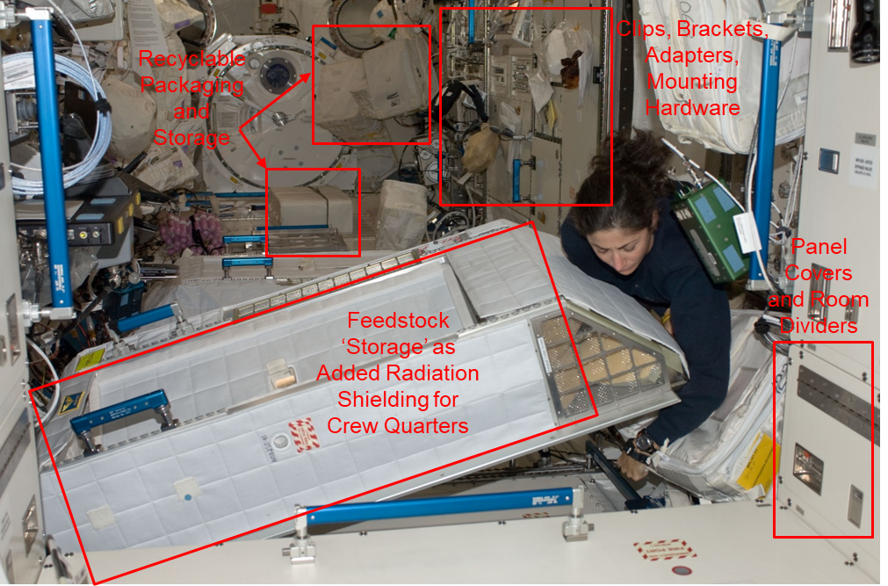
Reusable Materials for Space Exploration
In-space manufacturing will be critical to enable increased mission endurance and future mission independence from Earth.
The Problem: Mission resupply becomes increasingly difficult as we reach further from Earth
Extended timeline from recognition of need to site arrival
Risk mitigation is inhibited by launch mass limitations
The Need:
In-space manufacturing capability amenable to a broad array of applications
Quantitative Impact: development of recyclable/reusable material will enable launch mass savings, longer mission duration, and greater mission Earth-independence
Image credit: NASA

Slide 3

Challenge
Spares on ISS
Spares Aboard
Corrective
ISS Model
Failures
Losses
Re-Supply
ESPUR Mission
Preventative
Spares on Earth
On-Board Fabrication, Reuse, Recycling
Diagram adapted from: Owens, Andrew, and Olivier De Weck. "Systems Analysis of In-Space Manufacturing Applications for the International Space Station and the Evolvable Mars Campaign." AIAA SPACE 2016. 2016. 5394.

Slide 4
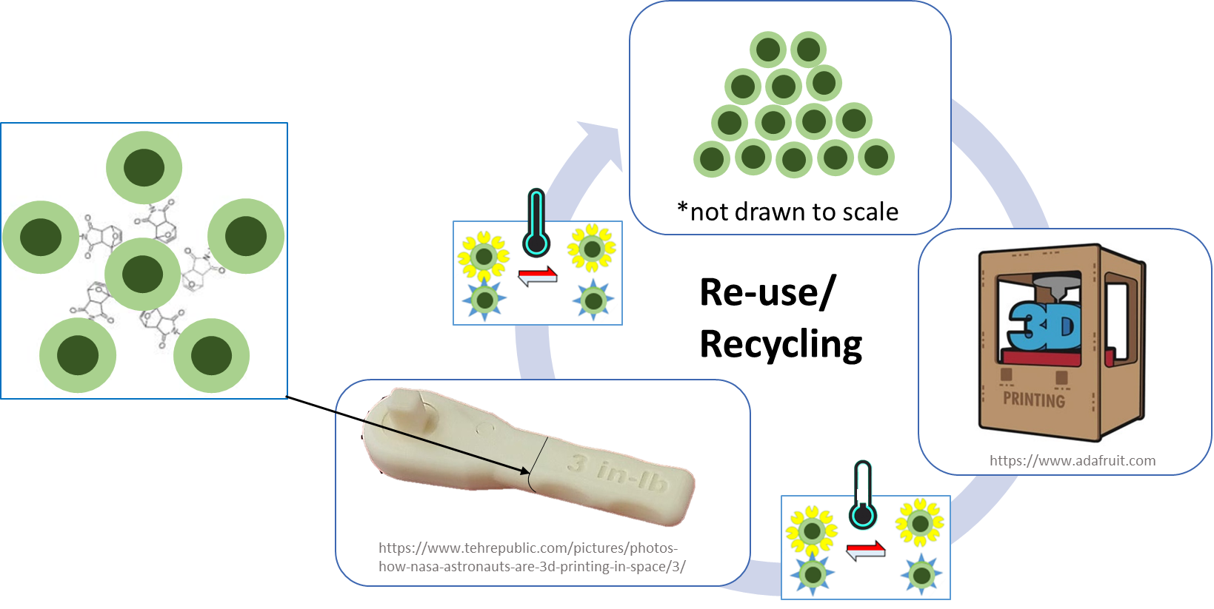
The ESPUR Concept
Enable Sustained Presence Beyond Low Earth Orbit (LEO)
Via Recyclable Feedstocks
Andrew Owens and Olivier De Weck. "Systems Analysis of In-Space Manufacturing Applications for the International Space Station and the Evolvable Mars Campaign", AIAA SPACE 2016, AIAA SPACE Forum, (AIAA 2016-5394)

Slide 5
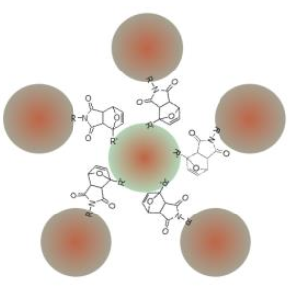
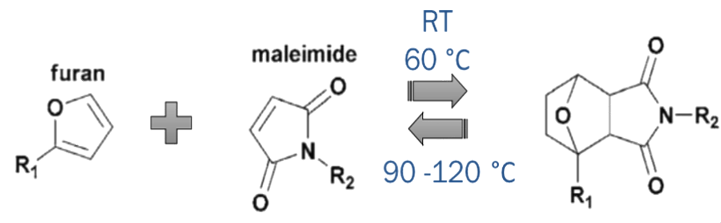
Components of ESPUR Material
Key
Epoxy Microparticle
Copoly(carbonate-urethane) polymer coating
Diels Alder Functionalities
Notes:
discuss that ESPUR made PCU, and coated Epoxy particles with it, but we have not yet tested PCU-coated microparticles (mechanical testing), nor have we incorporated diels alder functionalities to the coated particles

Slide 6
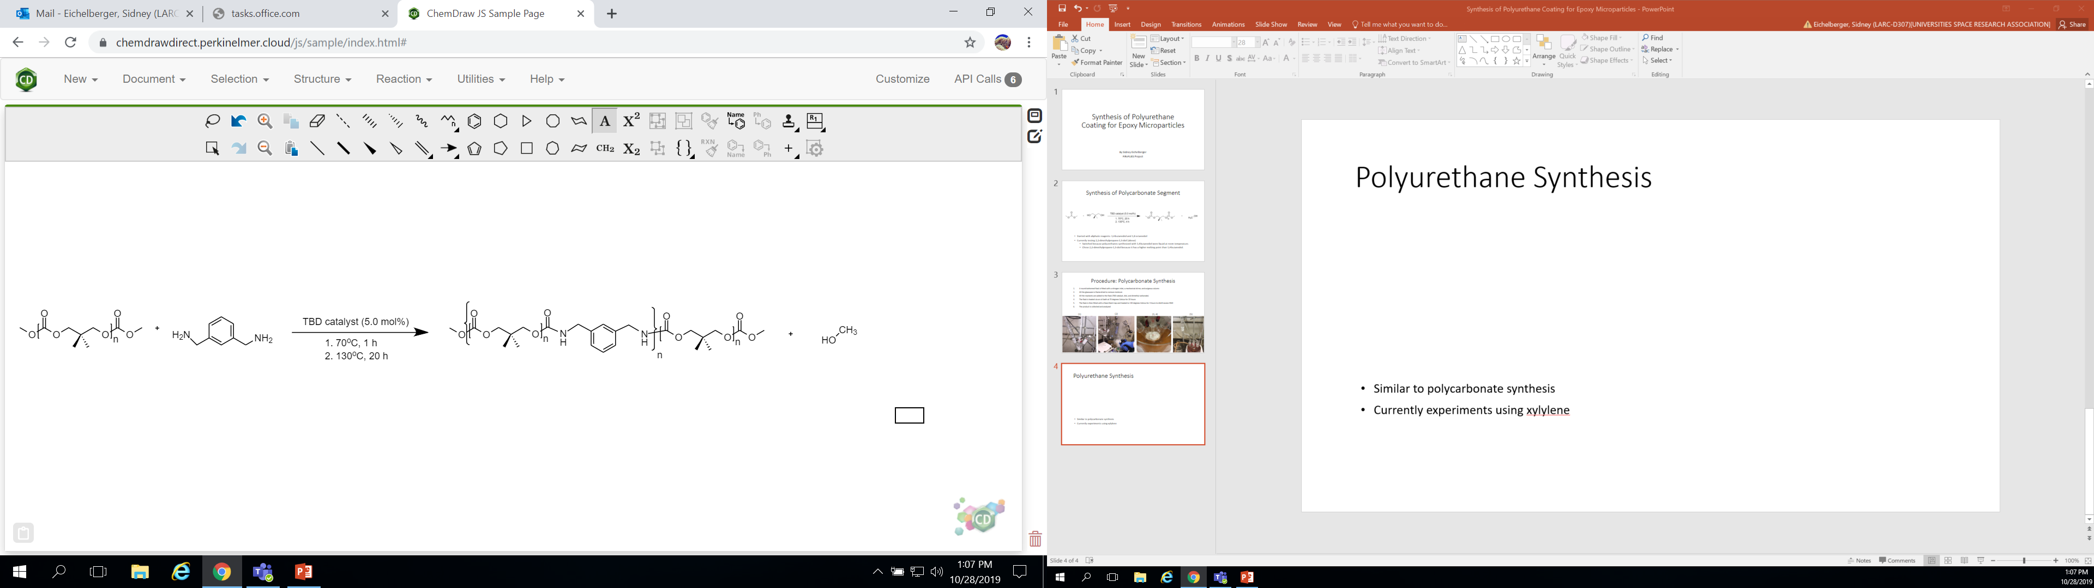
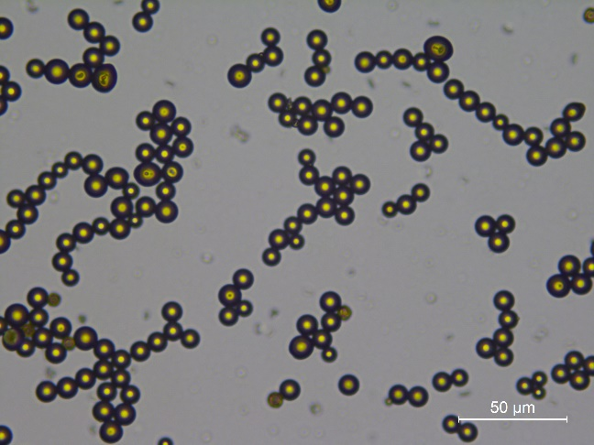
Tunability of ESPUR Material
Copoly(carbonate urethane) polymer
Thermal properties
Mechanical properties
Rheological properties
Epoxy microparticles
Particle size
Particle coating thickness
Particle organization
Polycarbonate
Urethane Linkage
50 μm
Image credit: NASA

Slide 7
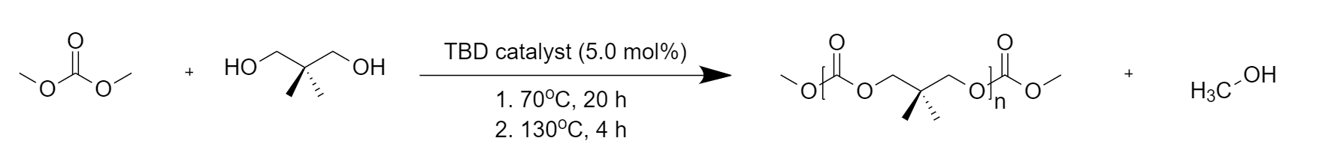
Polymer Coating-CPCU
A
B
2011, Macromol. Rapid Commun., 32, 1379-1385.
2012, Green Chem., 14, 1728-1735.
Image credit: NASA
Notes:
Polycarbonate hard-block synthesis example

Slide 8
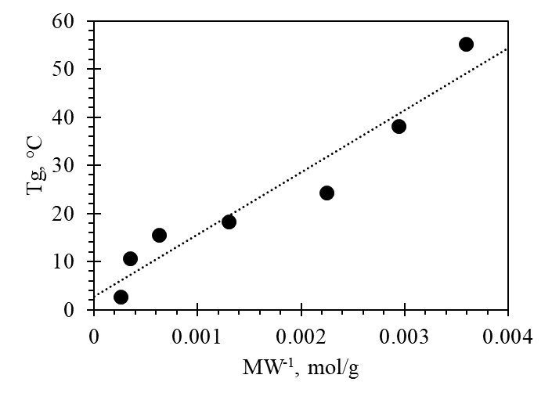

Tunability of ESPUR Material
Copoly(carbonate urethane) polymer
Thermal properties
Mechanical properties
Rheological properties
Epoxy microparticles
Particle size
Particle coating thickness
Particle organization
R²=0.93
$$T_{g}\left(M_{n}\right)=T_{g}\left(∞\right)−\frac{K}{M_{n}}$$
Flory-Fox Equation
Polycarbonate
Urethane Linkage

Slide 9
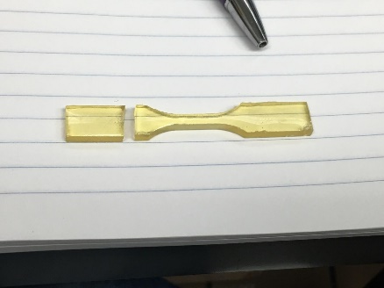
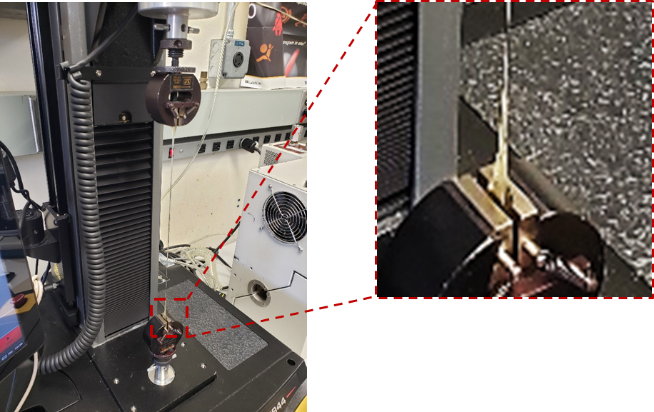
Tunability of ESPUR Material
Low Molecular Weight Polycarbonate
Copoly(carbonate urethane) polymer
Thermal properties
Mechanical properties-determined to be dependent on polycarbonate molecular weight
Rheological properties
Epoxy microparticles
Particle size
Particle coating thickness
Particle organization
T_{g} > RT
High Molecular Weight Polycarbonate
Polycarbonate
Urethane Linkage
T_{g} < RT
Image credit: NASA

Slide 10
Tunability of ESPUR Material
Copoly(carbonate urethane) polymer
Thermal properties
Mechanical properties-closely follows a trend enabling estimation of mechanical properties a priori
Rheological properties
Epoxy microparticles
Particle size
Particle coating thickness
Particle organization
Polycarbonate
Urethane Linkage

Slide 11
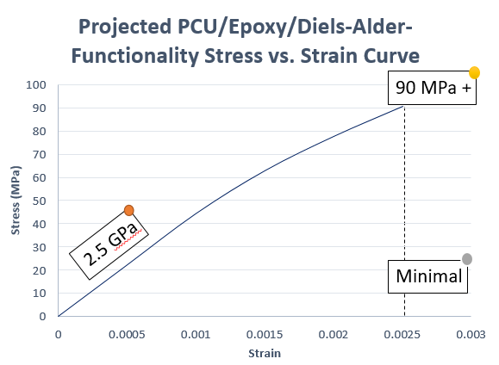
Tunability of ESPUR Material
Copoly(carbonate urethane) polymer
Thermal properties
Mechanical properties-TARGET mechanical properties and healing efficiency calculated from literature examples
Rheological properties
Epoxy microparticles
Particle size
Particle coating thickness
Particle organization
2 GPa
5 MPa
Healing Efficiency | Number of Cycles*
10 Cycles
Polycarbonate
Urethane Linkage
*Number of cycles refers to number of times feedstock has been healed, reused/recycled or reshaped.

Slide 12
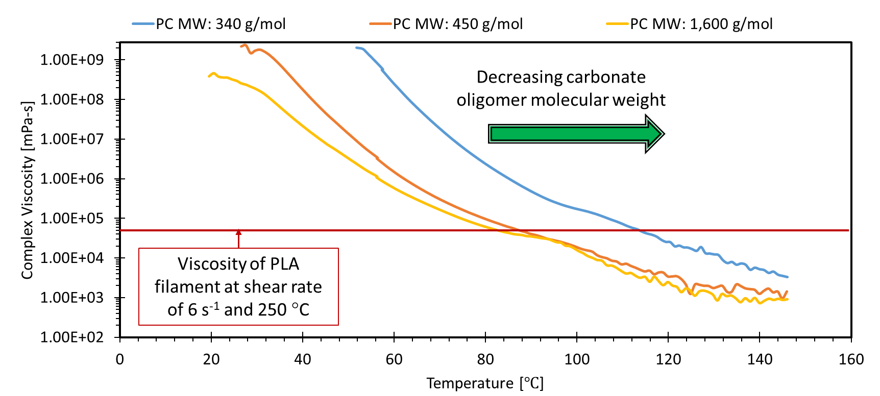
Tunability of ESPUR Material
Copoly(carbonate urethane) polymer
Thermal properties
Mechanical properties
Rheological properties-properties comparable to PLA at much lower temperatures
Epoxy microparticles
Particle size
Particle coating thickness
Particle organization
Viscosity of PLA filament from: Zhu, Pu, "Polymer Materials Via Melt Based 3D Printing: Fabrication and Characterization" (2018). All Theses. 2895.
https://tigerprints.clemson.edu/all_theses/2895
Polycarbonate
Urethane Linkage

Slide 13
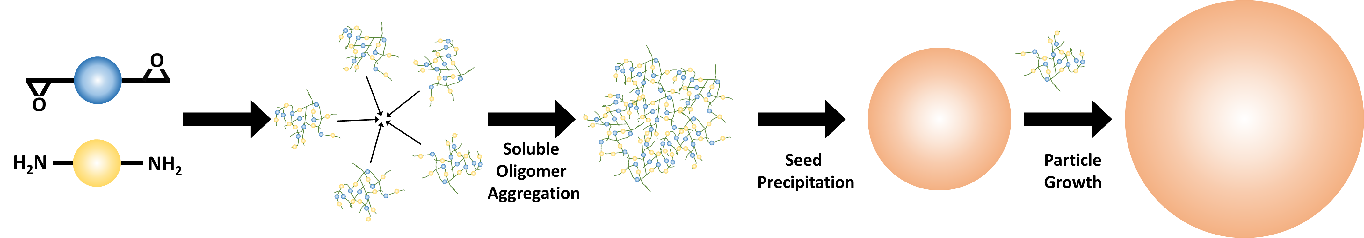
Tunability of ESPUR Material
Copoly(carbonate urethane) polymer
Thermal properties
Mechanical properties
Rheological properties
Epoxy microparticles
Particle size-particles are synthesized using precipitation polymerization. Repeatability and scalability have both been addressed up to 0.5 kg scale.
Particle coating thickness
Particle organization

Slide 14
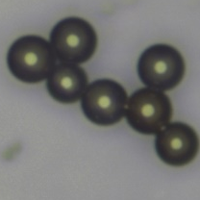
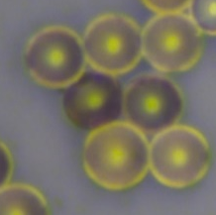
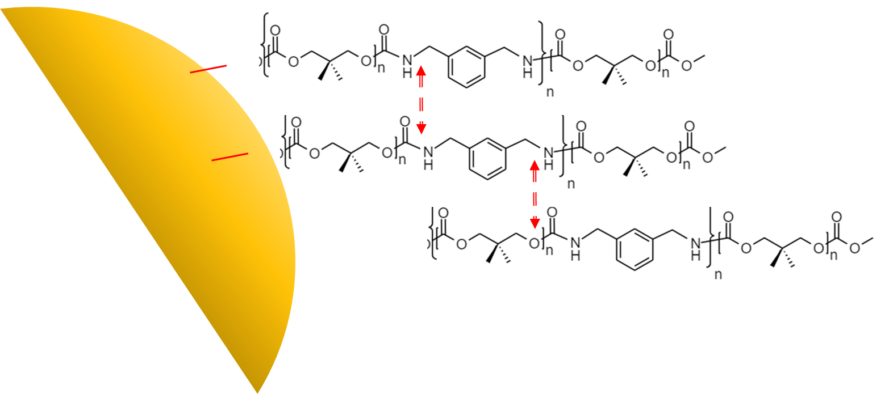
Tunability of ESPUR Material
Copoly(carbonate urethane) polymer
Thermal properties
Mechanical properties
Rheological properties
Epoxy microparticles
Particle size
Particle coating thickness- controlled by concentration of reactive species with polymerization occurring in the presence of particles
Particle organization
Uncoated
Coated
Chemical Bonding
Image credit: NASA
Hydrogen Bonding

Slide 15
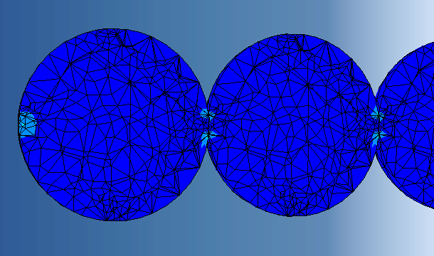
Tunability of ESPUR Material
Copoly(carbonate urethane) polymer
Thermal properties
Mechanical properties
Rheological properties
Epoxy microparticles
Particle size
Particle coating thickness
Particle organization-leveraging concepts from Shannon Entropy, scale-free research to enable generation of durable 3D architectures
Compressive Load
S.A. Beznosyuk et al., Informational Approach to Self-Assembling Aggregation of Colloidal Nanoparticles, Materials Science and Engineering C, 2009, 29, 884-888.

Slide 16
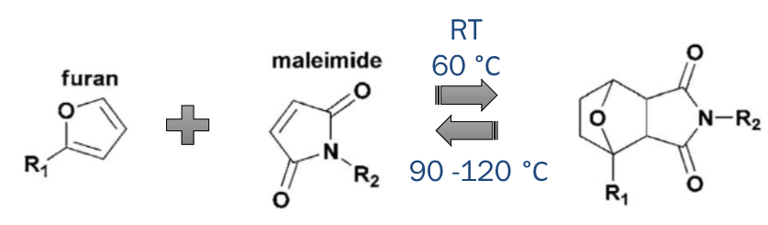
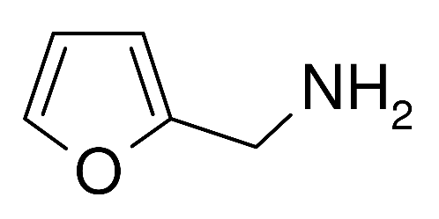

Reversible Click Chemistry
Maleimide-furan reaction
Prog. Polym. Sci. 2013, 38, 1-29.
Furfuryl amine
Naturally-derived
Maleimide
Derived from maleic anhydride
B. Zhang, et. al., Polym. Chem., 2015,6, 7368-7372

Slide 17
Maleimide End-Cap Synthesis
B. Zhang, et. al., Polym. Chem., 2015,6, 7368-7372

Slide 18
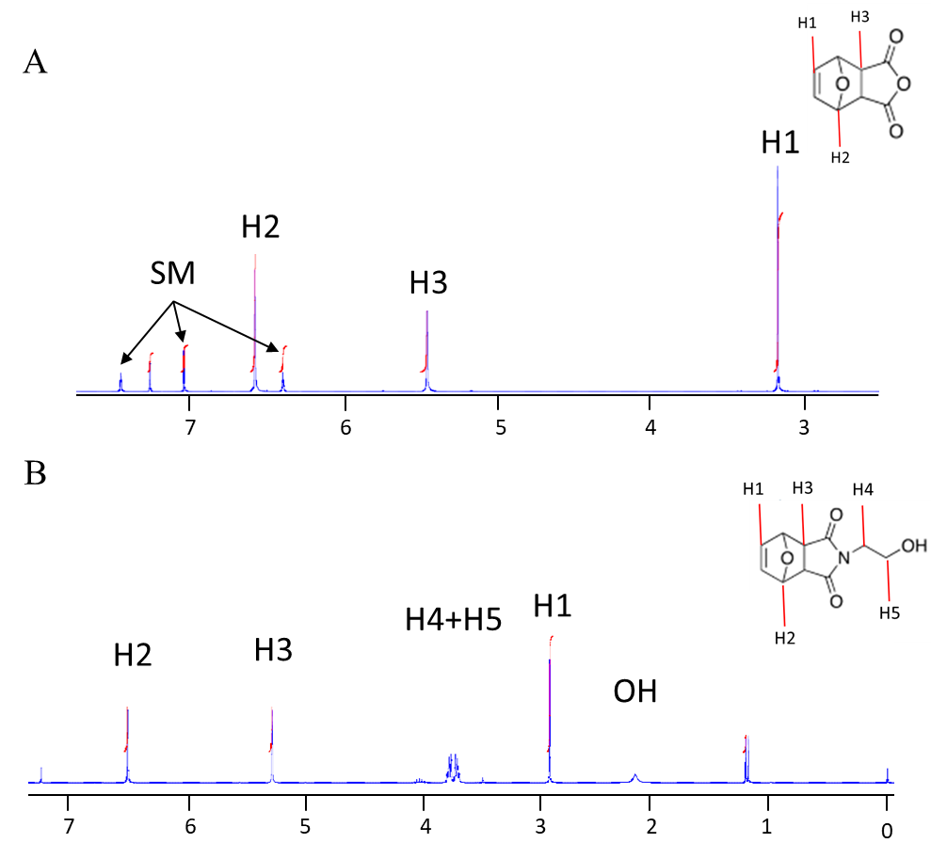
NMR Analysis of Intermediates*
*Final product has been synthesized. NMR analysis has been completed but spectrum cannot be shown due to lack of laboratory access

Slide 19
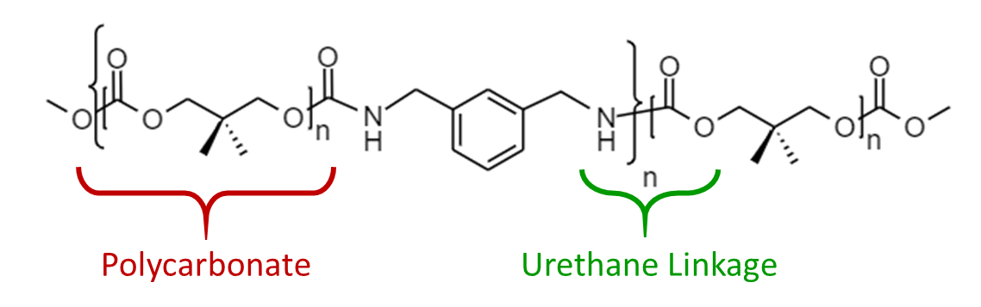
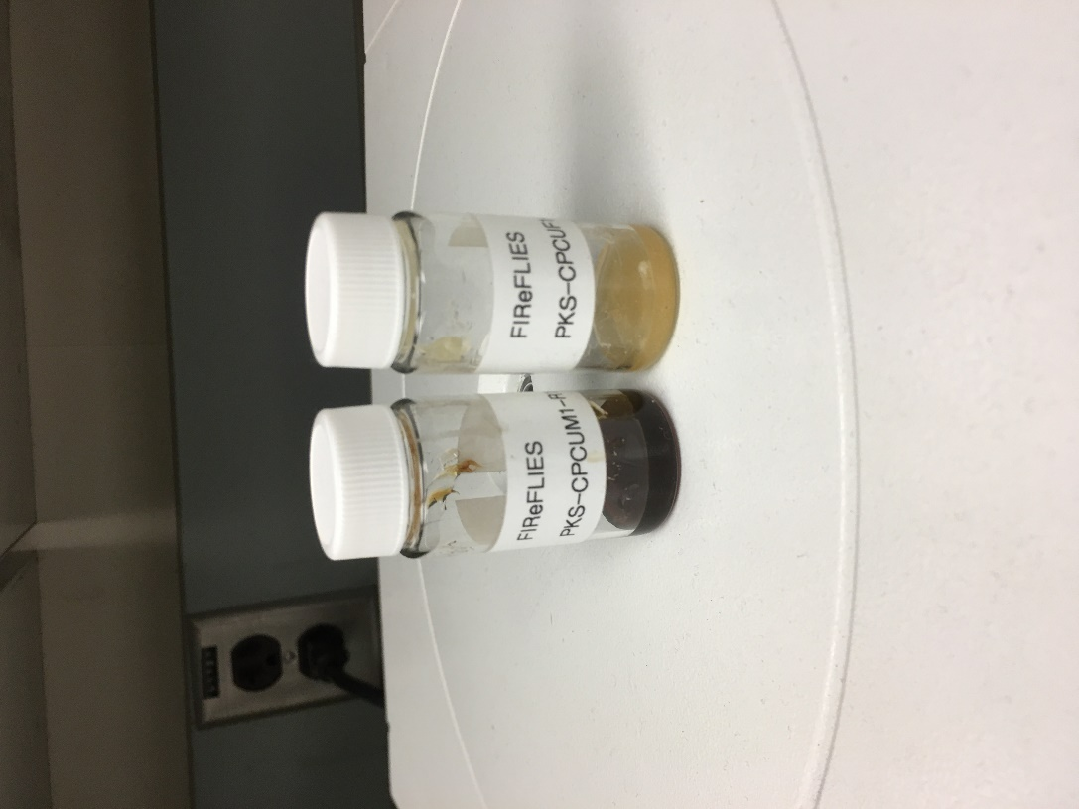
Ready for the Next Phase of Research … Proof of Concept*
+
+
Image credit: NASA
*Picture taken in March, 2020

Slide 20
Conclusions/Next Steps
In-space manufacturing can be a game-changing approach to realize long duration missions beyond low Earth orbit (LEO)
Utilization of recyclable feedstocks to extend mission lifetimes and reduce risk seems like a natural extension
Next Steps
Need to develop CPCU formulations for filament extrusion toward 3D printing applications
Need to evaluate the efficacy of click-chemistry functionalities integrated into CPCU
Need to demonstrate reversible assembly

Slide 21

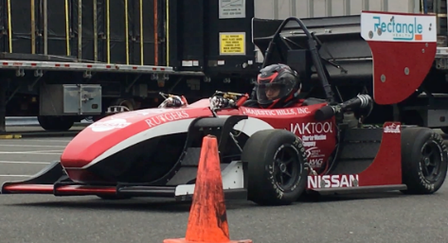


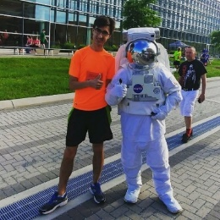
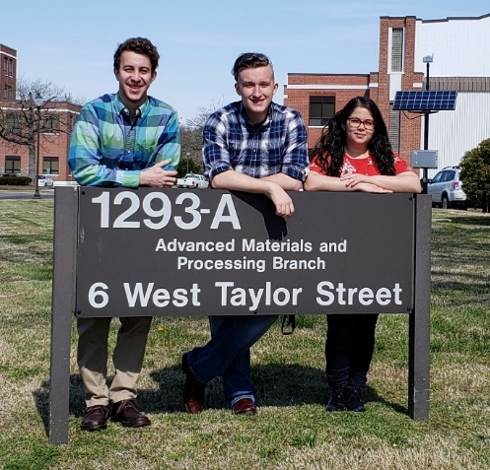
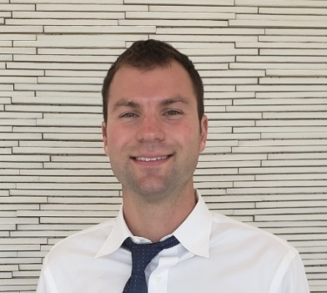


Acknowledgements
Advanced Materials and Processing Branch
Joseph G. Smith Jr., John W. Connell
NASA Marshall Space Flight Center
Tracie Prater, Michael Fisk
NIFS Program, IRAD Program
Nasef Junaid
Fall 2019
Charity Williams
Summer, 2019
Haley Ketteler
Summer, 2020
Carlex Morales Cruz
Spring, 2018
Matthew Swift
Summer, 2018
Team Lightning Bugs,
Ben Zusmann
Jonah Sayre
Jailyn Hernandez
Spring, 2019
Alec Werner
Summer, 2019 2020
Sidney Eichelberger
Fall, 2019
Sarah Gorski
Summer & Fall, 2020
Spring, 2021
Image credit: NASA

