Slide 1
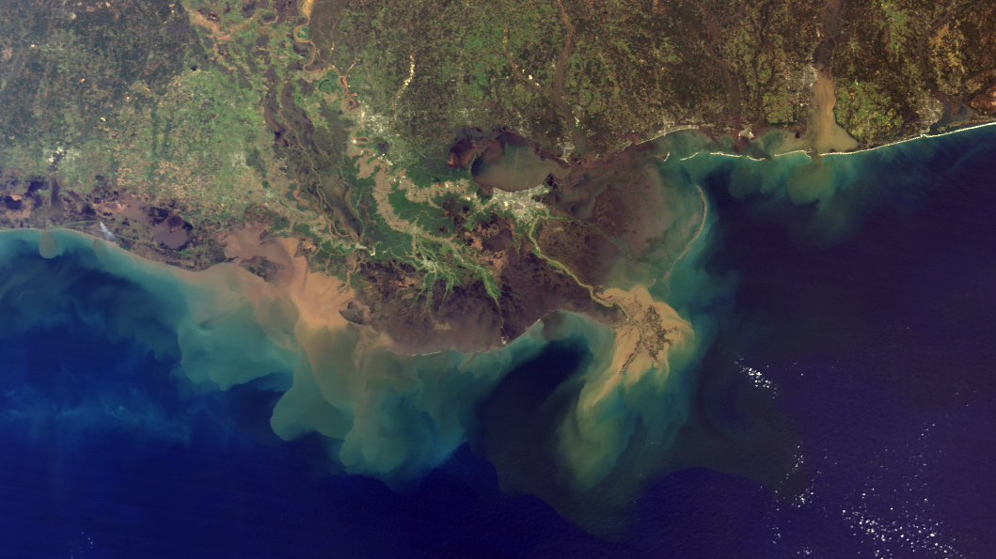
Coupled Analysis and Prediction with
NASA’s GEOS System
Steven Pawson
Global Modeling and Assimilation Office, NASA GSFC
UGOS Annual Meeting; Session: Operational Forecasts, Applications and Collaborations; February 10, 2021
https://earthobservatory.nasa.gov/images/1257/mississippi-river-sediment-plume
Notes:
Background: NASA’s congressionally awarded Science Budget in 2021 is >$7.3 Billion dollars, of which $2 Billion is for Earth Science
NASA presently has more than 20 space-based missions in Earth orbit, plus assets on ISS and joint with other agencies
https://earthobservatory.nasa.gov/images/1257/mississippi-river-sediment-plume
NASA’s “Image of the Day” for March 16, 2001
The Mississippi River carries roughly 550 million metric tonnes (500 million tons) of sediment into the Gulf of Mexico each year. This true-color image, acquired from the Moderate Resolution Imaging Spectroradiometer (MODIS) aboard NASA’s Terra satellite via direct broadcast on March 5, 2001 at 10:55 AM local time, shows the murky brown water of the Mississippi mixing with the dark blue water of the Gulf two days after a rainstorm. The river brings enough sediment from its 3,250,000 square km (1,250,000 square mi) basin to extend the coast of Louisiana 91 m (300 ft) each year.
New Orleans (gray pixels) is located in the center of the image, just below Lake Pontchartrain. Contained by levees, the surface of the Mississippi actually flows above the streets of the city. To the left of the Mississippi River delta is the Atchafalaya River, a “distributary” of the Mississippi that carries about 30% of the river’s total flow.
Image courtesy Liam Gumley, Space Science and Engineering Center, University of Wisconsin-Madison and the MODIS science team.

Slide 2
NASA GMAO’s Goals in Earth System Analysis and Prediction
Research-oriented focus using the “Global Earth Observing System” family of models (NWP, atmospheric composition, S2S, reanalysis, …)
GEOS products support NASA’s mission, including space- and ground-based observations, research studies, and contributions to national assessments etc.
A major focus is to incorporate NASA’s observations into global analyses and forecasts to examine processes and their interactions:
  Weather prediction: cloudy radiances, aerosols and composition, …
  Atmospheric reanalysis: aerosol, ozone, ice, …
  Ocean analysis: altimetry, salinity, ocean biology, …
  Seasonal prediction and predictability: soil moisture, sea ice, …
Notes:
Note that NASA analyses/forecasts are not operational like NOAA’s (NAOO has the mandate to distribute operational products).
The GMAO does produce analyses and weather forecasts in near-real time and distribute to the community supporting NASA’s mission and research endeavors, as well as applications.

Slide 3
Topics to Discuss
Present structure of the “GEOS-S2S” system, including atmosphere, ocean, land and ice models
How higher resolution will enable process interactions on regional scales to couple with the drivers from and feedbacks to the global environment
How NASA observations and the modeling/analysis capabilities drive efforts to stronger coupling among Earth system components (complexity)
Relevant to regional applications such as loop currents, Arctic environment, …
Dependence of ocean analyses on satellite altimetry observations (JASONs, IceSat2, …), Sentinel-6 Michael Freilich
Alignment to NASA missions, such as SMAP, PACE, SWOT, …

Slide 4
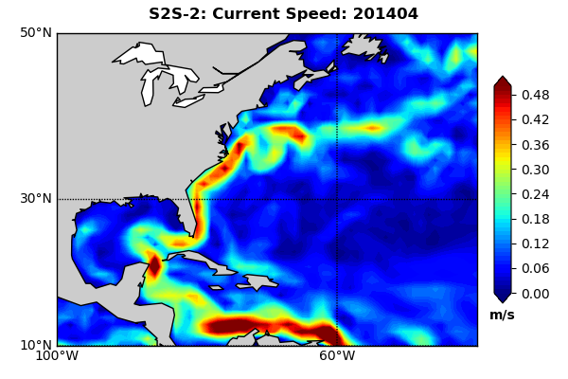
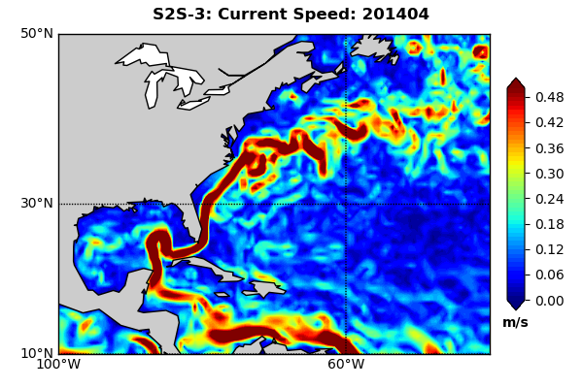
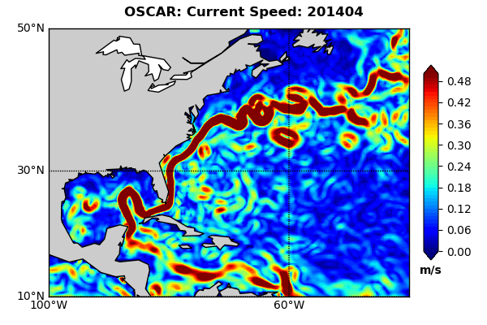
Improving Representation of Loop Current in GEOS-S2S
GEOS-S2S Version 2
MOM5 ocean (0.5ºL40)
In production since 11/2018
GEOS-S2S Version 3
MOM5 ocean (0.25ºL50)
Distribution starts ~3/2022
OSCAR
Direct surface analysis
https://www.esr.org/research/oscar
Loop currents and the overall boundary current structure are rendered more sharply with the increased (25-km) resolution in the MOM-5 ocean component in Version 3 of GEOS-S2S.
The example shown is the surface current speed for April 2014.
Notes:
Note the strong dependence on satellite altimetry data (sea-surface height), which was pioneered by NASA through international collaborations

Slide 5
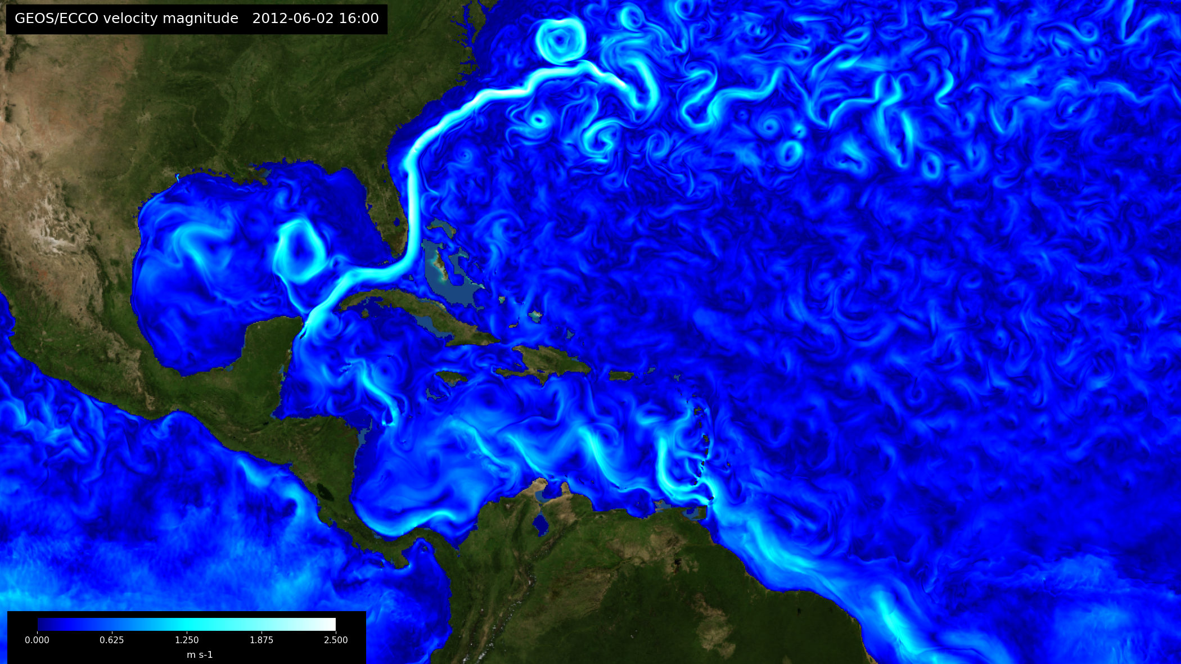
High Resolution Coupled Simulation
Exploring high-resolution global coupling:
GEOS Atmosphere (c1440: ~7km)
ECCO Ocean (llc2160: ~4km)
A tool to explore regional feedbacks in the global environment
Modeling: Andrea Molod (GMAO), Dimitris Menemenlis (JPL), and team
Image/Animation: NAS Visualization Group

Slide 6
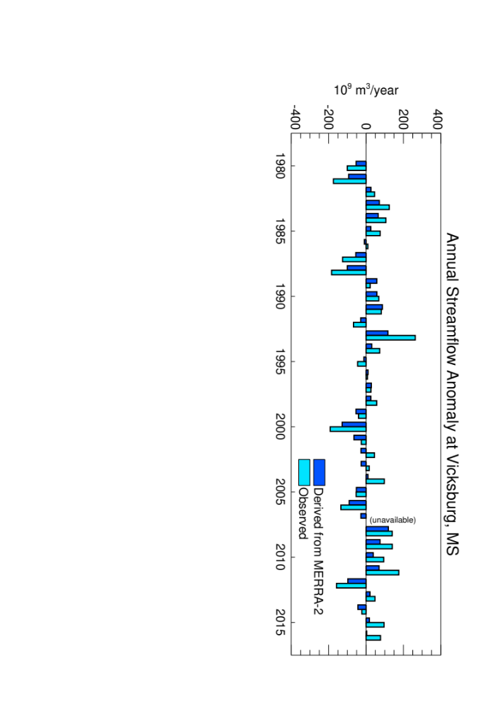
Earth System Feedbacks: Water Input from Mississippi
Streamflow derived using gauge-corrected precip. from MERRA-2 reanalysis
Invokes GMAO’s Catchment land model, with river routing module
Aspects of interannual variations in annual stream flow captured, despite lack of model for regulation
Development efforts will bring GPM precipitation and SMAP soil moisture into future GEOS reanalyses; plans to use river flow from SWOT (when launched)
Streamflow computed from the GMAO’s Catchment land model, driven by precipitation (etc.) from MERRA-2 reanalysis. Human impacts (flow regulation) that impact the observed flow are not included in the computation.
These impacts will be needed to improve accuracy of coupled predictions.
Analysis and image from Sarith Mahanama and Randy Koster (NASA GMAO)
Notes:
Getting this budget correct on an annual/seasonal basis is less challenging than capturing daily variations correctly

Slide 7
Summary and Outlook for Coupled GEOS Systems
Emerging versions of GEOS-S2S begin to capture loop currents – high-resolution coupled models capture finer features and their interactions
Natural coupling between ocean-atmosphere and land-ocean is represented in GEOS models and constrained by observations
    Enhancement of “scale” (model resolution)
    Expansion of complexity (coupled model processes)
    Introduction of new types of observations (physical/chemical/biological constraints)
Representing “human impacts” (such as regulated water flow) on Earth system analysis and prediction is a major challenge for accurate coupling:
    Analysis/reanalysis – careful book-keeping can suffice
    Prediction – need to model the trigger processes
Notes:
DA can not model individual eddies/migrations of the loop current but data assimilation and increased model resolution and data can improve overall model statistics can lead to improved forecasts

