Slide 1
Bio-inspired surface structures to mitigate interfacial particle adhesion and erosion
Presentation for the 44th Annual Meeting of The Adhesion Society, February 22-25, 2021, Virtual
Lopamudra Das^{1*}, Samuel J.A. Hocker², Valerie L. Wiesner², Christopher J. Wohl²,
¹National Institute of Aerospace, Hampton, VA 23666
²NASA Langley Research Center, Hampton, VA 23681
*Email address: lopamudra.das@nasa.gov

Slide 2
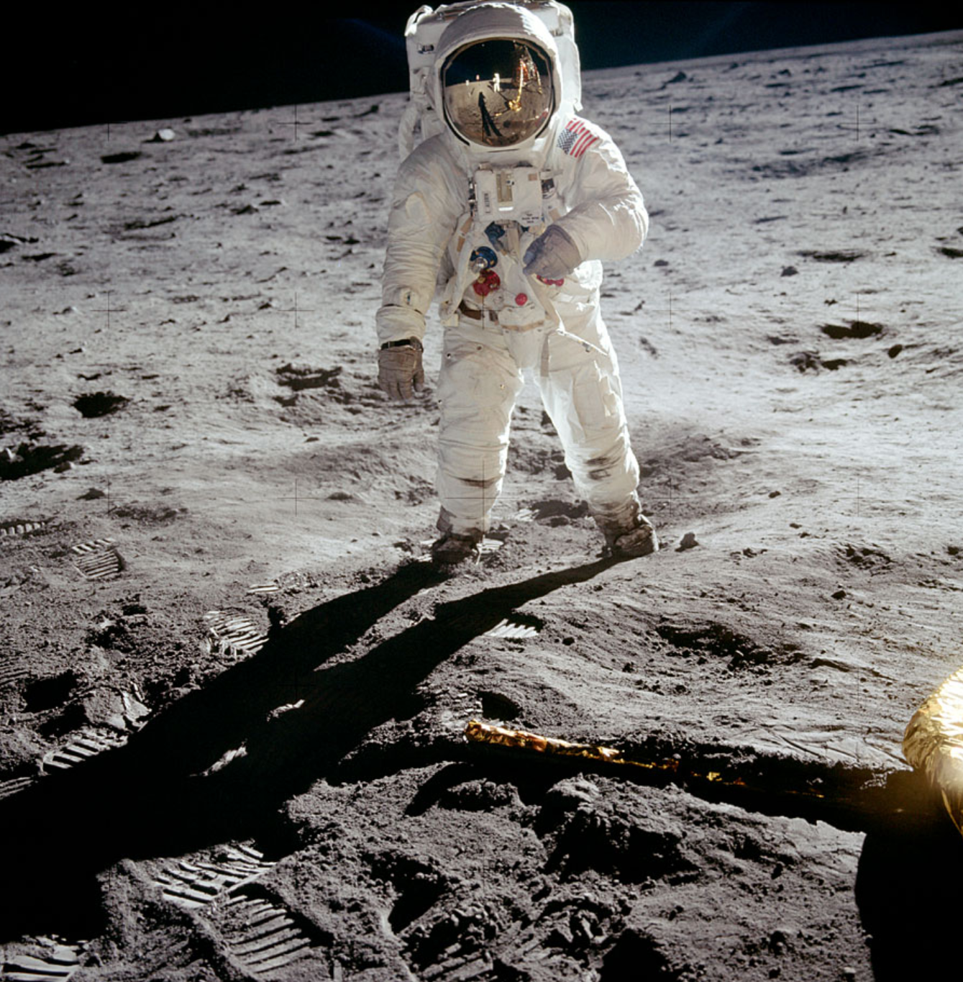
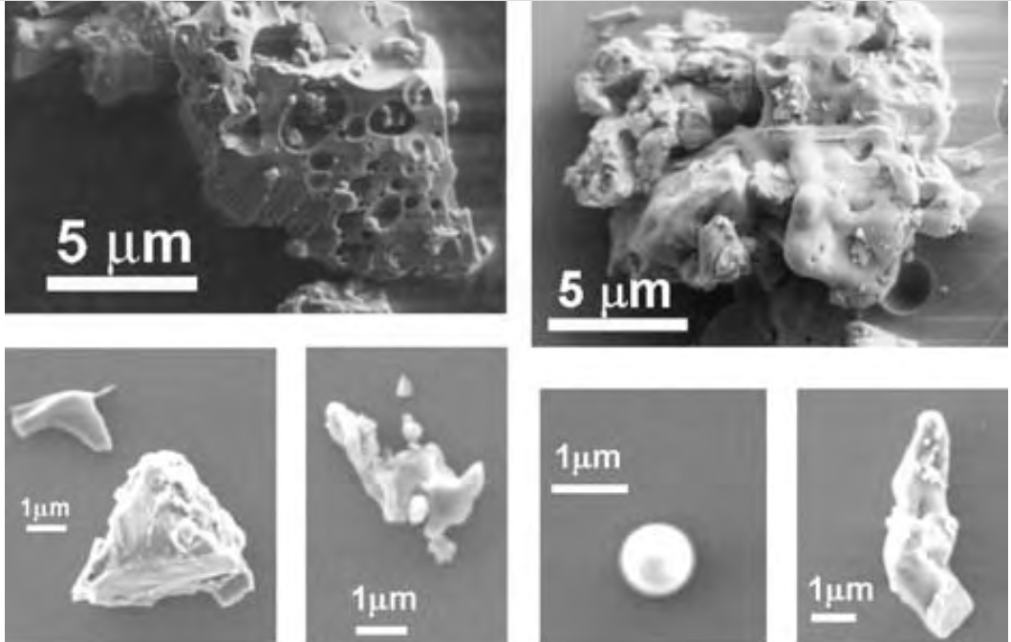
Lunar dust is a challenge!
Lunar dust characteristics
abrasive, jagged edges
chemically reactive
electrostatically charged
sometimes magnetic
strongly adheres to surfaces
Fig: Astronaut Buzz Aldrin walking on the lunar surface. Image credit: NASA
[1] Park, J. S., Liu, Y., Kihm, K. D., and Taylor, L. A.,“Micro-morphology and toxicological effects of lunar dust.” Lunar Planetary Scientific Conf. XXXVII (CD-ROM), Lunar and Planetary Institute, Houston(2006)
Fig: SEM images of Apollo 17 lunar dust
Image credit: [1]

Slide 3
Some surfaces for lunar dust mitigation
space suits - fabric, unique mechanisms
lunar habitat - outer surfaces, seals
lunar lander - wheels, bearings, gears
instruments - sensors, electronics, motors
thermal control surfaces - radiators
optical surfaces – visors, solar cells, windows
Image credit: NASA

Slide 4
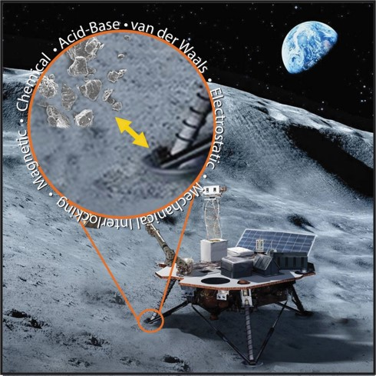
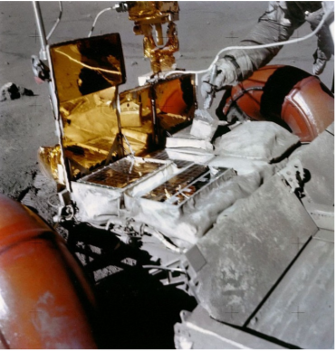
Strategies for lunar dust mitigation
Lunar dust adhesion can be attributed to a variety of forces:
  mechanical interlocking
  van der Waals forces
  magnetic forces
  chemical bonding
  electrostatic and coulombic interactions
3 strategies to minimize lunar dust adhesion:
active - e.g., mechanically powered brushes
passive – e.g., low surface energy coatings
combination of active and passive
Fig: Graphic view of lunar dust adhesion forces. Image credit: NASA
Fig: Astronaut brushing dust from radiators. Image credit: NASA

Slide 5
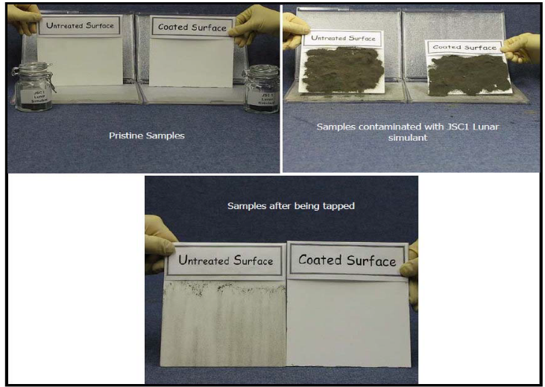
Bio-inspired surfaces to minimize lunar dust adhesion: Lotus Leaf
Lotus coated samples shed lunar dust simulant particles more effectively compared to non-coated samples
Self-cleaning properties, “Lotus effect”[2]
Unique surface architecture reduces surface energy and particle adhesion
Lotus mimicry coating for Lunar dust mitigation was developed at NASA GRC
The mimicked lotus surface consisted of a nanotextured material surface with a thin superhydrophobic coating
Fig: Anti-Contamination/self-cleaning properties assessment of untreated and treated Lotus coated radiator samples.
Image credit: [3]
[2] W. Barthlott, C. Neinhuis, Purity of the sacred lotus, or escape from contamination in biological surfaces, Planta. 202 (1997) 1–8. https://doi.org/10.1007/s004250050096
[3] D.V. Margiotta, W.C. Peters, S.A. Straka, M. Rodriguez, K.R. McKittrick, C.B. Jones, “The Lotus coating for space exploration: a dust mitigation tool,” Society of Photo-optical Instrumentation Engineers (SPIE) Conference Series, vol. 7794(2010). https://doi.org/10.1117/12.864480

Slide 6
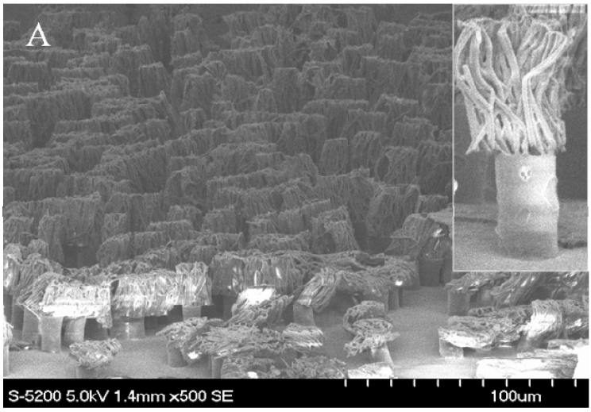
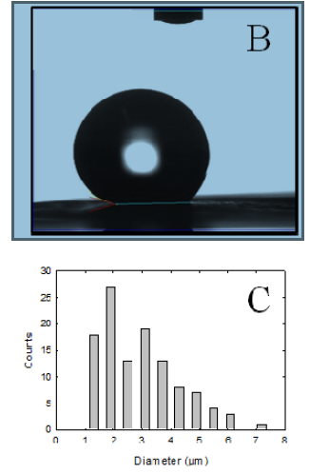
Bio-inspired surfaces to minimize lunar dust adhesion: Gecko Feet
Geckos remove particles from their feet in dry environments by stepping on a clean surface
Unique hierarchical surface topography:
  toes have setae that branch into nanoscale spatulae with enough van der Waals forces to support its weight
  dirt particles detach from the surface as it pulls off at high speeds
Surface mimicry for Lunar dust mitigation at NASA LaRC: Gecko mimetic surface structures were fabricated by modifying polypropylene film surfaces
SEM images revealed some entangled particles, further research aims to increase modulus of material or improve hierarchical size topographical features
Fig: HRSEM image of a hierarchical gecko toe biomimetic polypropylene surface. (B) Water contact angles increased significantly on these surfaces. (C) Representative remaining particle statistics on a hierarchical gecko-toe biomimetic surface after undergoing 5 cleaning “steps.” Image credit: [5]
[4] www.materialstoday.com/biomaterials/news/selfcleaning-gecko-feet-inspire-micromanipulator/
[5] Wohl, C. J., Connell, J. W., Lin, Y., Belcher, M. A., & Palmieri, F. L., “Generation and Evaluation of Lunar Dust Adhesion Mitigating Materials,” 40th Lunar and Planetary Science Conference(2009). https://doi.org/10.2514/6.2011-3676

Slide 7
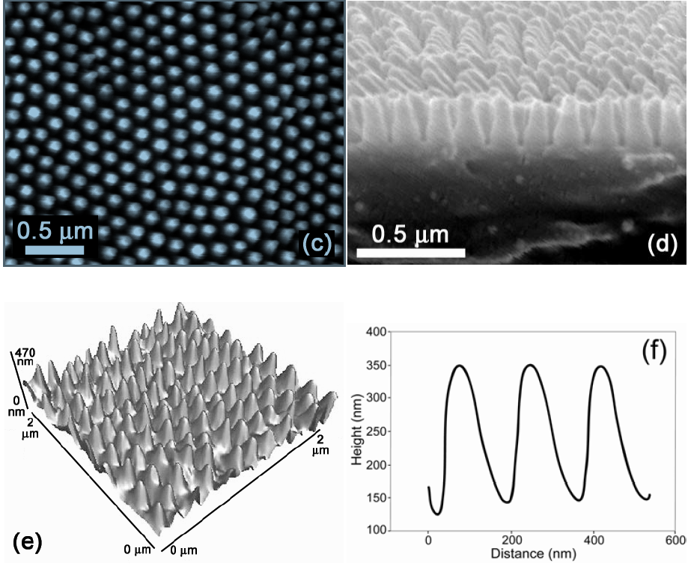
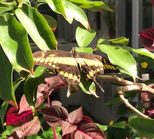
Bio-inspired surfaces to minimize adhesion
Rice leaf, Butterfly wings, Cicada wings
All have unique hierarchical surface structures that impact particle adhesion forces [6,7]
rice leaves: micropapillae superimposed by waxy nanobumps
butterfly wings: microgrooves on shingle-like scale structures provide superhydrophobicity and low adhesion.
These provide technical guidance for lunar dust adhesion mitigating surfaces
Low particle adhesion forces help minimize contamination on insect wings
Cicada wings show ultra-low adhesion forces of 20 nN for 31 µm sized silica particles (compared to 60 nN on PTFE)
Fig: Topographical SEM images of the top and cross-sectional layer of (c , d) Cicadetta oldfieldi cicada wing membranes, respectively, revealing an array of periodic structures (e , f) AFM topographical image and line profile of the array. Image credit: [7]
Fig: Butterfly on leaves. Image credit: Lopamudra Das
[6] G.D. Bixler, A. Theiss, B. Bhushan, S.C. Lee, “Anti-fouling properties of microstructured surfaces bio-inspired by rice leaves and butterfly wings,” Journal of Colloid and Interface
Science. 419 (2014) 114–133. https://doi.org/10.1016/j.jcis.2013.12.019.
[7] S. Watson, Gregory, A. Watson, Jolanta, Hu, Simon, Brown, Chris, W. Cribb, Bronwen, Myhra, Sverre,“Micro and nanostructures found on insect wings - designs for minimizing adhesion and friction,” International Journal of Nanomanufacturing(2010). https://doi.org/10.1504/IJNM.2010.029929

Slide 8
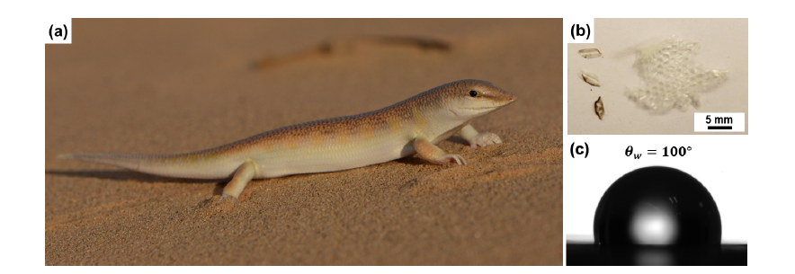
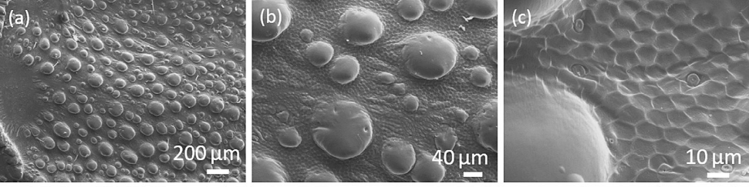
Adhesion and wear mitigating bio-surfaces in the desert
The extreme lunar environment, arid and dusty: similarities with Earth’s sandy deserts
Desert plants, animals, and insects have evolved material surfaces to survive sand adhesion, erosion and wear in the hot, dusty environment
Examples include:
sandfish skin
desert scorpion carapace
tamarisk plant
Fig: (a) Photograph of a sandfish (Scincus scincus) in its natural habitat (b) photographs of scales from its molted skin (c) typical contact angle of a single sandfish scale is about 100° (droplet volume 1 µl). Image credit: [8]
[8] Wu W. B, Lutz. C, Mersch. S, Thelen. R, Greiner. C, Gomard. G, Hölscher. H, “Characterization of the microscopic tribological properties of sandfish (Scincus scincus) scales by atomic force microscopy,” Beilstein J Nanotechnol 9: 2618 -2627(2018).
https://doi.org/10.3762/bjnano.9.243
[9] J. Zhang, W. Chen, M. Yang, S. Chen, B. Zhu, S. Niu, Z. Han, H. Wang, “The ingenious structure of scorpion armor inspires sand-resistant surfaces,” Tribology Letters. 65 (2017). https://doi.org/10.1007/s11249-017-0895-8.
Fig: (a), (b), (c) The gradually enlarged microstructures of the back of desert scorpion Androctonus australis by the SEM. Image credit: [9]

Slide 9
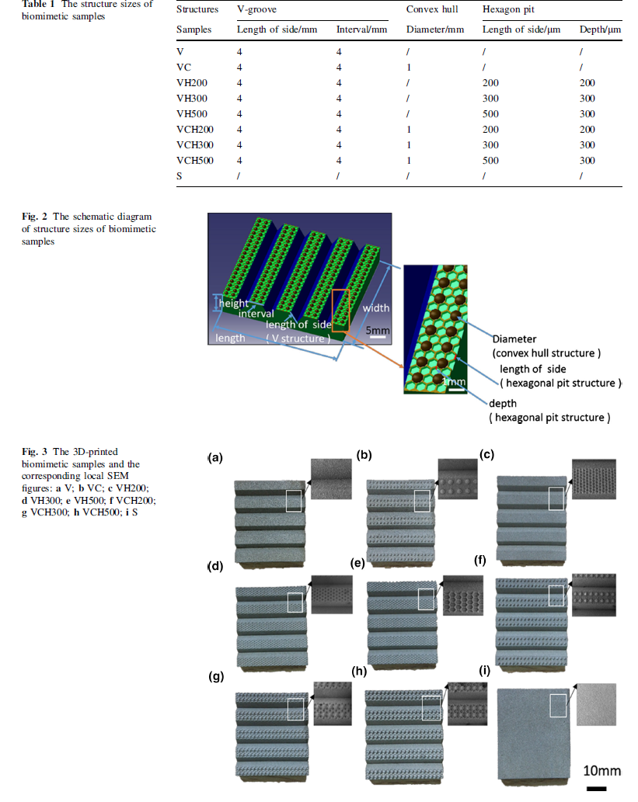
Adhesion and wear mitigating bio-surfaces in the desert: Scorpion carapace
biomimetic samples were 3D-printed and tested for erosion resistance
Fig: Biomimetic model and 3D-printed stainless-steel samples. Image credit: [9]
[9] J. Zhang, W. Chen, M. Yang, S. Chen, B. Zhu, S. Niu, Z. Han, H. Wang, “The ingenious structure of scorpion armor inspires sand-resistant surfaces,” Tribology Letters. 65 (2017). https://doi.org/10.1007/s11249-017-0895-8.

Slide 10
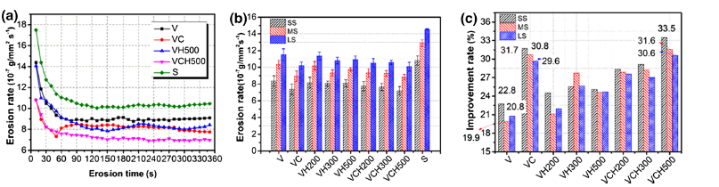
Adhesion and wear mitigating bio-surfaces in the desert: Scorpion carapace
erosion test results
Sample surface microstructure: V = V groove, C = convex hull, H = hexagonal pit, S = smooth surface; H200, H300 & H500 indicate hexagonal pit structure lengths of 200, 300 and 500 µm respectively.
Average size of sand particles for test: SS = small, ~ 260 µm, MS = medium,~ 544 µm, LS = large, ~ 941 µm.
Results: Smooth surfaces have the lowest erosion-resistance. VCH500 samples have the highest erosion resistance, followed by VC. The hexagonal pits affect the motion direction and reduce impact velocity of the particles, resulting in improved erosion resistance.
Fig: (a) The erosion rate of the samples changes with erosion time; (b) erosion rate of the eroded samples under the impact of three kinds of different solid particle sizes; (c) the improvement rate of the eroded samples under the impact of three kinds of different solid particle sizes. Image credit: [9]
[9] J. Zhang, W. Chen, M. Yang, S. Chen, B. Zhu, S. Niu, Z. Han, H. Wang, “The ingenious structure of scorpion armor inspires sand-resistant surfaces,” Tribology Letters. 65 (2017). https://doi.org/10.1007/s11249-017-0895-8.

Slide 11
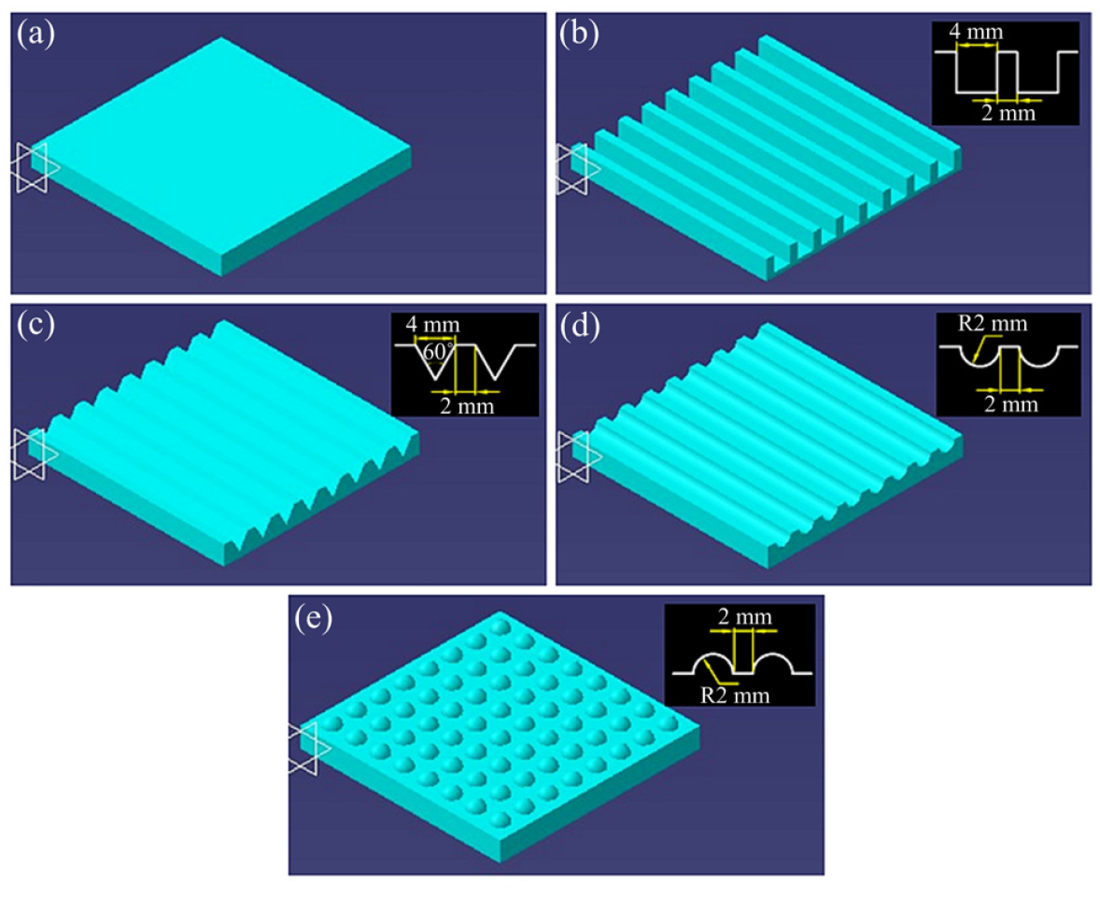
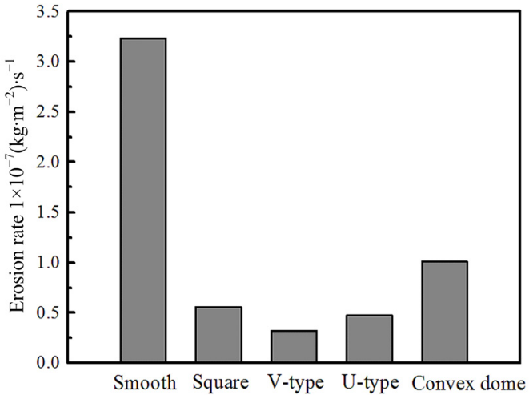
Adhesion and wear mitigating bio-surfaces in the desert: Tamarisk bark
special surface morphology resists erosion in sandstorms
bionic models and numerical simulation results
Fig: Bionic models according to surface morphology. Image credit: [10]
Fig: Numerical simulation of the erosion wear rates of different surface morphologies. Image credit: [10]
[10] Z. Han, W. Yin, J. Zhang, J. Jiang, S. Niu, L. Ren,” Erosion-resistant surfaces inspired by tamarisk,” Journal of Bionic Engineering. 10 (2013) 479–487. https://doi.org/10.1016/s1672-6529(13)60238-3.

Slide 12
Material properties for Lunar Missions
Ability to withstand extreme environment on lunar surface
high and low temperature cycles (+130C to -178C)
ultraviolet (UV) radiation
micrometeoroid impacts
Materials used on previous Lunar missions:
Stainless steel, Aluminum, Kevlar, Polyimides,
Processing needs: scalable, reliable, uniform.

Slide 13
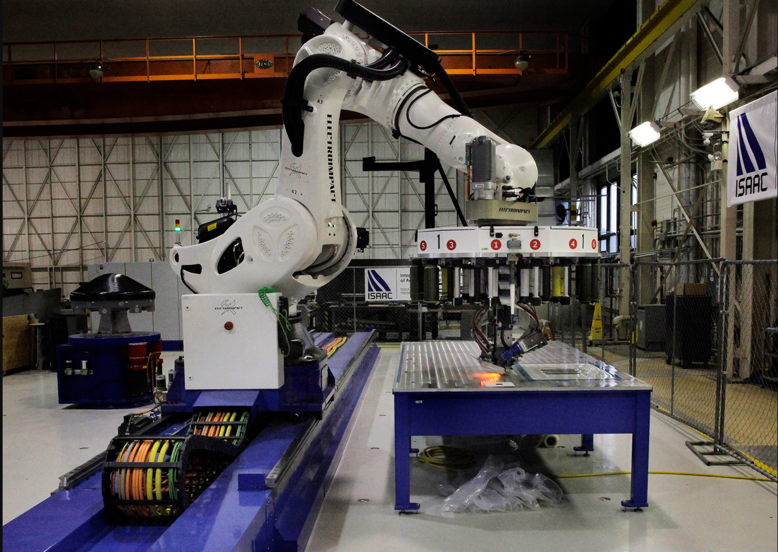
Common fabrication methods
Laser processing
Additive manufacturing
Hot embossing
Chemical processing
Combination of methods
Fig: ISAAC (Integrated Structural Assembly of Advanced Composites) Robot at NASA LaRC.
Image credit: NASA/David.C.Bowman

Slide 14
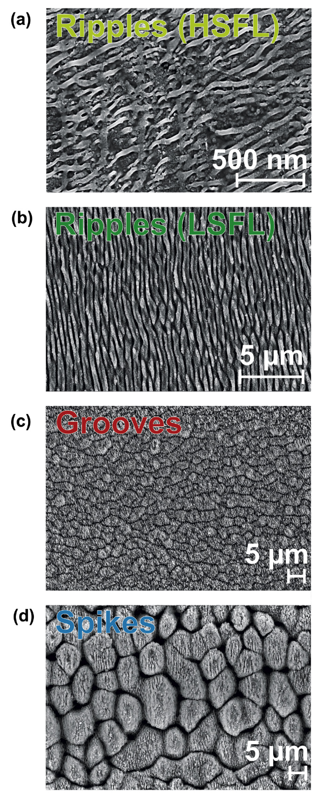
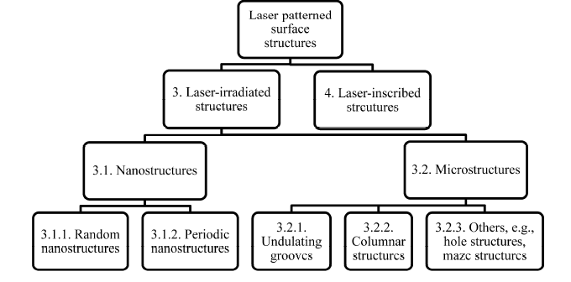
Common fabrication methods
Laser processing
create micro and nanostructures on surfaces
Fig: Top-view SEM images of four characteristic surface morphologies observed upon femtosecond laser scan processing of a steel surface. Image credit: [12]
Fig: Classification of laser –patterned surface structures. Image credit: [11]
[12]U. Hermens, S.V. Kirner, C. Emonts, P. Comanns, E. Skoulas, A. Mimidis, H. Mescheder, K. Winands, J. Kruger, E. Stratakis, J. Bonse,”Mimicking lizard-like surface structures upon ultrashort laser pulse irradiation of inorganic materials, ” Appl. Surf. Sci., 418 (2017), pp. 499-507. https://doi.org/10.1016/j.apsusc.2016.12.112
[11] K. M. Tanvir Ahmmed, Colin Grambow and Anne-Marie Kietzig, “Fabrication of Micro/Nano Structures on Metals by Femtosecond Laser Micromachining,” Micromachines 2014, 5, 1219-1253; https://doi.org/10.3390/mi5041219

Slide 15
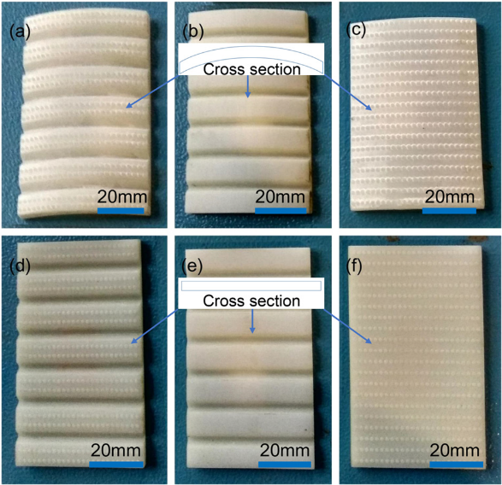
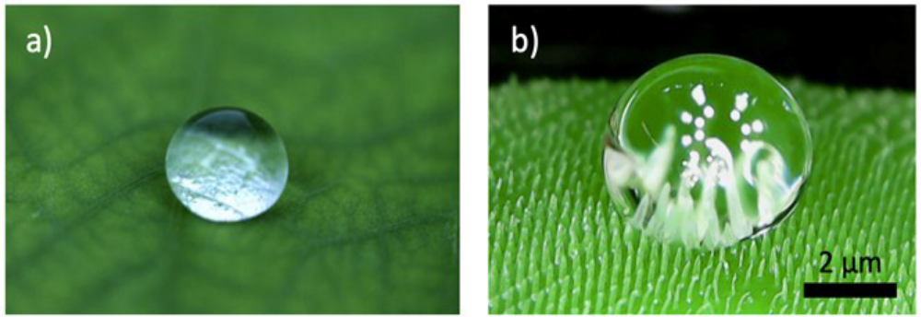
Common fabrication methods
Additive manufacturing
fast, flexible and efficient method, can be used with polymers, metals and ceramics
Fig: A drop of water on the surface of an artificial lotus leaf printed by the multiscale stereolithography process. Image credit: [14 ]
Fig: Bionic scorpion back microstructure samples fabricated on ABS polymer by 3D printing method. Image credit: [13]
[13] Z. Han, B. Zhu, M. Yang, S. Niu, H. Song, J. Zhang, “The effect of the micro-structures on the scorpion surface for improving the anti-erosion performance,” Surface and Coatings Technology. 313 (2017) 143–150. https://doi.org/10.1016/j.surfcoat.2017.01.061.
[14] Y. Li, H. Mao, P. Hu, M. Hermes, H. Lim, J. Yoon, M. Luhar, Y. Chen, W. Wu, “Bioinspired functional surfaces enabled by multiscale stereolithography,” Advanced Materials Technologies. 4 (2019) 1800638. https://doi.org/10.1002/admt.201800638.

Slide 16
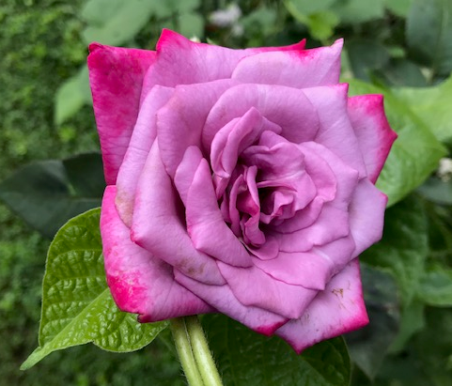
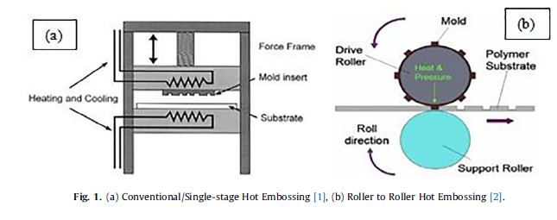
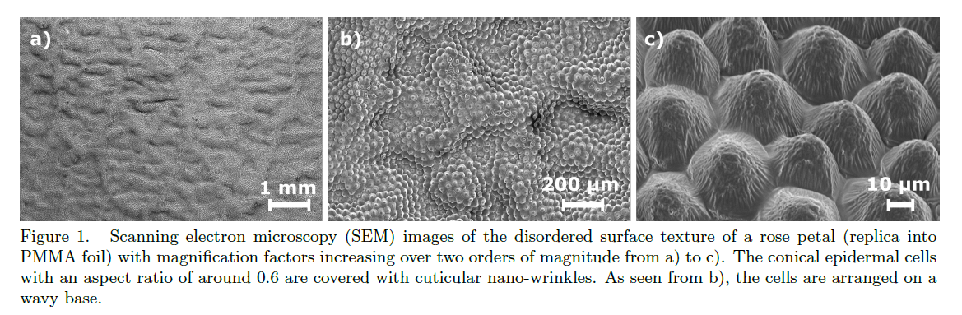
Common fabrication methods
Hot embossing
low cost, easy operation, high accuracy
optimization of process parameters is needed
Fig: Rose flower. Image credit: Lopamudra Das
Fig: SEM images of the disordered surface texture of a rose petal (replicas into PMMA foil) created by hot embossing method. Image credit: [16]
Fig: Schematic view of embossing processes
(a) Conventional/Single-stage hot embossing
(b) Roller to roller hot embossing. Image credit: [15]
[16] A. Roslizar, M. Guttmann, U. Lemmer, P.C. Soler, M. Langenhorst, M. Schneider, U. Paetzold, R. Huenig, B. Fritz, B. Richards, G. Gomard,”Towards mass fabrication of hot embossed plant surface texture replicas as photovoltaic cover layers,” Nanoengineering: Fabrication, Properties, Optics, and Devices XV, SPIE, 2018. https://doi.org/10.1117/12.2320555.
[15] S.S. Deshmukh, A. Goswami, “Hot embossing of polymers a review,” Materials Today: Proceedings. 26 (2020) 405–414.
https://doi.org/10.1016/j.matpr.2019.12.067

Slide 17
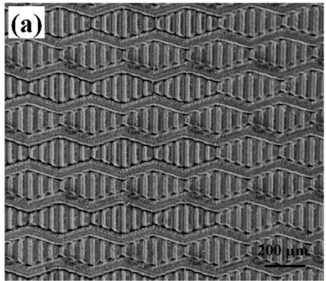
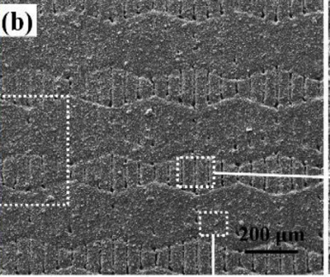
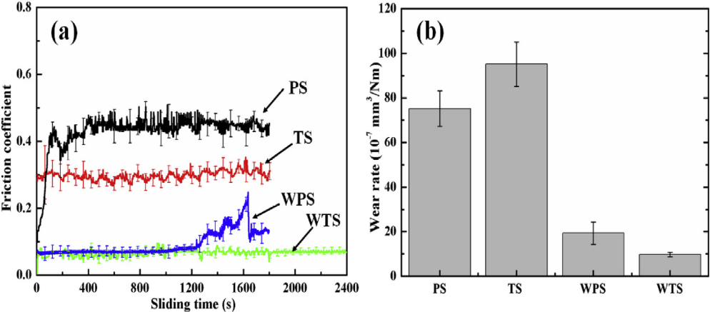
Common fabrication methods
Combination of methods
combine different processes to create the desired surface
laser pattern + coating: biomimetic shark skin,
Al₂O₃/TiC ceramic substrates were laser patterned then
coated with tungsten disulphide (WS₂) for dry friction
and wear properties
The friction coefficient after texturing with biomimetic shark skin and then WS₂ coating reduced by 29% and 84% compared to polished ceramic substrates
Fig: SEM images of (a) laser textured biomimetic shark skin (b) with tungsten disulphide(WS₂) coating applied on it. Image credit: [17]
Fig: (a) Friction coefficient curves and (b) steel ball wear rate for different samples. Image credit [17]
[17] X. Li, J. Deng, H. Yue, D. Ge, X. Zou, “Wear performance of electrohydrodynamically atomized WS2 coatings deposited on biomimetic shark-skin textured surfaces,” Tribology International. 134 (2019) 240–251. https://doi.org/10.1016/j.triboint.2019.02.015.
[The Al₂O₃/TiC ceramics substrates before and after texturing were named PS and TS.
The WS₂ coated ( ∼40 μm thick coating) Al₂O₃/TiC ceramic substrates with and without biomimetic shark skin were named WTS and WPS, respectively].

Slide 18
Summary
The vast potential in Nature's engineered surfaces remains to be fully explored
Novel fabrication methods and their combinations are needed to mimic natural surfaces
Different materials for different applications
Cost and scalability are important factors for lunar missions
Performance in lunar and extra-terrestrial environments needs to be evaluated for mission success.

Slide 19
References
Park, J. S., Liu, Y., Kihm, K. D., and Taylor, L. A.,“Micro-morphology and toxicological effects of lunar dust.” Lunar Planetary Scientific Conf. XXXVII (CD-ROM), Lunar and Planetary Institute, Houston(2006)
W. Barthlott, C. Neinhuis, Purity of the sacred lotus, or escape from contamination in biological surfaces, Planta. 202 (1997) 1–8. https://doi.org/10.1007/s004250050096
D.V. Margiotta, W.C. Peters, S.A. Straka, M. Rodriguez, K.R. McKittrick, C.B. Jones, “The Lotus coating for space exploration: a dust mitigation tool,” Society of Photo-optical Instrumentation Engineers (SPIE) Conference Series, vol. 7794(2010). https://doi.org/10.1117/12.864480
www.materialstoday.com/biomaterials/news/selfcleaning-gecko-feet-inspire-micromanipulator/
Wohl, C. J., Connell, J. W., Lin, Y., Belcher, M. A., & Palmieri, F. L., “Generation and Evaluation of Lunar Dust Adhesion Mitigating Materials,” 40th Lunar and Planetary Science Conference(2009). https://doi.org/10.2514/6.2011-3676
G.D. Bixler, A. Theiss, B. Bhushan, S.C. Lee, “Anti-fouling properties of microstructured surfaces bio-inspired by rice leaves and butterfly wings,” Journal of Colloid and Interface Science. 419 (2014) 114–133. https://doi.org/10.1016/j.jcis.2013.12.019.
S. Watson, Gregory, A. Watson, Jolanta, Hu, Simon, Brown, Chris, W. Cribb, Bronwen, Myhra, Sverre,“Micro and nanostructures found on insect wings - designs for minimizing adhesion and friction,” International Journal of Nanomanufacturing(2010). https://doi.org/10.1504/IJNM.2010.029929
Wu W. B, Lutz C, Mersch S, Thelen R, Greiner C, Gomard G, Hölscher H, “Characterization of the microscopic tribological properties of sandfish (Scincus scincus) scales by atomic force microscopy,” Beilstein J Nanotechnol 9: 2618–2627 (2018). https://doi.org/10.3762/bjnano.9.243
J. Zhang, W. Chen, M. Yang, S. Chen, B. Zhu, S. Niu, Z. Han, H. Wang, “The ingenious structure of scorpion armor inspires sand-resistant surfaces,” Tribology Letters. 65 (2017). https://doi.org/10.1007/s11249-017-0895-8.
Z. Han, W. Yin, J. Zhang, J. Jiang, S. Niu, L. Ren,” Erosion-resistant surfaces inspired by tamarisk,” Journal of Bionic Engineering. 10 (2013) 479–487. https://doi.org/10.1016/s1672-6529(13)60238-3.
K. M. Tanvir Ahmmed, Colin Grambow and Anne-Marie Kietzig, “Fabrication of Micro/Nano Structures on Metals by Femtosecond Laser Micromachining,” Micromachines 2014, 5, 1219-1253; https://doi.org/10.3390/mi5041219
U. Hermens, S.V. Kirner, C. Emonts, P. Comanns, E. Skoulas, A. Mimidis, H. Mescheder, K. Winands, J. Kruger, E. Stratakis, J. Bonse,”Mimicking lizard-like surface structures upon ultrashort laser pulse irradiation of inorganic materials, ” Appl. Surf. Sci., 418 (2017), pp. 499-507. https://doi.org/10.1016/j.apsusc.2016.12.112
Z. Han, B. Zhu, M. Yang, S. Niu, H. Song, J. Zhang, “The effect of the micro-structures on the scorpion surface for improving the anti-erosion performance,” Surface and Coatings Technology. 313 (2017) 143–150. https://doi.org/10.1016/j.surfcoat.2017.01.061.
Y. Li, H. Mao, P. Hu, M. Hermes, H. Lim, J. Yoon, M. Luhar, Y. Chen, W. Wu, “Bioinspired functional surfaces enabled by multiscale stereolithography,” Advanced Materials Technologies. 4 (2019) 1800638. https://doi.org/10.1002/admt.201800638.
S.S. Deshmukh, A. Goswami, “Hot embossing of polymers a review,” Materials Today: Proceedings. 26 (2020) 405–414. https://doi.org/10.1016/j.matpr.2019.12.067.
A. Roslizar, M. Guttmann, U. Lemmer, P.C. Soler, M. Langenhorst, M. Schneider, U. Paetzold, R. Huenig, B. Fritz, B. Richards, G. Gomard,”Towards mass fabrication of hot embossed plant surface texture replicas as photovoltaic cover layers,” Nanoengineering: Fabrication, Properties, Optics, and Devices XV, SPIE, 2018. https://doi.org/10.1117/12.2320555.
X. Li, J. Deng, H. Yue, D. Ge, X. Zou, “Wear performance of electrohydrodynamically atomized WS2 coatings deposited on biomimetic shark-skin textured surfaces,” Tribology International. 134 (2019) 240–251. https://doi.org/10.1016/j.triboint.2019.02.015.

Slide 20
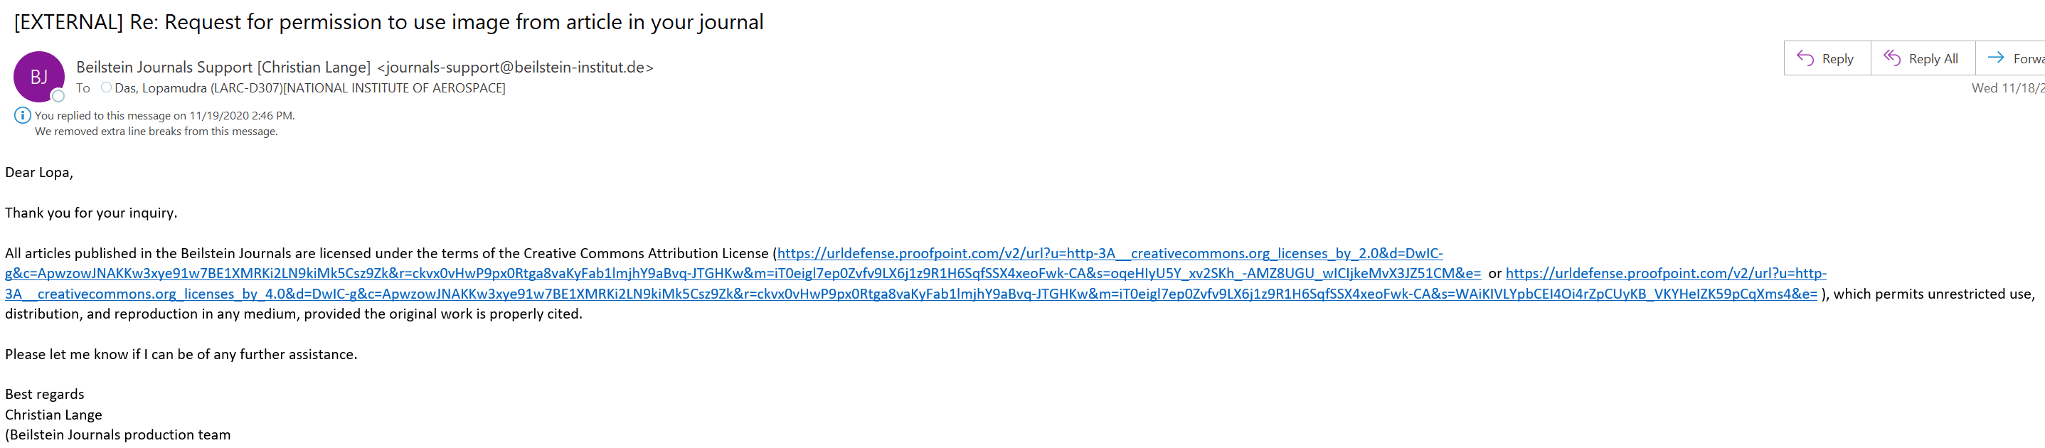
Permission for sandfish image

Slide 21
Thank you !!!

