Slide 1
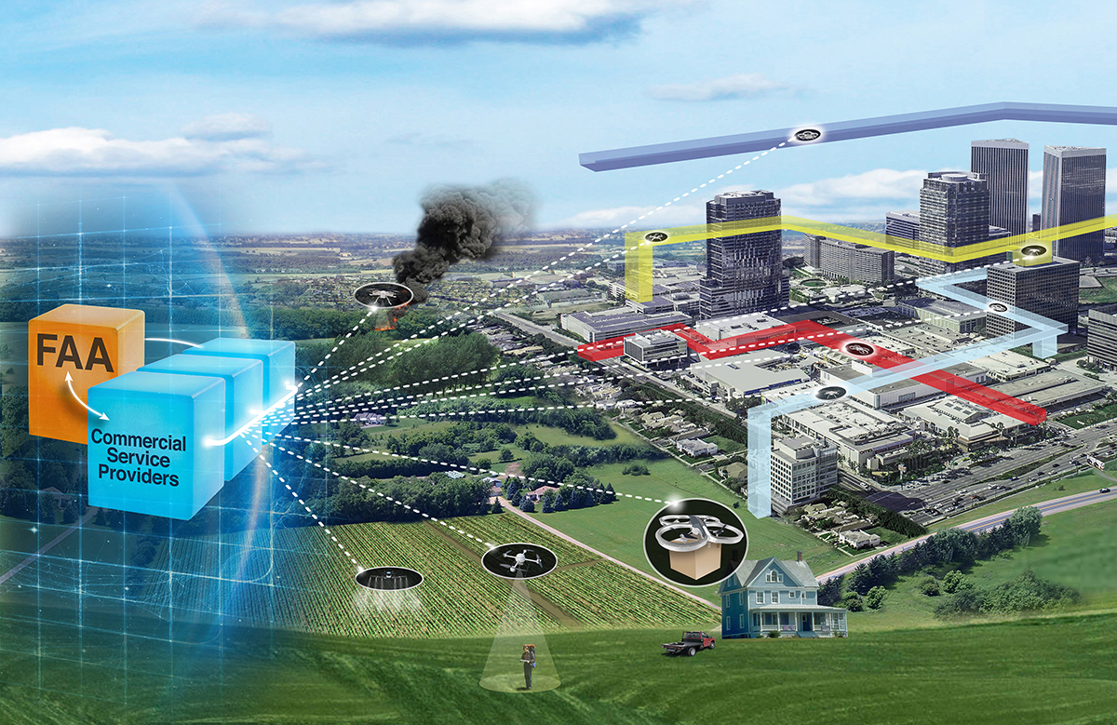


Unmanned Aircraft Systems (UAS) Traffic Management (UTM) Project
UTM Conflict Management
Dr. Marcus Johnson
UTM RTT
UTM Technical Interchange Meeting
February 23rd, 2021

Slide 2
Outline
Overview of Sense and Avoid (SAA) UTM RTT Subgroup
  Progression of the State of the Art
  Overview of the Conflict Management Model
Activities and Findings
Future Work Considerations
Summary and Impact
Publications

Slide 3
UTM RTT SAA Subgroup
The objective for this subgroup is to explore operator solutions to ensure that unmanned aircraft do not collide with other aircraft (unmanned [UA] or manned).
  Scope was expanded to consider collision risk with ground and air hazards
SAA subgroup kicked-off after TCL 1 concluded
  23 meetings including 3 joint meetings with the Communication and Navigation (C&N) subgroup
  At peak more than 60 UTM community members interacted in the subgroup
  Primary purpose was concept level discussion that informed the direction of NASA TCL evaluations, UPP evaluations and UTM ConOps
One technical documentation package produced, associated with TCL 2, TCL 3, and TCL 4

Slide 4

Progression of Conflict Management
Small UAS have limited size, weight, and power
Many detect and avoid technologies focuses on sensors or point solutions and do not holistically address collision risks to operations
Integration, interoperability, and human factors tends to be an afterthought in development
Completing a DAA system often falls on the UAS operator to “piece together” and test the necessary components to address the collision risk
Conflict Advisory and Alert
USS 2
USS
USS 1
Geofencing
V2V
Onboard DAA
Strategic Deconfliction
VLOS
Visual Observer
GBSAA
Surveillance SDSP

Slide 5
Desired State of UTM Conflict Management
Desired state is to treat conflict management mitigations as a continuum of independent and interoperable capabilities and services rather than disjoint sensors, algorithms, and functions
Service and capabilities with overlapping time horizons and well understood objectives and ”sphere of control”
Addresses air and ground hazards for transponding and non-transponding aircraft and static and dynamic obstacles while considering airspace constraints and other limitations
Approx. Time
to Collision
Pre-flight
3 - 1 minutes
1 min – 10 sec
10-0 sec
Strategic
Conflict
Management
Dynamic
Re-routing
Obstacle
Avoidance
Conflict Alert
Detect and Avoid
Plan mission with
minimal conflicts
Resolve conflict and minimize deviation from mission
Remain safely separated
Avoid
collision

Slide 6
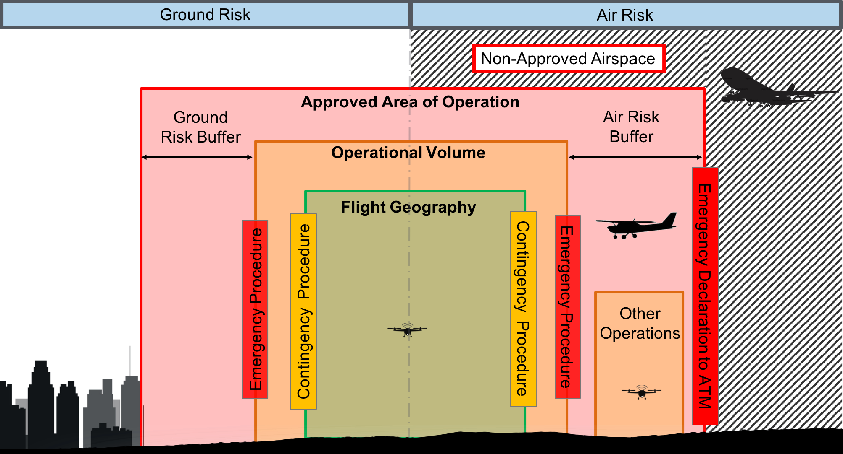
Contributing Hazards to Conflict Management in UTM
Notes:
Unmanned v. manned. Unmanned v. unmanned. Priority for public safety. Common situational awareness. Note that most of these elements are strategic in nature. There are also very tactical elements of UTM handled by specific technologies that I won’t have time or necessarily the depth of understanding to address today.

Slide 7
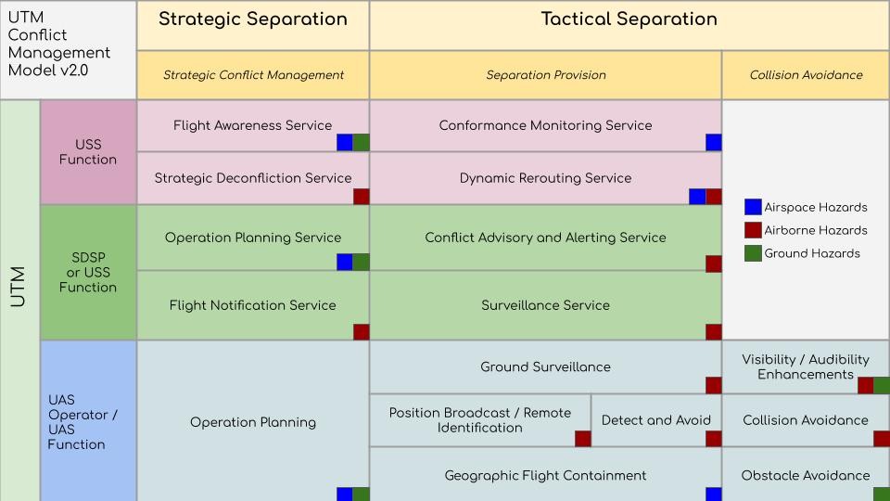
UTM Conflict Management Model

Slide 8
Conflict Management in the TCL Demonstrations

Slide 9





Risk Based Approach to Conflict Management
TCL1 (Remote)
TCL 2 (Rural)
TCL 3 (Suburban)
TCL 4 (Urban)
Visual Line of Sight
Notice of Operation
Position-Sharing (Optional)
Beyond Visual Line of Sight
Intent Sharing
Strategic De-confliction
Geographic Containment
Beyond Visual Line of Sight
Intent Sharing
Strategic De-confliction
Geographic Containment
Conflict Alert
Detect and Avoid (DAA)
Vehicle-to-Vehicle (V2V)
Beyond Visual Line of Sight
Intent Sharing
Strategic De-confliction
Geographic Containment
Detect and Avoid (DAA)
Vehicle-to-Vehicle (V2V)
Obstacle Avoidance
Dynamic Re-routing

Slide 10
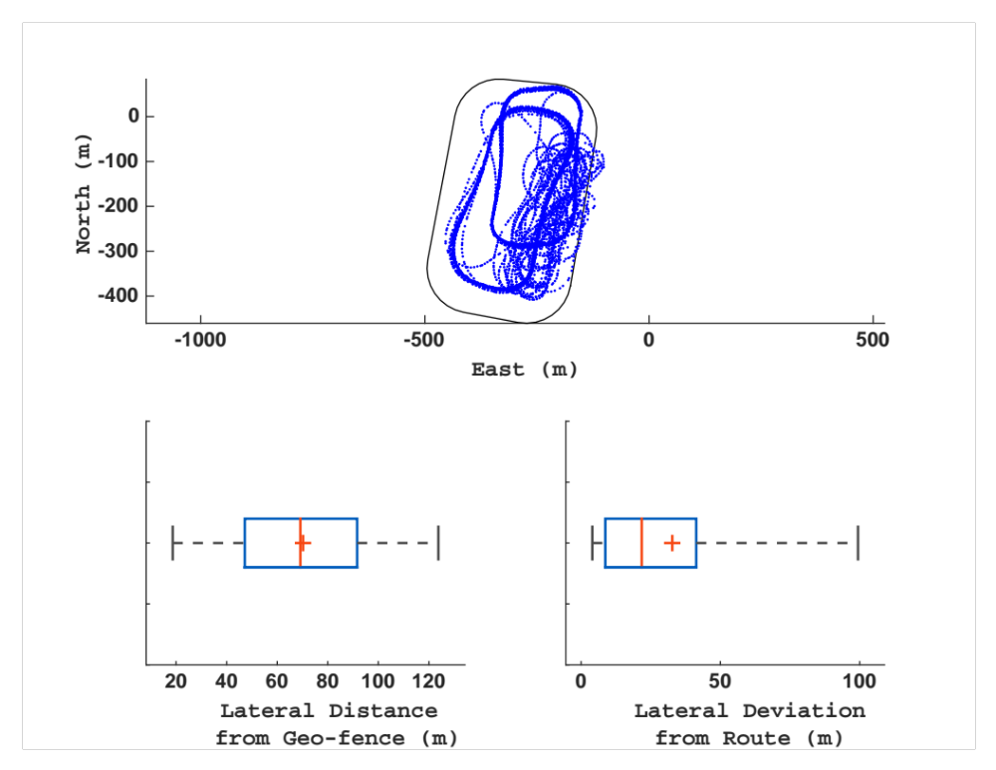
TCL 1 (August 2015)
  Operation Volume 1
Conflict Management (CM) Approach: Separation by Structure (Flight Notification)
Example CM Research Question:
  How well can a UA remain in its operational volume?
CM Lessons Learned:
  Lack of a common operating picture between UAS and UAS Operator and between UAS Operators resulted in overly conservative and undesirable behavior.
  Recommendation: UTM will need to provide common strategic and tactical view of the airspace operations and conditions to the UAS Operator.
  With varying atmospheric conditions and vehicle performance, UAS occasionally left operational volumes.
  Recommendation: Operation Volumes should incorporate flight technical error, and atmospheric conditions. Additional mitigations are needed for aircraft geographic containment (e.g., conformance monitoring, geofencing, etc.)
  Operation Volume 2

Slide 11
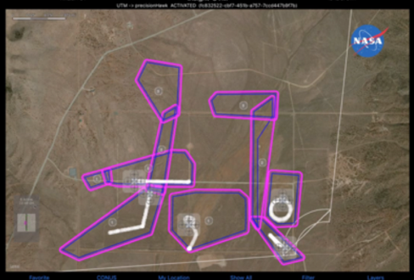
TCL 2 (October 2016 / May 2017)
Conflict Management (CM) Approach: Strategic Deconfliction, Geographic Containment, & Conflict Advisory and Alert
Example CM Research Question:
  What key considerations for flying altitude stratified?
CM Lessons Learned:
  Measurement and reporting of vehicle altitude was not consistent among airspace users
  Recommendation: Altitude reporting should be consistent or translatable across airspace users.
  The sources of weather information for this flight test were inadequate to support BVLOS operations.
  Recommendation: Initial routine BVLOS operations should not conduct altitude stratification unless there is accurate and timely information shared of the relative position of nearby UAS and improvements are made in the fidelity of the weather predictions along the flight path.

Slide 12
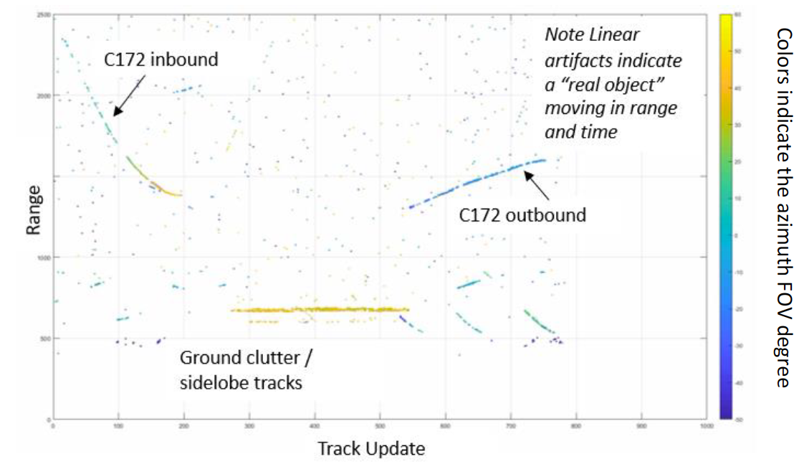
TCL 3 (May 2018)
Conflict Management (CM) Approach: Strategic Deconfliction, Geographic Containment, & Conflict Advisory and Alert, DAA, V2V
Example CM Research Questions:
  Do onboard sensors have suitable performance to support conflict management?
CM Lessons Learned:
  Using airborne and ground radar to support separation showed that a low SWaP airborne radar does not provide sufficient range to support the recommended well clear definition, had high false alerts, and is better suited to support collision avoidance.
  DSRC raised situation awareness and at close proximity (~.5 km or less) yields reliable data to support collision avoidance under slow closure rates
  Recommendation: Testing multiple layered mitigations to address hazards resulted in a raised situation awareness and achieving the needed increased range of surveillance. Continued evaluation is needed to address the technology interoperability and the data fusion between tracking aircraft with multiple sensors.

Slide 13
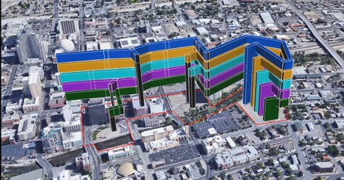
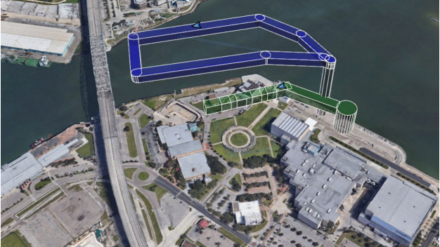
TCL 4 (Summer 2019)
Conflict Management (CM) Approach: Layered Conflict Management
Example CM Research Questions:
  What factors impact conflict management in urban environments?
CM Lessons Learned:
  UAS and onboard mitigations lacked appropriate reliability. Single point failures of nominal systems (e.g., motors) or safety mitigation systems (e.g., parachute) created hazardous conditions for people on the ground
  Urban environments contained numerous hazardous conditions:
    Diverse micro-climates
    High concentration of use of unlicensed RF (e.g., Wifi)
    Multi-pathing and GPS degradation
  Recommendation: Maturation of vehicle reliability, health monitoring, and contingency management systems (e.g., automated safe landing) are needed to support urban operations. UTM services can better support hazard awareness in urban environments (e.g., surveillance, weather, RF)
TCL 4 Testing at Reno, NV
TCL 4 Testing at Corpus Christi, TX

Slide 14


TCL 4 Return of the Altitude Issues
400 ft AGL
Height above ground level (AGL)
Above Take-off (ATO)
AGL
MSL
Height above ground level (AGL)
Height above mean sea level (MSL)
World Geodetic System (WGS 84)
UAS Facility Map Altitude
Manned Aircraft Indicated Altitude
UAS Indicated Altitude
USS Operation Volume
Obstructions

Slide 15

TCL 4 Return of the Altitude Issues
Airspace boundaries may not account for terrain (e.g., UASFM)
Inconsistent reference frames, measures, and units of altitude on the UA and GCS displays
Altitude sometimes coming from multiple sensors
400 ft AGL
Obstacles are typically mapped in AGL and are dependent on a terrain model
Errors in transforming MSL to other reference frames / WGS84 (e.g., local geoid undulation model)
USS may translate altitude from UAS to WGS84 but use different terrain models
UASFM Altitude
Manned Indicated Altitude
UAS Indicated Altitude
USS Operation Volume
Obstructions
Recommendation: Standardization is needed for (1) Reference Frame, (2) Measure, (3) Units, and (4) Translation Methods/Models used for each altitude measured, used, or communicated by/to a UAS, UAS Operator, and UTM/ATM

Slide 16
NASA Reference Technologies evaluating Conflict Management

Slide 17
DAA Reference Implementation
Safety Layers in UTM
Communications/data exchanges in UTM
Enables airspace controls
Supports response in emergencies impacting NAS
FIMS
Strategic Safety Assurance UAS Operations and Airspace Management
Airspace controls
Emergencies impacting NAS
Supports UAS with services (e.g., separation, weather, flight planning, contingency management, etc.)
USS
Airspace/geofences
Flight plans UAS with services (e.g., Weather information
Contingencies/emergencies
Mission Safety Responsibility
UAS Operator
Flight plans, geofences, aircraft state, alerts, health status, emergencies
UAS Onboard Systems
ICAROUS
Dynamic constraint monitoring, DAA and contingency management
Autopilot
Autonomous Navigation
Tactical Safety Assurance
Contingency Management for BVLOS Operations
UTM Risk Assessment Framework (URAF)
Real time safety assessment and tracking,
Safeguard
Static, assured, constraint monitoring,
Safe 2 Ditch
Identification of a safe landing location

Slide 18



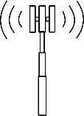




Vehicle Autonomy Requirements for Urban Operations (SAFE50)
Focused on autonomy requirements necessary for TLC 4 operations in urban environments
Urban operations challenges include:
  Navigation
  Communication
  Situation awareness
  Collision and Obstacle avoidance
  Vehicle reliability and health monitoring
  Risk management
Conflict management mitigations must factor in constraints to be effective
Environment Challenges
Atmospheric Uncertainty
Failures and Contingencies
Degraded RF, SAT-COM, GNSS
Winds and microbursts
Avoid endangering objects in environment.
Ground Operators and UTM System
Static Ground
Objects (SGO)
C3 and Surveillance Requirements
UAS
Other Aircraft
Detect, Operate-Near, and Avoid-Endangering SGOs
Detect, Operate-Near, Avoid-Endangering Other Aircraft
Detect, Operate-Near, and Avoid-Endangering DGOs
Dynamic Ground Objects (DGO)
Hazard Footprint Awareness,
Risk Minimization/Avoidance,
Health Monitoring

Slide 19
Example Lessons Learned from NASA Testing
Transponder-based Technology:
  ADS-B-in using a micro-ADS-B receiver and Flight Alarm (FLARM) have adequate performance to support for airborne sense and avoid sUAS to cooperative aircraft (e.g., general aviation)
  Low-power ADS-B also show promise for supporting sUAS and general aviation deconfliction
Conflict Resolution Algorithms:
  Algorithms included in ICAROUS provide well clear assurance for defined targets
    Continuously translating targets
    Dynamically maneuvering targets
Multi-sensor Data Fusion:
  Best practices should be developed for sensor fusion to support effective airborne sense and avoid
    Observations of ghost tracks, split tracks, and DAA mitigations to incorrect target can have implications on unexpected behavior that could lead to collisions.
Non-Transponder-based Technology:
  Low-cost prototype airborne radars may be able to provide well clear assurance from GA and sUAS traffic but are susceptible to clutter and false targets
  Electro-optical systems from low-cost high-resolution cameras can support effective image object detection and collision avoidance within limited range.
    While the performance is adequate and can support DAA with manned aircraft (visibility permitting) the SWaP requirements were not as amenable for many sUAS platforms

Slide 20
Summary and Impact Of Work
Research Activities
Products
Outcomes
Research Transition Team Working Groups
Software Prototypes
Fielded Systems
NASA USS
UAS Operator Client
FAA-NASA UTM Pilot Project and Operational Evaluation
Sense and Avoid
Concept and Software Development
ICDs and APIs
UAS Rule Making
USS-USS Specification
Weather and Surveillance SDSP ICD
V2V Communication Specification
UTM Implementation Plan
UAS Service Supplier
Supplemental Data Service Providers
UAS Operator Client
DAA Reference Implementation
Industry Guidance and Standards
Concept Documents
UTM CONOPS and Use Cases
UTM Conflict Mitigation Model
Hazard Identification and Analysis
Requirements for Urban Operations
ASTM DAA Standard
ASTM UTM Specification
ASTM Surveillance SDSP
IEEE V2V Specification
Field Testing and Technology Evaluation
TCL Field Demonstrations
Targeted Technology Evaluations
Reference Technology Implementations
International Harmonization
Simulation and Analysis
JARUS Specific Operational Risk Assessment (e.g. UTM Annex)
Urban Operations Studies
Integrated Detect and Avoid System

Slide 21
Future Considerations
FAA and Industry
  FAA BEYOND program will focus on BVLOS and DAA/UTM requirements
  Conflict management topics will be further developed in UTM Implementation plan and updates to the UTM CONOPS
  ASTM and IEEE standards (UTM, DAA, Surveillance SDSP, V2V, etc.) will continue to evolve to consider interoperability between conflict management systems
NASA
  Advanced Air Mobility High Density Vertiport Subproject – conflict management near vertiport operations
  Scalable Traffic management for Emergency Response (STEReO) – Layered conflict management in constrained disaster response scenarios (e.g., TFR for a wildfire)
  System Wide Safety (In-time Safety Management Systems) – Integration of conflict management with health monitoring and UTM services (e.g., SDSPs)
  Air Traffic Management eXploration Urban Air Mobility – Onboard / Service-based conflict management interoperability

Slide 22
Publications
M. Johnson, J. Larrow, UAS Traffic Management Conflict Management Model. (https://utm.arc.nasa.gov/documents.shtml), June 2020.
C. Ippolito, K. Krishnakumar. Concept of Operations Towards Fully Autonomous UAS Operations over Urban Environments. AIAA InfoTech@Aerospace, 2019.
​
C Ippolito, K. Krishnakumar. An Autonomy Architecture for Autonomous Urban Environment Operations. AIAA InfoTech@Aerospace, 2019.
Brendan Duffy, Swee Balachandran, María Consiglio, Louis Glaab, César Muñoz, Kyle Smalling, Nicholas Rymer, David Bradley, David Hare, Richard Grube, Matthew Coldsnow, Scott Sims, Jeffrey Hill, and Mahyar Malekpour, Sense and Avoid Characterization of the ICAROUS Architecture , Technical Memorandum, NASA/TM-2020-220591, May 2020.
Brendan Duffy, Swee Balachandran, Andrew Peters, Kyle Smalling, María Consiglio, Louis Glaab, Andrew Moore, and César Muñoz, Onboard Autonomous Sense and Avoid of Non-Conforming Unmanned Aerial Systems, Proceedings of the 39th Digital Avionics Systems Conference (DASC 2020), Virtual Conference, US, 2020.
Maria Consiglio, Brendan Duffy, Swee Balachandran, Louis Glaab, César Muñoz, Sense and Avoid Characterization of the Independent Configurable Architecture for Reliable Operations of Unmanned Systems. ATM2019, June 17-21, 2019, Vienna, Austria. ​
See NASA UTM website for full list of publications: (https://utm.arc.nasa.gov/documents.shtml)

Slide 23
Thank You

