Slide 1
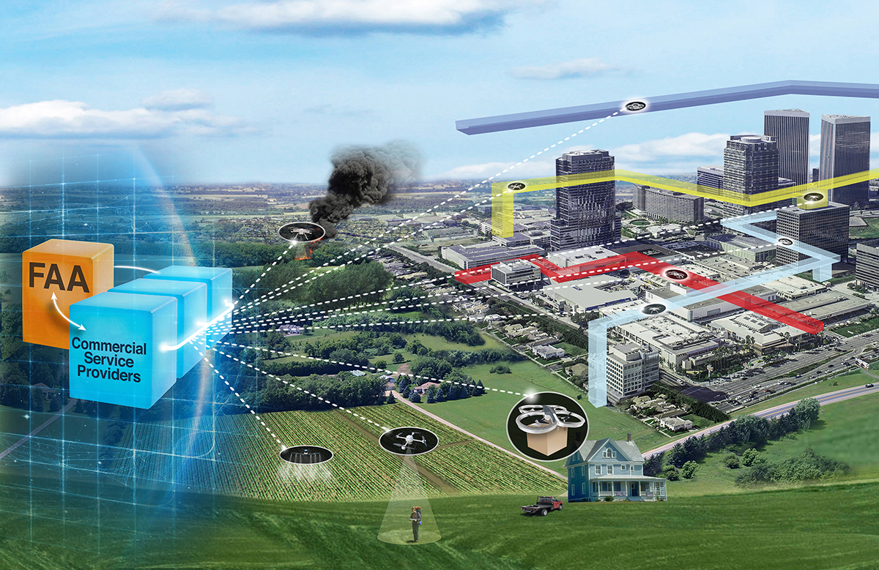


Unmanned Aircraft Systems (UAS) Traffic Management (UTM) Project
UTM Concepts and Use Cases
Jeffrey Homola
NASA/FAA UTM RTT Concepts and Use Cases
Working Group Co-coordinator
UTM Technical Interchange Meeting
February 23rd, 2021

Slide 2
Outline
UTM RTT Concepts and Use Cases Working Group (CWG) Overview
Activities
Publications
Test Involvement
Areas of Future Work
Summary and Impact

Slide 3
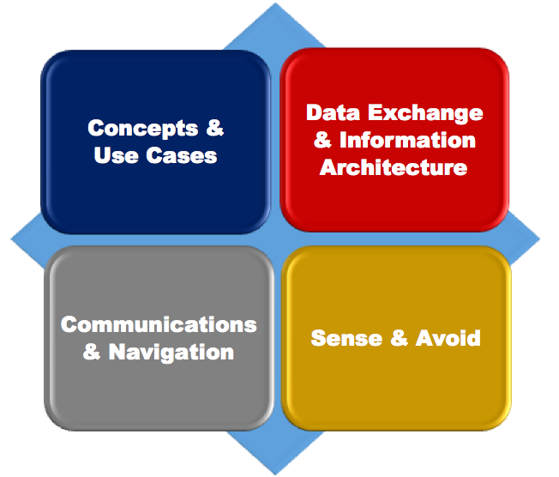
UTM RTT Working Groups
NASA-FAA UTM Research Transition Team (RTT) has been a joint undertaking for the development and eventual implementation of UTM
UTM RTT initiated in 2016
Four primary working groups
Joint Management Plan (JMP) formulated with Research Transition Products for each group to deliver as part of RTT goals and objectives
JMP signed in 2017

Slide 4
CWG Overview
The CWG was chartered with collaboratively defining the UTM concept through the development of supporting use cases that will ultimately span the range of UTM operations and environments.
Through this process, the CWG worked to identify information flows and exchanges, supporting architectures, and the roles and responsibilities of those entities interacting with the UTM ecosystem. The process and its output served as input to other programs and UTM RTT Working Groups.

Slide 5
CWG Process
The CWG was composed of a small core membership between NASA and the FAA
Regular meetings were held for use case development and concept discussions. Number of attendees fluctuated depending on the focus of discussion.
The majority of discussions centered around the development of use cases that highlighted concept elements that in turn clarified and refined the assumptions, stakeholder roles, and operational processes envisioned for the future UTM environment.
Participation and coordination among all RTT leads in the CWG was an important part of the development process.

Slide 6
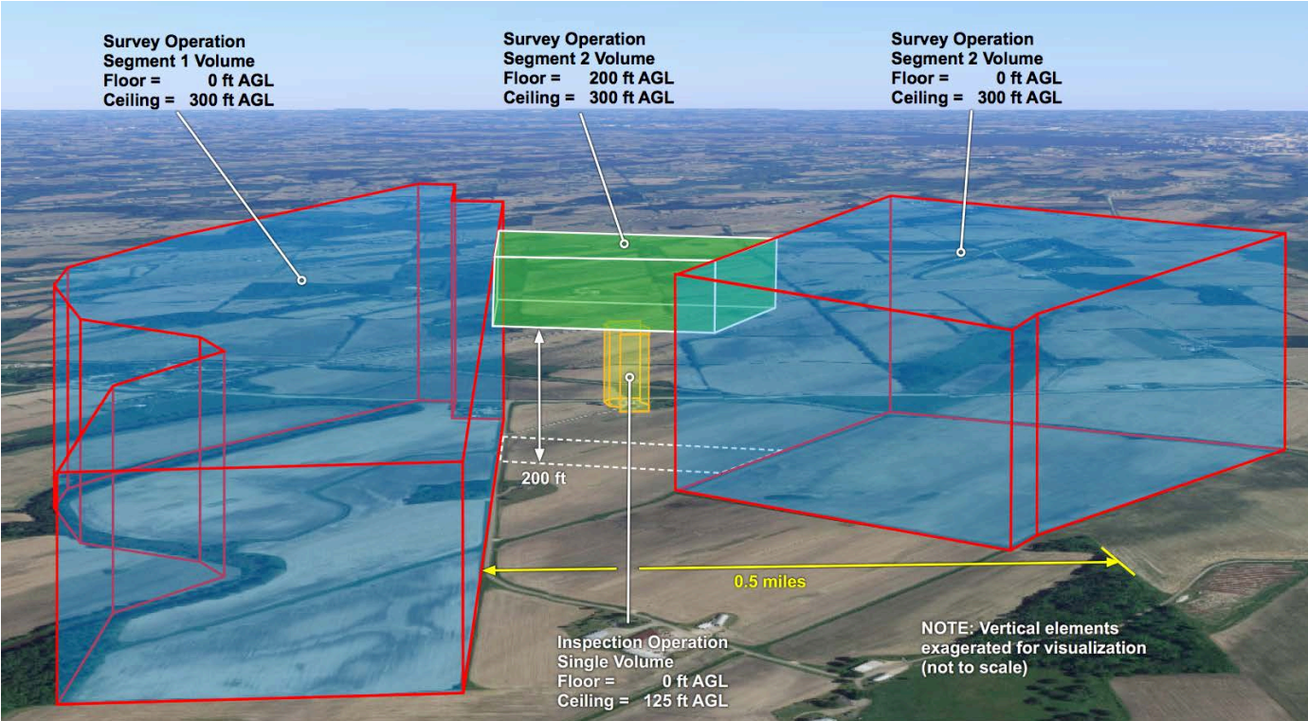
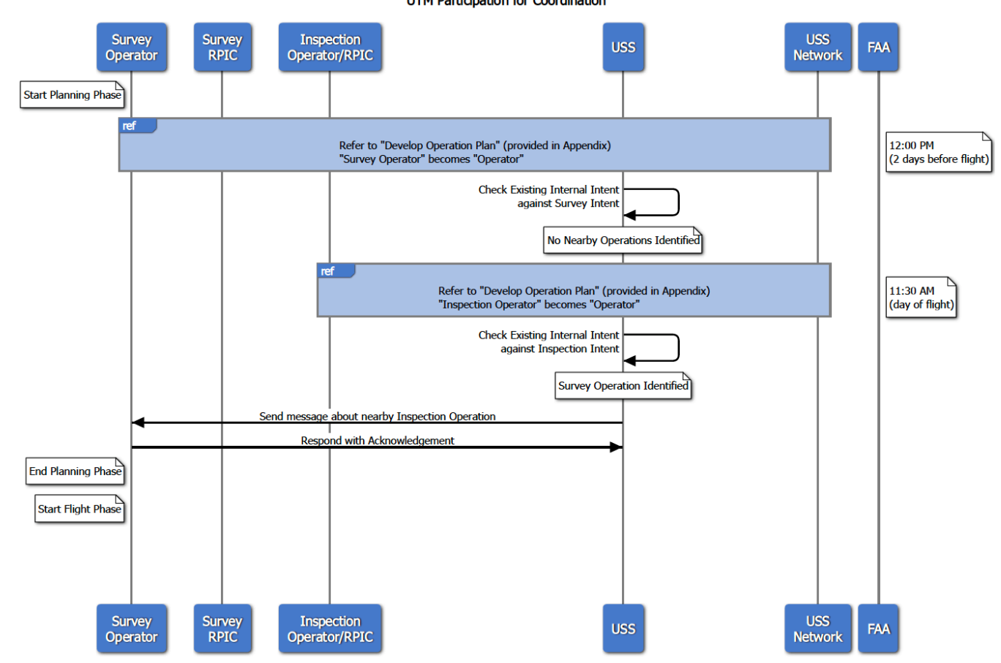
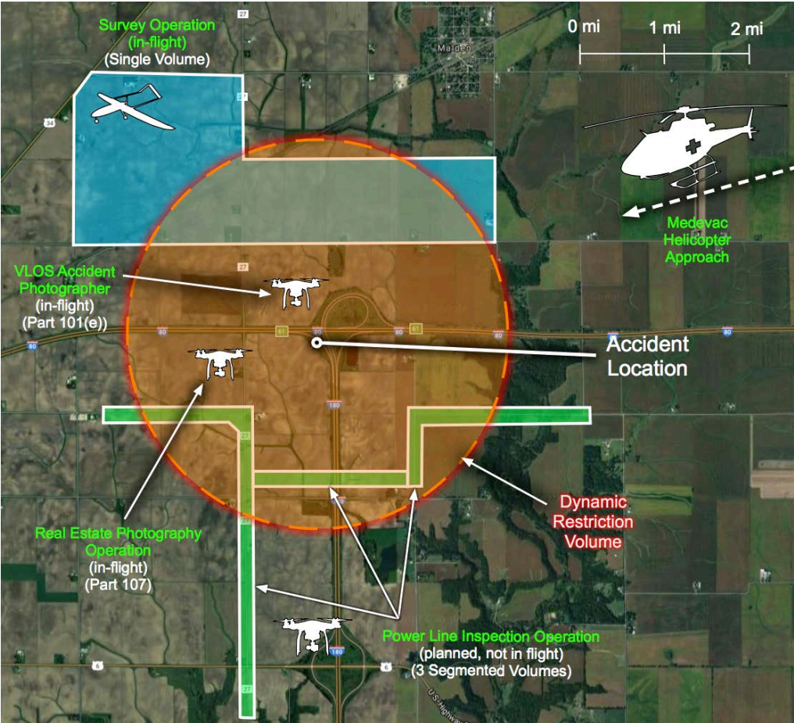
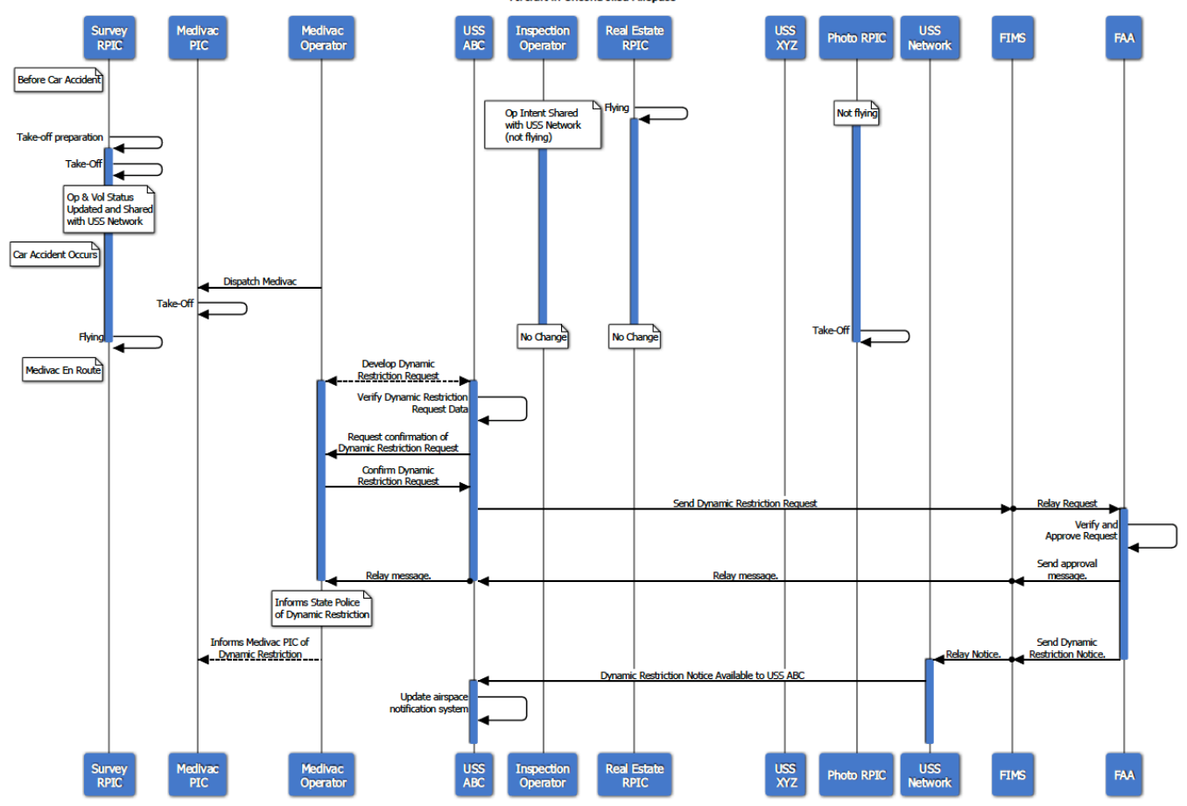
CWG Activities
Each technical capability level had an associated Research Transition Product (RTP) in the form of a use case package
Overarching Concept of Operations (ConOps) were also planned for publication to capture major elements and outputs of the ongoing RTT collaboration
TCL 1 Example: VLOS Operation with Voluntary UTM Participation
TCL 2 Example: Priority Operation in Uncontrolled Airspace

Slide 7
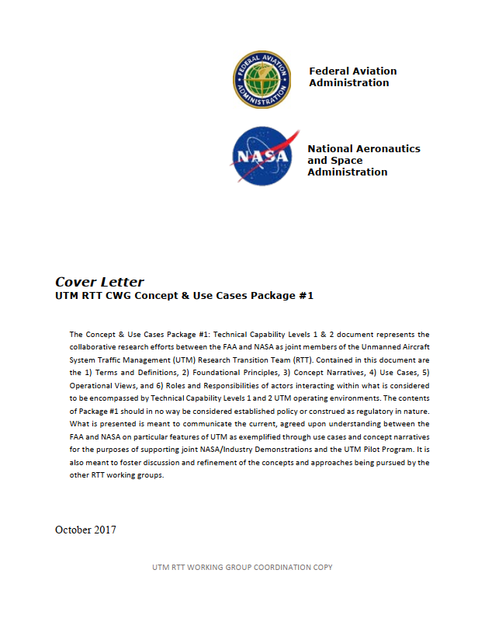
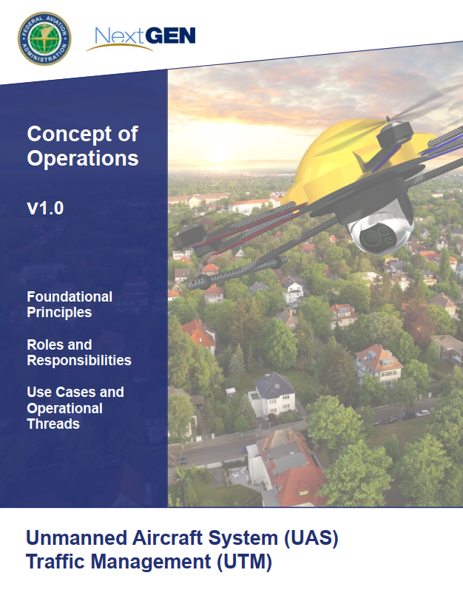
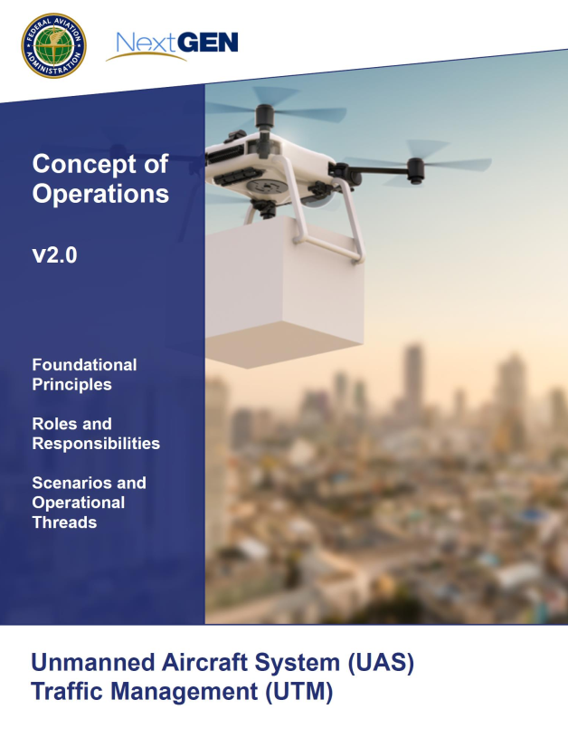
CWG Use Case Packages and ConOps

Slide 8
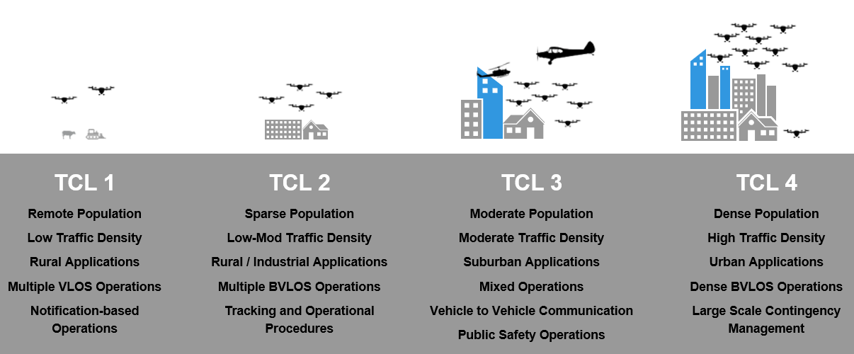
CWG Use Case Packages
Three use case packages produced through the CWG as part of RTT deliverables
Each package developed to encompass specific concept elements related to the UTM environment envisioned as part of a given Technical Capability Level (TCL)
Package #1
Package #2
Package #3

Slide 9
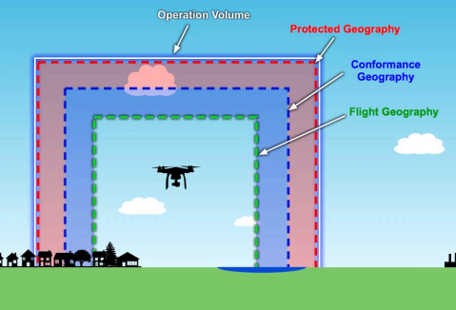
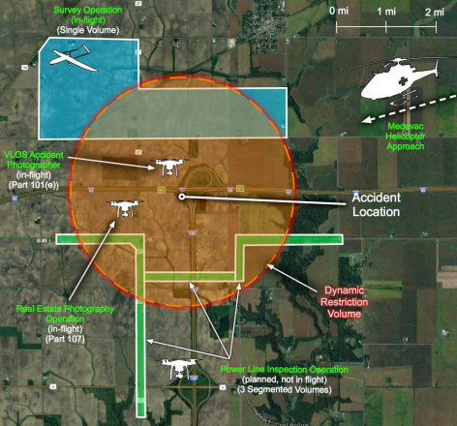
CWG Use Case Package #1: TCLs 1 & 2
Published October 2017
Basic elements introduced as part of TCL 1:
  1 use case: 2 VLOS operations
Greater complexity included as part of TCL 2:
  4 use cases: 1 BVLOS 1 VLOS operation, 2 BVLOS near airport, Emergency medical priority, BVLOS conformance violation into Class D

Slide 10
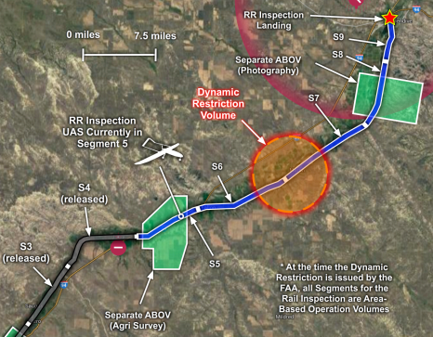
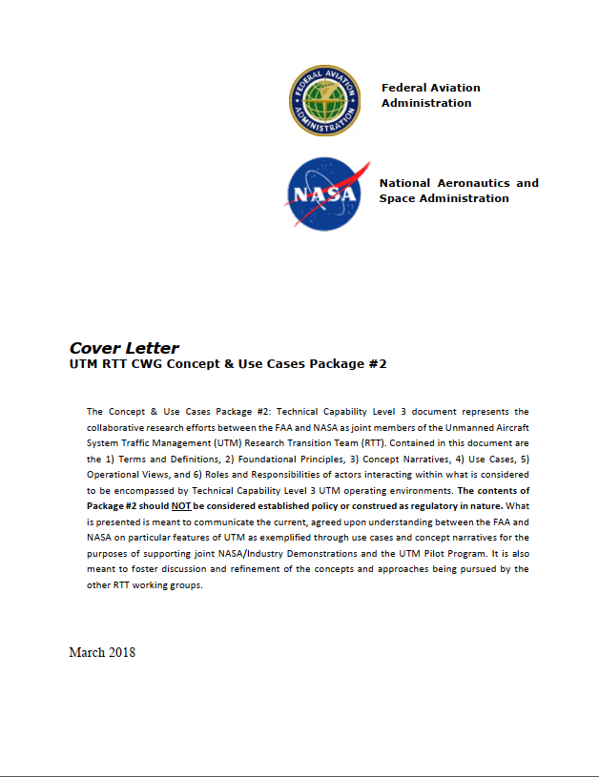
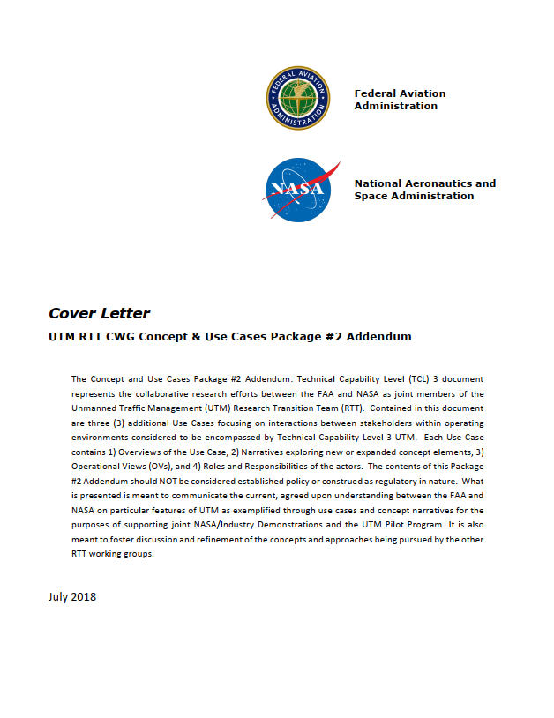
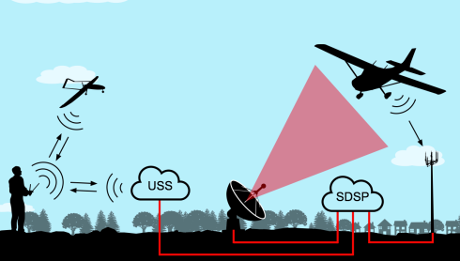
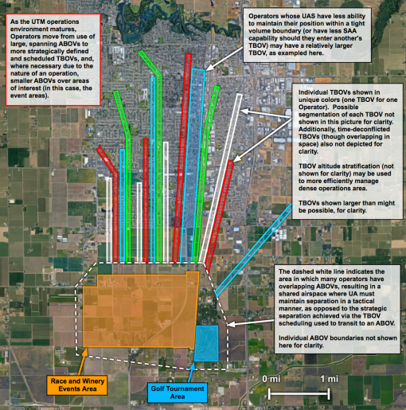
CWG Use Case Package #2: TCL 3
Two publications in 2018
Use cases and topics:
  One-Way BVLOS Flight, Separate Landing/Take-Off Locations
  Negotiation between Operators Due to Dynamic Restriction
  UAS Interaction with Manned Aircraft
  High Density UTM Operations
  Last-Mile Rural Deliveries under Mode C Veil
  sUAS Operator In-Flight Loss of Performance Capabilities

Slide 11
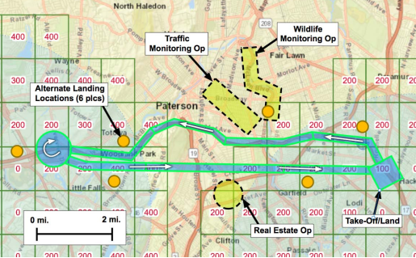
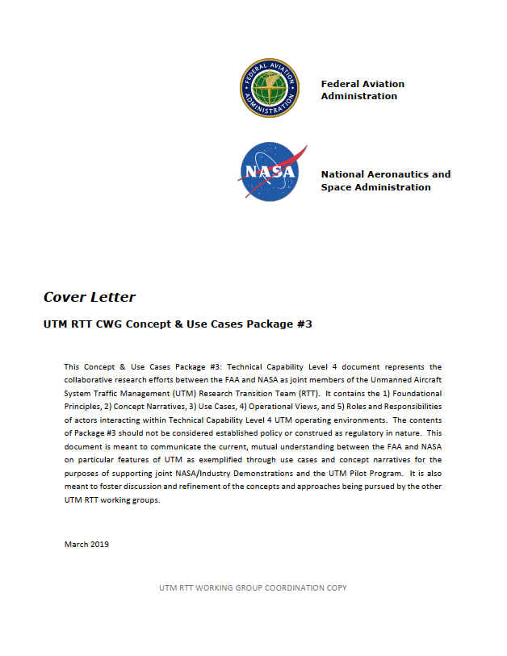
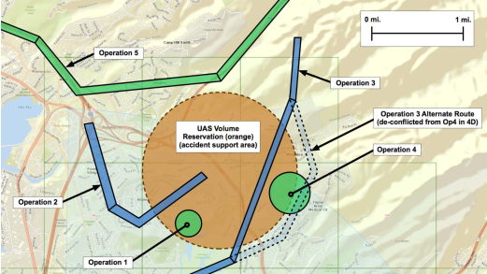
CWG Use Case Package #3: TCL 4
Published March 2019
Use cases and topics:
  BVLOS UTM Operation within UAS Facility Maps
  Historical UTM Information Queries by Authorized Entities
  UAS Urgency/Distress Condition with Alternate Landing and UTM Coordination
  UAS Volume Reservation in Controlled Airspace
  Report to FAA due to UAS Flight Incident

Slide 12
UTM Concept of Operations
Published May 2018
First formal publication setting out the joint vision of UTM with broader input from multiple organizations and industry
Established initial framework and definitions that included:
  Notional architecture
  Roles and Responsibilities of actors and entities
  Airspace management philosophy with respect to safety, security, and equity
  Eight illustrative use cases

Slide 13
UTM Concept of Operations
Published March 2020
Updated view of UTM concept informed by work of RTT and testing developments
Addressed:
  Operations of greater complexity in controlled and uncontrolled airspace
  Expanded discussion of Performance and Airspace Authorizations
  Introduction of Remote ID
  Expanded discussion of Safety, Security, and Equity
  Five illustrative use cases

Slide 14
CWG Test Involvement
Flight demonstrations provided a means to test aspects of the UTM concept in real world environments
TCL 3 involved dedicated tests as a distinct thrust under the concepts area
TCL 4 scenario foundations provided by CWG
Concept elements incorporated into FAA UTM Pilot Program (UPP) testing

Slide 15
CWG: TCL 3 Demonstration
Five distinct tests were included in the TCL 3 Statement of Work:
  CON1: BVLOS Landing
  CON2: Contingency Initiation
  CON3: Public Portal
  CON4: Multiple TCL 2/TCL 3 Operations for a Sustained Period
  CON5: FIMS/USS Interaction When a Vehicle Heads Towards Controlled or Unauthorized Airspace
A total of 17 CON tests were conducted across five test sites

Slide 16
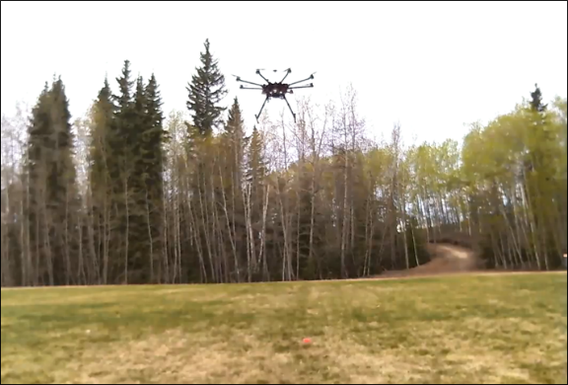
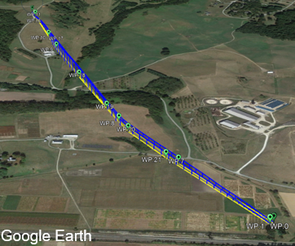
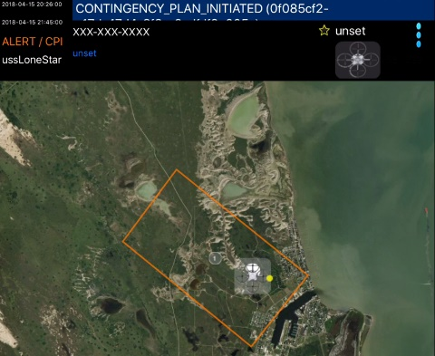
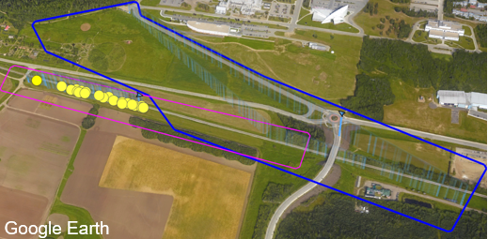
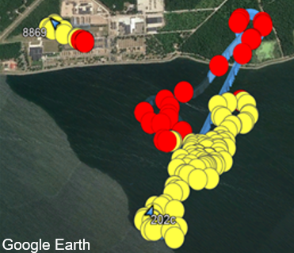
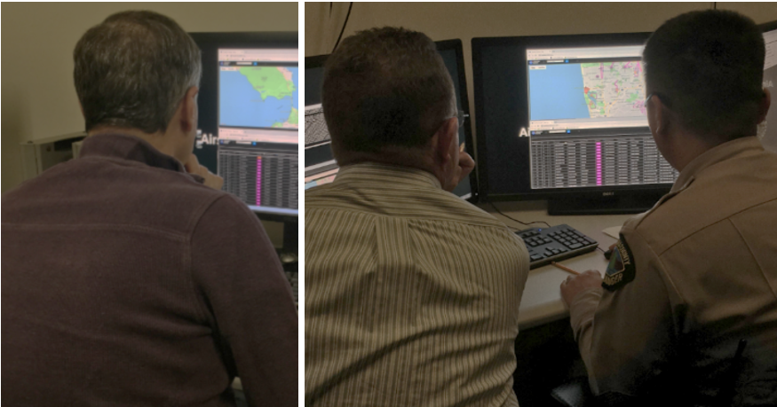
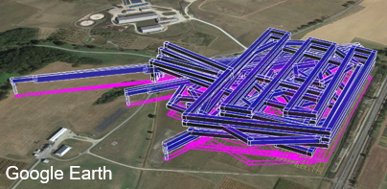
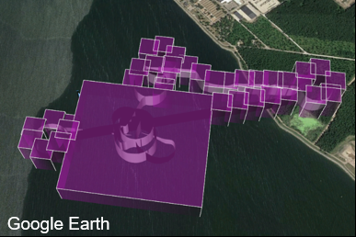
CWG: TCL 3 Demonstration
CON 1: BVLOS Landing
CON 2: Contingency
CON 5: Airspace Alerting
CON 3: Public Portal
CON 4: Multiple Ops Long Duration

Slide 17
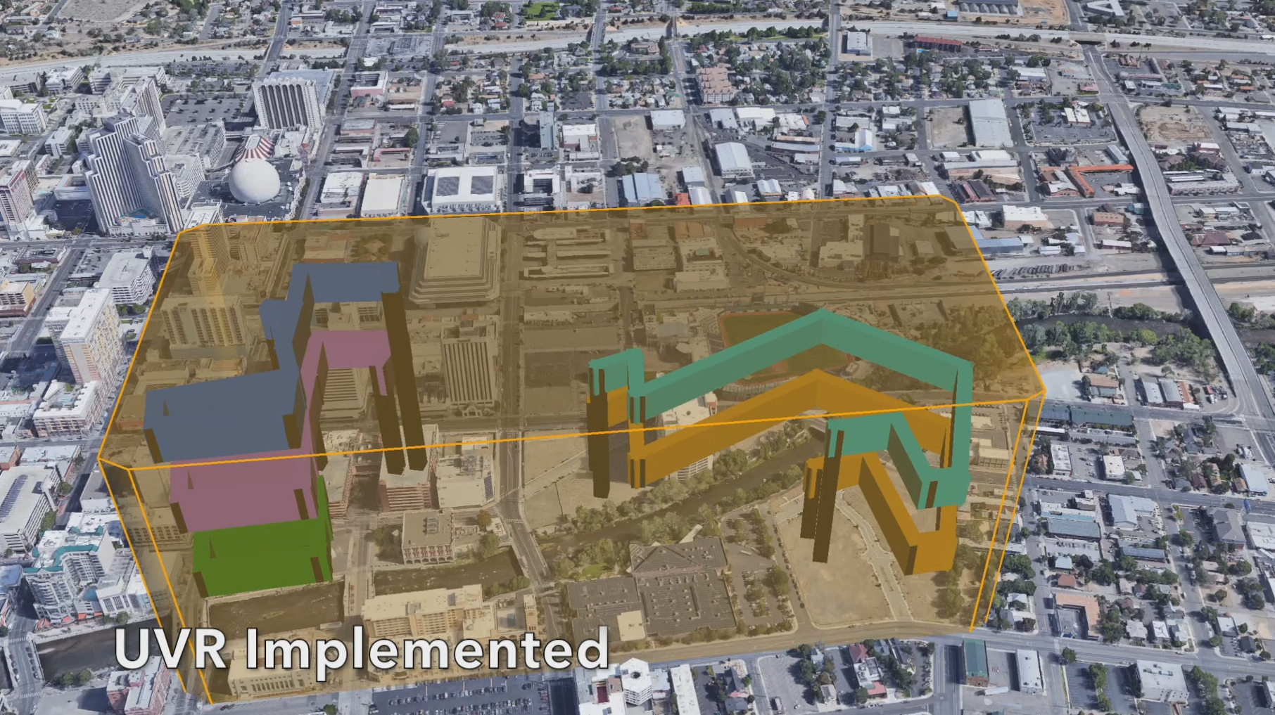

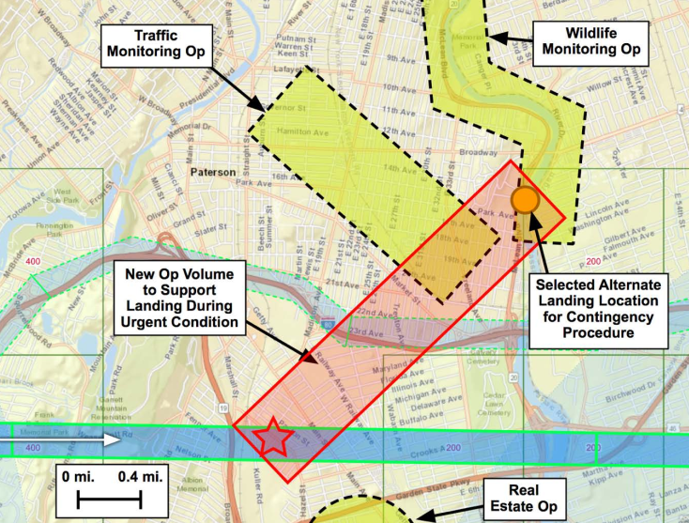
CWG: TCL 4 Demonstration
Developed initial scenarios based on CWG and broader RTT discussions
Five scenarios generated to examine a “day in the life” that addressed concept elements related to:
  High density operations
  Priority/Public Safety operations
  UAS Volume Reservations in dense environments
  Contingency Management
  Remote ID

Slide 18
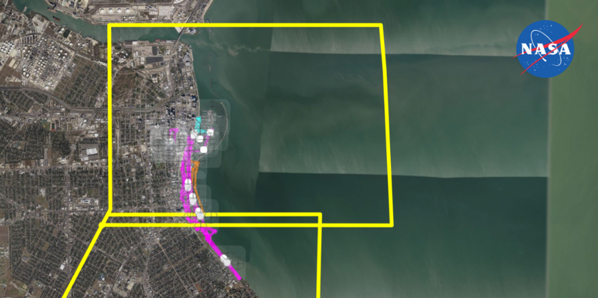
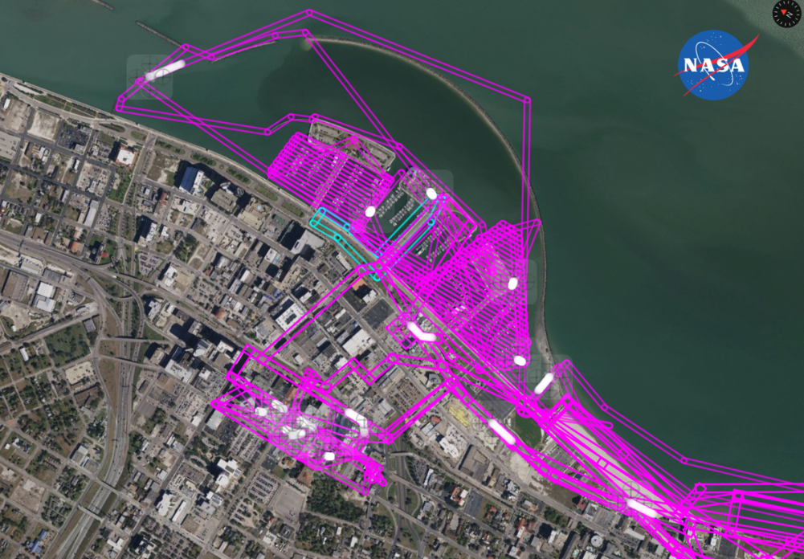
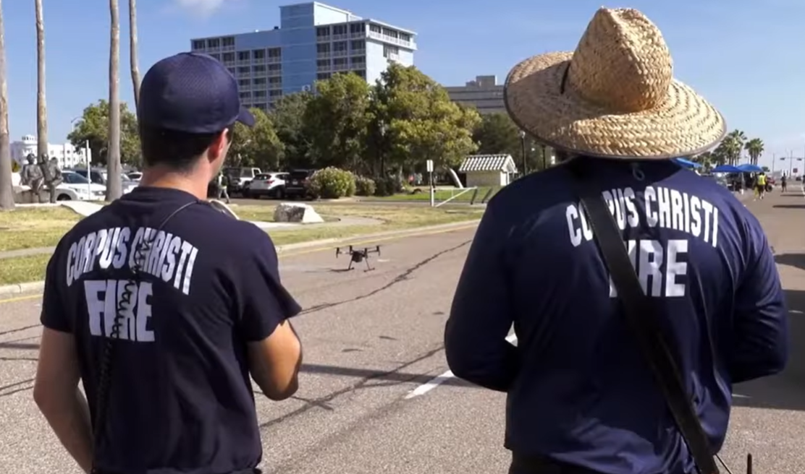
CWG: TCL 4 Demonstration
Large-scale Contingency Events
High Density Operations in Urban Environment
Public Safety Priority Operations

Slide 19
CWG Areas of Future Work
Addressing comments related to ConOps v2.0
UTM ConOps v3.0 in formulation stages
Continued engagement between NASA and FAA on further development and refinement of the UTM concept and related areas covered through the RTT
Additional areas of work and testing opportunities in discussion

Slide 20
CWG Summary and Impact
Three use case packages and two formal concept of operations were published that defined the concept and laid the foundations for subsequent progress in the UTM domain
CWG involvement in NASA and FAA testing ensured concept elements were explored and helped frame the targeted technical testing in other working group areas
The work of CWG and its collaborative nature resulted in the development of strong working relationships across multiple teams and the open exchange of information and ideas that will continue to drive the UTM concept from its humble beginnings to the vision of its promising future reality

