Slide 1
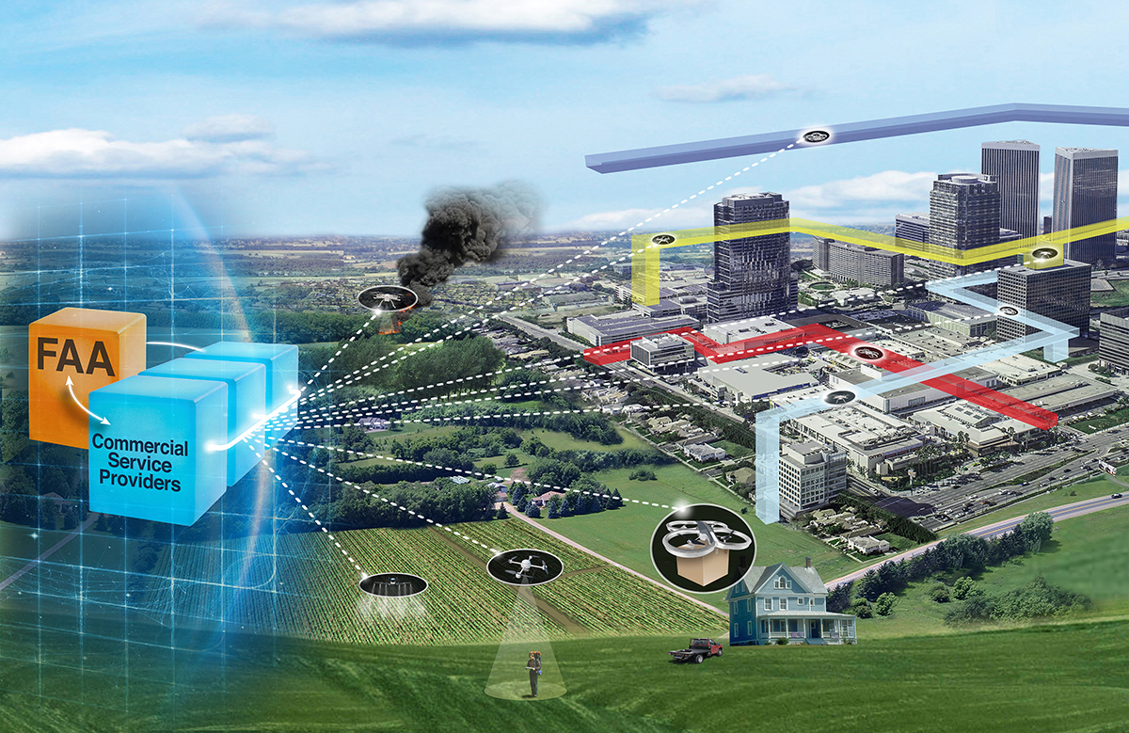

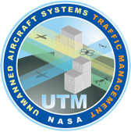
Unmanned Aircraft Systems (UAS) Traffic Management (UTM) Project
Project Overview and History
Joseph Rios, Chief Engineer
Jaewoo Jung, Project Manager (Acting)
      UTM Technical Interchange Meeting
        February 23rd, 2021

Slide 2

UTM Vision, Goals and Objectives
Vision
Define and safely enable future airspace operations (2025+) of small Unmanned Aircraft Systems (UAS) in the National Airspace System (NAS)
Goals
Allow diverse small UAS mix and airspace uses (e.g., package delivery, inspections, public safety and security)
Safely enable scalability to accommodate future demand
Accommodate a variety of business models (e.g., hub-and-spoke, point-to-point)
Establish highly efficient, predictable, agile, safe, and affordable airspace operations system
Maintain global competitiveness and domestic viability by innovation in technology and business models to manage airspace operations
Objectives
  Develop and validate airspace operations and integration requirements to enable safe, large-scale UAS operations
  Provide prototype (software) UTM system for further FAA testing and development

Slide 3
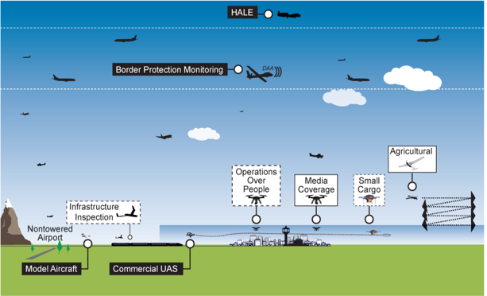
What is UTM?
UTM is an “air traffic management” ecosystem for uncontrolled airspace
UTM utilizes industry’s ability to supply services under FAA’s regulatory authority where these services do not exist
UTM development will ultimately enable the management of large scale, low-altitude UAS operations
ATM
Established policies & procedures
UTM
Cooperative interaction
Credit: FAA
            Operational concept will address beyond visual line of sight UAS operations under 400 ft. AGL, Class G airspace
  Roles/responsibilities of FAA and operators
  Information architecture, data exchange protocols, software functions
  System performance requirements

Slide 4

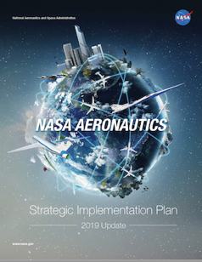
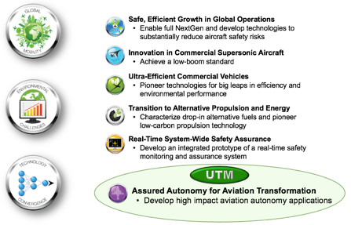
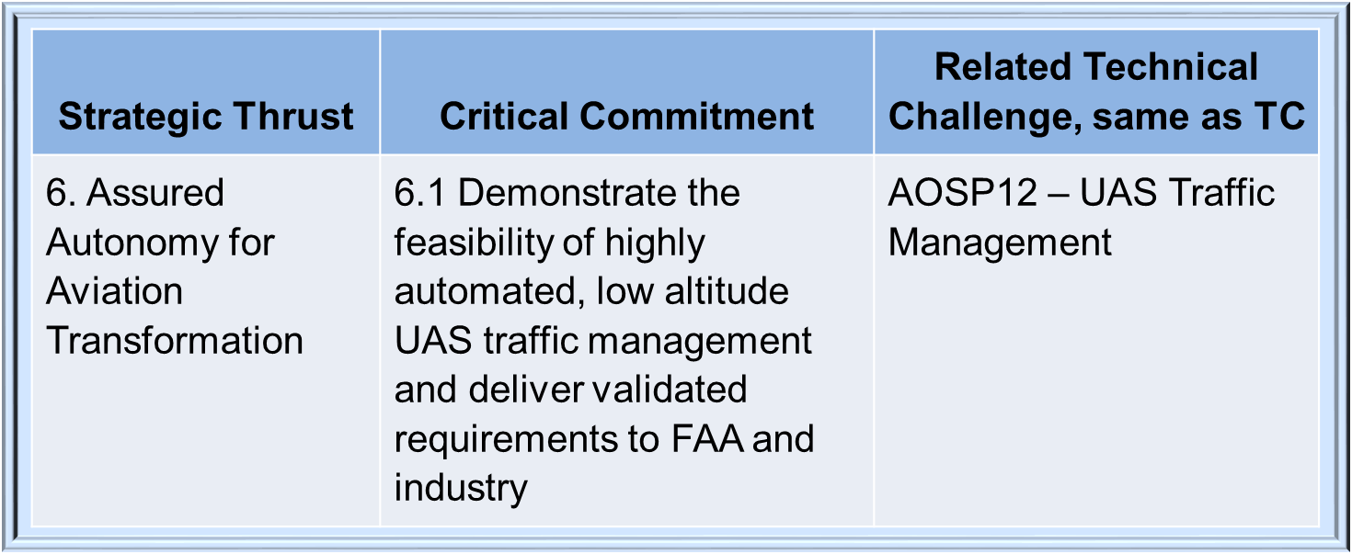
UTM Support of Agency Strategic Goals and Critical Commitment

Slide 5



UTM Activity Areas
System Development & Demonstrations
  Develop UTM system to meet the operational concept and requirements of a service-based architecture
  Test UTM functionality in field with many newcomers to small UAS (sUAS) operations
  Accelerate industry development
Focused Flight Tests
  Performance characterization of specific challenge areas
Simulations & Analyses
Evaluate the scalability and robustness of the concept
Focused
Flight
Tests
System Development & Demonstrations
Simulations
&
Analyses

Slide 6
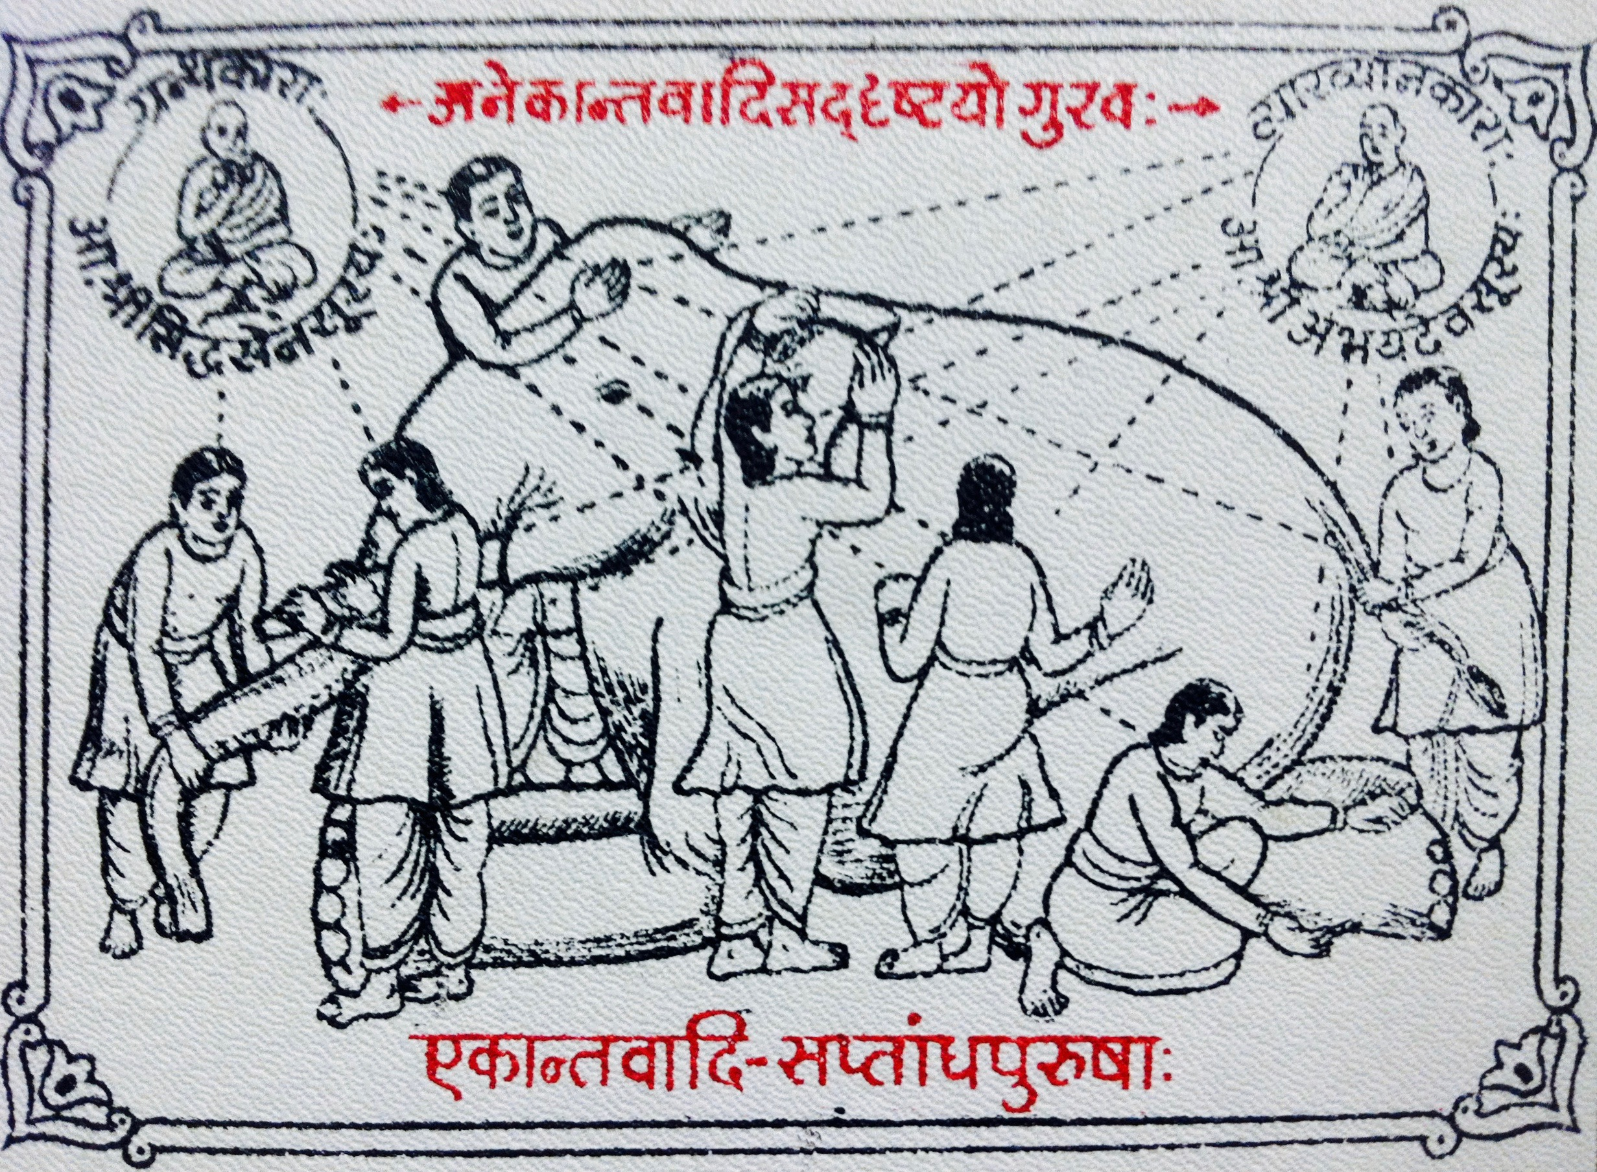
Notes:
Anekantavada: Theory of non-onesidedness… reality is complex, people will have individual views that may be hard to reconcile, yet all based in reality.
https://commons.wikimedia.org/wiki/File:Medieval_Jain_temple_Anekantavada_doctrine_artwork.jpg

Slide 7
UTM
Public
Pilots
Operators
Regulators
Service Providers
Public safety
Manufacturers
Notes:
https://commons.wikimedia.org/wiki/File:Medieval_Jain_temple_Anekantavada_doctrine_artwork.jpg

Slide 8

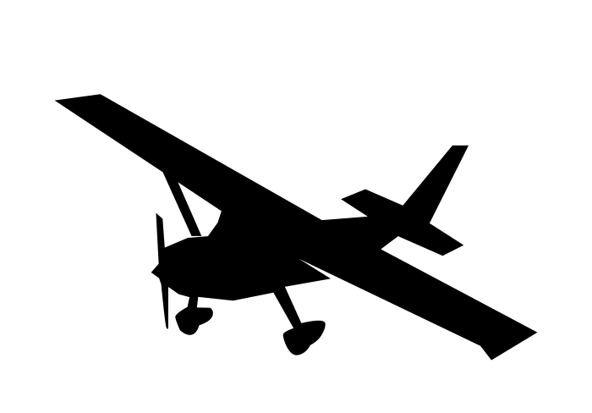




UTM Core Operating Principles
banana
banana
4444-8888-44441234ABCD
cat
apple
?
Notes:
Next slide: how are we actualizing these principles?

Slide 9
UTM Baseline Architecture and Information Flow Management Adopted and Adapted for Future NASA R&D
Industry Development & Deployment
Flight Information Management System
Enables airspace controls
Facilitates requests
Supports response in emergencies impacting NAS
UAS Service Supplier
Federated Structure
Cloud-based system
Automated System
Supports UAS with services (e.g. separation, weather, flight planning, contingency management, etc.)
Supplemental Data Service Provider
Supplies supplemental data to USS and UAS Operator to support operations
UAS / UAS Operator
Individual Operator
Fleet Management
On-board capabilities to support safe operations
FAA Development & Deployment
Supplemental Data Service Provider
Inter-USS communication and coordination
Terrain
Weather
Surveillance Performance
National
Airspace
System
Inter-data provider communication and coordination
NAS Data Sources
Flight
Information
Management
System
Constraints, Directives
UAS
Service
Supplier
Requests, Decisions
NAS
state
Operations, Deviations
NAS
impacts
Operations
Constraints
Modifications
Notifications
Information
Operations, Constraints,
Notifications,Information
Operation
requests
Real-time
information
Public Safety
Public
UAS
Operator
UAS
Operator
UAS
Operator
Color Key:
…
FAA Function
Operator Function
Discovery
Registration Data/Services
Authentication/Authorization
V2V
Comm.
Other Stakeholders
UAS
UAS
UAS
FAA/Industry Shared Responsibilities

Slide 10
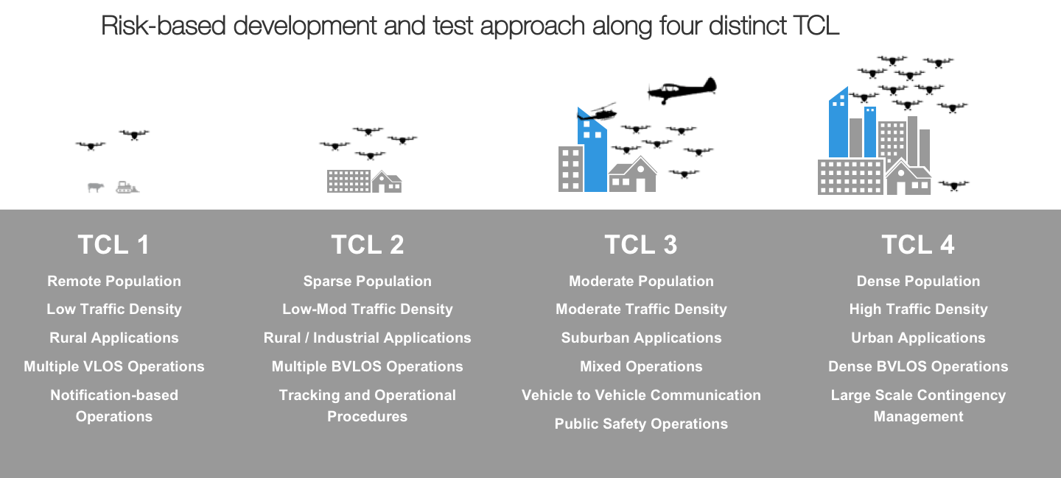
UTM Progression: Technical Capability Levels (TCL)

Slide 11
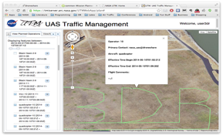


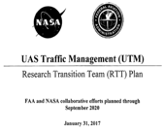


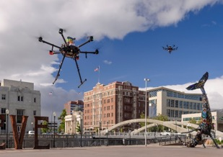
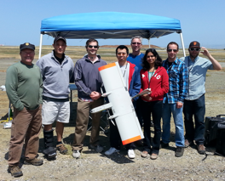
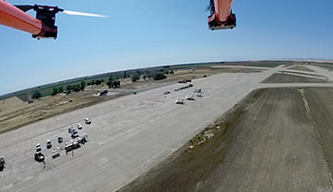
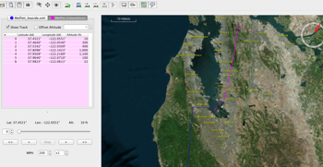
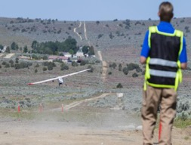
Project Timeline
Initial UTM Workshop with industry
Integration with commercial partners
First multi-operation demo
National Campaign #1 at 6 FAA Test Sites
RTT Plan signed by FAA+NASA
TCL 3 Demo across 6 FAA Test Sites
Feb 2014
Nov 2014
Jul 2015
May 2016
Jan 2017
May 2018
FY 2013
May 2014
May 2015
Aug 2015
Oct 2016
May 2017
Summer 2019
Internal seedling effort at NASA to investigate UTM
Initial prototyping
First live flights under UTM
TCL 1 Demo
TCL 2 Demo, NV Test Site
National Campaign #2 at 6 FAA Test Sites
TCL 4 Demo NV+TX

Slide 12
UTM Partnership
DoD
ASTM
CTIA
Industry
(85 Space Act Agreements)
ANSI
…
Standards & Research Groups
SaRP
NASA UTM Project
Industry
Research Transition Team
International Organizations
FAA
JAXA
FAA UAS Test Sites
Other Gov. Agencies
JARUS
Partnership Strategy
Lead, Leverage & Collaborate
ICAO

Slide 13
Acceptance of TCLs and UTM
FAA and Community acceptance of NASA-UTM is demonstrated by:
  FAA UTM Pilot Program use of NASA-UTM federated architecture and commercial service providers partnered with NASA
  FAA Low Altitude Authorization and Notification Capability (LAANC) operational system utilizes NASA-UTM construct
  FAA UTM ConOps, rulemaking, and national implementation plan informed by NASA-UTM
  Growing market of UAS Service Suppliers (UTM graduates): AirMap, AiRXOS, Amazon, etc.
  Domestic and international standards groups adopting NASA-UTM and adding further definition
  DHS/DoD adopting NASA-UTM construct and adapting for their missions
“The FAA is already deploying a preliminary version of UTM … it’s the wave of the future
and we are using UTM to lead that way.”
– Steve Bradford, Chief Scientist for Architecture, NextGen, FAA

Slide 14
How the Project met the Critical Commitment
Demonstrate the feasibility of highly automated, low altitude UAS traffic management and deliver validated requirements to the FAA and industry
How we demonstrated the feasibility of highly automated, low altitude UAS traffic management
  Workshops and working groups develop use cases and scenarios
  Collaboratively develop data interfaces and protocols to support use cases
  Demonstrate use cases via collaborative simulations and flight tests
  Incorporate industry leaders in flight tests to nurture their development and show state of art
How we delivered validated requirements to the FAA and industry
  Technical Memos and internal documentation provided in Tech Transfers to FAA and publicly (examples)
    USS Specification (NASA/TM-2019-220376)
    USS Framework for Authentication and Authorization (NASA/TM–2019–220364)
    Strategic Deconfliction: System Requirements
    UAS Service Supplier Checkout (NASA/TM–2019–220456)
    Automated Management of sUAS Comm and Nav Contingency (AIAA 2020)
  Field-tested Application Programming Interfaces published via GitHub
  Supporting analysis of test results via TM and conferences

Slide 15
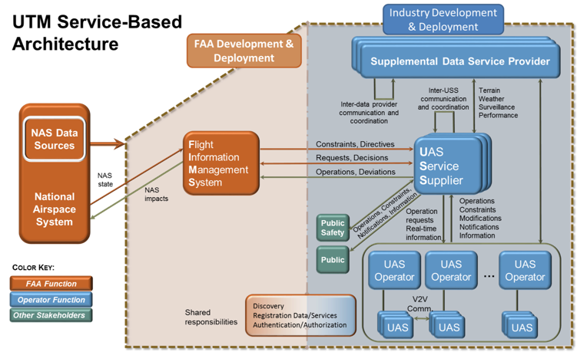
UTM Influence
FAA UTM RTT
FIMS Prototype
USS Checkout Process
TCL 1-4 CONOPS and Use Cases
International
UTM Annex for JARUS SORA
UTM Architecture for ICAO
C&N Requirements for GUTMA/3GPP
ASTM WK69690 Ground Surveillance
UTM Surveillance API
TCL DAA Results
Conflict Management Model
ASTM WK63418 UTM Services
USS Specification
Authorization & Authentication
CTIA UAS Working Group
TCL C&N Results
UTM C&N Model and Requirements
DOD / DHS
Federal USS Prototype
Unmanned Aircraft Safety Team
Off-Nominal Reporting
UTM Hazards Analysis
ASTM WK6540 UAS Remote ID
TCL Remote ID Results
Discovery Specification
ASTM WK62669 Detect & Avoid
TCL DAA Results
Conflict Management Model
IEEE P1920.2 V2V for UAS
TCL V2V Results
Conflict Management Model

Slide 16
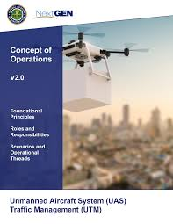
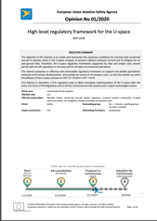
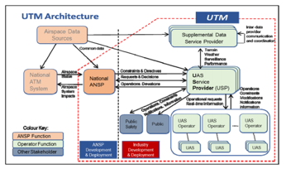
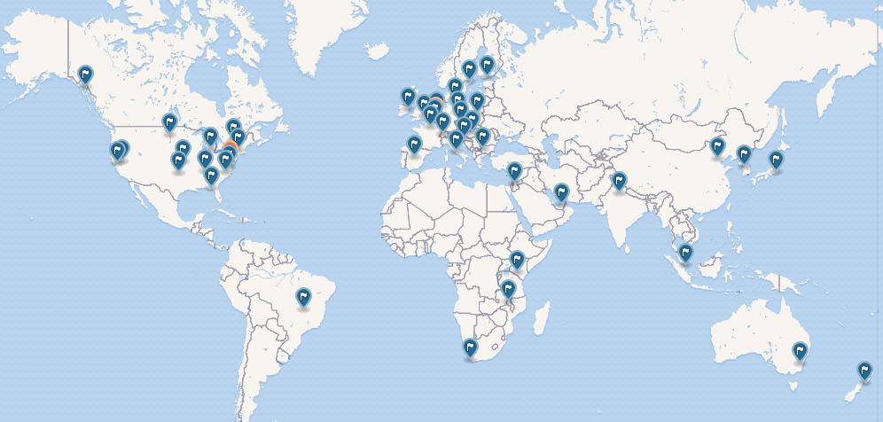
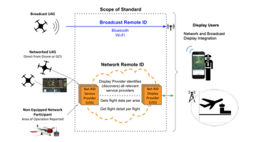
International Impact of UTM
UTM has directly influenced the regulation and policy, concepts and architectures, and standards across the world for implementing UAS traffic management
FAA - “UTM Conops v2.0”
EASA – ”High Level regulatory framework for the U-space”
ICAO - “UTM - A Common Framework with Core Principles”
JARUS – ”SORA v2.0 Annex H- UTM Services”
NASA UTM Concept
GUTMA - “Map of Global UTM Implementations”
ASTM - “New Specification for Service provided under UAS Traffic Management"
ISO – ” Requirements for UTM services and service providers”

Slide 17
UTM Project Ends but UTM Construct Continues
UTM
DoD/DHS
ATM-X
FAA UPP 2.0
Adapt the UTM construct and apply lessons learned to mature the concept of operations for managing Urban Air Mobility (UAM) traffic and enabling cooperative operations in Upper Class E airspace
Expand the UTM architecture for testing in National Campaign and performing High-Density UAM operations in R&D
AAM
Extend the UTM code base for managing government agency operations with an emphasis on security
FAA uses FIMS part of code base
The UTM concept has been very successful in evolving to new applications and spring boarding projects
Notes:
ATM-X: Adapt the UTM construct and apply lessons learned to mature the concept of operations for managing Urban Air Mobility (UAM) traffic and enabling cooperative operations in Upper Class E airspace
AAM: Expand the UTM architecture for testing in National Campaign and performing High-Density UAM operations R&D
DoD/DHS: Extend the UTM code base for managing government agency operations with an emphasis on security

Slide 18
The UTM Journey from 2015 to 2020
In 2015, the small UAS industry was just beginning to accelerate with no clear concept of how this new traffic would be safely managed
Through partnerships with FAA, industry, and academia, a concept was created and UTM was developed to meet stakeholder’s needs
A prototype UTM system of federated services was tested through a series of increasingly complex events in realistic environments to prove the concept
Industry has created business models around providing UTM services and is taking leadership in standards development
The FAA is embarking on the UTM implementation program that will unleash, in a disciplined way, a multi-billion-dollar industry
Now in 2020, the UTM concept is the springboard for managing UAS in all airspace domains and will influence the future NAS transformation

