Slide 1
Designing an optimal strategy for GMAO S2S ensemble forecast
Background
Why do we need ensembles for Subseasonal-to-Seasonal forecasts?
Motivation
What can we learn from existing systems?
Study approach
What do we want to address in our design?
Anna Borovikov, Siegfried Schubert, Jelena Marshak
February 17, 2021
1
Notes:
1

Slide 2
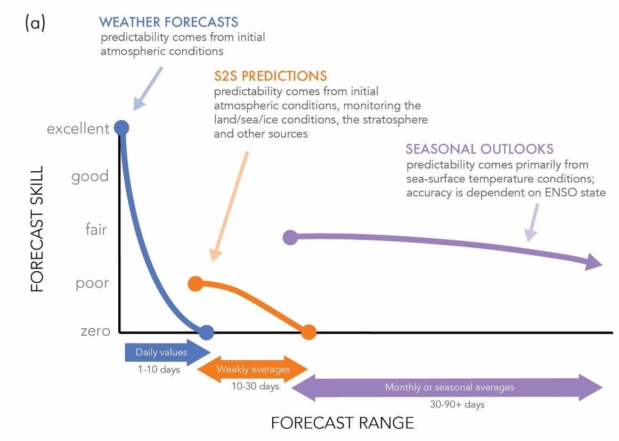
Why do we need ensembles for S2S forecasts?
To improve subseasonal-to-seasonal forecasts predictability, consistency and reliability we need large properly initialized ensembles.
Designing the most optimal ensemble strategy is part of the research on NASA observations value in the S2S forecasts.
White et al., (2017) Potential application of subseasonal-to-seasonal (S2S) predictions. Meteorol. Appl. 24
2
Notes:
Mention atm, ocn and interface initialization importance for extended range forecasts. Going beyond the limits of predictability – we need ensembles to increase the skill of the mean, potential predictability.
We want to have best possible S2S forecast system. Then we can understand the impact of obs.
Old stuff:
Consistency: do the observations statistically belong to the distributions of the forecast ensembles?
Is the ensemble spread an indicator of forecast uncertainty?
To what extent is the ensemble spread related to the model’s climatological variability and is that variability realistic?

Slide 3
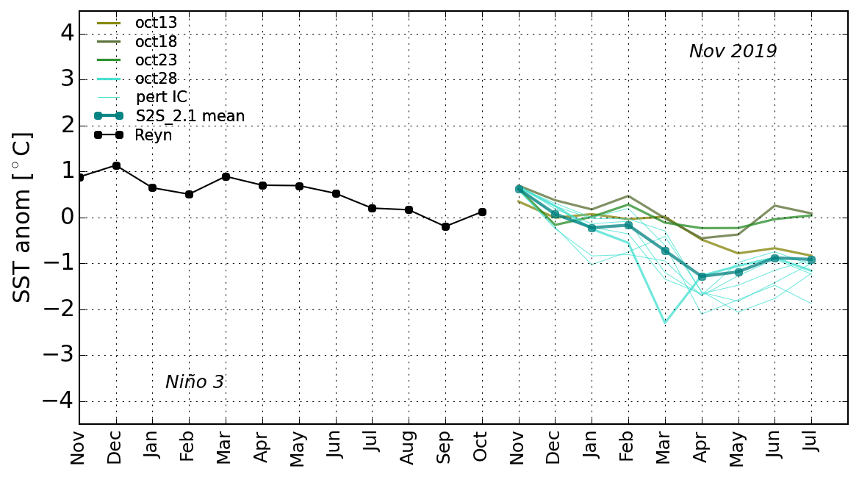
Initialization techniques: lag and/or burst? Both current and previous GMAO S2S systems use a similar lag/burst combination.
Coupled Assimilation, Atmosphere Replay to FPIT
a typical forecast month
future
GEOS-S2S-2
seasonal forecast:
- unperturbed
- perturbed
ENSO.
A critical phenomenon to capture in the seasonal forecast.
3
Notes:
Mentions sub-seasonal: separate now, to be combined with seasonal in the new design.
Explain lag/burst.

Slide 4
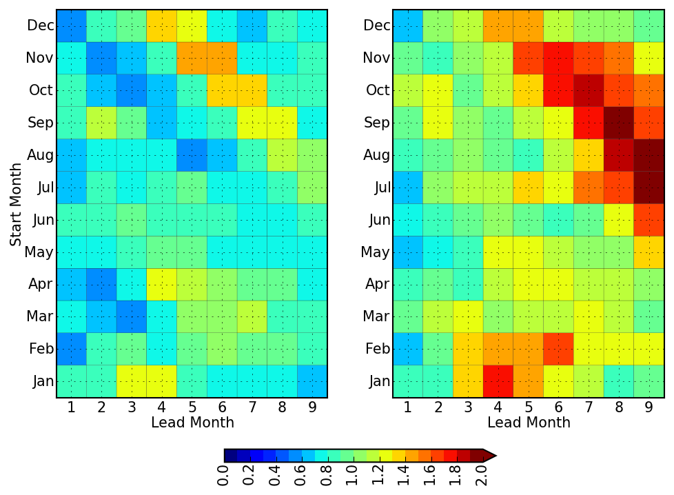
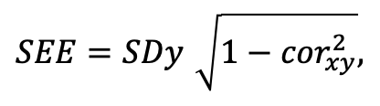
What do we know so far? Learning from S2S-1 and S2S-2. Is the ensemble spread an indicator of forecast uncertainty?
Metric to quantify the quality of the ensemble.
Following Barnston et al (2015) we compare the mean intra-ensemble standard deviation with the standard error of the estimate (SEE):
$$SEE=SDy\sqrt{1−{cor}_{xy}^{2}},$$
where SDy is the standard deviation of the observation (y), and cor_{xy}² is the squared correlation between the ensemble mean forecast (x) and the observation.
σ: standard deviation of the intra-ensemble spread
R = σ/SEE, which should be close to 1 for a perfect model:
if R < 1 the model is under dispersive
if R > 1 model is over dispersive
S2S-1
S2S-2
S2S-1 is under dispersive for most of the seasons, especially at early lead times.
S2S-2 is much better, but still slightly under dispersive at early leads and over dispersive for spring forecasts at long leads.
4
Notes:
Use the fig from the paper w/o signs, put a diagonal line for march. Put little schematics here – maybe.
Thus we compute (for Niño3.4, all initial months, all leads):
cor_{xy}: correlation between the ensemble mean and observations
SEE: standard error estimate of the forecast error

Slide 5
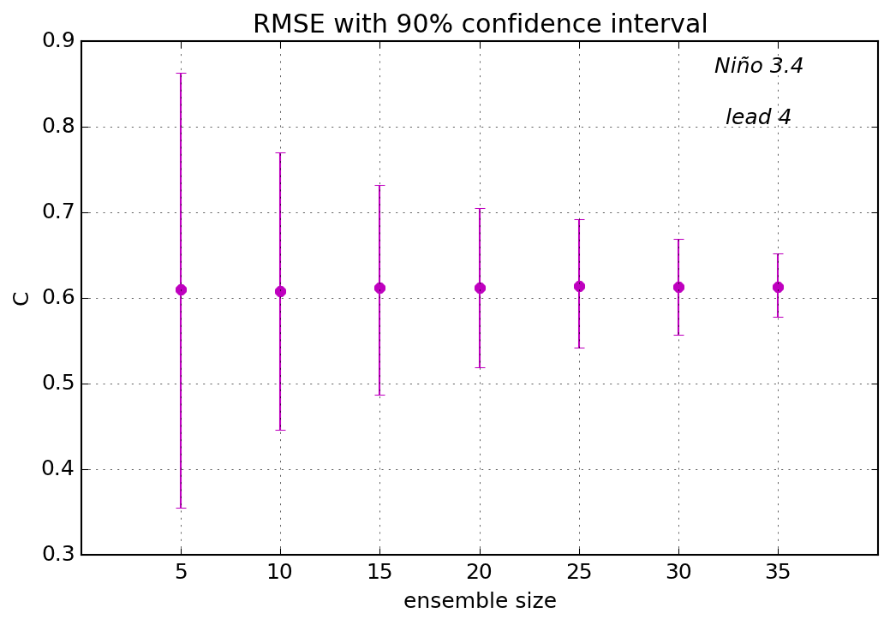
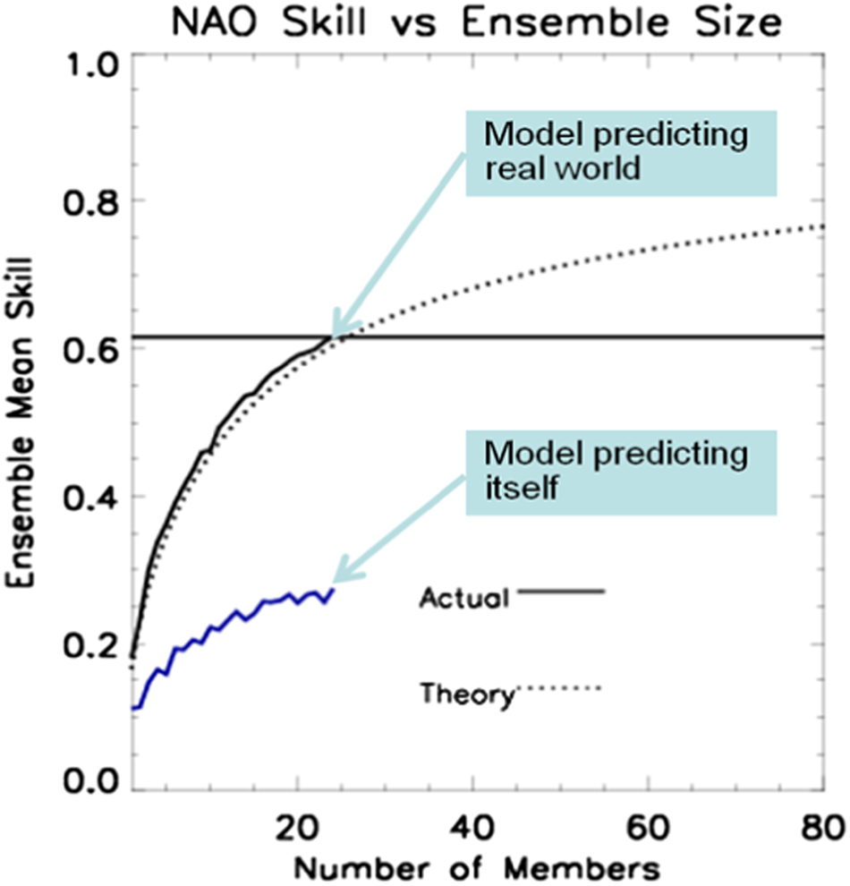
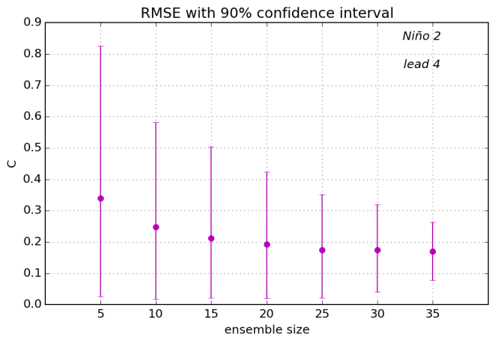
How big of an ensemble do we need?
ENSO at 4 months lead
NAO at 1 month lead
(after Scaife & Smith, 2018)
N ≡ maximum test ensemble size
M ≡ sub-sampled ensemble size
K ≡ number of random samples from combinations(N,M)
N = 40
K = 1000
repeat for M = 5, 10, 15, 20, 25, 30, 35
For each sub-sampled ensemble, the mean ensemble error is computed for each lead time for k from 1 to 1000.
Nov27 2017
2010
Plot the mean of │E_{k}│and the 90% confidence interval.
We need lots of ensemble members, but not for the long-range ENSO.
5
Notes:
Scaife figure: ensemble size important for NAO. We can measure its impact on ENSO. We need them for subX, but not so much for seasonal.

Slide 6
Ensemble design for S2S-3.
Motivation:
For ENSO improve the under-dispersion at short lead time; control the over-dispersion at long leads.
For sub-seasonal teleconnections improve the ensemble mean skill by increasing ensemble size.
Ideas explored/developed for GEOS S2S-3:
The various patterns (eigenvectors) of perturbations and scaling.
Different combinations of lag and burst.
Use of large ensemble size for season-long forecasts, then sub-sample and continue with fewer members for the long-range forecasts.
Methods:
Bursts of forecasts on a single date using initial conditions perturbations, generated from instantaneous states from coupled analysis at varying separations. Synchronized Multiple Time-lagged (SMT) approach.
Stratified sampling to select ensemble members for long range forecast.
6

Slide 7
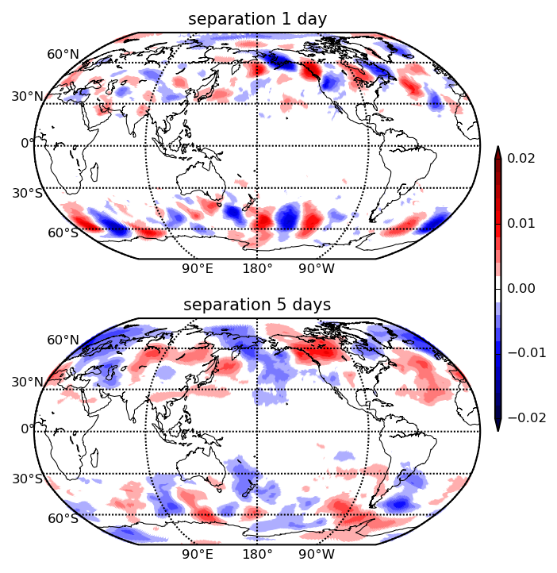
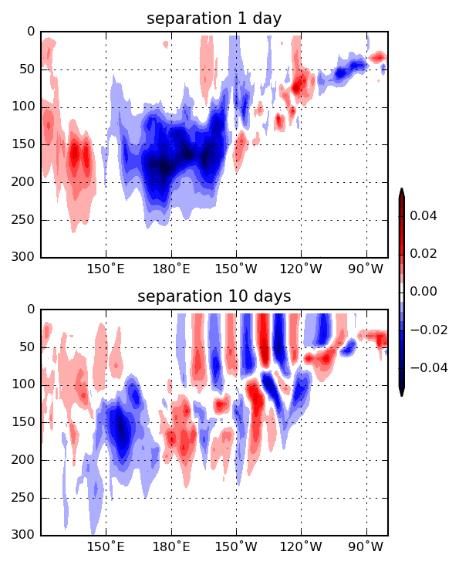
Spatial patterns of perturbations. Span all scales rather than 5 days in the current system.
EOF 1
Potential Temperature (500mb)
EOF 1
T(EQ, Pacific)
By varying the separation time between nearby analysis states we are able to generate a wide array of different types of atmospheric and oceanic perturbations that represent physically realistic and important modes of variability.
1 day: synoptic-scale
1 day:
variations
in the thermocline
Scaling. To make the perturbations amplitude a small fraction (10% in terms of STD) of the natural variability and independent of the separation, we produced an average set of scaling factors that vary only with season and states separation for ocean and atmosphere variables.
5 days: teleconnections
10 days:
vertically-coherent
wave-type variability
7
Notes:
Typical structure of ocean temperature perturbations at τ equals 1-day (top left) and 10-day (top right) separations. The structures are the leading EOFs of the Pacific equatorial x-z cross section of temperature averaged between 2°S-2°N, and extending down to a depth of 300 meters. The top panels show the correlations of tropical Pacific SST with the leading EOF for 1-day separation (left) and 10-day separation (right).

Slide 8
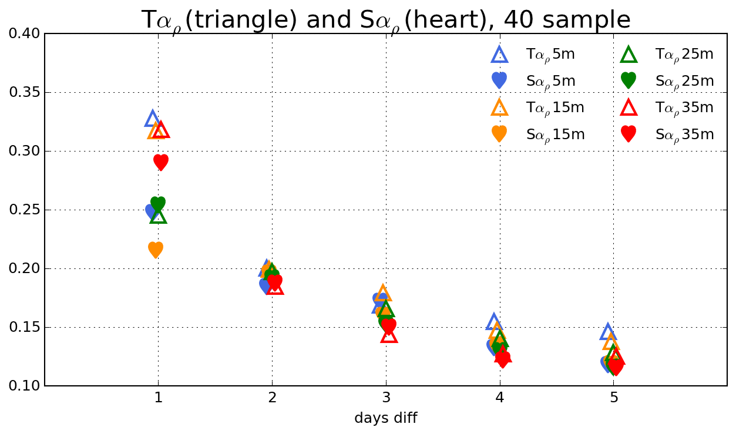
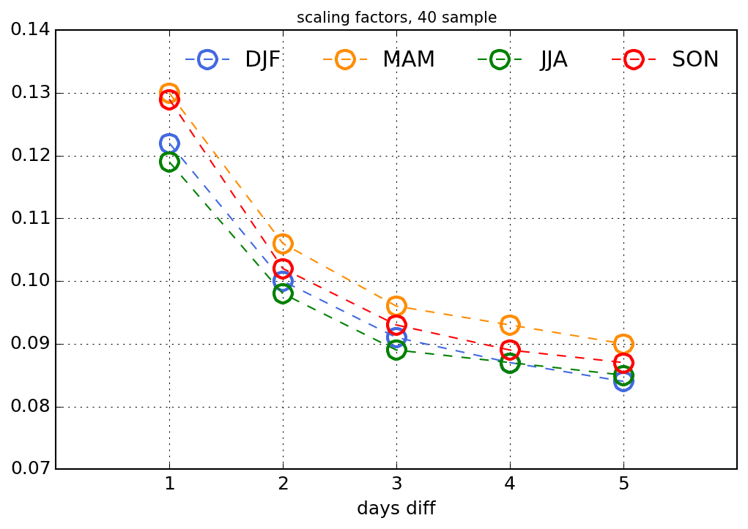
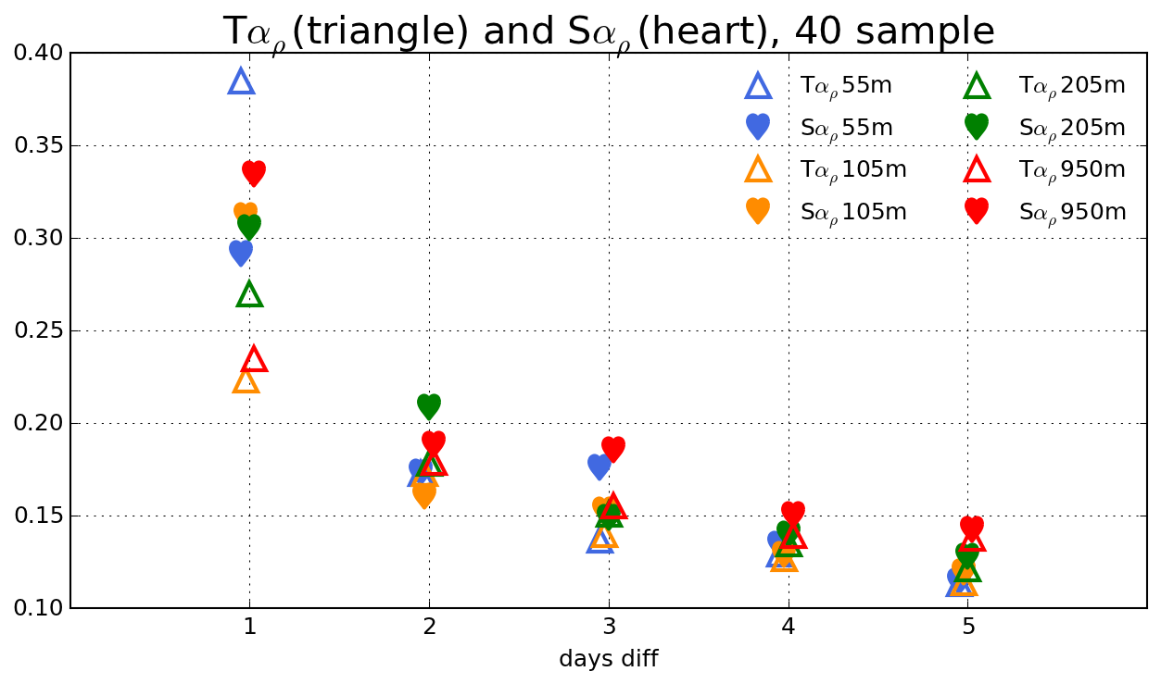
Scaling of perturbations.
Perturbations Δ𝑥_{𝜏}(𝑡) ≡ 𝑥(𝑡 + 𝜏) − 𝑥 (𝑡), 𝜏 = 1, 2 , 3…. 𝑑𝑎𝑦𝑠
We want to find scaling 𝛼(𝜏) such that the perturbations have the same magnitude relative to climatology, independent of the separation
Δ𝑥_{𝜏_sc} ≡ 𝛼(𝜏) Δ𝑥
𝛼_{𝜌}(𝜏) = 𝜖/(2(1 − 𝜌(𝜏)))^{1/2}
𝜌(𝜏) = 𝑐𝑜𝑟𝑟(𝑥(𝑡 + 𝜏), 𝑥(𝑡)) is the autocorrelation based on the daily data
𝜖 is whatever fraction of the climatological standard deviation one wants the magnitude of the perturbations to be
typical value 𝜖 = 0.1
Overall atmospheric scaling factors.
Ocean scaling factors have significantly different amplitude.
8

Slide 9
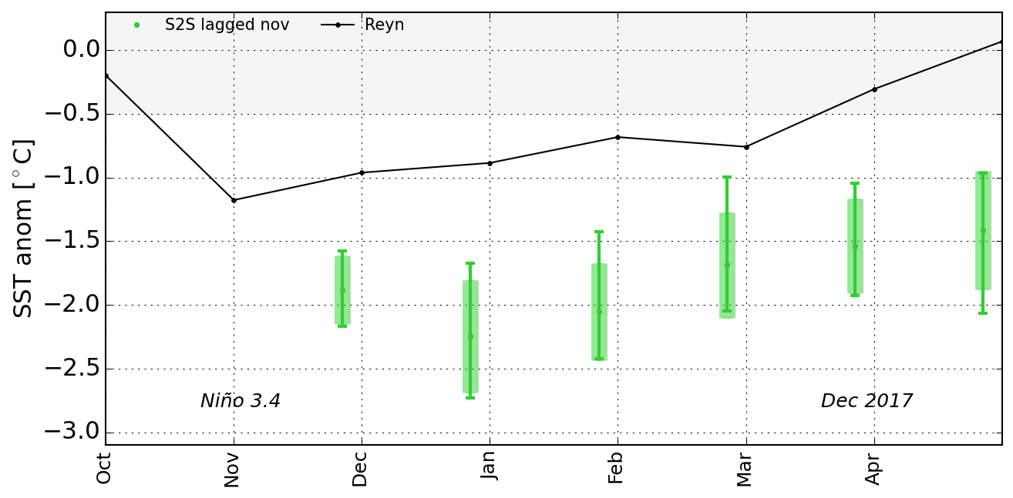
Testing various types and combinations of lag/burst.
current S2S
lag: 4 dates
9
Notes:
Case study: need big spread to capture large error.
A comparison of various strategies for producing initial ensemble members: impact on ensemble spread shown as box and whisker plots where the whiskers denote the maximum and minimum values and the box has length equal to the standard deviation centered on the ensemble mean. Results are for forecasts initialized during November 2017, with the nominal first month of the forecast being December. Here S2S-2 lagged nov results (green) are for the 4 lagged forecasts (initialized 5 days apart) from our production forecasts, while the lagged results (magenta) are based on 30 members- initialized each day during November.

Slide 10
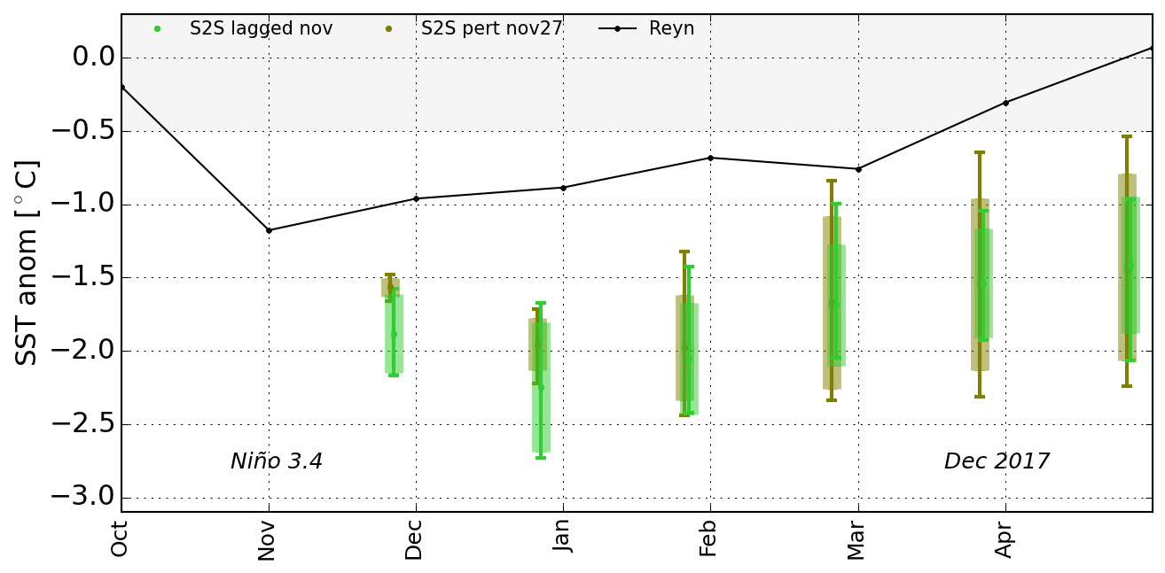
Testing various types and combinations of lag/burst.
current S2S
lag: 4 dates
current S2S
burst: 6 mem
10
Notes:
Case study: need big spread to capture large error.
A comparison of various strategies for producing initial ensemble members: impact on ensemble spread shown as box and whisker plots where the whiskers denote the maximum and minimum values and the box has length equal to the standard deviation centered on the ensemble mean. Results are for forecasts initialized during November 2017, with the nominal first month of the forecast being December. Here S2S-2 lagged nov results (green) are for the 4 lagged forecasts (initialized 5 days apart) from our production forecasts, while the lagged results (magenta) are based on 30 members- initialized each day during November.

Slide 11
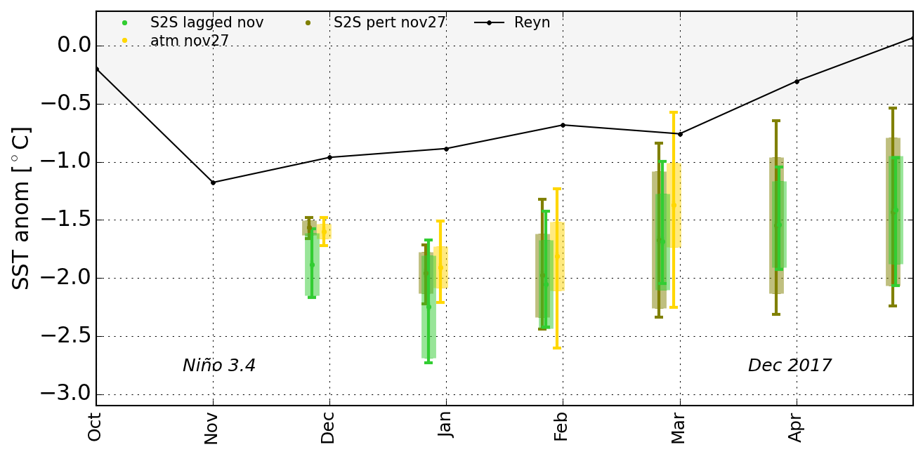
Testing various types and combinations of lag/burst.
current S2S
lag: 4 dates
current S2S
burst: 6 mem
atm burst:
40 mem
11
Notes:
Case study: need big spread to capture large error.
A comparison of various strategies for producing initial ensemble members: impact on ensemble spread shown as box and whisker plots where the whiskers denote the maximum and minimum values and the box has length equal to the standard deviation centered on the ensemble mean. Results are for forecasts initialized during November 2017, with the nominal first month of the forecast being December. Here S2S-2 lagged nov results (green) are for the 4 lagged forecasts (initialized 5 days apart) from our production forecasts, while the lagged results (magenta) are based on 30 members- initialized each day during November.

Slide 12
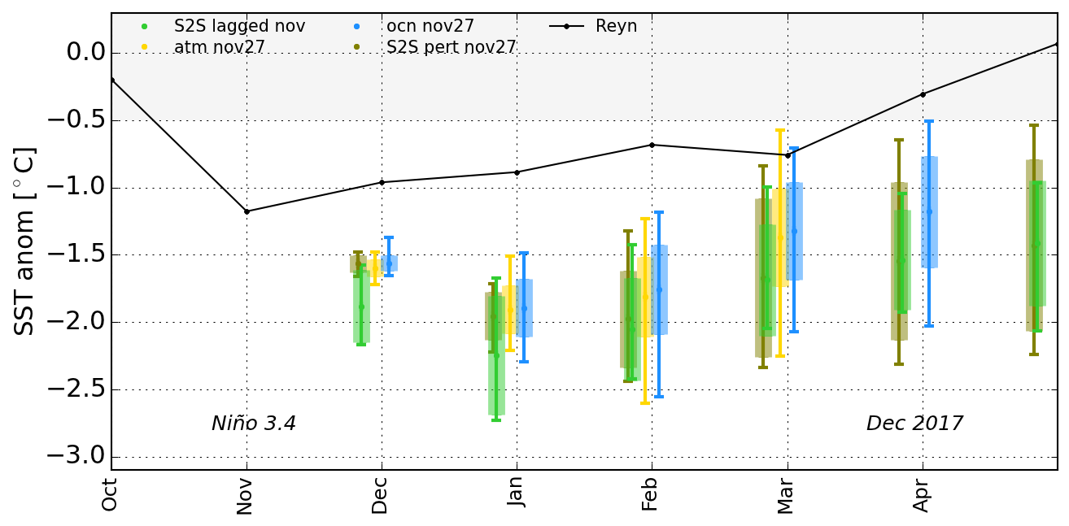
Testing various types and combinations of lag/burst.
current S2S
lag: 4 dates
current S2S
burst: 6 mem
atm burst:
40 mem
ocn burst:
40 mem
12
Notes:
Case study: need big spread to capture large error.
A comparison of various strategies for producing initial ensemble members: impact on ensemble spread shown as box and whisker plots where the whiskers denote the maximum and minimum values and the box has length equal to the standard deviation centered on the ensemble mean. Results are for forecasts initialized during November 2017, with the nominal first month of the forecast being December. Here S2S-2 lagged nov results (green) are for the 4 lagged forecasts (initialized 5 days apart) from our production forecasts, while the lagged results (magenta) are based on 30 members- initialized each day during November.

Slide 13
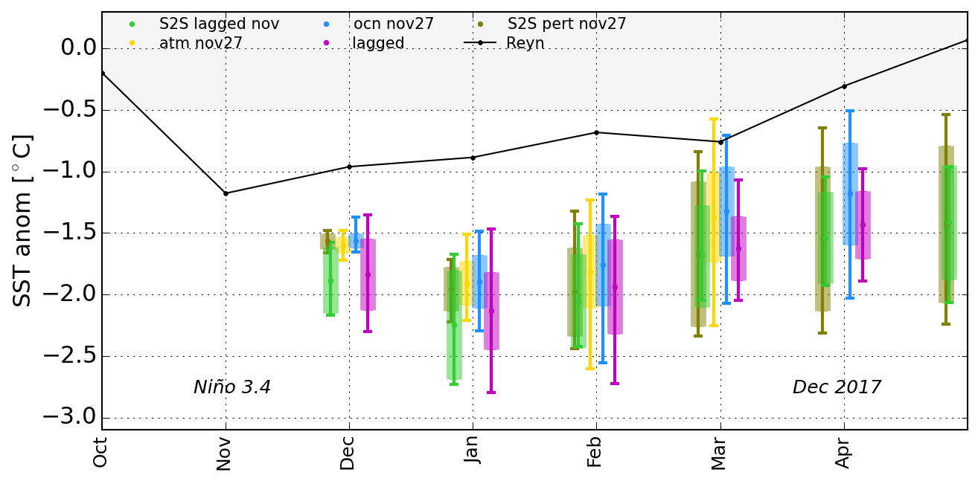
Testing various types and combinations of lag/burst.
current S2S
lag: 4 dates
current S2S
burst: 6 mem
atm burst:
40 mem
ocn burst:
40 mem
lag: 30 dates
mean drift
Lag initialization does help at early leads; burst at the extended range.
13
Notes:
Case study: need big spread to capture large error.
A comparison of various strategies for producing initial ensemble members: impact on ensemble spread shown as box and whisker plots where the whiskers denote the maximum and minimum values and the box has length equal to the standard deviation centered on the ensemble mean. Results are for forecasts initialized during November 2017, with the nominal first month of the forecast being December. Here S2S-2 lagged nov results (green) are for the 4 lagged forecasts (initialized 5 days apart) from our production forecasts, while the lagged results (magenta) are based on 30 members- initialized each day during November.

Slide 14
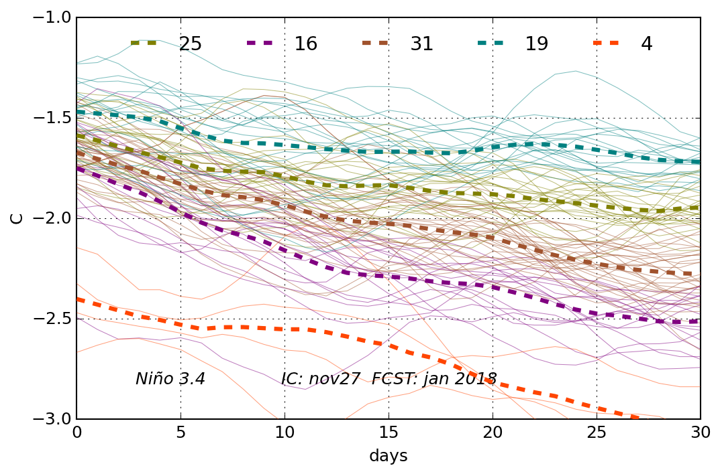
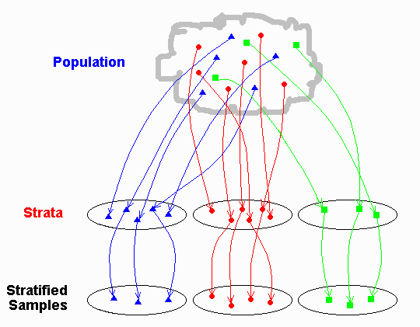
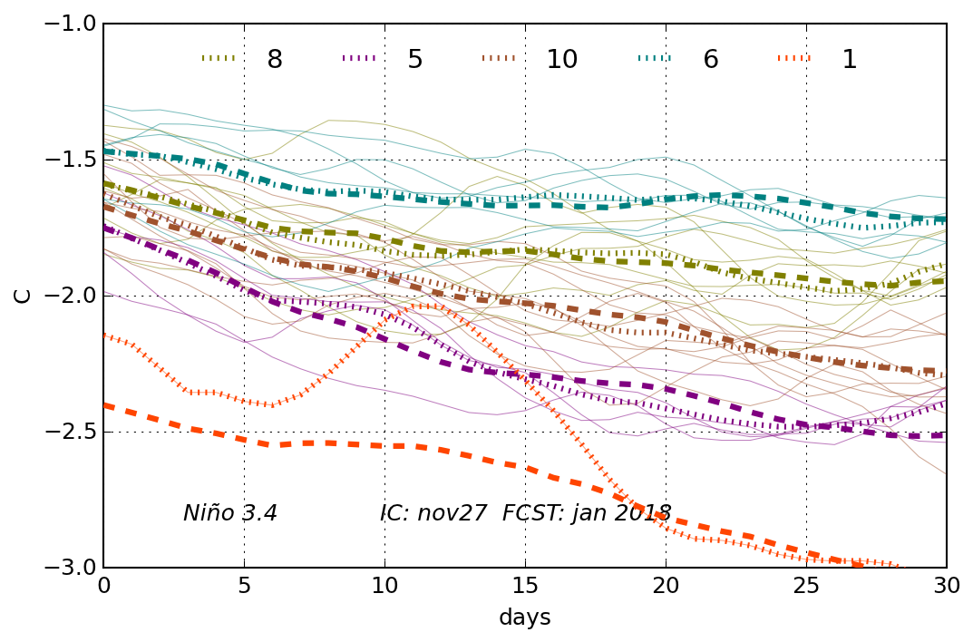
Stratified sampling. KMEANS.
1 mon forecasts
EXAMPLE:
original clusters
and means
extend forecasts with smaller sample
EXAMPLE:
sub-sampled clusters
and means
(dotted lines)
original means (dashed lines)
We take advantage of the information about the early error growth that can be obtained from the relatively large initial ensemble, in a way that ensures the capture of the leading directions (in phase space) of error growth (Schubert et al. 1992).
14
Notes:
Clusters are color coded.

Slide 15
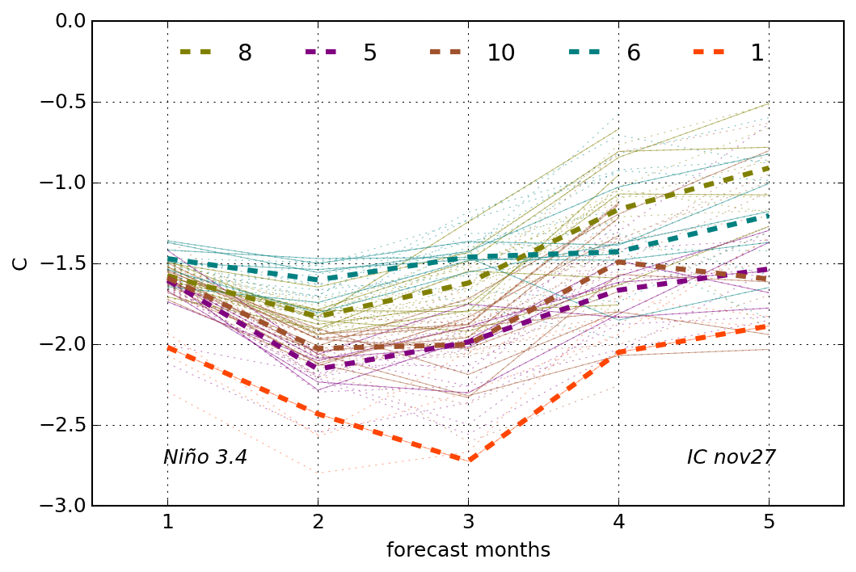
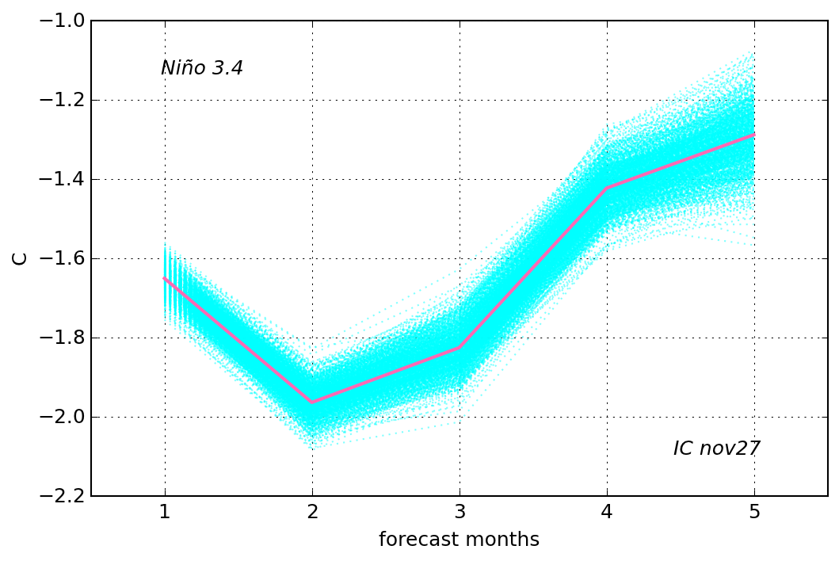
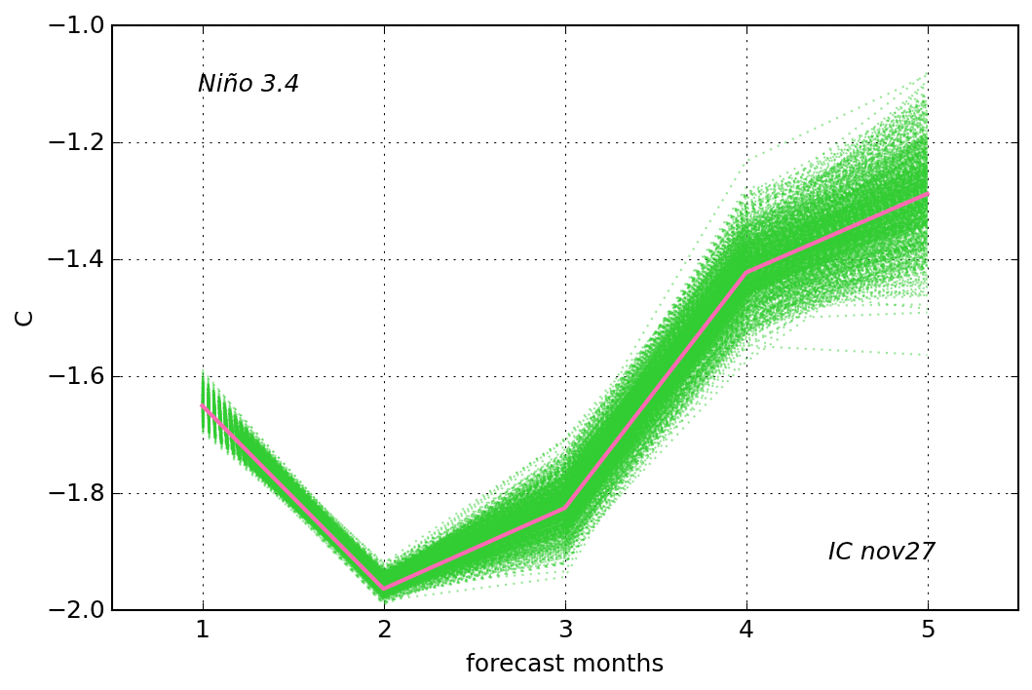
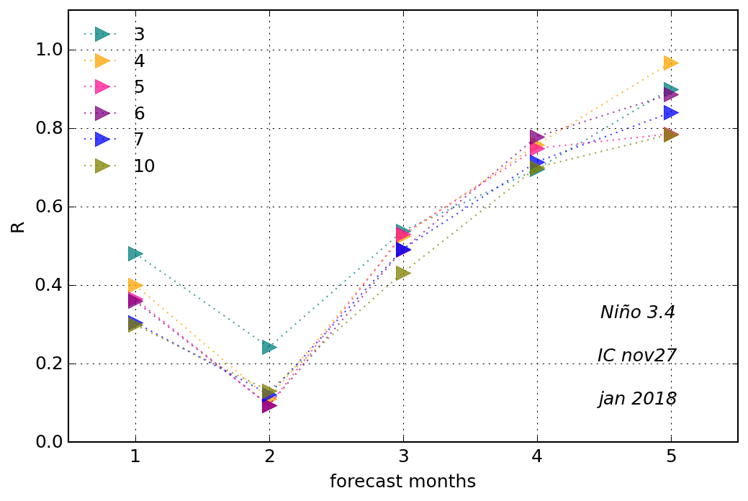
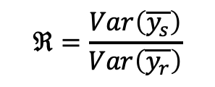
Stratified sampling.
Quantifying the results.
$$ℜ=\frac{Var\left(\overline{y_{s}}\right)}{Var\left(\overline{y_{r}}\right)}$$
Sub-sampling based on the 2nd month of integration
Random sample mean
Stratified sample mean
y_{r}
y_{s}
Performing the stratification very early in the forecasts emphasizes the variance structure of the initial perturbations, and those structures are not well maintained as the forecasts evolve beyond the first month.
By the second month the clusters are more likely to reflect the uncertainties associated with the underlying dynamical evolution of the climate system, which are maintained much longer into the forecast.
15
Notes:
Just keep the 2nd month results

Slide 16
Final ensemble design.
a typical forecast month
1982
MERRA2-OCEAN-S2S-3
future
(analysis)
- unperturbed
- Atm SMT perturbations
Stratified sub-sampling
- Ocn SMT perturbations
Subseasonal forecast
future
(forecast)
This strategy is implemented in GEOS-S2S-3. Production of coupled reanalysis and forecasts starts soon.
Seasonal forecast
Schubert Siegfried, Anna Borovikov, Young-Kwon Lim, and Andrea Molod, 2019. Ensemble Generation Strategies Employed in the GMAO GEOS-S2S Forecast System. NASA Technical Report Series on Global Modeling and Data Assimilation, NASA/TM-2019-104606, Vol. 53, 75 pp.
16
Notes:
For S2S-3 we implemented a strategy for ensemble forecasting that is overall similar to our current approach, in that the strategy employs a combination of time-lagged and burst ensemble members.
A key difference is that, for the burst mode, we introduced perturbations based on a range of different time lags, using a Synchronized Multiple Time-lagged (SMT) approach, which injects uncertainty (at a specified time) into a number of key atmospheric and oceanic modes of variability.
For ensemble size, we start with 40 (30 lag and 10 burst) members, and after 2 months lead time reduce to 10 for 3-9 months forecasts by applying a stratified sampling to the early larger ensemble that accounts for the emerging directions of error growth. This will optimize the use of the computational resources and satisfy timeliness constraints (e.g., for delivery of the forecasts to NMME).
This strategy is in the final testing stage for S2S-3, which will be frozen in early 2020 and released to the public later that year.

Slide 17
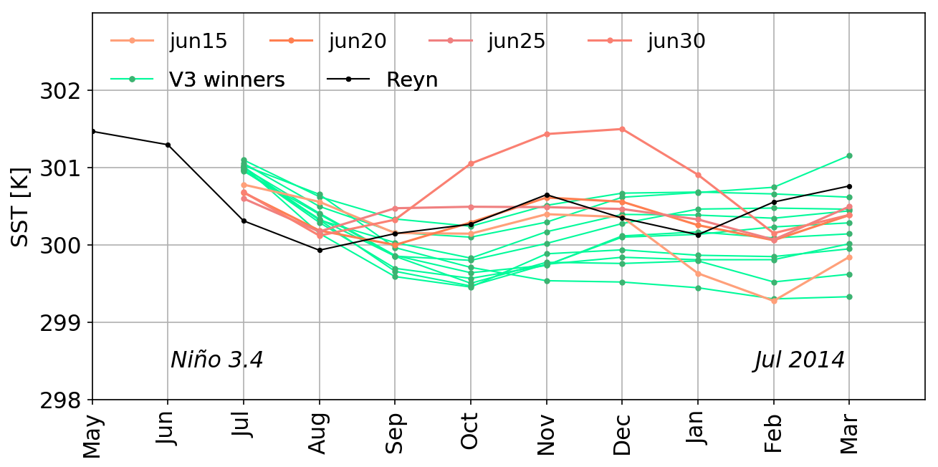
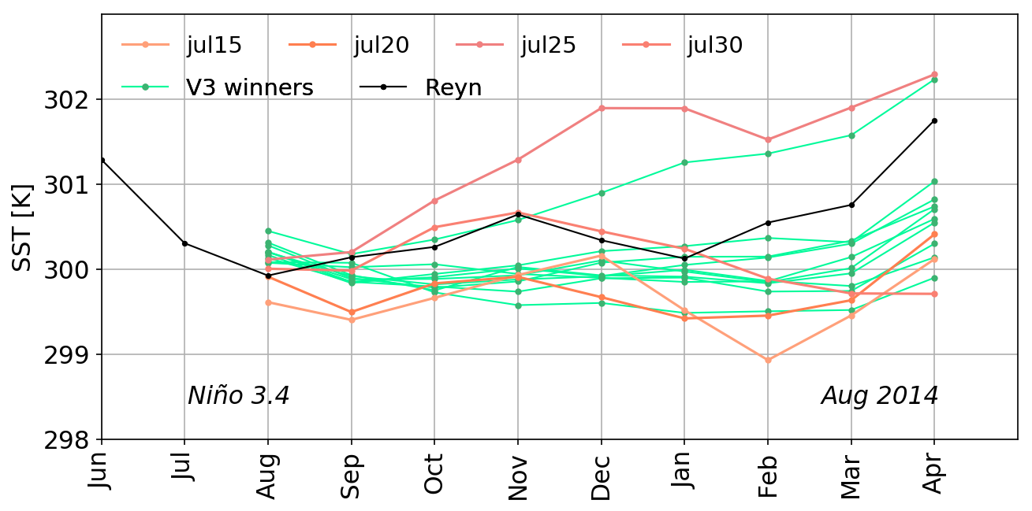
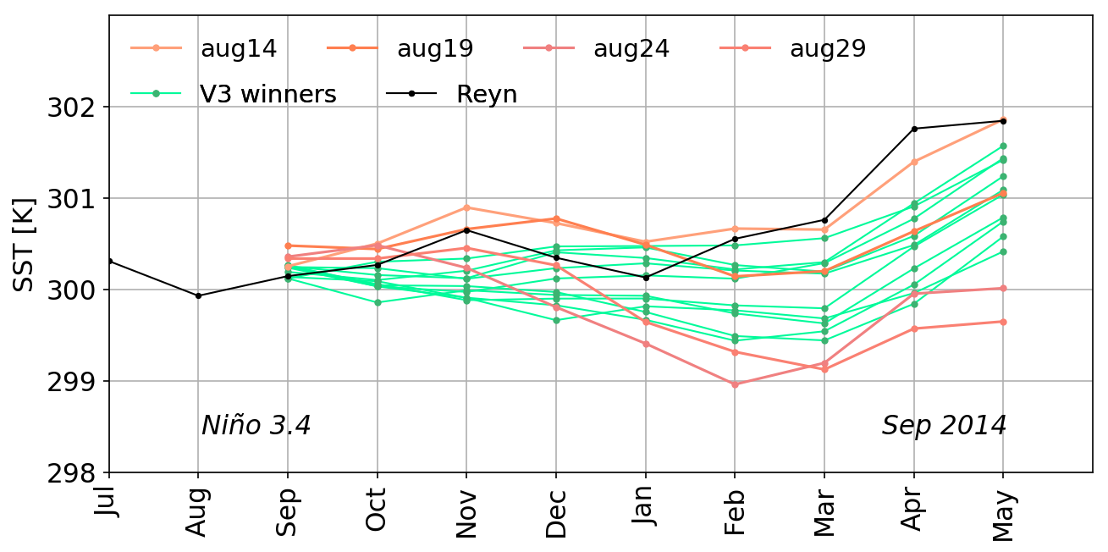
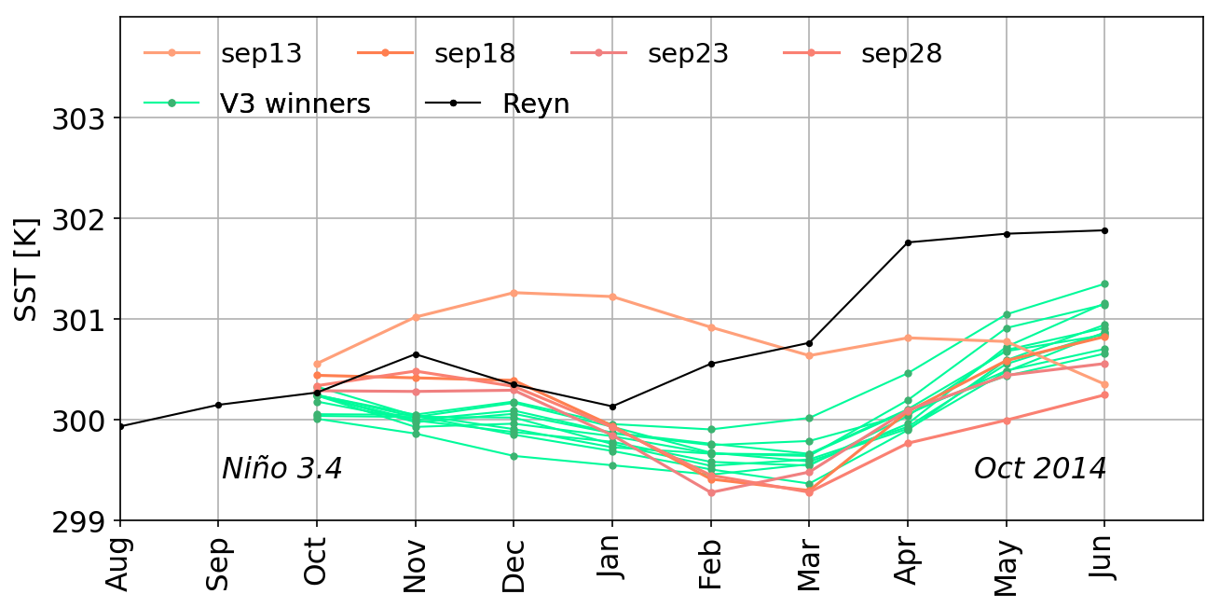
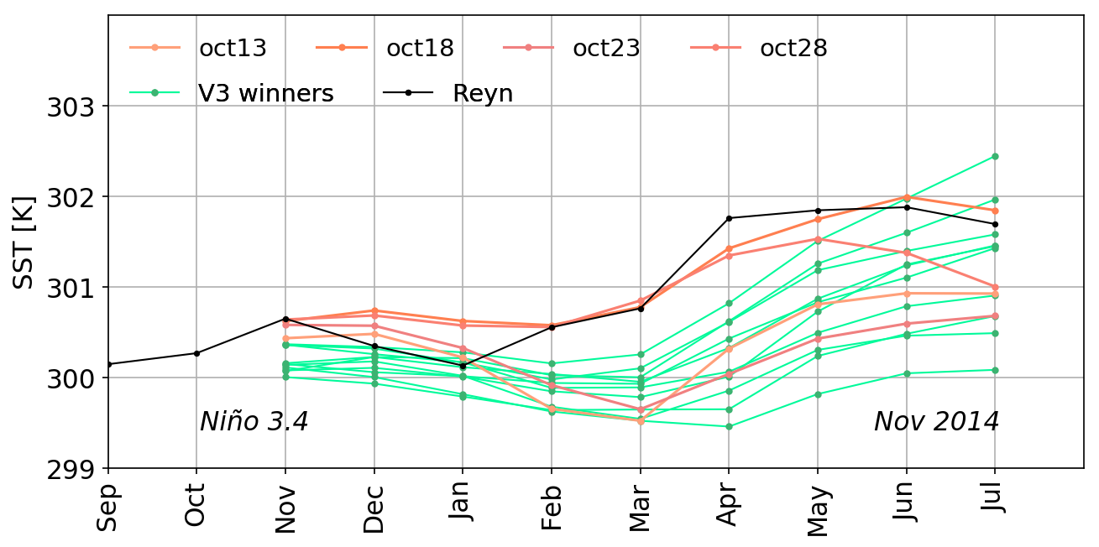
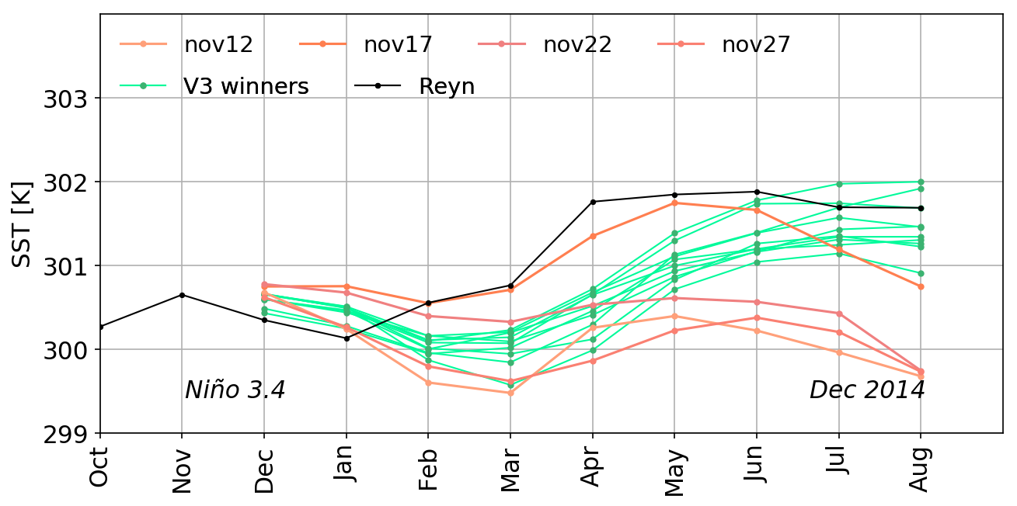
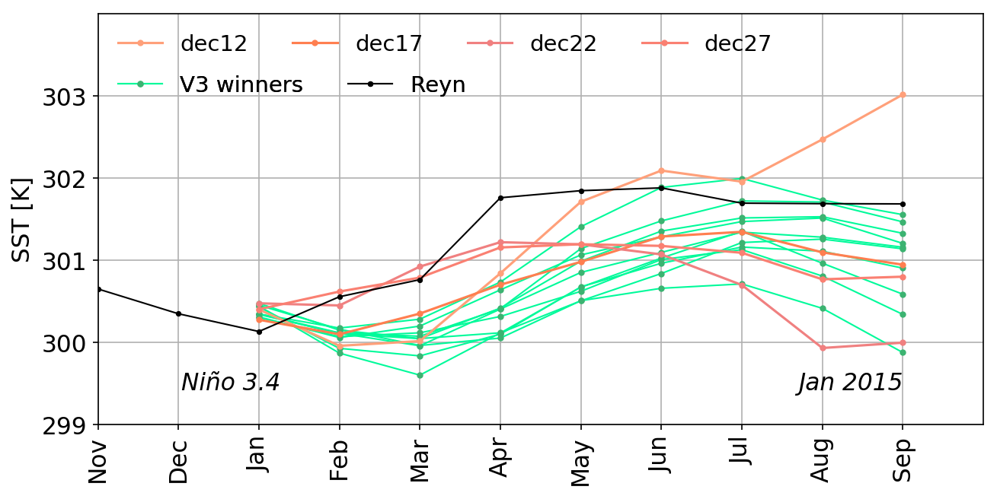
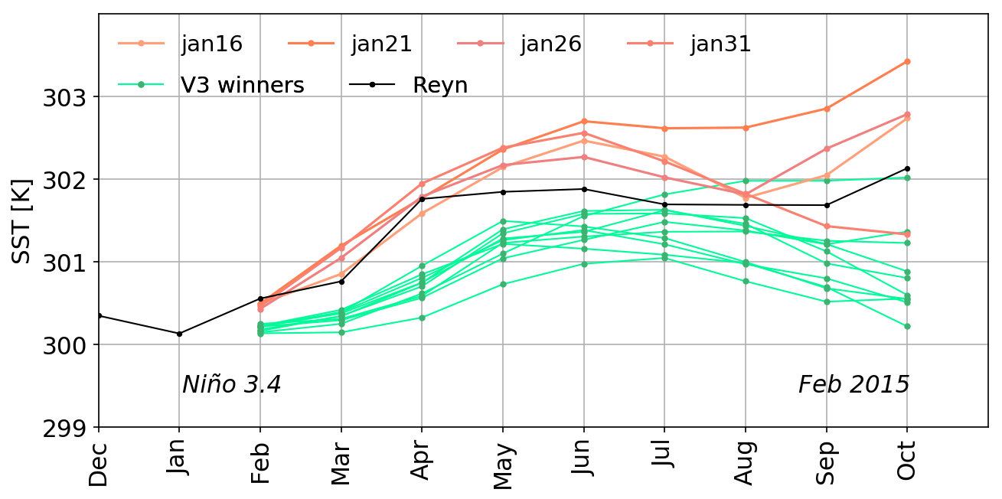
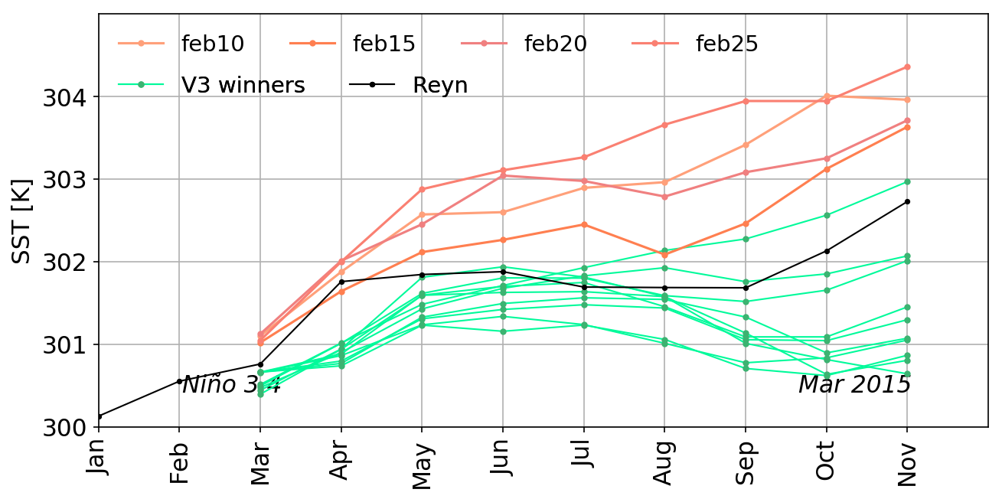
S2S-3 10-member seasonal test forecasts.
Preliminary results with S2S-3 system are encouraging. The Niño 3.4 SST ensemble forecast spread and ensemble mean skill is comparable or better than S2S-2.
Summer 2014 ICs
Autumn 2014 ICs
Winter 2014-15 ICs
17

Slide 18
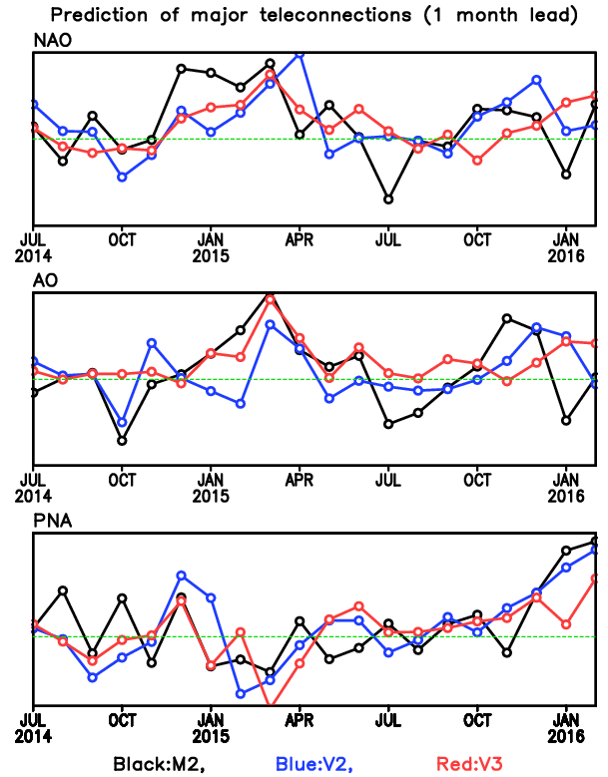
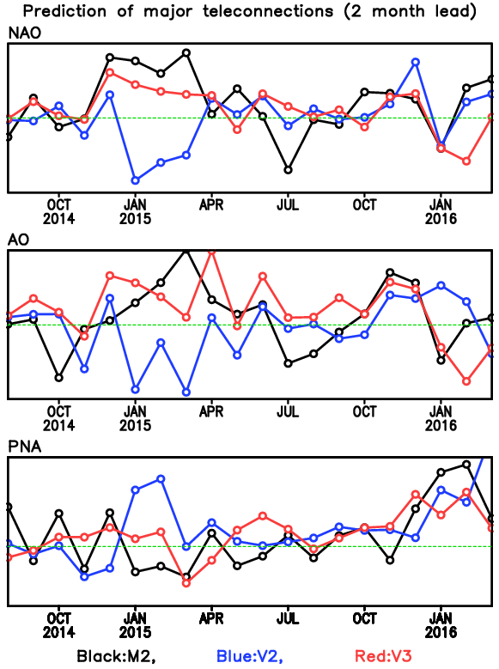
S2S-3 40-member sub-seasonal test forecasts.
Low frequency modes ensemble mean forecasts have higher skill than S2S-2 (4-member ensemble), especially at 2-month lead.
1 month lead
2 months lead
NAO
Corr = 0.36, 0.41
Corr = -0.15, 0.38
AO
Corr = 0.42, 0.46
Corr = -0.24, 0.36
PNA
Corr = 0.63, 0.55
Corr = 0.24, 0.54
Analysis and figures are by Young-Kwon Lim
18

