Slide 1
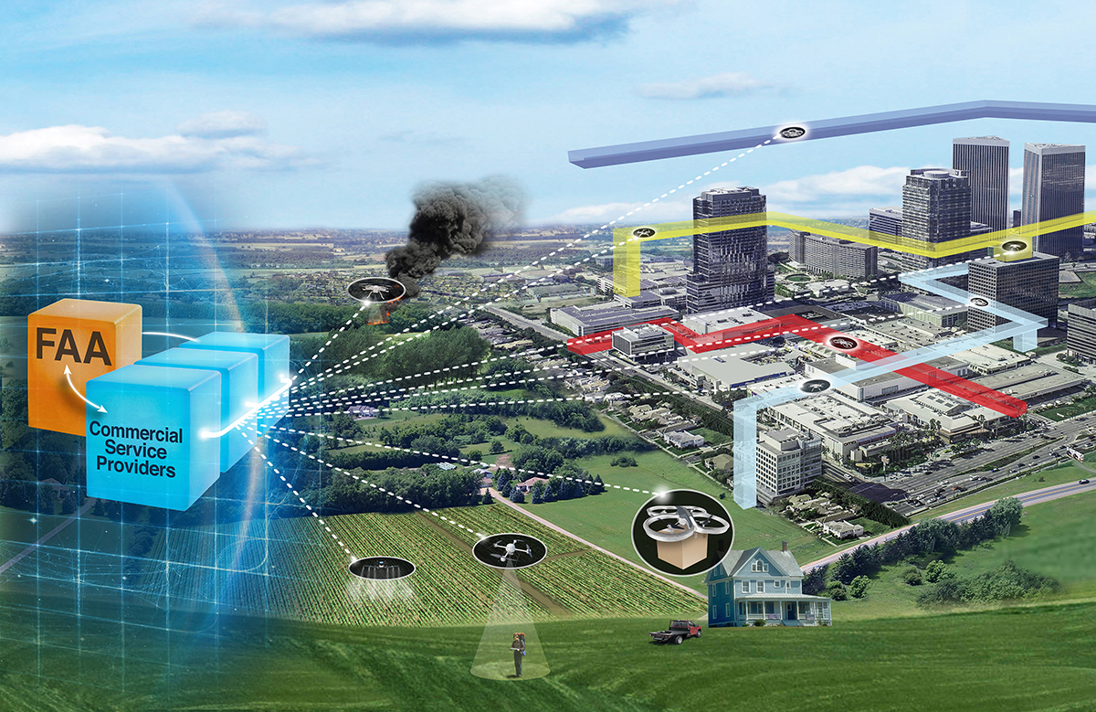


Unmanned Aircraft Systems (UAS) Traffic Management (UTM) Project
System Architecture and Data Transfers
Joseph Rios
NASA UTM Project Chief Engineer
NASA/FAA UTM RTT Data and Architecture WG Coordinator
UTM Technical Interchange Meeting
February 23rd, 2021

Slide 2
Outline
UTM RTT Data Exchange & Information Architecture Subgroup
Federated Airspace Management
System Architecture
Data and Protocols
Publication of Research Findings
Future Evolution
Summary and Impact

Slide 3
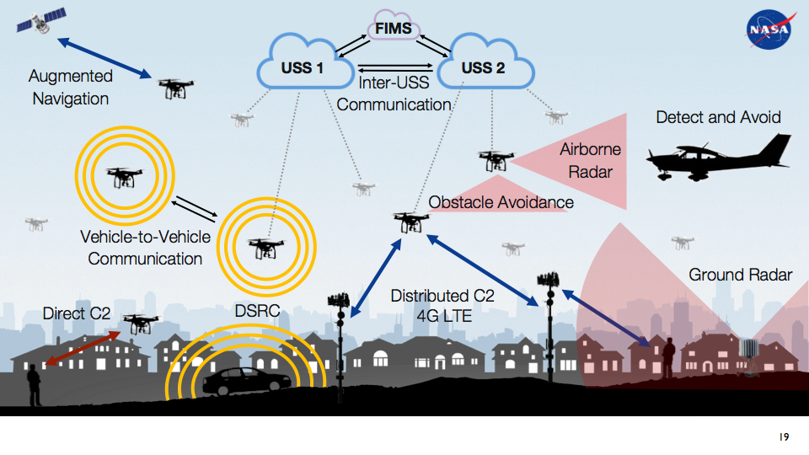

Slide 5

Federated Airspace Management
[F]ederated enterprise architecture is a collective set of architectures with the following attributes:
It operates collaboratively, where governance is divided between a central authority and constituent units, balancing organizational autonomy with enterprise needs.
The central authority's architecture can focus on the dynamics of economies of scale, standards, and the well-being of the enterprise.
Constituent units' architectures have the flexibility to pursue autonomous strategies and independent processes
MITRE Systems Engineering Guide, Architectures Federation
https://www.mitre.org/publications/systems-engineering-guide/enterprise-engineering/engineering-informationintensive-enterprises/architectures-federation

Slide 6
Federated Airspace Management
[F]ederated enterprise architecture is a collective set of architectures with the following attributes:
It operates collaboratively, where governance is divided between a central authority and constituent units, balancing organizational autonomy with enterprise needs.
The central authority's architecture can focus on the dynamics of economies of scale, standards, and the well-being of the enterprise.
Constituent units' architectures have the flexibility to pursue autonomous strategies and independent processes
MITRE Systems Engineering Guide, Architectures Federation
https://www.mitre.org/publications/systems-engineering-guide/enterprise-engineering/engineering-informationintensive-enterprises/architectures-federation

Slide 7
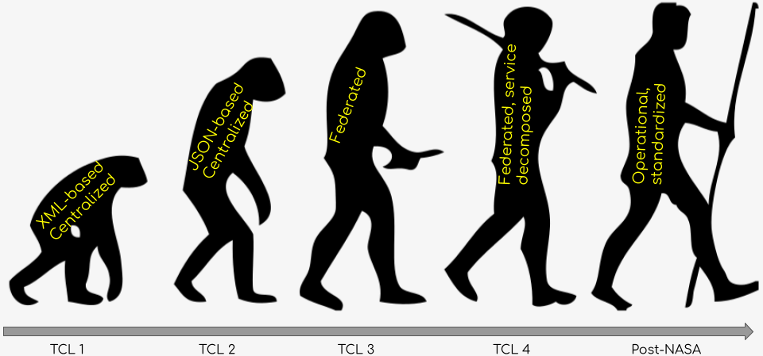
Architectural Evolution

Slide 8
UTM Architecture
UTM
Supplemental Data Service Provider
Supplemental Data Service Provider
Industry Development and Deployment
Supplemental Data Service Provider
FAA Development and Deployment
National Airspace System
Terrain
Weather
Surveillance
Performance
NAS Data Sources
Inter-data provider communication and coordination
UAS Service Supplier
UAS Service Supplier
Flight Information Management System
UAS
Service
Supplier
Public Safety
Public
UAS Operator
UAS Operator
UAS Operator
Color Key:
…
ANSP Function
Discovery
Registration Data/Services
Authentication/Authorization
Operator Function
UAS
UAS
UAS
UAS
UAS
UAS
Other Stakeholders
UAS
UAS
UAS
Notes:
Not a deep dive. See NASA conops for more information.

Slide 9
UTM Architecture
UTM
NASA Specification published
ASTM Specification forthcoming
USSs share data for operations that are under their management. Data include intent, updates, requests, position reports, alerts, and other operational messages
Conceptually designed to be highly automated. In early stages, humans are in the loop for more complex tasks
Supplemental Data Service Provider
Supplemental Data Service Provider
Industry Development and Deployment
Supplemental Data Service Provider
FAA Development and Deployment
National Airspace System
Terrain
Weather
Surveillance
Performance
NAS Data Sources
Inter-data provider communication and coordination
UAS Service Supplier
UAS Service Supplier
UAS Service Supplier
UAS Service Supplier
UAS
Service
Supplier
Flight Information Management System
UAS
Service
Supplier
Public Safety
Public
UAS Operator
UAS Operator
UAS Operator
Color Key:
…
ANSP Function
Discovery
Registration Data/Services
Authentication/Authorization
Operator Function
UAS
UAS
UAS
UAS
UAS
UAS
Other Stakeholders
UAS
UAS
UAS
Notes:
Not a deep dive. See NASA conops for more information.

Slide 10
UTM Architecture
UTM
Exercised in TCLs and UPPs
NASA tech transfer of initial FIMS code to FAA. FAA further developed to integrate with other systems and further concept development
R+D here may help us to understand future requirements for other non-traditional/new entrant operations beyond small UAS
Supplemental Data Service Provider
Supplemental Data Service Provider
Industry Development and Deployment
Supplemental Data Service Provider
FAA Development and Deployment
National Airspace System
Terrain
Weather
Surveillance
Performance
National Airspace System
NAS Data Sources
NAS Data Sources
Inter-data provider communication and coordination
UAS Service Supplier
UAS Service Supplier
Flight Information Management System
UAS
Service
Supplier
Flight Information Management System
Public Safety
Public
UAS Operator
UAS Operator
UAS Operator
Color Key:
…
ANSP Function
Discovery
Registration Data/Services
Authentication/Authorization
Operator Function
UAS
UAS
UAS
UAS
UAS
UAS
Other Stakeholders
UAS
UAS
UAS
Notes:
Not a deep dive. See NASA conops for more information.

Slide 11
UTM Architecture
UTM
USS Discovery process highlighted by NASA as key architectural concern. Posed initial solution in TCL2 timeframe. Industry developed improved solution tested in TCL3 and 4. Input from NASA testing and industry collaboration moved discovery to an open source project driven by ASTM and industry (DSS).
Authentication and authorization paper published by NASA with close FAA discussion. Paper summarizes authorization architecture through TCL4 and somewhat beyond. As part of UPP2, industry engaged to further develop security questions and overall requirements/design.
Supplemental Data Service Provider
Supplemental Data Service Provider
Industry Development and Deployment
Supplemental Data Service Provider
FAA Development and Deployment
National Airspace System
Terrain
Weather
Surveillance
Performance
NAS Data Sources
Inter-data provider communication and coordination
UAS Service Supplier
UAS Service Supplier
Flight Information Management System
UAS
Service
Supplier
Public Safety
Public
UAS Operator
UAS Operator
UAS Operator
Color Key:
…
ANSP Function
Discovery
Registration Data/Services
Authentication/Authorization
Discovery
Registration Data/Services
Authentication/Authorization
Operator Function
UAS
UAS
UAS
UAS
UAS
UAS
Other Stakeholders
UAS
UAS
UAS
Notes:
Not a deep dive. See NASA conops for more information.

Slide 12
UTM Architecture
UTM
Supplemental Data Service Provider
Supplemental Data Service Provider
Supplemental Data Service Provider
Supplemental Data Service Provider
Supplemental Data Service Provider
Industry Development and Deployment
Supplemental Data Service Provider
FAA Development and Deployment
National Airspace System
Terrain
Weather
Surveillance
Performance
NAS Data Sources
Inter-data provider communication and coordination
Many SDSP types have been tested: surveillance, weather, vehicle health, static and dynamic risk assessment, conflict avoidance, communication coverage, and others
Significant opportunity for industry innovation in this aspect of UTM
Certain SDSPs may require regulatory scrutiny and ANSP support depending on safety criticality, adoption rate, or other concerns
NASAs major contribution is the architectural context and the demonstration of proof-of-concept services
UAS Service Supplier
UAS Service Supplier
Flight Information Management System
UAS
Service
Supplier
Public Safety
Public
UAS Operator
UAS Operator
UAS Operator
Color Key:
…
ANSP Function
Discovery
Registration Data/Services
Authentication/Authorization
Operator Function
UAS
UAS
UAS
UAS
UAS
UAS
Other Stakeholders
UAS
UAS
UAS
Notes:
Not a deep dive. See NASA conops for more information.

Slide 13
UTM Architecture
UTM
Every TCL has touched on public safety, and the UPP activities continue to develop it
Engagement with government agencies from the local through the national level is vital to maturing this part of the architecture
Supplemental Data Service Provider
Supplemental Data Service Provider
Industry Development and Deployment
Supplemental Data Service Provider
FAA Development and Deployment
National Airspace System
Terrain
Weather
Surveillance
Performance
NAS Data Sources
Inter-data provider communication and coordination
UAS Service Supplier
UAS Service Supplier
Flight Information Management System
UAS
Service
Supplier
Public Safety
Public Safety
Public
Public
UAS Operator
UAS Operator
UAS Operator
Color Key:
…
ANSP Function
Discovery
Registration Data/Services
Authentication/Authorization
Operator Function
UAS
UAS
UAS
UAS
UAS
UAS
Other Stakeholders
UAS
UAS
UAS
Notes:
Not a deep dive. See NASA conops for more information.

Slide 14
UTM Architecture
UTM
Supplemental Data Service Provider
Supplemental Data Service Provider
Industry Development and Deployment
Supplemental Data Service Provider
FAA Development and Deployment
National Airspace System
Terrain
Weather
Surveillance
Performance
NAS Data Sources
Inter-data provider communication and coordination
UAS Service Supplier
UAS Service Supplier
Flight Information Management System
UAS
Service
Supplier
Public Safety
Public
UAS Operator
UAS Operator
UAS Operator
Color Key:
…
ANSP Function
Discovery
Registration Data/Services
Authentication/Authorization
Operator Function
UAS
UAS
UAS
UAS
UAS
UAS
Other Stakeholders
UAS
UAS
UAS
Notes:
Not a deep dive. See NASA conops for more information.

Slide 15







Data and Protocols
1. Operator plans mission
2. Operator submits plan to its supporting USS
My USS
3. USS checks plan against other entities in airspace
FIMS
4. USS writes appropriate op data to DSS, discovering other USSs
5. USS notifies operator of plan submission success
USS A
6. USS sends appropriate op data to other USSs as required
USS B
7. FIMS used throughout USS-USS and USS-DSS comms for auth services
Operator
DSS

Slide 16
Data and Protocols
1. Operator plans mission
2. Operator submits plan to its supporting USS
My USS
3. USS checks plan against other entities in airspace
FIMS
4. USS writes appropriate op data to DSS, discovering other USSs
5. USS notifies operator of plan submission success
USS A
6. USS sends appropriate op data to other USSs as required
USS B
7. FIMS used throughout USS-USS and USS-DSS comms for auth services
Operator
DSS

Slide 17
Data and Protocols
1. Operator plans mission
2. Operator submits plan to its supporting USS
My USS
3. USS checks plan against other entities in airspace
FIMS
4. USS writes appropriate op data to DSS, discovering other USSs
5. USS notifies operator of plan submission success
USS A
6. USS sends appropriate op data to other USSs as required
USS B
7. FIMS used throughout USS-USS and USS-DSS comms for auth services
Operator
DSS

Slide 18
Data and Protocols
1. Operator plans mission
2. Operator submits plan to its supporting USS
My USS
3. USS checks plan against other entities in airspace
FIMS
4. USS writes appropriate op data to DSS, discovering other USSs
5. USS notifies operator of plan submission success
USS A
6. USS sends appropriate op data to other USSs as required
USS B
7. FIMS used throughout USS-USS and USS-DSS comms for auth services
Operator
DSS

Slide 19
Data and Protocols
1. Operator plans mission
2. Operator submits plan to its supporting USS
My USS
3. USS checks plan against other entities in airspace
FIMS
4. USS writes appropriate op data to DSS, discovering other USSs
5. USS notifies operator of plan submission success
USS A
6. USS sends appropriate op data to other USSs as required
USS B
7. FIMS used throughout USS-USS and USS-DSS comms for auth services
Operator
DSS

Slide 20
Data and Protocols
1. Operator plans mission
2. Operator submits plan to its supporting USS
My USS
3. USS checks plan against other entities in airspace
FIMS
4. USS writes appropriate op data to DSS, discovering other USSs
5. USS notifies operator of plan submission success
USS A
6. USS sends appropriate op data to other USSs as required
USS B
7. FIMS used throughout USS-USS and USS-DSS comms for auth services
Operator
DSS

Slide 21
Data and Protocols
1. Operator plans mission
2. Operator submits plan to its supporting USS
My USS
3. USS checks plan against other entities in airspace
FIMS
4. USS writes appropriate op data to DSS, discovering other USSs
5. USS notifies operator of plan submission success
USS A
6. USS sends appropriate op data to other USSs as required
USS B
7. FIMS used throughout USS-USS and USS-DSS comms for auth services
Operator
DSS

Slide 22
Data and Protocols
1. Operator plans mission
2. Operator submits plan to its supporting USS
My USS
3. USS checks plan against other entities in airspace
FIMS
4. USS writes appropriate op data to DSS, discovering other USSs
5. USS notifies operator of plan submission success
USS A
6. USS sends appropriate op data to other USSs as required
USS B
7. FIMS used throughout USS-USS and USS-DSS comms for auth services
Operator
DSS

Slide 23
Data and Protocols
1. Operator plans mission
2. Operator submits plan to its supporting USS
My USS
3. USS checks plan against other entities in airspace
FIMS
4. USS writes appropriate op data to DSS, discovering other USSs
5. USS notifies operator of plan submission success
USS A
6. USS sends appropriate op data to other USSs as required
USS B
7. FIMS used throughout USS-USS and USS-DSS comms for auth services
Operator
DSS

Slide 24
Data and Protocols
Upon commencing operation, the operator would share state data with its USS. Certain changes in the airspace or other operations are pushed to the operator from its supporting USS. Off-nominal conditions are pushed to the USS Network. DSS facilitates USS communications and synchronizing data.
All of these interactions can be summarized into groups of required and optional services of a USS. Defining those services is an effort that has been handed off to the FAA and industry for UTM.
My USS
FIMS
USS A
USS B
Operator
DSS

Slide 25







Data and Protocols Documentation
Search GitHub for “utm-apis” to see the NASA APIs for UTM TCL activities
Search GitHub for “astm-utm” to see current ASTM drafts
See the following NASA Technical Memos for the first USS Specification and UTM Authentication and Authorization approach as well as the NASA briefing on strategic deconfliction. These docs are major input and starting points for much of the FAA and standardization work currently on-going:
UAS Service Supplier Specification
Rios, Joseph L., Irene Smith, NASA Ames Research Center, Priya Venkatesen, SGT Inc., Jeffrey R. Homola, Marcus A. Johnson, Jaewoo Jung, NASA Ames Research Center. NASA/TM-2019-220376, October 2019.
UAS Service Supplier Framework for Authentication and Authorization
Rios, Joseph L., Irene Smith, NASA Ames Research Center, Priya Venkatesen, SGT Inc. NASA/TM-2019-220364, September 2019.
NASA UTM Strategic Deconfliction Final Report
NASA Ames Research Center, July 31, 2018.
My USS
FIMS
USS A
USS B
Operator
DSS

Slide 26
Other Publications
UTM-A Complementary Set of Services to ATM
Raju, Praveen, Federal Aviation Administration; Joseph Rios, NASA Ames Research Center; Addam Jordan, LS Technologies. ICNS 2018, April 10-12, 2018, Herndon, VA.
Provides an FAA perspective on the UTM service architecture.
UAS Service Network Performance: Results and Analysis from Flight Testing Multiple USS Providers in NASA's TCL4 Demonstration
Rios, Joseph L., Irene Smith, Daniel Mulfinger, Brandon Cook, NASA Ames Research Center; Priya Venkatesan, Vijay Baskaran, Madhavrao Lakshiminarasimha, Abraham Ishihara, Daniel Liddell, Qiang Li, SGT, Inc.; Punma Verma, Universities Space Research Association; David Smith, Sherry Jurcak, Logyx LLC; Hemil Modi, Science and Technology Corp. NASA/TM-2020-220462, January 2020.
Strategic Deconfliction Performance: Results and Analysis from the NASA UTM Technical Capability Level 4 Demonstration
Rios, Joseph, Jeffrey Homola, NASA Ames Research Center, Nicholas Craven, Millennium Engineering and Integration Company, Punam Verma, Universities Space Research Association, Vijay Baskaran, SGT, Inc. NASA/TM-2020-5006337, August, 2020.
Two papers describing measures of performance for the USS Network within TCL4, helping to inform future USS requirements
UTM UAS Service Supplier Development - Sprint 2 Toward Technical Capability Level 4
NASA/TM-2018-220050, NASA Ames Research Center, December 2018.
UTM UAS Service Supplier Development - Sprint 1 Toward Technical Capability Level 4
NASA/TM-2018-220024, NASA Ames Research Center, November 2018.
Two papers describing the build-up to TCL4 and outlining a process that may be applicable to future operationalization of USSs.

Slide 27
Future Evolution
Standardization
xTM: eXtensible Traffic Management
Advanced Air Mobility and Urban Air Mobility
The work in NASA UTM laid out initial research questions and a framework for evaluating the architecture. With that work transitioned to industry and the FAA, there is a great deal of effort on standardizing components and protocols that meet both civilian and government/public safety needs.
NASA UTM uncovered a previously undiscovered approach to managing airspace in a collaborative manner amongst stakeholders, complementing the conventional Air Traffic Services provided by the FAA. This approach is being generalized by NASA and the FAA to extract the common features that are applicable to several current and future aviation domains.
The principles of collaborative airspace management and increased automation are critical enabling future mobility concepts.
High-Altitude Traffic Management
Operations over 60,000ft typically do not receive air navigation services and they can span international boundaries. Also, vehicle performance operating in these altitudes varies greatly, from balloons to hypersonic aircraft. Allowing operators more agency in the management of the airspace with their fellow operators can expand operational opportunities in that environment.
Conventional Aviation
Concepts related to the provisioning of services and increasing automation may be applicable to the conventional operators in the National Airspace System potentially allowing for safer, lower-cost operations.

Slide 28
Summary and Impact
The NASA UTM Project along with its partners in the FAA an industry defined a novel, feasible, federated, stakeholder-driven approach to managing the airspace.
The concept of federated airspace management allows for operators to take a key role in the management of the airspace in which they fly.
In a short time, NASA research has spawned numerous international standardization efforts, a new industry for service suppliers, and a path for safe, efficient, scalable, and fair management of the airspace.
The architecture is recognized as a key enabler to other new aviation entrants like air taxis and high-altitude operations.

