Slide 1
From Engineering to Aerospace Medicine
Rob Mulcahy, MD, MPH
Rice ’08 / ChBE
1

Slide 2
Who Am I?
Rice University – Class of 2008
  Chemical & Biomolecular Engineering
  Hanszen College
University of Texas Medical Branch (UTMB)
  Medical School – Class of 2012
  Aerospace Medicine/Internal Medicine Residency – Class of 2016
NASA Johnson Space Center
  Flight Surgeon

Slide 3
Why Did I Decide on Medicine?
Enjoyed engineering in school
During summer internship, realized that I didn’t enjoy engineering in practice
Always fascinated by medicine
  Mom was a nurse
  Roommates were pre-med
But medical training is a long road
Decided that the extra time spent in training was a solid investment if I enjoyed the job for the rest of my life

Slide 4
Careers in Medicine for Engineers
Positives that made it a better choice than engineering for me
  Care for others
  Social interaction
  Engineering problem-solving skills are very useful
  Medical school is easy compared to engineering problem sets!
Negatives
  Human body is not as predictable as inorganic things
  Long training pathway (your engineering classmates will be earning money while you’re taking loans)
  Work hours may be longer than typical engineering jobs

Slide 5
How is Aerospace Medicine Different?
Engineering knowledge and communication skills can be very helpful
Less clinical care
Strong focus on prevention
Job certification exams & occupational medicine
Operational medical support
Non-clinical activities
  Astronaut selection
  Centrifuge training
  Health Stabilization Program (pre-launch quarantine)
  Medical requirements for new space vehicle design (e.g. Artemis missions to the moon)
  Mission Control
  Neutral Buoyance Laboratory (NBL)
  T-38

Slide 6
NASA Flight Surgeon Duties

Slide 7
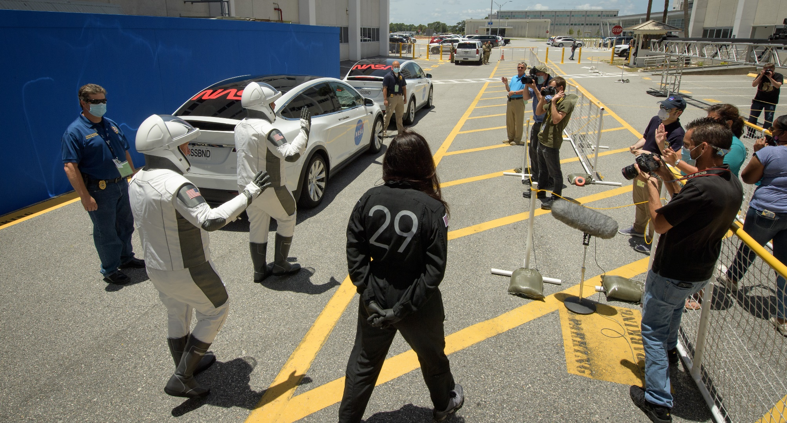
Launch at Kennedy Space Center
SpaceX Demo-2

Slide 8
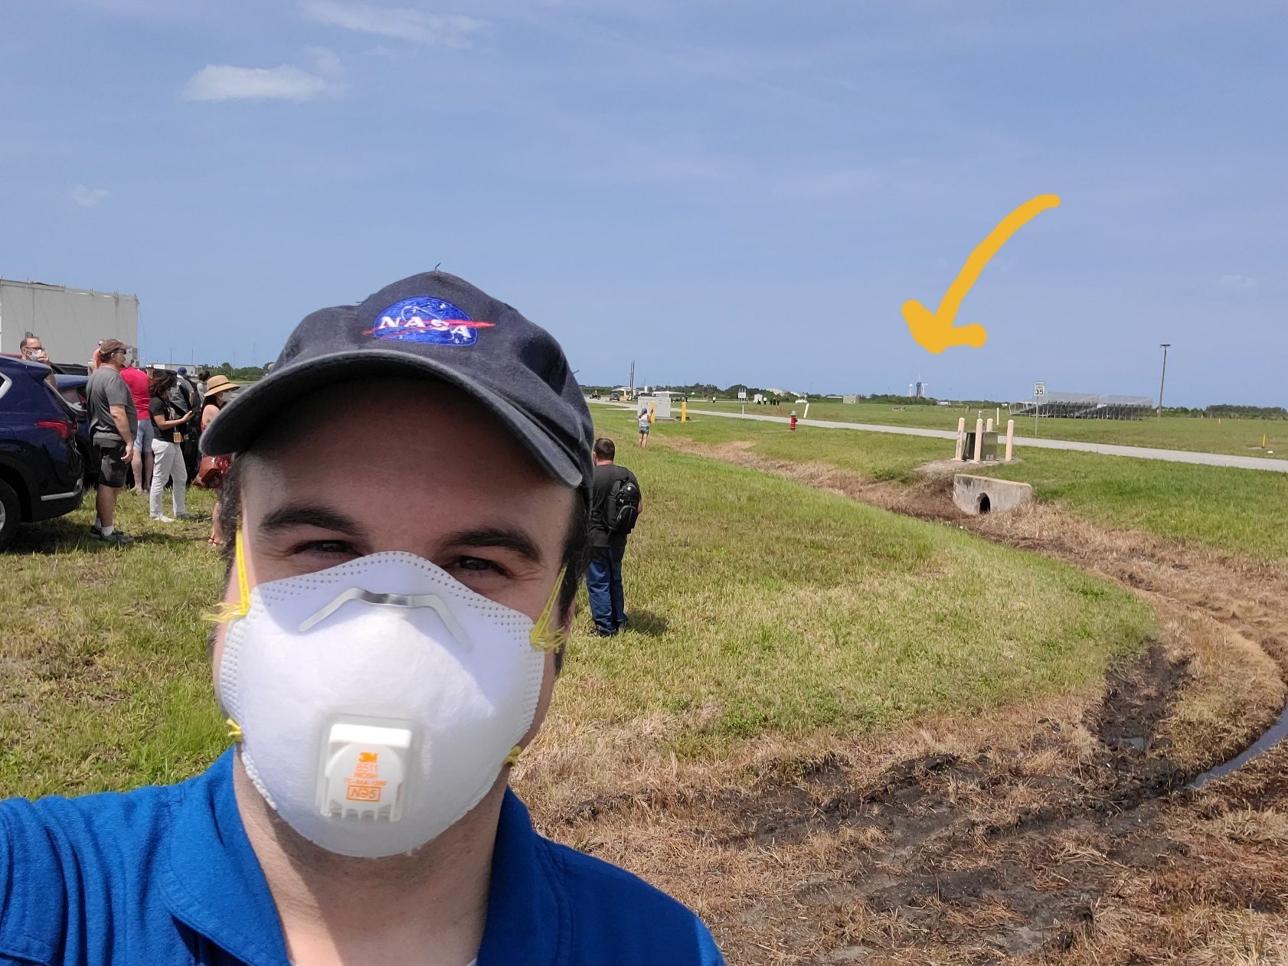
Launch at Kennedy Space Center
SpaceX Demo-2

Slide 9
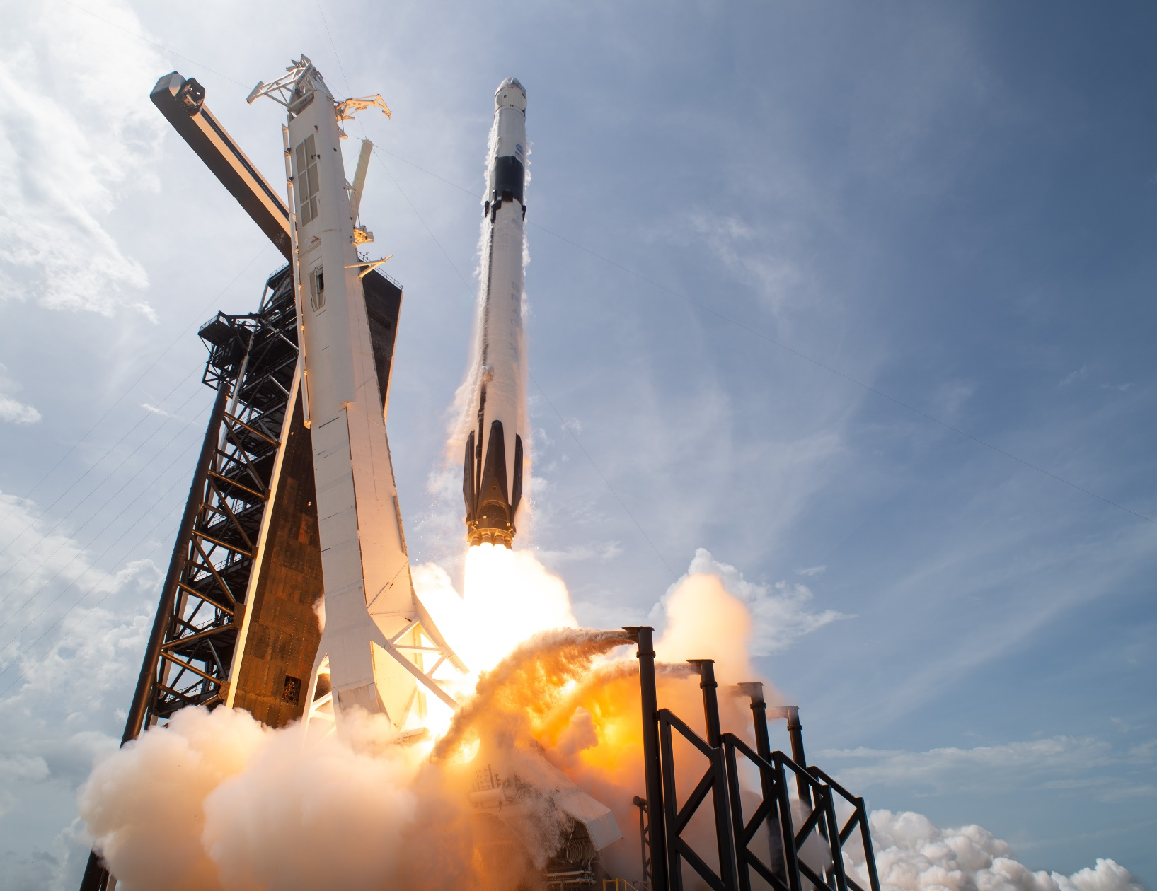
Launch at Kennedy Space Center
SpaceX Demo-2

Slide 10
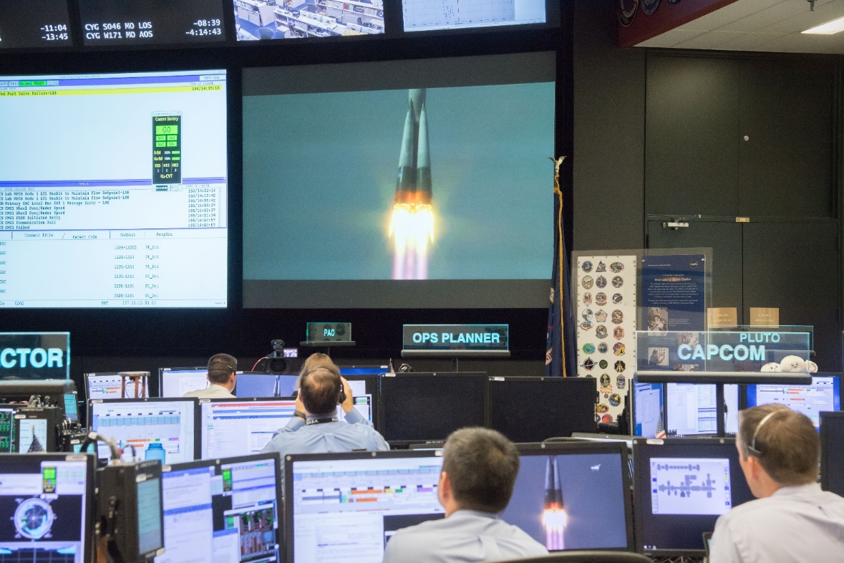
Mission Control
Soyuz 55S Launch

Slide 11
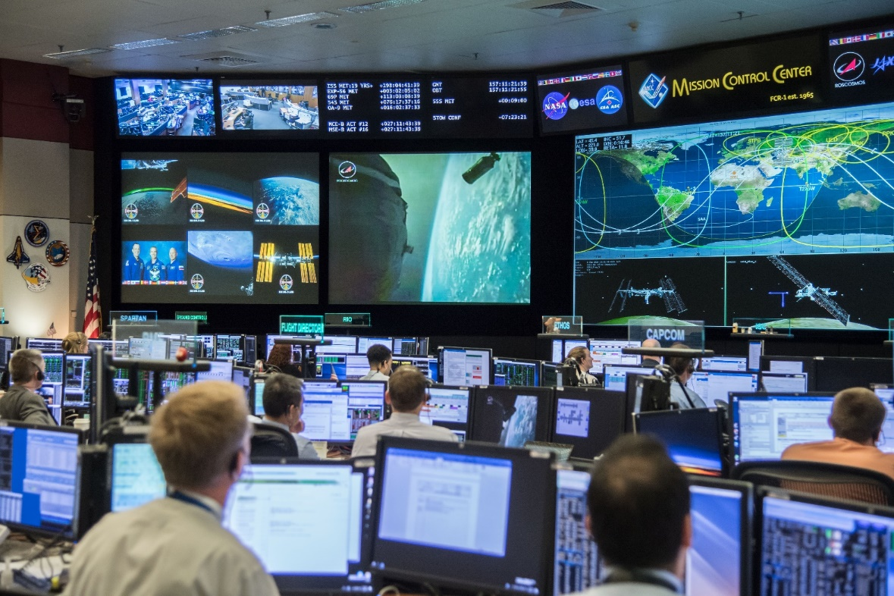
Mission Control
Soyuz 55S Launch

Slide 12
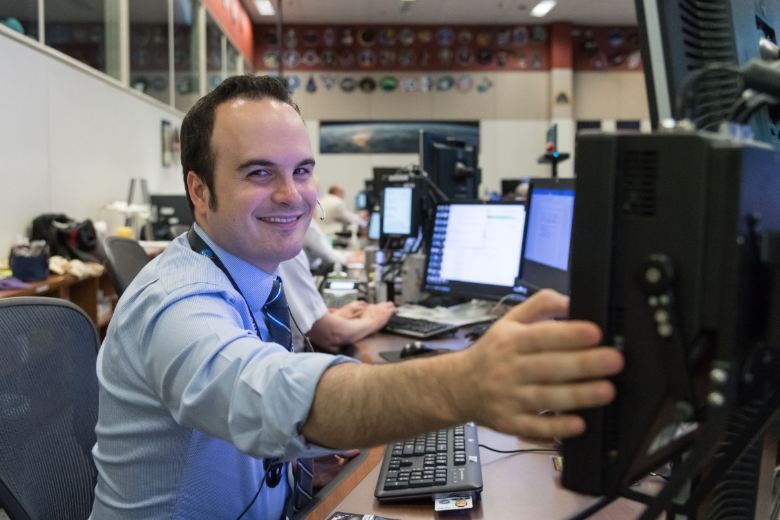
Mission Control

Slide 13
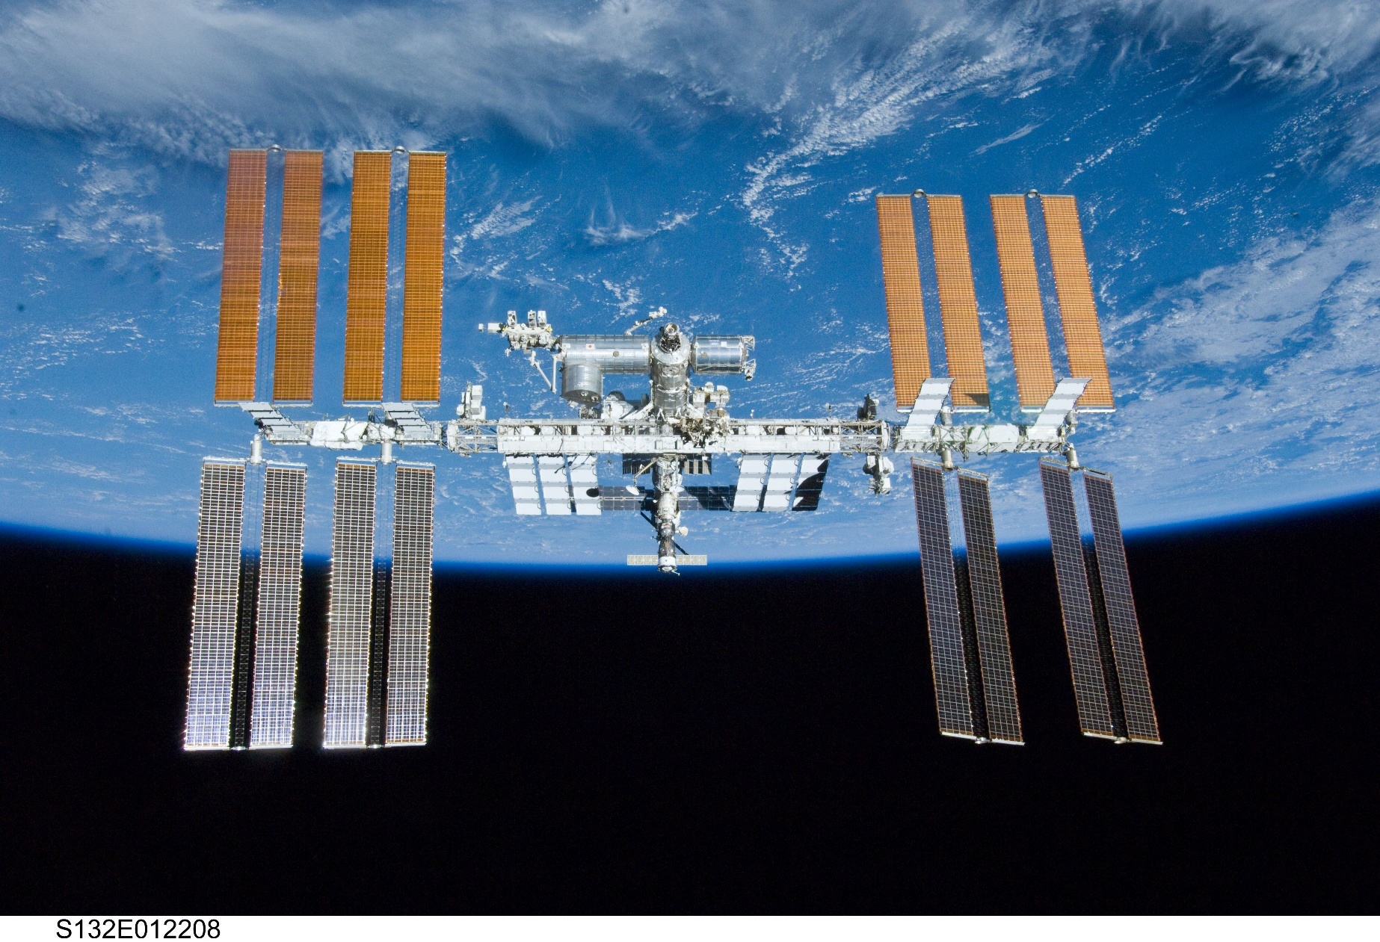
International Space Station

Slide 14
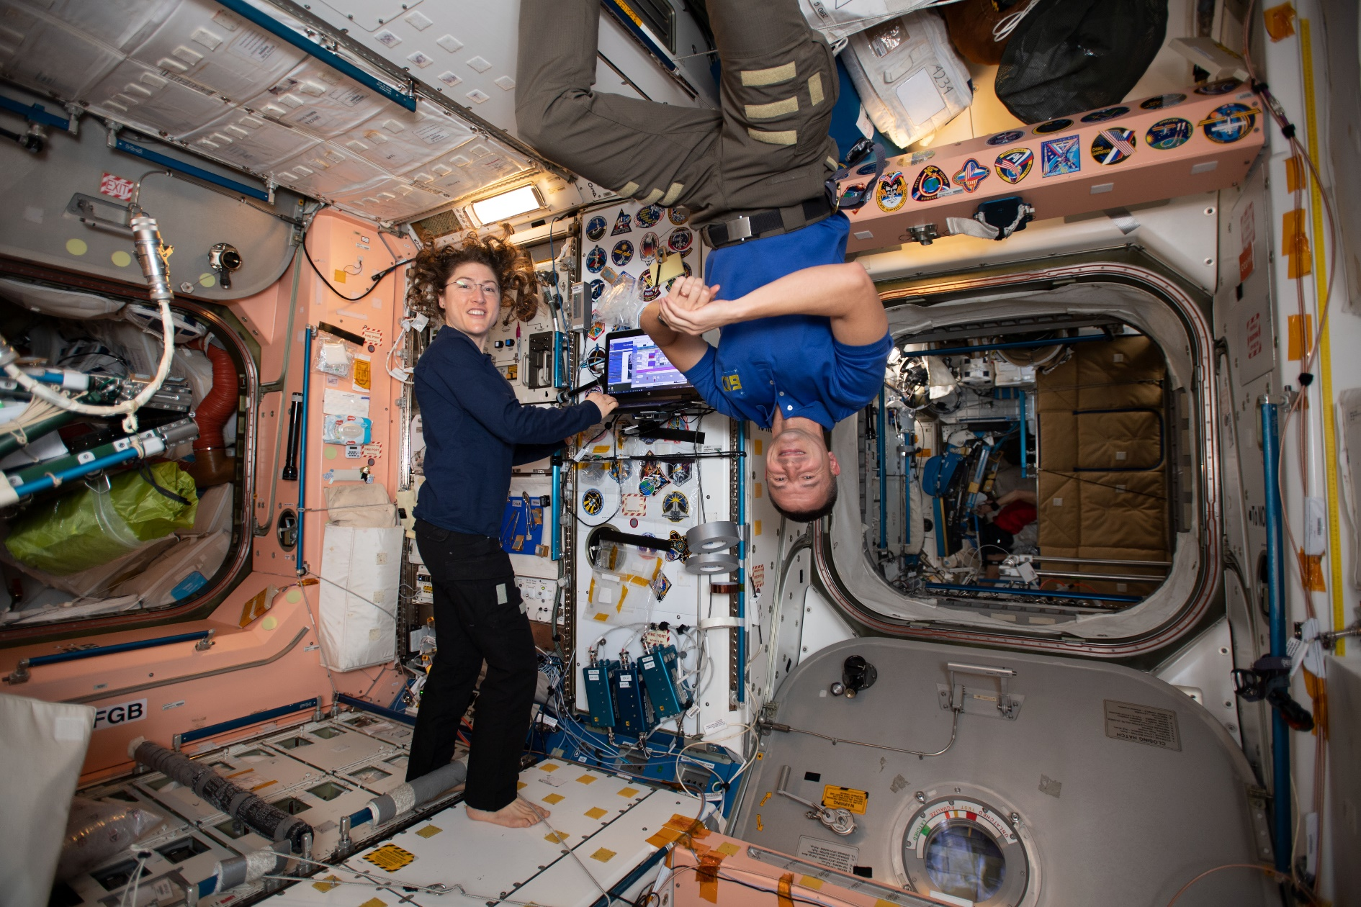
International Space Station
Christina Koch & Drew Morgan

Slide 15
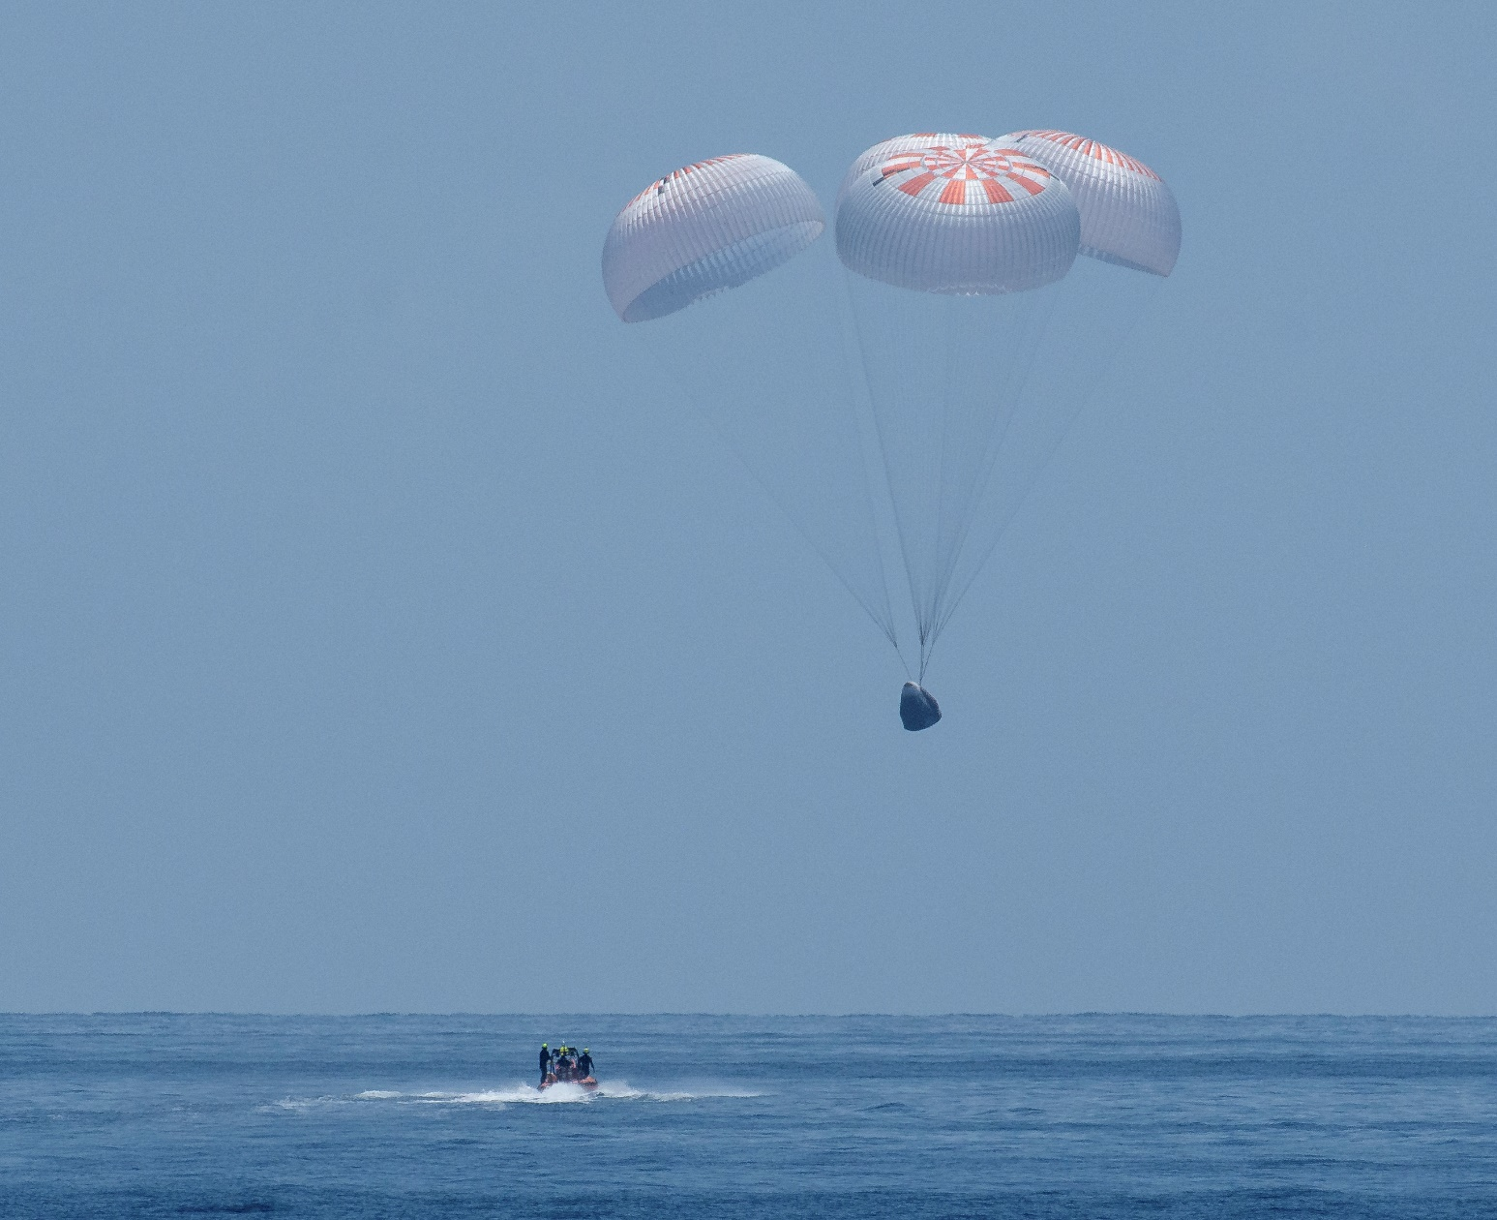
Landing in United States
SpaceX Demo-2

Slide 16
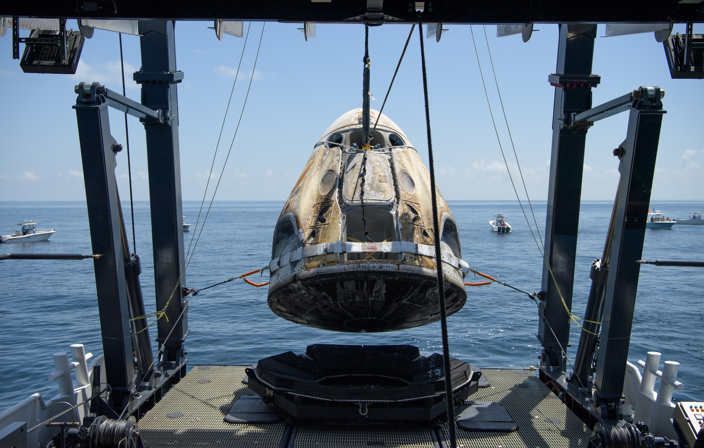
Landing in United States
SpaceX Demo-2

Slide 17
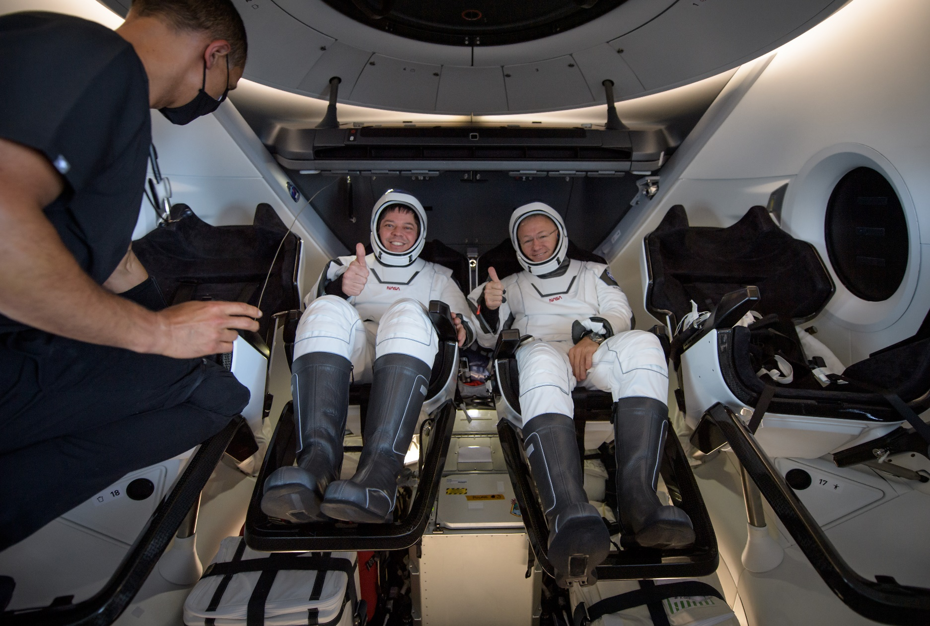
Landing in United States
SpaceX Demo-2

Slide 18
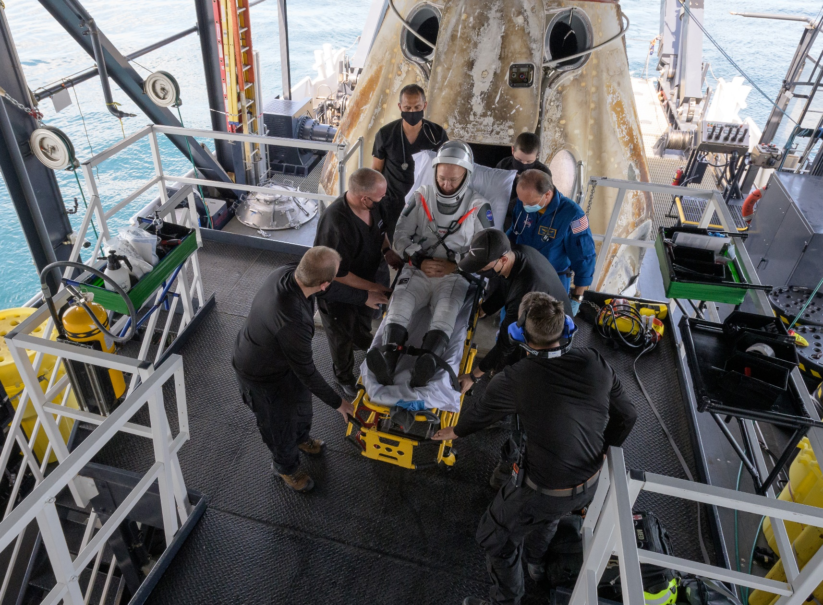
Landing in United States
SpaceX Demo-2

Slide 19
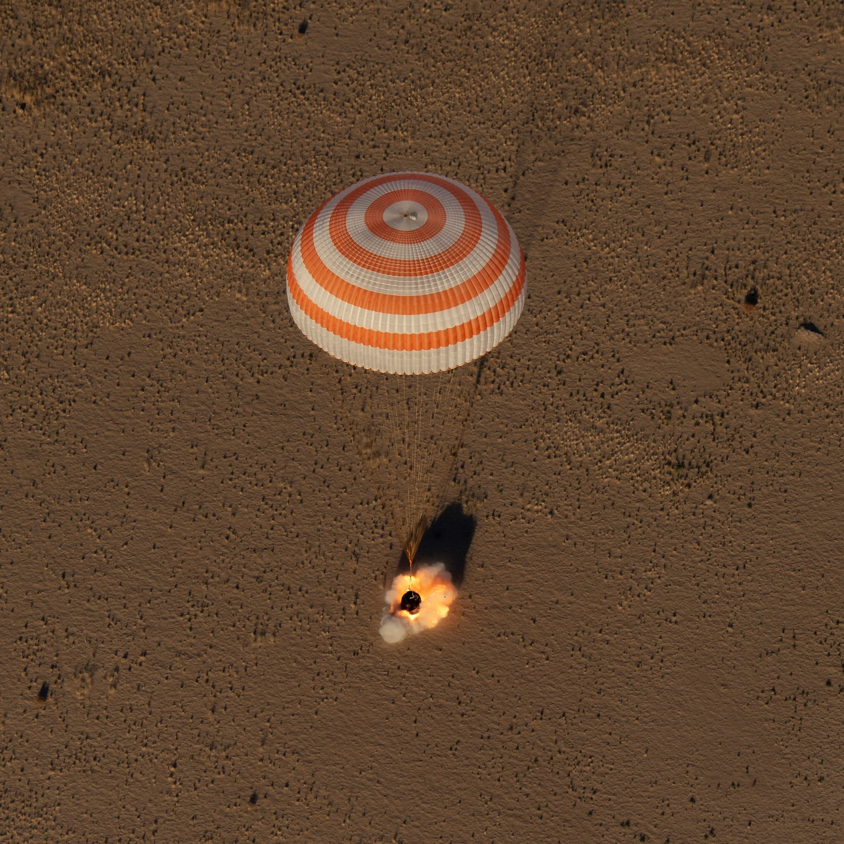
Landing in Kazakhstan
Soyuz 54S/MS-08

Slide 20
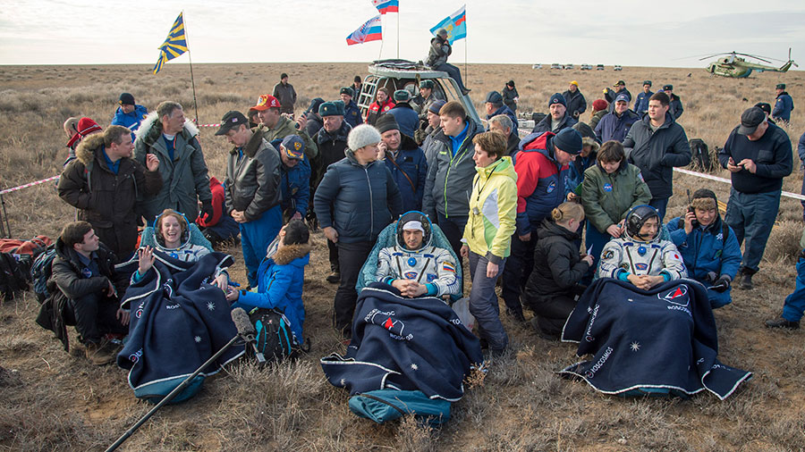
Landing in Kazakhstan
Kate Rubins on Soyuz 47S/MS-01

Slide 21
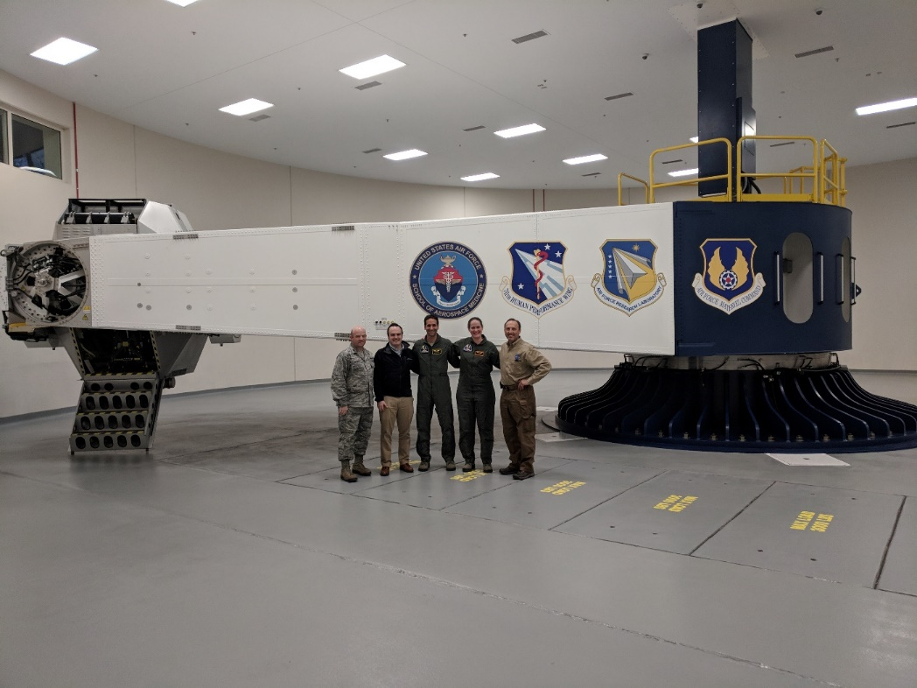
Centrifuge Training
Wright-Patterson Air Force Base

Slide 22
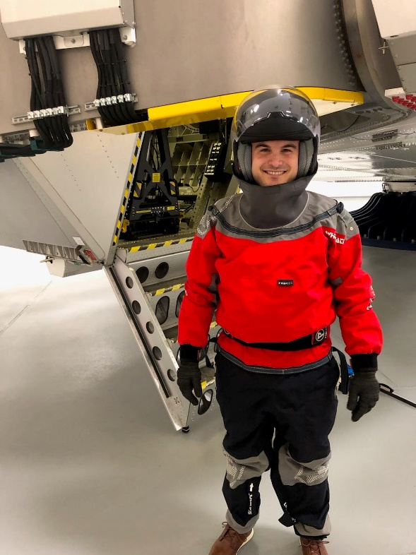
Centrifuge Training
Wright-Patterson Air Force Base

Slide 23
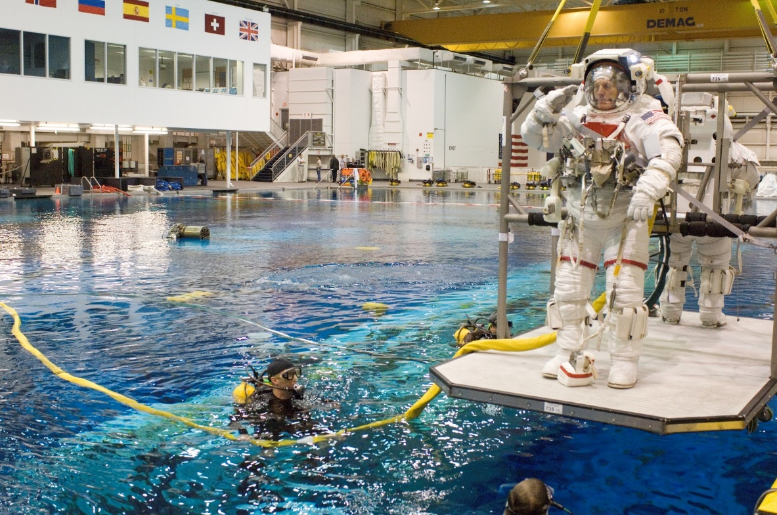
Neutral Buoyancy Lab

Slide 24
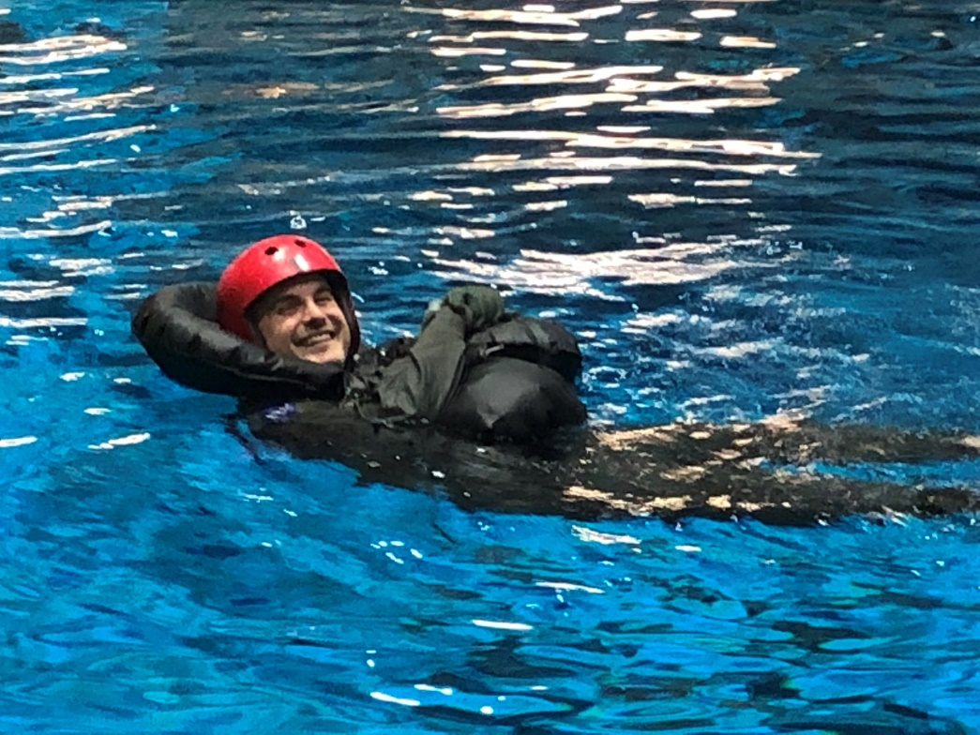
Neutral Buoyancy Lab
Water Survival Training

Slide 25
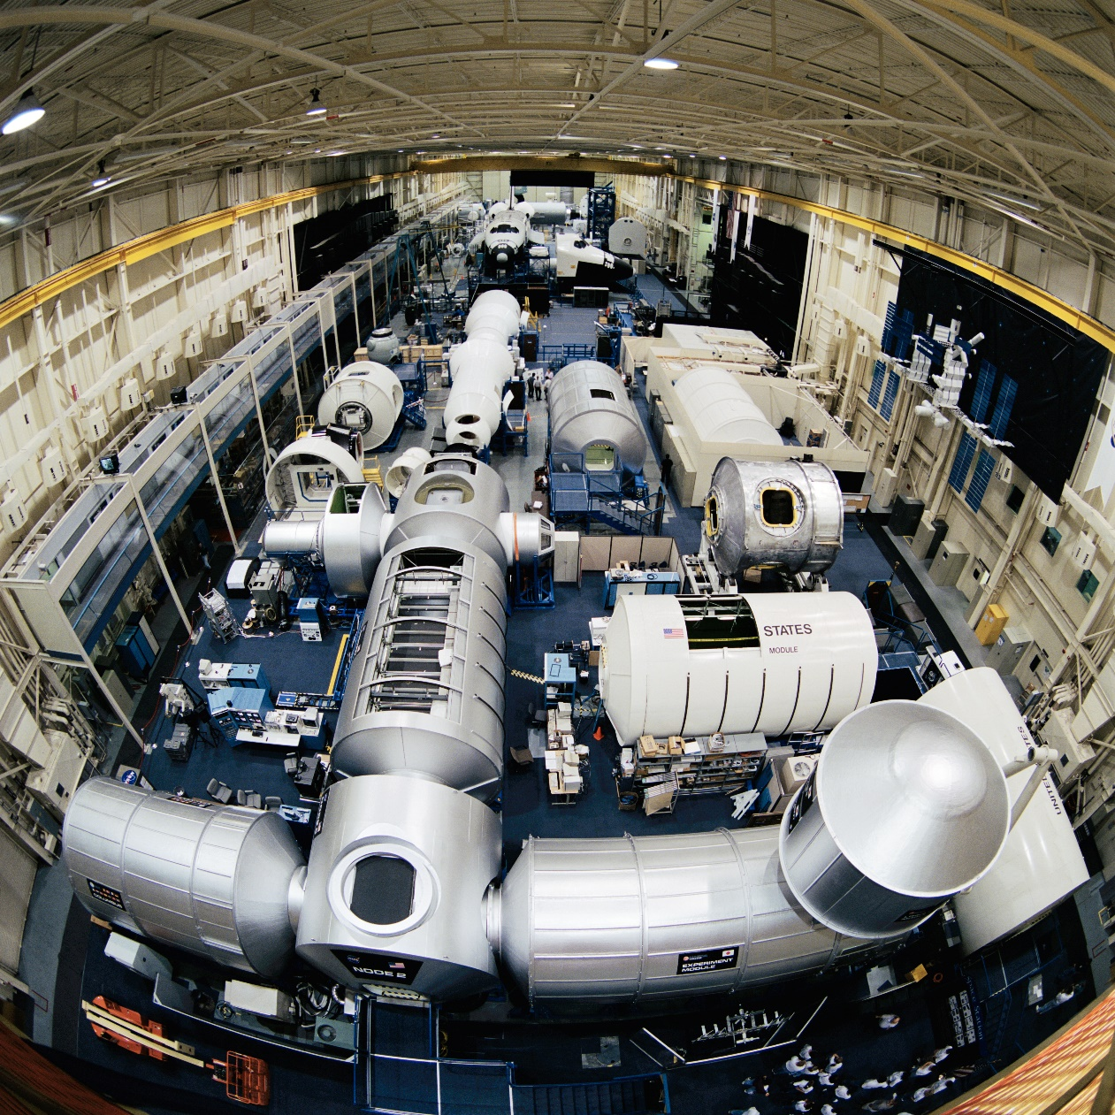
International Space Station Mock-Ups

Slide 26
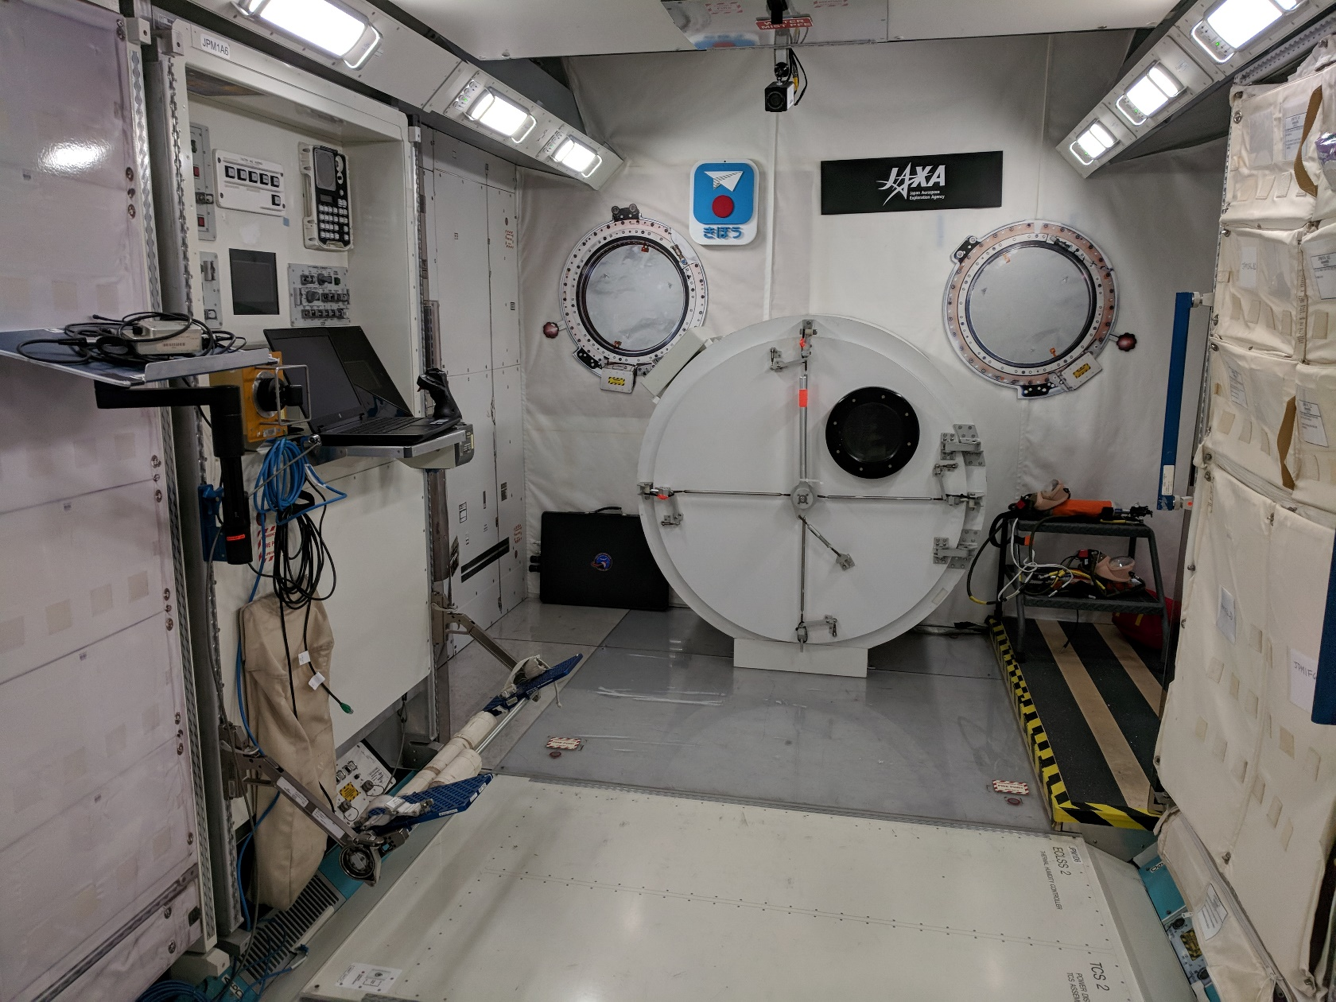
International Space Station Mock-Ups

Slide 27
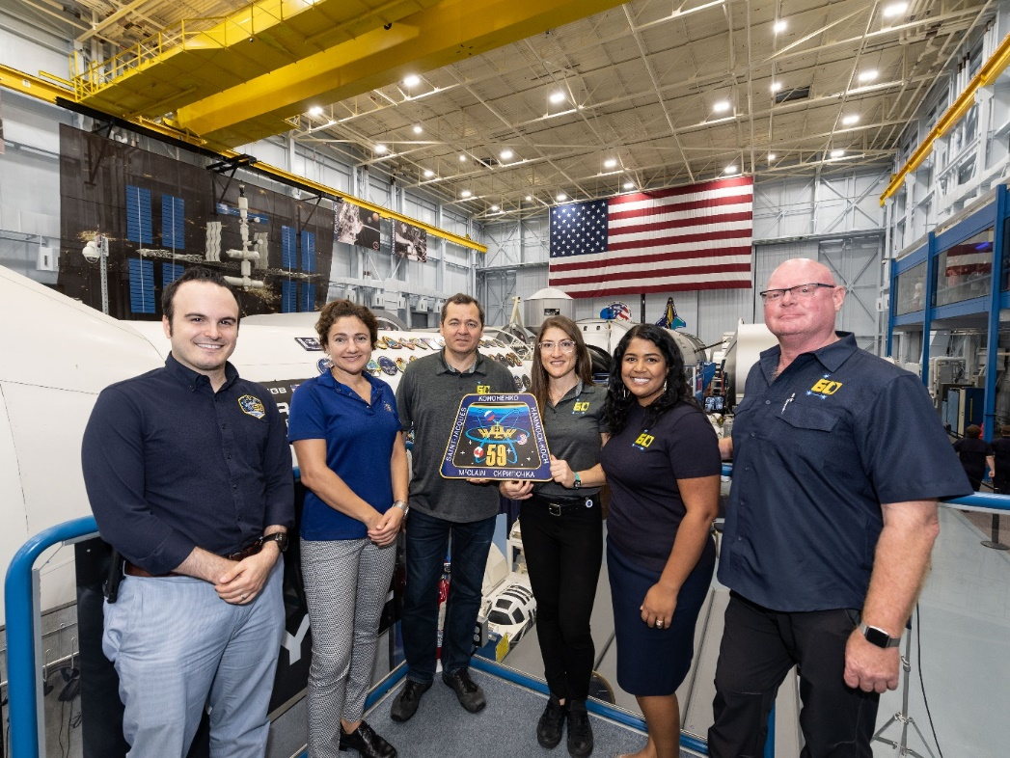
International Space Station Mock-Ups

Slide 28
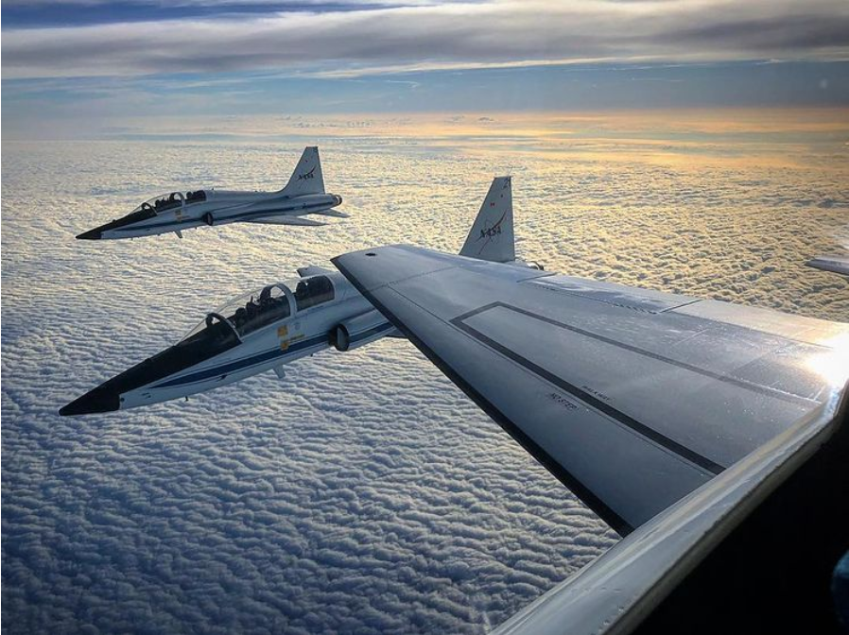
T-38

Slide 29
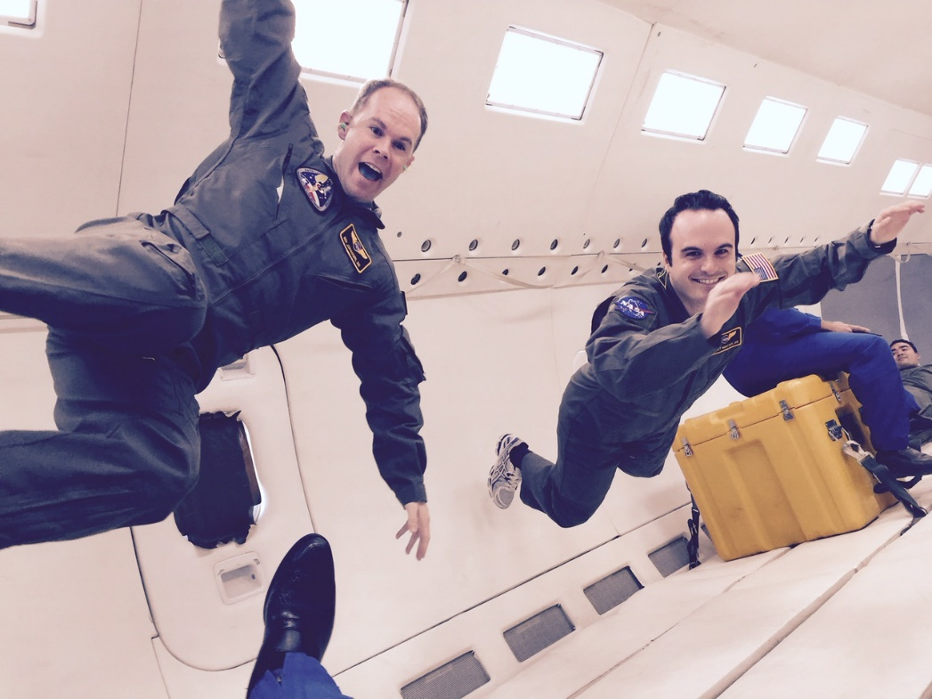
Reduced Gravity Training
NASA “Vomit Comet”

Slide 30
Flight Surgeon Training

Slide 31
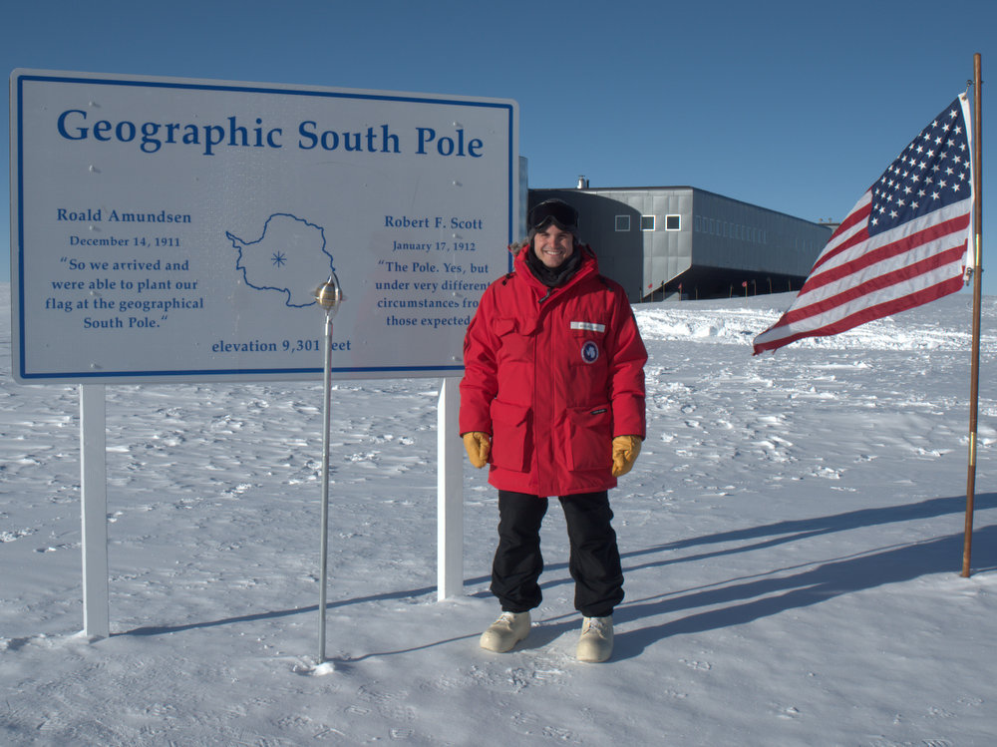
Antarctica
Amundsen–Scott South Pole Station

Slide 32
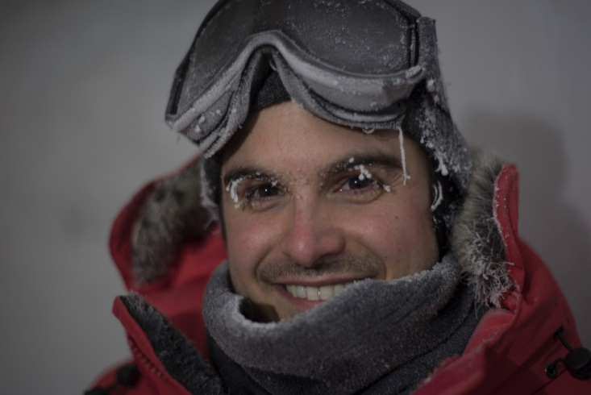
Antarctica
Amundsen–Scott South Pole Station

Slide 33
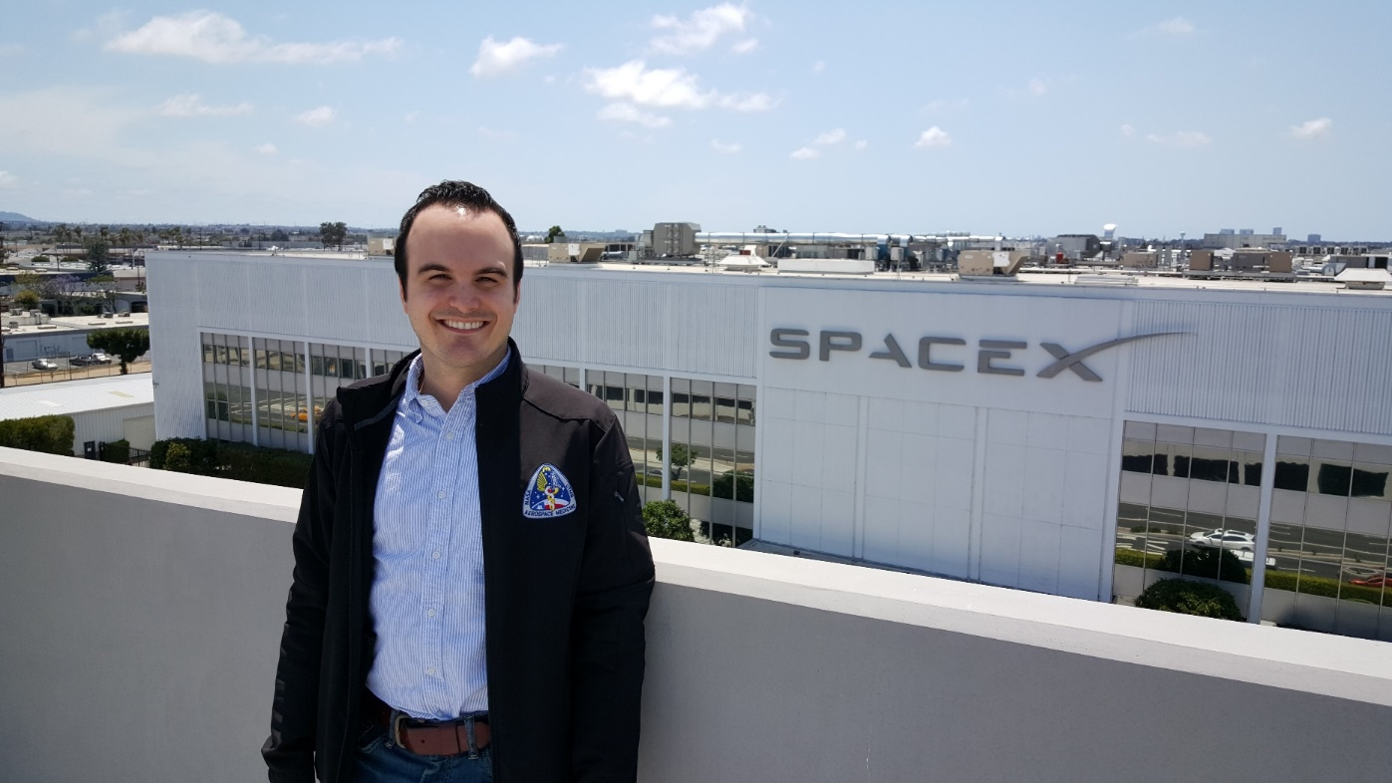
SpaceX

Slide 34
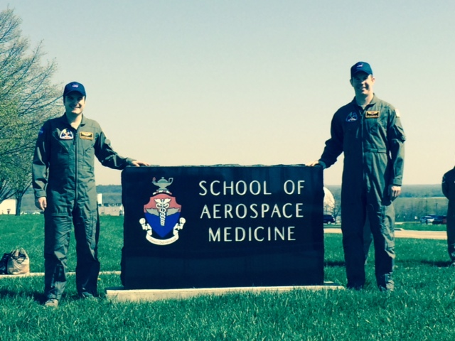
US Air Force

Slide 35
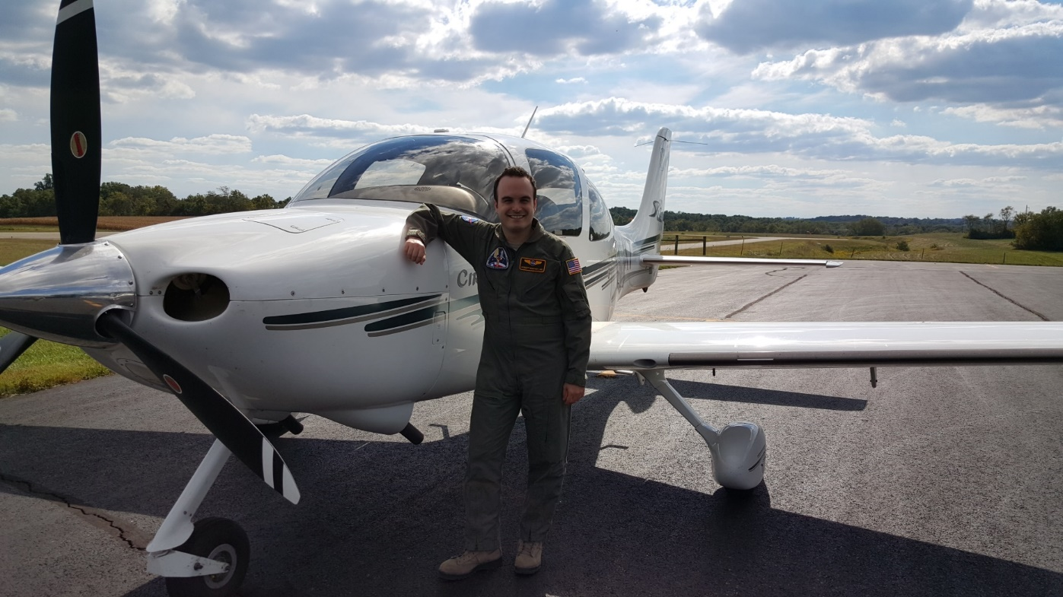
US Air Force

Slide 36
Questions?

