Slide 1

DAIDALUS, ICAROUS, SIRIUS, and Their Batch Simulation Capabilities
Presented by César Muñoz
February 22, 2021
ICAROUS Team: María Consiglio (NASA), César Muñoz (NASA), Swee Balachandran (NIA), Brendan Duffy (NIA), Andrew Peters (NIA), Marco Feliu (NIA), Víctor Carreño (NIA)

Slide 2
DAA Research at LaRC
2007-2013: RTCA SC-203 SG3 (Unmanned Aircraft System – UAS Airspace Integration)
2012: First NASA publication described the concept later adopted by RTCA SC228 and the UAS community*
2013-2015: SARP (Science and Research Panel) for DAA convened by DOD and MIT-LL on the development and evaluation of DAA WC models
2013-…: RTCA SC-228, Minimum Performance Standards (MOPS) for UAS Detect and Avoid (DAA)
2017: RTCA DO 365 MOPS (Phase 1: En-route). NASA’s DAIDALUS (Detect and Avoid Alerting Logic for Unmanned Systems) included as the reference implementation for DAA in MOPS**
2020: DO 365A MOPS (Phase 2: Terminal Area): DAIDALUS v2.0.1
2021: DO 365B MOPS (Phase 3: Non-cooperative aircraft): DAIDALUS v2.0.2
* Concept of integration for UAS operations in the NAS, M. Consiglio, J. Chamberlain, C. Muñoz, and K. Hoffler, Proceedings of the 28th International Congress of the Aeronautical Sciences (ICAS 2012), 2012.
** https://shemesh.larc.nasa.gov/fm/DAIDALUS/

Slide 3


From Separation Assurance to DAA
(1x1 State-Based CD&R Algorithms)
(1x1 State-Based CD&R Library)
(1xN State-Based CD&R )
(1xN Intent-Based CD&R)
(DAIDALUS v0)

Slide 4
DAIDALUS: DAA Software Library
(https://github.com/nasa/daidalus)
Detect and Avoid Alerting Logic for Unmanned Systems (DAIDALUS) is an open-source software library (available in Java and C++) that implements a configurable detect and avoid (DAA) concept
Formally verified, ownship-centric, state-less core algorithms:
  Detection Logic: Determines the current pairwise well-clear status
  Maneuver Guidance Logic: Computes maneuver guidance to maintain or regain well-clear status:
    suggestive guidance: kinematic and instantaneous bands
    directive guidance: track, ground speed, vertical speed, altitude
  Alerting Logic: Determines alert level

Slide 5
DAIDALUS High Level Architecture

Slide 6
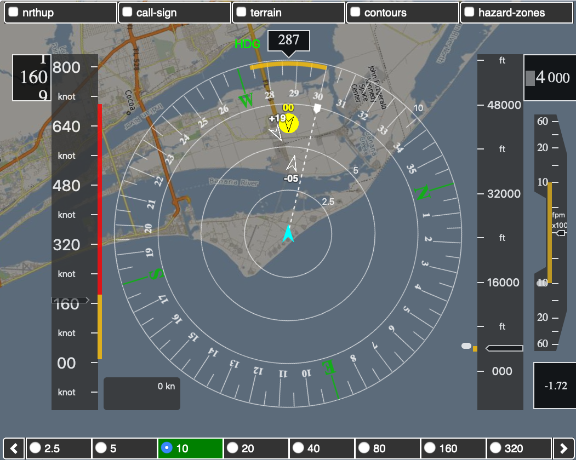
DAIDALUS Outputs
Suggestive Guidance
Alert Level
Directive Guidance

Slide 7
DAIDALUS Features to Explore in UAM
Support for dynamic alerters depending on type of aircraft, sensor source, participant vs. non-participant, phase of flight, etc. Each alerter defines well-clear volume and alert levels.
Intruder-centric alerting logic
Sensor Uncertainty Mitigation (SUM) logic
Hysteresis and persistence logic
DAA Terminal Areal (DTA) logic
Beyond DO-365:
  Directive guidance
  Ground speed maneuvers
  Implicit coordination and priority rules

Slide 8
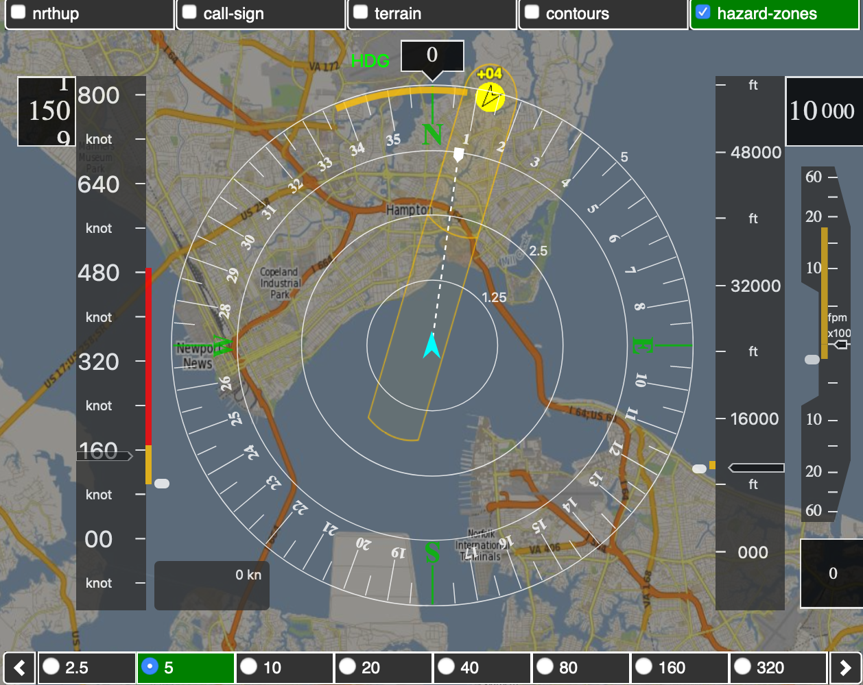
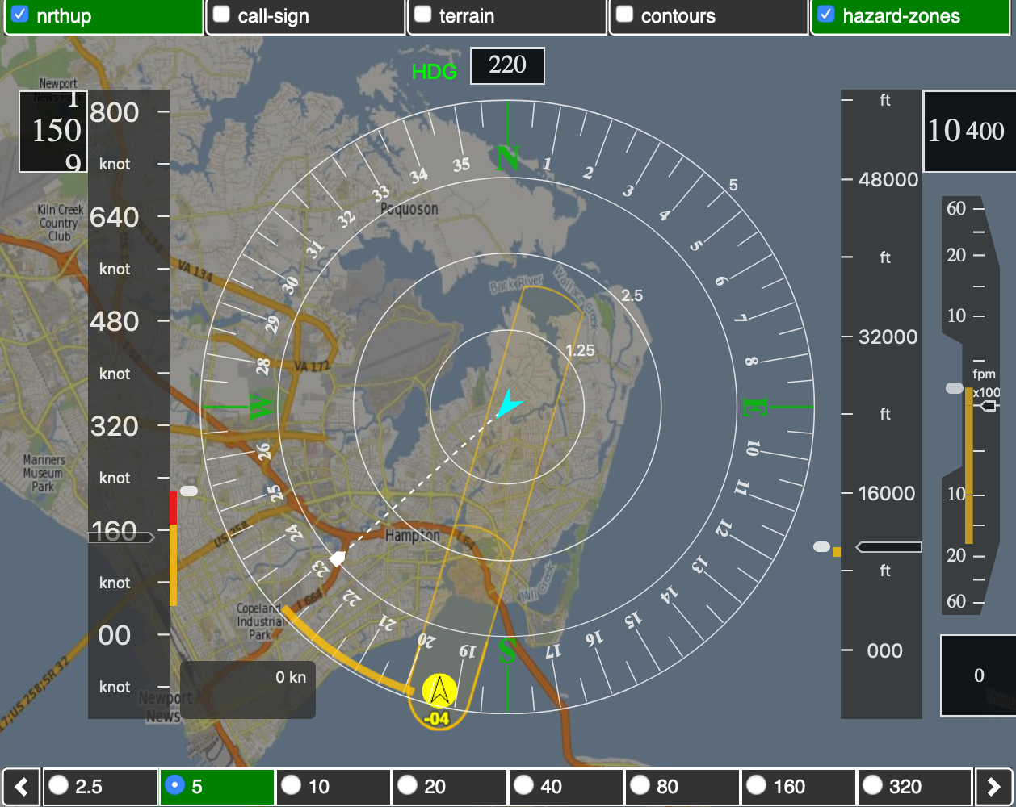
DAIDALUS Directive Guidance is (Mostly) Implicitly Coordinated
From Ownship’s Point of View
From Intruder’s Point of View

Slide 9
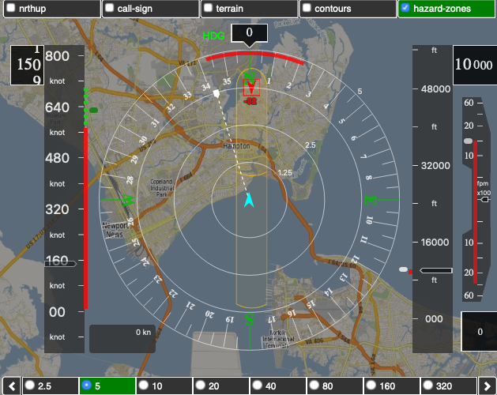
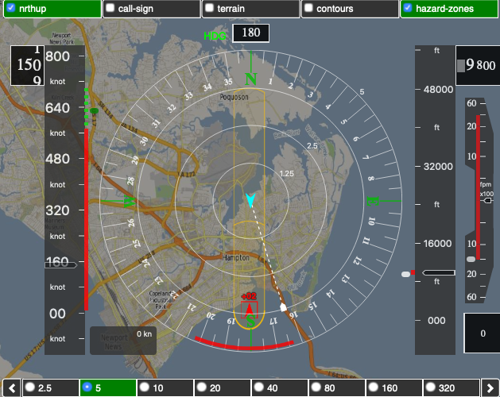
DAIDALUS Directive Guidance Doesn’t Necessarily Follow Right of Way Rules (14 CFR 91.113)
From Ownship’s Point of View
From Intruder’s Point of View

Slide 10
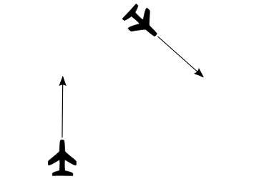
Right of Way (14 CFR 91.113)
“(d) When aircraft of the same category are converging at approximately the same altitude (except head-on, or nearly so), the aircraft to the other’s right has the right-of-way.
(e) When aircraft are approaching each other head-on, or nearly so, each pilot of each aircraft shall alter course to the right.
(f) Each aircraft that is being overtaken has the right-of-way.”
AC1
Which aircraft has the right-of-way?
AC0
A. Narkawicz, C. Muñoz, and J. Maddalon, A Mathematical Analysis of Air Traffic Priority Rules, Proceedings of the 12th AIAA Aviation Technology, Integration, and Operations (ATIO) Conference, AIAA-2012-5544, Indianapolis, Indiana, 2012.

Slide 11

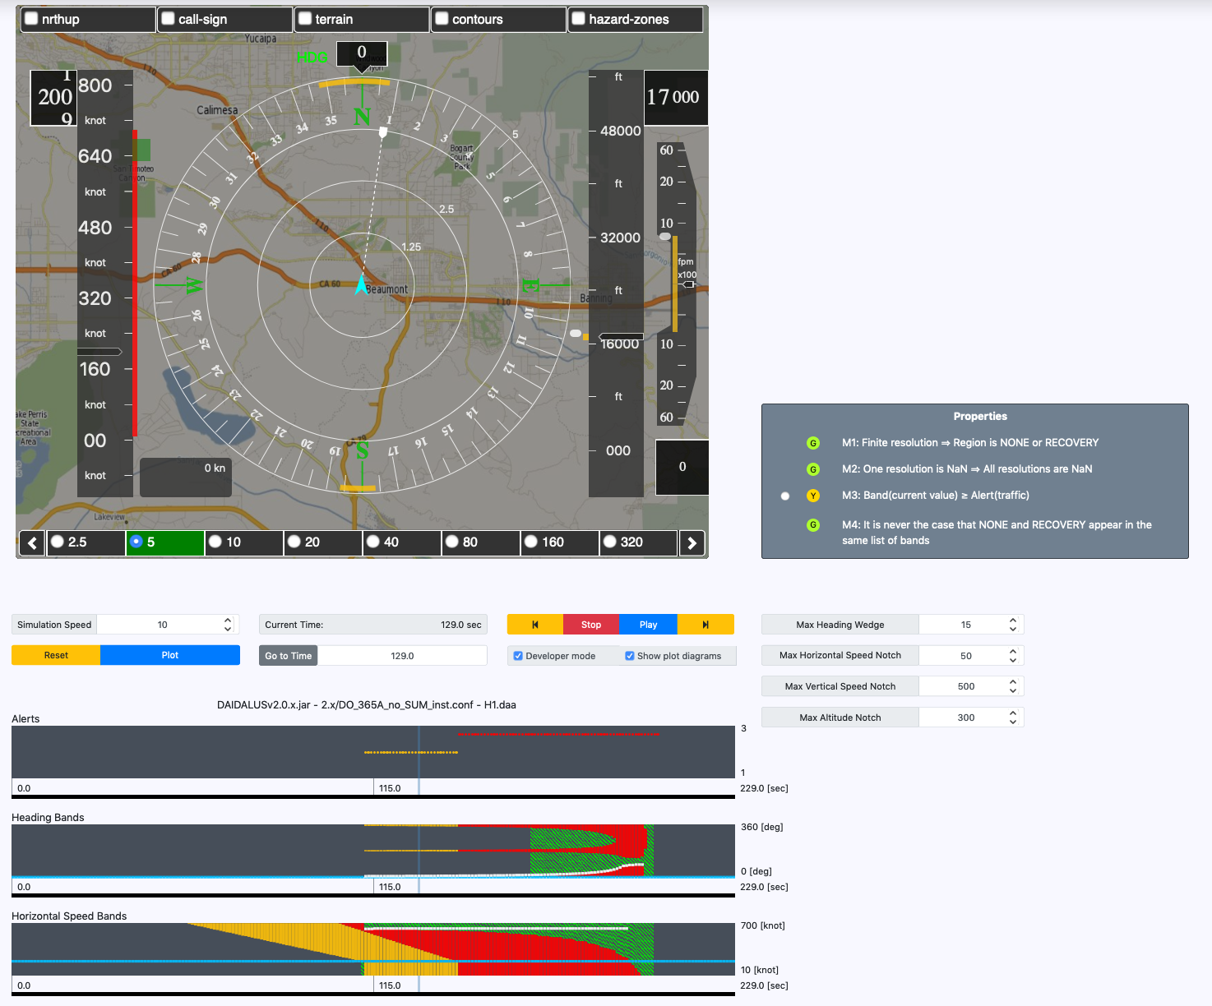
DAA-Displays: DAA Visualization and Analysis Tool
(http://github.com/nasa/daa-displays)*
DAA-Displays
v1
Encounter
(.daa)
v2
ACAS Xu
Configuration
(.conf)
* Joint work with P. Masci (NIA)
Replay encounters (list of aircraft states at a series of times)
Different configurations and DAA logics, e.g., DAIDALUS v1, DAIDALUS v2, and, future, ACAS Xu
Visualize maneuver guidance, alerts, compliance to functional requirements, etc.
Time-step by time step computation of DAA metrics, e.g., tcpa, dcpa, etc.

Slide 12

ICAROUS: DAA On-Board System
(https://github.com/nasa/icarous)
ICAROUS is an on-board software system of distributed services for autonomous UAS
Provide modules that monitor and autonomously enforce containment constraints such as detect and avoid (DAA), geofencing, path planning, path conformance, distributed merging and spacing, etc.
Use formally verified algorithms such as DAIDALUS (DAA) and PolyCARP (Geofencing)
Support for ACAS sXu (collaboration with JHU/APL)
C++ software available under NASA Open Source Agreement
Over 400 flight tests under the UTM project.

Slide 13
ICAROUS High Level Architecture
DAIDALUS provides DAA functionality.
ICAROUS autonomously implements avoidance maneuver and returns to mission.

Slide 14
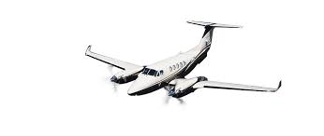
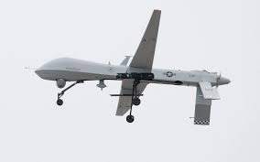
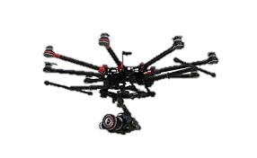
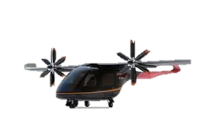
ICAROUS/DAIDALUS Evolution
ACCORD/Stratway
2001-2012
DAIDALUS
2013-2017
ICAROUS
2016-2020
ICAROUS
2019-…
4D trajectories.
DAA and airspace constraints (path conformance, corridors)
Varying levels of autonomy
Merging and crossing corridors
Formally developed and verified models and algorithms
for DAA.
Provides maneuver guidance and conflict alerting for the pilot in command to maintain “well clear” separation.
Formally developed and verified models and algorithms for
conflict detection and resolution for airborne separation assurance. Predicts potential conflicts and computes resolution routes.
Small UAS, very Low altitude operations, sUAS (<55 lbs)
Airspace segregation (time/space) constraints (geofencing)
RTCA SC228 DAA Requirements for TCAS interoperability and Alerting
UTM
Small UAS-Very Low Altitude Operations.
Airspace Segregation. Performance Based Authorization.
UAM
4D trajectories.
DAA and airspace constraints (path conformance, corridors)
Varying levels of autonomy
Merging and crossing corridors
Manned aviation
Large UAS (IFR)
Small UAS (<55lbs))
UAM VTOL

Slide 15
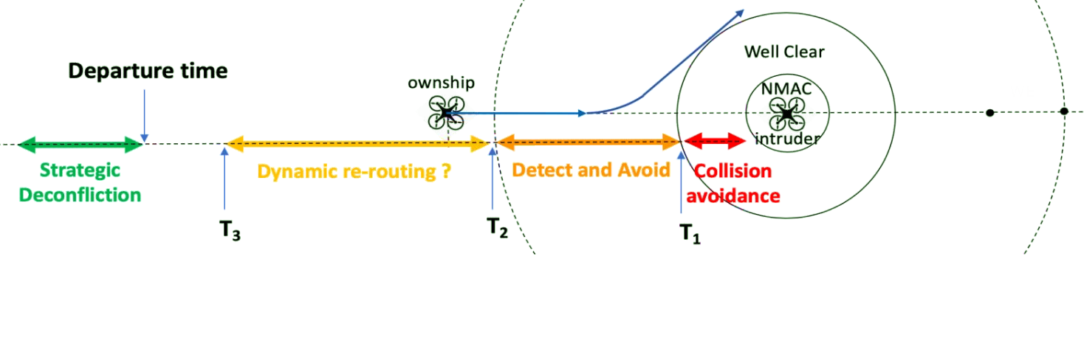
UAM Separation: From Pre-Flight to Collision Avoidance*
Pre-flight, Strategic Deconfliction
Operations Planning and runtime monitoring
Tactical Separation, DAA/CA
PSU
UAM Operator
DAA/On board systems
ICAROUS
Airspace and Operations Authorization, Emergencies/Off-Nominal Conditions
ATC
*Min Xue, Generalized Conflict Management Model

Slide 16
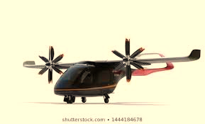

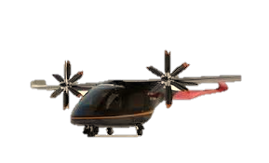

DAA Encounters Type in UAM
VFR Traffic
(Non-equipped)
Crossing UAM Traffic
Merging UAM Traffic
Aircraft complies with a 4D trajectory comprised of time- controlled segments.
Conflict 1: Non-UAM Traffic
UAM vehicle flying a 4D trajectory as provided by the UAM scheduler. A conflict is predicted with a non-participating GA aircraft entering the UAM corridor. An ownship avoidance maneuver is computed that makes best effort to maintain separation and ownship time constraints.
Conflict 2: UAM Crossing Coordination: A coordinated resolution maneuver is executed and both aircraft proceed safely to their destination
Conflict 3: UAM Merging Coordination: A coordinated merge is executed as the two UAM vehicles communicate to agree on a merging order. Both aircraft proceed safely to their destination maintaining safe in-trail spacing.

Slide 17
ICAROUS Features in Support of UAM Research
✓
4D kinematic trajectories
  Linear 4-D trajectories
  Kinematic 4-D trajectories (LaRC’s EUTL)
Aircraft dynamic models
  Simple point-mass
  6-DOF High Fidelity Rotorcraft UAS
  6-PAX Quad EVT
Real- and fast-time simulation
✓
✓

Slide 18
ICAROUS Integration with External Systems
ICAROUS Vehicle 1
Standalone Bridges
Langley’s UAM Software
cFS
ZMQ IFACE
ZeroMQ
ICAROUS
Gateway
Langley
TestBed
DDS
UAMSim
ATS TIGAR
Flight Kiosk
Telemetry
Commands
…
…
cFS
DAIDALUS
Software Bus Network
ACAS sXu
ZeroMQ
ACAS sXu
Server
cFS
PolyCARP
cFS
Merging &
Spacing
Ames
TestBed
ActiveMQ
…
ICAROUS Vehicle 2

Slide 19
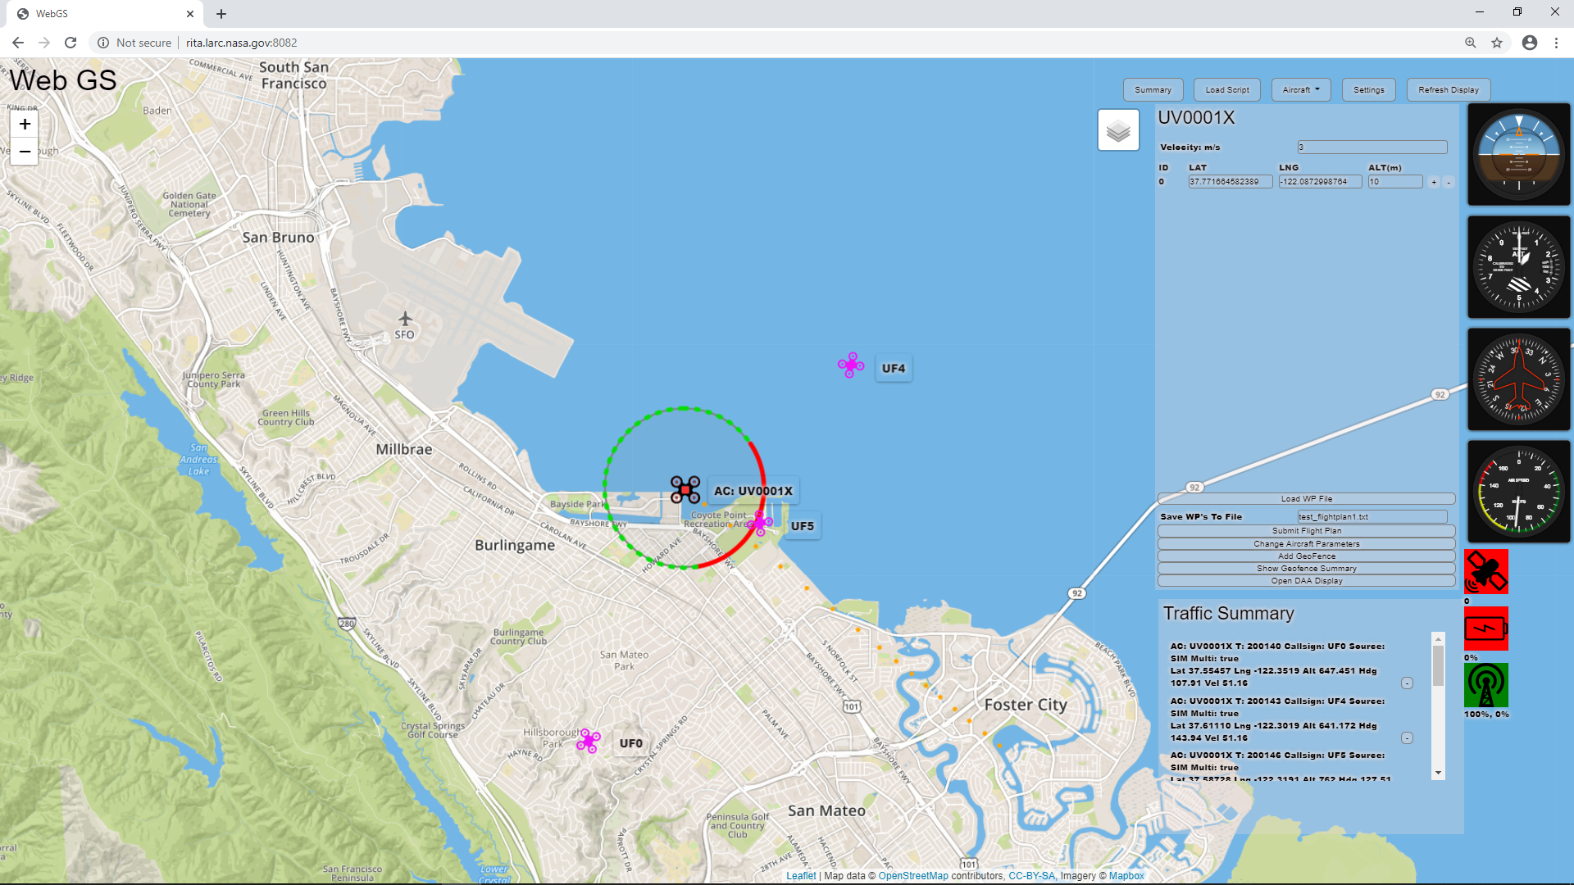
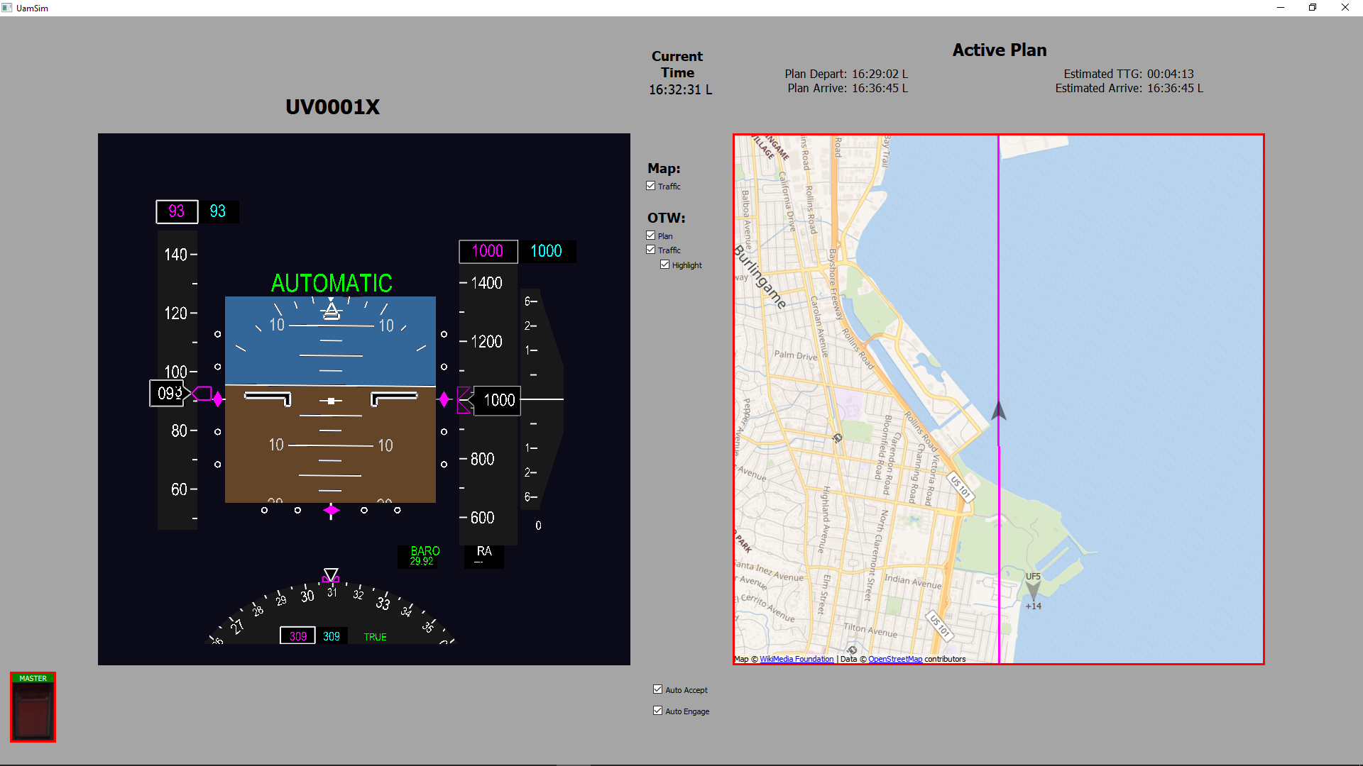
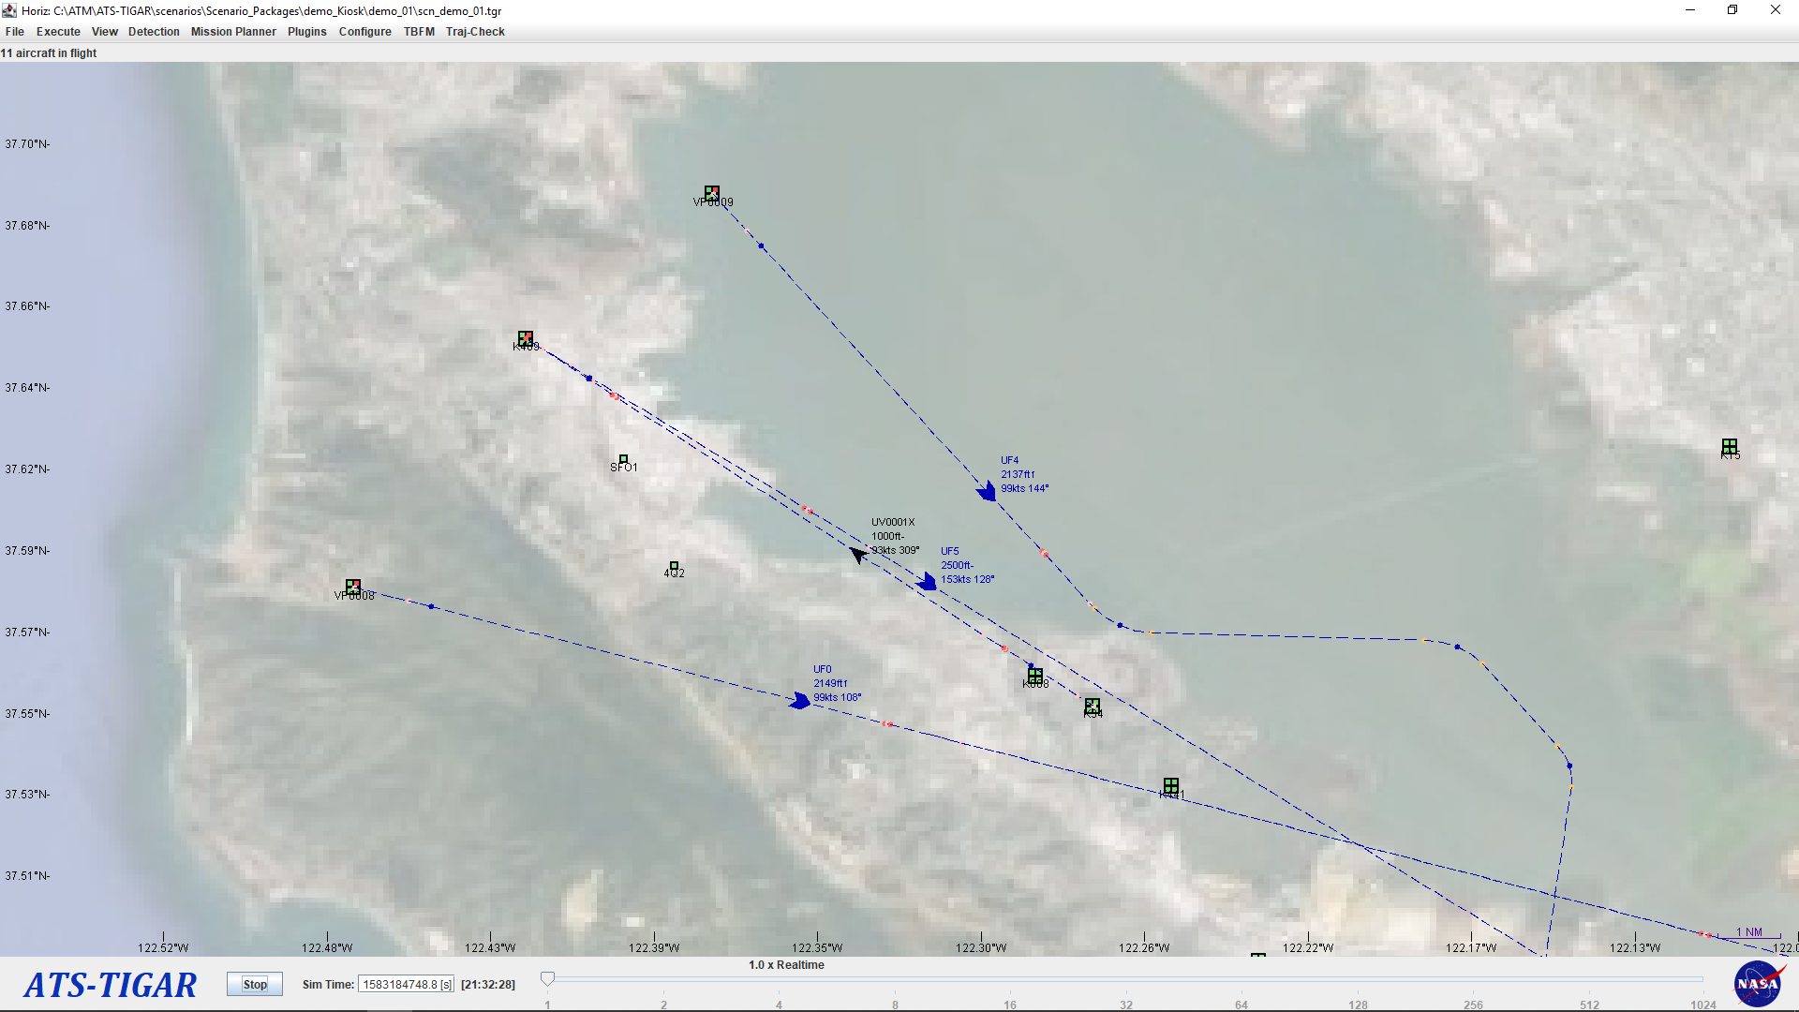
ICAROUS Testbed Software Integration
Implemented bi-directional communication between ICAROUS, ATS TIGAR, and UAM Sim through LaRC Test Bed.
ATS TIGAR uses the Vertiport Scheduler to provide deconflicted trajectories for a fleet of UAM vehicles.
The ownship is simulated in the UAM Sim and is running ICAROUS.
ICAROUS detects potential ownship conflicts and provides maneuver guidance.
UAM Sim automatically implements maneuver guidance.
WebGS (a web-based research ground station) displays ICAROUS information.
WebGS
Configuration
ICAROUS
ICAROUS Gateway
Interface
Information
(Linux)
Traffic and Ownship
State Information
Bands, 4D Trajectory
Resolutions
(Mac OSX)
LaRC Testbed
Bands, 4D Trajectory
Resolutions
ATS TIGAR
4D Trajectories
Ownship State
UAM SIM
Vertiport Scheduler
(MS Windows)
(MS Windows)

Slide 20
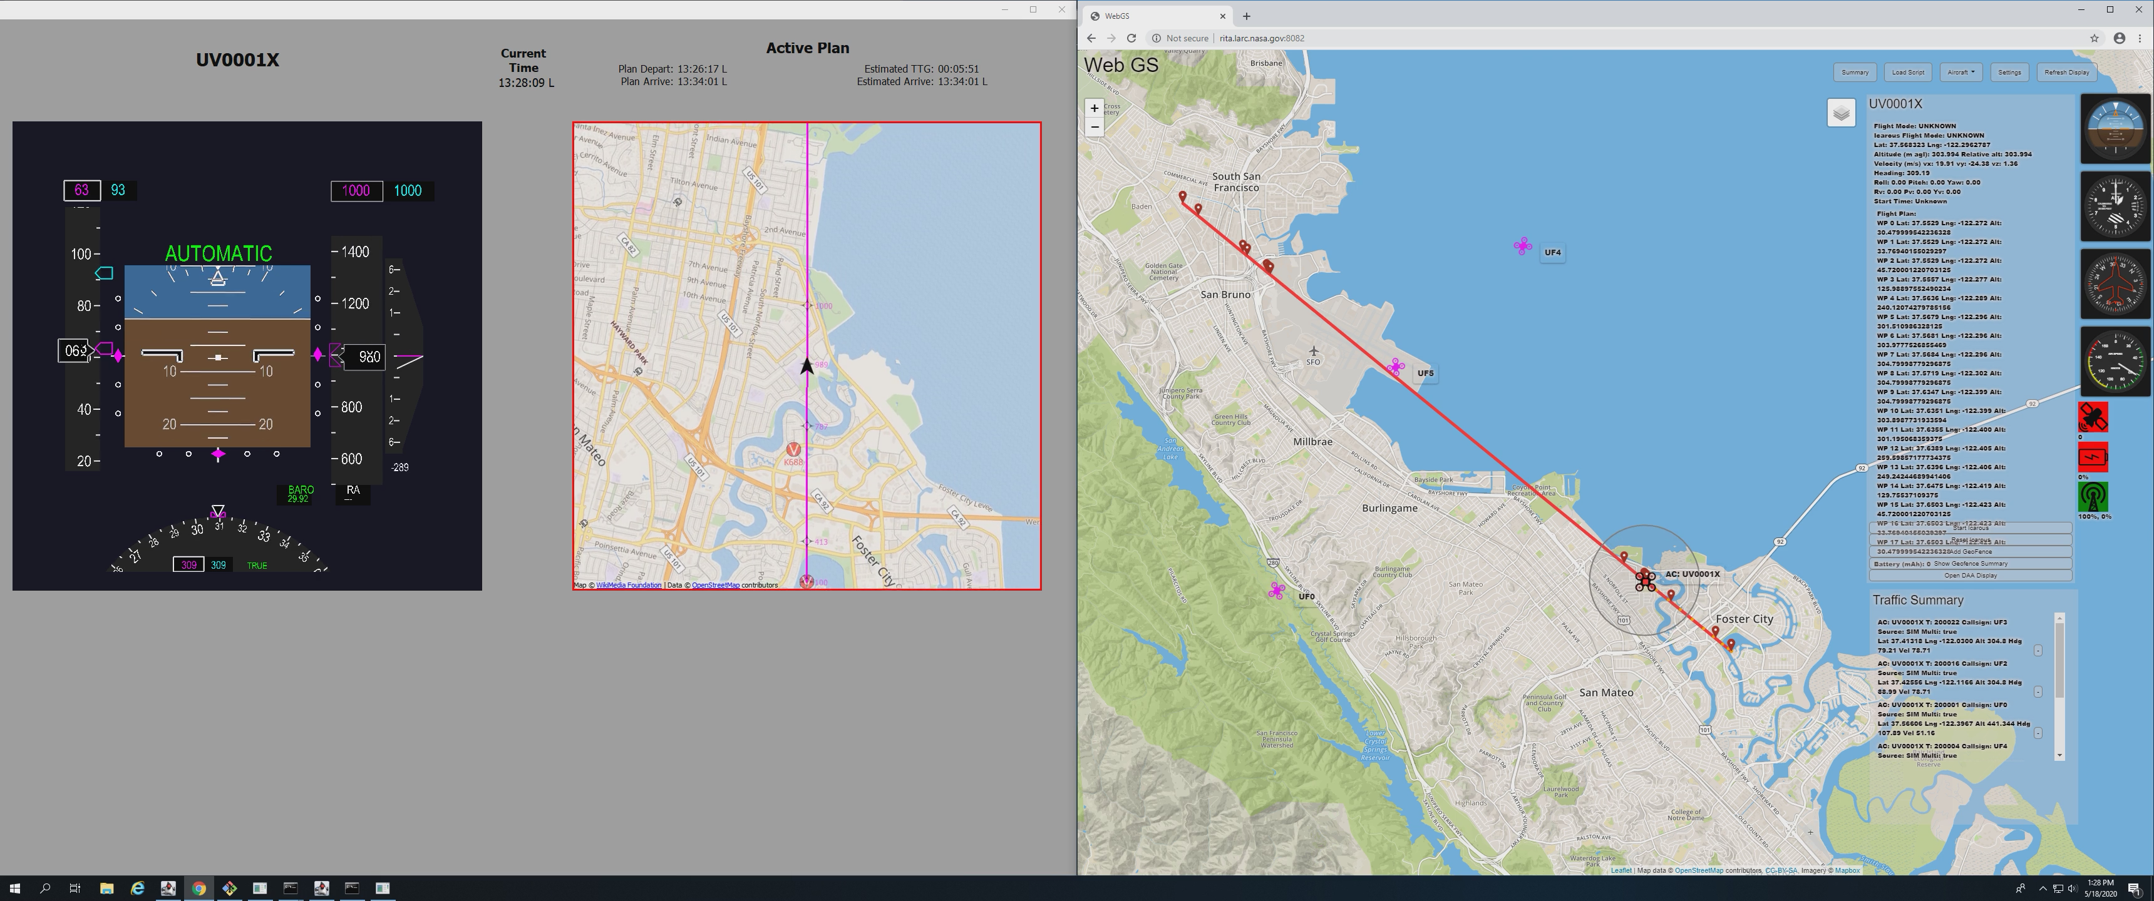
ICAROUS Testbed Software Integration (Demo)
Maneuver
Guidance
Maneuver
Guidance
New 4D Trajectory
New 4D Trajectory

Slide 21
SIRIUS: Fast Time Simulation of DAA for UAM
(https://gitlab.larc.nasa.gov/larc-nia-fm/Sirius)
Simulation Infrastructure for Research on Interconnected Unmanned System (SIRIUS)
Graphical research environment for fast-time simulation and analysis of Urban Air Mobility (UAM) airspace operations.
SIRIUS provides a seamless integration of
  detect and avoid (DAIDALUS), merging and spacing, path planning, and geofencing capabilities (PolyCARP),
  an autonomous decision-making on-board architecture (ICAROUS),
  a fast-time batch simulation environment, and
  graphical analysis tools
  for evaluating alerting and guidance performance of separation provisions for UAM

Slide 22
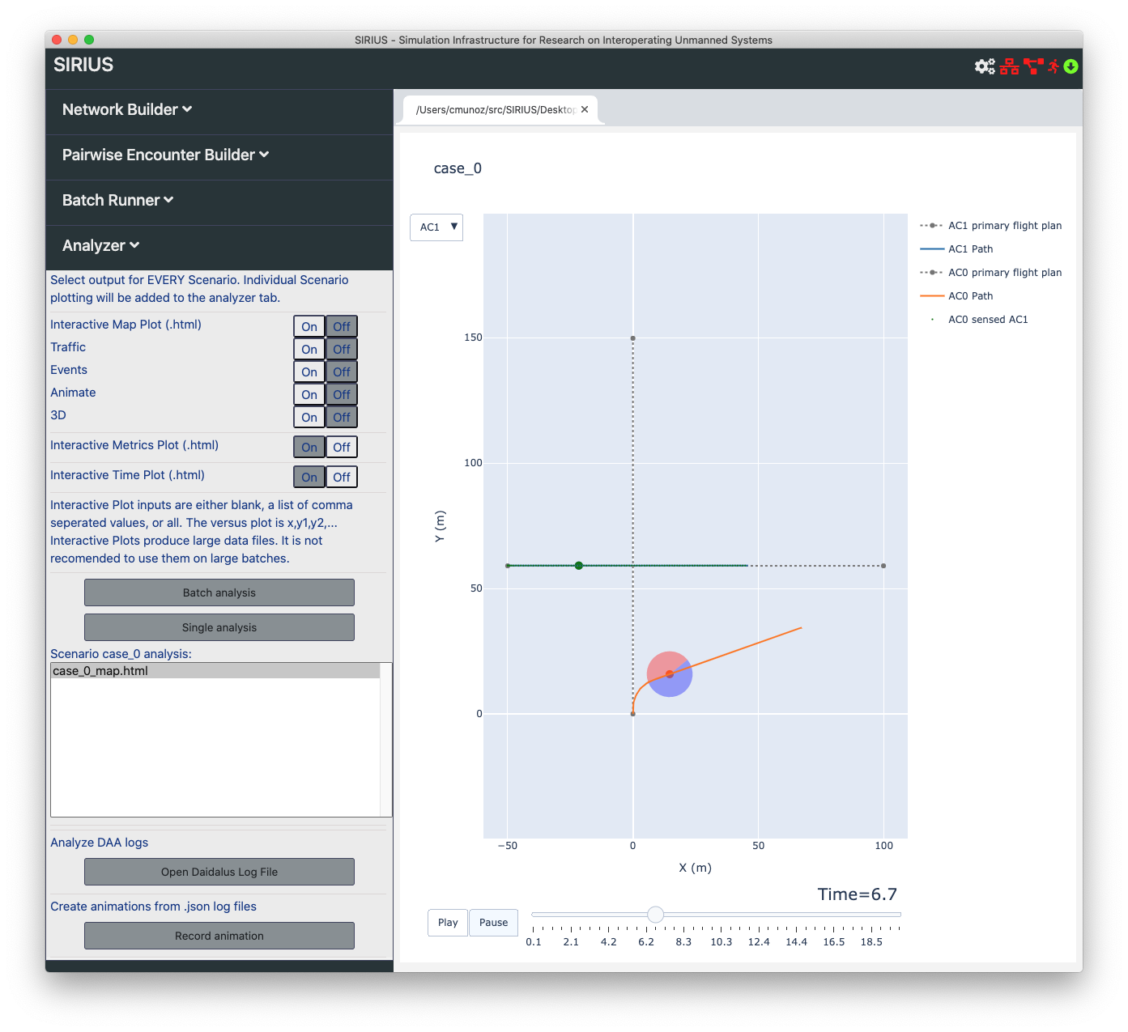
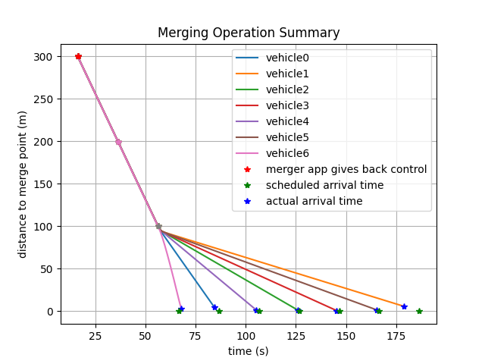
SIRIUS High Level Architecture
Configuration
Encounter
Builder
DAA Parameters
Pairwise Encounter
Builder
ICAROUS Parameters
Python
Simulation Environment
for ICAROUS
Logs and Data
Pycarous
Network
Builder
Python
Simulation Environment
for ICAROUS
Pycarous
Encounter
Parameters
Python
Simulation Environment
for ICAROUS
Communication
and
Environment
Parameters
Pycarous
Analyzer
Surveillance
Uncertainty
Simulation
Parameters

Slide 23
Batch Parallelization
Scenario 1 Controller
Aircraft A1
Aircraft A2
Aircraft A3
Aircraft An
Aircraft A1
Aircraft A2
Aircraft A3
Aircraft Bn
Scenario 2 Controller
Decision
Making
Decision
Making
Decision
Making
Decision
Making
Decision
Making
Decision
Making
Decision
Making
Aircraft 1
Aircraft 2
Aircraft C3
Aircraft Cn
DAIDALUS
DAIDALUS
DAIDALUS
DAIDALUS
Decision
Making
Merging
DAIDALUS
DAIDALUS
DAIDALUS
DAIDALUS
Merging
Merging
Merging
Decision
Making
Decision
Making
Decision
Making
Decision
Making
Planning
Merging
Merging
Merging
Merging
Planning
Planning
Planning
DAIDALUS
DAIDALUS
DAIDALUS
DAIDALUS
PolyCARP
Planning
Planning
Planning
Planning
PolyCARP
PolyCARP
PolyCARP
Merging
Merging
Merging
Merging
Aircraft simulator
PolyCARP
PolyCARP
PolyCARP
PolyCARP
Aircraft simulator
Aircraft simulator
Aircraft simulator
Planning
Planning
Planning
Planning
Aircraft simulator
Aircraft simulator
Aircraft simulator
Aircraft simulator
PolyCARP
PolyCARP
PolyCARP
PolyCARP
Aircraft simulator
Aircraft simulator
Aircraft simulator
Aircraft simulator
Python Simulation Environment
Python Simulation Environment
Computer 1
Computer 2
Python Simulation Environment
Computer 3

Slide 24
Pairwise Encounter Configuration
Type of Encounter:
  DAA
  Merging
Type of Simulation:
  Exhaustive
  Monte Carlo (Uniform, Normal, Gamma, Exponential)
Type of Geometry:
  Based on Miss Distance
  Based on Convergence Angle

Slide 25
Communication and Surveillance Configuration*
Propagation Model*:
  Constant, No Loss, Free Space, Two Ray Ground
Reception Model*:
  Perfect, Deterministic, Constant, Rayleigh, Nakagami
Communication Delay
Wind
Ownship and intruder covariances and z-score for position and velocity
*https://gitlab.larc.nasa.gov/larc-nia-fm/icarous/-/blob/master/Python/pycarous/communicationmodels/modelinformation.md

Slide 26
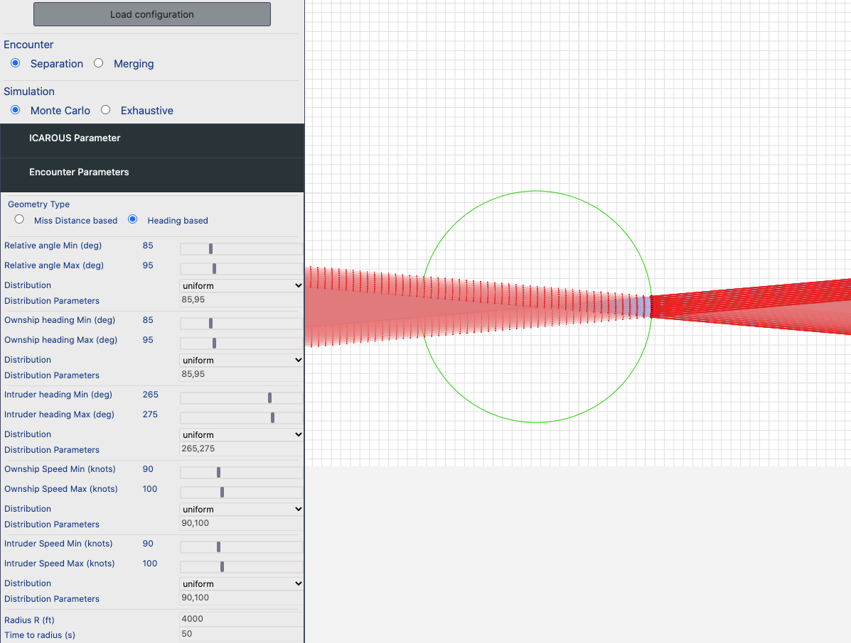

Slide 27
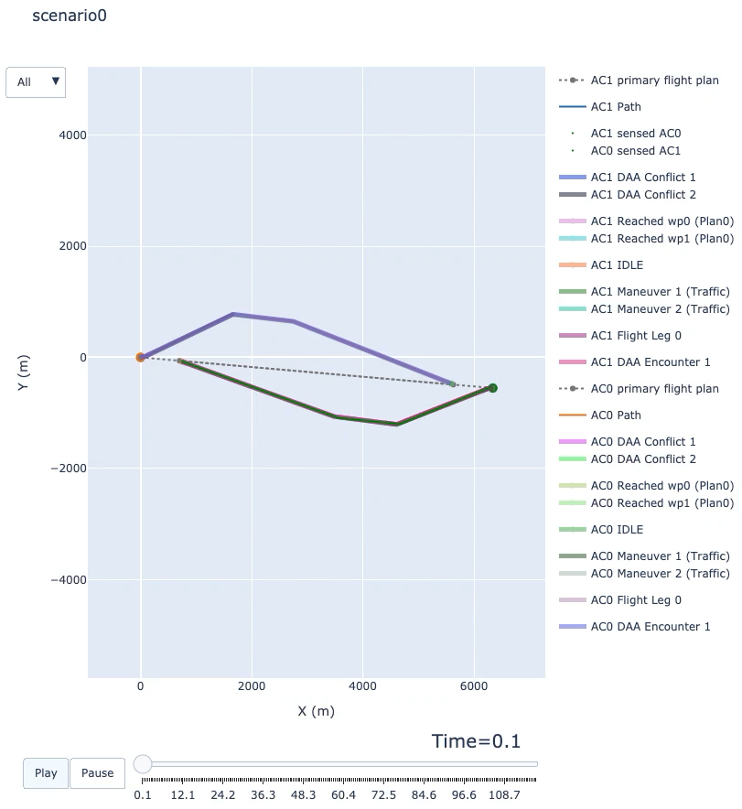
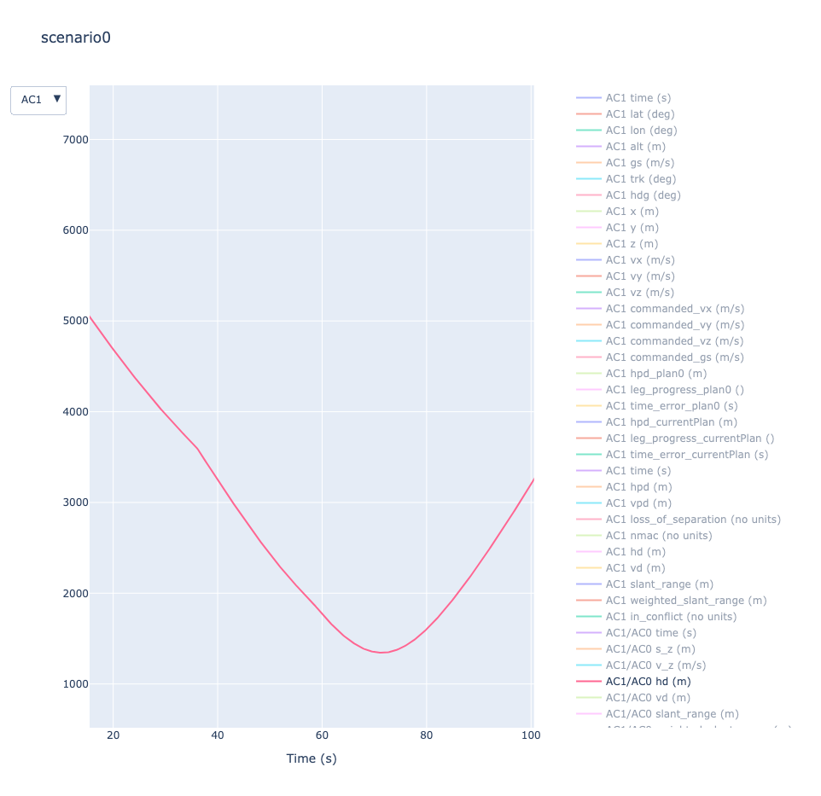
Head-on Encounter

Slide 28
Network Builder
Ports have an output rate and output variance
Support for merging waypoints
Waypoints have multiple inputs and outputs.
Random generation of scenarios

Slide 29
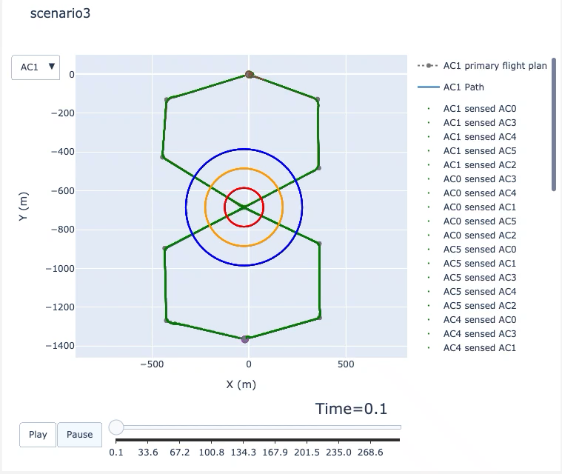

Slide 30
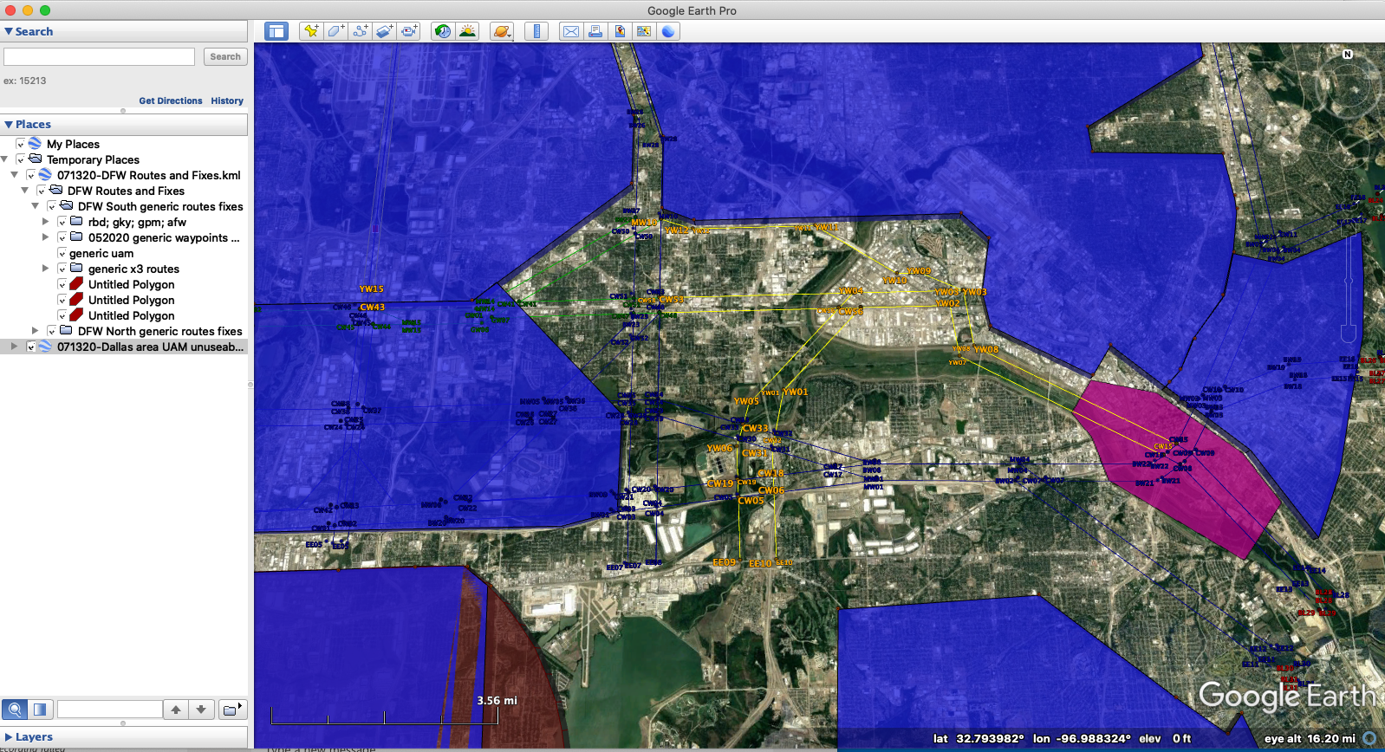
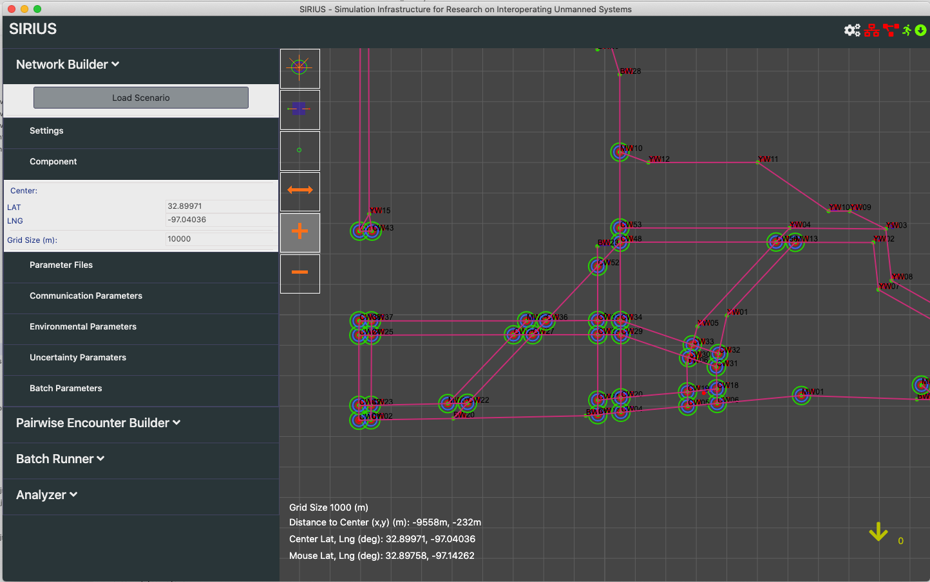
Dallas-Fort-Worth (DFW) Area in SIRIUS

Slide 31
SIRIUS Main Features
Highly Configurable:
  DAA: Well-clear definition, alerting logic, maneuver guidance, support for intruder-centric DAA logic
  Uncertainties: Surveillance, communication delays, winds
  Equipped and non-Equipped aircraft
  Aircraft models: point mass, 6-DOF High Fidelity Rotorcraft UAS, 6-PAX Quad EVTOL aircraft models
Support for 4-D Kinematic Trajectories (LaRC’s EUTL)
Batch Parallelization:
  Scenarios can be run in parallel on different computers
  Aircraft from the same scenario can be run on different computers
Modular:
  Support for alternative DAA logic, e.g., Xu, noise models, metrics, etc.
Deterministic and Monte-Carlo based generation of scenarios

Slide 32
On-Going and Future Work
Network builder
  Integration with TIGAR/Vertiport Scheduler
  Integration of concepts such as ”routes”, “tracks”, ”corridors” as defined for the UAM project
Design of case studies and specific metrics, e.g.,
  Implicit coordination and priority
  Recapture strategy (next way point, to segment)
  Airspace complexity metrics

