Slide 1
Modeling Spacecraft Separation Dynamics in Julia
Jonnie Diegelman
Guidance, Navigation, and Control Engineer
a.i. solutions / NASA Launch Services Program
SIAM 2021 Conference on Computational Science and Engineering
Symposium on High Performance Simulation and Estimation with Julia’s SciML
March 5, 2021

Slide 2

Intro
NASA Launch Services Program

Slide 3

Intro
NASA Launch Services Program
NASA LSP: “Earth’s Bridge to Space”

Slide 4
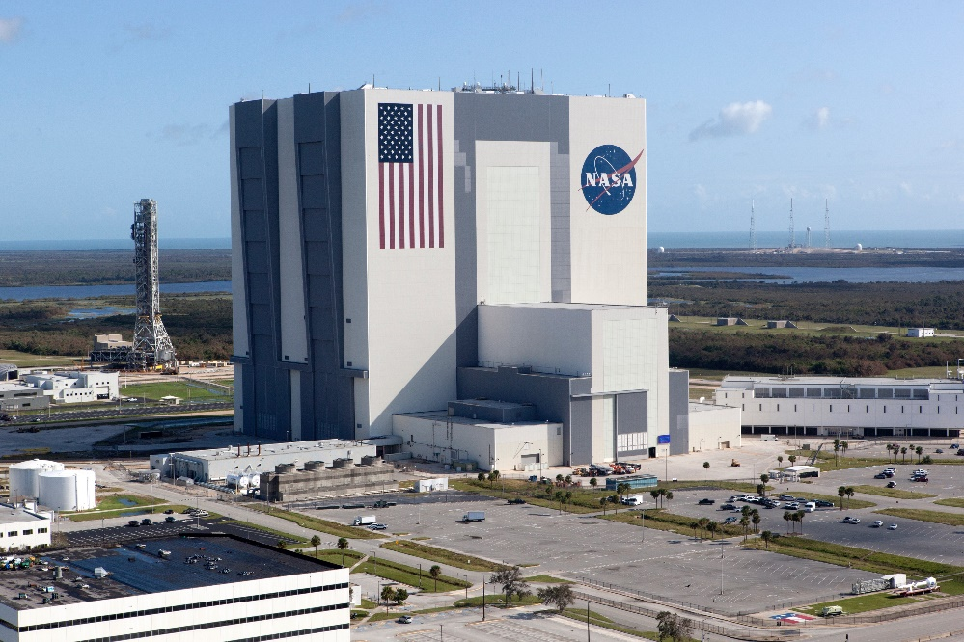
Intro
NASA Launch Services Program
NASA LSP: “Earth’s Bridge to Space”
Kennedy Space Center, FL

Slide 5
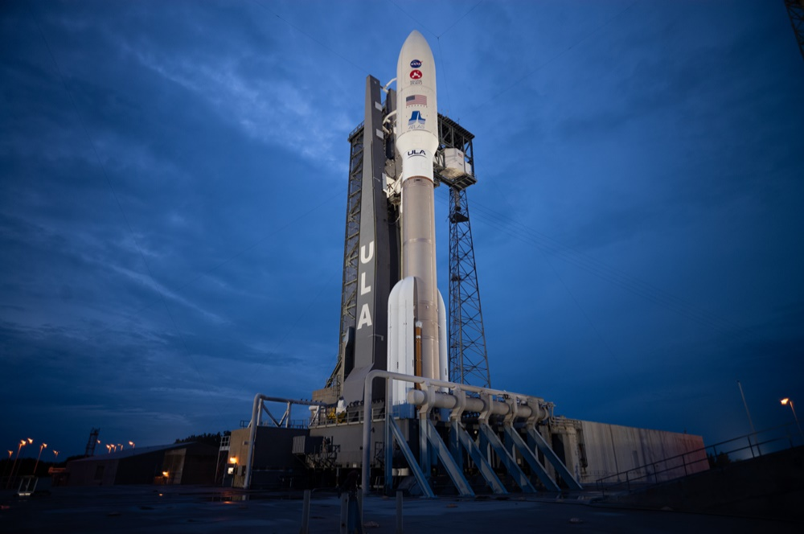
Intro
NASA Launch Services Program
NASA LSP: “Earth’s Bridge to Space”
Kennedy Space Center, FL
Connecting NASA scientific missions to commercial launch vehicle providers

Slide 6
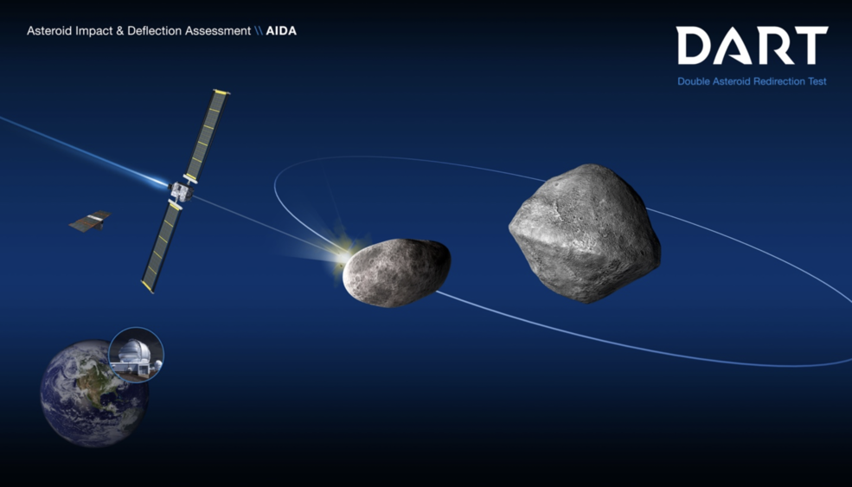
Intro
LSP Mission Analysis
Mission planning

Slide 7
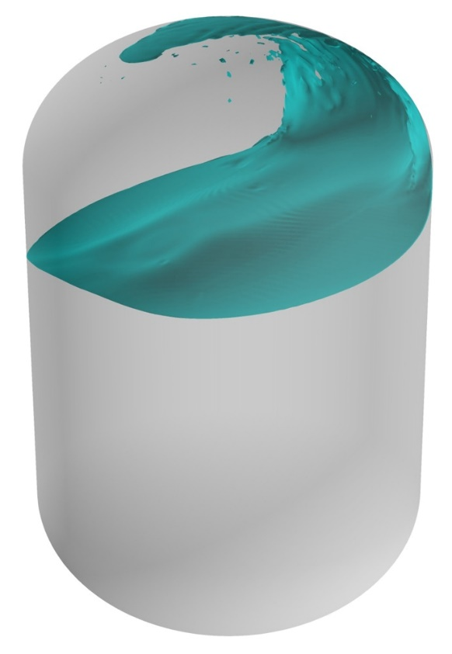
Intro
LSP Mission Analysis
Mission planning
Analysis and simulation
  Loads
  Thermal
  Fluids
  Space environments/radiation
  Flight controls
  Trajectory analysis
  etc.

Slide 8
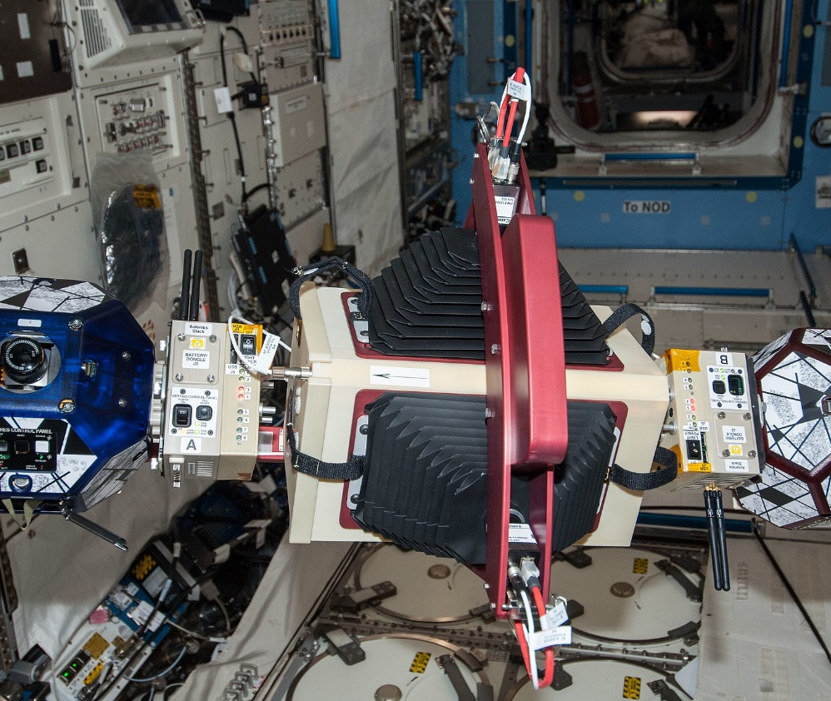
Intro
LSP Mission Analysis
Mission planning
Analysis and simulation
Special studies

Slide 9
Spacecraft Separation

Slide 10
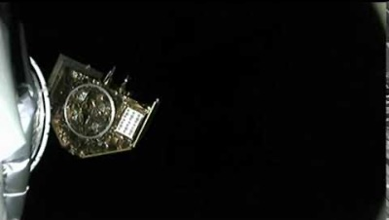
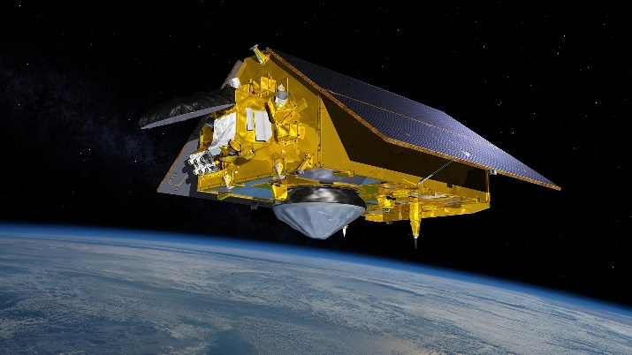
Spacecraft Separation
Sentinel 6 Michael Freilich

Slide 11

Spacecraft Separation
Modeling
Rigid body dynamics

Slide 12
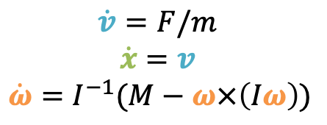
Spacecraft Separation
Modeling
Rigid body dynamics
  Velocity, position, and rotation rate equations about center of mass
$$\dot{v}=F/m$$
$$\dot{x}=v$$
$\dot{ω}=I^{−1}(M−ω×\left(Iω\right))$

Slide 13
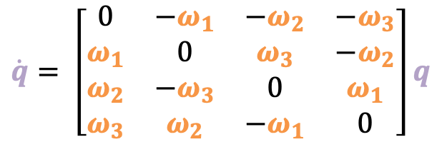
Spacecraft Separation
Modeling
Rigid body dynamics
  Velocity, position, and rotation rate equations about center of mass
  Quaternion attitude update
$\dot{q}= \left[\begin{matrix}0 & −ω_{1} & −ω_{2} & −ω_{3} \\ ω_{1} & 0 & ω_{3} & −ω_{2} \\ ω_{2} & −ω_{3} & 0 & ω_{1} \\ ω_{3} & ω_{2} & {−ω}_{1} & 0\end{matrix}\right]q$

Slide 14
Spacecraft Separation
Modeling
Rigid body dynamics
  Velocity, position, and rotation rate equations about center of mass
  Quaternion attitude update
Forcing functions

Slide 15
Spacecraft Separation
Modeling
Rigid body dynamics
  Velocity, position, and rotation rate equations about center of mass
  Quaternion attitude update
Forcing functions
  Clampband release

Slide 16
Spacecraft Separation
Modeling
Rigid body dynamics
  Velocity, position, and rotation rate equations about center of mass
  Quaternion attitude update
Forcing functions
  Clampband release
  Pusher springs

Slide 17
Spacecraft Separation
Modeling
Rigid body dynamics
  Velocity, position, and rotation rate equations about center of mass
  Quaternion attitude update
Forcing functions
  Clampband release
  Pusher springs
  Various connectors (not pictured)

Slide 18
Current Separation Analysis Tool

Slide 19
Current Separation Analysis Tool
Overview
Written in block-diagram-based causal modeling language (Simulink)
User-facing input deck – MATLAB script

Slide 20
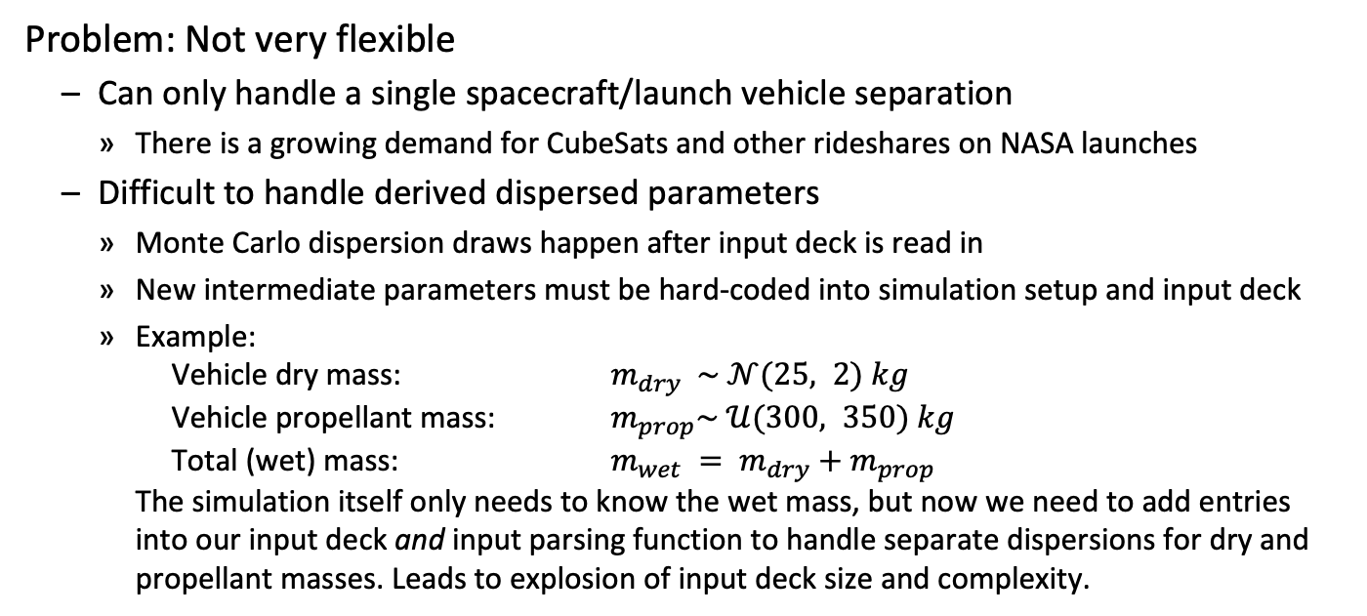
Current Separation Analysis Tool
Problems
Problem: Not very flexible
  Can only handle a single spacecraft/launch vehicle separation
    There is a growing demand for CubeSats and other rideshares on NASA launches
  Difficult to handle derived dispersed parameters
    Monte Carlo dispersion draws happen after input deck is read in
    New intermediate parameters must be hard-coded into simulation setup and input deck
    Example:
    Vehicle dry mass: $m_{dry} \sim 𝒩(25, 2) kg$
    Vehicle propellant mass: $m_{prop}\sim 𝒰(300, 350) kg$
    Total (wet) mass: ${m_{wet} = m}_{dry}+m_{prop}$
    The simulation itself only needs to know the wet mass, but now we need to add entries into our input deck and input parsing function to handle separate dispersions for dry and propellant masses. Leads to explosion of input deck size and complexity.

Slide 21
Current Separation Analysis Tool
Problems
Problem: Complicated
  Input deck --> “explosion of complexity”
  Current input script is over 1000 lines of MATLAB code
  Error-prone
    Did you remember to set all the parameters you needed?
    Did you remember to unset all the parameters you didn’t need?
  Prohibits quick turn-around analyses
  High learning curve

Slide 22
Current Separation Analysis Tool
Problems
Problem: Slow
  ~15 minutes for 514 Monte Carlo runs
  “Engineer time vs. compute time”
    Engineer time is expensive, compute is cheap…
    … until it takes engineering hours to iterate with slow tools
    When computation takes minutes, debugging takes hours
  Cannot interactively explore design trade-offs or parameter sensitivities
  Too slow for robust design parameter optimization

Slide 23
Alternative Frameworks

Slide 24
Alternative Frameworks
Acausal Modeling
Examples: Simscape, Modelica
Pros
Cons
Simple initial set up – no hand-deriving equations of motion
Easier to add new features or do custom mission-unique work
Modular
Can be even slower
  Prohibitive for Monte Carlo analysis
Limited by features of framework
DAEs: Overkill for spacecraft separation simulation?

Slide 25
Alternative Frameworks
Standard ODE Solver
Examples: ODEPACK, MATLAB, Sundials
Pros
Cons
Fast
Difficult to set up
Not modular: flat state vector
  Q: How do you handle an arbitrary number of spacecraft with a flat state vector?
  A: Lots of index juggling
  Q: What about nested spacecraft separations (spacecraft with child spacecraft)?
  A: ??

Slide 26
Alternative Frameworks
ODE Solver+ (SciML and Julia Ecosystem)
Pros
Cons
Fast
Composable with Julia ecosystem
  Modularity: ComponentArrays.jl
  Derived uncertain parameters: MonteCarloMeasurements.jl
  Physical unit checking: Unitful.jl
  Sensitivity analysis: DiffEqSensitivity.jl
  Interactive exploration: Pluto.jl
  3D visualization: Meshcat.jl
  etc.
Users must learn new language

Slide 27
RECURSAT

Slide 28
RECURSAT
Requirements
RECURSAT requirements

Slide 29
RECURSAT
Requirements
RECURSAT requirements
Efficient – Be able to run hundreds of Monte Carlo runs in under a second for interactive exploration

Slide 30
RECURSAT
Requirements
RECURSAT requirements
Efficient
Composable – Must work together with external tools, such as optimizers

Slide 31
RECURSAT
Requirements
RECURSAT requirements
Efficient
Composable
Universal – Handle every type of mission, including multiple spacecraft or even nested spacecraft

Slide 32
RECURSAT
Requirements
RECURSAT requirements
Efficient
Composable
Universal
Reasonably simple – Easy to learn with no “explosion of complexity” when adding new features

Slide 33
RECURSAT
Requirements
RECURSAT, the
Efficient
Composable
Universal
Reasonably simple
Separation
Analysis
Tool

Slide 34
RECURSAT
Design
Recursive Design

Slide 35
RECURSAT
Design
Recursive Design
Forces and points of application are calculated from a vehicle’s parent separation system (if it has one)
(it doesn’t)

Slide 36
RECURSAT
Design
Recursive Design
Forces and points of application are calculated from a vehicle’s parent separation system (if it has one)
The function is called on all children

Slide 37
RECURSAT
Design
Recursive Design
Forces and points of application are calculated from a vehicle’s parent separation system (if it has one)
The function is called on all children

Slide 38
RECURSAT
Design
Recursive Design
Forces and points of application are calculated from a vehicle’s parent separation system (if it has one)
The function is called on all children

Slide 39
RECURSAT
Design
Recursive Design
Forces and points of application are calculated from a vehicle’s parent separation system (if it has one)
The function is called on all children

Slide 40
RECURSAT
Design
Recursive Design
Forces and points of application are calculated from a vehicle’s parent separation system (if it has one)
The function is called on all children

Slide 41
RECURSAT
Design
Recursive Design
Forces and points of application are calculated from a vehicle’s parent separation system (if it has one)
The function is called on all children
The net force and moment goes into the vehicle’s equations of motion

Slide 42
RECURSAT
Design
Recursive Design
Forces and points of application are calculated from a vehicle’s parent separation system (if it has one)
The function is called on all children
The net force and moment goes into the vehicle’s equations of motion
The function returns equal and opposite force points to parent

Slide 43
RECURSAT
Design
Recursive Design
Forces and points of application are calculated from a vehicle’s parent separation system (if it has one)
The function is called on all children
The net force and moment goes into the vehicle’s equations of motion
The function returns equal and opposite force points to parent

Slide 44
RECURSAT
Design
Recursive Design
Forces and points of application are calculated from a vehicle’s parent separation system (if it has one)
The function is called on all children
The net force and moment goes into the vehicle’s equations of motion
The function returns equal and opposite force points to parent

Slide 45
RECURSAT
Design
Recursive Design
Forces and points of application are calculated from a vehicle’s parent separation system (if it has one)
The function is called on all children
The net force and moment goes into the vehicle’s equations of motion
The function returns equal and opposite force points to parent

Slide 46
RECURSAT
Design
Recursive Design
Forces and points of application are calculated from a vehicle’s parent separation system (if it has one)
The function is called on all children
The net force and moment goes into the vehicle’s equations of motion
The function returns equal and opposite force points to parent

Slide 47
RECURSAT
Design
Recursive Design
Forces and points of application are calculated from a vehicle’s parent separation system (if it has one)
The function is called on all children
The net force and moment goes into the vehicle’s equations of motion
The function returns equal and opposite force points to parent
Update state

Slide 48
RECURSAT
Requirements Met
Efficient
514 Monte Carlo runs in < 60 ms
15,000x faster* than the baseline model
*Some features of the baseline model are not implemented yet, expect this number to drop a small amount

Slide 49
RECURSAT
Requirements Met
Composable
MonteCarloMeasurements.jl: random variables that propagate through arithmetic operations
Unitful.jl: physical unit checking
DiffEqSensitivity.jl: global or local sensitivity analysis
ForwardDiff.jl or Zygote.jl: automatic differentiation
DiffEqUncertainty.jl + Optim.jl: robust design optimization under uncertainty
dry_mass = (25 ± 2)kg
prop_mass = (300..350)kg
mass = dry_mass + prop_mass

Slide 50
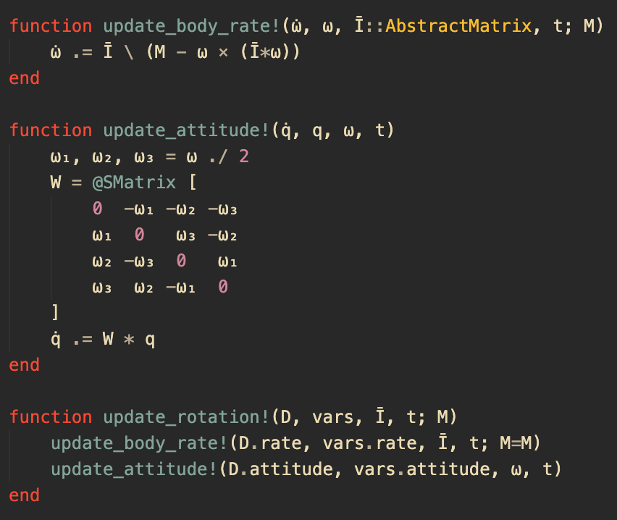
RECURSAT
Requirements Met
Universal
Recursive structure allows for completely arbitrary configuration
ComponentArrays.jl lets complex, nested structures pass through differential equation solver as a flat vector

Slide 51
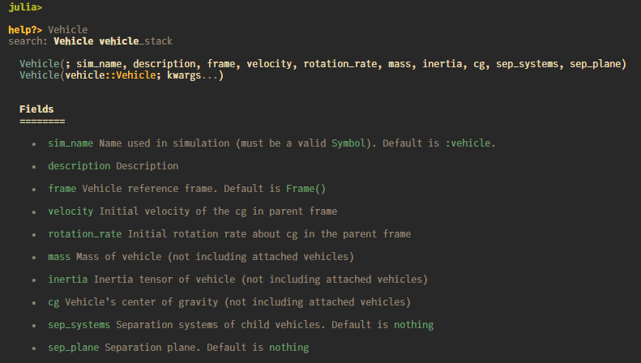
RECURSAT
Requirements Met
Reasonably Simple
New models can be set up in minutes with few lines of code
Import types and functions from library rather filling out input deck
  Specify only what you need
  No more “exploding complexity”
  View docstrings of exported functions in REPL

Slide 52
RECURSAT Example

Slide 53
RECURSAT Example
Intro
Assumptions
Launch vehicle and one spacecraft
514 Monte Carlo runs
Stacked vehicle starts with dispersed body rates about the combined center of mass.
Requirements
Tip-off Rates
< 1°/sec rotation rate in all spacecraft axes for all runs
Separation Velocity
> 0.55 m/sec relative velocity (between launch vehicle and spacecraft) for all runs

Slide 54
RECURSAT Example
Input Specification
The .. and ± operators are imported from MonteCarloMeasurements.jl to describe uniform and normal random variables, respectively
kg, m, and mm are imported from Unitful.jl to enforce correct units
spacecraft = Vehicle(
sim_name = :SC,
mass = (1000..1200)kg,
inertia = inertia_tensor(
xx = (500..600)kg*m^2,
yy = (1500..2500)kg*m^2,
zz = (1600..2600)kg*m^2,
xy = (5 ± 20)kg*m^2,
xz = (5 ± 20)kg*m^2,
yz = (-20..20)kg*m^2,
),
cg = Vector3(
x = (1.4..1.6)m,
y = -(20..40)mm,
z = -(40..60)mm,
),
sep_plane = Plane(
normal = Vector3(x=-1)
),
)

Slide 55
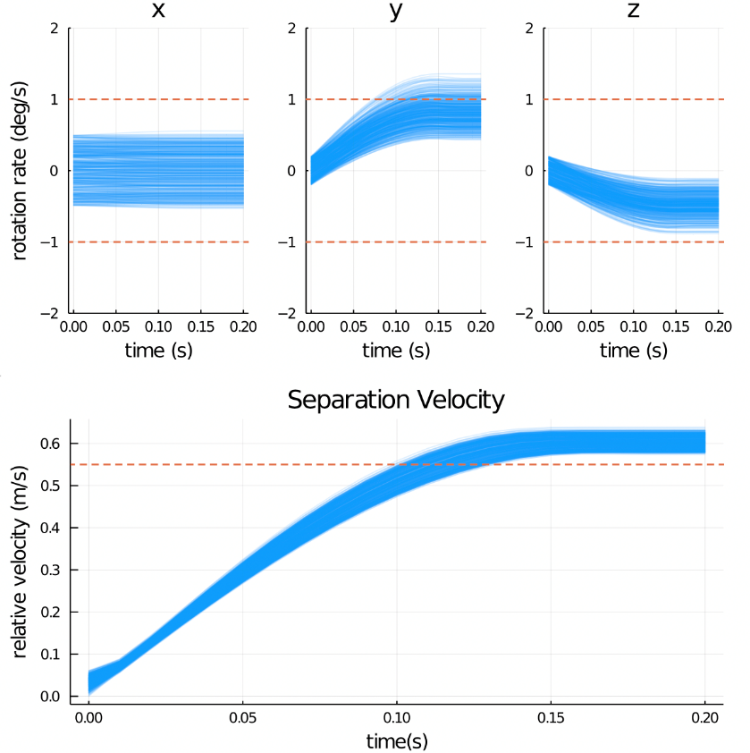
RECURSAT Example
Results
Not meeting tip-off requirement about the spacecraft y-axis.
High center of mass offset along -z direction

Slide 56
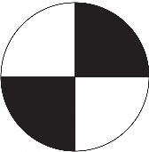
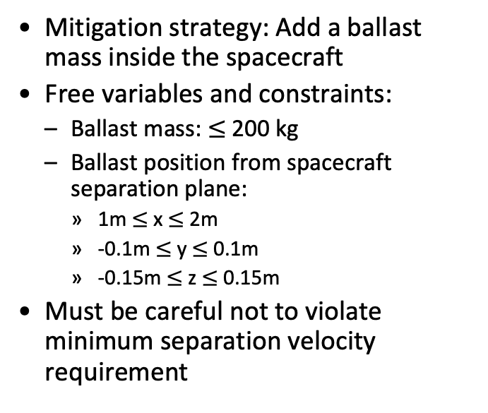
RECURSAT Example
Mitigation Strategy
Mitigation strategy: Add a ballast mass inside the spacecraft
Free variables and constraints:
  Ballast mass: $≤$ 200 kg
  Ballast position from spacecraft separation plane:
    1m $≤$ x $≤$ 2m
    -0.1m $≤$ y $≤$ 0.1m
    -0.15m $≤$ z $≤$ 0.15m
Must be careful not to violate minimum separation velocity requirement

Slide 57
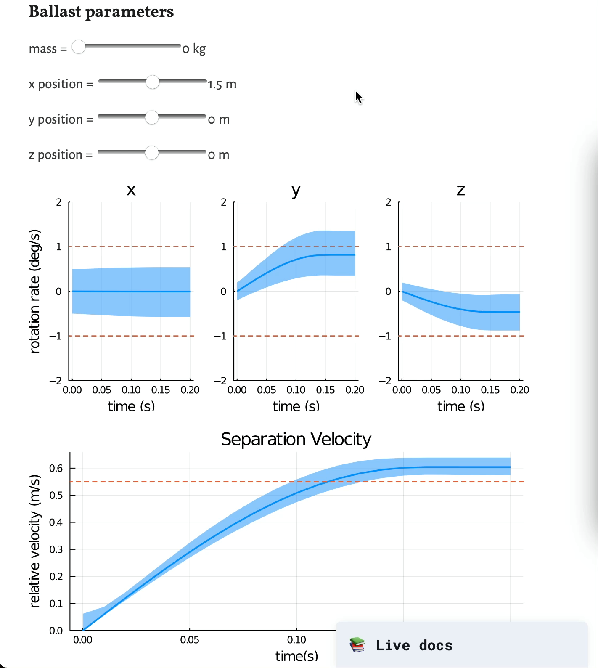
RECURSAT Example
Mitigation Strategy

Slide 58
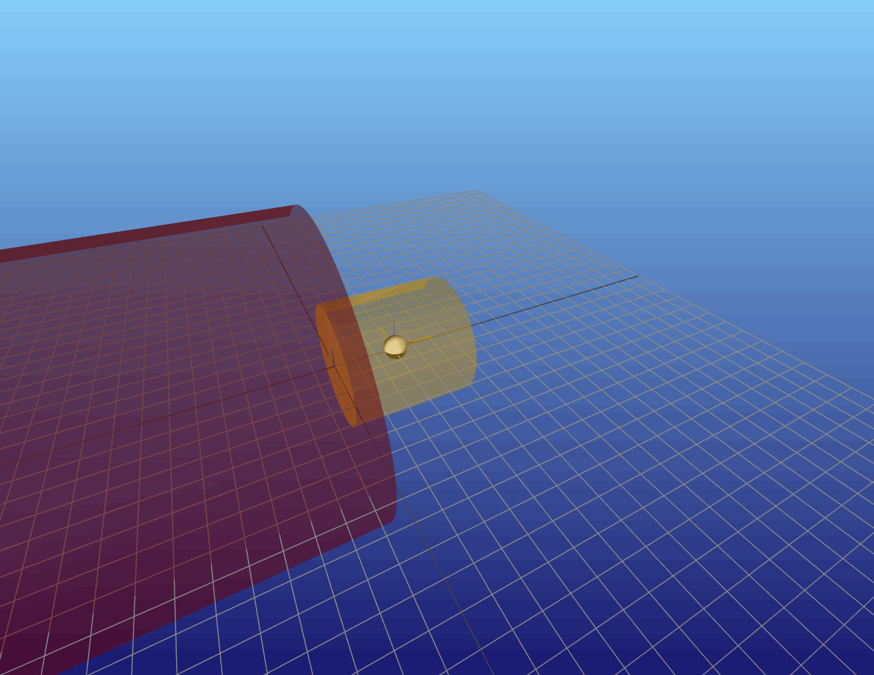
RECURSAT Example
3D Visualization

Slide 59
Backup

