Slide 1

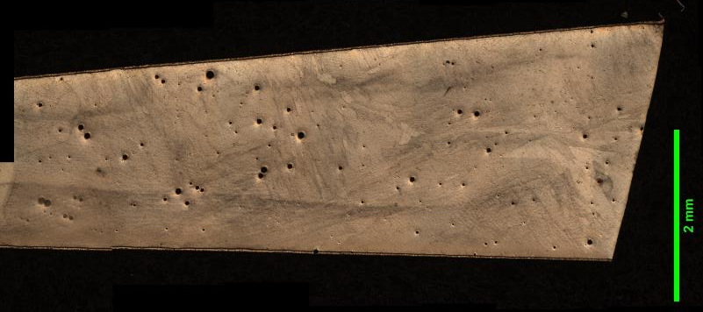
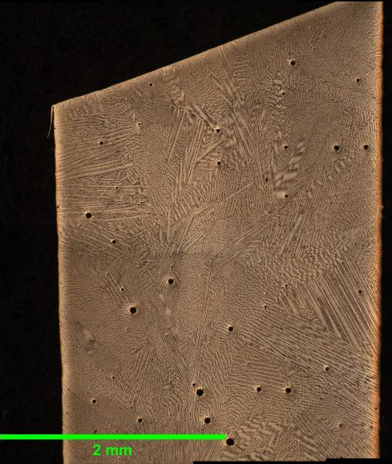
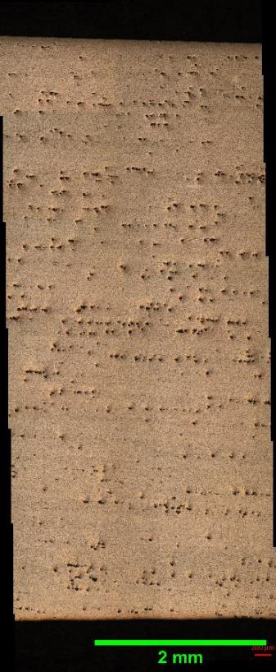
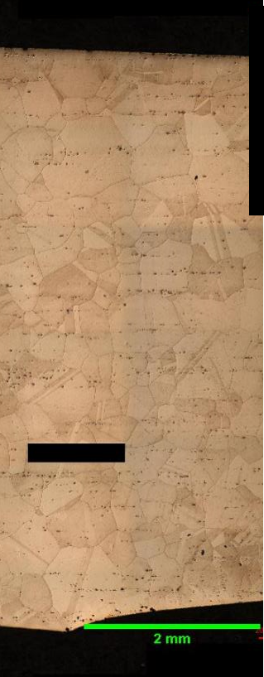
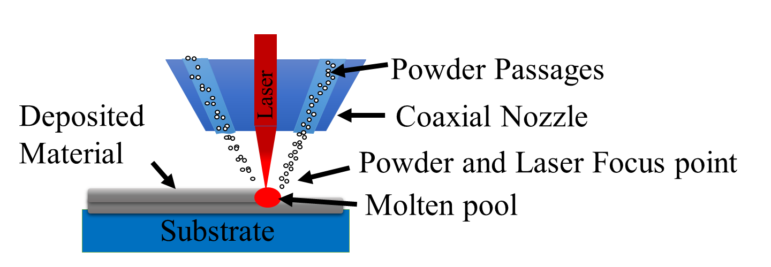
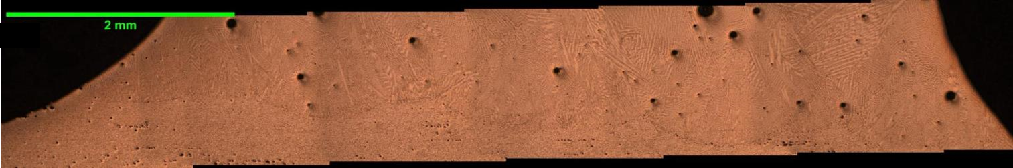
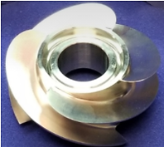
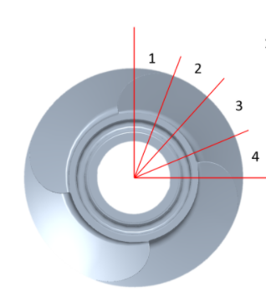
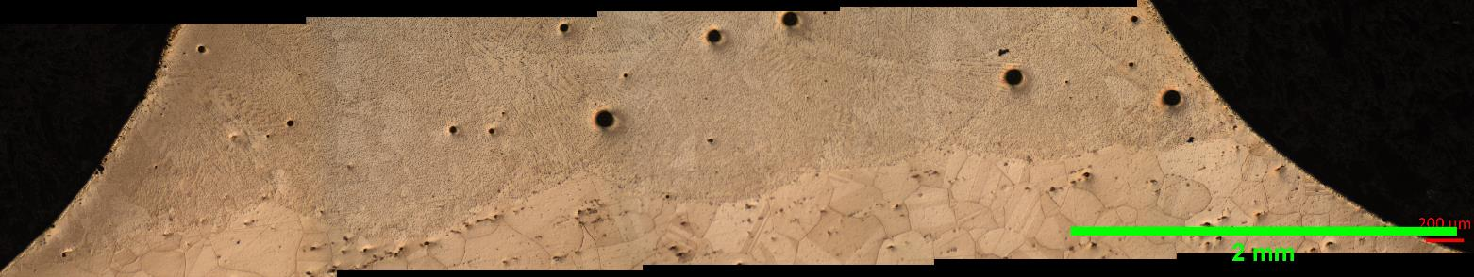
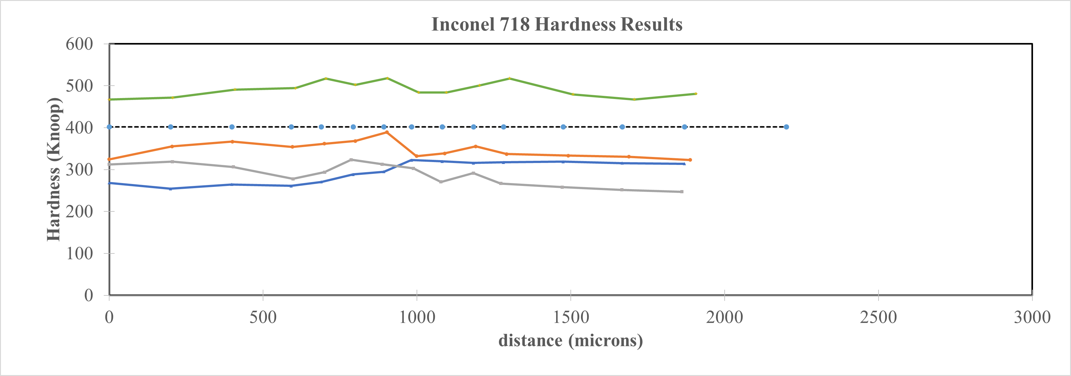
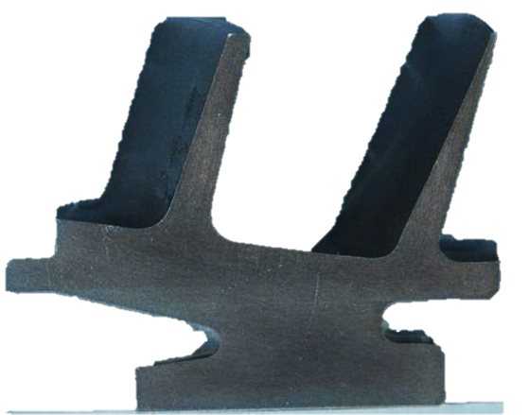
Microstructural Analysis Across a Hybrid Inconel 718 Turbopump Inducer Following a Scheduled Heat Treatment Process
Giancarlo Puerto¹ Judy Schneider¹ Chris Hill²
¹University of Alabama in Huntsville, ²NASA Marshall Space Flight Center
Abstract
Wrought Microstructure
BP-DED Fin Microstructure
Additive Manufacturing (AM) provides a low-cost method to fabricate near net shape complex parts. In this study, a turbopump inducer was fabricated using blown powder direct energy deposition (DED) of Inconel 718 to form the fins on a wrought hub. By utilizing this combination process, more cost-effective methods are possible for complex parts. A series of heat treatments were applied to the assembly per ASTM F330.
Background
As Built
Full Heat Treatment
Interface Microstructure
LP-BPD process through a co-axial nozzle.
As Built
As Built
Full Heat Treatment
Full Heat Treatment
Micro Hardness Results
As Received Inducer
Top-Down Schematic
Full Heat Treatment
Fin
Fin
Reference Wrought
Stress Relief
As Built
Interface
(BPD)
(Interface)
(Wrought)
Homogenization
Wrought Base
Inducer Sectioned Cut
 | Temperature (˚F) | Time (hr) | Standard for PBF
Stress Relief | 1950 | 1 | ASTM F3301
Hot Isostatic Pressing (HIP)/Homogenization | 2125 | 3 | ASTM F3301
Solution | 1950 | 1 | F3301/AMS 5664
Age Part 1 | 1400 | 10 | F3301/AMS 5664
Age Part 2 | 1200 | 10 | F3301/AMS 5664
Summary
References and Acknowledgements
Good interface bonding was visually observed from the LP-BPD process onto wrought alloy.
Differences were observed between the LP-BPD and wrought microstructures.
Uniform hardness measurements across the interface was observed after the heat treatments.
Funding provided by the NASA-MSFC CAN, “Evaluation of Alternative Nickel Based Superalloys for Additive Manufacturing of Liquid Rocket Components,” Grant # 80MSFC19M0017.
ASTM F3301-18a,”Post Processing Methods/Thermal Post Processing Metal Parts Made Via Powder Bed Fusion”
AMS/SAE Specification 5664e
ASTM Standard E384-17,”Microindentation Hardness of Materials”
Heat Treatment for the Inconel 718 Inducer

