Slide 1
SVGS:
Smart Video Guidance Sensor
Ivan Bertaska (ivan.r.bertaska@nasa.gov)

Slide 2
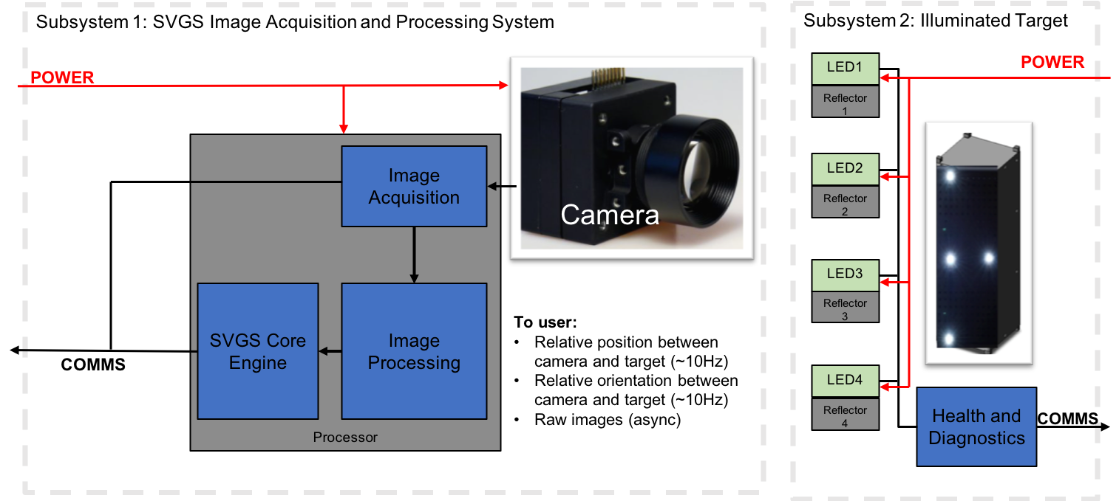
Overview
SVGS (Smart Video Guidance Sensor) will be a camera-based sensor that produces the relative position and orientation between a camera and a known target configuration.
Technology development of the Video Guidance Sensor family:
  1990’s: Video Guidance Sensor (VGS) flew on STS-87 and STS-95 and validated the VGS concept for autonomous rendezvous and docking (AR&D).
  2000’s: Advanced Video Guidance Sensor (AVGS) flew on DART and Orbital Express missions. Successful demonstrated AR&D.
  2010’s: Smartphone VGS ported the VGS/AVGS functionality to a Smartphone app. Successfully demonstrated EMFF on ground-based RINGS devices.
  2020’s: Smart Video Guidance Sensor is the space-qualifiable version of Smartphone VGS and the miniaturized version of AVGS/VGS. Target <1.5kg, <1U in size, and <12W power (split between target and camera).
Applications for SVGS include Rendezvous, Proximity Operations, and Docking (RPOD); Entry, Descent, and Landing (EDL) and lunar surface navigation.
Current funding goals (FY21-FY22 Game Changing Development Funding):
  TRL6 camera subsystem that has been environmentally qualified for both RPOD and EDL applications.
  TRL6 target subsystem that has been qualified for RPOD applications.

Slide 3
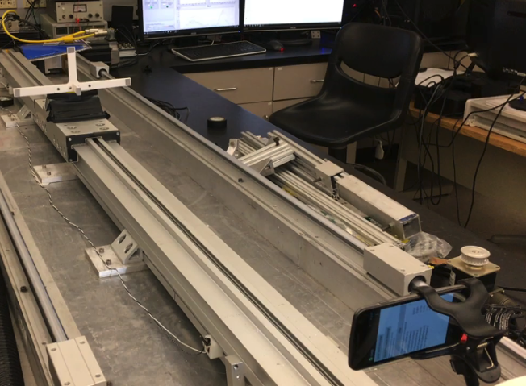

Concept of Operations
TARGET
Camera image after filtering and processing.
Image is Smartphone VGS calibration activity from partnership with Florida Institute of Technology.
CAMERA
  SVGS and Smartphone VGS Concept of Operations:
    Camera images target and passes image to processor (top left)
    Processor performs light image processing to isolate “blobs” - i.e., return signature from retroreflective or LED markers – (top right).
    Core Photogrammetry Engine (CPE) is applied to post-processed image to return the relative distances and relative orientation between target and camera (“relative pose”).
      Linear optimization algorithm provides fast and robust method of computing relative pose.

Slide 4
Technology Development Plan
SVGS algorithm has a high level of maturity, while there is an opportunity to raise TRL of hardware through center TIP funding and agency GCD/ECI/SSTP funding.
Past developments:
  FY13 Center Investment Fund (CIF): SVGS algorithm is ported from VGS/AVGS and implemented in Android OS on a Google Nexus “smartphone.”
  FY15 Technology Investment Program (TIP): First external customer for SVGS is a CubeSat ground demonstration vehicle. External interface and API created. TIPs are internally funded by MSFC.
  FY15-FY17 Intern Projects: Student interns integrate SVGS into new platforms and bring in new features, such as color blob tracking.
  FY17-FY18 Cooperative Agreement Notice (CAN): SVGS is used in closed-loop formation flying of multiple RINGS units with FIT.
  FY18-FY19 Small Business Technology Transfer (STTR): SVGS is ported to Astrobee hardware and validated in preparation for 6DOF experiments on ISS by FY21. These experiments will be run on two Astrobee units using SVGS to obtain their relative poses.
  Present Day: Developing SVGS technology on flight qualifiable hardware.
SVGS on Flat Floor CubeSats
SVGS on RINGS/Astrobee (ISS)
SVGS on Aerial Drones
 | FY13 | FY14 | FY15 | FY16 | FY17 | FY18 | FY19 | FY20 | FY21 | FY22 | FY23
TRL 3
TRL 4
TRL 5
TRL 6
TRL 7
TRL 8
FY13 CIF
FY15 TIP
FY17 CAN
FY18 CAN
FY20 CAN and/or Other Funding
FY18 STTR Phase I
FY19 STTR Phase II
FY20 TIP
Advanced Features for SVGS Image Processing
SVGS on SmallSats
Intern Labor
GCD/ECI
X-Project/TDM
SVGS for Lunar Applications
Lunar Lander Module/EDL

Slide 5
GCD FY21-FY22 Organization
Space Technology Mission Directive
Project Manager
Mallory Johnston
ST23 | 1.0 FTE
Technical Lead
Ivan Bertaska
EV41 | 0.5 FTE
Resource Analyst
Lynne Ellett Hines
RS60 | 0.1 WYE
Algorithm Support
Alex Summers
EV41 | 0.25 FTE
Software Lead
Bridgette Steiner
ES52 | 0.20 FTE
Hardware Lead
Garrick Merrill
ES34 | 1.0 FTE
Fabrication/Packaging Support
Matthew Strickland
ES33 | 0.2 FTE
Mentors:
John Rakoczy (EV41)
Ricky Howard (Retired)
Tom Bryan (ES35)
Software Support
TBD
ES52 | 0.8 FTE
Hardware Support
Brian Gibson
ES34 | 1.0 FTE

Slide 6
Backup

