Slide 1
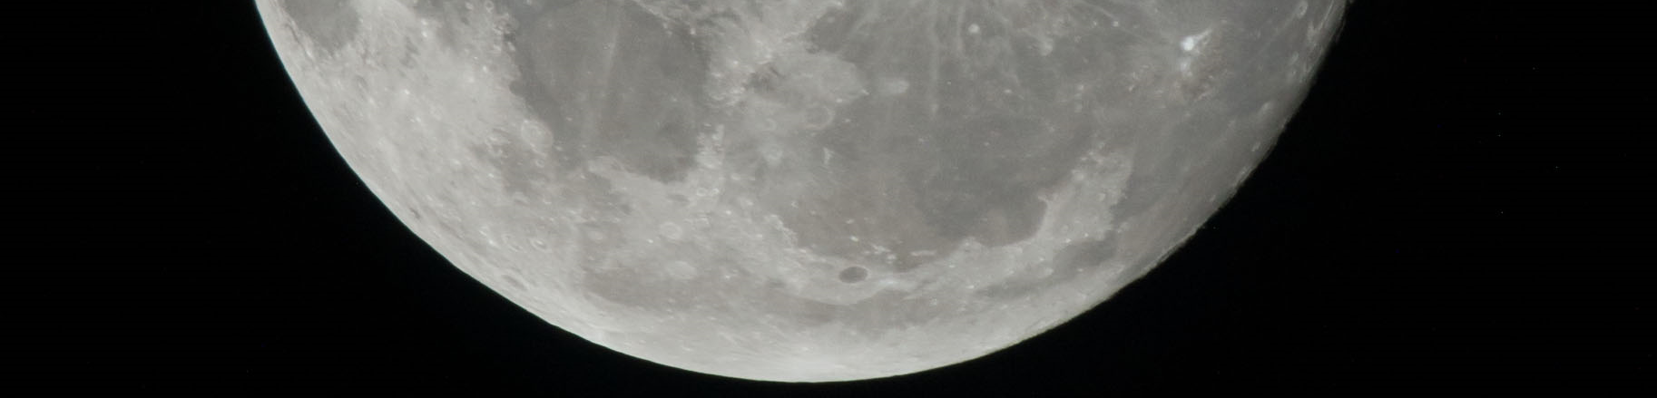

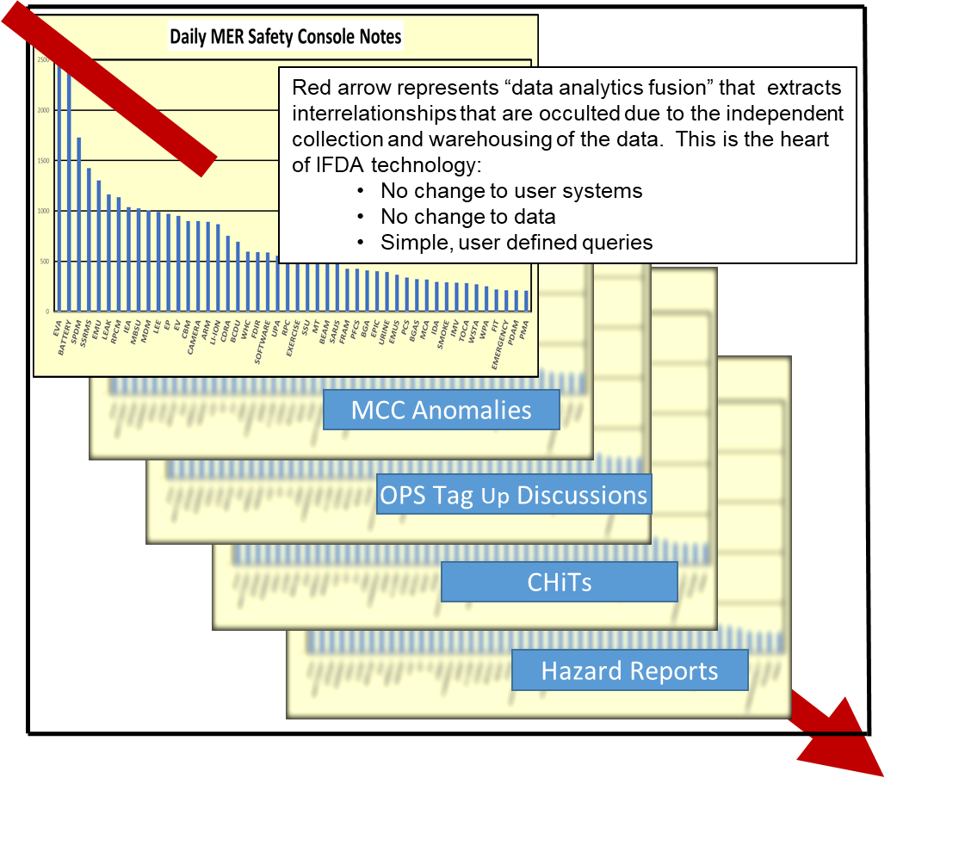
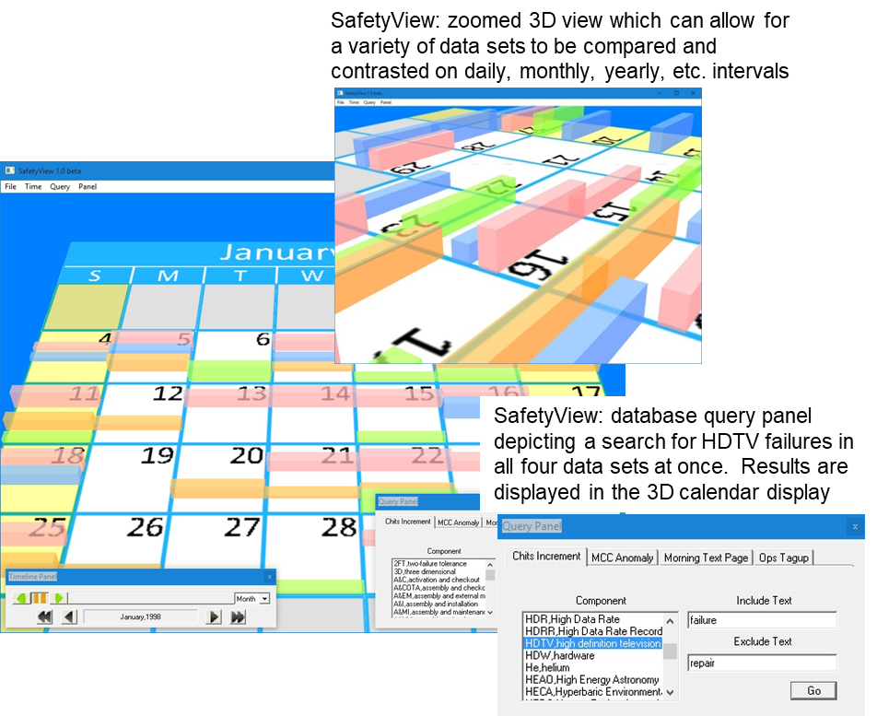
Information Fusion & Analytics for Human Lunar Exploration
National Aeronautics and Space Administration
Johnson Space Center (JSC) / White Sands Test Facility (WSTF) 2020 JSC Technology Showcase: FY20 CIF IRAD
John Euker / john.euker@nasa.gov, Tom Duncavage, Terry Mayes
Technology Taxonomy Area (TX): 11.2.4.5 - Software Infrastructure for Sensor Webs; 11.4.6 Cyber Infrastructure
TRL: start 2 / current 4
FY20 IRAD PROJECT Overview
The Information Fusion & Data Analytics (IFDA) project commenced in FY20. The objective is the fusion and rapid accessibility of large quantities of disparate sourced human spaceflight data. IFDA leverages the JSC ER7 modeling, simulation, and data fusion capabilities to collect, warehouse, and augment human exploration, data integration and analysis techniques. IFDA is a platform tailored for NA (S&MA) to develop highly advanced operational data integration and analysis techniques. The IFDA project’s integrated data will be utilized in two validation scenarios and provide the concept for development of a full-scale data analysis suite and storage solution useful to all JSC organizations engaged in real time operations and safety tasks. IFDA will be useful as a pathfinder for the Digital Transformation Program.
INNOVATION
The NASA Human Spaceflight data and informatics isolation problem exists due to technology and cultural barriers that have not been addressed historically. Lack of data analysis causes cost overruns, technical missteps, and program terminations. The solution is data fusion and subsequent data analysis. This data integration and utilization will take on more complexity with Gateway as NASA assets are spread over immense areas and with TBD connectivity. This project will address the gap by demonstrating how to: A. Import disparate source data sets to include very large (big data genre) sets and multiples into a single interactive and easily accessible visualization environment. B. Fuse such data without content interpolation or other core modification. C. Generate visualizations that are data-interactive for test and evaluation. D. Generate final product data-driven visualizations for program knowledge base, public transport, and knowledge archive.
Outcome (FY20 Products)
Delivered prototypical hardware & software system with the following features:
  Mini-ITX embedded system motherboard
  5 SATA controllers w/SSD
  Ultra low power (35 Watt) core i7 processor with 8 GB memory
  12 TB (expandable) of hard drive space in a case 7.5” x 7.75” x 10”
Data collected includes ISS telemetry 1998-2005, ISS acoustic data, Safety Console Notes, MCC anomalies, Operations Tag-up minutes, CHiTS, and ISS hazard reports.
Histogram analysis of common phrases, Microsoft Outlook parser, Microsoft Excel parser, and full English language thesaurus.
Infusion Space / Earth
IFDA’s tooling and analytics visualization environment allows astronauts, flight controllers, engineers, and managers to observe a detailed and integrated visual composite of relevant data sets simultaneously, thereby detecting trends and latent safety risks that might otherwise be overlooked when data sets are individually analyzed using traditional methods and computational environments.
As an example, IFDA’s SafetyView application is a dynamic histogram tool that displays historical trends of incidents, warnings, and lessons learned in an interactive calendar formatted visual presentation.
SafetyView
PARTNERSHIPS / collaborations
This work has been proceeding with support from the following divisions and directorates: NE, SA/SK, OZ, OI, EA/ER EC, CK, AD, and XT/XA. These JSC partners are providing data source sharing and user data insights. IFDA capitalized upon previous collaboration between the ER Concept Exploration Lab, the Hobby Center for Public Affairs, the University of Houston, the State of Texas DFPS, and Katoen Natie Gulf Coast. The toolkits, libraries, and algorithms of past collaboration technologies were modified to create the IFDA toolset.
Future Work
The second year of this project has focused exclusively on creating information fusion tools to perform advanced data mining and analytics. These tools take the disparate data supplied in the first year and analyze the data, providing actionable information to user. Given the data is made accessible, IFDA will easily identify and significantly minimize risk gaps between NASA programs, commercial providers, and new NASA programs such as Gateway, lunar exploration, operations, as well as future Mars programs
26883-1

