Slide 1
Simultaneous Development and Robust Optimization of a Microstructure Dependent Material Model
Leveraging Sequential Monte-Carlo Methods to Enhance Symbolic Regression Analysis
Karl Garbrecht¹, Nolan Strauss¹, Geoffrey Bomarito², Patrick Leser², Jacob Hochhalter¹
¹ University of Utah
² NASA Langley Research Center

Slide 2
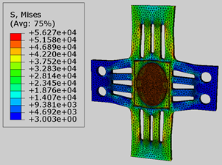
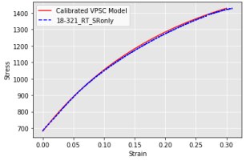
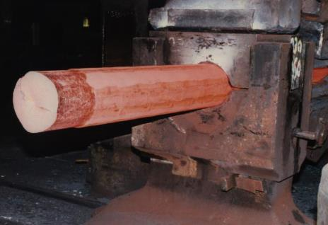

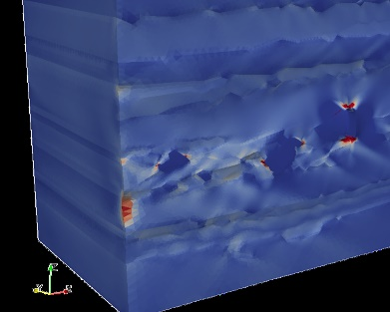
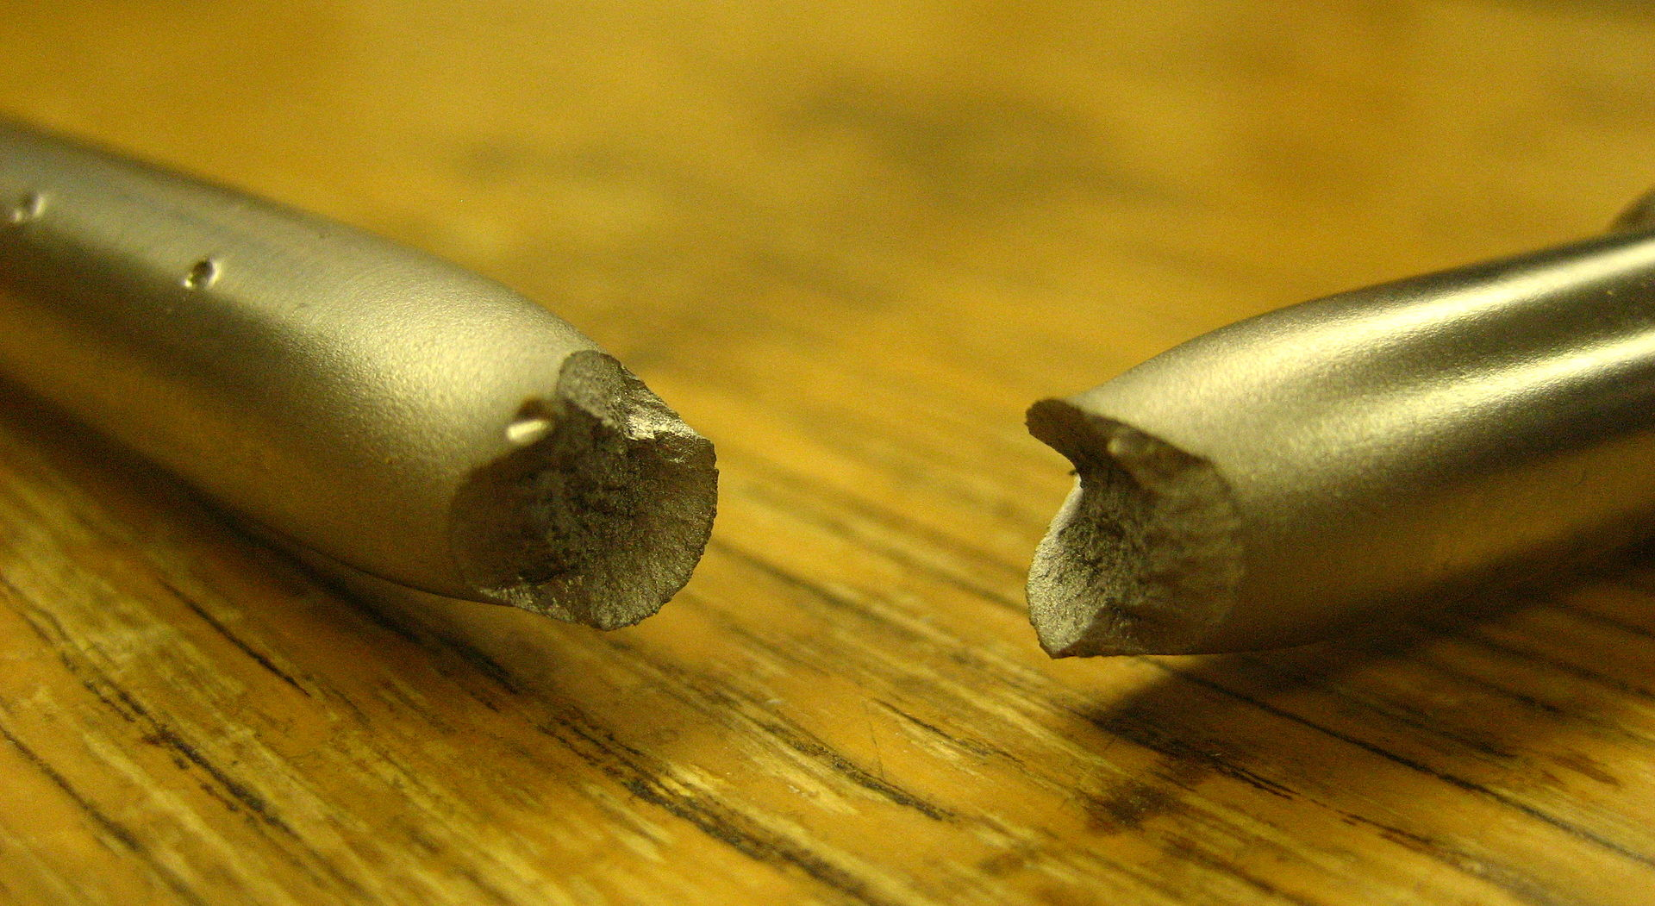
Multi-Scale Material Models
f(Physical, Meso, Micro Properties)
Macroscale Response = f(Continuum Properties) =
https://en.wikipedia.org/wiki/Fracture
https://en.wikipedia.org/wiki/Forging
Design Scale of Interest
Scale of
Variables
Notes:
.

Slide 3
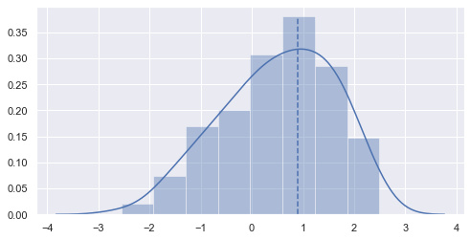
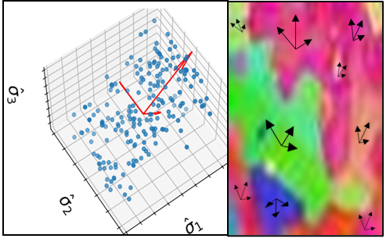
Homogenized Parameters
Grain Size
Parameter homogenization
provides method around microscale modeling
loss of fidelity
potentially abstract variables
additional processing steps
Scalars
- mean
- variability
Texture
Tensors, Vectors, Scalars
- texture tensor ¹
cos sim / projection
magnitude, mean/var
1 - S. Kotha, D. Ozturk 2019 (presentation of several microstructural homogenization parameters)

Slide 4



Symbolic Regression
Genetic Programming Symbolic Regression (GPSR) - proposes, evaluates, and evolves solutions given fitness function and training data
Initial Solution Generation
Model Represented as a Directed Acyclic Graph
Chromosome | 6 | 5 | 4 | 3 | 2 | 1 | 0
Main | + | * | a | sin() | a | b | X
Topological | 5 | 4 | - | - | - | - | -
 | 1 | 3 | - | 0 | - | - | -
Evaluation
+
Propose New Models
Evolution
b
*
a
$$a∗\sin\left(x\right)+b$$
SIN
Potential Solutions
X

Slide 5
GPSR Traditional Regression
Effectively, regression analysis without specifying model form
Similar to traditional regression:
  response will be given as a function of selected input variables (implicit possible)
  data quality important (size, scaling, variability, domain sample locations)
  extrapolation and interpolation accuracy unknown
Unlike traditional regression:
  coefficient significance/feature selection is automated
  no closed form solution: computationally expensive, no guarantee of optimum solution
  larger data set required (possibly much larger)
  currently developing technique, less established

Slide 6
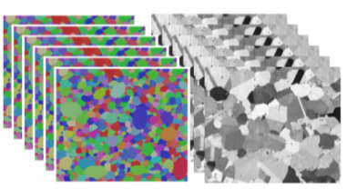
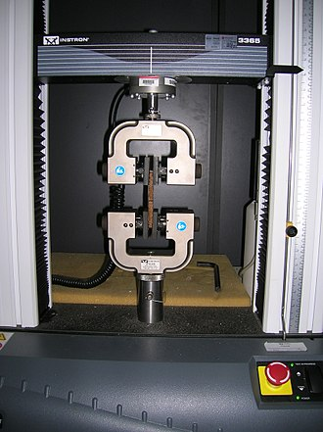

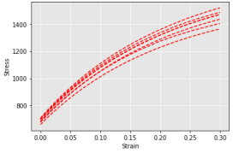
Data Collection and Generation
Microscopy Data
Mechanical Test Data
Measured Data
Independent Variables
&
Response Variables
https://en.wikipedia.org/wiki/Tensile_testing
Calibrate with Measured Data
Create Training Data
Measured &
Modeled Data
Homogenized
Material Parameters
VPSC
Continue to Machine Learning
Response Variables

Slide 7


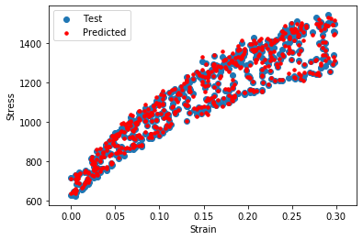
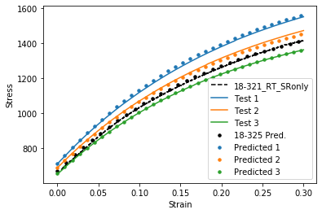
GPSR Solution Results
Error Metric | Results
MAPE | 0.78
MSE | 140
ε = Plastic Strain (%) α = Texture Alignment β = Texture Alignment Variability
MAPE = Mean Absolute Percent Error (%)
MSE = Mean Square Error (MPa^2)
Scatter Plot of 500 Randomly Sampled Data Points vs. GPSR Predicted Solution
Plot of 3 Randomly Sampled Specimen Stress-Strain Training Data vs. GPSR Predicted Solution
Test 1
ε = True Plastic Strain (%) σ = True Stress (MPa)

Slide 8
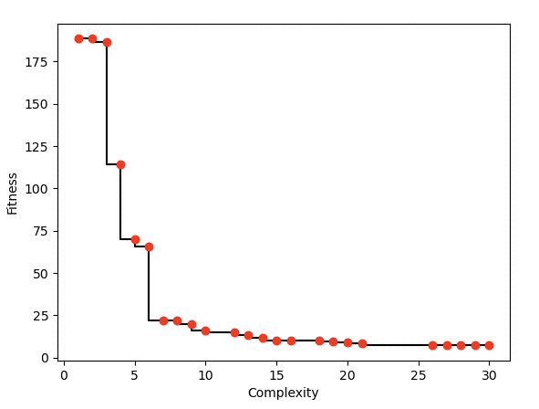
GPSR Results Discussion
Deterministic Algorithm: deterministic fitness
  can find linear or nonlinear multi- dimensional solutions
  prone to generate complex or overfitted models with many parameters and terms
  must select “best” model out of final
  pool of models
Complexity vs Fitness
Probabilistic Algorithm: Bayesian fitness
  allows for unbiased model comparisons wrt observed data
  evaluation includes model complexity

Slide 9
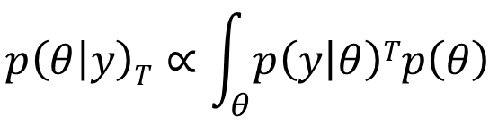

GPSR with Sequential Monte Carlo (SMC)
Initial Solution Generation
Bayesian Reformulation of Evaluation
Set Equation Priors Around Optimized Parameters
Sequentially Temper Posterior and Evaluate Equation
Selection via Bayesian Comparison
Evaluation
- Iteratively Increase T,
Propose New Models
Evolution
- Then use Fractional Bayes Factor³ (FBF) for model selection
Potential Solutions
3 – A. O’Hagan, 1995
9

Slide 10
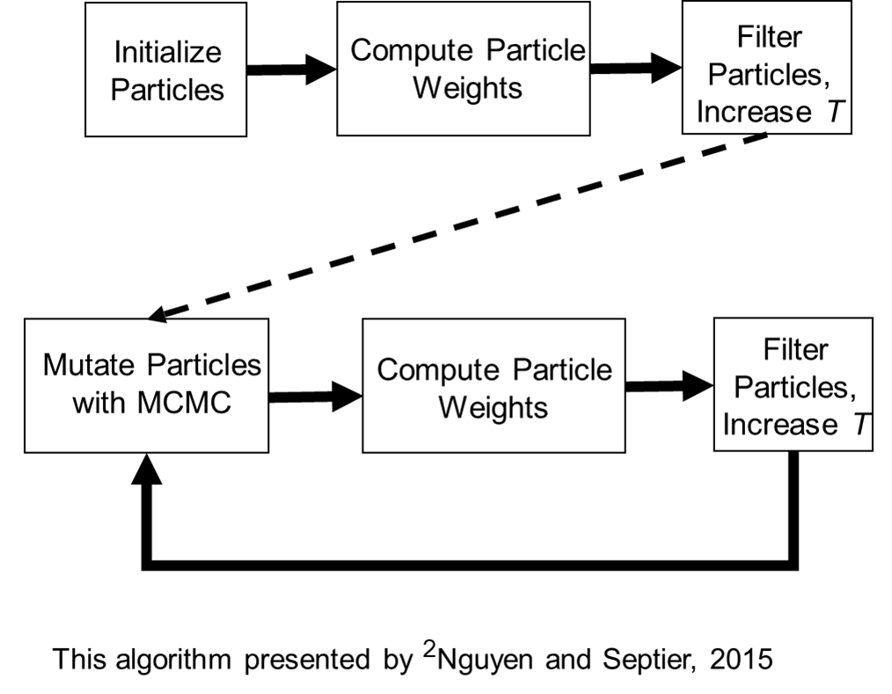
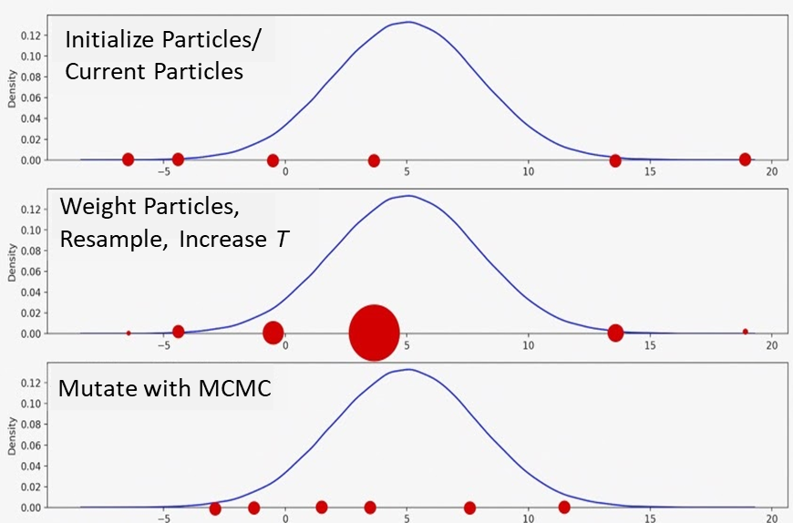
SMC Implementation
Probability Weighted Particle Filtering

Slide 11
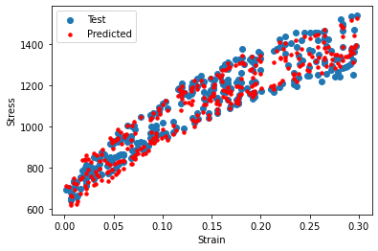
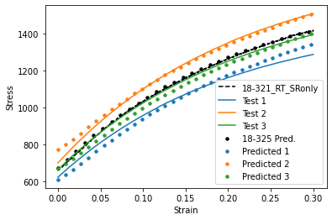

SMC-GPSR Solution Results
$$σ=1432+λ−1056∗sin⁡(\text{α})+1056∗λ^{cos⁡sin⁡(ε)}$$
Error Metric | Results
MAPE | 2.2
NMLL | 410
$$λ(ε)={2ε}^{{2ε}^{2ε}}$$
ε = Plastic Strain (%) α = Texture Alignment
MAPE = Mean Absolute Percent Error (%)
NMLL = Normalized Marginal Log Likelihood
Scatter Plot of 500 Randomly Sampled Data Points vs. GPSR Predicted Solution
Plot of 3 Randomly Sampled Specimen Stress-Strain Training Data vs. GPSR Predicted Solution
ε = True Plastic Strain (%) σ = True Stress (MPa)

Slide 12
SMC-GPSR Results Discussion
Direct comparison difficult due to different hyperparameters (HP)
HP
 | Islands | Population | Generations | Data Set Size | Test Error (%) | Training Error (%) | Time
Parallel GPSR | 50 | 3,000 | 4,000 | 2,000 | 0.78 | 0.75 | 11 hr
GPSR | 1 | 100 | 1000 | 100 | 6.5 | 6.2 | 2 min
GPSR | 1 | 100 | 100 | 100 | 4.0 | 3.6 | <0.5 min
SMC – GPSR | 1 | 100 | 100 | 100 | 2.2 | 2.0 | 1.5 hr
SMC – GPSR | 1 | 100 | 100 | 100 | 2.3 | 2.2 | 1.5 hr
Run
Initial Observations of SMC-GPSR Implementation
good performance vs generation (more testing required due to influence of initialization)
models generalized from small data set
computationally expensive
additional HPs associated with SMC

Slide 13
Conclusions and Continuing Efforts
With current serial implementation:
GPSR with Bayesian selection feasible
significant increase in run time to achieve equivalent results to deterministic GPSR
Continuing Efforts:
full-scale testing of parallel implementation
formal evaluation against GPSR
improve algorithm efficiency

Slide 14
Acknowledgments and Reference
Acknowledgments
The authors are grateful for experimental data made available by MID3AS Additive Manufacturing Challenge and project support from NASA Grant 80NSSC20M0128
References
Shravan Kotha, Deniz Ozturk. 2019. Somnath Ghosh. “Parametrically homogenized constitutive models (PHCMs) from micromechanical crystal plasticity FE simulations, part I: Sensitivity analysis and parameter identification for Titanium alloys”. International Journal of Plasticity, vol.120, p. 296-319. ISSN 0749-6419.
Thi Le Thu Nguyen, Francois Septier, Gareth W. Peters, and Yves Delignon. 2015. “Efficient Sequential Monte-Carlo Samplers for Bayesian Inference”. IEEE Transactions on Signal Processing, vol. 64, no. 5, p. 1305-1319, DOI: 10.1109/TSP.2015.2504342.
O'Hagan, A. 1995. “Fractional Bayes Factors for Model Comparison”. Journal of the Royal Statistical Society: Series B (Methodological), vol. 57: p. 99-118. DOI: 10.1111/j.2517-6161.1995.tb02017.

