Slide 1



Characterization of Dendritic Spatially Extended 3D Patterns in Directional Solidification: Microgravity Experiments in DECLIC-DSI Onboard ISS and 3D Phase-field Simulations
Kaihua Ji¹, F.L. Mota², L.L. Strutzenberg³,
R. Trivedi⁴, N. Bergeon², A. Karma¹
¹Northeastern University
²IM2NP, Aix-Marseille Université
³Marshall Space Flight Center
⁴Iowa State University
Notes:
Enter speaker notes here.

Slide 2
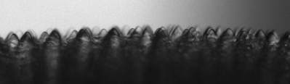
Outline
Microgravity experiment: DEvice for the study of Critical LIquids and Crystallization - Directional Solidification Insert (DECLIC-DSI).
Evolution of the primary spacing with a flat solid-liquid interface. The effect of divergent and convergent sub-grain boundaries.
Evolution of the primary spacing with a macroscopically curved solid-liquid interface. Effects of the macroscopic curvature.
Summary and outlook.

Slide 3
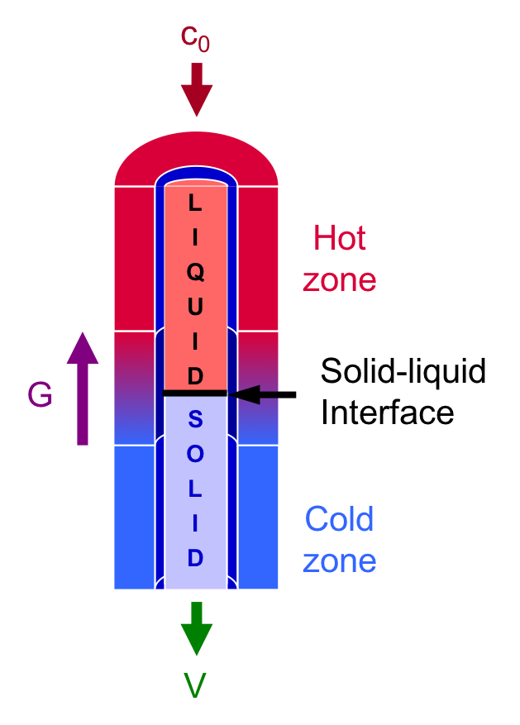
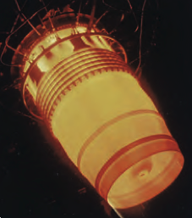
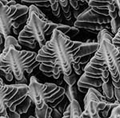
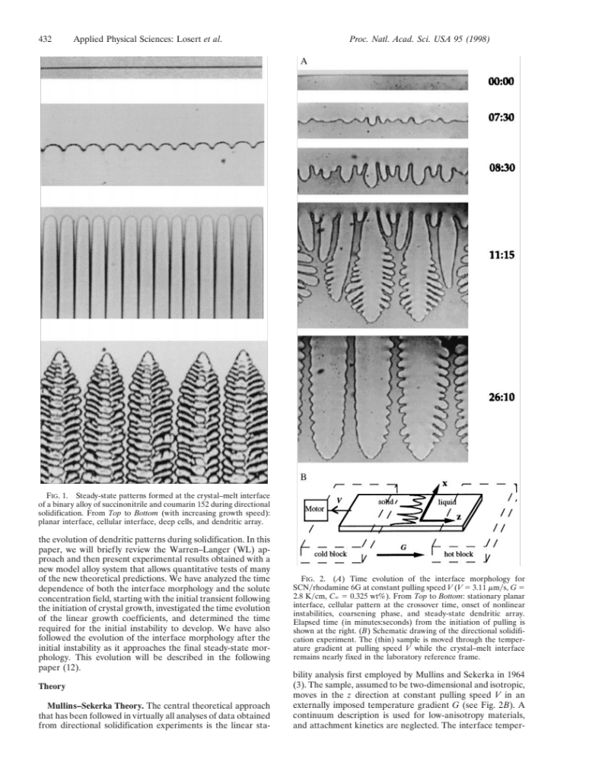

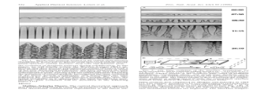
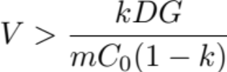
The system – directional solidification
Microstructure formation under well-controlled growth conditions (G, V, C0)
Temperature gradient G
Growth velocity V
Solute concentration C0
Giamei (2013)
Losert, Shi, and Cummins (1998)
Constitutional supercooling
David et al. (1992)

Slide 4
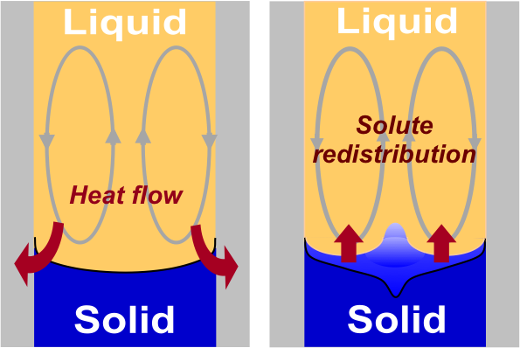
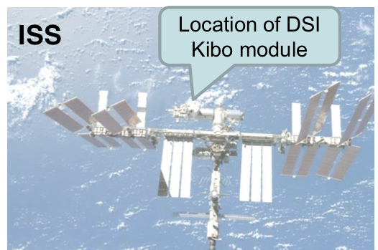
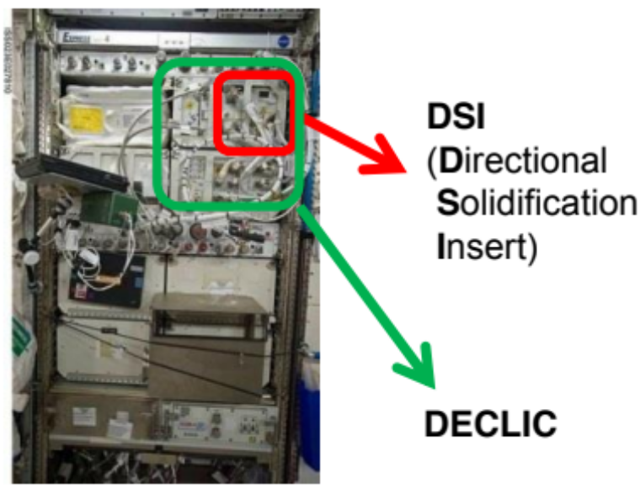
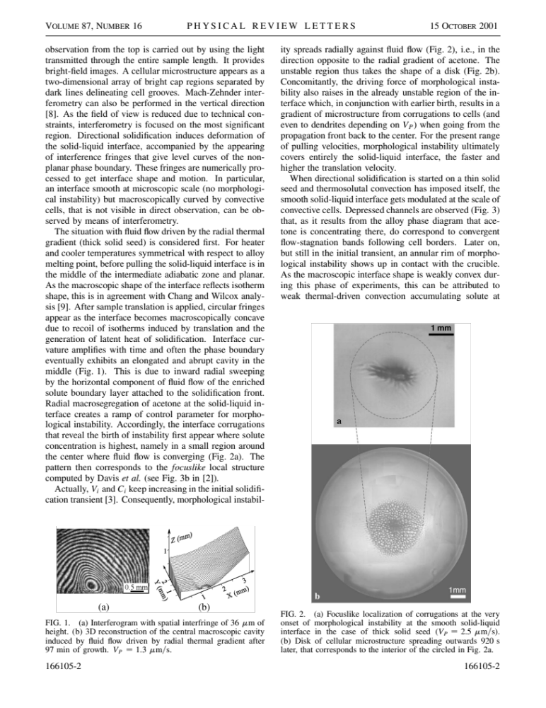
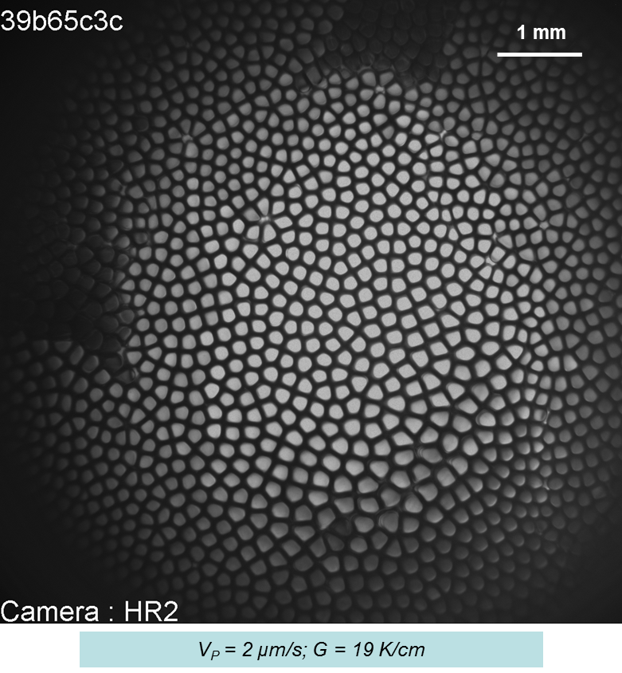
Microgravity experiments
Gravity-induced convection
Microgravity experiment
Two campaigns:
1) Microgravity experiments from 2009-2011 dedicated to cellular regime (DSI).
2) Microgravity experiments from 2017-2018 dedicated to dendritic regime (DSI-R).
Microstructure heterogeneities
Jamgotchian et al., PRL (2001)
Notes:
Heterogeneities
DECLIC-DSI: two campaigns

Slide 5
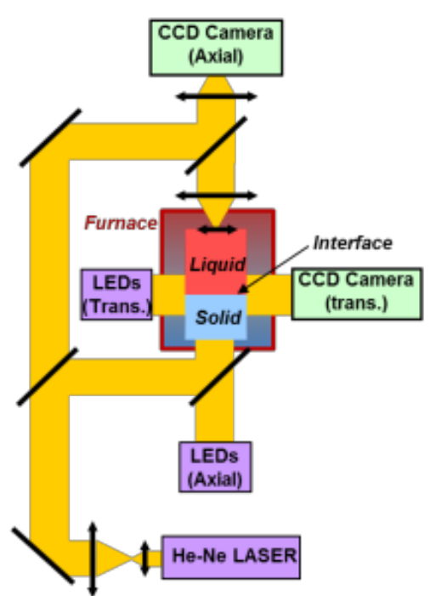
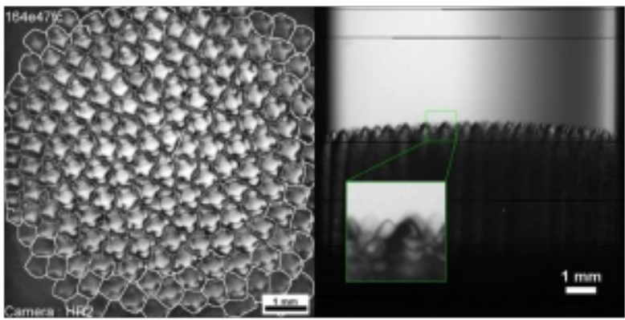
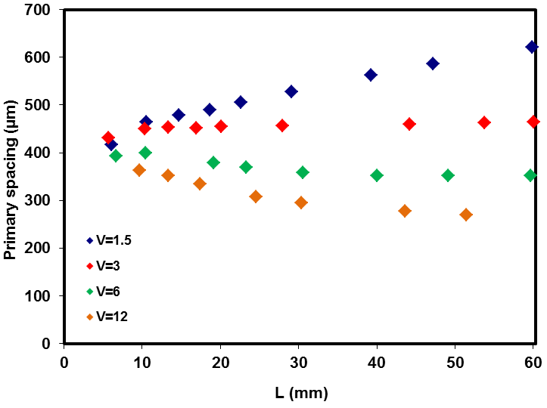

Evolution of the primary spacing
The DECLIC-DSI setup enables to observe the solid-liquid interface from axial and transverse views.
The average of the primary spacing evolves over time. Two factors need to be considered: the sub-grain boundary and the macroscopic curvature.
Representation of the optical apparatus of the DECLIC-DSI.
Direct observation from the axial and transverse views
Mota, F. L., K. Ji, T. Lyons, L. Strutzenberg, R. Trivedi, A. Karma, and N. Bergeon. 70th International Astronautical Congress. 2019.
Notes:
- Use a transparent alloy

Slide 6
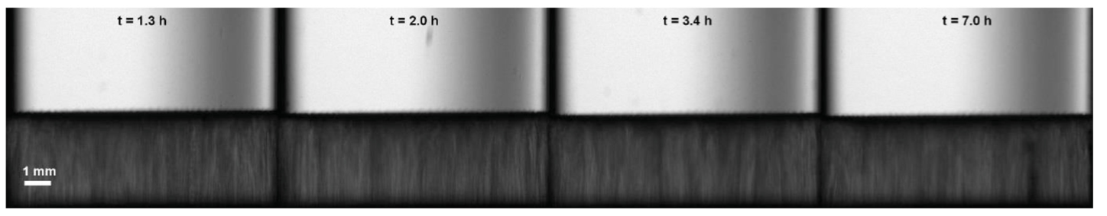
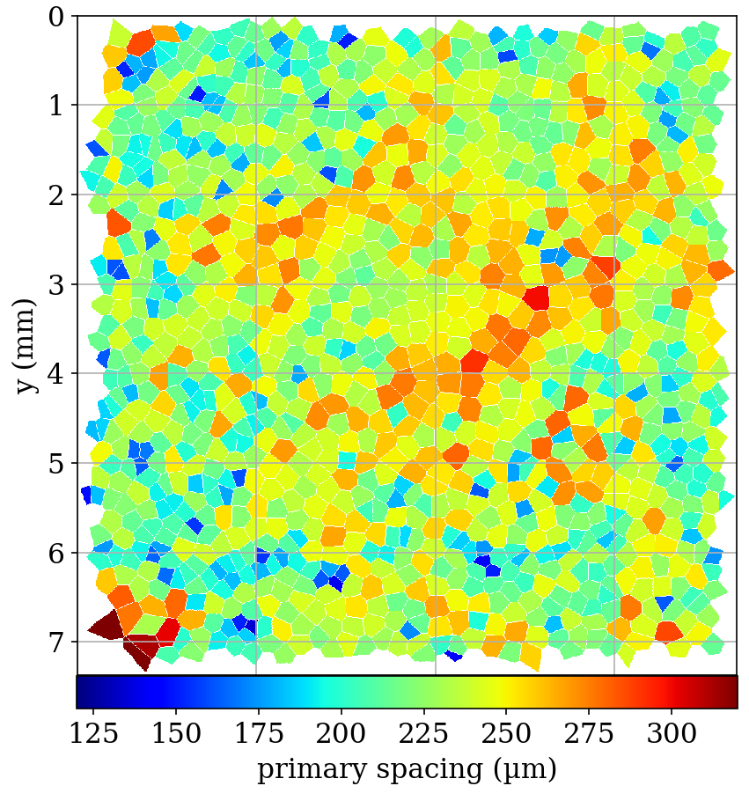
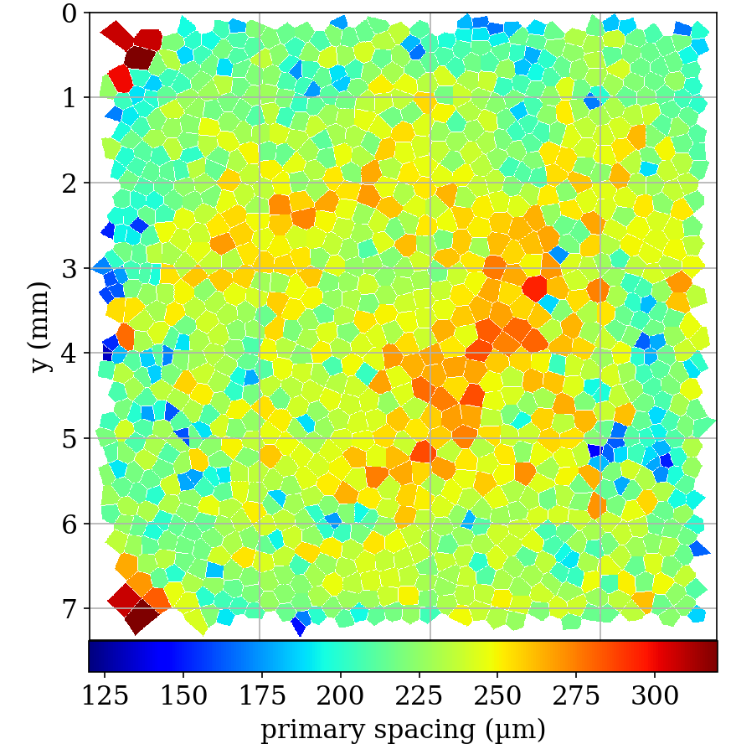
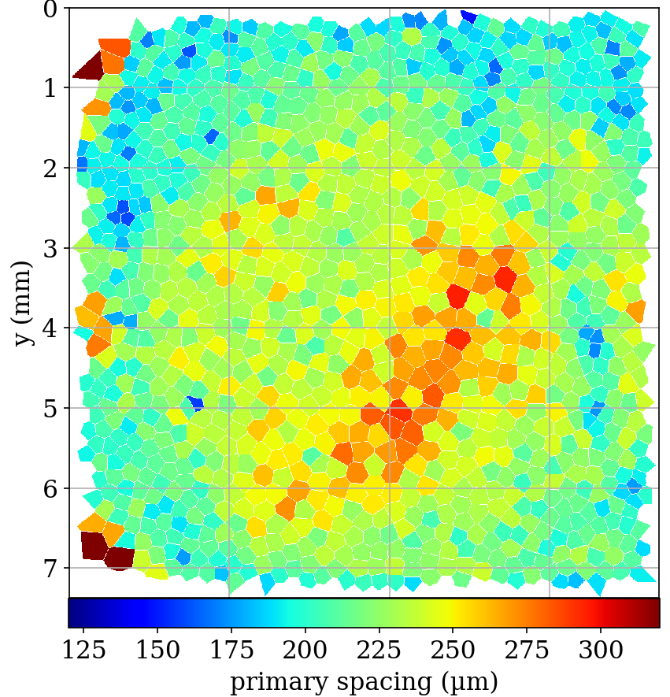
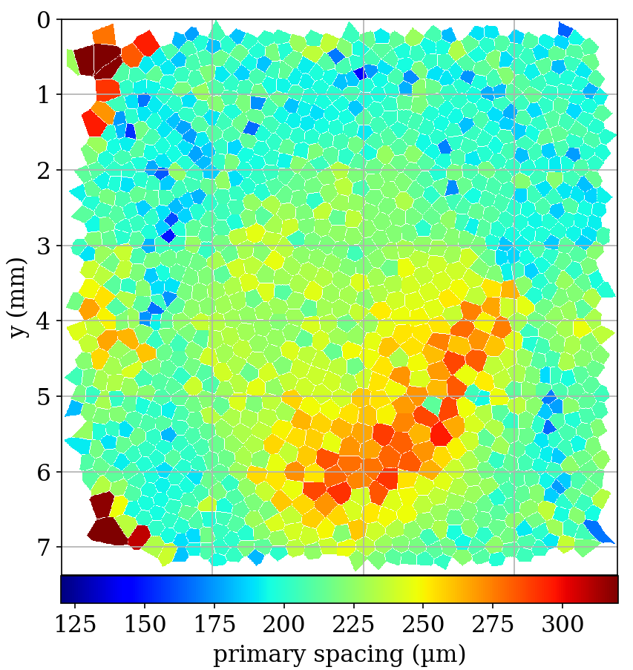
Spacing evolution with a flat interface
Side view
Top view
Mota, F. L., J. Pereda, K. Ji, Y. Song, R. Trivedi, A. Karma, and N. Bergeon. Acta Materialia 204 (2021): 116500.
Notes:
For a flat interface, the primary spacing evolves due to

Slide 7
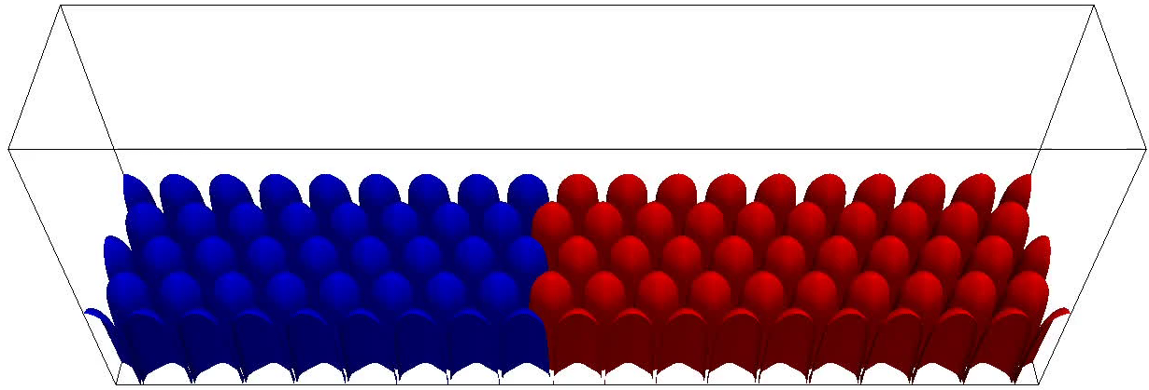
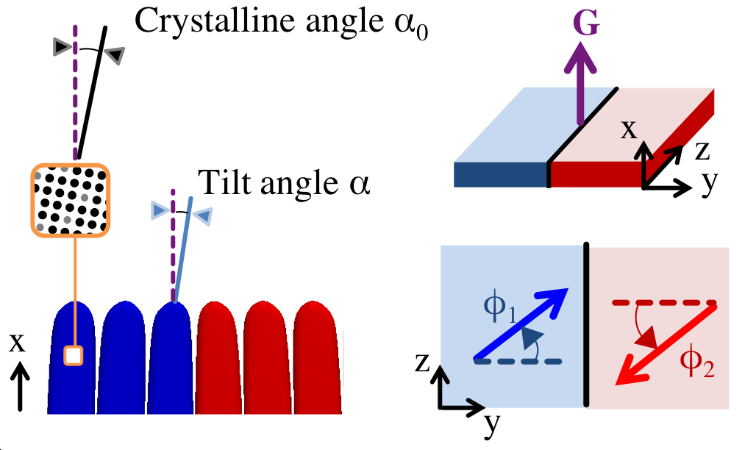
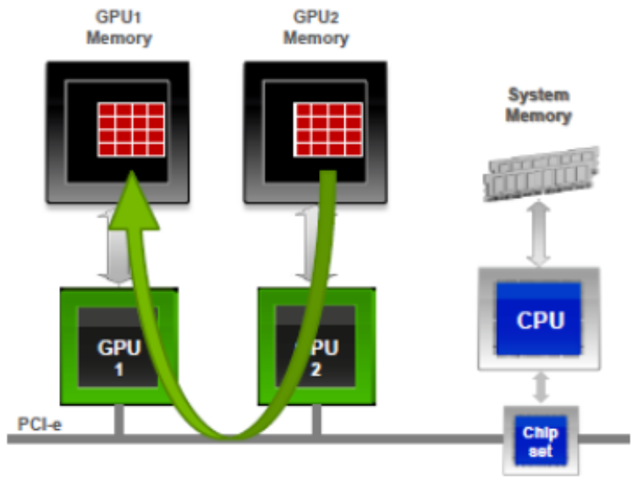
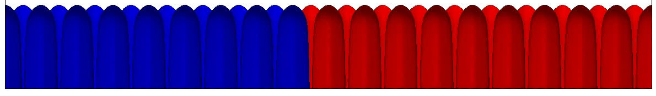
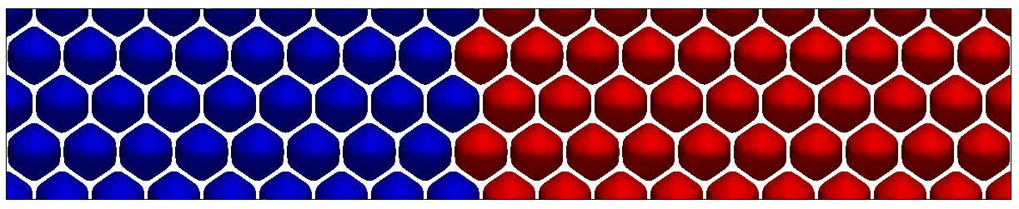
Phase-field simulation
3960 μm
760 μm
Simulation geometry
Grid dimensions: 600×1586×306 ≈ 300 million, over 4 million iterations!
Simulation of SCN-0.24wt% Camphor, G = 19 K/cm, V = 2 μm/s over 4 hours
Multi-GPU intra-node communication

Slide 8
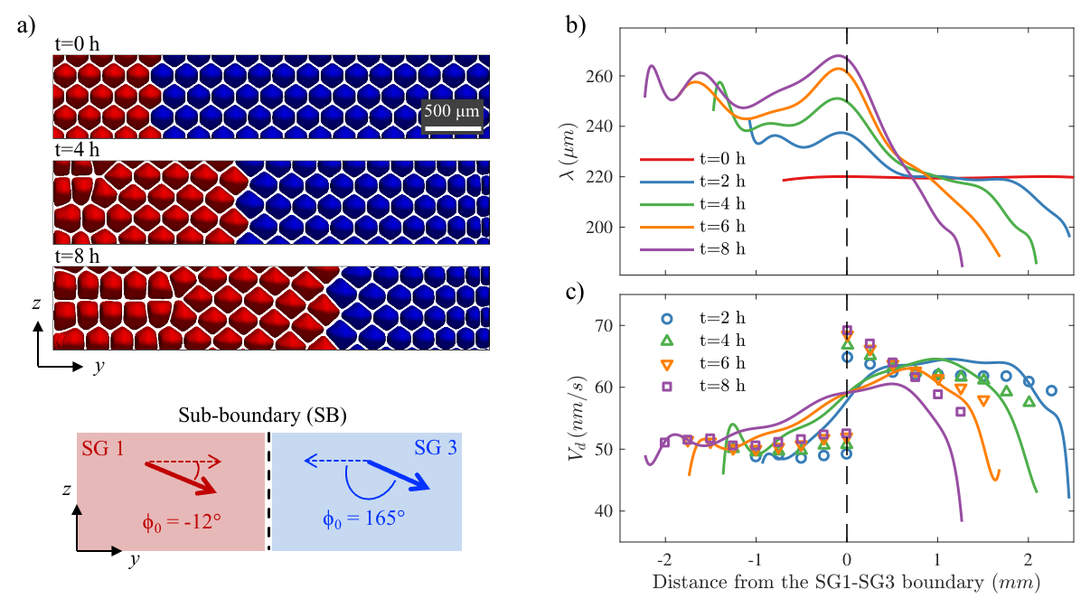
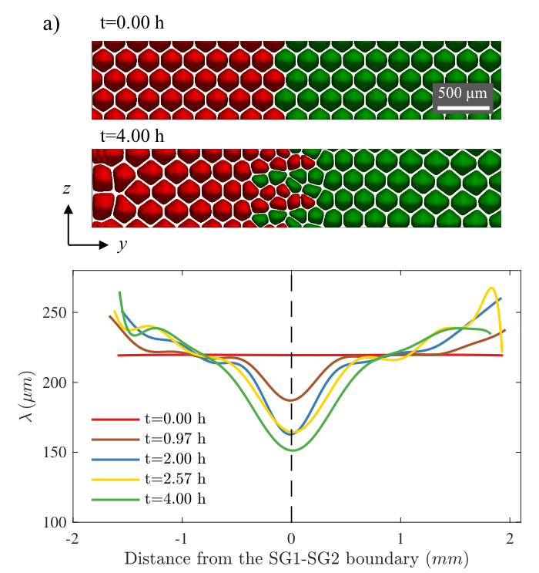
Phase-field simulation
Primary spacing evolution near a divergent sub-grain boundary.
Primary spacing evolution near a convergent sub-grain boundary.
Mota, F. L., J. Pereda, K. Ji, Y. Song, R. Trivedi, A. Karma, and N. Bergeon. Acta Materialia 204 (2021): 116500.

Slide 9
Spacing evolution with a macroscopic curvature
Combined effects of sub-grain boundaries and the macroscopic curvature.
Spacing evolution depends on the growth velocity.
V = 1.5 µm/s
V = 3 µm/s
V = 6 µm/s
V = 12 µm/s
V = 12 µm/s
V = 1.5 µm/s
SCN-0.46wt% Camphor, G = 12 K/cm

Slide 10
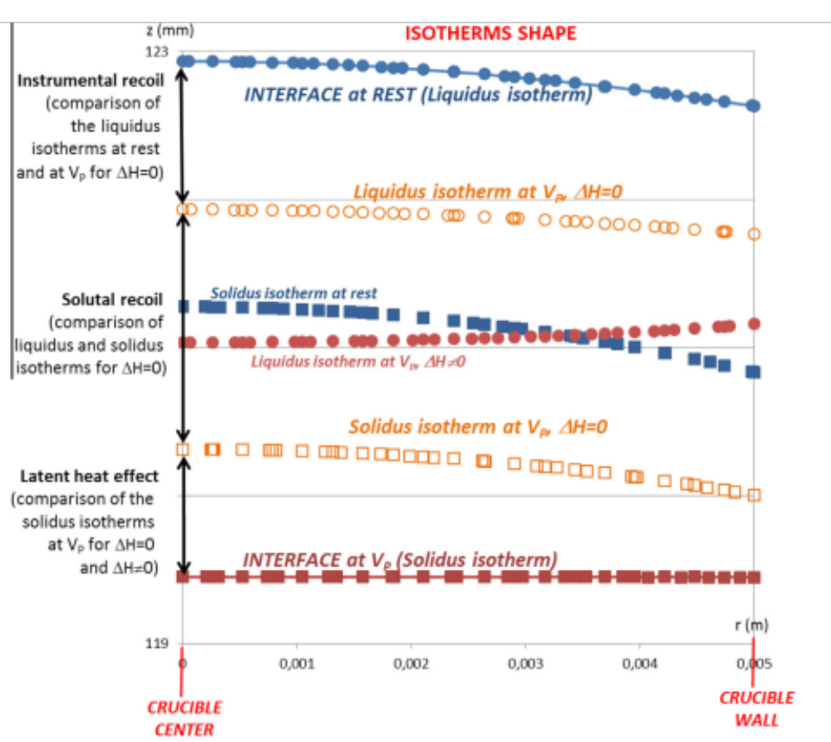
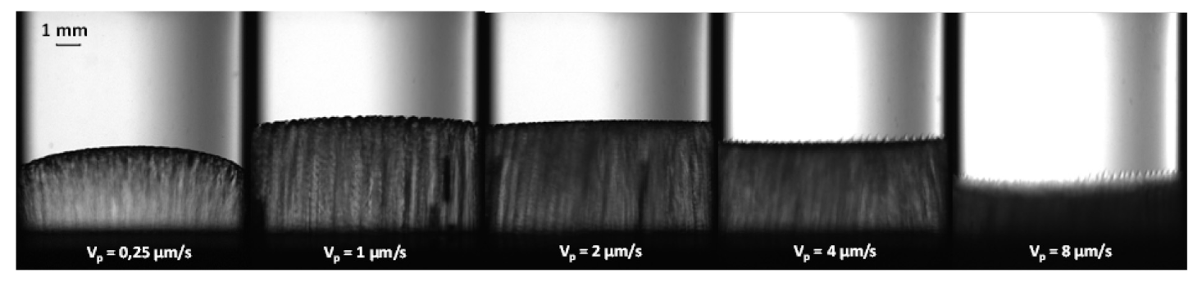
Macroscopic curvature of the interface
The amplitude of curvature depends on the growth velocity.
Mota, F. L., et al. Acta Materialia 85 (2015): 362-377.

Slide 11
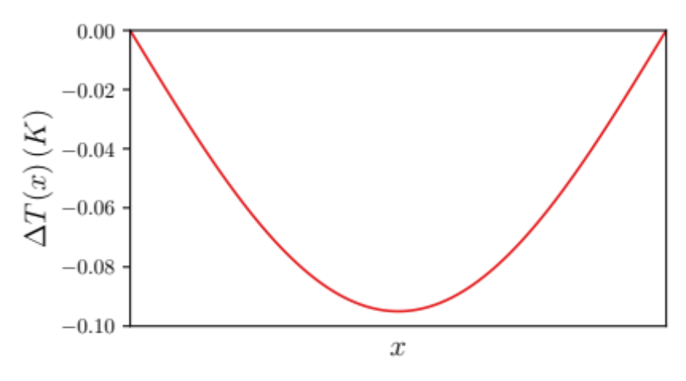
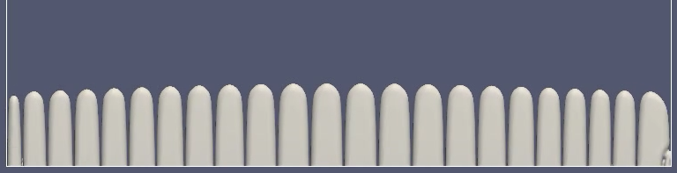
Simulation of a macroscopically convex interface
In PF simulations, the temperature is 𝑇(𝑥,𝑦)=[𝑇(𝑦)+∆𝑇(𝑥)], where 𝑇(𝑦) follows frozen temperature approximation and ∆𝑇(𝑥) is the lateral temperature profile (on the right).
Cells drifting towards the boundaries. The average primary spacing increases.
y
x
PF simulation of SCN-0.24wt% Camphor, G = 19 K/cm, V = 2 μm/s
Notes:
- Cell elimination at the boundaries.

Slide 12
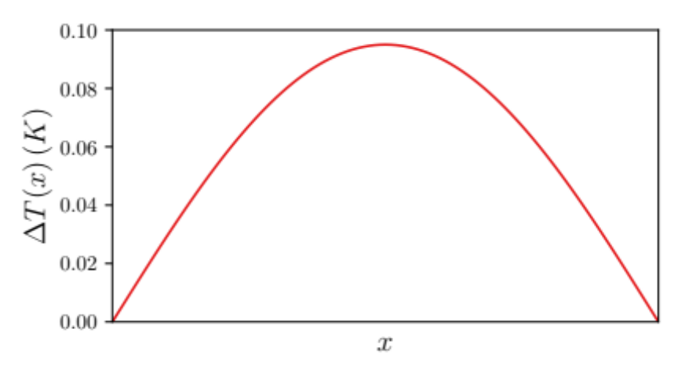
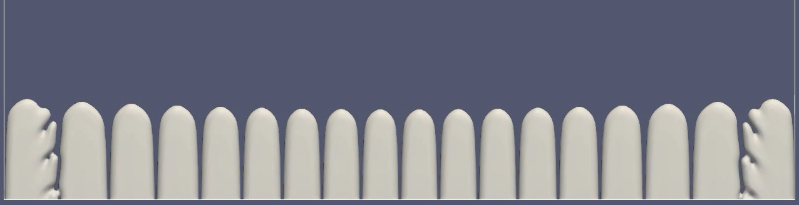
Simulation of a macroscopically concave interface
In PF simulations, the temperature is 𝑇(𝑥,𝑦)=[𝑇(𝑦)+∆𝑇(𝑥)], where 𝑇(𝑦) follows frozen temperature approximation and ∆𝑇(𝑥) is the lateral temperature profile (on the right).
Cells drifting towards the center. The average primary spacing decreases.
y
x
PF simulation of SCN-0.24wt% Camphor, G = 19 K/cm, V = 2 μm/s
Notes:
- Sources at the boundaries.

Slide 13
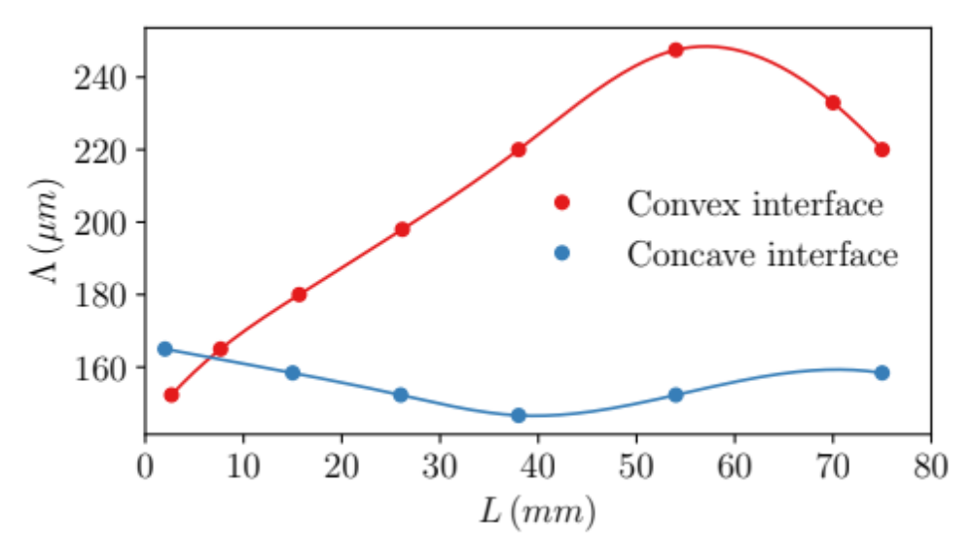
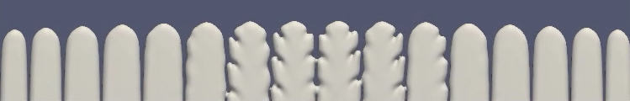
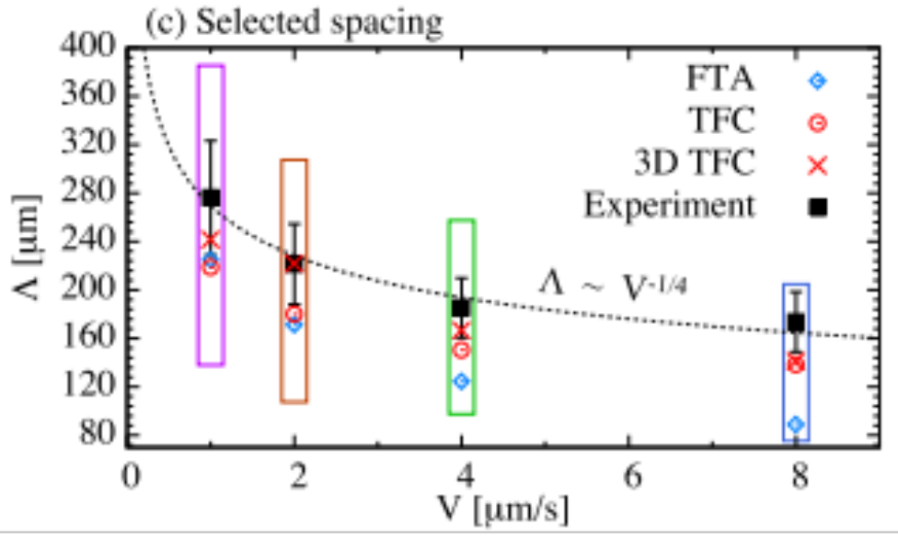
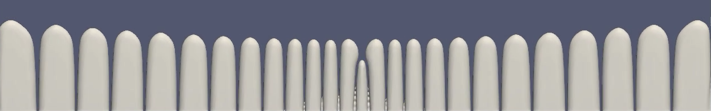
Spacing evolution in a thin sample
For a microscopically convex interface, the tail instability at the center can cause the average spacing to decrease.
For a microscopically concave interface, the cell elimination instability at the center can cause the average spacing to increase.
Song et al. (2018)
PF simulations of SCN-0.24wt% Camphor, G = 19 K/cm, V = 2 μm/s
Notes:
Enter speaker notes here.

Slide 14
Summary
Both the divergent and convergent grain boundaries can affect the primary spacing distribution during directional solidification of binary alloys, even for the low angle sub-boundaries.
A macroscopically convex interface can cause cells to drift away from the center. As cells eliminated at boundaries, the average spacing increases. Meanwhile, the tail instability at the center can cause the average spacing to decrease.
A macroscopically concave interface can cause cells to drift towards the center. As cells created at boundaries, the average primary spacing decreases. Meanwhile, the cell elimination instability at the center can cause the average spacing to increase.
Notes:
Enter speaker notes here.

Slide 15
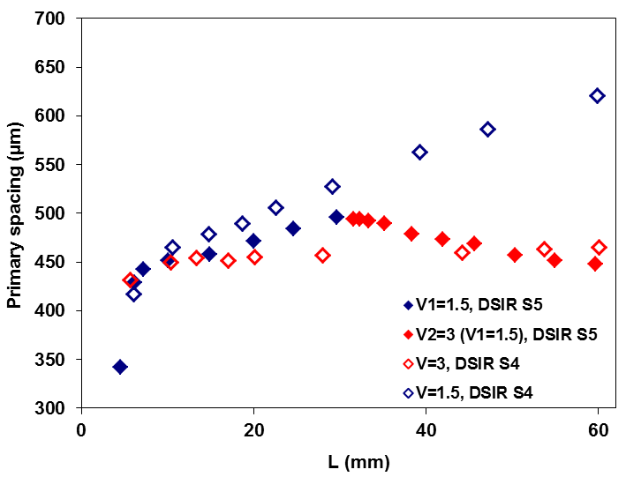
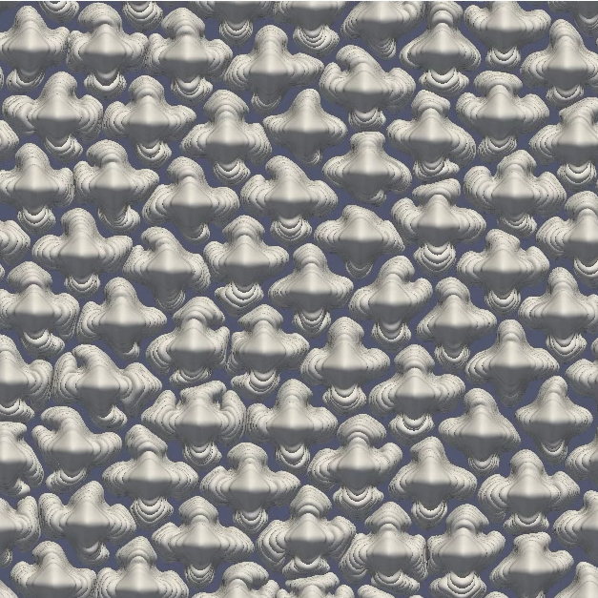
Outlook
Phase-field simulations of the macroscopically curved interface in a 3D bulk sample. Quantitative comparison with microgravity experiments.
Solidification with pulling rate jump for studying the “history-dependence” of the primary spacing selection.
Experiment
Simulation

Slide 16







Acknowledgement
Kaihua Ji, A. Karma
Northeastern University
F.L. Mota, N. Bergeon
Aix-Marseillé Université
R. Trivedi
Iowa State University
L.L. Strutzenberg
Marshall Space Flight Center
This research is supported by NASA through awards 80NSSC19K0135 and NNX16AL77G, and CNES through the MISOL3D project (Microstructures de SOLidification 3D).
Notes:
Enter speaker notes here.

Slide 17
Thank you
for your attention
Notes:
Enter speaker notes here.

