Slide 1
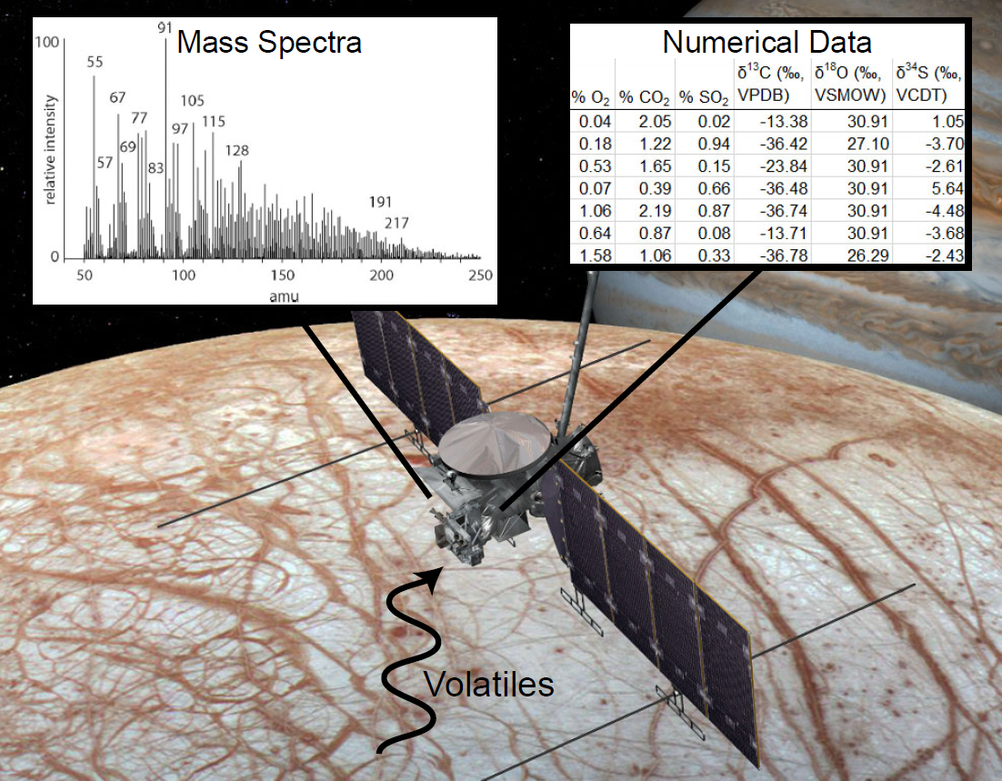
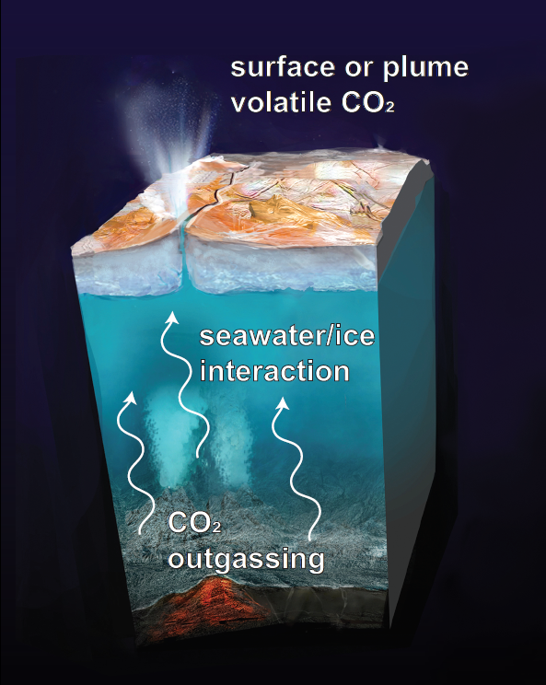

Predicting the Seawater Chemistry of an Ocean World Using Machine Learning on Isotopic Measurements of Volatile CO₂
Dr. Bethany Theiling¹, Victoria Da Poian^{1,2}, Brian Powell¹
¹NASA Goddard Space Flight Center, ²Southeastern Universities Research Association
Could we use machine learning to perform rapid ground-in-the loop data analysis?
Laboratory analogs of planetary processes

Slide 2
Can we know the composition of the seawater from CO₂ alone?
848 IRMS spectra of CO₂ from lab-generated ‘seawaters’ with known salt composition and amount initial CO₂
CO₂
Can we know the composition of the seawater from CO₂ alone?
Machine learning analysis:
varying levels of ‘supervision’
UMAP (Uniform Manifold Approximation and Projection) visualization
CO₂
Cl⁻
Na⁺
HCO₃⁻
δ¹⁸O
SO₄²⁻
Seawater Composition | Amount CO₂ | Retention time | Peak area | Intensity | δ¹³C | δ¹⁸O
δ¹³C
intensity
Mg²⁺
Peak area
Retention time
UMAP ‘point’
% CO₂
Composition

Slide 3
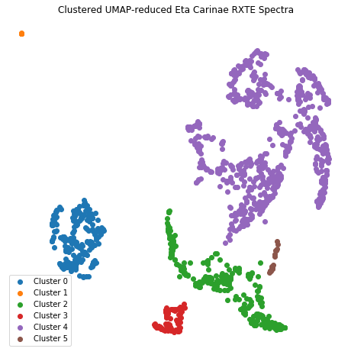
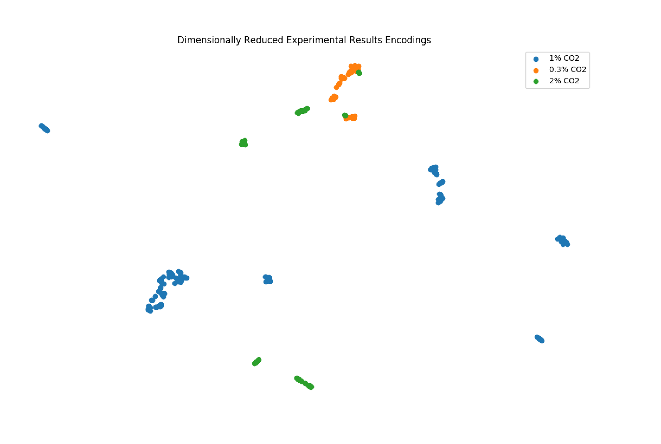

Preliminary algorithm development suggests: 1) CO₂ mass spectra have inherent features that are characteristic of the seawater the gas interacted with, and that 2) we could identify known and ‘new’ spectra
Unsupervised:
Pretty Good
Use a fully connected neural network autoencoder
Clustering ≈ amount of CO₂ gas interacting
1
1
Somewhat supervised:
Better!
Use a Temporal Convolutional Network Autoencoder
Clustering = chemical composition of ‘seawater’
+ amount of CO₂ gas interacting
2
2

