Slide 1

National Aeronautics and Space Administration
NASA High Speed Flight Research
Jimmy Kenyon
Director, Advanced Air Vehicles Program
March 2, 2021

Slide 2
Bottom Line Up Front
NASA is progressing high-speed flight research to connect people faster open new markets for U.S. leadership
The Low Boom Flight Demonstrator Mission is developing to gather the data needed to establish an en route noise standard for overland supersonic flight
NASA recently launched Technical Challenge to reduce LTO noise prediction uncertainty
NASA is engaged in fundamental research on dual-use applications to enable routine, reusable, airbreathing hypersonic flight
Recent market studies identified potentially viable markets for high-speed air transportation

Slide 3
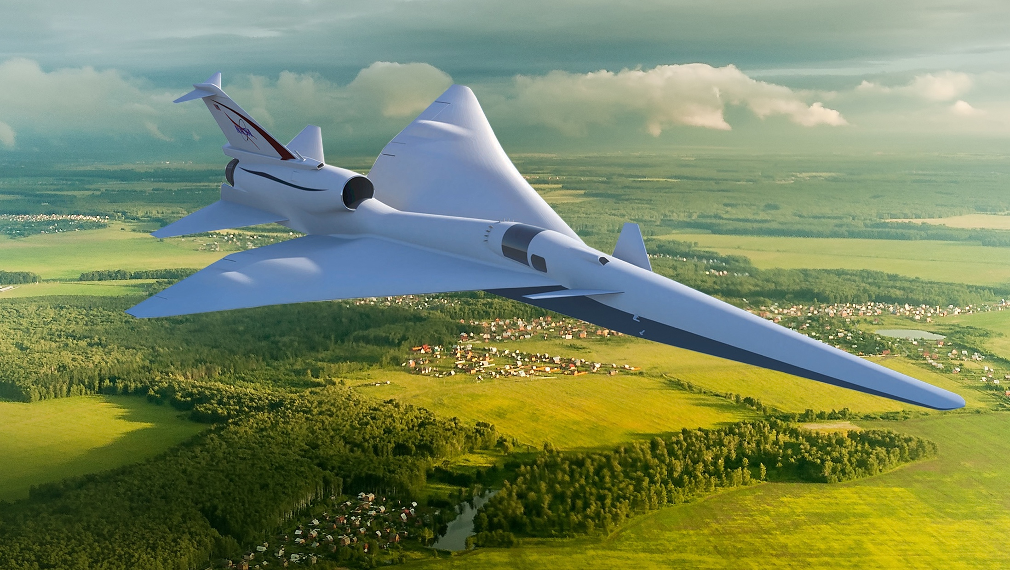

Overcoming the Barrier to Overland Flight
  Standards to Replace Current Prohibitions
New Environmental Standards are needed to open the market to supersonic flight
An En Route Noise Standard is the biggest challenge
  Requires proof of new design approaches, test procedures and response metrics
  No relevant data exists to define limits - community data from large, diverse population is a requirement
  Standard must be accepted internationally

Slide 4
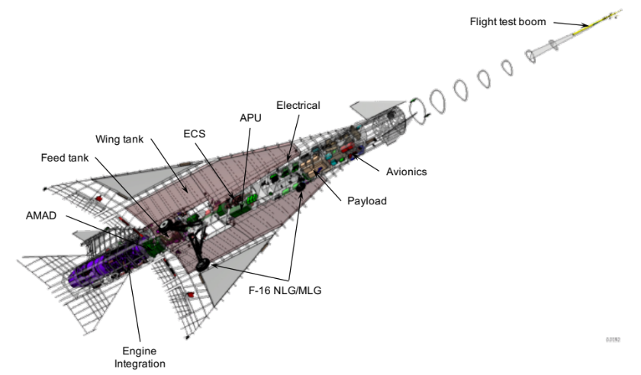
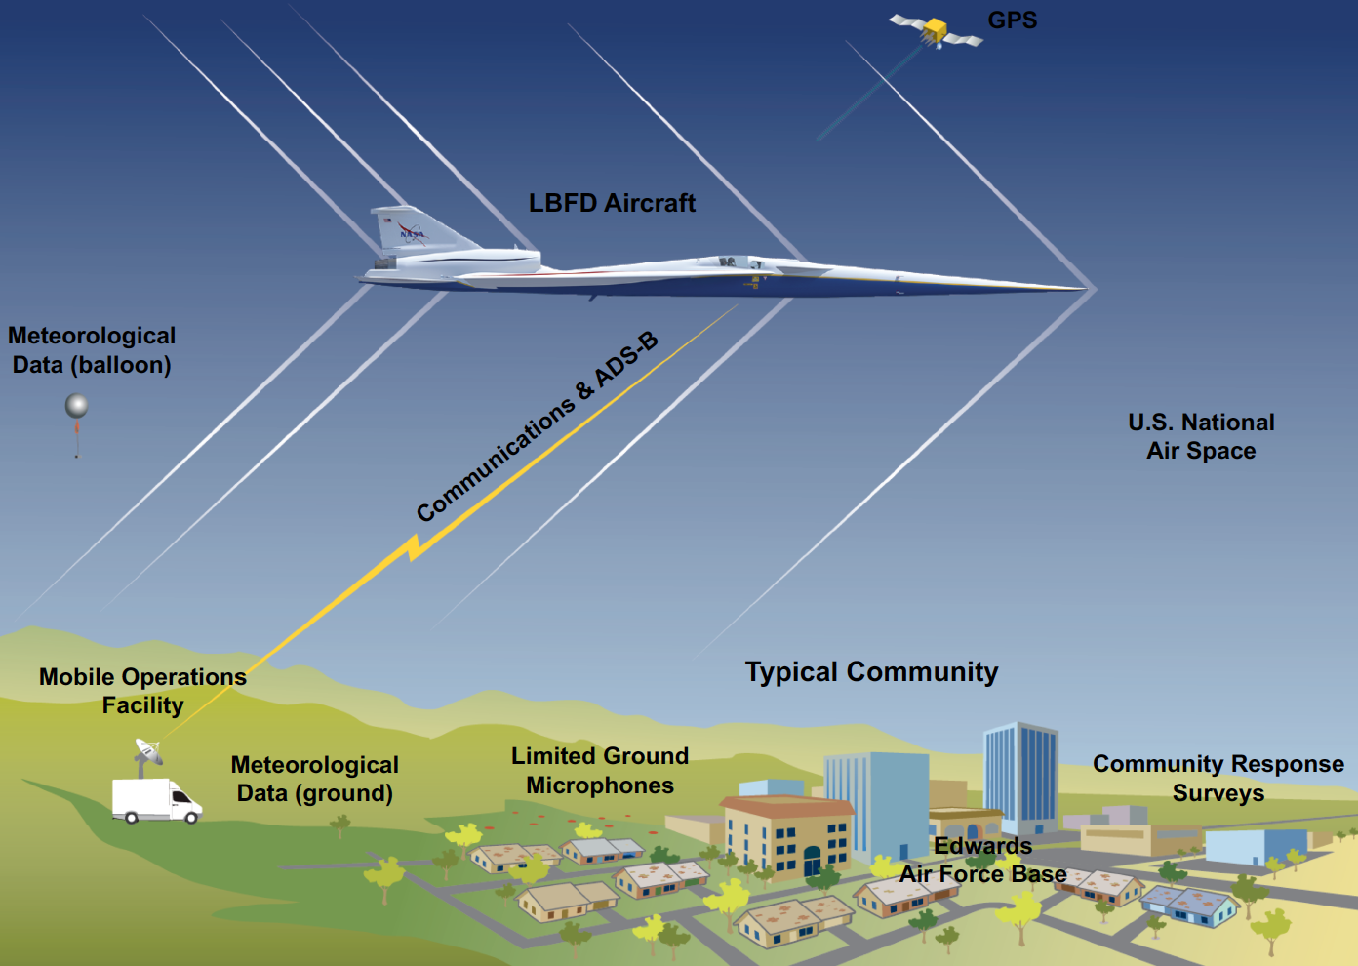
Low Boom Flight Demonstration Mission
Phase 1 – X-59 Aircraft Development (FY18 - 22)
  Detailed design
  Fabrication, integration, ground test
  Checkout flights
  Subsonic and supersonic envelope expansion
Phase 2 – Acoustic Validation (FY22 - 24)
  Aircraft operations & support, range ops, support aircraft
  Ground and in-flight measurement capabilities
  Validation of X-59 boom signature and prediction tools
  Development of acoustic prediction tools
Phase 3 – Community Response (FY24 - 26)
Initial community response overflight study
Multiple campaigns (4 to 6) over representative communities and weather across the U.S.
Noise exposure measurements and community response surveys

Slide 5
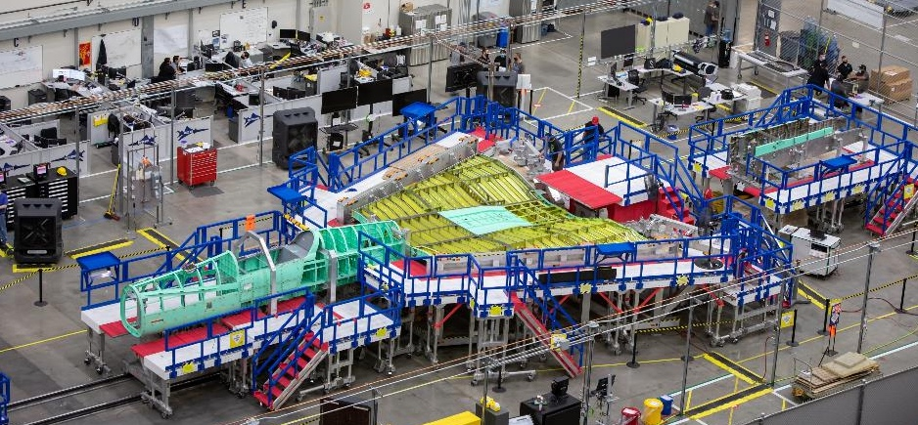
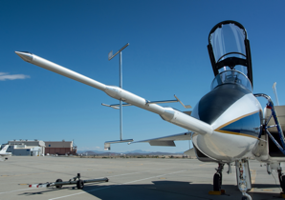
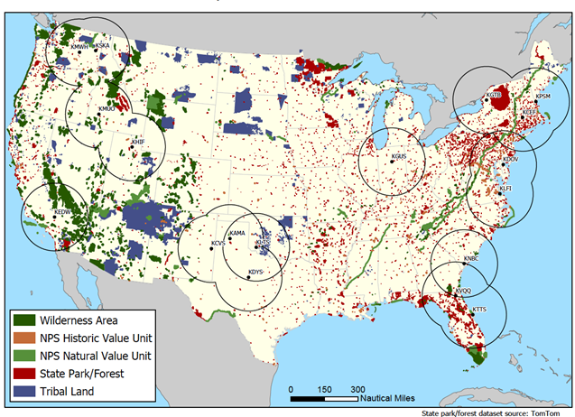
Low Boom Flight Demonstration Progress
  Significant progress despite COVID-19 pandemic impacts
X-59 Aircraft Development
Design and drawings complete
Assembly and systems testing underway
Acoustic Measurement
Awarding contract for Ground Recording System development
Continuing progress on airborne acoustic measurement systems
Community Test Planning
Test airfield selection process underway
Test support team contract solicitation in progress
Conducted Community Test International Workshop
International Standards Development
On-going engagement with ICAO CAEP and international research community
Image Credit: Lockheed Martin
Potential Community Test Airfield Locations Combined with Regions of Noise-Sensitive Considerations
Notes:
FAA engagement: TO BE VERIFIED BY LORI
FAA Office of Environment & Energy:
Coordination with ASCENT COE on Over the Top Boom (with PSU), High Altitude Emissions (Projects 47 and 48)
Guidance/input on community response planning
Support for and engagement with ICAO; specifically STCA modeling and LTO noise predictions
Support for the Notice of Proposed Rulemaking for supersonic aircraft

Slide 6
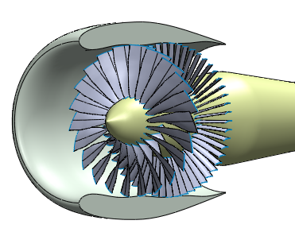
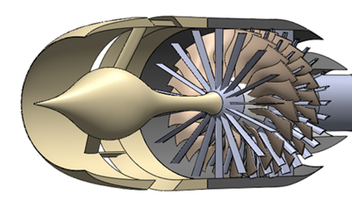

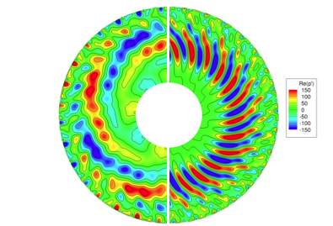
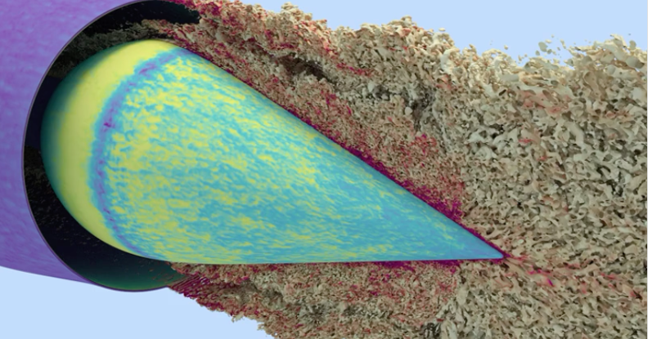
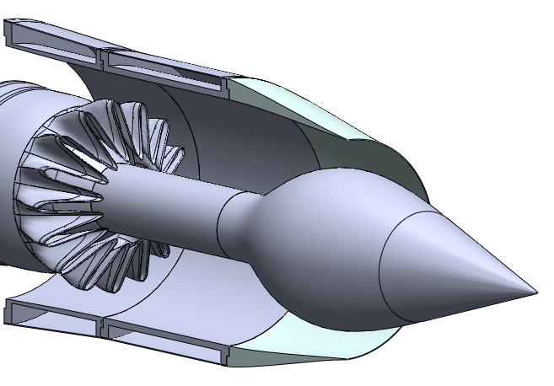
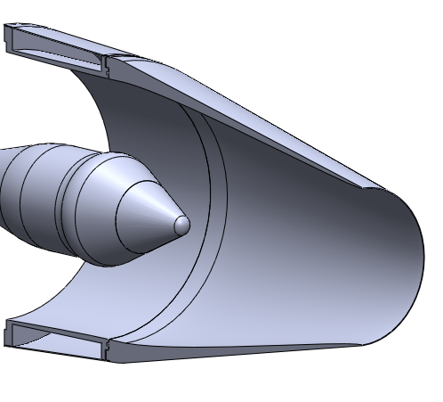
LTO Noise Prediction Uncertainty Reduction
  New effort reduce uncertainty in LTO noise predictions
Noise Uncertainties
LTO Noise prediction uncertainty is a key problem for emerging supersonic market
FAA’s NPRM based on NASA predictions for ICAO, despite large uncertainty
Launched new Technical Challenge to reduce uncertainty in prediction of noise for supersonic aircraft
  Physics-based simulations of supersonic-relevant inlet, fan, and nozzle designs
  with OEM input
  Input to system-level tools and Monte Carlo simulations
  Data releasable for impact on international regulators
  Potential validation approaches being assessed
Conventional Product Development
2019 ICAO Study Supersonic
Test
Prediction
Cumulative
EPNL
Design
Prediction
Fan
Jet
Notes:
Although there have been budget cuts to our airport noise work, we are still committed to kicking off a new technical challenge. We have descoped it to be focused on reducing the uncertainty in LTO predictions. As shown the uncertainty in the predictions for LTO noise are currently much larger than that for subsonic vehicles.
We had a contract with GE to design and test a releasable flow-path and fan which we re-negotiated to include just the design aspect. The budget profile shown highlights that we were able to fully fund that renegotiated contract to offset our inability to get the CTPE contract awarded. This allowed us to obligate most of our FY20 funding and that contract should complete in FY21. The TC will be planned with the ability for on ramps for testing if budgets allow.
But we feel even with this reduced scope, this work is so critical that it needs to be raised to the level of a technical challenge.
Develop a releasable flow-path and fan design for a commercial supersonic transport relevant geometry to enable Landing/Take-Off noise predictions and testing.

Slide 7
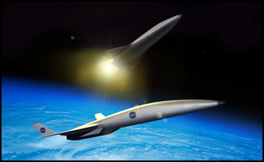
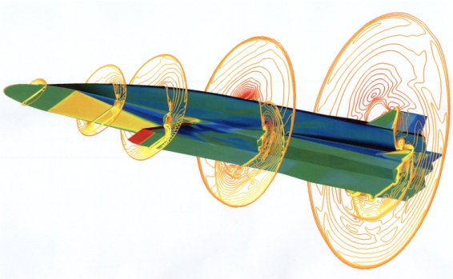
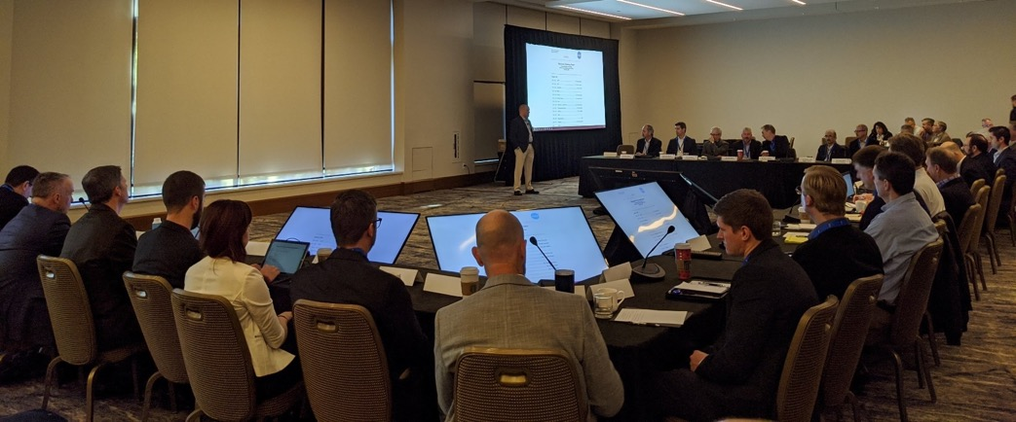
Hypersonic Technology Project
Fundamental Research on Dual-Use Applications
Strong DoD Partnership
Industry Engagement on Future Commercial Hypersonic Vision

Slide 8
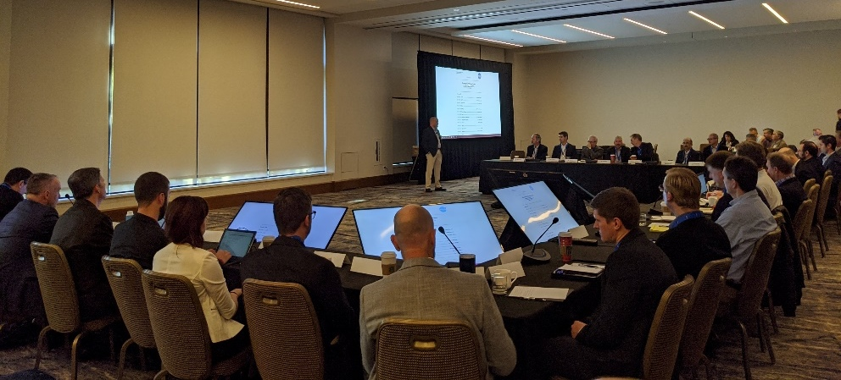
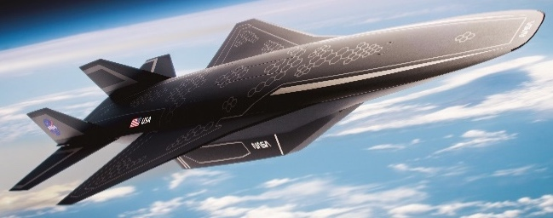
Hypersonic Strategy Assessment
  Enabling routine, reusable, airbreathing hypersonic flight
Industry announcements reveal interest in commercial applications
Workshop held to understand interest and identify needs
  Independent market study
  Regulatory and data protection concerns
  Hypersonic ground and flight test capability
  Technology development
Assessing strategy in light of growing industry interest
Emerging industry vision for potential future commercial hypersonic market

Slide 9
Independent Market Studies
  Potentially viable markets for high-speed air transportation
Favorable High-Speed Market Characteristics
Key Findings
  SAIC: Commercial and private segments are most
  viable. Cargo demand not strong for civil use.
  Deloitte: Commercial, private, and cargo are all
  viable segments. Top routes vary by segment.
  Barriers largely similar to commercial supersonic
  flight, e.g., certification, LTO noise, emissions,
  field length, airspace integration
  Concern with export controls and market impacts
Industry Feedback on Results
  Favorable markets in a speed regime between
  NASA’s current supersonic and hypersonic portfolios
  Desire to extend market study to explore additional areas (e.g., including transpacific routes and alternative aircraft fuels)
  Interest in potential synergy between civil and defense applications for lowering required investment
  Role for NASA in facilitating working group with FAA, Department of State, Department of Defense, airport authorities, and industry to address certification, regulatory, and environmental barriers
 | SAIC (with Bryce Space and Technology) | Deloitte (with SpaceWorks & NIA)
Mach | 3 | 2 - 4
Range | 4500 nmi | 4000 nmi – 4500 nmi
Number of routes⁽¹⁾ | 300 | 90
Aircraft Size (# PAX) | 10 GA or 50 Commercial | 20 to 50
Aircraft Cost | $200M - $300M | $131M - $228M⁽²⁾
⁽¹⁾ Deloitte only considers over water routes
⁽²⁾ Mach 3 at 4500 nmi

Slide 10
Summary
NASA is progressing high-speed flight research to connect people faster open new markets for U.S. leadership
The Low Boom Flight Demonstrator Mission is developing to gather the data needed to establish an en route noise standard for overland supersonic flight
NASA recently launched Technical Challenge to reduce LTO noise prediction uncertainty
NASA is engaged in fundamental research on dual-use applications to enable routine, reusable, airbreathing hypersonic flight
Recent market studies identified potentially viable markets for high-speed air transportation

Slide 11




