Slide 1


Terrain Relative Navigation Basics
Carolina Restrepo (NASA Goddard)
Andrew Johnson (NASA JPL)
with contributions from ALHAT, SPLICE, Mars2020, and OSIRIS-Rex
Workshop on Lunar Mapping for Precision Landing
March 2, 2021

Slide 2
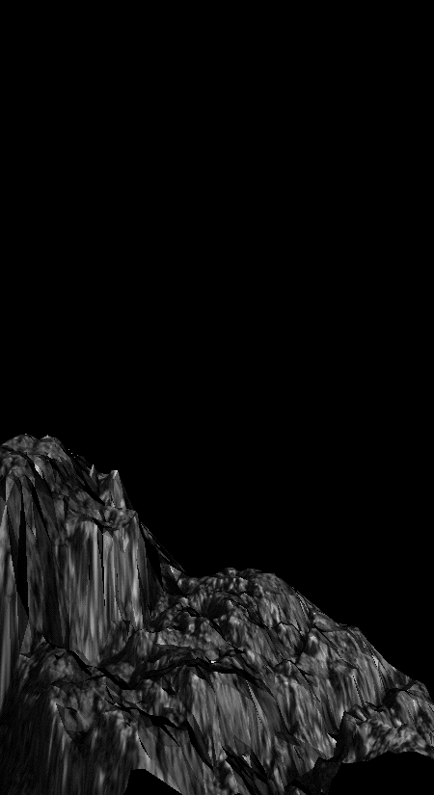


PRECISION
LANDING
FUNCTIONS
Terrain Sensing and Recognition Functions
Terrain Relative Navigation (TRN)
Reduce Navigation Dispersions During
Braking Burn and Eliminate Map Tie Error
De-Orbit
Coast
SAFE LANDING
FUNCTIONS
Braking
Burn
Hazard Detection and Avoidance (HDA)
Detect Crater, Rock and Slope Hazards
and Select a Reachable Safe Site
Powered
Descent
Hazard Relative Navigation (HRN)
Navigate Precisely Relative to
Hazards Detected On-Board to
Land at Specified Safe Site
Terminal
Descent
Divert
Maneuver
IMU
TRN Imaging
HDA/HRN Imaging
X
Velocity & Ranging
Safe Site
not to scale
Image Credit: Autonomous Landing and Hazard Avoidance Technology Project
Notes:
In general, any lander mission goes through these phases during the descent. An IMU is active the entire flight, and usually landers have altimeters and velocimeters that are active during powered descent.
Also during powered descent, a TRN system would provide global position estimates that would reduce landing errors.
Lower to the ground, reconnaissance images do break down because of poor resolution when compared against the images taken during flight. Once this happens, sensors and algorithms that perform hazard detection and avoidance would take over TRN to scan the ground for smaller hazards and provide the vehicle with coordinates for safe landing sites.
Once a safe landing site is selected, the lander would likely dead-reckon to it only with its IMU since dust near the ground affects the sensors functionality.

Slide 3
Precision Landing Definitions
Precise Landing – Where are we exactly?
  Global navigation solution obtained by matching terrain sensing data with a priori reconnaissance data
  Minimizes landing errors from target site and large surface hazards are identified ahead of time
  DEMs must be as close as possible to the truth terrain
Safe Landing – Hazard Detection and Avoidance
  Real-time terrain sensing of lander-scale surface hazards to identify safe landing sites that are undetectable in orbital imagery
  Enables real-time divert maneuver planning relative to local hazards
  DEMs must show lander-scale surface hazards
Controlled Landing – soft touchdown
  Surface-relative velocity measurements independent of global positioning errors
DEM - Digital Elevation Map
Precise Landing
PL&HA
Safe
Landing
Controlled Landing
NASA has given the Human Landing System a requirement to land within 100m of the target site.
Notes:
This is what the precision landing and hazard avoidance community considers that we need for future lander missions.
Controlled landing requires IMU, altimeter, velocimeter and Touchdown sensor. However, this still constitutes a blind landing without any knowledge of global position or position relative to the ground.
Precise Landing means knowing where we are and currently can be achieved with Terrain relative Nav. JPL has shown TRN with their Lander Vision System on Mars2020. TRN allows us to spot large craters and boulders and even possibly avoid them while we are still flying high. But onboard maps resolution breaks down before small lander-sized hazards can be avoided. TRN is not enough to plan real-time divert maneuvers to avoid small hazards on the ground last minute.
In order to avoid those hazards and make the landing actually safe, we need hazard detection systems onboard and the computational power to quickly calculate a new trajectory that takes the lander to a safe place right away.
So for future human missions, and likely even for some future robotic missions, we need all of these things.

Slide 4
What is TRN?
Terrain Relative Navigation uses onboard camera images and/or range sensor data of the surface taken with an onboard camera to localize the spacecraft with respect to a map that is generated ahead of time and loaded on the flight computer
TRN measurements that go into the Navigation filter are essentially the errors obtained when comparing the images/data to the onboard maps that represent the “truth” terrain
  Measurements are only as good as the onboard map
  Clean, high-resolution maps with minimal error sources are required
TRN can work at various altitudes and with varying map resolution, but here we will focus on Landing

Slide 5
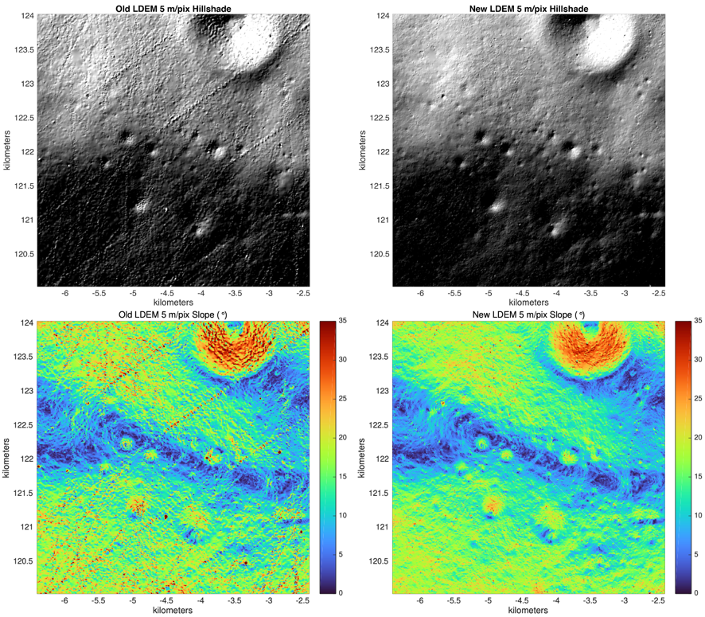
What is TRN?
1. Take Image of surface
2. Process Image (alignment, distortion) and match* to reference map
3. Derive spacecraft position and attitude relative to surface
2D Camera image
(lat, lon)
Position
Attitude
Reference Map
* Can be image correlation or feature matching

Slide 6
TRN, Feature Tracking, Visual Odometry
In the context of this presentation, TRN means matching a camera image to its location on an onboard map to extract the spacecraft altitude and attitude with respect to that map
  The onboard map has been loaded ahead of time and built from orbital imagery data
  The onboard map is typically an image rendered under the expected day-of-flight lighting conditions, and with the necessary resolution to meet the mission’s navigation requirements.
  Image matching can be based on either image correlation or feature matching
Features can be identified on any image and can be tracked from image-to-image. These features can be either known (landmarks with coordinates) or unknown (identified in real-time by a computer vision algorithm).
Visual Odometry relies on tracking features in a sequence of images to yield information about the change of spacecraft position and attitude with respect to those surface features

Slide 7
What is Hazard Detection and Avoidance?
Real-time sensing of surface features during descent with a LIDAR (or camera-based approaches) generates high-resolution Digital Elevation Map of the surface
DEM coordinates are tied to Lander’s Navigation state at the time the DEM was built
HD Algorithm analyzes DEM and detects safe landing sites in local DEM coordinates
The local DEM or the coordinates of the candidate safe sites are provided to the Lander’s guidance system for planning divert maneuvers
TRN can be performed with respect to an a-priori DEM but also with respect to the HD Lidar DEM

Slide 8
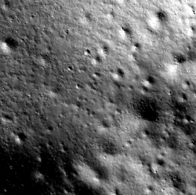
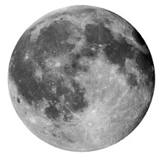
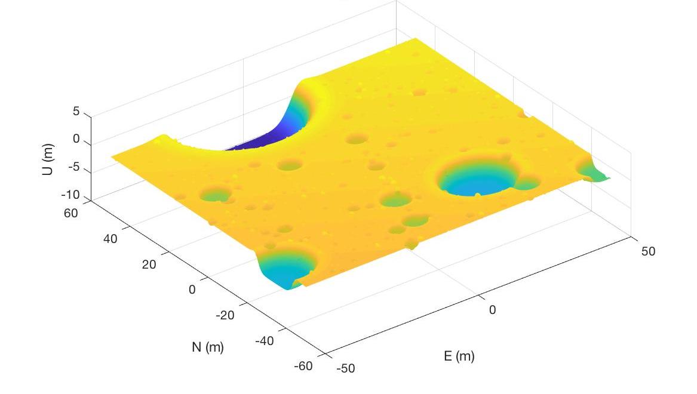
Terrain Relative Navigation Flowchart
Process Images (warping, alignment, feature ID, etc)
2D Camera images
Spacecraft Navigation Filter ingests available TRN Measurements (either global or surface-relative):
Position
Velocity
Attitude
Bearing
Direction of motion
Distance to surface landmarks
Surface
Compare images to onboard map
Process range measurements
LIDAR Altimetry
Compare Lidar ranges to known onboard topography data
Hazard Detection LIDAR
3D Map of surface hazards
Provide DEM or hazard locations

Slide 9
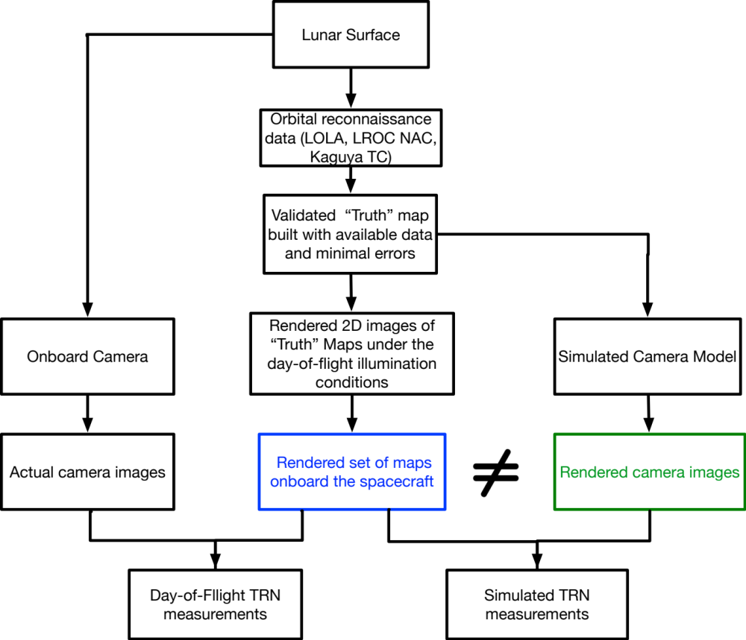
Maps for TRN
The Day-of-Flight TRN measurements are the errors between real-time camera images of the surface and the set of onboard maps rendered a-priori
The TRN system development and testing flow requires the same rendered onboard maps but also separately rendered camera images as seen from a simulated camera model

Slide 10

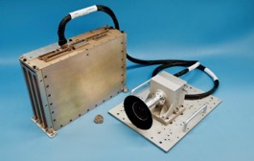
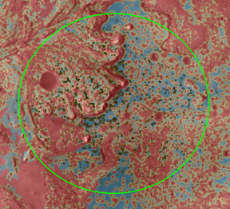




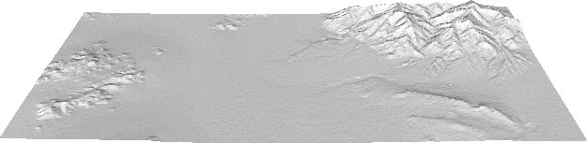
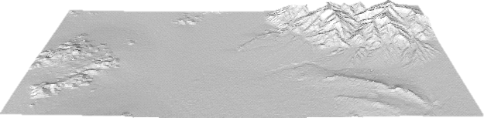
Mars 2020 Terrain Relative Navigation
Jezero Crater Landing Site
descent
imaging
Hazard Map
Vision Compute Element
Safe Target Points
LCAM
The Lander Vision System estimates map relative position
IMU
Safe Target Selection picks a landing site that avoids hazards and existing MSL systems guide the vehicle to a safe landing
LVS
map
Simple TRN interface “does no harm” to MSL EDL
Can still land without TRN
Launch: July 2020
EDL: February 18th, 2021

Slide 11
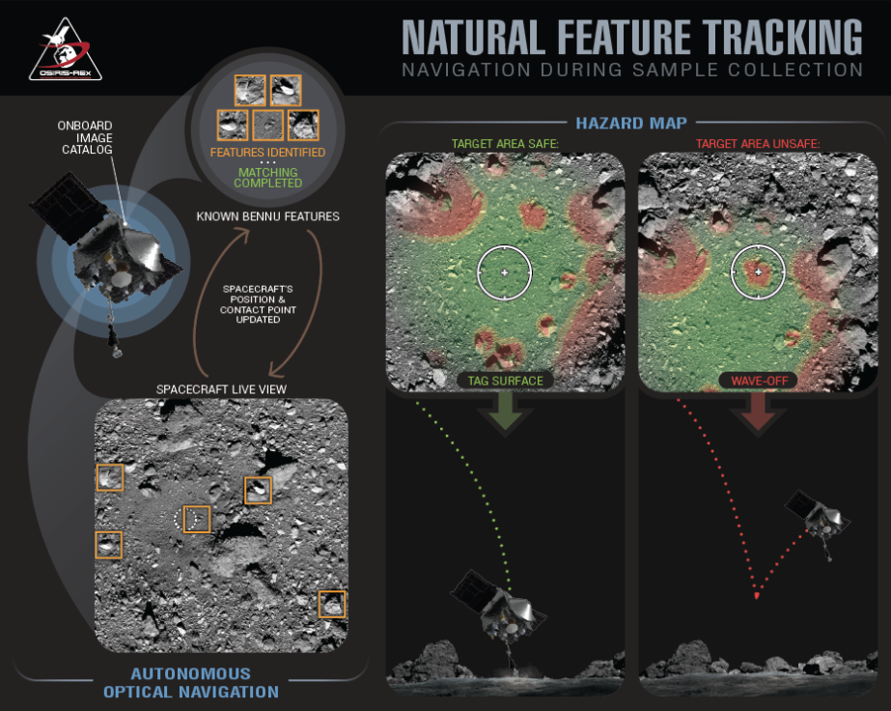
Image credit: asteroidmission.org
Notes:
Very quick overview of NFT as used on OSRISI-REx. More details will be given later. NFT operates on the same principles as LVS, we are taking DTMs to render what we expect the camera to see, finding those points in the captured image, and then navigating based off of the located image points.
The primary difference is that instead of pre-rendering our map based on our expect descent trajectory, we render each one "on the fly" based off the predicted spacecraft location from the on-board filter.
This gives flexibility in the errors that we can handles, but leads to slower updates since we need to render the maps as we go.
We also don't render a full map, but rather "maplets" which are small portions of surface (much smaller than the footprint of the image). The location of these maplets in the image are tied to the body-fixed location of the center of the maplet and fed to the navigation filter.
That's some basic talking points. Once I get an idea of what you will discuss for LVS I might suggest some modifications.
When I use that graphic I normally don't even credit it, since I'm presenting on behalf of the mission. I guess you can just credit the website. Also, I normally make it the full slide and then just talk through it

Slide 12
Closing Thoughts
TRN works by comparing day of flight images to an onboard accurate map built ahead of time to navigate with respect to that map
TRN algorithms must account for the fact that the onboard maps have inherent error sources (i.e. maps are not perfect) and those error sources
TRN systems need rendered images for development and testing
  Rendered onboard maps for navigation and testing
  Rendered camera images for testing

