Slide 1
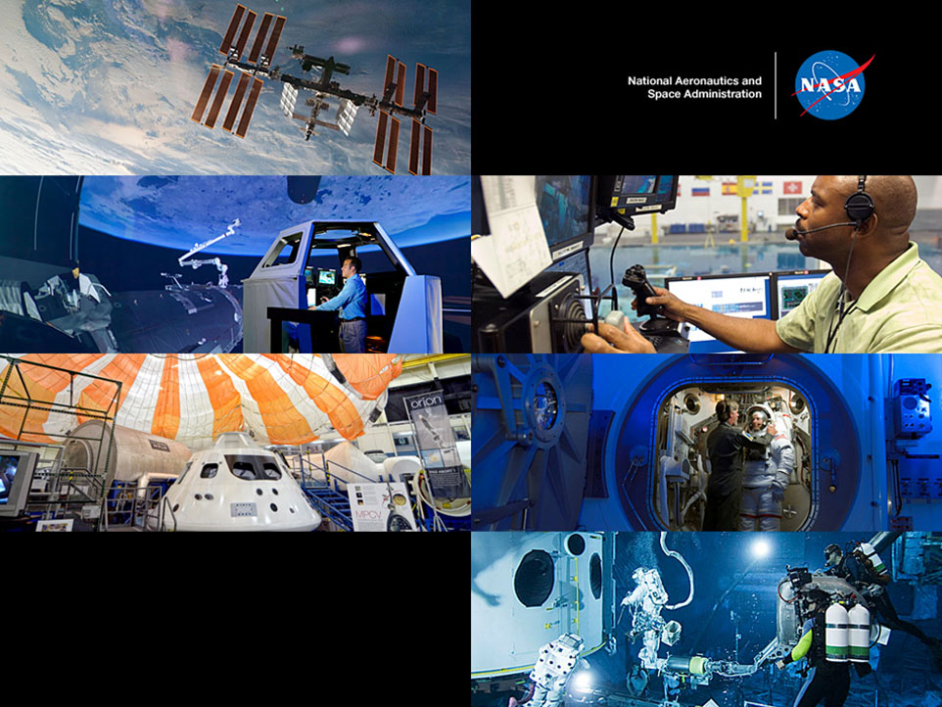
NASA Internships
at Ames Research Center
in Silicon Valley

Slide 2

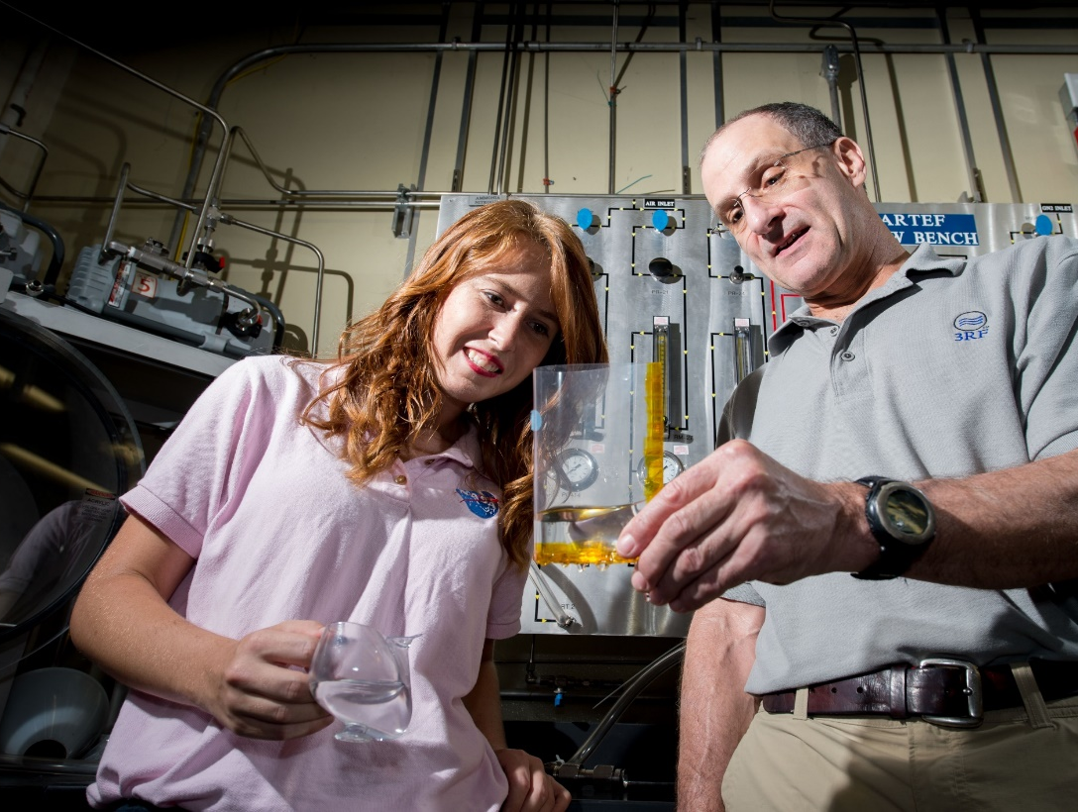
NASA Internships Overview
NASA Internships are competitive awards to support educational opportunities that provide unique NASA-related research & operational experiences for educators, high school, undergraduate & graduate students.
These opportunities integrate interns with career professionals emphasizing mentor-directed, degree-related tasks, while contributing to the operation of a NASA facility or the advancement of NASA’s missions.
Notes:
Competitive = you have to apply and be selected
Educational = learning experience
Mentor-directed = you work closely with a scientist/researcher at the top of their field
Degree-related = working on a project relevant to your major
Advancement of NASA’s missions = working hands-on on a NASA project. You are directly contributing to NASA’s work!

Slide 3

NASA Internships Overview
Three sessions:
  16-week Spring
  10 or 12-week Summer
  16-week Fall Sessions
One application is used agency wide:
Intern.nasa.gov
Notes:
Emphasize intern.nasa.gov. Used for all projects at all centers.

Slide 4
Internship Requirements
US citizen (by birth or naturalization)
Minimum 3.0 GPA on a 4.0 grade scale
Undergraduate and graduate students must be accepted/enrolled full-time in an accredited community college or four-year college or university. (Note: If you graduate before the opportunity start date, you must be able to demonstrate pursuit of next academic level.)
Notes:
Eligible for an internship within 6 months of graduating

Slide 5
What Majors Does NASA Look For?
Primarily we look for STEM Majors (Science, Technology, Engineering, and Mathematics). Additionally, some projects will call for Communications, Public Affairs, Journalism, Education, Graphics, Business and Finance.
Project needs change each session according to the organization’s needs. Some skills that NASA routinely needs are:
Programming: C++, JAVA, HTML
CAD, PRO-E, Matlab, 3D Modeling
Networking
Machine Shop, fabricating, design, prototyping
3D printing
Social Media
Technical Writing
Database Administration
Notes:
The types of projects vary by center. At Ames specifically, we have a lot of engineering, computer science, and biosciences. Our internships are predominantly in STEM, However, we have opportunities in business, communications, and law.
The skills listed can make a big impact on your application. Mentors love to see that you have experience coding or using certain software or hardware.

Slide 6
Frequently Asked Questions
Do I Need a Letter of Recommendation?
Yes, applicants must submit at least one letter of recommendation however, 2-3 letters are common. Your letter(s) of recommendation can weigh a great amount in the final decision. Assure that your recommender is someone who can speak highly of your skills, work ethic and leadership..
Will Housing Be Provided?
Interns must provide for their own housing and relocation expenses. Upon acceptance, interns will be forwarded a Housing Guide that may be helpful in identifying housing options in the area.
How Much Will I Be Paid?
Fall/Spring Internship – 16 Weeks
Undergraduates: $11,680
Graduates: $14,400
Summer Internship – 10 Weeks
Undergraduates: $7,300
Graduates: $9,000
Notes:
You need one letter of recommendation for your application to be complete, but you can add more than one if you’d like.
Housing is not provided. Ames has a lodge available for interns to stay on-site during their internship for a discounted rate.
Undergrads paid $730/week, graduates $900/week.

Slide 7
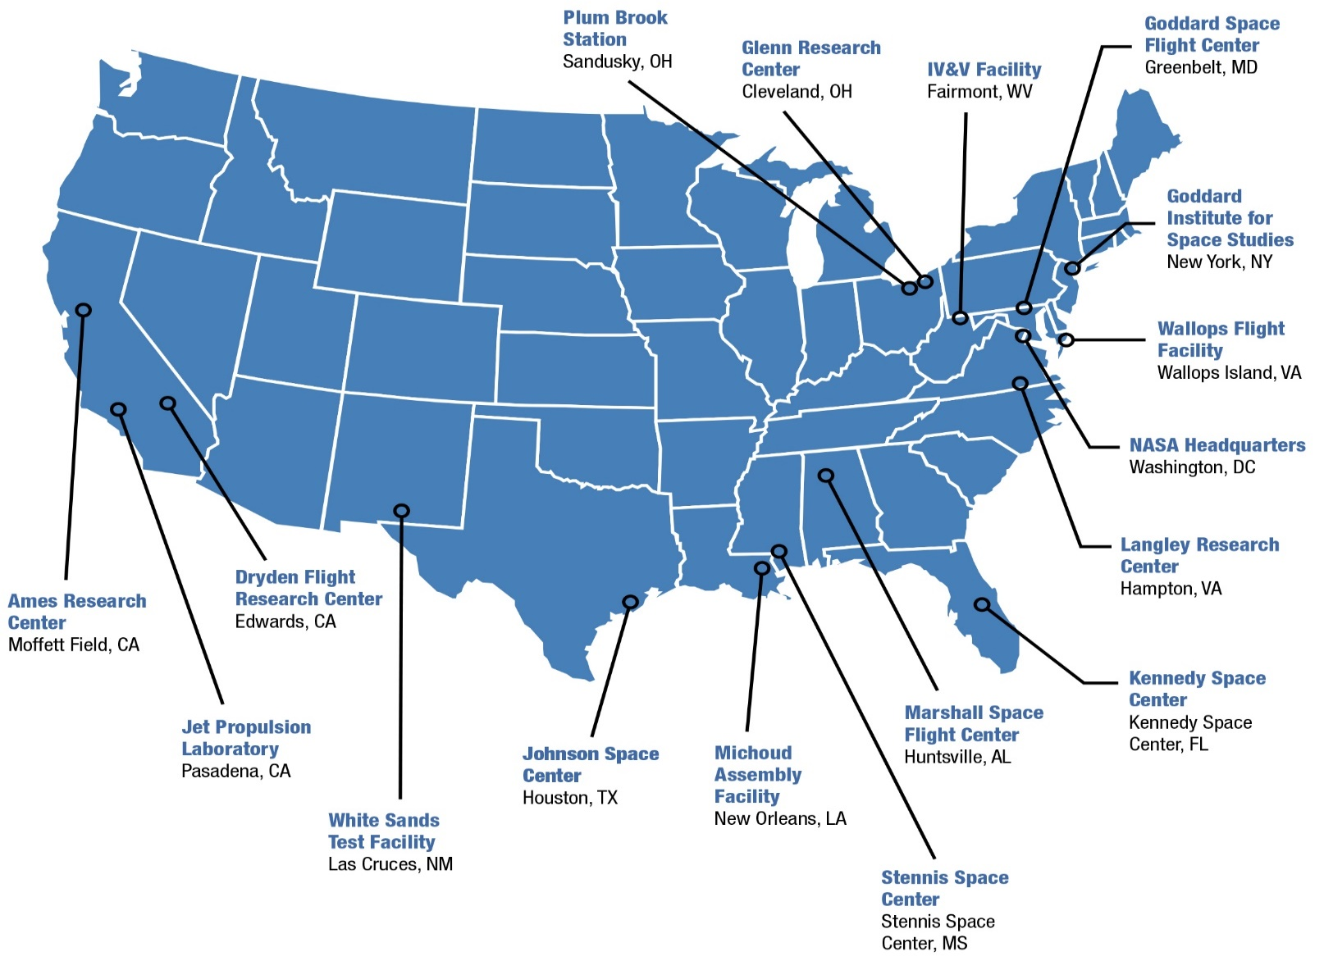
NASA Centers and Field Sites
Notes:
We have 10 NASA centers, plus a few field sites. Each center has it’s own focus. Some students prefer to apply to centers nearby, some apply to centers based on specialty, some apply to all centers. At intern.nasa.gov you only need to submit one application and are able to apply to projects at any center.
At Ames we have a wide variety of specialties. Armstrong is just outside LA and specializes in flight testing. Johnson in Houston has more business opportunities. Etc.

Slide 8
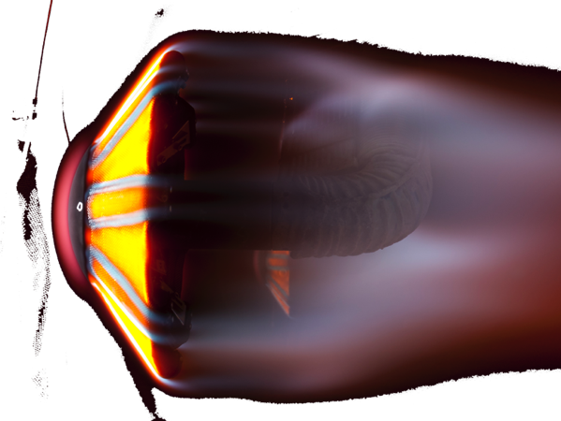


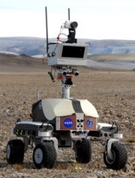
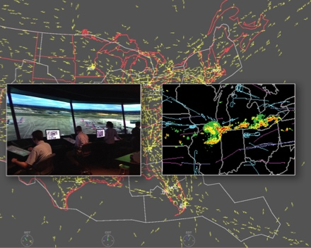
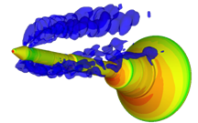
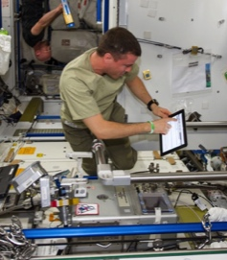
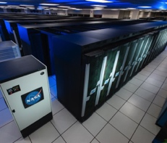
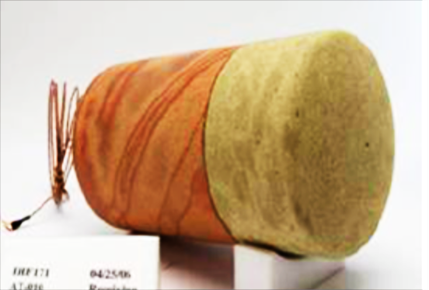

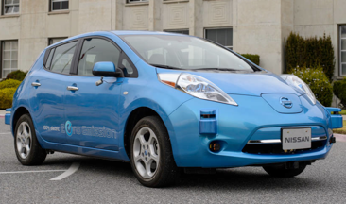
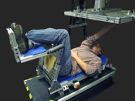

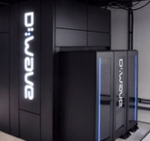
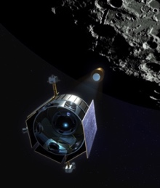
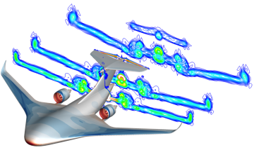
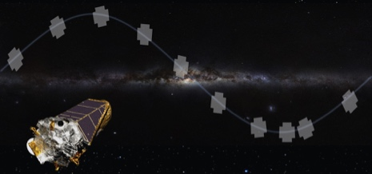
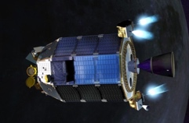
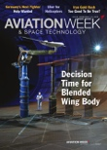
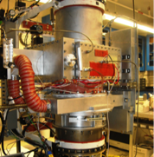
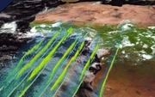

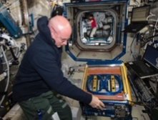

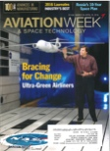

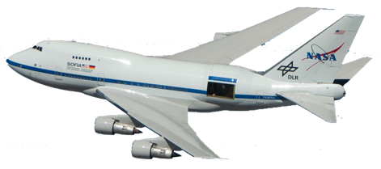
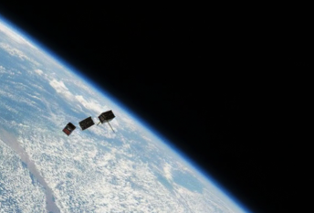
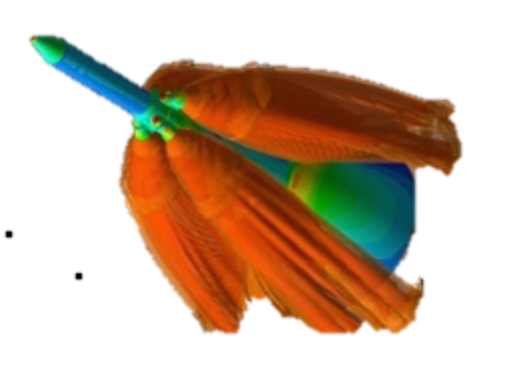
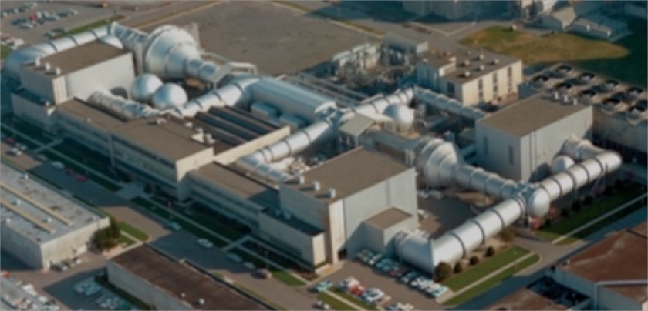

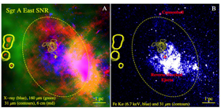
Core Competencies at NASA Ames Research Center
Air Traffic Management
Advanced Computing & IT Systems
Entry Systems
Intelligent/ Adaptive Systems
Cost-Effective Space Missions
Aerosciences
Astrobiology and Life Science
Space and Earth Sciences
Notes:
These are Ames’ focus areas.
Air traffic management: Entry systems: Heat shields, entry and reentry, working on making sure when we send our astronauts to Mars that we can bring them back safely
Computing: We have one of the world’s fastest super computers
Intelligent/Adaptive systems: lots of robotics projects, including Astrobee
Cost-Effective space missions: satellites and sending payloads to the ISS
Aeroscience: We have lots of wind tunnels! Including the world’s largest wind tunnel (80x120). We do testing on military aircraft and for the Space Launch System.
Astrobiology and Life Science: We have researchers studying space dust to find the origin of life. We also do experiments in collaboration with the ISS.
Space and Earth Sciences: We have projects in geology that study both the Earth and other planets. SOFIA = Giant telescope on board a 747 airplane. We’ve had interns take a ride on SOFIA in the past.
We have interns in all of these areas.

Slide 9
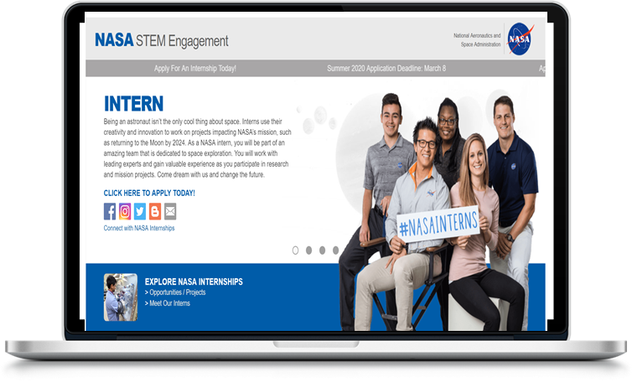
Ready to Apply?
intern.nasa.gov
Apply early!

Slide 10
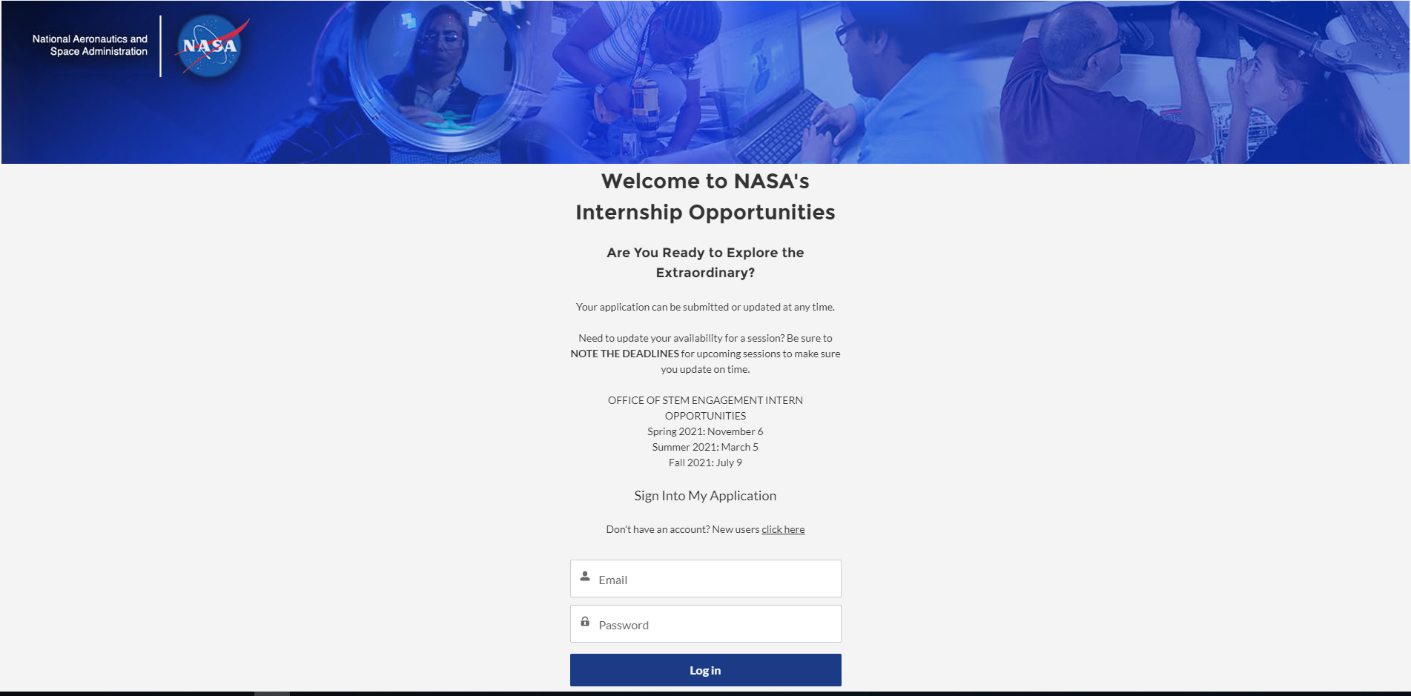
Notes:
Able to preview the available projects before submitting your application.

Slide 11
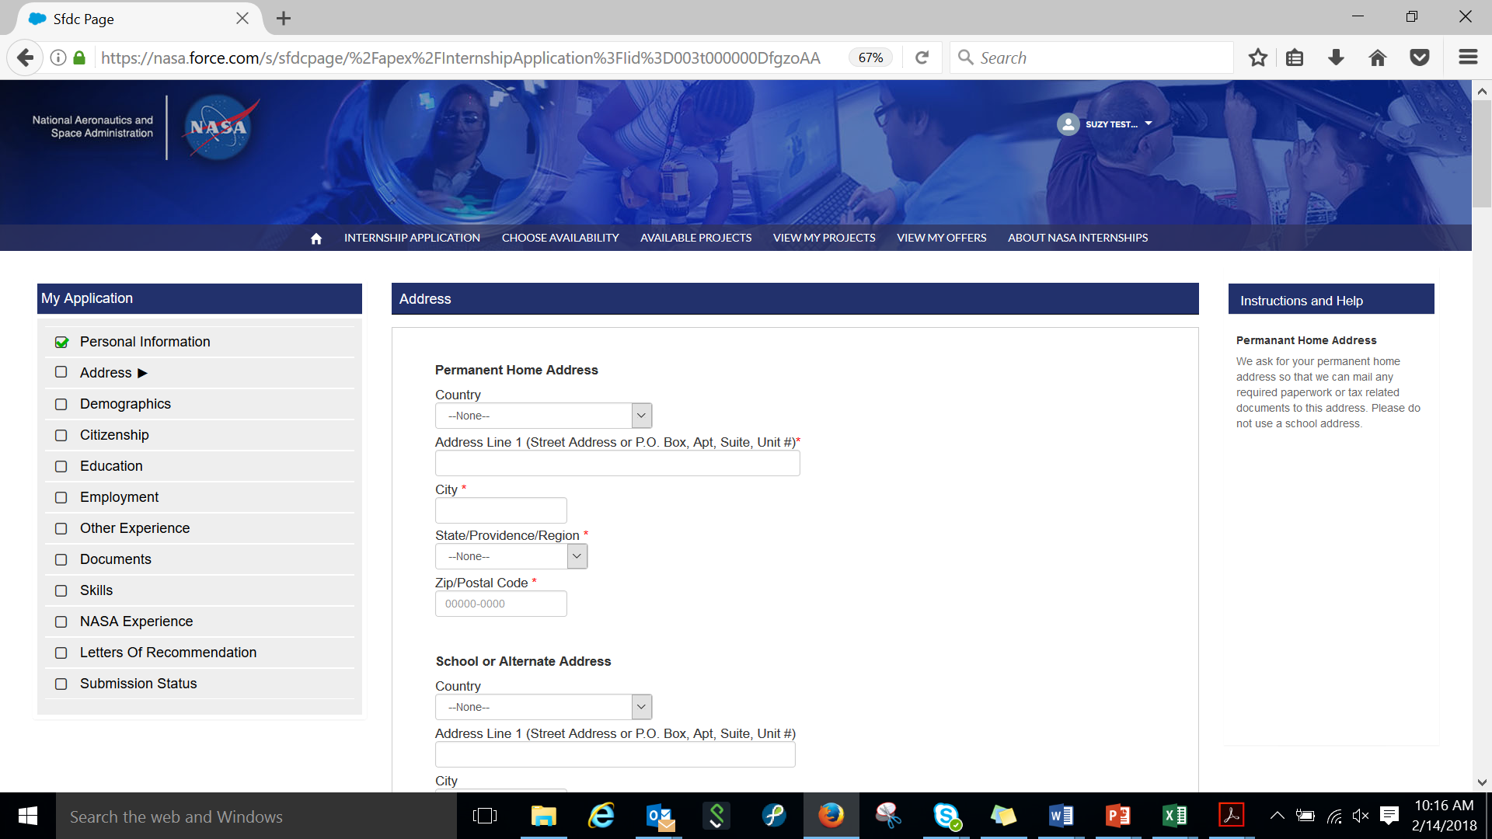
Notes:
Fill out the application once, then search for projects to submit your application to.

Slide 12
Make Your Application Stand Out
Apply to every session that you are available for an internship.
Apply to as many opportunities that interest you. You can apply to up to 15 opportunities!
Spell out any program acronyms
  NCAS: NASA Community College Aerospace Scholars
Explain in detail your research interests and technical skills. Think “filters,” using key words may boost the chances of your application being viewed by a mentor.
Notes:
Take advantage of your 15 applications! Not all positions end up getting funded. Even if you are offered a position that isn’t your top choice, you have your foot in the door and that increases your chances of getting the position you want in the future. Learn new skills and network to help you get your dream position.

Slide 13
Make Your Application Stand Out
Important sections of your application are:
  Computer Skills – Be thorough, as this is what filters will catch. Avoid exhaustive paragraphs.
  Special Skills – List any skill you are proficient in that you feel may be helpful (social media, foreign languages, sewing, machine shop, graphic artist, acoustical analysis, heat transfer, gas spectroscopy, chromatography, anthropometry, technical writing, photography, etc.). List anything that will separate you from other candidates. Use key words.
  How your interests fit with a NASA opportunity – State how you can advance this project to the next level. What is it about you that distinguishes your skills from others that inspires NASA to select you? Be concise. Describe your experiences and how your skill set will benefit NASA now and in the future.
Notes:
How your interests fit with a NASA opportunity – tell us why you want to work at NASA and how it aligns with your interests/academic and professional goals. How will your skills contribute to NASA’s missions?

Slide 14
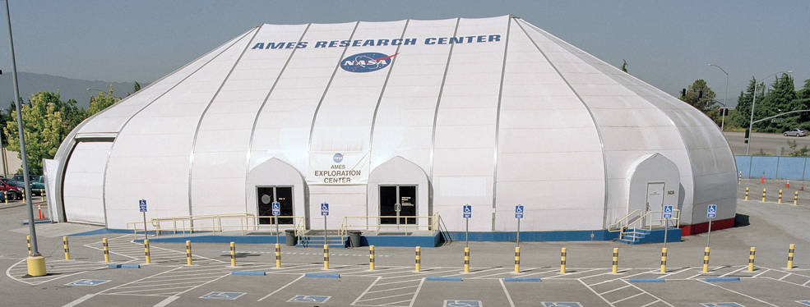
Stay Connected
You can stay connected with NASA Internships through social media.
  Follow us on Twitter : @NASAInterns
  Follow us on Facebook: @NASAinterns
  Follow us on Instagram: @NASAinternships
  Follow Ames on Twitter, Facebook, and Instagram: @NASAames
Notes:
Learn about our current interns and projects by following us on social media.

Slide 15
What does an in-person NASA Ames Research Center
and
NASA Armstrong Flight Research Center
internship look like?

Slide 16
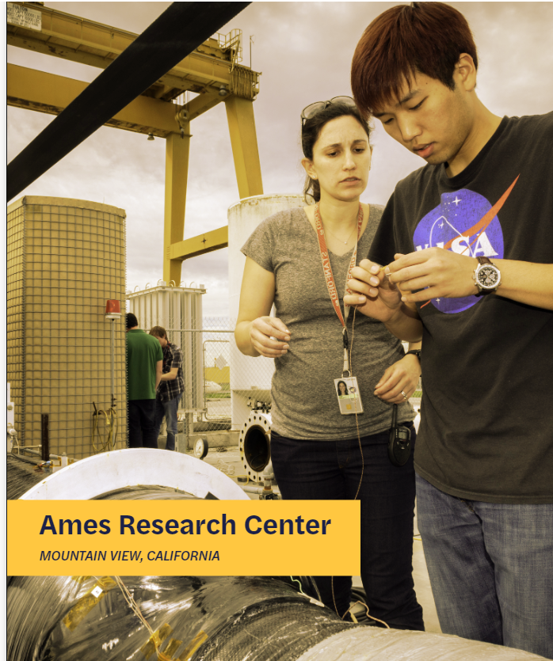

Slide 17
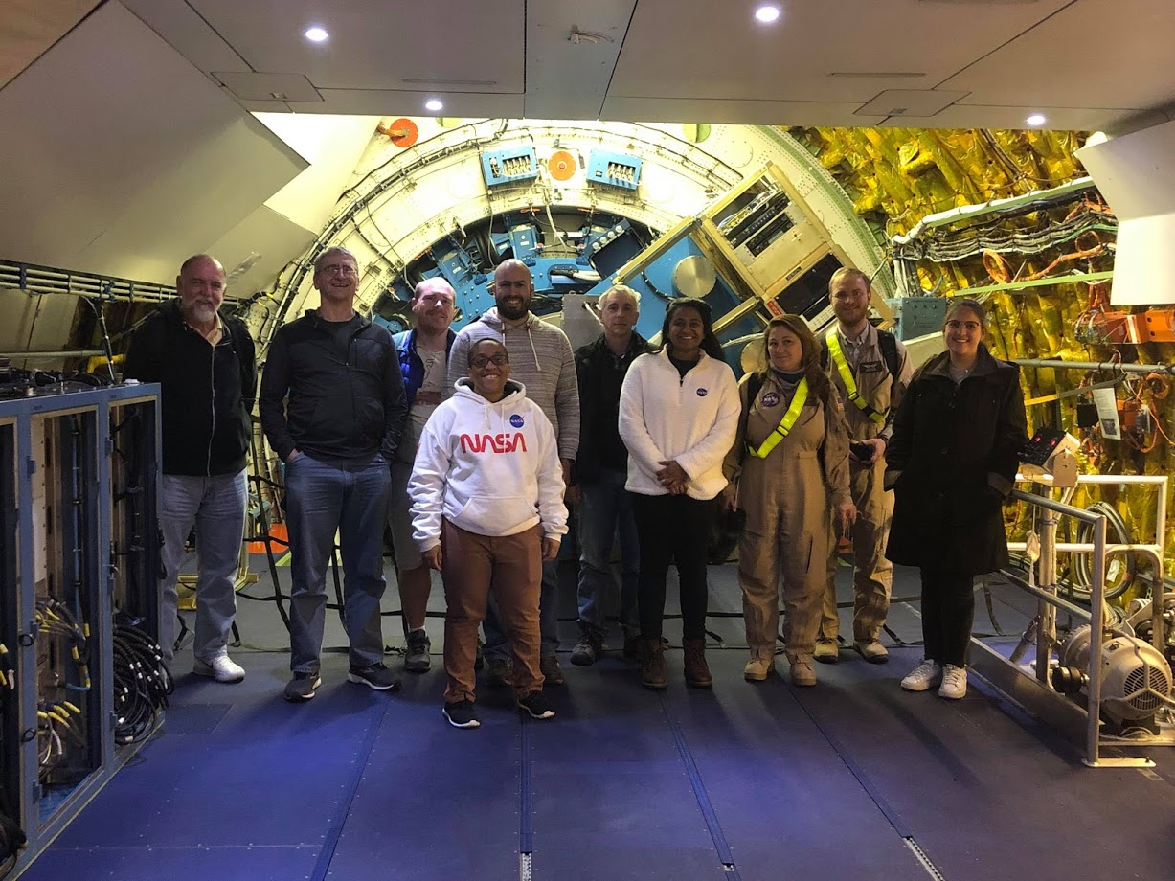

Slide 18
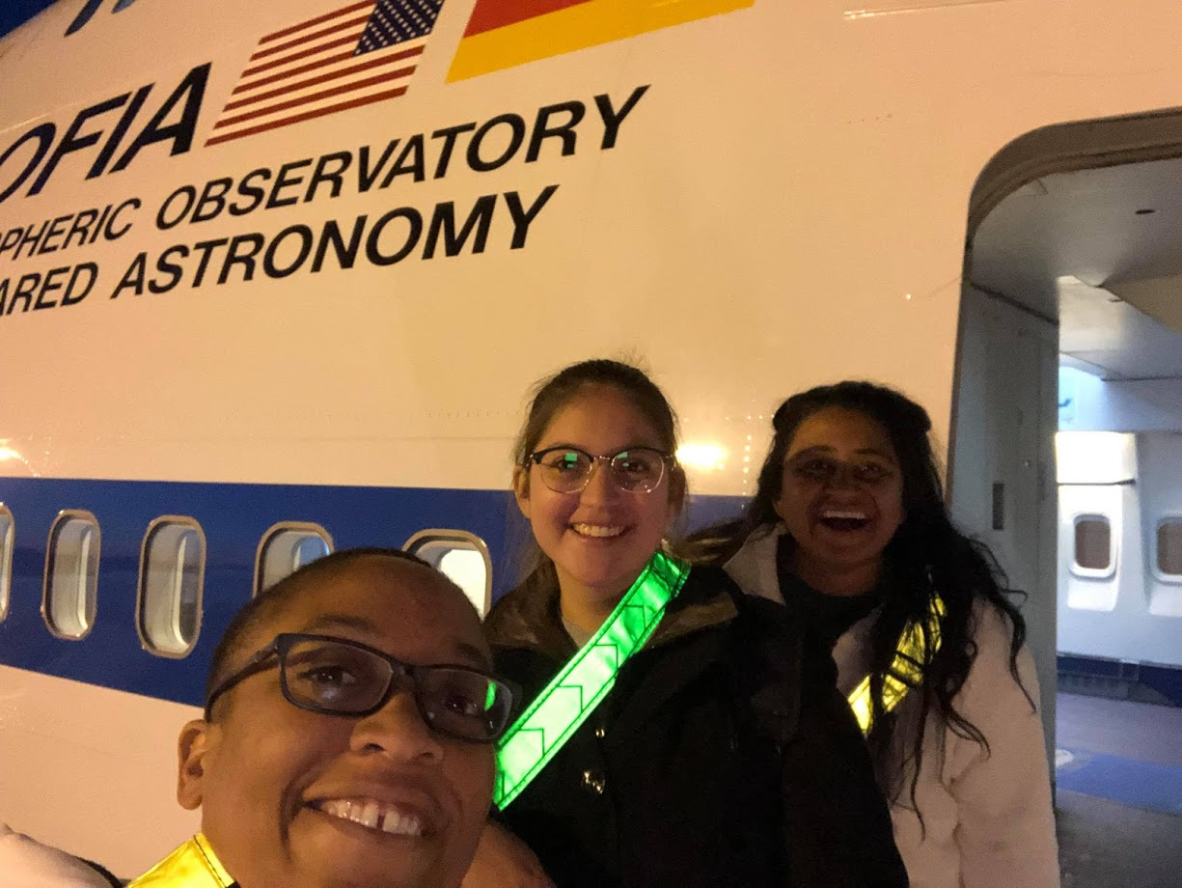

Slide 19
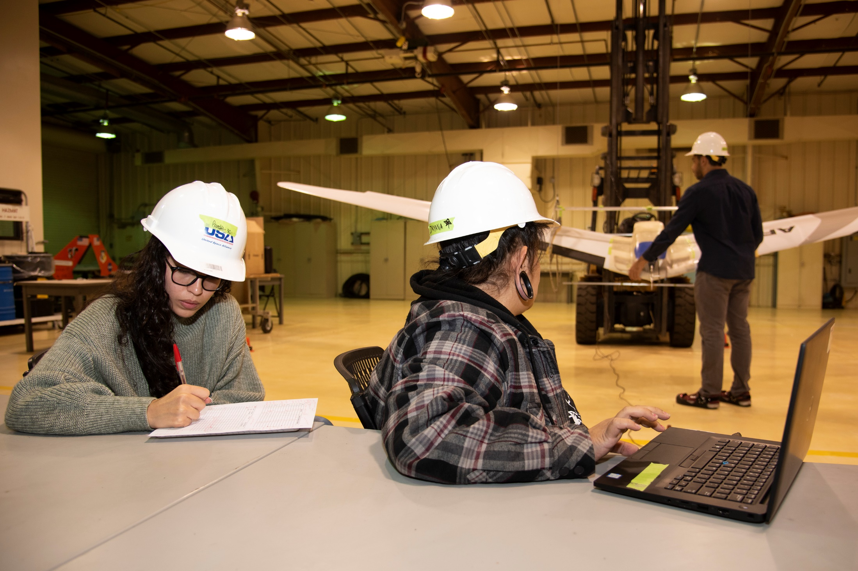

Slide 20
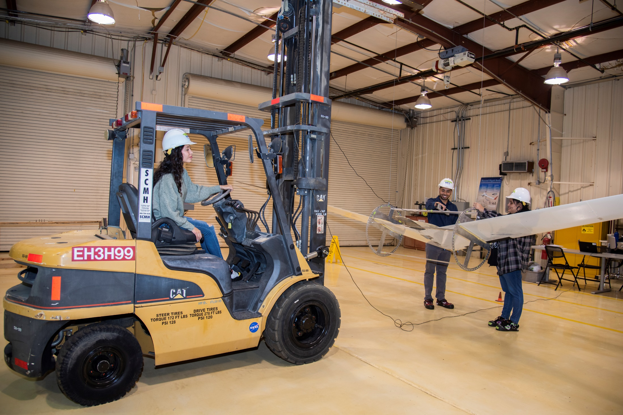

Slide 21
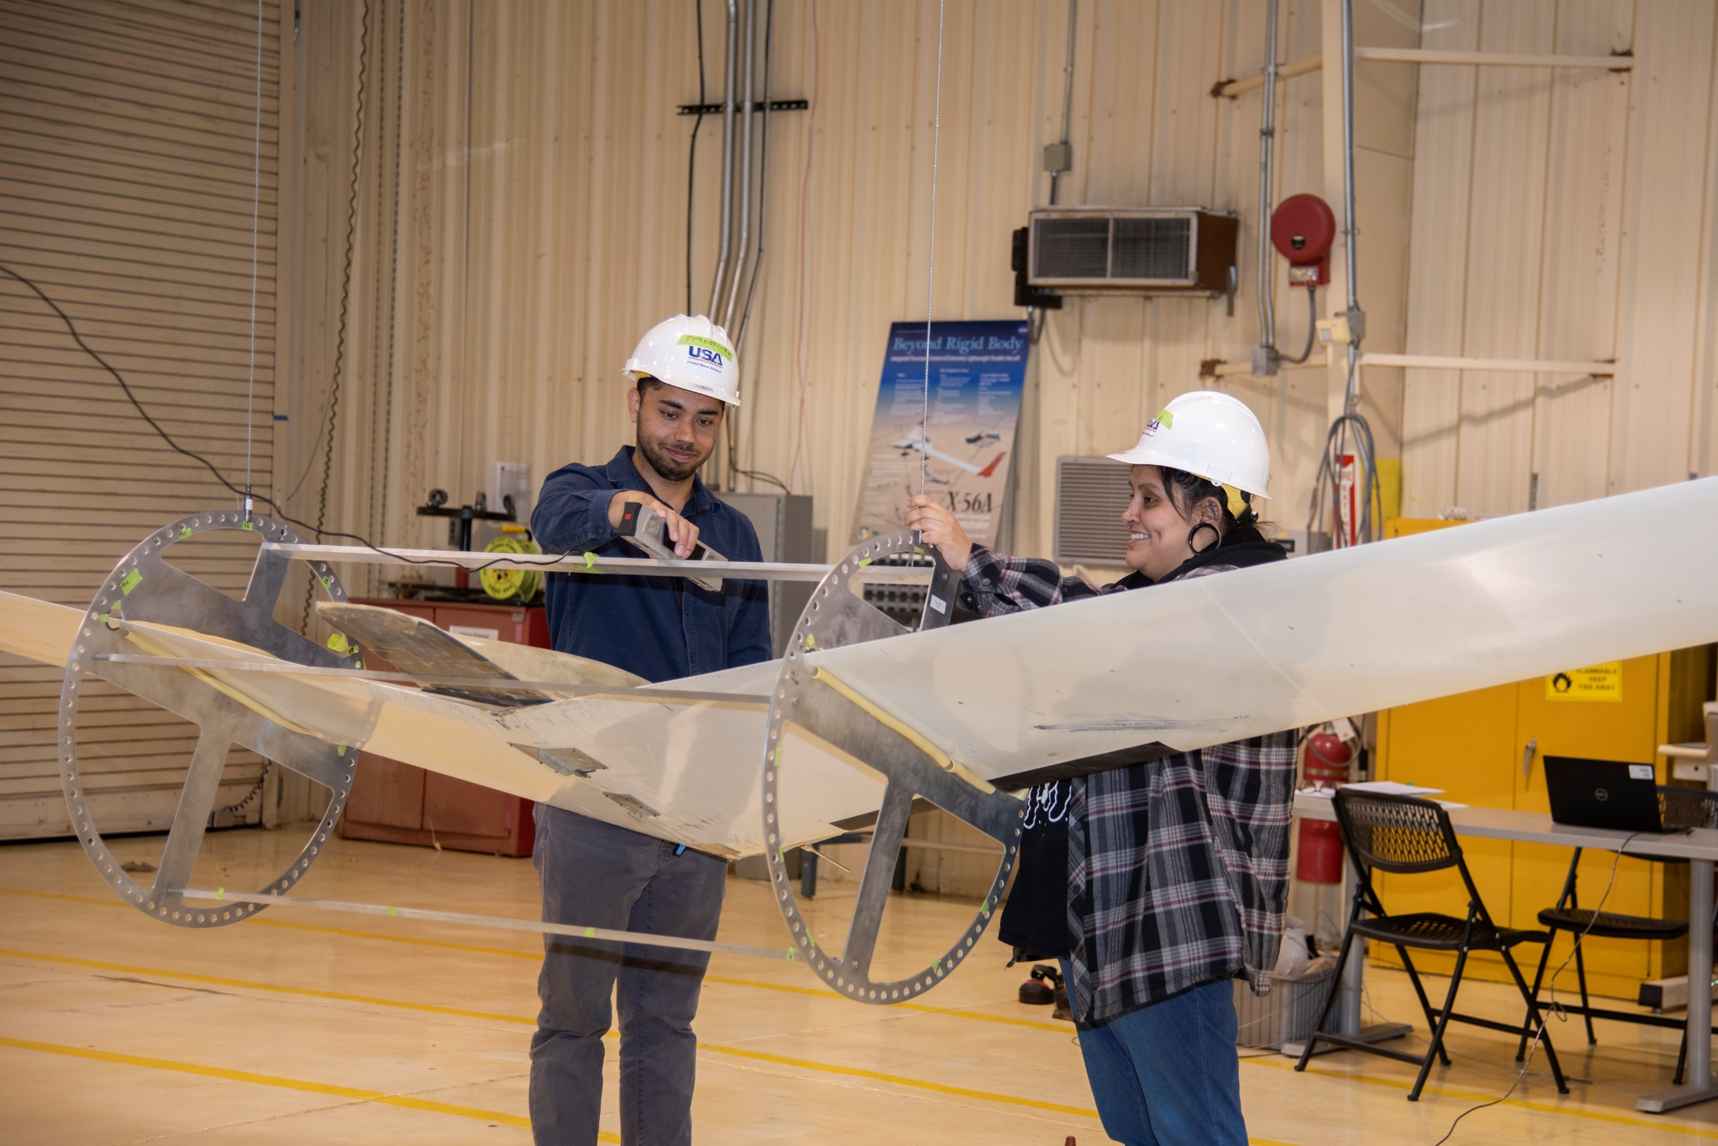

Slide 22
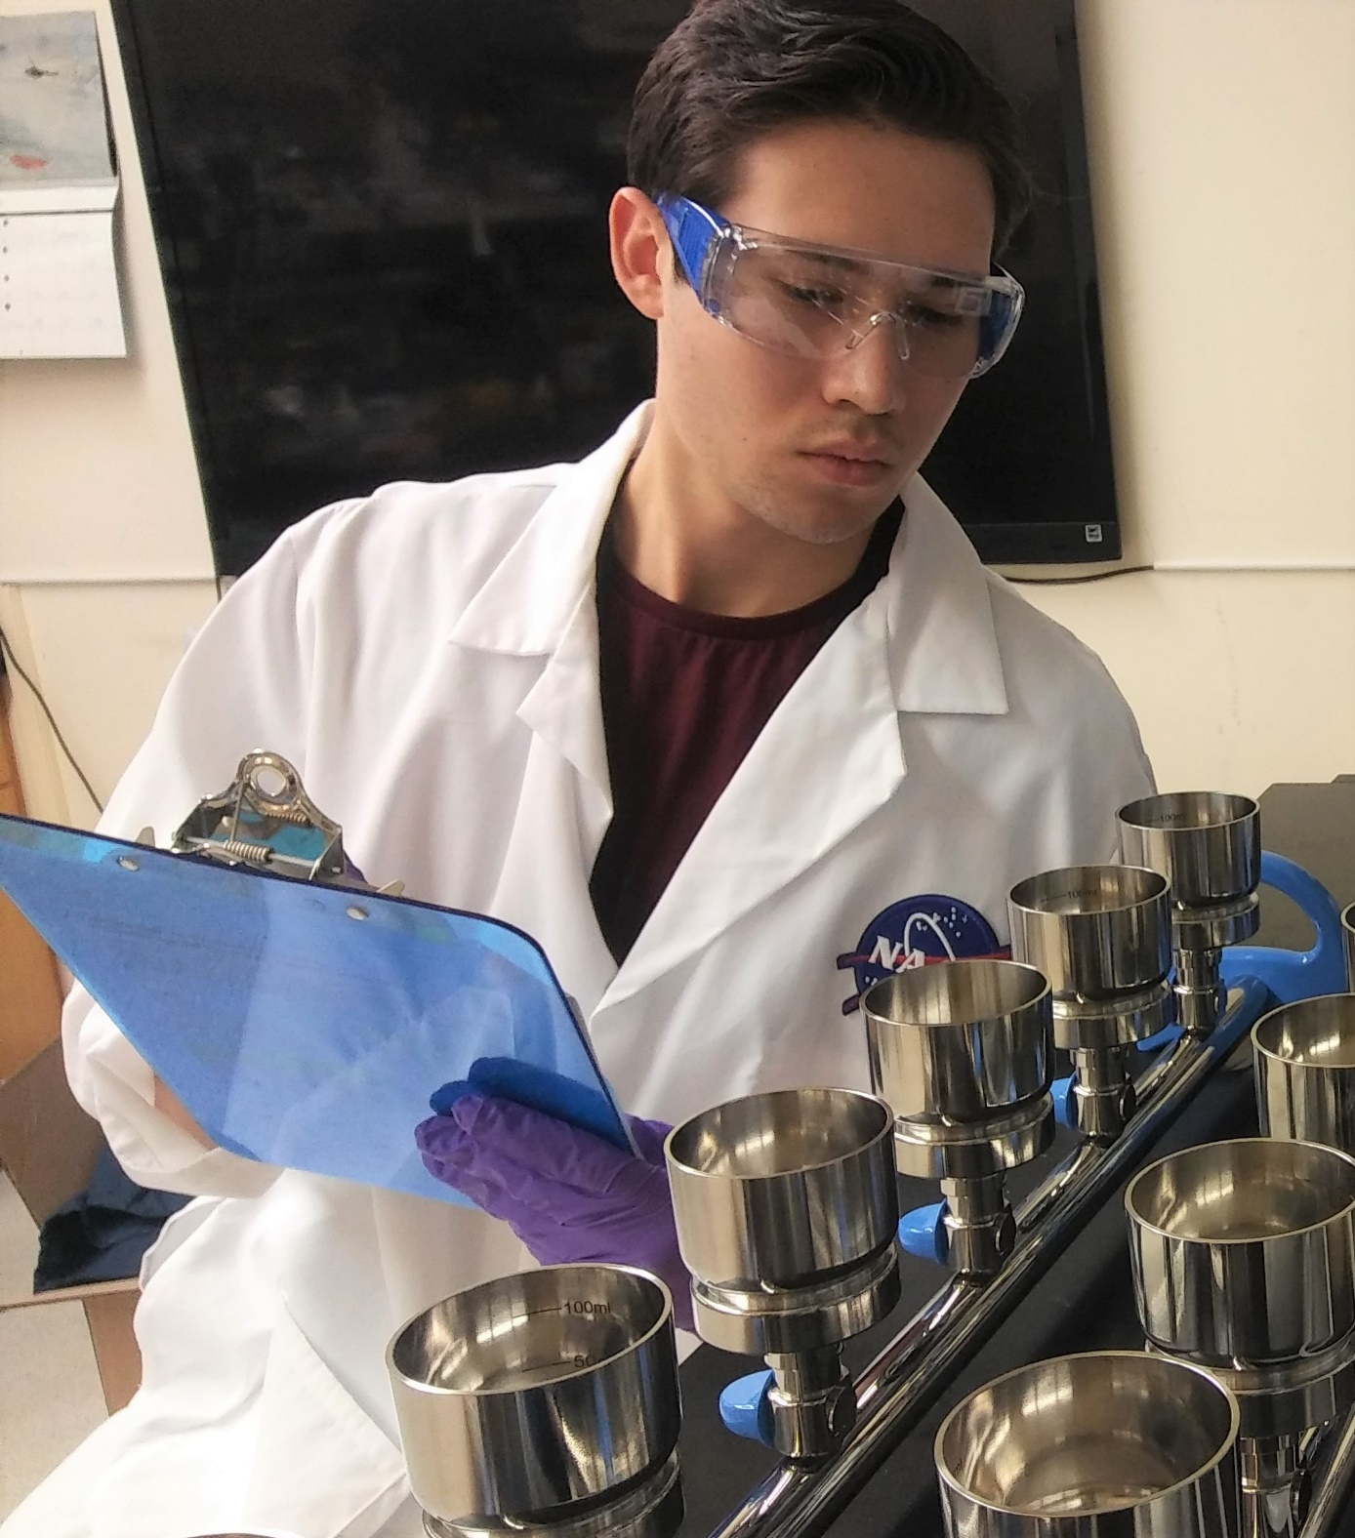

Slide 23
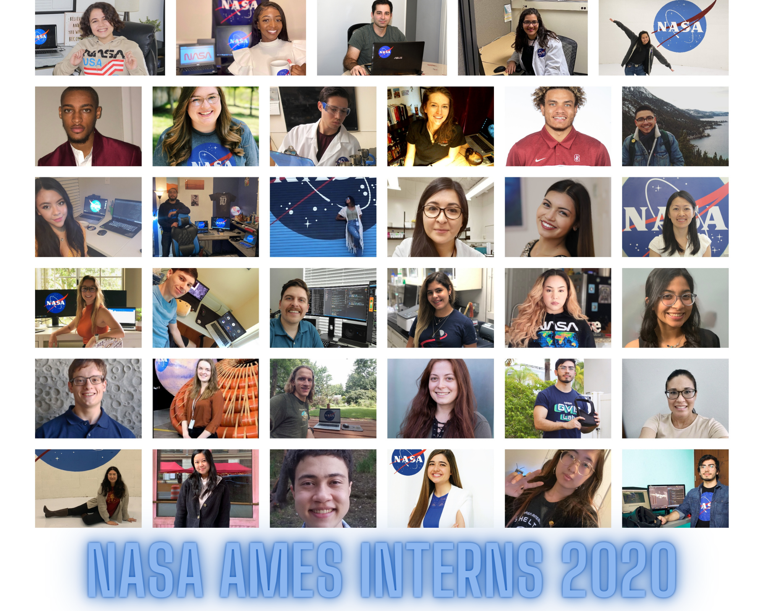

Slide 24
ARC Internships Team - Coordinators
Haley Feck
haley.feck@nasa.gov
Carlos Aguirre
carlos.a.aguirre@nasa.gov
Questions?

